Slide 1
Chapter 12.
Supervised Learning
28th July 2021
SANG-HO YOON
Bioinformatic & Genomics Lab.
Link to chaper 12. supervised learning

Slide 2
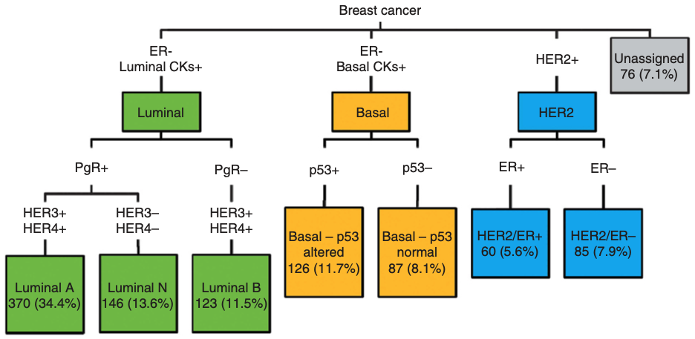
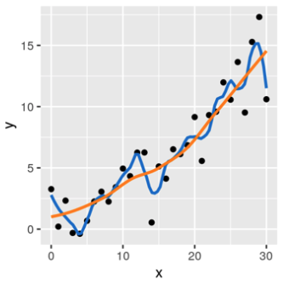
Introduction
Supervised learning (statistical learning)
- “Prediction” of a property of interest (disease type, cell type, etc.) using other properties (predictors)
Study data
Predictors
(objective
or
response)
Training data
Test data
- Unlike unsupervised learning, the answers are known in study data
- Issues: overfitting & generalizability
Apply to new data
- Overfitting: predict 100% accuracy on the training data, but poorly perform on any new data
- Generalizability: application of the model to new data
- Continuous response variables → regression
- Categorical (discrete) response variables → classification
A. R. Green et al. British journal of cancer (2013)

Slide 3
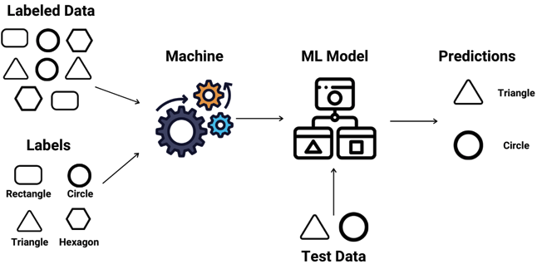
Study goals
Supervised learning (statistical learning)
1. Discriminant analysis
2. Performance measures
3. Overfitting
4. Regularization (penalization)
5. Cross-validation

Slide 4
Predicting diabetes type
The data structure
- object x feature (dataframe); transposed gene x sample matrix
→ to find a mathematical function that predicts the value of one of the features from the others
→ usu. without missing values
kernel methods use distances or measures of similarity between objects
→ the more objects, the better

Slide 5
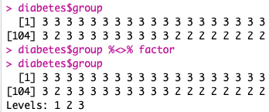
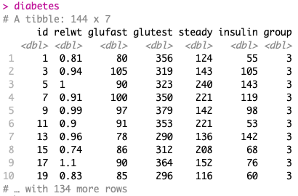
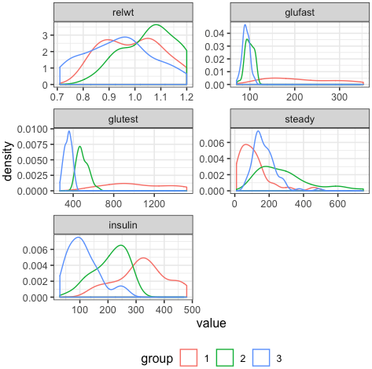
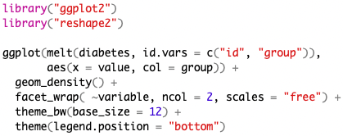
Predicting diabetes type
The diabetes dataset (Reaven and Miller 1979)

Slide 6
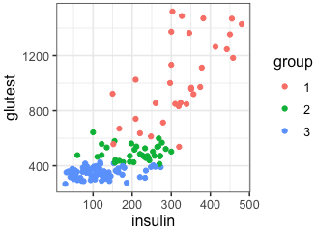
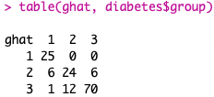
Linear discrimination
*Objects are described by two continuous features (2D plane)
*Objects fall into one of three groups
→ Aim to define class boundaries
- Linear discriminant analysis (LDA)
Misclassification rate

Slide 7
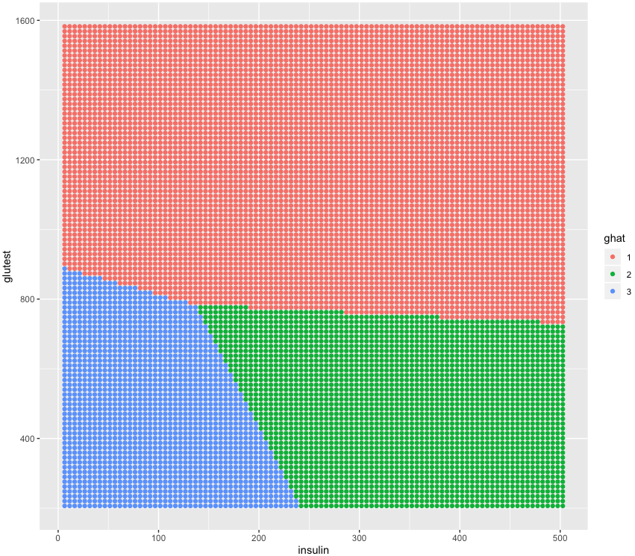
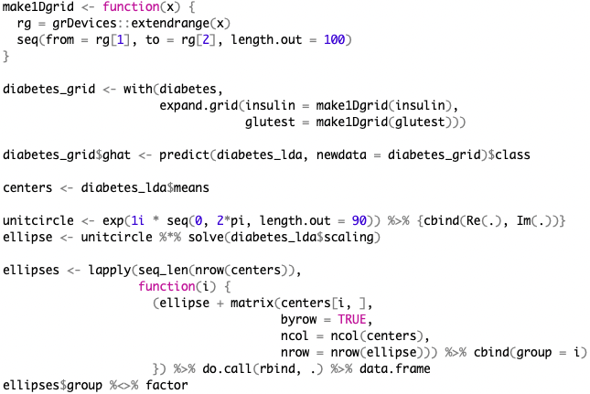
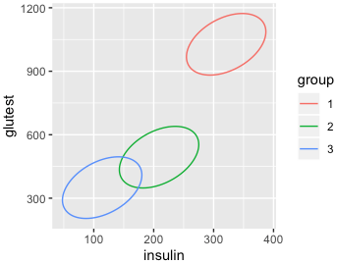
Linear discriminant analysis (LDA)
- Visualization

Slide 8
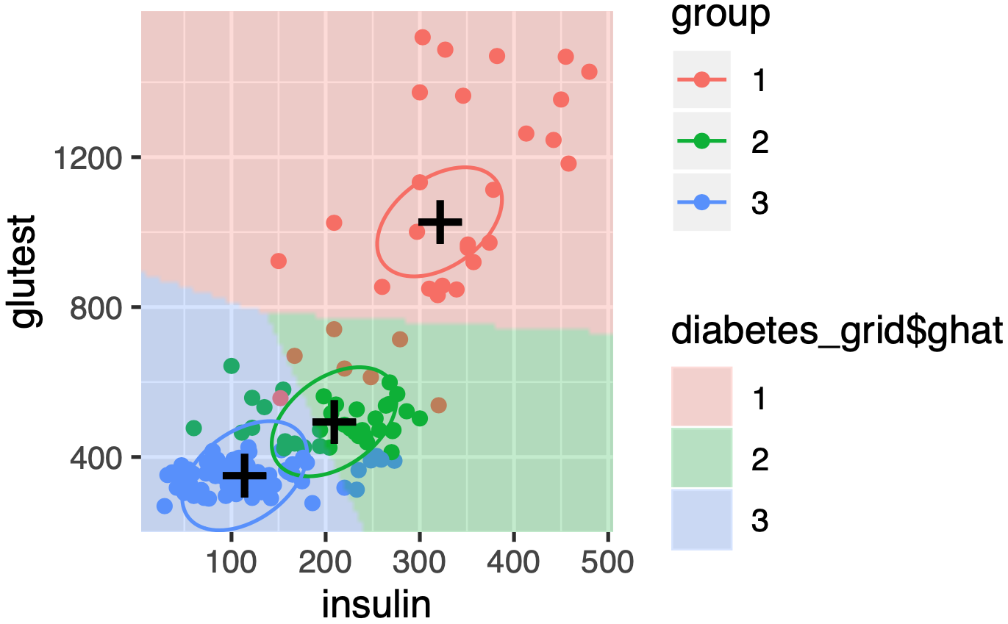
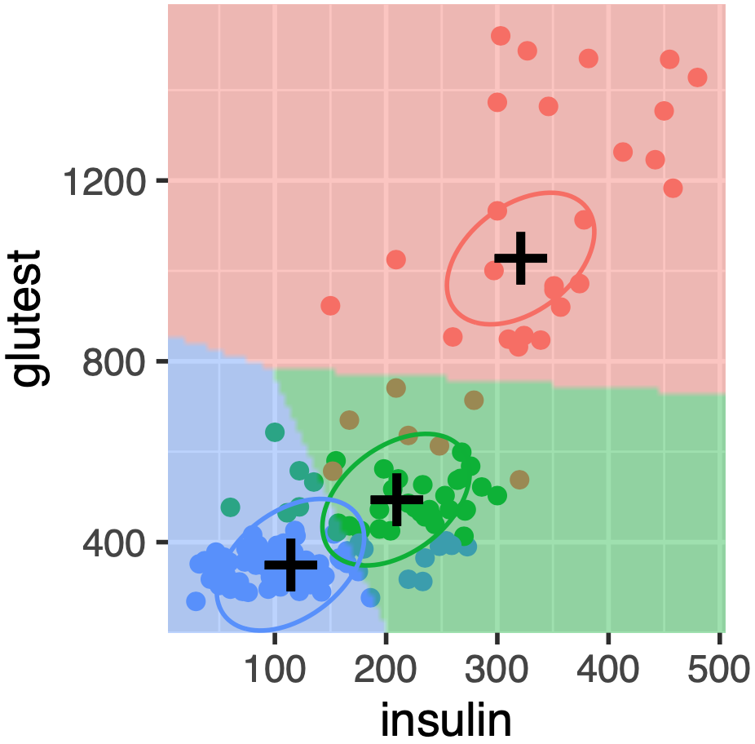
Linear discriminant analysis (LDA)
- Visualization

Slide 9
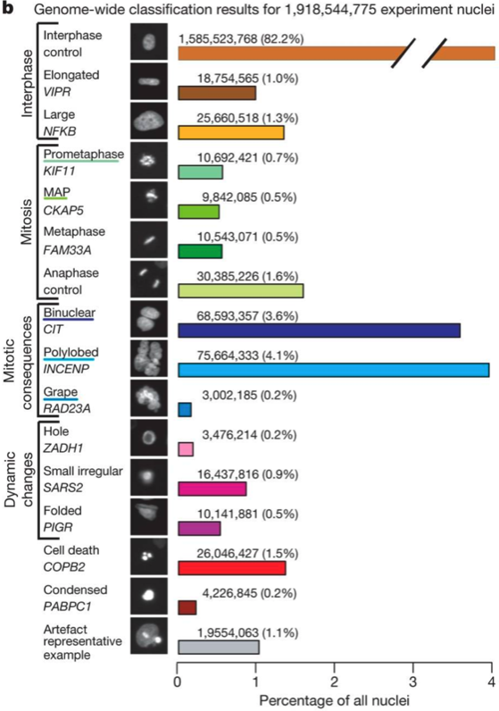
Predicting cellular phenotypes
Live-cell imaging by Neumann et al. Nature (2010)
- Human cancer cells w/ GFP tagged histones were screened with a genome-wide RNAi library
- Cells were recorded to observe effect of the siRNA

Slide 10
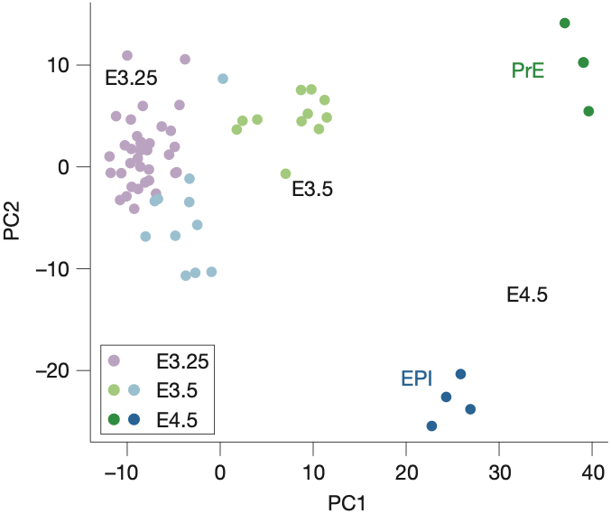
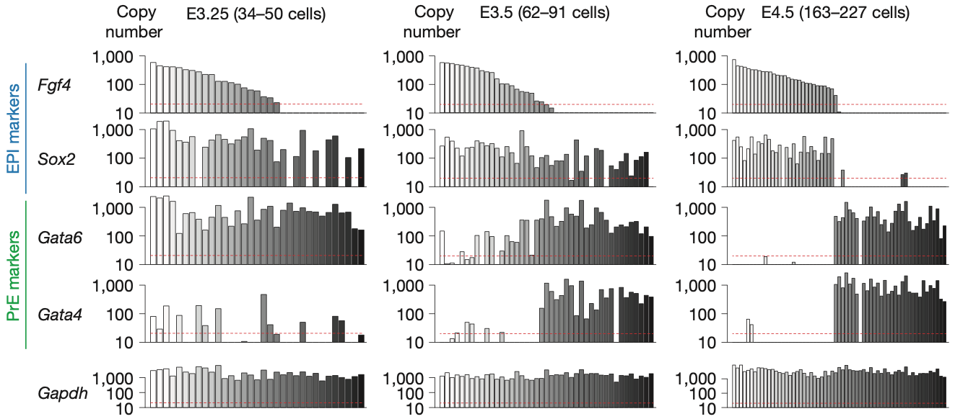
Predicting embryonic cell states
Single cell analysis of blastocyst by Ohnishi et al. Nature cell biology (2014)

Slide 11
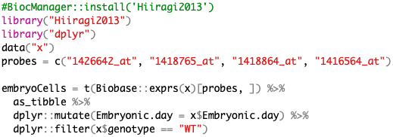
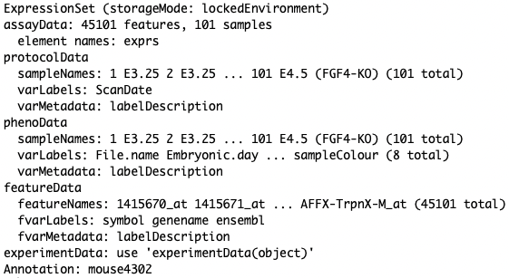
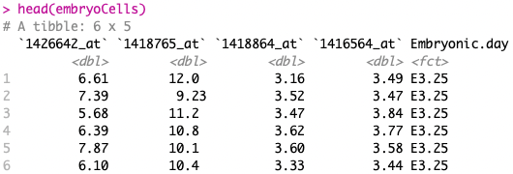
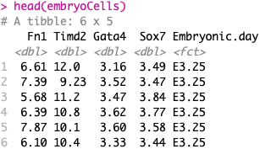
Predicting embryonic cell states

Slide 12
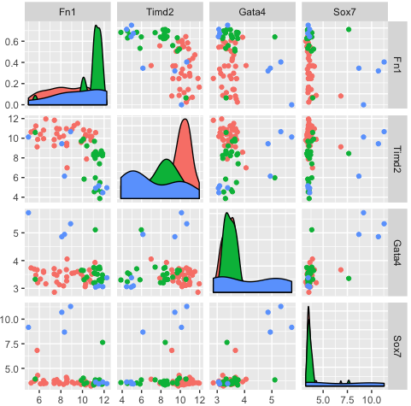
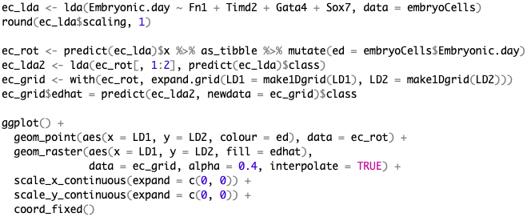
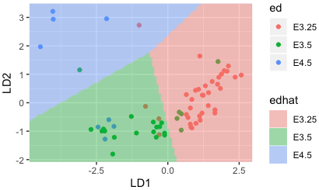
Predicting embryonic cell states (LDA)

Slide 13
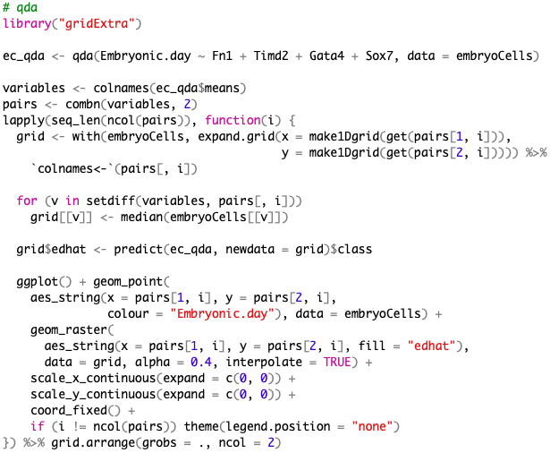
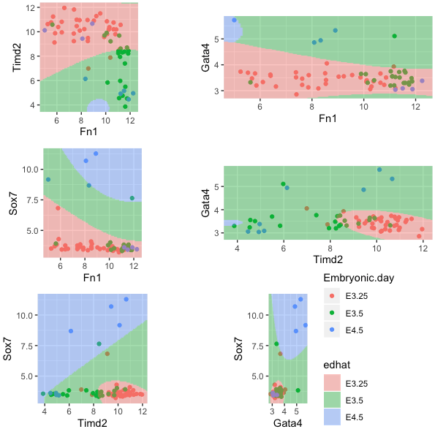
Predicting embryonic cell states (QDA)
Quadratic discriminant analysis (QDA)
- A variant of LDA which allows for non-linear separation of data

Slide 14
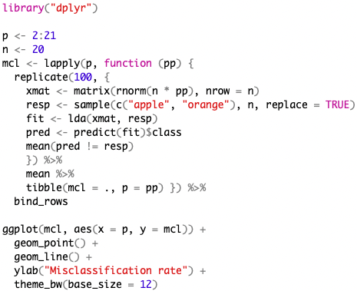
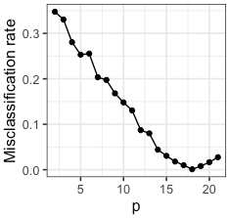
Machine learning vs. rote learning
Generalizability
- The major goal in statistical learning
Good predictions about unseen data
e.g. Classification of apple or orange using random data w/ different number of features
Almost zero
“Over-parameterized”
→ The model performance was evaluated on the training data

Slide 15
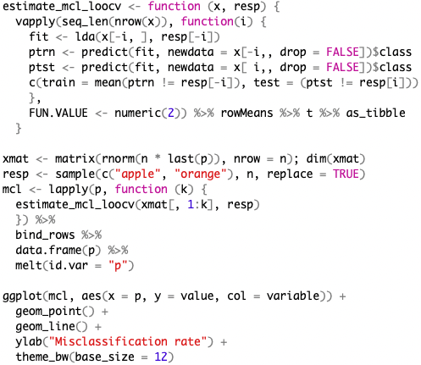
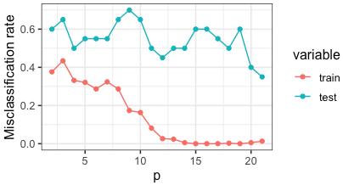
Cross-validation
Splitting data in training and test sets
- Multiple times; to achieve more stable results than one-time random split
- In unequal sizes; the performance depends on the number of observations (training > testing)
e.g., n-1 observations for training and the remaining one for testing; leave-one-out CV
When the sample size is limiting
Very similar training sets, time-consuming
k-fold cross-validation
- The observations are repeatedly split into a n(k-1)/k training set and a n/k test set

Slide 16
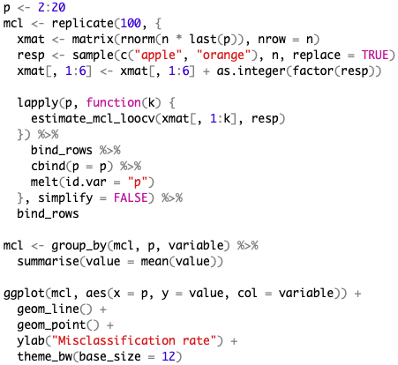
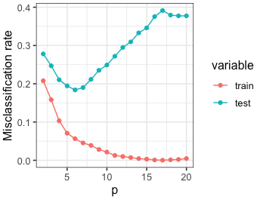
Overfitting
~ feature #6
@ p = 6
Misclassification increases
along with p
Curse of dimensionality by Bellman (1961)
- high-dimensional spaces are very hard to sample thoroughly
- Fitting models to data with thousands of features (data << features)

Slide 17
Objective functions (risk or cost functions)
Misclassification rate (MCR)
for a finite sample,
In binary classification,
- Sensitivity (true positive rate or recall)
classification of healthy as healthy; misclassification of healthy as ill
- Specificity (true negative rate)
misclassification of ill as healthy
- A single parameter (a threshold) can be modified → trade-off b/w sensitivity and specificity
- All possible thresholds are tested → receiver operating characteristic (ROC) curve
Jaccard index
Mean squared error (MSE)
- For continuous response variables (regression)

Slide 18
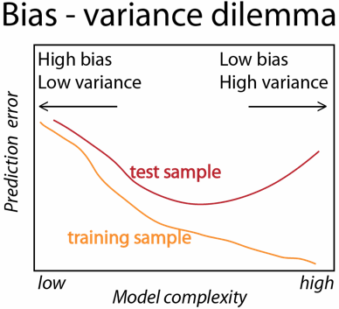
Variance-bias trade-off
MSE is a natural choice for evaluation of statistical learning models
One goes down while the other goes up
- Minimization of MSE; ST a small bias & greatly reduced variance
- In classification, other risk objective functions are generally used
MSE is not always straightforward to decompose as the equation
- The discreteness of the response absorbs certain biases
higher bias with almost zero cost & smaller variance
Regularization – penalization
- High variance in high-dimensional data (# of parameters > # of data points)
- One can control variance-bias trade-off using penalization
- Logistic regression is a more general approach for high-dim. setting

Slide 19
Penalization & logistic regression
Multinomial logistic regression
i = 1, ..., k-1 counts over the different classes
Data matrix x with n (obs.) * p (features)
$β$i is a p-dimensional vector determines how the classification odds for class i versus class k depend on x
$β$i0 is an intercept; classes’ prior probabilities
- The model is fit by maximizing the log-likelihood l($β$, $β$0; x),
- But as p increases while the sample size n remains the same,
the maximum likelihood estimate is unidentifiable
→ Penalized version of the objective function
$λ$ ≥ 0
penalty function
ridge regression: pen($β$) = |$β$|²
lasso regression: pen($β$) = |$β$|¹

Slide 20
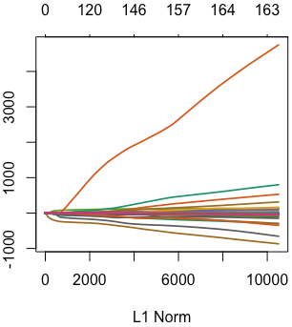
Penalization & logistic regression
Metagenome sequencing data from fecal samples of 156 humans (CRC & tumor-free controls)
The # of non-zero coef.
coefficient
Different variables

Slide 21
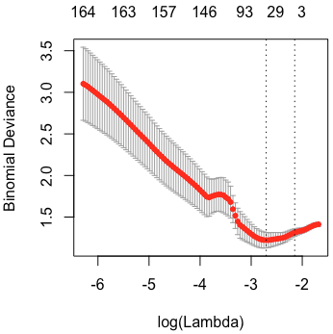
Penalization & logistic regression
Optimal 𝜆 parameter
- Try all possible choices of 𝜆 and assess classification performance (using cross-validation)
Built-in cross-validation
Often too small
→ weak penalization

Slide 22
Exploring other methods
There are many different learning algorithms
- Projects that provide unified interfaces to run different machine learning approaches
caret & mlr
- The caret package supports 238 different algorithms
To achieve higher accuracy and generalize to a new dataset
- Many methodical choices as possible
- Outer cross-validation loop
- Validation on truly unseen data

Slide 23
Summary
Prediction of categorial variables
- Linear and quadratic discriminant analysis
partitioning a two-dimensional data plane into regions using linear or quadratic separation lines
- Logistic regression
more amenable to operating in higher dimensions and to regularization
- Regularization; penalization
to avoid overfitting which happens in the context of the so-called curse of dimensionality

