Slide 1
Modern Statistics for Modern Biology
Chapter 5: Clustering
2021.07.16
Seokju Park
Bioinformatics and Genomics Lab

Slide 2
5.1 Goals for this chapter
Study the different types of data that can be beneficially clustered.
See measures of (dis)similarity and distances that help us define clusters.
Uncover hidden or latent clustering by partitioning the data into tighter sets.
Run nonparametric algorithms such as k-means and k-medoids.
Experiment with recursive approaches to clustering: hierarchical clustering.
Study how to validate clusters.

Slide 3
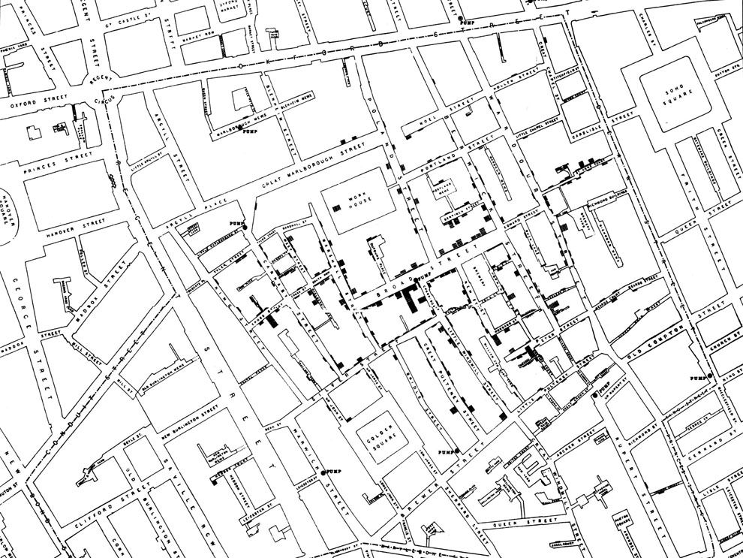
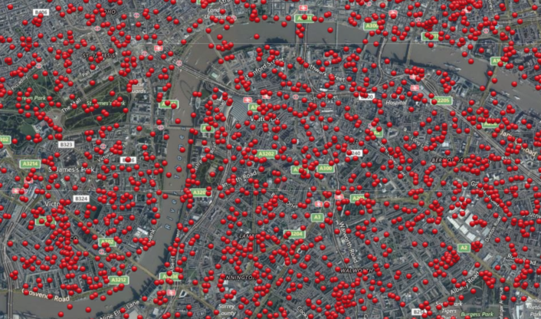
5.2 What are the data and why do we cluster them?
John Snow made a map of Cholera cases and identified the proximity of dense clusters of cases to the Broadstreet pump.
In World War II, the bombings were randomly distributed without any patterns.
https://www.nationalgeographic.org/activity/mapping-london-epidemic/

Slide 4
5.2 What are the data and why do we cluster them?
Clustering is a useful technique for understanding complex multivariate data.
Clustering is an unsupervised method using exploratory techniques.
For instance, clustering has enabled researcher to enhance their understanding of cancer biology.

Slide 5
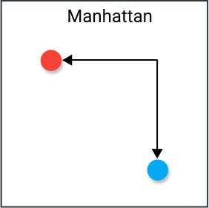
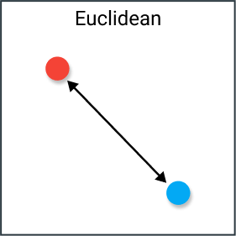
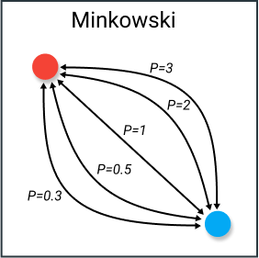
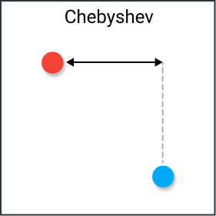
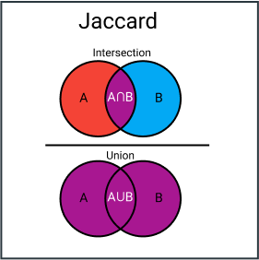
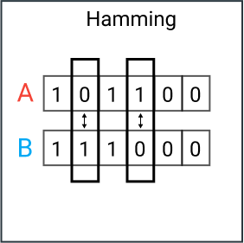
5.3 How do we measure similarity?
First step is to decide what we mean by similar.
After selecting the relevant features, we have to decide how we combine differences between the multiple features.
https://web.stanford.edu/class/bios221/book/Chap-Clustering.html#fig:bombings

Slide 6
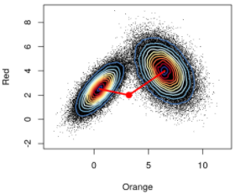
5.3 How do we measure similarity?
Mahalanobis distance

Slide 7
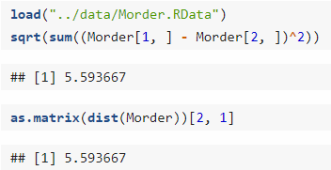
5.3 How do we measure similarity?
The “dist” function computes one of six choices of distance (euclidean, maximum, manhattan, canberra, binary, minkowski) and outputs distance matrix.
The function returns a special object of class “dist” that encodes the relevant vector of size n x (n-1) / 2.

Slide 8
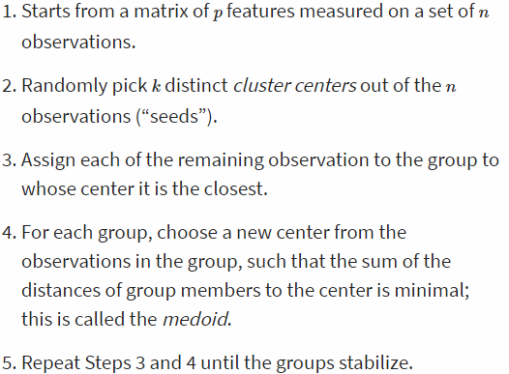
5.4 Nonparametric mixture detection by k-methods
Partitioning or iterative relocation methods work well in high-dimensional settings, where we cannot easily use probability densities, the EM algorithm and parametric mixture modeling.
k-medoids and PAM (partitioning around medoids)

Slide 9
5.4 Nonparametric mixture detection by k-methods
K-means
In the EM algorithm, each point participates in the computation of the mean of all the groups. In the k-means method, each point participates only in the computation of the center of one cluster.

Slide 10
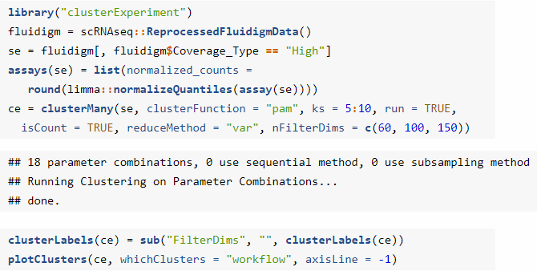
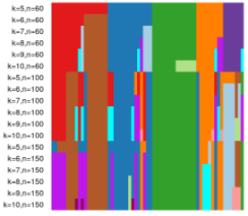
5.4 Nonparametric mixture detection by k-methods
Tight clusters with resampling.
Repeating a clustering procedure multiple times on the same data, but with different starting points creates strong forms.
Repeated subsampling and applying a clustering method will result in groups of observations that are “almost always” grouped together (tight clusters).

Slide 11
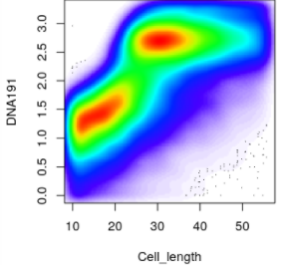
5.5 DBscan
Using flow cytometry and mass cytometry data
Immune cells express unique combinations of proteins on their surfaces.
CDs (clusters of differentiation)

Slide 12
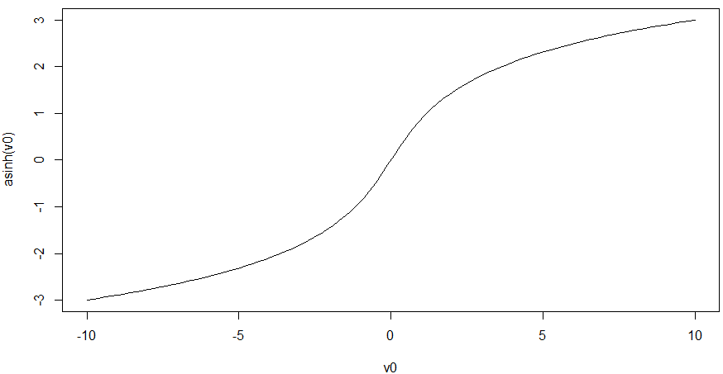
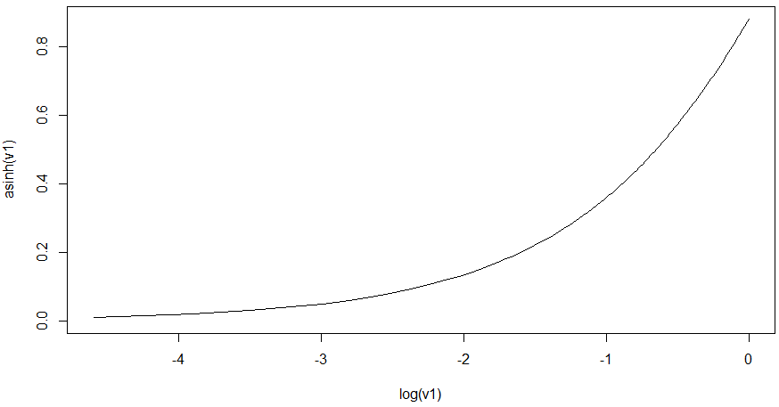
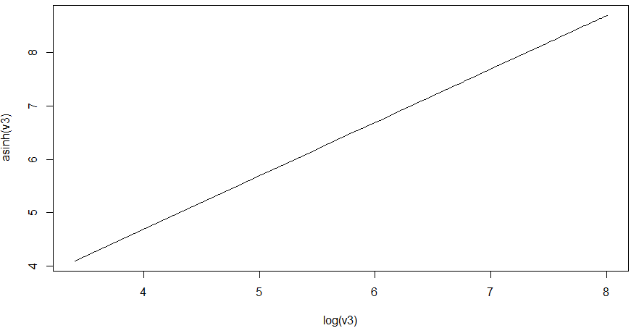
5.5 DBscan
Cell clustering can be improved by carefully choosing transformations of the data.
Data transformation: hyperbolic arcsin (asinh).
Standard to transform both flow and mass cytometry data
dc

Slide 13
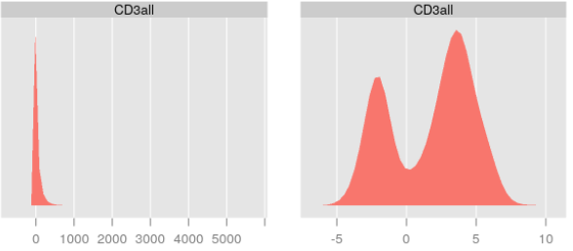
5.5 DBscan

Slide 14
5.5 DBscan

Slide 15
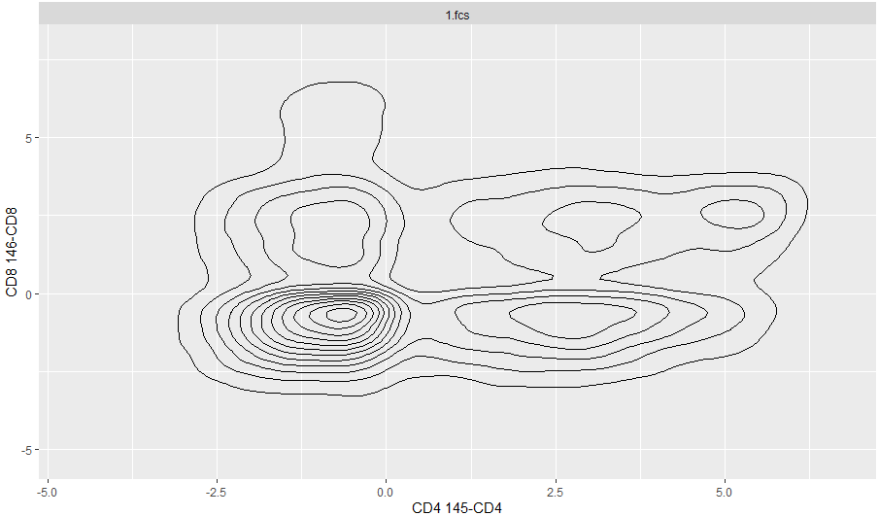
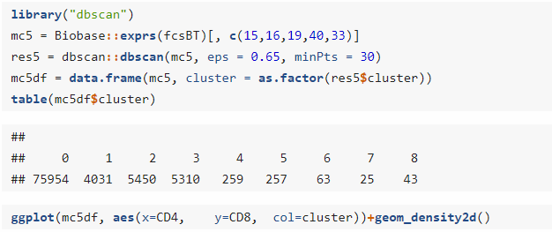
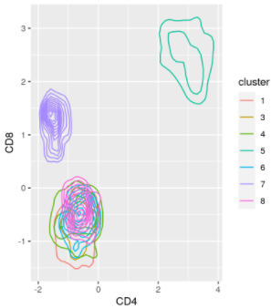
5.5 DBscan
Density-based clustering
DBscan (Density-based spatial clustering of applications with noise)
eps: size (radius) of the epsilon neighborhood.
minPts: number of minimum points required in the eps neighborhood for core points (including the point itself).

Slide 16
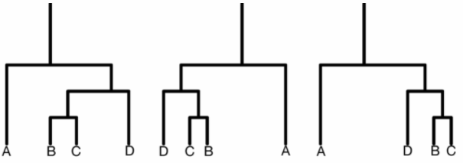
5.6 Hierarchical clustering
Hierarchical clustering is a bottom-up approach, where similar observations and subclasses are assembled iteratively.
Dendrogram ordering
Top-down approach takes all the objects and splits them sequentially according to a chosen criteria by recursive partitioning methods.

Slide 17
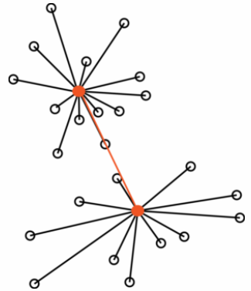
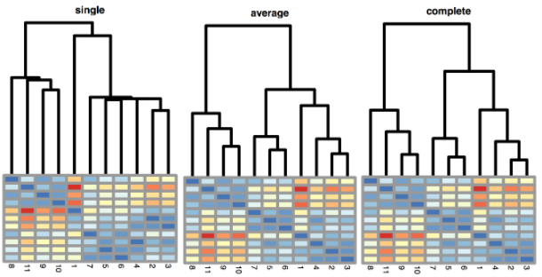
5.6 Hierarchical clustering
Compute (dis)similarity

Slide 18
5.7 Validating and choosing the number of clusters
Methods of quantification whether the clusters are real.
The quality of a clustering result is to ask to what extent it maximizes the between group differences while keeping the within-group distances small.
k: the number of clusters
C_{ℓ}: the set of objects in the ℓ-th cluster
¯x_{ℓ}: the center of mass (the average point) in the ℓ-th cluster.
n_{ℓ}: the size of the ℓ-th cluster

Slide 19
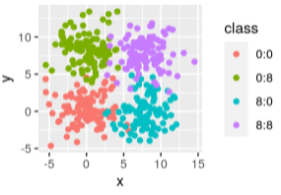
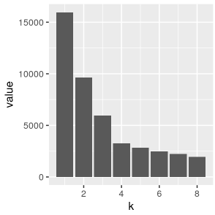
5.7 Validating and choosing the number of clusters

Slide 20
5.7 Validating and choosing the number of clusters
Methods of quantification whether the clusters are real.
The quality of a clustering result is to ask to what extent it maximizes the between group differences while keeping the within-group distances small.
Calinski-Harabasz index
k: the number of clusters
C_{ℓ}: the set of objects in the ℓ-th cluster
¯x_{ℓ}: the center of mass (the average point) in the ℓ-th cluster.
n_{ℓ}: the size of the ℓ-th cluster
¯x: the overall center of mass (average point).

Slide 21
5.7 Validating and choosing the number of clusters

Slide 22
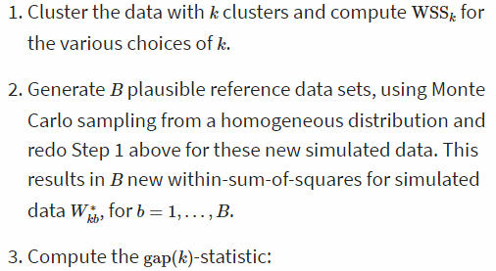
5.7 Validating and choosing the number of clusters
Methods of quantification whether the clusters are real.
Gap statistic
Taking logarithm of the WSS and comparing it to averages from simulated data with less structure.

Slide 23
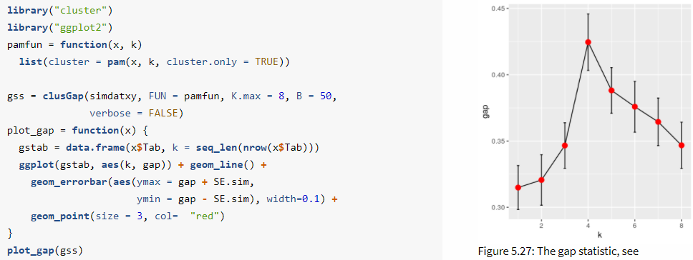
5.7 Validating and choosing the number of clusters

Slide 24
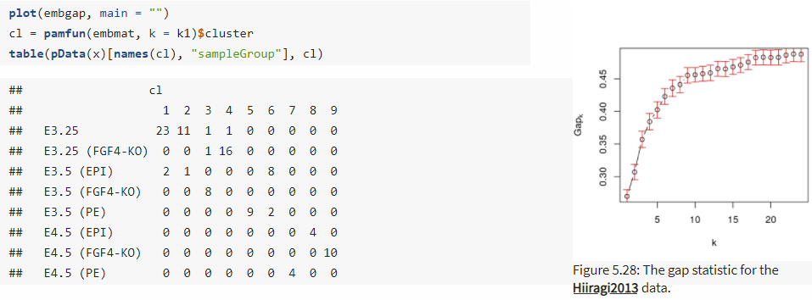
5.7 Validating and choosing the number of clusters
k1: The first value of k for which the gap is not larger than the first local maximum minus a standard error.
k2: The smallest k such that

Slide 25
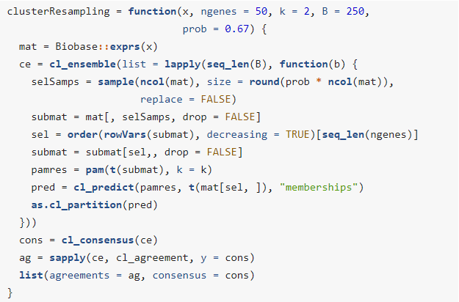
5.7 Validating and choosing the number of clusters
Methods of quantification whether the clusters are real.
Bootstrap
In Hiiragi, the inner cell mass of the mouse blastocyst in embryonic day 3.5 (E3.5) falls “naturally” into two clusters corresponding to pluripotent epiblast (EPI) versus primitive endoderm (PE), while the data for embryonic day 3.25 (E3.25) do not yet show this symmetry breaking.

Slide 26
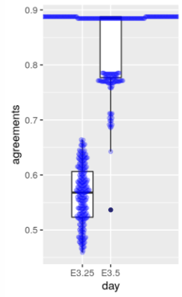
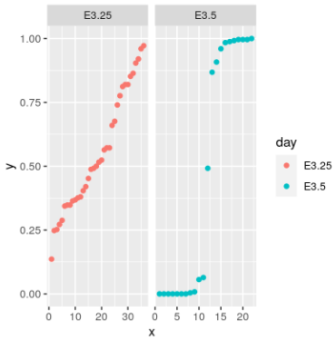
5.7 Validating and choosing the number of clusters

Slide 27
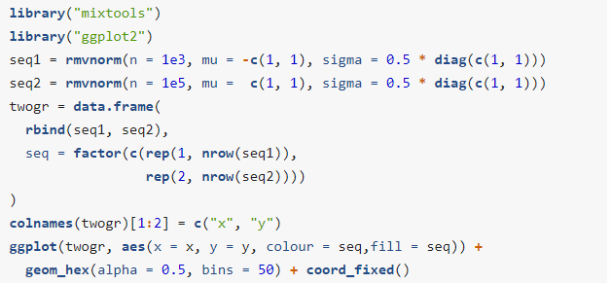
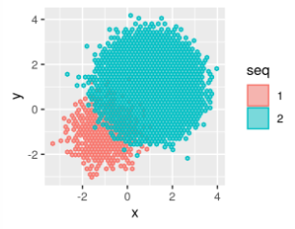
5.8 Clustering as a means for denoising
Noisy observations with different baseline frequencies
The methods based on similarities suffer from the biases inherent in the representativeness heuristic.

Slide 28
5.8 Clustering as a means for denoising

Slide 29
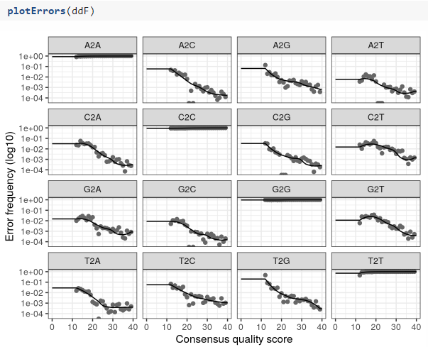
5.8 Clustering as a means for denoising
Denoising sequencing errors
DADA method (Divisive Amplicon Denoising Algorithm)
A parameterized model of substitution errors that distinguishes sequencing errors from real biological variation.

Slide 30
5.9 Summary of this chapter
How to compare observations
How finding the right distance
Two ways of clustering
Iterative partitioning approaches (k-means / k-medoids)
Hierarchical clustering
Biological examples
Validation the clusters
Distances and probabilities
Distances are not everything.

