Slide 1
Modern Statistics for Modern Biology Chapter 2 Statistical Modeling
2021/07/13 (Tue)

Slide 2
Introduction
In the previous chapter
Learned about generative models (binomial, Poisson, multinomial) and their respective parameters.
Learned how to attribute biological data to these models and obtain probabilities for decision making.
e.g., epitope detection
Limitations
In many real situations, neither the generative model nor the parameters are known and need to be estimated based on the data. → Statistical inference (bottom-up)
In this chapter
“Probability” vs. “Statistics”
Estimate parameters through maximum likelihood.
Make inferences from data for which we have prior information using the Bayesian paradigm.
Use statistical models and estimation to evaluate dependencies in binomial and multinomial distributions.
Analyze some historically interesting genomic data.
Make Markov chain models for dependent data.
Do a few concrete applications counting motifs in whole genomes and manipulate special Bioconductor classes dedicated to genomic data.

Slide 3
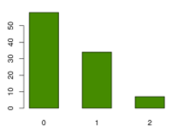
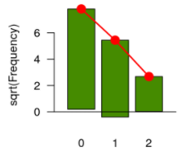
2.3 – A simple example of statistical modeling
Why is it important to know what distribution a variable follow?
Knowing a variable of interest follows a Poisson, binomial, multinomial distribution or another parametric family will enable us to have quick answers to questions about the parameters of the model and compute quantities such as p-values and confidence intervals.
Probabilistic analysis (mathematical deduction)
Requirements
Prior knowledge of which generative model best fits the randomness in the data AND its parameters.
Used to compute the probability of an event.
Statistical inference
After observing the data, an appropriate probability model F (Poisson, normal, binomial) and the missing parameter(s) are estimated.
Part 1: Start with the data
Find a fit from candidate distributions.
→ “Goodness-of-fit”

Slide 4
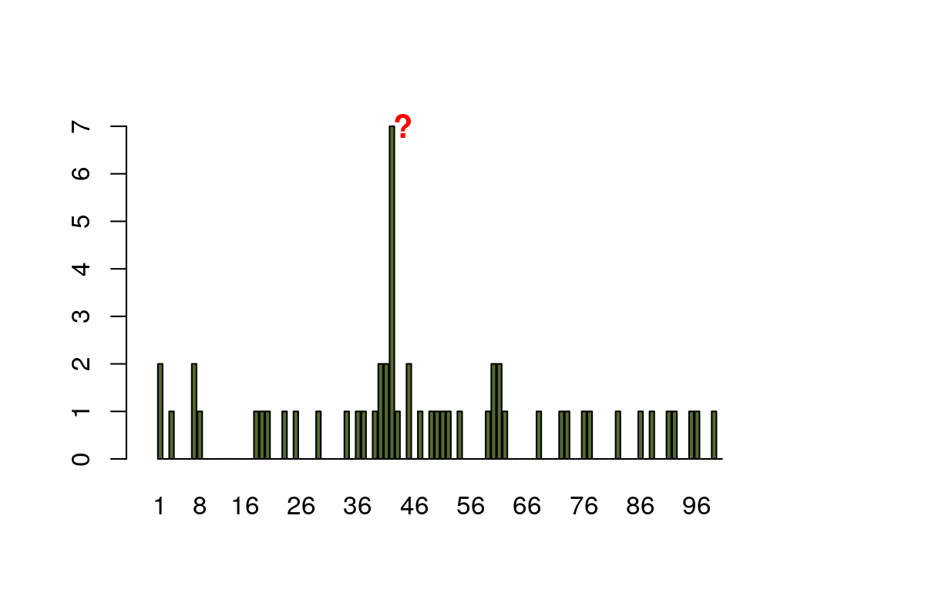
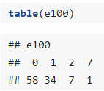
2.3 – A simple example of statistical modeling
Patients: 50
False positive epitope detection rate: 0.01
➔ False positive epitope detection rate per position (lambda) = 0.5

Slide 5
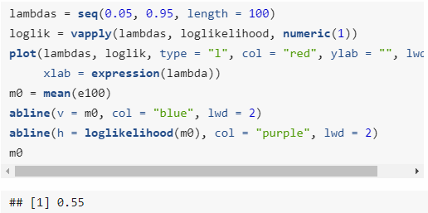
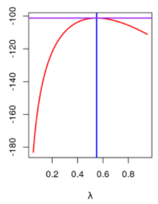
2.3 – A simple example of statistical modeling
Statistical inference
Part 1: Start with the data
Estimate parameter(s) for the chosen distribution.
Maximum likelihood estimator (MLE)

Slide 6
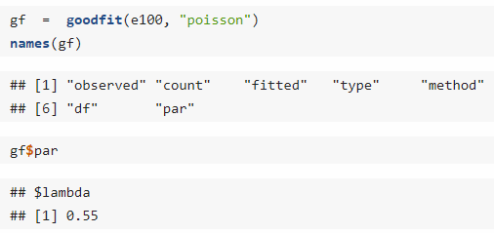
2.3 – A simple example of statistical modeling
Statistical inference
Part 1: Start with the data
Estimate parameter(s) for the chosen distribution.
Maximum likelihood estimator (MLE)

Slide 7
2.3 – A simple example of statistical modeling
Statistical inference
Part 2: Statistical testing
Set up a single model, the null model, for the data.
This model formulates an “uninteresting” baseline, such that all observations come from the same random distribution regardless of which group or treatment they are from.
We then test whether there is something more interesting going on by computing the probability that the data are compatible with that model.
This is the best we can do since we do not know what the “interesting”, non-null or alternative model should be.

Slide 8
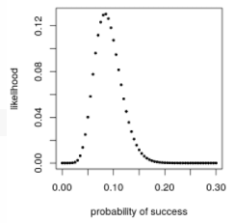
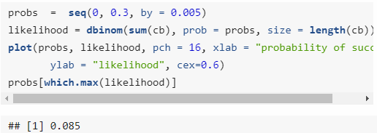
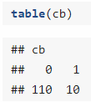
2.4 – Binomial distributions and maximum likelihood
Binomial distributions
n: number of trials
p: probability of an event (1) → Often unknown
An example: red-green colorblindness in males
n = 120
P → ?

Slide 9
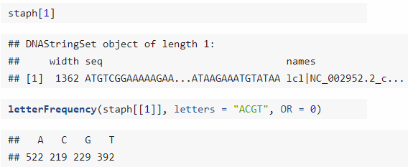
2.5 – More boxes: multinomial data
An example: DNA from one strand of DNA for the genes of S. aureus bacterium
Evolutionary selection can act on nucleotide frequencies
Do nucleotides occur in the same proportions in the first 10 genes?
If not, this would provide us with evidence for varying selective pressure on these ten genes.

Slide 10
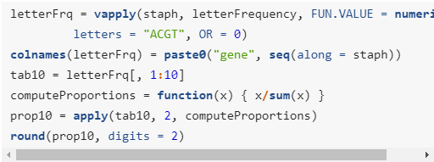
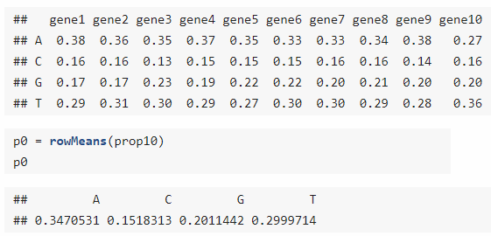
2.5 – More boxes: multinomial data
An example: DNA from one strand of DNA for the genes of S. aureus bacterium
Evolutionary selection can act on nucleotide frequencies
Do nucleotides occur in the same proportions in the first 10 genes?
If not, this would provide us with evidence for varying selective pressure on these ten genes.

Slide 11
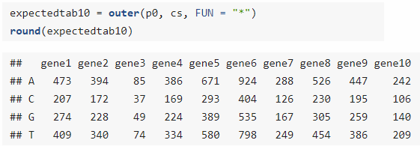
2.5 – More boxes: multinomial data
An example: DNA from one strand of DNA for the genes of S. aureus bacterium
Evolutionary selection can act on nucleotide frequencies
Do nucleotides occur in the same proportions in the first 10 genes?
If not, this would provide us with evidence for varying selective pressure on these ten genes.

Slide 12
2.5 – More boxes: multinomial data
An example: DNA from one strand of DNA for the genes of S. aureus bacterium
Evolutionary selection can act on nucleotide frequencies
Do nucleotides occur in the same proportions in the first 10 genes?
If not, this would provide us with evidence for varying selective pressure on these ten genes.

Slide 13
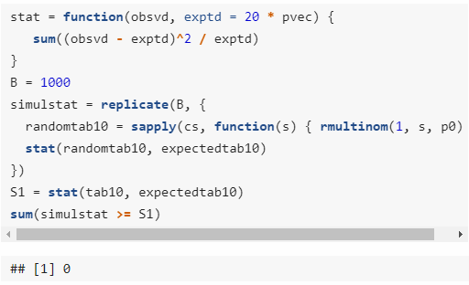
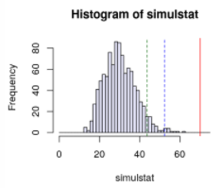
2.5 – More boxes: multinomial data
An example: DNA from one strand of DNA for the genes of S. aureus bacterium
Evolutionary selection can act on nucleotide frequencies
Do nucleotides occur in the same proportions in the first 10 genes?
If not, this would provide us with evidence for varying selective pressure on these ten genes.

Slide 14
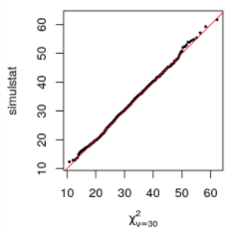
2.6 – The χ² distribution
We can use statistical theory to come to the same conclusion without running the Monte Carlo simulations.
Monte Carlo has limitations, so if any theory is applicable that tends to be useful.
The granularity of the computation is 1/B, so we cannot estimate any probabilities smaller than that, and the uncertainty of the estimate is larger.
Many simulations take a long time.
The theoretical distribution of the simulstat statistic is called the χ² (chi-squared) distribution with parameter 30 (degree of freedom (df) = 10 x (4-1)).
Can be confirmed using the QQ (quantile-quantile) plot, another visual goodness-of-fit tool.
When comparing two distributions, whether from two different samples or from one sample versus a theoretical model, just looking at histograms is not informative enough.

Slide 15
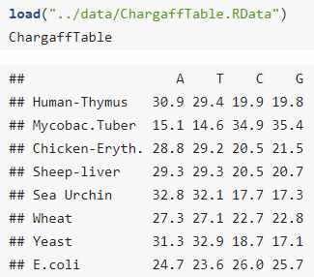
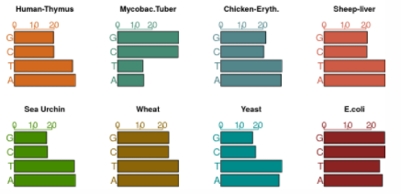
2.7 – Chargaff’s rule
Chargaff’s rule: A + G = T + C ➔ A=T & G=C

Slide 16
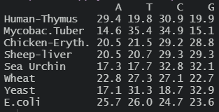
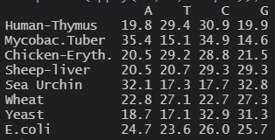
2.7 – Chargaff’s rule
Chargaff’s rule: A + G = T + C ➔ A=T & G=C

Slide 17
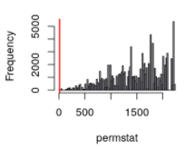
2.7 – Chargaff’s rule
Chargaff’s rule: A + G = T + C ➔ A=T & G=C

Slide 18
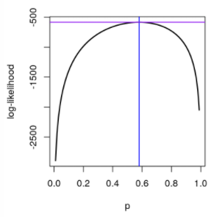
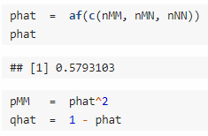
2.7.2 – A special multinomial: Hardy-Weinberg equilibrium
Postulates
Allele frequencies are independent of each other.
There is random mating in a larger population with equal distribution of the alleles among sexes.
Two alleles: M (p), N (q = 1-p)
Three genotypes: MM (p²), MN (2pq), NN (q²)

Slide 19
2.9 – Bayesian thinking
The Bayesian paradigm
A practical approach where prior and posterior distributions are used as models of our knowledge before and after collecting some data and making an observation.
Start with a hypothesis (H) and use data to decide whether the hypothesis is true.
We can formalize our prior knowledge about H in the form of a prior probability, P(H).
After we see the data, we can model the posterior probability, P(H|D).
P(H|D) may be higher or lower than P(H), depending on what the data D were.

Slide 20
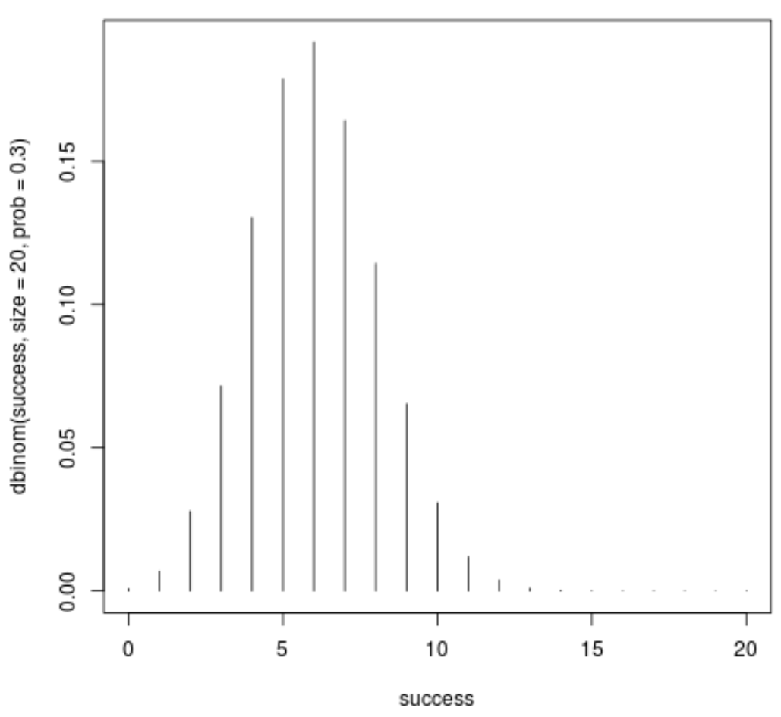
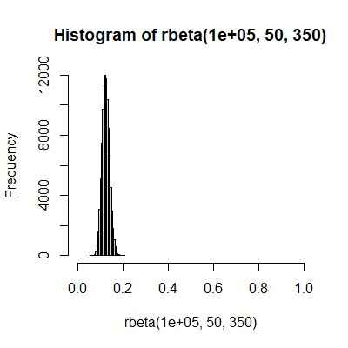
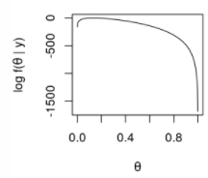
2.9 – Bayesian thinking
Example data
n = 300
y = 40 (successes)
Modelled by the binomial distribution
Theta: the probability of success
40

Slide 21
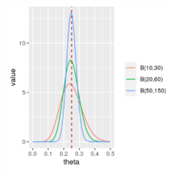
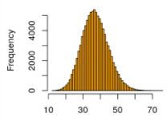
2.9 – Bayesian thinking
Example data
n = 300
y = 40 (successes)
Modelled by the binomial distribution
Theta can be drawn from a statistical distribution (= not a single, fixed value).
Y ~ B(n = 500, p = 0.4) → Binomial distribution of Y
Y ~ B(n = 500, p = (follows a distribution) ) → Marginal distribution of Y
Using prior knowledge of the data, we first define a seemingly likely distribution of theta. → Prior distribution
After observing the data, we update the theta distribution. → Posterior distribution

Slide 22
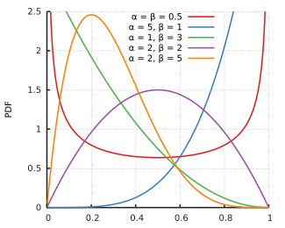
2.9 – Bayesian thinking
Example data
n = 300
y = 40 (successes)
Modelled by the binomial distribution
Theta can be drawn from a statistical distribution (= not a single, fixed value).
When looking at a parameter that expresses a proportion of a probability (0 <= p <= 1), it is convenient to use the beta distribution.
If the prior distribution is beta-shaped, the updated posterior distribution will also have a beta distribution.

Slide 23
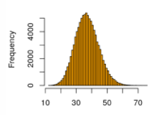
2.9 – Bayesian thinking
Example data
n = 300
y = 40 (successes)
Modelled by the binomial distribution
Using prior knowledge of the data, we first define a seemingly likely distribution of theta. → Prior distribution
Run 100,000 simulations and get 100,000 success counts from a binomial distribution with n = 300 and 100,000 different thetas generated from a beta distribution B(a=50, b=350).

Slide 24
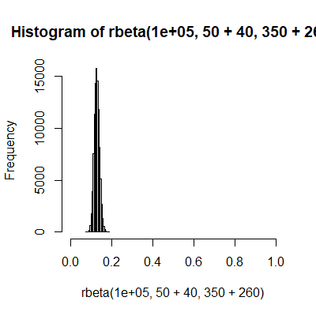
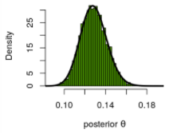
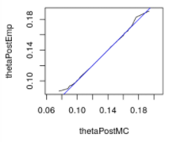
2.9 – Bayesian thinking
Example data
n = 300
y = 40 (successes)
Modelled by the binomial distribution
After observing the data, we update the theta distribution. → Posterior distribution
The posterior distribution of theta is the distribution of the thetas that resulted in y = 40.
The posterior distribution is a beta distribution with a = 50+y, b = 350+(n-y).

Slide 25
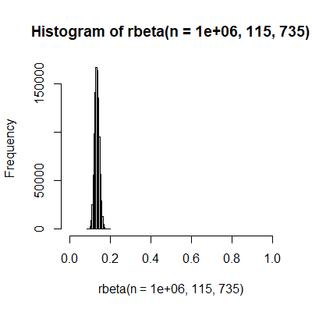
2.9 – Bayesian thinking
New data
n = 150
y = 25 (successes)
Modelled by the binomial distribution
After observing the data, we update the theta distribution. → Posterior distribution
The posterior distribution is a beta distribution with a = 90+25, b=610+125.

Slide 26
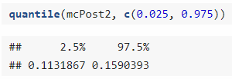
2.9 – Bayesian thinking
As a general rule, the prior rarely changes the posterior distribution substantially except it if is very peaked.
This would be the case if, at the outset, we were already rather sure of what to expect.
Another case when the prior has an influence is if there is very little data.
The best situation is to have enough that to swamp the prior so that its choice doesn’t have much impact on the final result.
The posterior distribution is a beta distribution with a = 50+y, b = 350+(n-y).

Slide 27
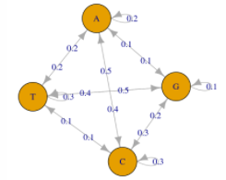
2.10.1 – Modeling in the case of dependencies
2.10 – Example: occurrence of a nucleotide pattern in a genome
Markov assumption
A good prediction of tomorrow’s weather is that it will most likely be the same as today’s weather.
The prediction for a day’s weather only depends on the state of the previous k days, but not on yesterday or three weeks ago.
This can be applied to biological sequences
The probability that a nucleotide will appear at a certain position depends on the previous nucleotide.
The probability of a sequence of nucleotides can be represented as a Markov chain.

Slide 28
2.10.1 – Modeling in the case of dependencies
2.10 – Example: occurrence of a nucleotide pattern in a genome
An example of dependency modeling using a Markov chain.
Get the sequences of all CpG islands in chromosome 8 of the human genome.
CpG islands: chromosomal regions highly enriched in cytosine and guanine.
Calculate the frequencies of all digrams (e.g., AA, AG, …, TC, TG) in CpG island sequences.
Calculate the frequencies of all digrams in non-CpG island sequences (gaps between CpG islands).
For a given sequence, calculate the probability it originated from a CpG island, the probability it originated from a non-CpG region, and the odds ratio.
For a group of sequences from both CpG islands and non-CpG regions, draw the odds ratio distributions.

Slide 29
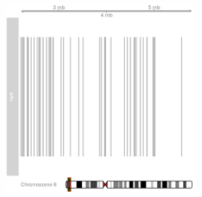
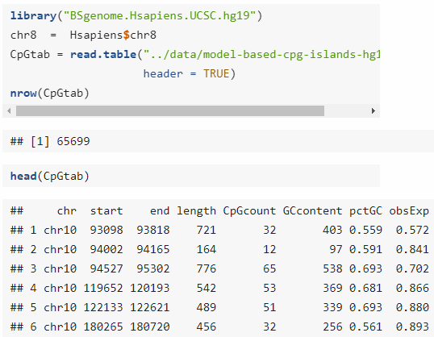
2.10.1 – Modeling in the case of dependencies
2.10 – Example: occurrence of a nucleotide pattern in a genome
An example of dependency modeling using a Markov chain.
Get the sequences of all CpG islands in chromosome 8 of the human genome (Irizarry, Wu, and Feinberg, 2009).
CpG islands: chromosomal regions highly enriched in cytosine and guanine.

Slide 30
2.10.1 – Modeling in the case of dependencies
2.10 – Example: occurrence of a nucleotide pattern in a genome
An example of dependency modeling using a Markov chain.
Get the sequences of all CpG islands in chromosome 8 of the human genome (Irizarry, Wu, and Feinberg, 2009).
CpG islands: chromosomal regions highly enriched in cytosine and guanine.

Slide 31
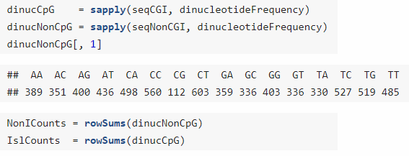
2.10.1 – Modeling in the case of dependencies
2.10 – Example: occurrence of a nucleotide pattern in a genome
An example of dependency modeling using a Markov chain.
Calculate the frequencies of all digrams (e.g., AA, AG, …, TC, TG) in CpG island sequences.
Calculate the frequencies of all digrams in non-CpG island sequences (gaps between CpG islands).

Slide 32
2.10.1 – Modeling in the case of dependencies
2.10 – Example: occurrence of a nucleotide pattern in a genome
An example of dependency modeling using a Markov chain.
For a given sequence, calculate the probability it originated from a CpG island, the probability it originated from a non-CpG region, and the log odds ratio (log-likelihood ratio).
Sequence: ACGTTATACTACG

Slide 33
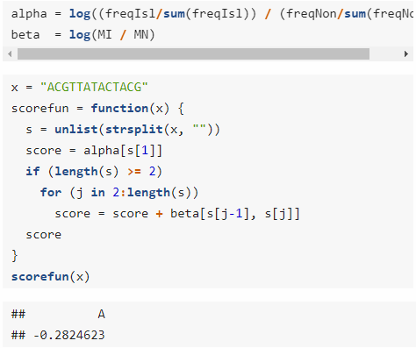
2.10.1 – Modeling in the case of dependencies
2.10 – Example: occurrence of a nucleotide pattern in a genome
An example of dependency modeling using a Markov chain.
For a given sequence, calculate the probability it originated from a CpG island, the probability it originated from a non-CpG region, and the log odds ratio (log-likelihood ratio).
Sequence: ACGTTATACTACG

Slide 34
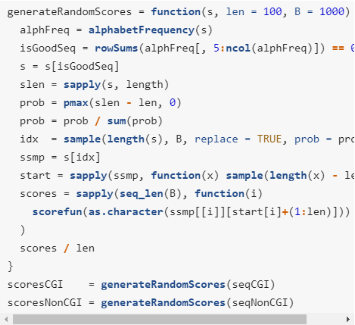
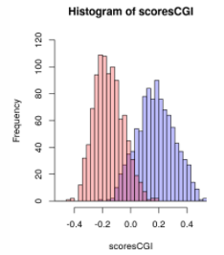
2.10.1 – Modeling in the case of dependencies
2.10 – Example: occurrence of a nucleotide pattern in a genome
An example of dependency modeling using a Markov chain.
For a group of sequences from both CpG islands and non-CpG regions, draw the log odds ratio distributions.
Objective: See if its possible to determine if a sequence originates from a CpG island or not based on its log-likelihood ratio.
Draw the distribution of log-likelihood ratios for all CpG island and non-CpG region sequences of length 100 nt.
Bimodality
→ Ch. 4

