Slide 1
Modern Statistics for Modern Biology
10. Networks and Trees
BIG lab, Hanyang University
Min-hak Choi 2021-07-26

Slide 2
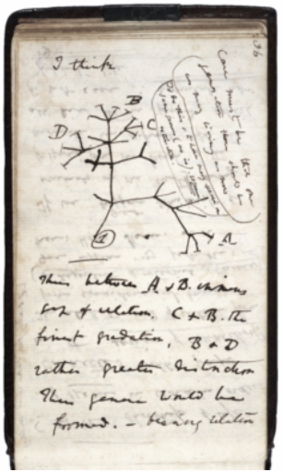
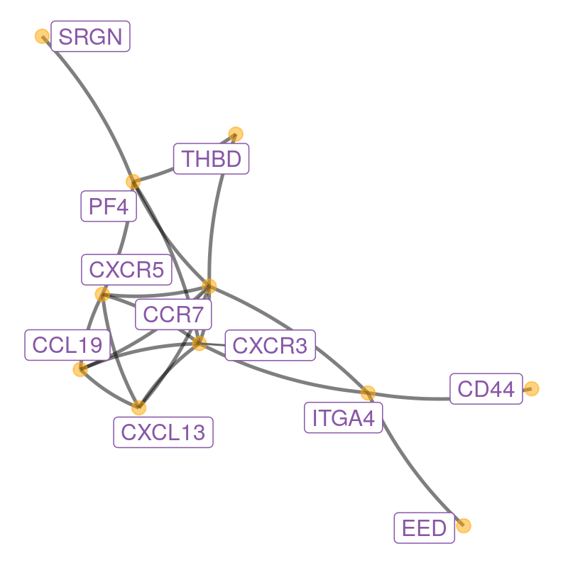
Introduction
Networks and trees are often used to represent both biological data and knowledge about a system. Phylogenetic trees were used to represent family relationships between species even before Darwin’s famous notebook sketch. Networks are often used to schematize complex interactions between proteins involved in diseases as in Figure 10.1

Slide 3
10.1 Goals for this chapter
In this chapter we will
Use the formal definition of a graph’s components: edges, vertices, layout to see how we can manipulate them in R using both adjacency matrices and lists of edges.
We will transform a graph object from igraph into an object that can be visualized according to the layers approach in ggplot2 using ggnetwork. We will experiment with covariates that we attach to graph edges and nodes.
Graphs are useful ways of encoding prior knowledge about a system, and we will see how they enable us to go from simple gene set analyses to meaningful biological recommendations by mapping significance scores onto the network to detect perturbation hotspots.
We will build phylogenetic trees starting with from DNA sequences and then visualize these trees with the specifically designed R packages ape and ggtree.
We will combine a phylogenetic tree built from microbiome 16S rRNA data with covariates to show how the hierarchical relationship between taxa can increase the power in multiple hypothesis testing.
A special tree called a minimum spanning tree (MST) is very useful for testing the relations between a graph and other covariates. We’ll see how to implement different versions of what is known as the Friedman-Rafsky test. We’ll study both co-occurrence of bacteria in mice litters and strain similarities in HIV contagion networks.

Slide 4
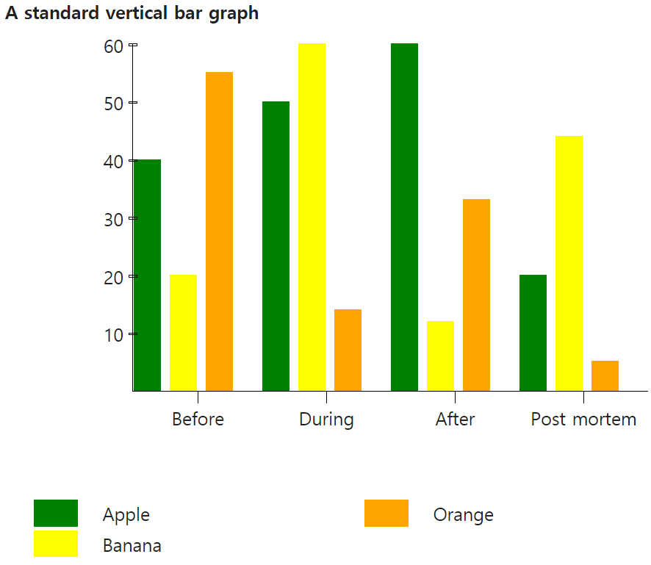
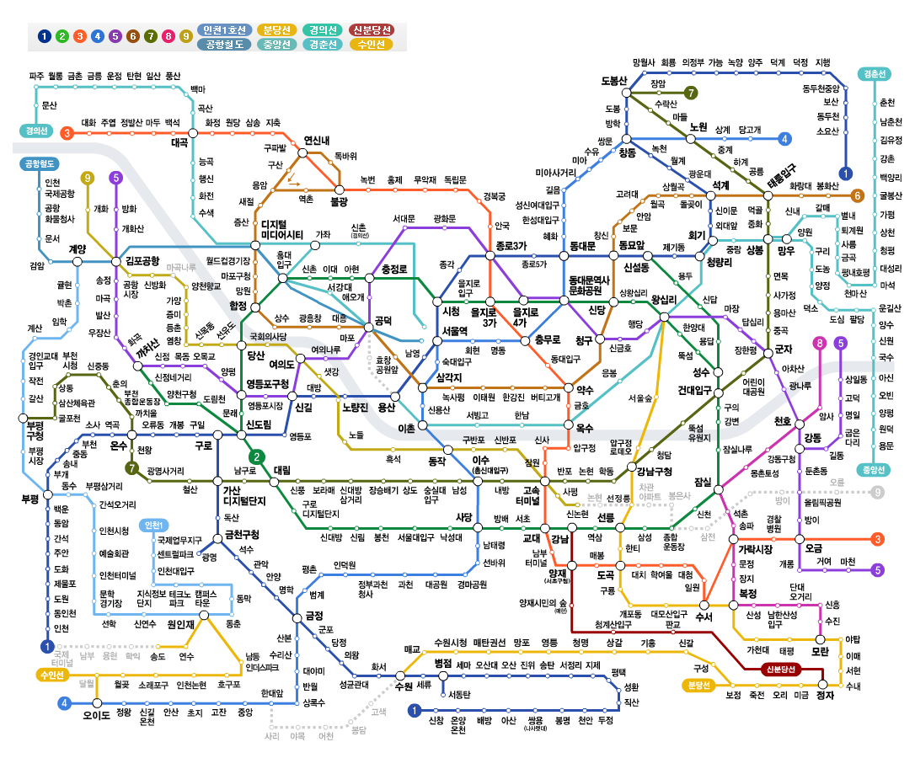
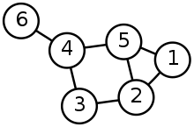
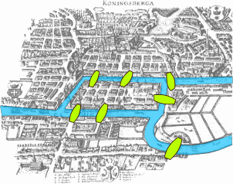
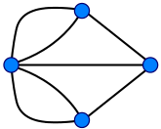
10.2.1 What is a graph and how can it be encoded?
A graph is formed by a set of nodes or vertices (often called V) and a set of edges between these vertices E. – “undirected graphs” and “directed or oriented graphs”
Koenigsberg bridge problem (Seven Bridges of Königsberg)
Eulerian trail (1736)
From wikipedia

Slide 5
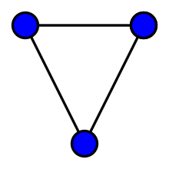
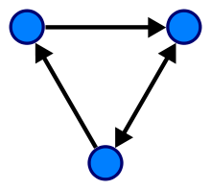
10.2.1 What is a graph and how can it be encoded?
A graph is formed by a set of nodes or vertices (often called V) and a set of edges between these vertices E. – “undirected graph” and “directed or oriented graph”
A graph (sometimes called undirected graph or simple graph) is a pair G = (V, E), where V is a set whose elements are called vertices and E is a set of paired vertices, whose elements are called edges (sometimes links or lines).
- vertices x and y of an edge {x, y} are called the endpoints of the edge.
Directed graph (or digraph) is a graph in which edges have orientations
From wikipedia

Slide 6
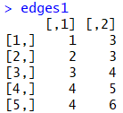
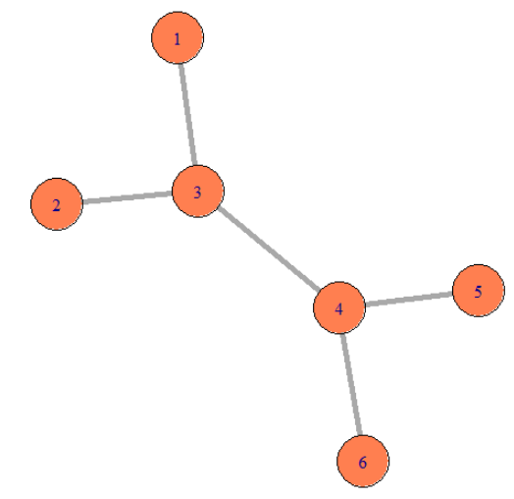
10.2.1 What is a graph and how can it be encoded?
An adjacency matrix is a square matrix used to represent a finite graph.
For a simple graph with vertex set U = {u₁, …, u_{n}}, the adjacency matrix is a square n × n matrix A such that its element A_{ij} is one when there is an edge from vertex u_{i} to vertex u_{j}, and zero when there is no edge.
U₁
 | U₁ | U₂ | U₃
U₁ | 0 | 1 | 1
U₂ | 1 | 0 | 1
U₃ | 1 | 1 | 0
U₂
U₃

Slide 7
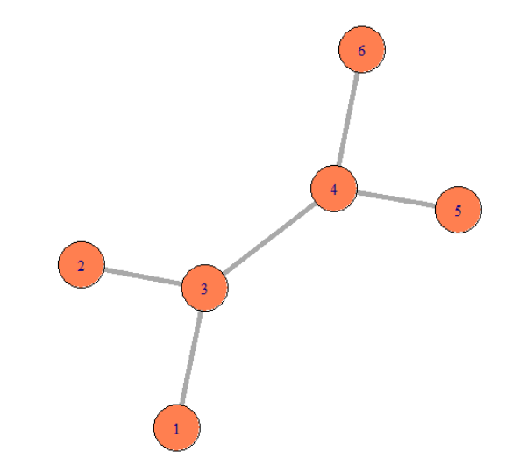
10.2.1 What is a graph and how can it be encoded?
An adjacency matrix is a square matrix used to represent a finite graph.
For a simple graph with vertex set U = {u₁, …, u_{n}}, the adjacency matrix is a square n × n matrix A such that its element A_{ij} is one when there is an edge from vertex u_{i} to vertex u_{j}, and zero when there is no edge.

Slide 8
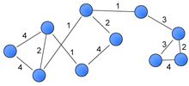
10.2.1 What is a graph and how can it be encoded?
Elements of a simple graph - Edge lengths, when not specified, we suppose they are all one and compute the distance between vertices on the graph as the number the edges traversed. - We call a weighted, directed graph a network
Weighted graph A weighted graph or a network is a graph in which a number (the weight) is assigned to each edge.
For example, in shortest path problems such as the traveling salesman problem

Slide 9
10.2.1 What is a graph and how can it be encoded?
Graph statistics - If the number of edges is similar to the number of nodes, we say that the graph is sparse ( dense).
- Some graphs have many nodes, for instance the package ppiData contains a predicted protein interaction (ppipred) graph on about 2500 proteins with 20,000 edges.
→ A complete adjacency matrix: 6,250,000 elements
U₁
 | U₁ | U₂ | U₃
U₁ | 0 | 1 | 1
U₂ | 1 | 0 | 1
U₃ | 1 | 1 | 0
→ {(U1,U2), (U1,U3), (U2,U3)} a list of edges and ‘weight’ (this only use 60,000 elements)
U₂
U₃

Slide 10
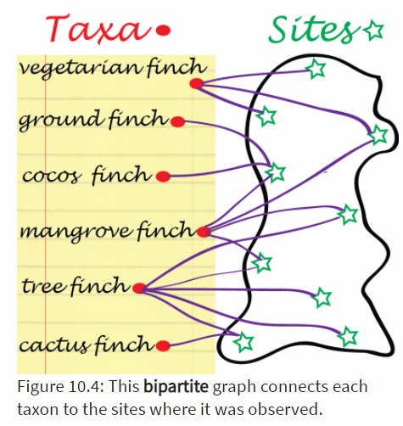
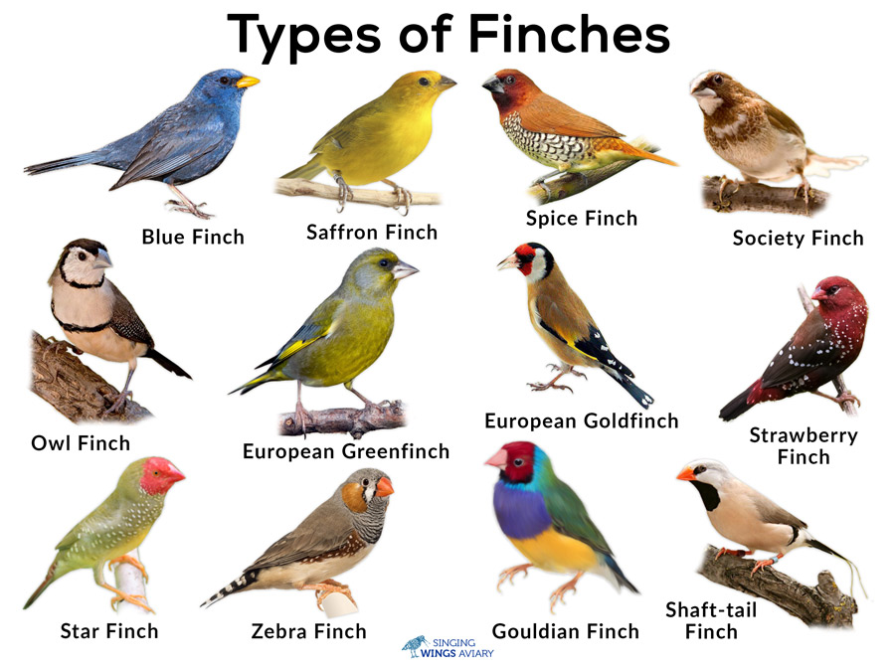
10.2.1 What is a graph and how can it be encoded?
Graphs from data Usually data do not arrive in the form of graphs.
From distance: Graphs can simplify distance matrices by rounding the smaller distances down to zero. This requires defining a threshold t and then making edges between points
Binary data: Some data arrive naturally as 0/1 matrices, for instance presence or absence of the different finches in the Galapagos archipelago can be encoded with a 0/1 table.

Slide 11
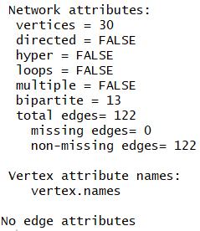
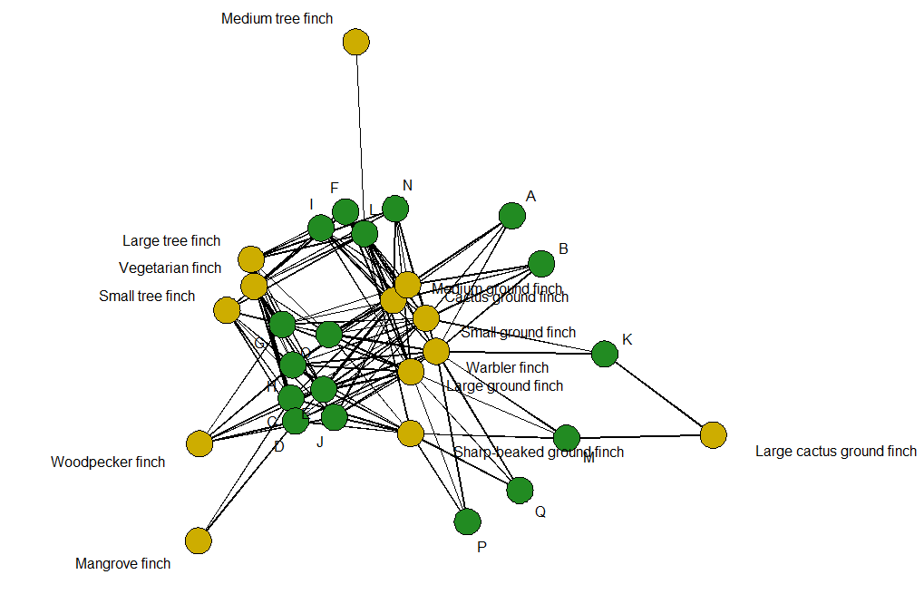
10.2.1 What is a graph and how can it be encoded?
Graphs from data Binary data: Some data arrive naturally as 0/1 matrices, for instance presence or absence of the different finches in the Galapagos archipelago can be encoded with a 0/1 table.

Slide 12
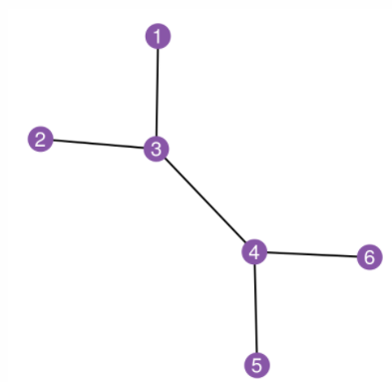
10.2.1 What is a graph and how can it be encoded?
Graphs from data Binary data: Some data arrive naturally as 0/1 matrices, for instance presence or absence of the different finches in the Galapagos archipelago can be encoded with a 0/1 table.

Slide 13
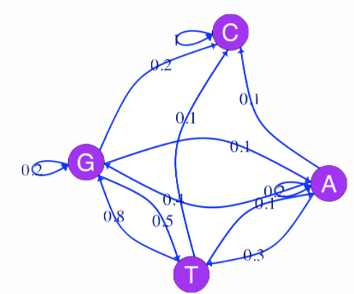
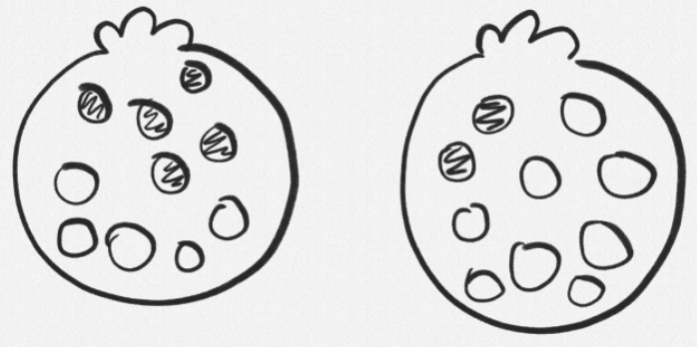
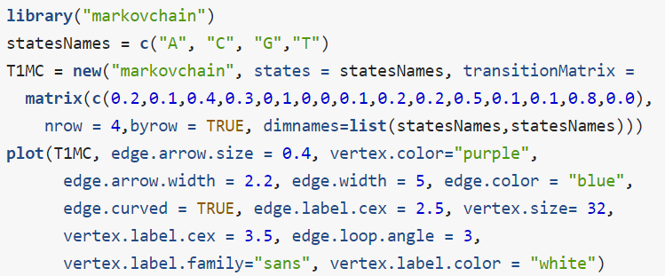
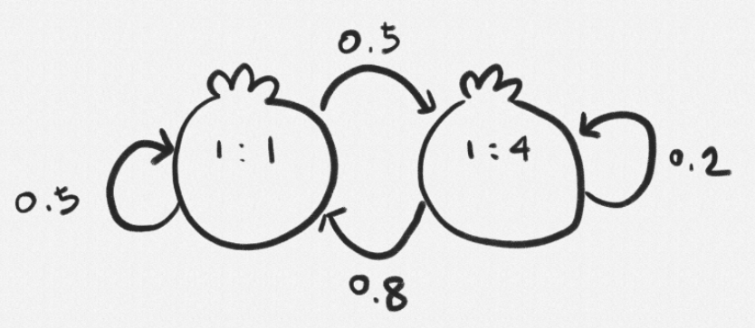
10.2.1 What is a graph and how can it be encoded?
An example: a four state Markov chain In Chapter 2 we saw how a Markov chain can summarize transitions between nucleotides (considered the states of the system).

Slide 14
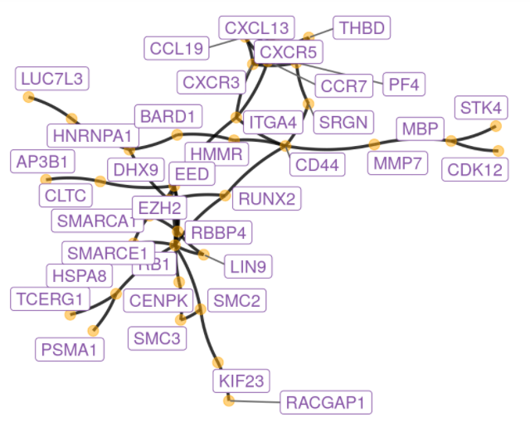
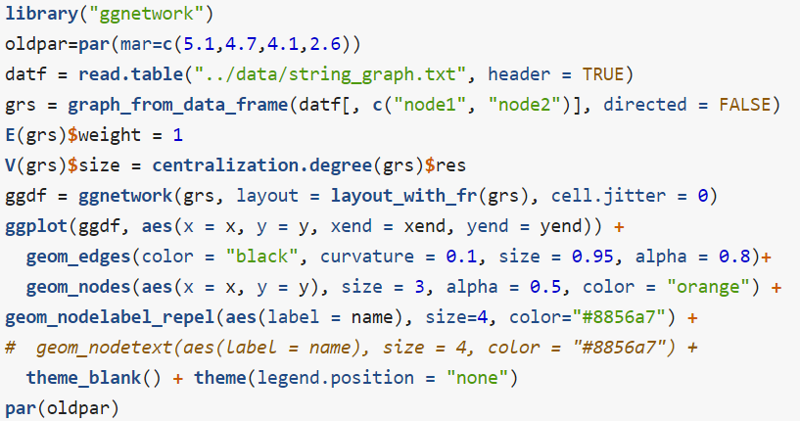
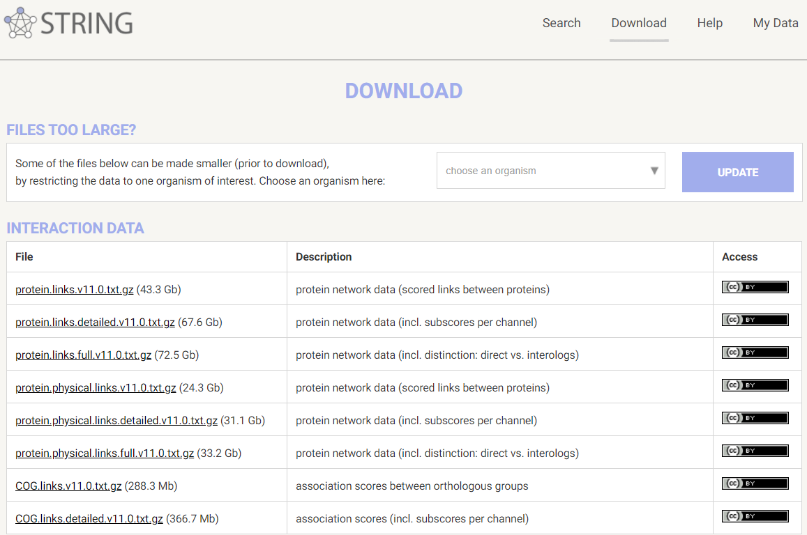
10.2.2 Graph with many layers: labels on edges and nodes
Here is an example of plotting a graph downloaded from the STRING database with annotations at the vertices.
Figure 10.8 shows the full perturbed chemokine subnetwork discovered in the study of breast cancer metastasis using GXNA (Nacu et al. 2007) and reported by Yu et al. (2012).

Slide 15
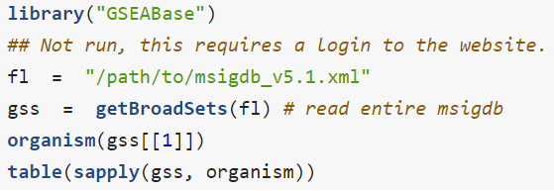
10.3 From gene set enrichment to networks
Gene Set Enrichment Analysis (GSEA) is a computational method that determines whether an a priori defined set of genes shows statistically significant, concordant differences between two biological states (e.g. phenotypes).
The Gene Ontology (GO) is a collection of three ontologies that describe genes and gene products. - Molecular function, Biological process, Cellular component
The main purpose of using GO annotations for a particular set of Genes designated as significant in an experiment is to look for the enrichment of a GO term in this list, we will give this term a statistical meaning below.

Slide 16
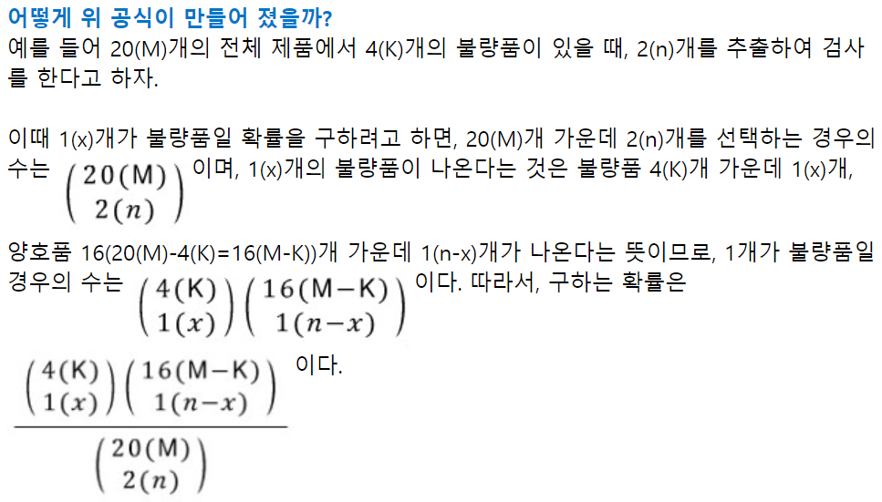
10.3.2 Gene set analysis with two-way table tests
Here, we start by explaining a basic approach often called or hypergeometric testing. - X = (M, K, n)
 | Yellow | Blue | Red
Significant | 25 | 25 | 25
Universe | 500 | 100 | 400
N=1,000, m=75 (genes are labeled as significant), Is the blue category enriched or overrepresented?
https://m.blog.naver.com/PostView.naver?isHttpsRedirect=true&blogId=sw4r&logNo=110159926579

Slide 17
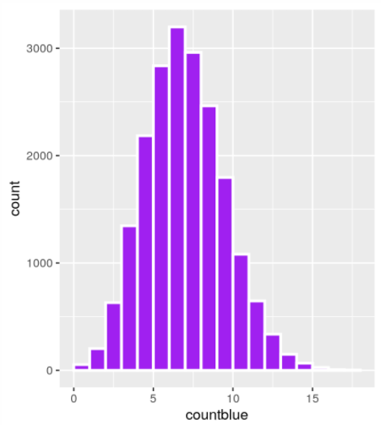
10.3.2 Gene set analysis with two-way table tests
 | Yellow | Blue | Red
Significant | 25 | 25 | 25
Universe | 500 | 100 | 400

Slide 18
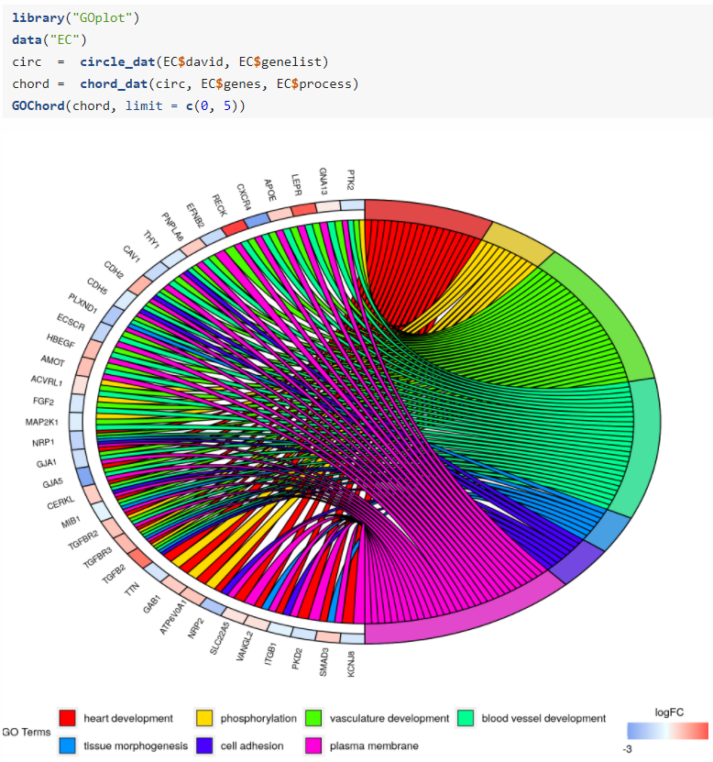
10.3.2 Gene set analysis with two-way table tests

Slide 19
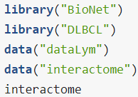
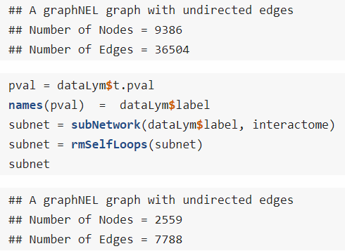
10.3.3 Significant subgraphs and high scoring modules
A careful implementation with many improvements is available as the Bioconductor package BioNet (Beisser et al. 2010). These methods all search for the subgraphs or modules of a scored-skeleton network that seem to be particularly perturbed. Each gene-node in the network is assigned a score that can either be calculated from a t-statistic or a p-value.

Slide 20
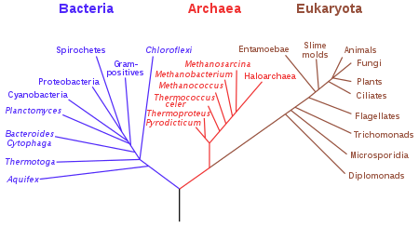
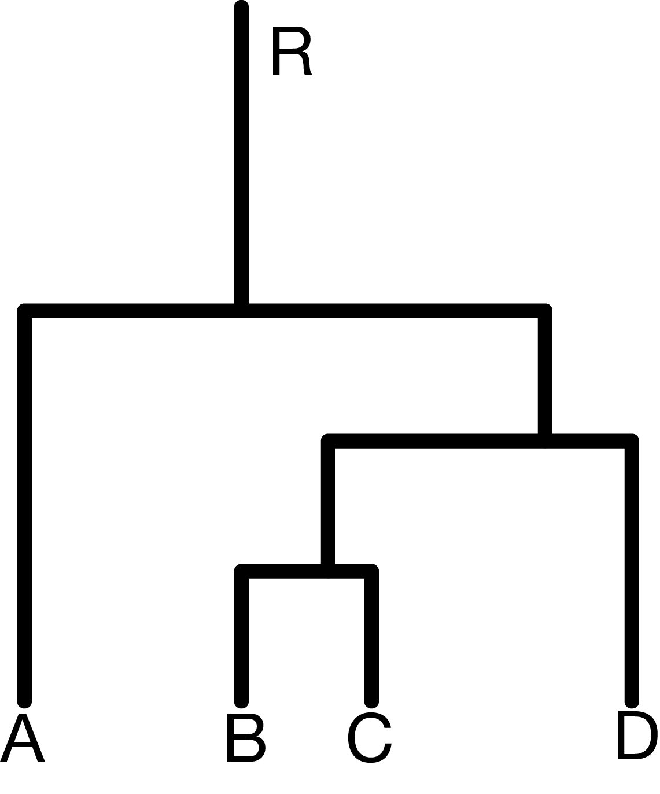
10.4 Phylogenetics Trees
One really important use of graphs in biology is the construction of phylogenetic trees.
Trees are graphs with no cycles (the official word for loops, whether self loops, or ones that go through several vertices).
A phylogenetic tree (also phylogeny or evolutionary tree is a branching diagram or a tree showing the evolutionary relationships among various biological species or other entities based upon similarities and differences in their physical or genetic characteristics.
From wikipedia

Slide 21
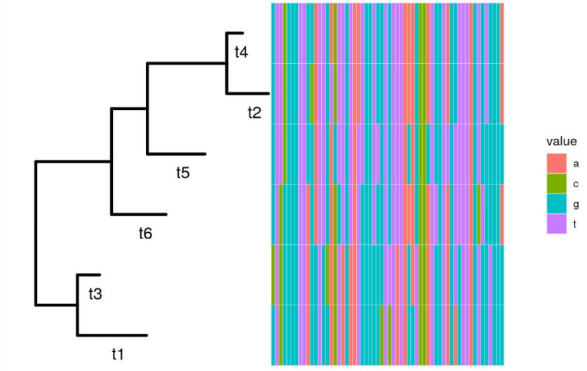
10.4.2 Simulating data and plotting a tree
Suppose we already know our phylogenetic tree and want to simulate the evolution of the nucleotides down this tree.

Slide 22
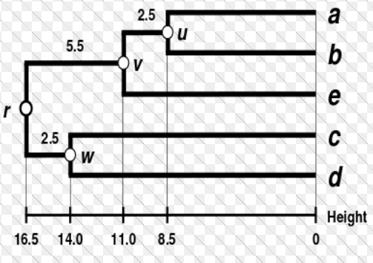
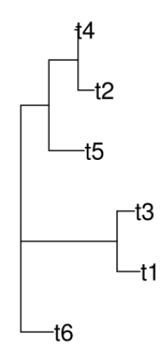
10.4.3 Estimating a phylogenetics tree
There are several approaches to estimation: tree `building’ is no exception, here are the main ones: A nonparametric estimate: the parsimony tree Parsimony is a nonparametric method
A parametric estimate: the maximum likelihood tree
Bayesian posterior distributions for trees
The semi-parametric approach: distance based methods : Neighbor Joining and UPGMA

Slide 23
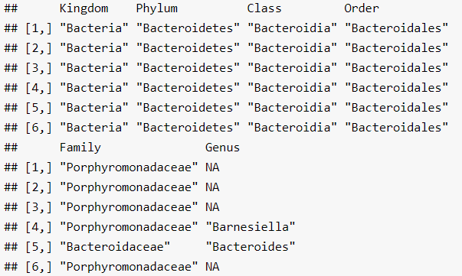
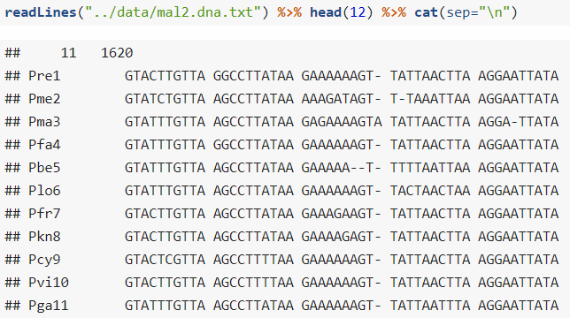
10.4.4 Application to 16S rRNA
In Chapter 5 we saw how to use a probabilistic clustering method to denoise 16S rRNA sequences. We can now reload these denoised sequences and preprocess them before building their phylogeny.

Slide 24
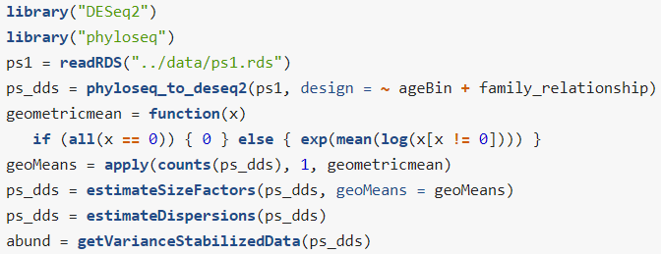
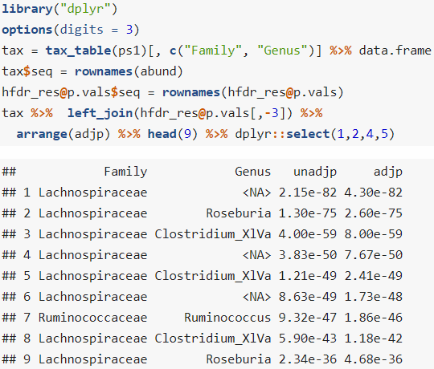
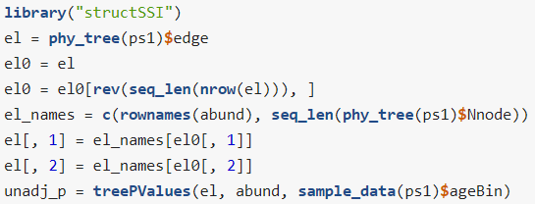
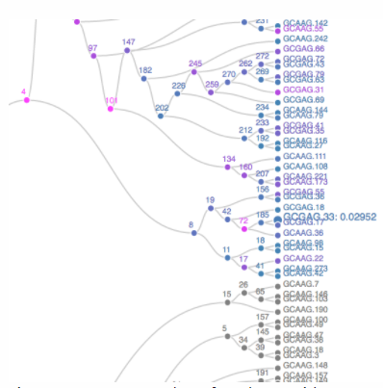
10.5.1 Hierarchical multiple testing
We apply this method to test the association between microbial abundance and age.

Slide 25
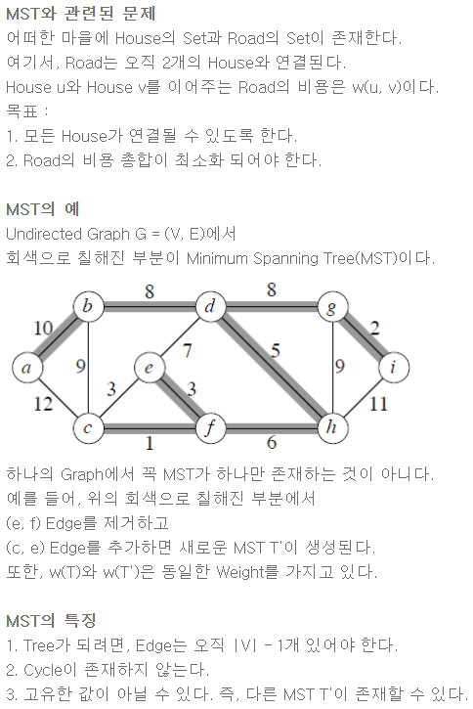
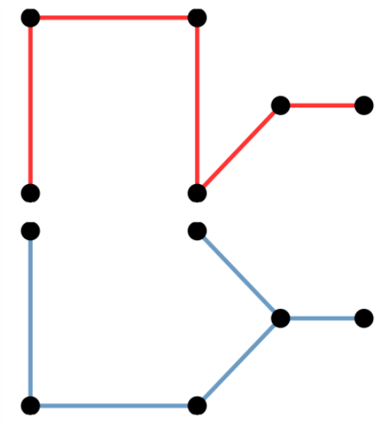
10.6 Minimum spanning trees
A very simple and useful graph is the so-called minimum spanning tree (MST). Given distances between vertices; the MST is the tree that spans all the points and has the minimum total length
Here we are going to take the DNA sequence distances between strains of HIV from patients all over the world and construct their minimum spanning tree.
https://blog.naver.com/babobigi/221884140229

Slide 26
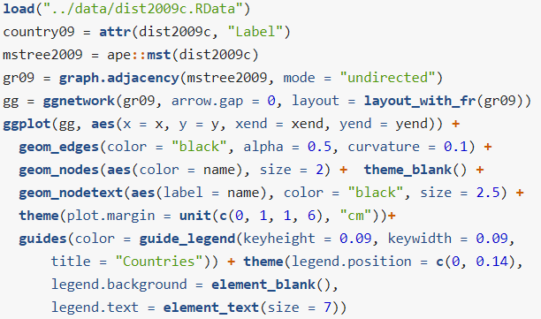
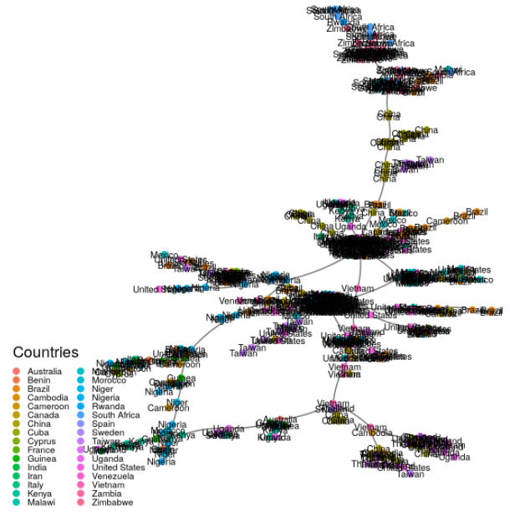
10.6 Minimum spanning trees
Here we are going to take the DNA sequence distances between strains of HIV from patients all over the world and construct their minimum spanning tree.

Slide 27
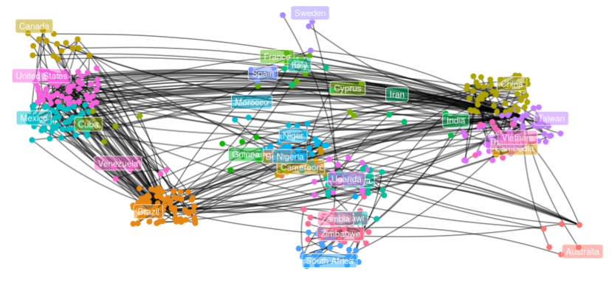
10.6 Minimum spanning trees
Here we are going to take the DNA sequence distances between strains of HIV from patients all over the world and construct their minimum spanning tree.
The DNA distances were computed using the Jukes-Cantor mutation model (JC69).

Slide 28
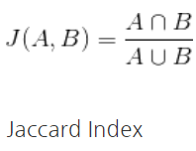
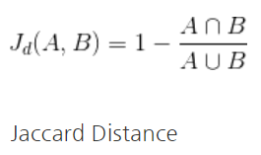
10.6.1 MST based testing: the Friedman-Rafsky test
Graph-based two-sample tests were introduced by Friedman and Rafsky (Friedman and Rafsky 1979) as a generalization of the Wald-Wolfowitz runs test.
The Wald–Wolfowitz runs test (or simply runs test), named after statisticians Abraham Wald and Jacob Wolfowitz is a non-parametric statistical test that checks a randomness hypothesis for a two-valued data sequence.
10.6.2 Example: Bacteria sharing between mice
Here we illustrate the idea on a collection of samples from mice whose stool were analyzed for their microbial content.

Slide 29
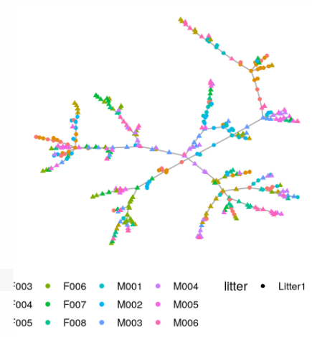
10.6.1 MST based testing: the Friedman-Rafsky test
10.6.2 Example: Bacteria sharing between mice
Here we illustrate the idea on a collection of samples from mice whose stool were analyzed for their microbial content.

