Slide 1
Chapter1.Generative models for discrete data
2021-07-12
Kyung-Tae Lee

Slide 2
Discrete data
In molecular biology, many situations involve counting events: how many codons use a certain spelling, how many reads of DNA match a reference, how many CG diagrams are observed in a DNA sequence -> Discrete data
If we know the rules that the mechanisms under study follow, even if the outcomes are random, we can generate the probabilities of any events we are interested in by computations and standard probability laws → Top-down approach
In this chapter, See how we can experiment with the most useful generative models for discrete data: Poisson, binomial, multinomial.

Slide 3
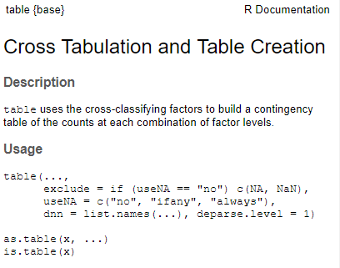
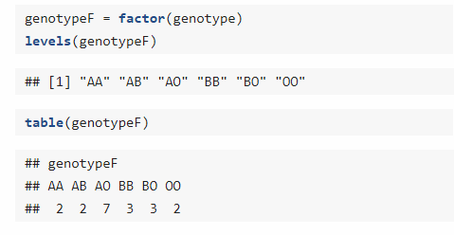
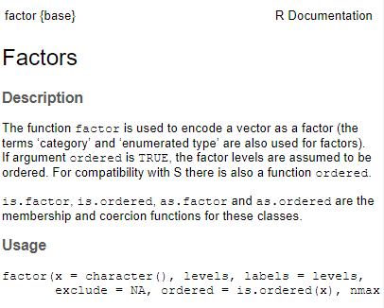
Using discrete probability models
When we measure a categorical variable on a sample, we often want to tally the frequencies of the different levels in a vector of counts. R has a special encoding for categorical variables and calls them factors

Slide 4
Bernoulli trials
A Bernoulli trial (or binomial trial) is a random experiment with exactly two possible outcomes, "success" and "failure", in which the probability of success is the same every time the experiment is conducted
In R, specification of the model is followed by R. rbinom, where binom is the abbreviation used for bionomial
Example of tossing a coin -> head or tail
15 : number of trials / prob : probability of success / size=1, we declared that each individual trial consists of just one single coin toss.

Slide 5
Binomial success counts
If trials are independent to each other and we only care about the number of success (the order does not matter), we can get the number of success by the code below
The number of success, 5, is called a binomial random variable or random variable that follows the B(15,0.3) distribution.
When we have only two possible outcomes such as heads or tails, success or failure, CpG or non-CpG, M or F, Y = pyrimidine or R = purine, diseased or healthy, true or false. We only need the probability of “success” p, because “failure” (the complementary event) will occur with probability 1−p.

Slide 6
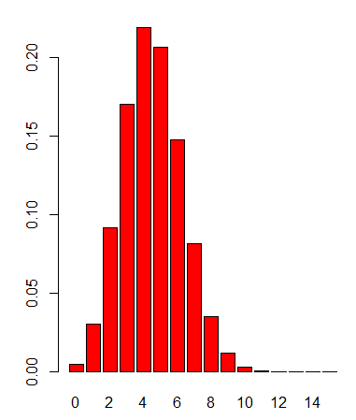
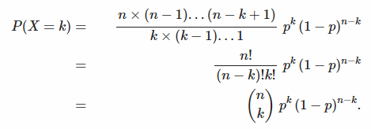
Binomial distribution
The complete probability mass distribution
Plotting the distribution
Mathematical theory tells us that for XX distributed as a binomial distribution with parameters (n,p) written X~B(n,p), the probability of seeing X=k successes is

Slide 7
Poisson distribution
When the probability of success pp is small and the number of trials n large, the binomial distribution B(n,p) can be faithfully approximated by a simpler distribution, the Poisson distribution with rate parameter λ=np
For Poisson, the mean and the variance are both lambda (λ)
It is a discrete probability distribution that expresses the probability of a given number of events occurring in a fixed interval of time or space if these events occur with a known constant mean rate and independently of the time since the last event

Slide 8
Poisson distribution
What is the probability mass distribution of observing 0:12 mutations in the genome of n=10⁴ nucleotides, when the probability is p=5X10⁻⁴ per nucleotide
Poisson probabilities
If λ=5 and we want to calculate P(X=3)
If we use R function, “dpois”

Slide 9
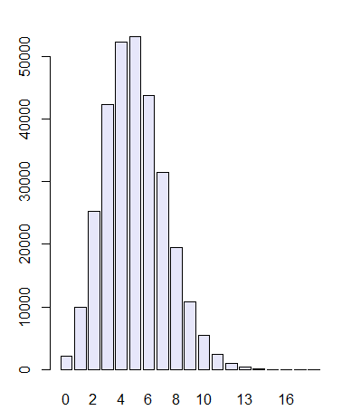
Simulation using binomial distribution
Simulate a mutation process along 10,000 positions with a mutation rate of 5×10−4 and count the number of mutations

Slide 10
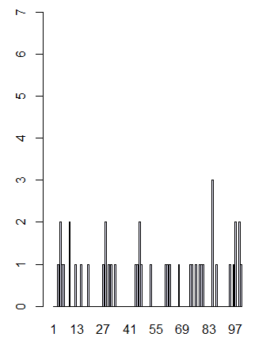
A generative model for epitope detection
When testing certain pharmaceutical compounds, it is important to detect proteins that provoke an allergic reaction. The molecular sites that are responsible for such reactions are called epitopes
ELISA assays are used to detect specific epitopes at different positions along a protein. Suppose the following facts hold for an ELISA array we are using:
The baseline noise lever per position, or more precisely the false positive rate, is 1%. This is the probability of declaring a hit – we think we have an epitope – when there is none. We write this P( declare epitope | no epitope)
The protein is tested at 100 different positions, supposed to be independent
We are going to examine a collection of 50 patient samples

Slide 11
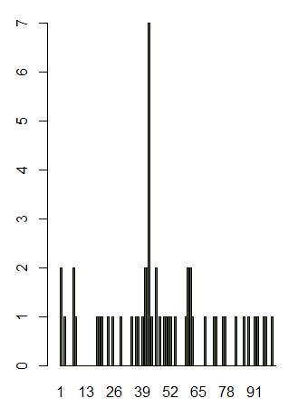
A generative model for epitope detection
Now suppose we see actual data as shown below
What are the chances of seeing a value as large as 7, if no epitope is present?

Slide 12
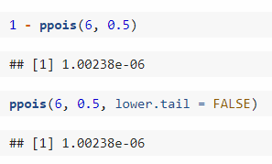
A generative model for epitope detection
This is, of course, the same as 1−P(X≤6). The probability P(X≤6) is the so-called cumulative distribution function at 6.

Slide 13
A generative model for epitope detection
There is flaw in the previous reasoning : instead of asking what the chances are of seeing a Poisson(0.5) as large as 7, we should ask ourselves, what are the chances that the maximum of 100 Poisson(0.5) trials is as large as 7? (Extreme value analysis)
Calculation of the probability
Using binomial theorem
2. Another, equivalent, route goes by using the approximation e−ϵ≃1−ϵ, which is the same as log(1−ϵ)≃−ϵ

Slide 14
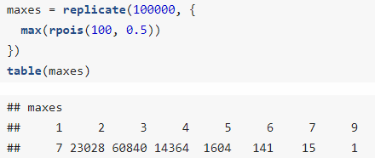
Computing probabilities by simulation
In practice, things tend to be more complicated, and we are better to compute our probabilities using the Monte Carlo method: a computer simulation based on our generative model that finds the probabilities of the events we’re interested in

Slide 15
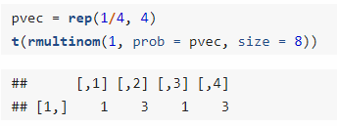
Multinomial distributions: the case of DNA
multinomial distribution is a generalization of the binomial distribution
For example, it models the probability of counts for each side of a k-sided die rolled n times. For n independent trials each of which leads to a success for exactly one of k categories, with each category having a given fixed success probability, the multinomial distribution gives the probability of any particular combination of numbers of successes for the various categories
Xi : Vector of counts / Pi : probability
Example : four category of equal probabilities (0.25)

Slide 16
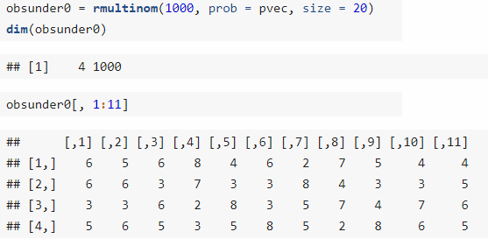
Simulating for power
Using Monte Carlo for the multinomial
The term power has a special meaning in statistics. It is the probability of detecting something if it is there, also called the true positive rate
Let’s call H0H0 the null hypothesis that the DNA data we have collected comes from a fair process, where each of the 4 nucleotides is equally likely (pA,pC,pG,pT)=(0.25,0.25,0.25,0.25)
Looking at a sequence of length n=20, we can detect whether the original distribution of nucleotides is fair or whether it comes from some other (“alternative”) process
We generate 1000 simulations from the null hypothesis using the rmultinom function

Slide 17
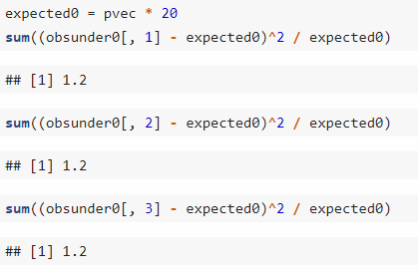
Creating a test
We also need a measure of variability that will enable us to describe how much variability is expected and how much is too much
How much do the first three columns of the generated data differ from what we expect?

Slide 18
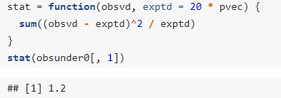
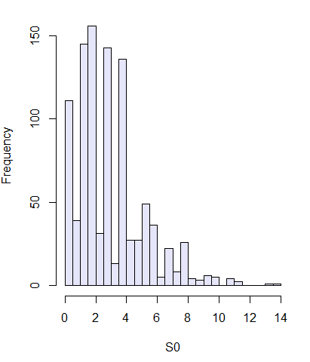
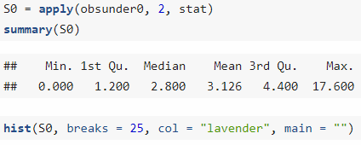
Creating a test
Using custom R function
Compute the measure for all 1000 instances and store these values in a vector we call S0: it contains values generated under H0

Slide 19
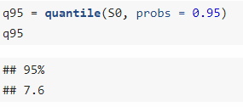
Creating a test
We can approximate the 95% quantile (a value that separates the smaller 95% of the values from the 5% largest values)
So wee see that 5% of the S0 values are larger than 7.6. We’ll propose this as our critical value for testing data and will reject the hypothesis that the data come from a fair process, with equally likely nucleotides, if the weighted sum of squares stat is larger than 7.6

Slide 20
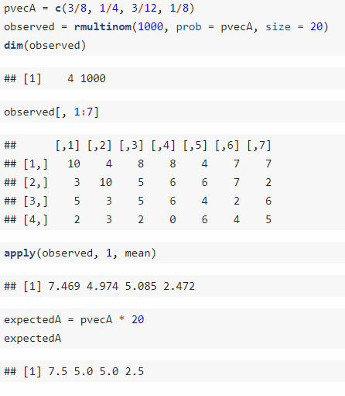
Determining our tests’ power
We must compute the probability that our test –based on the weighted sum-of-square differences– will detect that the data in fact do not come from the null hypothesis.
We compute the probability of rejecting by simulation. We generate 1000 simulated instances from an alternative process, parameterized by pvecA

Slide 21
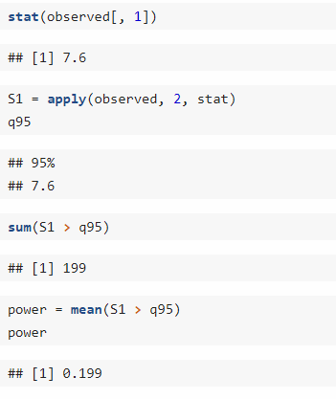
Determining our tests’ power
To determine the number of simulated cases that reject the null hypothesis
Run across 1000 simulations, the test identified 199 as coming from an alternative distribution. We’ve thus computed that the probability P(reject H0|HA)is 0.199
With a sequence length of n=20 we have a power of about 20% to detect the difference between the fair generating process and our alternative

Slide 22
Exercise 1.8
C. elegans genome nucleotide frequency: Is the mitochondrial sequence of C. elegans consistent with a model of equally likely nucleotides?
a. Explore the nucleotide frequencies of chromosome M by using a dedicated function in the Biostrings package from Bioconductor.
b. Test whether the C. elegans data is consistent with the uniform model (all nucleotide frequencies the same) using a simulation

Slide 23
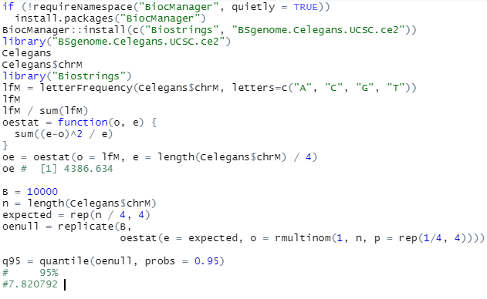
Exercise 1.8

