Slide 1
7 Multivariate Analysis
Jang-il Sohn

Slide 2
7.1 Goals for this chapter
Matrices
Dimension reduction
PCA
Visualize what this decomposition achieves and learn how to choose the number of principal components.
Run through a complete PCA analysis from start to finish.
Project factor covariates onto the PCA map to enable a more useful interpretation of the results.

Slide 3












Subjects
Variables
Multivariate analysis

Slide 4
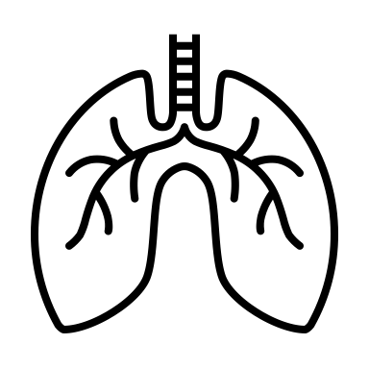











Variables
Subjects

Slide 5
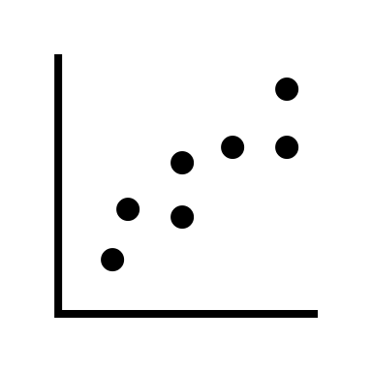
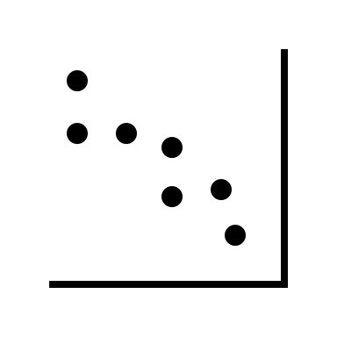
Multivariate analysis
Dimensionality reduction
Principal component analysis (PCA)
Correlated
(or anti-correlated)

Slide 6
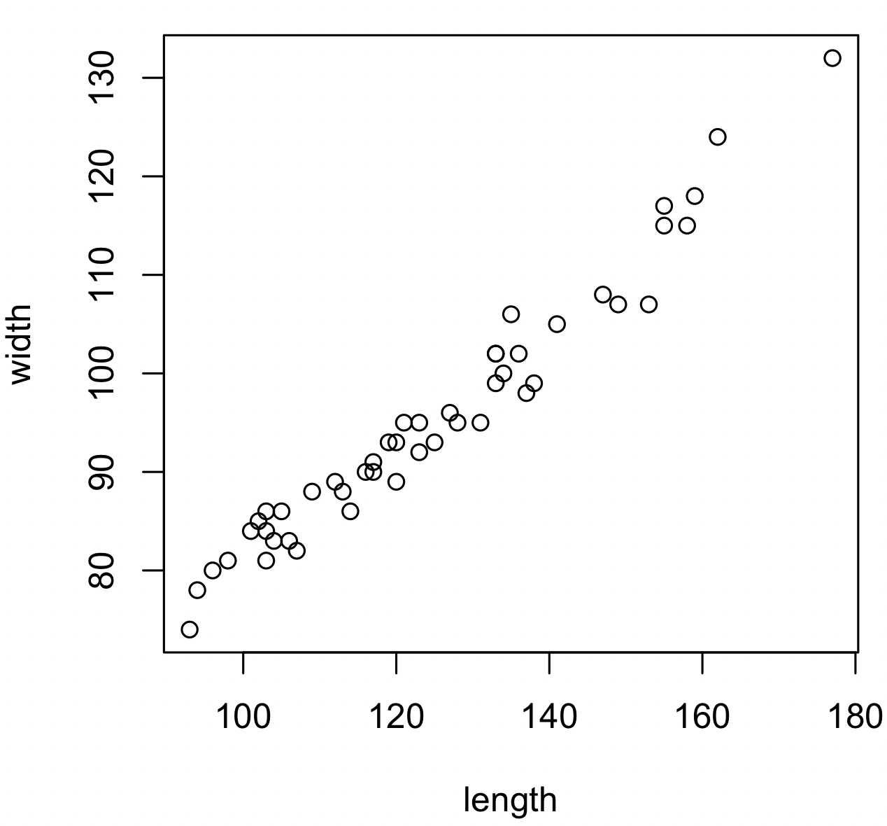
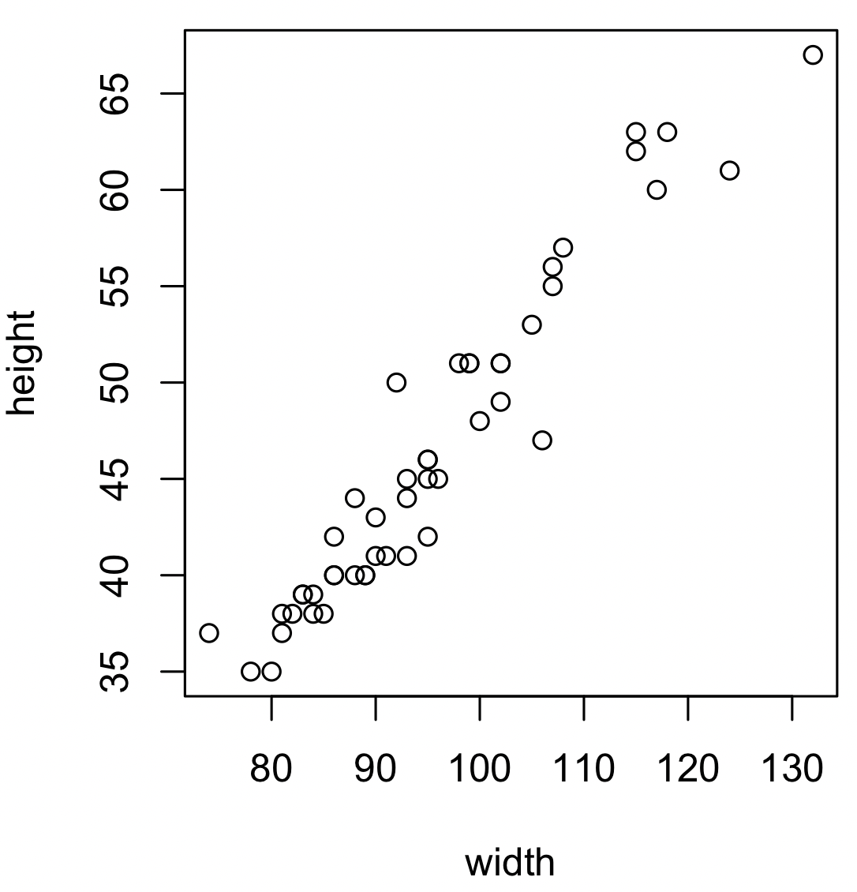
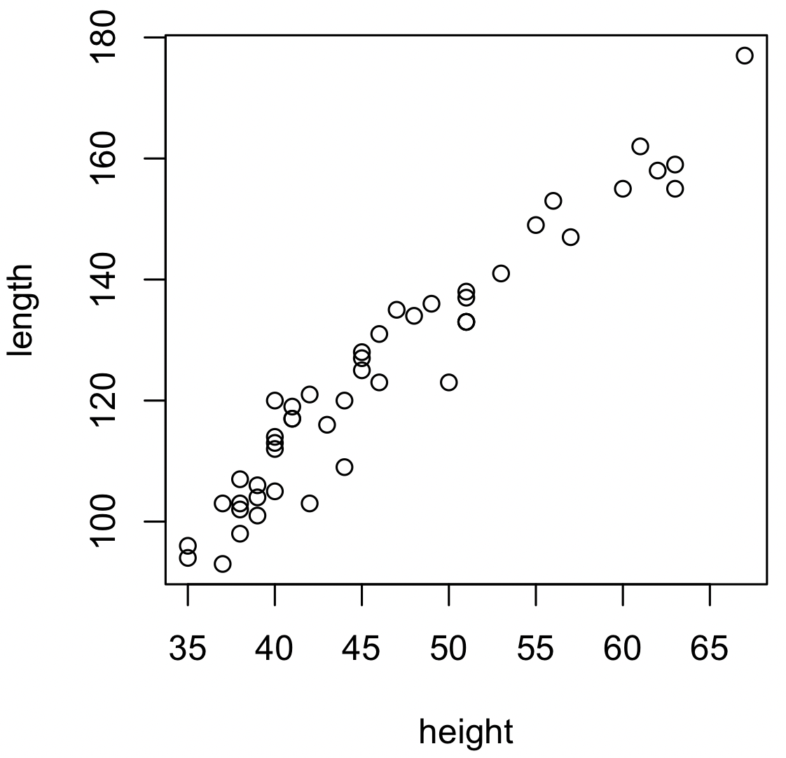
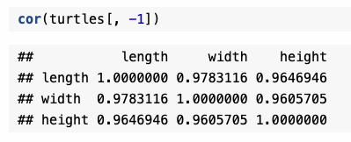
7.2.1 Low-dimensional data summaries and preparation
Pearson’s correlation coefficient
Painted turtle
turtles = read.table("../data/PaintedTurtles.txt", header = TRUE)
> turtles
sex length width height
1 f 98 81 38
2 f 103 84 38
3 f 103 86 42
> turtles[, -1]
length width height
1 98 81 38
2 103 84 38
3 103 86 42

Slide 7
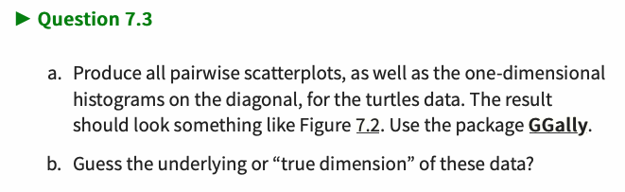
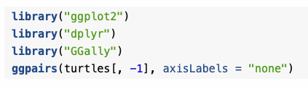
legnth
The size of turtle
correlated
width
hdight

Slide 8


ggpairs(athletes, axisLabels = "none")
Athletes
  load("../data/athletes.RData")
  library("pheatmap")
  athletes
10 variables
m100 long weight highj m400 m110 disc pole javel m1500
1 11.25 7.43 15.48 2.27 48.90 15.13 49.28 4.7 61.32 268.95
2 10.87 7.45 14.97 1.97 47.71 14.46 44.36 5.1 61.76 273.02
3 11.18 7.44 14.20 1.97 48.29 14.81 43.66 5.2 64.16 263.20
4 10.62 7.38 15.02 2.03 49.06 14.72 44.80 4.9 64.04 285.11
5 11.02 7.43 12.92 1.97 47.44 14.40 41.20 5.2 57.46 256.64
6 10.83 7.72 13.58 2.12 48.34 14.18 43.06 4.9 52.18 274.07
7 11.18 7.05 14.12 2.06 49.34 14.39 41.68 5.7 61.60 291.20
8 11.05 6.95 15.34 2.00 48.21 14.36 41.32 4.8 63.00 265.86
9 11.15 7.12 14.52 2.03 49.15 14.66 42.36 4.9 66.46 269.62
10 11.23 7.28 15.25 1.97 48.60 14.76 48.02 5.2 59.48 292.24
11 10.94 7.45 15.34 1.97 49.94 14.25 41.86 4.8 66.64 295.89
12 11.18 7.34 14.48 1.94 49.02 15.11 42.76 4.7 65.84 256.74
13 11.02 7.29 12.92 2.06 48.23 14.94 39.54 5.0 56.80 257.85
14 10.99 7.37 13.61 1.97 47.83 14.70 43.88 4.3 66.54 268.97
15 11.03 7.45 14.20 1.97 48.94 15.44 41.66 4.7 64.00 267.48
16 11.09 7.08 14.51 2.03 49.89 14.78 43.20 4.9 57.18 268.54
17 11.46 6.75 16.07 2.00 51.28 16.06 50.66 4.8 72.60 302.42
18 11.57 7.00 16.60 1.94 49.84 15.00 46.66 4.9 60.20 286.04
19 11.07 7.04 13.41 1.94 47.97 14.96 40.38 4.5 51.50 262.41
20 10.89 7.07 15.84 1.79 49.68 15.38 45.32 4.9 60.48 277.84
21 11.52 7.36 13.93 1.94 49.99 15.64 38.82 4.6 67.04 266.42
22 11.49 7.02 13.80 2.03 50.60 15.22 39.08 4.7 60.92 262.93
23 11.38 7.08 14.31 2.00 50.24 14.97 46.34 4.4 55.68 272.68
24 11.30 6.97 13.23 2.15 49.98 15.38 38.72 4.6 54.34 277.84
25 11.00 7.23 13.15 2.03 49.73 14.96 38.06 4.5 52.82 285.57
26 11.33 6.83 11.63 2.06 48.37 15.39 37.52 4.6 55.42 270.07
27 11.10 6.98 12.69 1.82 48.63 15.13 38.04 4.7 49.52 261.90
28 11.51 7.01 14.17 1.94 51.16 15.18 45.84 4.6 56.28 303.17
29 11.26 6.90 12.41 1.88 48.24 15.61 38.02 4.4 52.68 272.06
30 11.50 7.09 12.94 1.82 49.27 15.56 42.32 4.5 53.50 293.85
31 11.43 6.22 13.98 1.91 51.25 15.88 46.18 4.6 57.84 294.99
32 11.47 6.43 12.33 1.94 50.30 15.00 38.72 4.0 57.26 293.72
33 11.57 7.19 10.27 1.91 50.71 16.20 34.36 4.1 54.94 269.98

Slide 9
Athletes
  load("../data/athletes.RData")
  library("pheatmap")
  pheatmap(cor(athletes), cell.width = 10, cell.height = 10)
  About pheatmap() function
  https://www.rdocumentation.org/packages/pheatmap/versions/1.0.12/topics/pheatmap
Running
Throwing
m100
m110
m400
m1500
Running
javel
weight
disc
Throwing
highj
long
pole
Jumping
Jumping
10 variables
3 variables
Dimension reduction

Slide 10
7.2.2 Preprocessing the data
Centering
Scaling or
standardizing
NOTE:
If their original scale is relevant, then we can (should) leave the data as is.

Slide 11
7.2.2 Preprocessing the data
scaledTurtles = scale(turtles[, -1])
data.frame(scaledTurtles, sex = turtles[, 1]) %>%
ggplot(aes(x = width, y = height, group = sex)) +
geom_point(aes(color = sex)) + coord_fixed()
data.frame(turtles[,-1], sex = turtles[, 1]) %>%
ggplot(aes(x = width, y = height, group = sex)) +
geom_point(aes(color = sex)) + coord_fixed()
Before scale
After scale

Slide 12
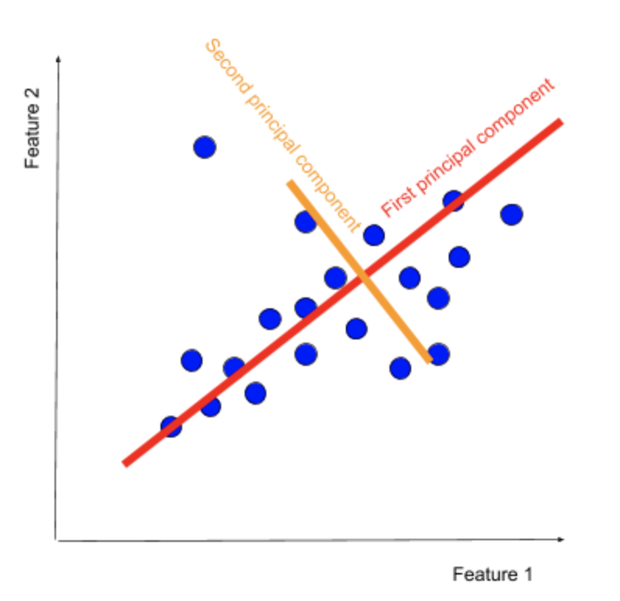



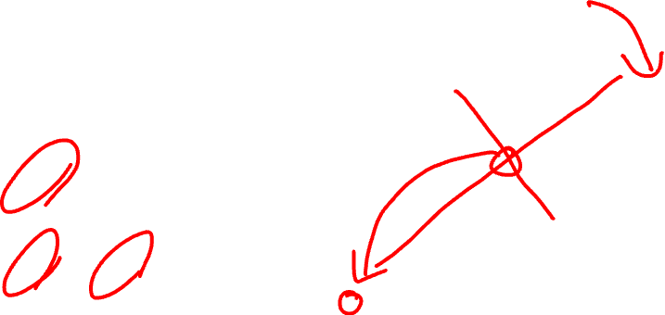


7.3 Dimension reduction
Principal Component Analysis (PCA)
These features are not orthogonal.
Principal components (PCs) are orthogonal.

Slide 13
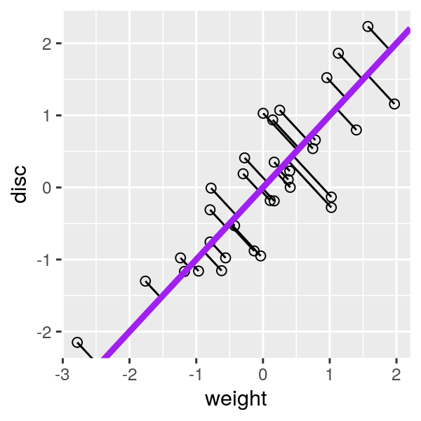
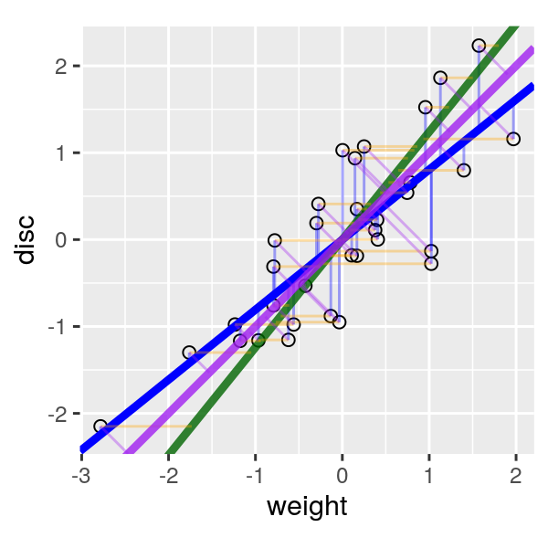
7.3 Dimension reduction
Principal Component Analysis (PCA)
Minimizing variance
to PC (projection)
Maximizing variance
along PC

Slide 14
We do not need to calculate variances for all possible cases
Pearson’s correlation coefficient
Covariance
Covariance matrix

Slide 15
7.6.3 Singular value decomposition (SVD)
n
m
n
n
X
U
S
V
n
m
m
m

Slide 16
Rank reduction
n → p
n
p
p
n
p
p
V^{t}
X
U
S
m
m

Slide 17
How to solve SVD manually?
orthonormal
orthonormal
orthogonal
Covariance
matrix

Slide 18
How to solve SVD manually?
Eigenvalue equation
Eigenvalues
Singluar values
Eigen vectors
V₁=PC₁
V₂=PC₂
V₃=PC₃
Principal component (PC)

Slide 19
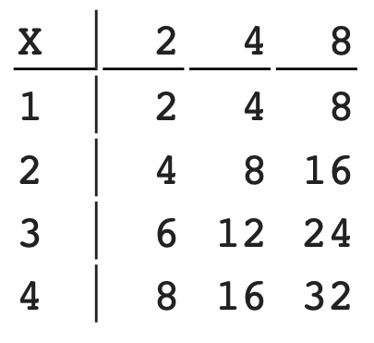
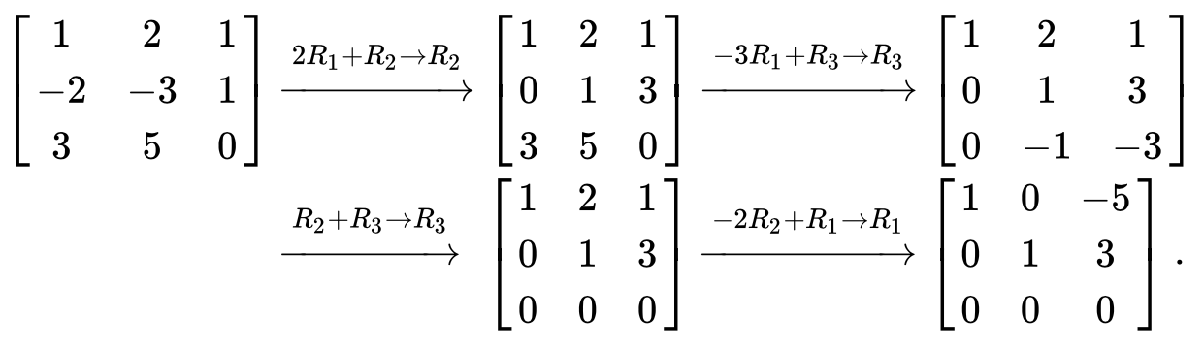
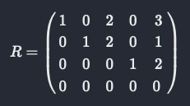
7.6 The inner workings of PCA: rank reduction
What is RANK?
The number of independent columns
The number of meaningful features.
Gaussion elimination
r1
r2
r3
r4
Rank = 2
r1:r2:r3:r4=1:2:3:4
c1
c2
c3
c1:c2:c3=1:2:3
Rank(X) = 1
Note: Row rank = column rank
  row rank = No. of non-0 row
  col. Rank = No. of basic col
Rank(R)=3

Slide 20

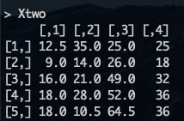
7.6.3 Singular value decomposition (SVD)

Slide 21
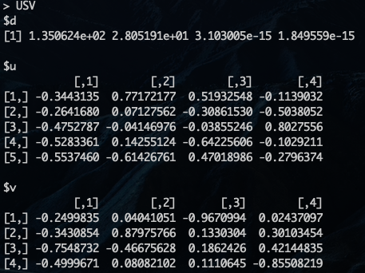
7.6.3 Singular value decomposition (SVD)
Rank=2

Slide 22
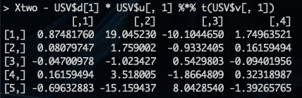
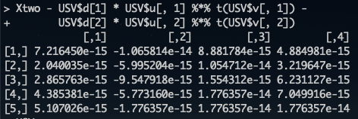
7.6.3 Singular value decomposition (SVD)
Rank != 1
Rank == 2

Slide 23
Rank reduction
n → p
n
p
p
n
p
p
V^{t}
X
U
S
m
m

Slide 24
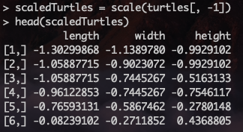
7.6.3 PCA of the turtles data
ggpairs(as.data.frame(scaledTurtles), axisLabels = "none" )

Slide 25
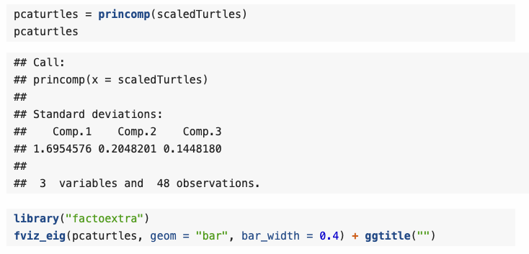
7.6.3 PCA of the turtles data
The data are (almost) one-dimensional.

Slide 26
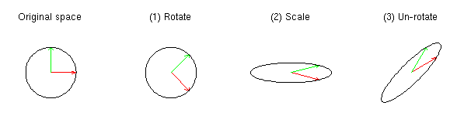
SVD rotates coordinates
M
V^{t}
S
U
To be scaled
before SVD.
[scale() fuction in R]

Slide 27
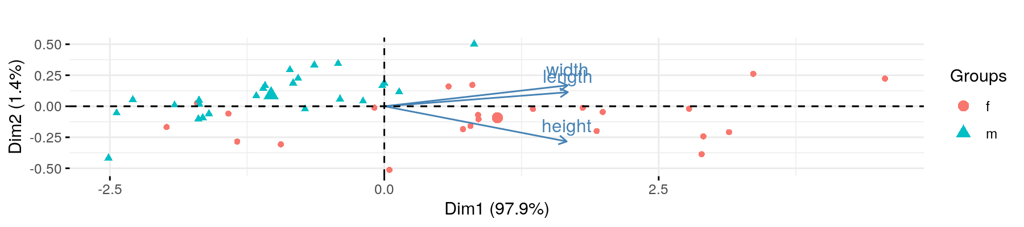

7.6.3 PCA of the turtles data
See factoextra package about this function
https://cran.r-project.org/web/packages/factoextra/
Bioplot
PCA
The variance of points in the PC1 direction is $λ_{1}=s_{1}^{2}$.

Slide 28
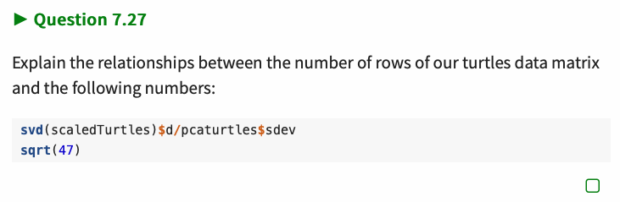


7.6.3 PCA of the turtles data
The variance of points in the PC1 direction is $λ_{1}=s_{1}^{2}$.
n=48 → n-1=47

Slide 29
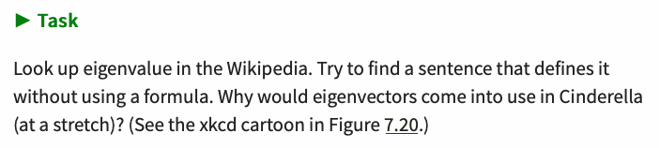
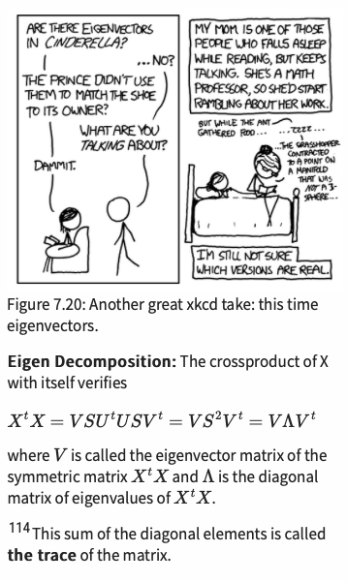

Slide 30
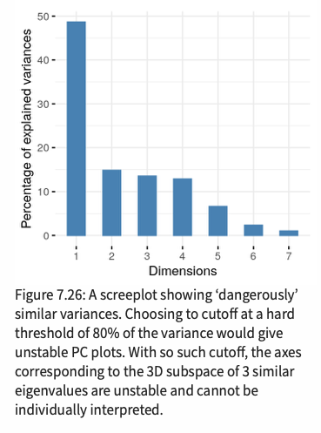
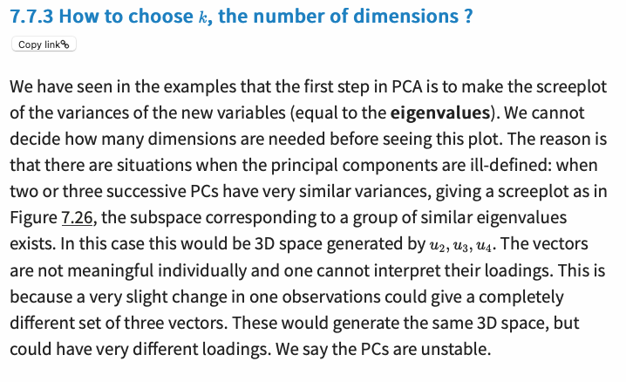
Danger!!!

Slide 31

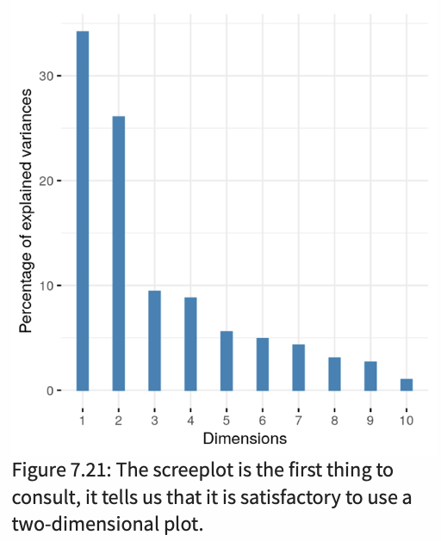
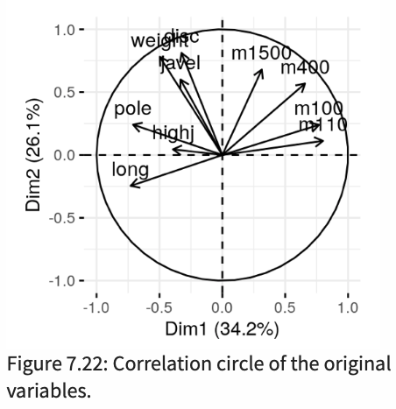
7.6.3 A complete analysis: the decathlon athletes
pca.ath = dudi.pca(athletes, scannf = FALSE)
fviz_eig(pca.ath, geom = "bar", bar_width = 0.3) + ggtitle("")
fviz_pca_var(pca.ath, col.circle = "black") + ggtitle("")
Running

Slide 32
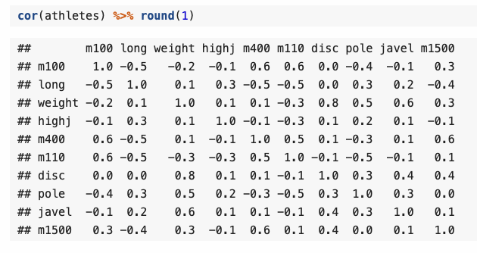
1
5
6
10

Slide 33
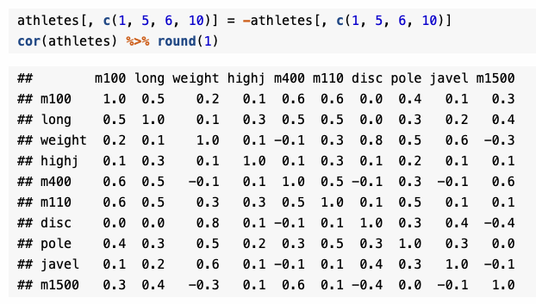
1
5
6
10

Slide 34
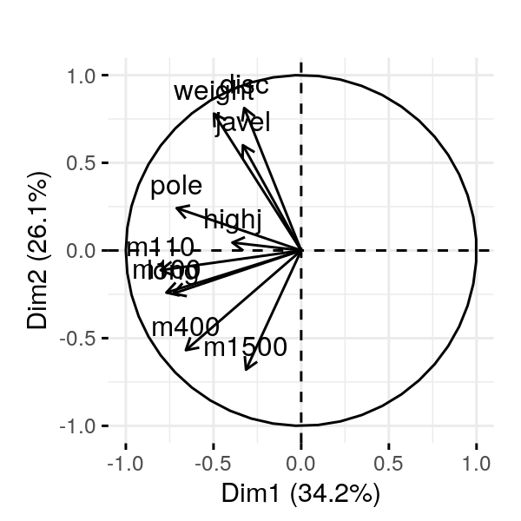
pcan.ath = dudi.pca(athletes, nf = 2, scannf = FALSE)
fviz_pca_var(pcan.ath, col.circle="black") + ggtitle("")
fviz_pca_ind(pcan.ath) + ggtitle("") + ylim(c(-2.5,5.7))

Slide 35
fviz_pca_biplot(pca.ath, col.circle = "black") + ggtitle("")

Slide 36
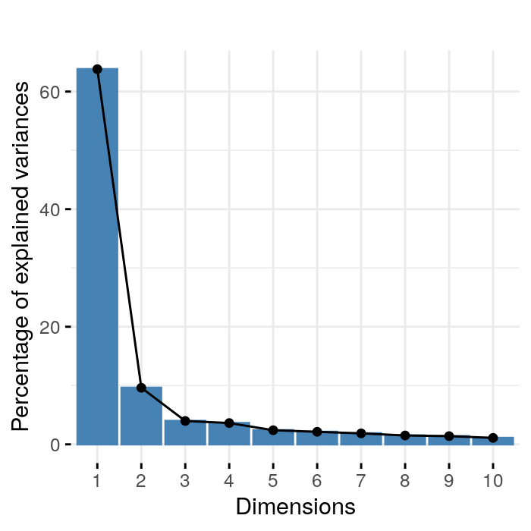
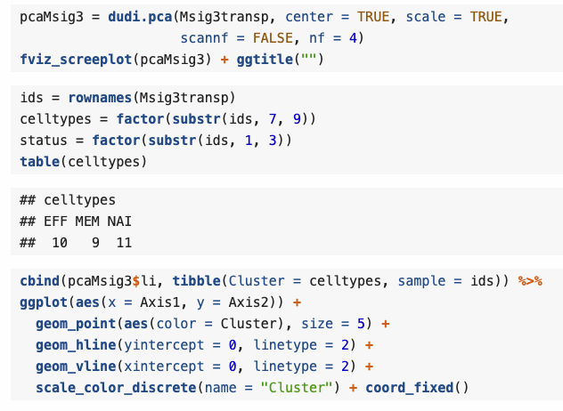
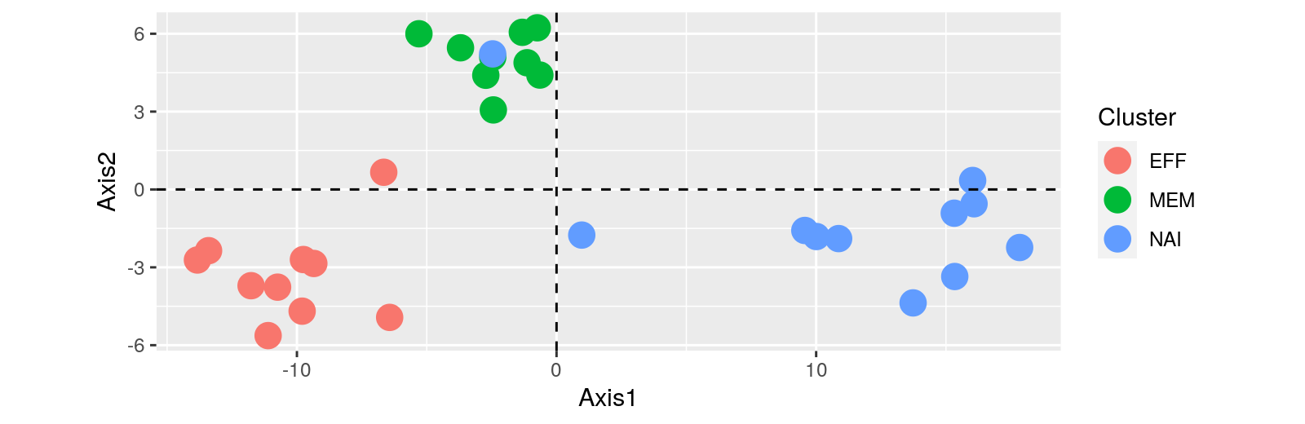
Cell Types: Holmes et al. (2005) studied gene expression profiles of sorted T-cell populations from different subjects. The columns are a subset of gene expression measurements, they correspond to 156 genes that show differential expression between cell types.
load("../data/Msig3transp.RData")

Slide 37
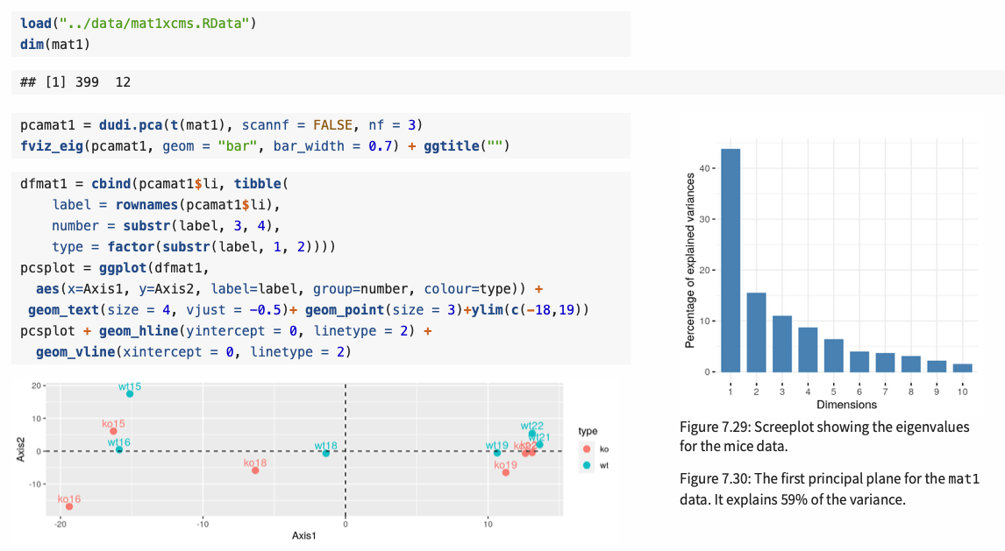
7.8.1 Mass Spectroscopy Data Analysis
It looks random.

Slide 38
7.8.1 Mass Spectroscopy Data Analysis
Actually not.
This is because of knock-out.
It looks random.

Slide 39
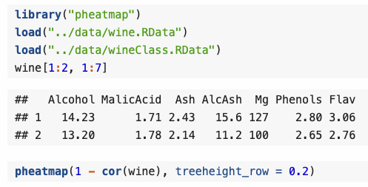
7.8.2 Biplots and scaling

Slide 40
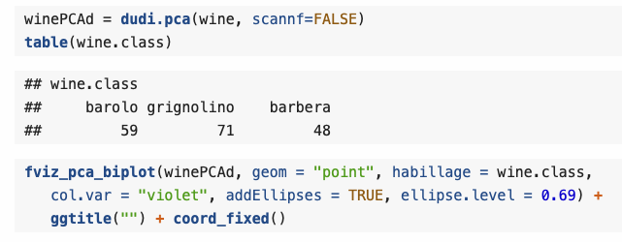
7.8.2 Biplots and scaling

Slide 41
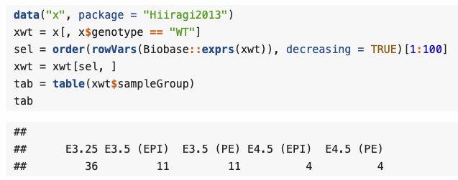
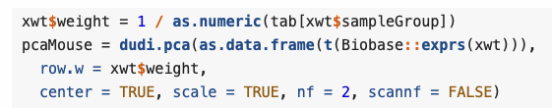
7.8.2 An example of weighted PCA
If the groups have very different sizes.

Slide 42
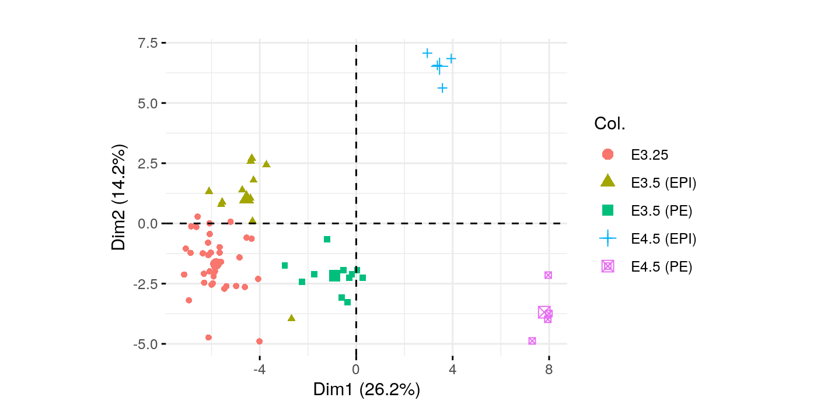
7.8.2 An example of weighted PCA
If the groups have very different sizes.

