Slide 1
Modern Statistics for Modern Biology
Chapter 9. Multivariate methods for heterogeneous data
21.07.22
Jihoon Kim

Slide 2
9.1 Goals for this chapter
Extend linear dimension reduction methods to cases when the distances between observations are available, known as multidimensional scaling (MDS) or principal coordinates analysis.
Find modifications of MDS that are nonlinear and robust to outliers.
Encode combinations of categorical data and continuous data as well as so-called 'supplementary' information. We will see that this enables us to remove batch effects.
Use chi-square distances and correspondence analysis (CA) to see where categorical data (contingency tables) contain notable dependencies.
Generalize clustering methods that can uncover latent variables that are not categorical. This will allow us to detect gradients, 'pseudotime' and hidden nonlinear effects in our data.
Generalize the notion of variance and covariance to the study of tables of data from multiple different data domains.

Slide 3
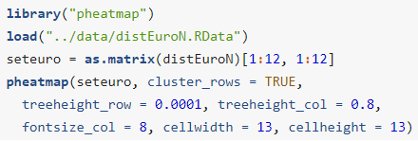
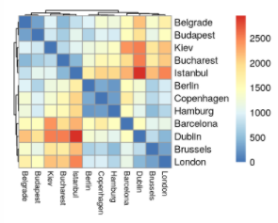
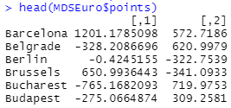
9.2 Multidimensional scaling and ordination
Sometimes, data are not represented in a feature space

Slide 4
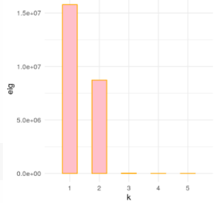
9.2 Multidimensional scaling and ordination
Unlike in PCA, MDS has some negative eigenvalues
> Data do not come from a Euclidean space

Slide 5
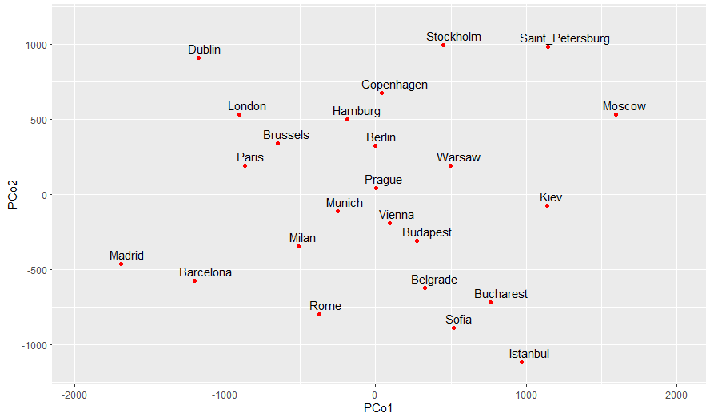
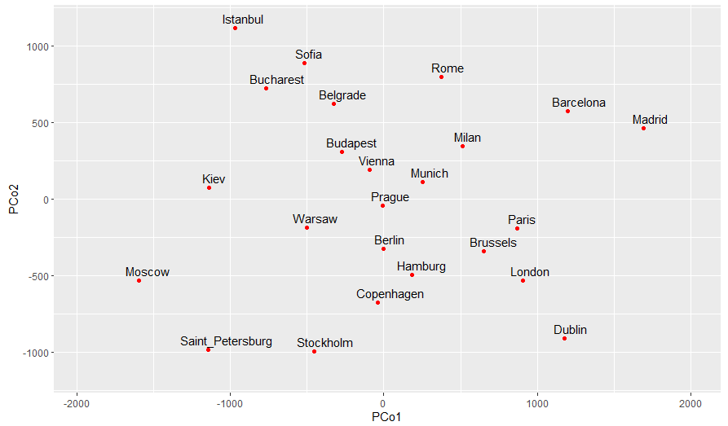
9.2 Multidimensional scaling and ordination

Slide 6
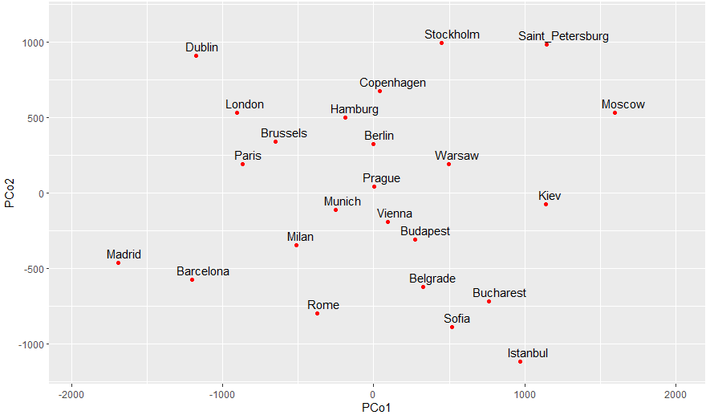
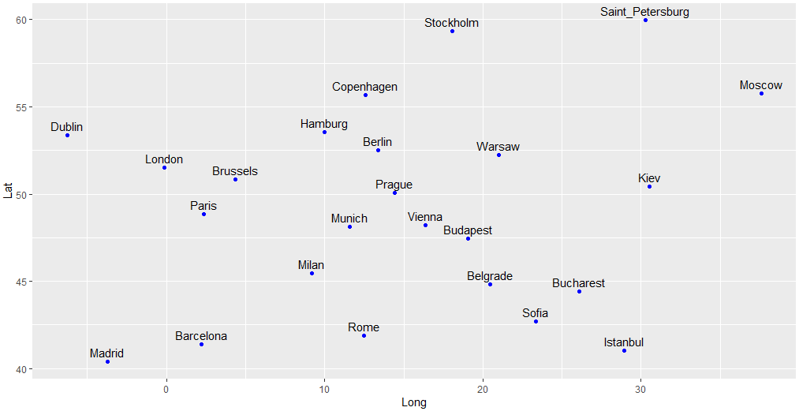
9.2 Multidimensional scaling and ordination

Slide 7
9.2.1 How does the method work?
Classical MDS Algorithm
Cross product of centered matrix :
$$B=(HX){(HX)}^{t}$$
Double center the interpoint distance squared and multiply it by $−\frac{1}{2}$
$$B=−\frac{1}{2}H\left(D∙D\right)H$$
Diagonalize $B$
$$B=UΛU^{t}$$
Extract $\tilde{X}$
$$\tilde{X}=UΛ^{1/2}$$
Centering Matrix :
$$H=I_{n}−\frac{1}{n}J_{n}$$
Eigenvector Matrix of B
Diagonal Matrix filled with Eigenvalues of B

Slide 8
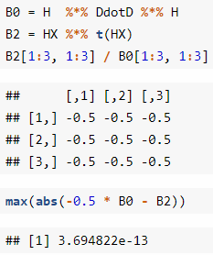
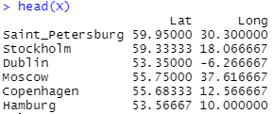
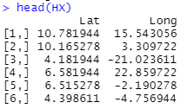
9.2.1 How does the method work?
$$(HX){(HX)}^{t}=−\frac{1}{2}H\left(D∙D\right)H$$

Slide 9
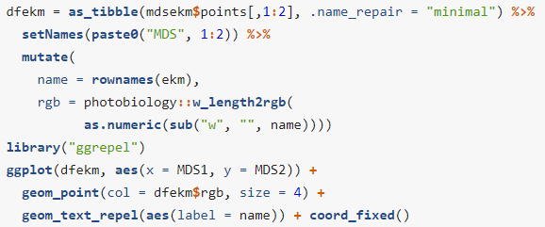
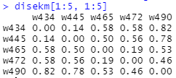
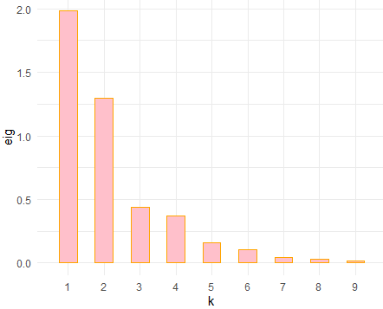
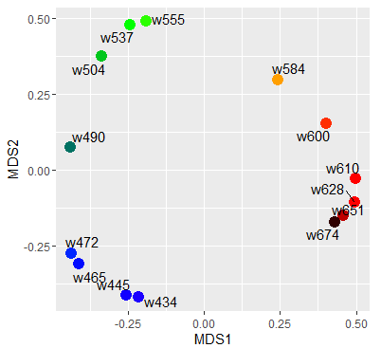
9.2.1 How does the method work?

Slide 10
9.2.2 Robust versions of MDS
Robust ordination, non-metric multidimensional scaling (NMDS)
> Useful when we are not quite sure about the 'scale' of our measurements
> Rank based approach, Reduce sensitivity to outliers
> Measure quality of approximation:

Slide 11
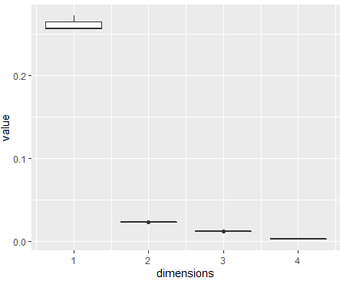
9.2.2 Robust versions of MDS

Slide 12
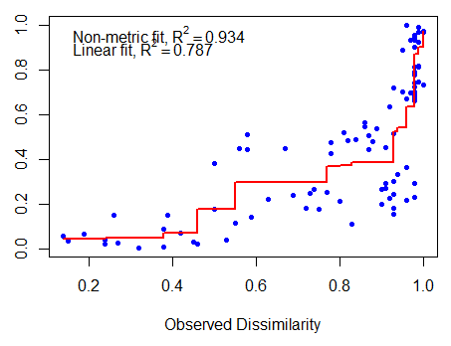
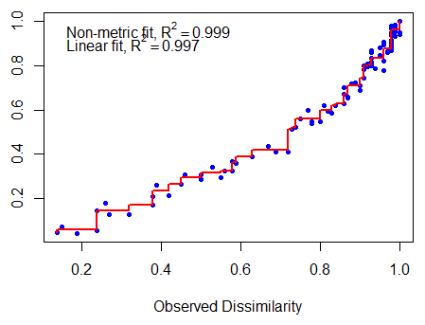
9.2.2 Robust versions of MDS
k = 1
k = 2

Slide 13
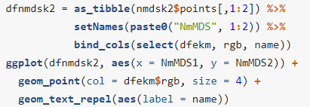
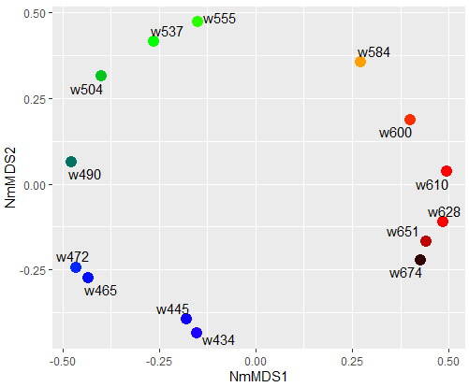
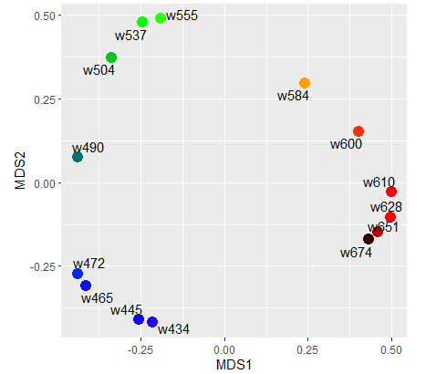
9.2.2 Robust versions of MDS

Slide 14
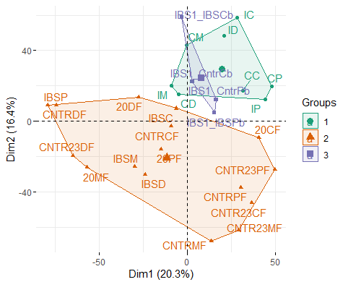
9.3 Contiguous or supplementary information
Sample batches: Dates of measurement, Different protocols etc.
Bacterial abundance data of
Healthy Rat vs. Irritable Bowel Syndrome Rat
Day

Slide 15
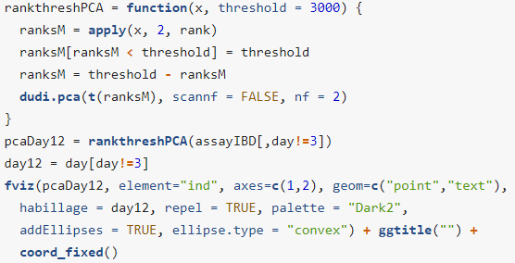
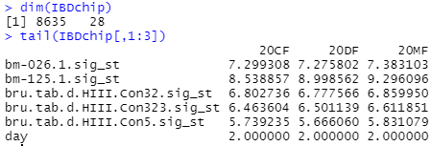
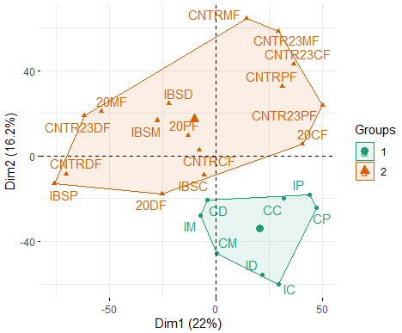
9.3.1 Known batches in data

Slide 16
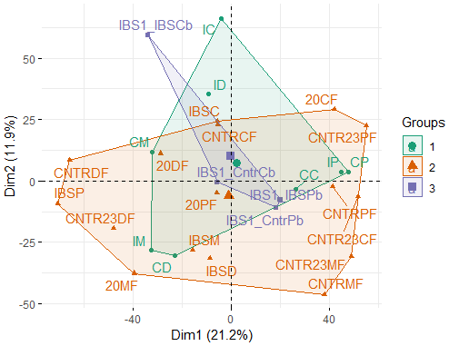
9.3.2 Removing batch effects

Slide 17
9.3.3 Hybrid data and Bioconductor containers

Slide 18
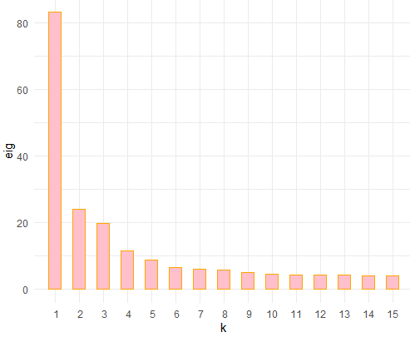
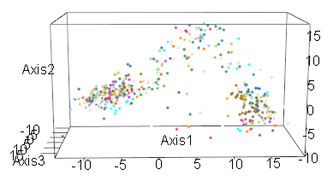
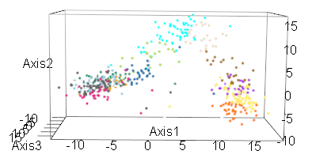
9.3.3 Hybrid data and Bioconductor containers

Slide 19
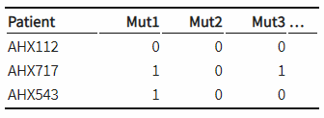
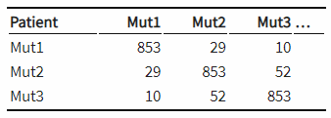
9.4 Correspondence analysis for contingency tables
Categorical data: Sequence status / Phenotypes etc.
Cross-tabulation
Measure of Independence: Chi-square distance

Slide 20
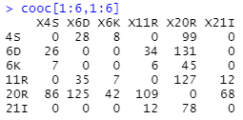
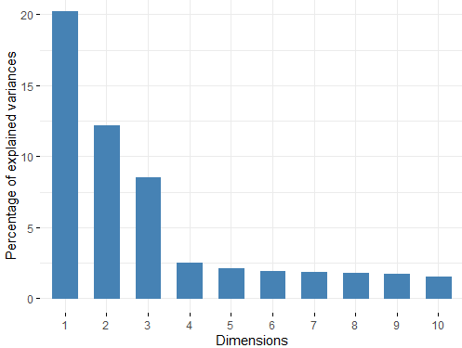
9.4.1 Cross-tabulation and contingency tables

Slide 21
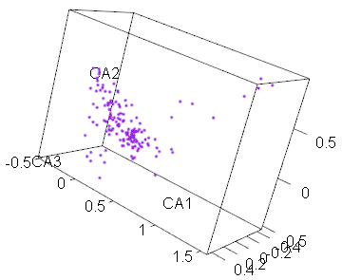
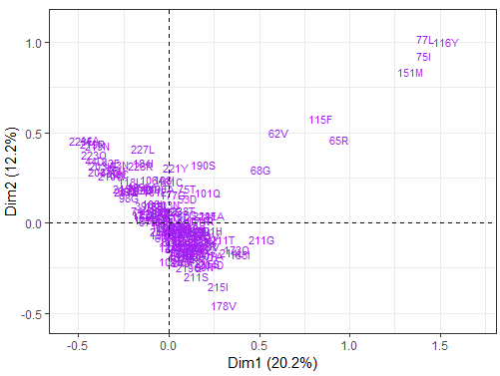
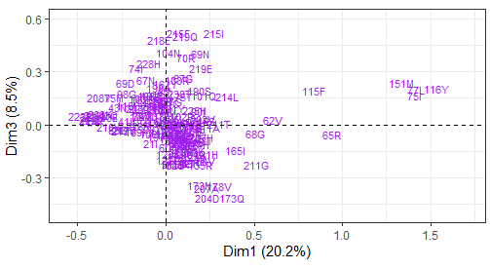
9.4.1 Cross-tabulation and contingency tables

Slide 22
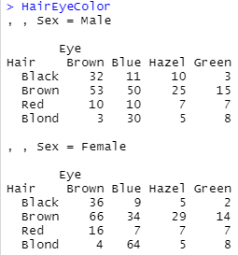
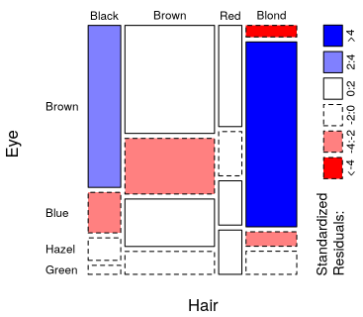
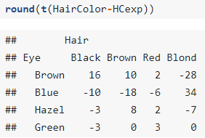
9.4.2 Hair color, eye color and phenotype co-occurrence

Slide 23
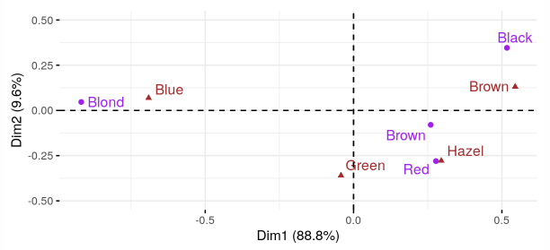
9.4.2 Hair color, eye color and phenotype co-occurrence

Slide 24
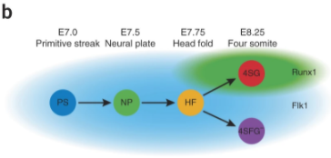
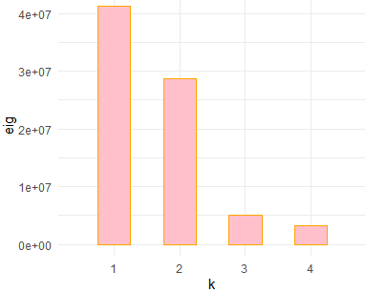
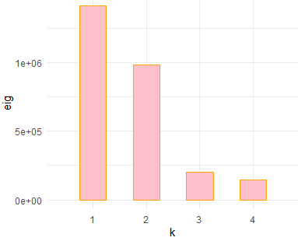
9.5.1 Dynamics of cell development
Moignard et al., Nature Biotechnology, 2015

Slide 25
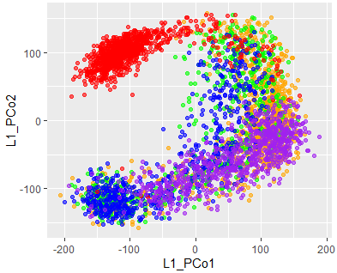
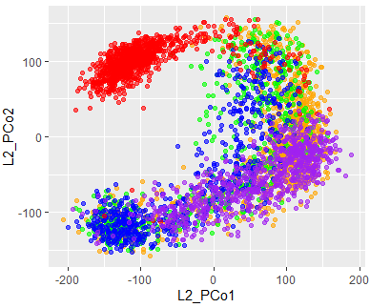
9.5.1 Dynamics of cell development

Slide 26
9.5.2 Local, nonlinear methods
MDS / NMDS aims to represent all distances as precisely
But, this method restrict approximation of close points
Kernels can be used to solve this problem
> Kernel method decrease the importance of far points
> It can be useful as the precision of close points
> t-SNE is one of the kernel methods

Slide 27
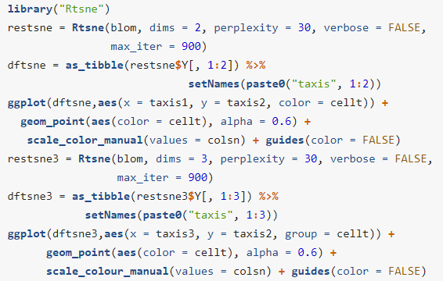
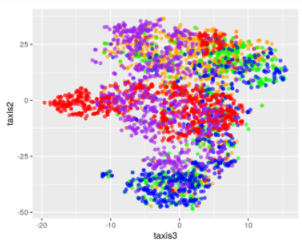
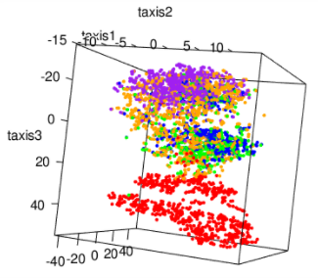
9.5.2 Local, nonlinear methods

Slide 28
9.6 Multitable techniques
Covariance
Mantel coefficient and test of distance correlation
Canonical correlation analysis (CCA)
Sparse CCA (sCCA)

