Slide 1
Modern Statistics for Modern Biology Chapter 8 High-throughput Count Data
2021/07/21 (Wed)

Slide 2
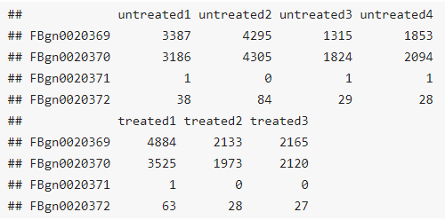
Introduction
Many measurement devices in biotechnology are based on massively parallel sampling and counting of molecules.
DNA sequencing
Genome sequencing
Polymorphism analysis
ChIP-seq
HiC
etc.
RNA sequencing (RNA-seq)
Differential gene expression (DGE) analysis
etc.
Ideally, we might want to sequence and count all molecules of interest in the sample. Generally, this is not possible (the biochemical protocols are not 100% efficient) and is often not even necessary.
Instead, we sequence and count a statistical sample.
This sampling nature of the data is important when it comes to analyzing them.
We hope that the sampling is sufficiently representative for us to identify interesting trends and patterns.

Slide 3
Goals
Become familiar with count data from high-throughput sequencing applications such as RNA-seq.
Understand and model the sampling processes that underlie the data in order to interpret them.
Detect and quantify systematic changes between samples from different conditions (e.g., untreated vs. treated), while distinguishing between systematic changes from sampling variations and experimental variability within the same conditions.
Understand statistical concepts and tools needed for this purpose:
Multifactorial designs, linear models and analysis of variance
Generalized linear models
Robustness and outlier detection
Shrinkage estimation
Look at data transformations that make the data amendable to unsupervised methods and make it easier to visualize the data.

Slide 4
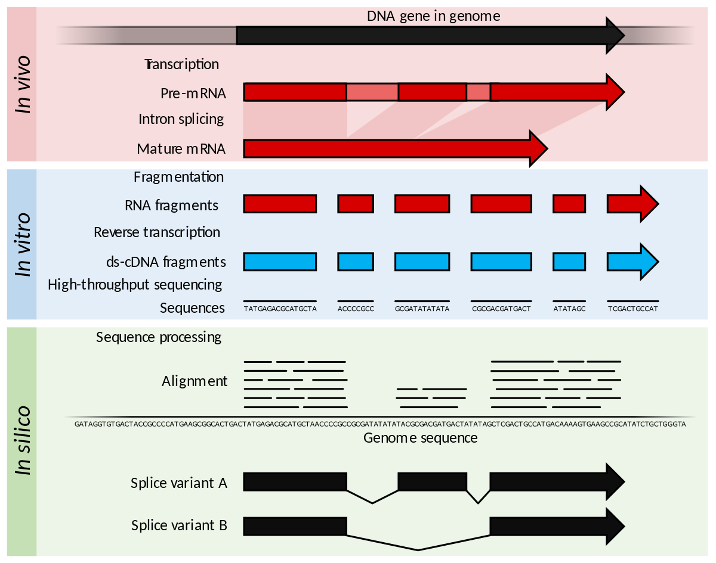
8.2 – Some core concepts
Key terminology
Sequencing library
Fragments
Read
Single-end
Paired-end
Aggregation of reads

Slide 5
8.3 – Count data
Pasilla RNA-seq data
A table of non-negative integer values (raw counts of sequenced reads)
14599 rows (genes) x 7 columns (samples)

Slide 6
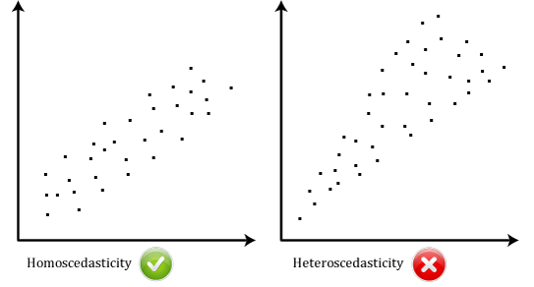
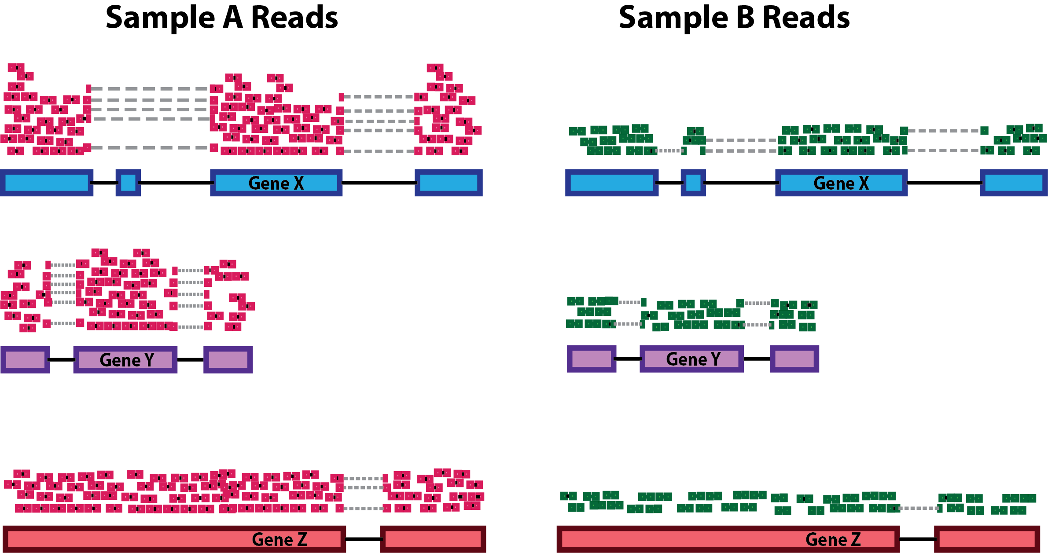
8.3 – Count data
Challenges of count data
Heteroskedasticity → The data have a large dynamic range (e.g., 0 ~ 1,00o,000), and the variation is not constant.
The data are non-negative integers, and their distribution is not symmetric – thus normal or log-normal distributions may be a poor fit.
Normalization → Need to adjust for systematic sampling biases (sequencing depth, gene length, GC content etc.).
We need to understand the stochastic properties of the sampling, as well as other sources of stochastic experimental variation (especially for experiments with small sample sizes).

Slide 7
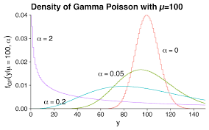
8.4 – Modeling count data
Dispersion
For bulk RNA-seq:
The number of genes is in the tens of thousands.
The total library size (n) will usually be in the billions or trillions.
The number of reads (r) is usually in the tens of millions, and thus much smaller than n.
For a single sample:
The probability that a given read maps to the i^{th} gene (p_{i}) = n₁/n, and is independent of the mapping of other reads.
→ Can be modeled by a Poisson distribution:
For a single condition (multiple biological replicates):
In practice, we are usually interested in comparing counts between libraries (not within one library).
Empirically, replicate experiments vary more than what the Poisson distribution predicts.
→ The gamma-Poisson (a.k.a. negative binomial) distribution suits our modeling needs.
n
r
n₂
n₁
…
…
n_{i}
…
…
…

Slide 8
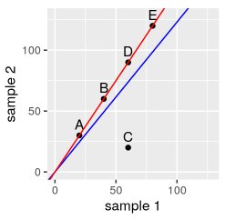
8.4 – Modeling count data
Normalization
The most important systematic bias stems from variations in the total number of reads in each sample.
If we have more reads for one library than in another, then we might assume that, everything else being equal, the counts are proportional to each other with some proportionality factor s.
Naively, we could prepose that a decent estimate of s for each sample is simply given by the sum of the counts of all genes.
There are more sophisticated methods.
→ The slope of the red line can be obtained by robust regression.

Slide 9
8.5 – A basic analysis
Example dataset: the pasilla data
An experiment on Drosophila melanogaster cell cultures that investigated the effect of RNAi knockdown of the splicing factor pasilla on the cells’ transcriptomes → To look for differentially expressed genes (DEGs).
Two experimental conditions (“condition”): 4 untreated (negative control) vs. 3 treated (pasilla siRNA)
Two sequencing batches (“type”): 3 single-end libraries, 4 paired-end libraries
→ A “nuisance factor”

Slide 10
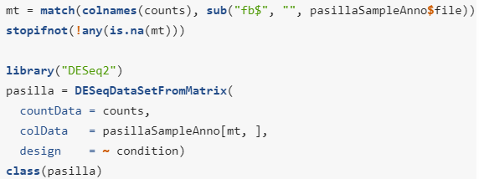
8.5 – A basic analysis
The DESeq2 method
Uses a specialized data container (“class”), called DESeqDataSet to store the datasets it works with.
Helps keep together related data. → Avoids bugs due to loss of synchronization between related data.
Simplifies codes to be executed.

Slide 11
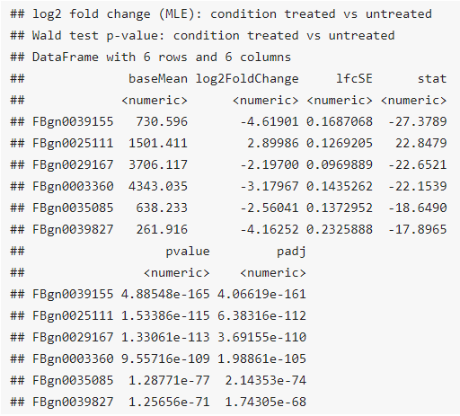
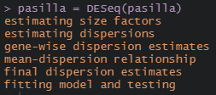
8.5 – A basic analysis
The DESeq2 method
Goal: to identify genes that are differentially abundant between the treated and untreated cells (DEGs).
A choice of standard analysis steps are wrapped into a single function, DESeq.
A wrapper that calls (in order):
estimateSizeFactors → Normalization
estimateDispersions → Dispersion estimation
nbinomWaldTest → Hypothesis test for differential abundance

Slide 12
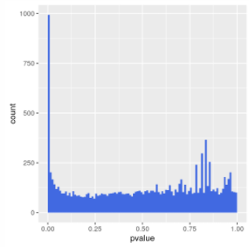
8.5 – A basic analysis
Exploring the results
Essential quality assessment measures
The histogram of p-values
A peak of small p-values →993 DEGs (False discovery rate (FDR) ~= 10%)
Uniform background → non-DEGs
The MA plot
An ordination plot
A heatmap

Slide 13
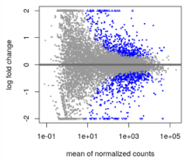
8.5 – A basic analysis
Exploring the results
Essential quality assessment measures
The histogram of p-values
The MA plot
An ordination plot
A heatmap

Slide 14
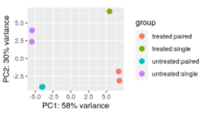
8.5 – A basic analysis
Exploring the results
Essential quality assessment measures
The histogram of p-values
The MA plot
An ordination plot (e.g., PCA plot)
Useful for visualizing the overall effect of experimental covariates and/or to detect batch effects.
PC1 → Aligned with the experimental covariate of interest (untreated vs. treated)
PC2 → Roughly aligned with the sequencing protocol (single vs. paired)
A heatmap

Slide 15
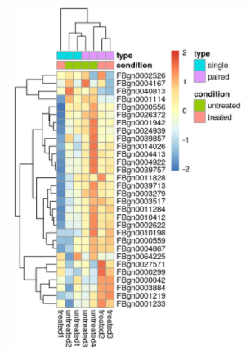
8.5 – A basic analysis
Exploring the results
Essential quality assessment measures
The histogram of p-values
The MA plot
An ordination plot
A heatmap
A powerful way of quickly getting an overview over a matrix-like dataset.
Plot the subset of the 30 most variable genes.
pheatmap arranges the rows and columns of the matrix by the dendrogram from unsupervised clustering.
The clustering is dominated by the ‘type’ factor.
Our differential analysis was probably too naïve and we should adjust for this strong ‘nuisance’ factor.

Slide 16
8.6 – Critique of default choices and possible modifications
The few changes assumption
Underlying the default normalization and the dispersion estimation in DESeq2 (and many other DE methods) is that most genes are not differentially expressed.
This assumption is often reasonable, but a subset of ‘negative control’ genes can also be used instead (“spiked in” features).
Point-like null hypothesis
As a default, the DESeq function test against the null hypothesis that each gene has the same abundance across conditions.
We can modify the test to use a more permissive, interval-based null hypothesis.

Slide 17
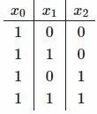
8.7 – Multi-factor designs and linear models
What is a multifactorial design?
Let’s assume that in addition not the siRNA knockdown of the pasilla gene, we also want to test the effect of a certain drug.
Conditions
Negative control (x₀)
pasilla siRNA (x₁)
Drug (x₂)
Both (x₁₂)
Coefficients
β₀ : The base level in the negative control (the intercept)
β₁ : The logarithmic fold change due to siRNA treatment
β₂ : The logarithmic fold change due to drug treatment
β₁₂ : The interaction effect of siRNA and drug (the effects of these two differential experimental factors do not simply add up, but combine in a more complicated fashion) → Can be excluded if desired.
= x₀β₀

Slide 18
8.7 – Multi-factor designs and linear models
What about noise and replicates?
If our data (the ys) were absolutely precise, we could set up a linear system of equations and solve for the βs.
We usually wish to analyze real data that are affected by noise.
We then need replicates to estimate the levels of noise and assess the uncertainty of our estimated βs.
Only then can we empirically assess whether any of the observed changes between conditions are significantly larger than those occurring just due to experimental or natural variation.
Linear model of expression (analysis of variance, ANOVA)
→ Decompose the variability of the observed y into elementary components
j: sample index / ε_{j}: residual for sample j (noise)
Example
3 replicates for each of the four conditions (12 total)
= x₃β₃

Slide 19
8.7 – Multi-factor designs and linear models
Example
3 replicates for each of the four conditions (12 total)
y = log2(gene expression)
(0,1)
(1,0)
x₂
= Drug
x₁₂
(1,1)
x₁
= siRNA

Slide 20
8.7 – Multi-factor designs and linear models
On additional modeling component is needed
We now have more variables (12 εs, 4 βs) than equations (12, one for each j).
To fix this, we require the ε_{j} to be small.
One popular way is to minimize the sum of squared residuals (least sum of squares fitting).
The βs represent the average effects of each experimental factor.
The ε_{j}s represent the experimental fluctuations around the mean between the replicates.
y = log2(gene expression)
β₀
(0,1)
(1,0)
x₂
= Drug
x₁₂
(1,1)
x₁
= siRNA

Slide 21
8.7 – Multi-factor designs and linear models
On additional modeling component is needed
We now have more variables (12 εs, 4 βs) than equations (12, one for each j).
To fix this, we require the ε_{j} to be small.
One popular way is to minimize the sum of squared residuals (least sum of squares fitting).
The βs represent the average effects of each experimental factor.
The ε_{j}s represent the experimental fluctuations around the mean between the replicates.
y = log2(gene expression)
β₀
β₁
(0,1)
(1,0)
x₂
= Drug
x₁₂
(1,1)
x₁
= siRNA

Slide 22
8.7 – Multi-factor designs and linear models
On additional modeling component is needed
We now have more variables (12 εs, 4 βs) than equations (12, one for each j).
To fix this, we require the ε_{j} to be small.
One popular way is to minimize the sum of squared residuals (least sum of squares fitting).
The βs represent the average effects of each experimental factor.
The ε_{j}s represent the experimental fluctuations around the mean between the replicates.
y = log2(gene expression)
β₂
β₀
β₁₂
β₁
(0,1)
(1,0)
x₂
= Drug
x₁₂
(1,1)
x₁
= siRNA

Slide 23
8.7 – Multi-factor designs and linear models
Robustness
Methods based on the least sum of squares are sensitive to outliers (have a low breakdown point).
y = log2(gene expression)
β₂
β₀
β₁₂
β₁
(0,1)
(1,0)
x₂
= Drug
x₁₂
(1,1)
x₁
= siRNA

Slide 24
8.7 – Multi-factor designs and linear models
Robustness
Methods based on the least sum of squares are sensitive to outliers (have a low breakdown point).
The median has a much higher breakdown point (is robust).
y = log2(gene expression)
β₂
β₀
β₁₂
β₁
(0,1)
(1,0)
x₂
= Drug
x₁₂
(1,1)
x₁
= siRNA

Slide 25
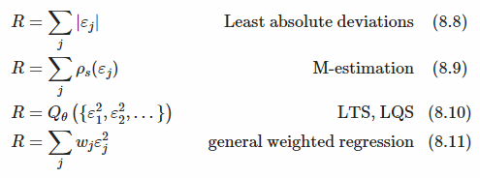
8.7 – Multi-factor designs and linear models
Robustness
To achieve a higher degree of robustness against outliers, other choices than the sum of squares can be used as the objective of minimization (R: the quantity to be minimized).
Least absolute deviations regression: a generalization of the median
M-estimation: uses a penalization function p_{s} (least-squares regression: p_{s}(ε) = ε²).
Least quantile of squares (LQS) regression: minimizes a quantile (e.g., Q₅₀).
Least trimmed sum of squares (LTS) regression: a sum of squared residuals over a fraction of the smallest residuals.
General weighted regression
Assumes we have some way of deciding what weight we want to give each observation, presumably down-weighting outliers.
DESeq2 assesses the leverage of each data point on the estimated βs using a measure called Cook’s distance (a measure of how much a single sample is influencing the fitter coefficients for a gene).
For those data whose Cook’s distance is deemed too large, the weight is set to 0, otherwise 1.
The default cutoff depends on the sample size and number of parameters to be estimated.
While the least sum of squares optimization can be done through straightforward linear algebra, more complicated iterative optimization algorithms are needed for certain choices.

Slide 26
8.7 – Multi-factor designs and linear models
Robustness
All of these approaches to outlier robustness introduce a degree of subjectiveness and rely on sufficient replication.
The subjectiveness is reflected by the parameter choices that need to be made.
One scientist’s outlier may be the Nobel prize of another.
Outlier removal is no remedy for sloppy experiments and no justification for wishful thinking.
p-values for each coefficient can be obtained and thus the effect of a condition on the expression of a gene can be assessed.

Slide 27
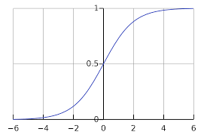
8.8 – Generalized linear models
Modeling the data on a transformed scale
It can be fruitful to consider the data after some transformation.
Logarithm-scale → Compares fold-changes of expression
Sigmoid → Useful for predicting values between 0 and 1 (e.g., an indicator of disease risk) ➔ Logistic regression
This idea can be generalized, since depending on the context, other transformations are useful.
Other error distributions
The other generalization regards the minimization criterion.
This criterion can be derived from a specific probabilistic model and the maximum likelihood principle.
Minimizing the sum of squared residuals is the same as assuming the residuals follow a normal distribution (mean = 0, SD = σ) and maximizing the probabilities.
The generalization we can now make is to use a different probabilistic model.
➔ To deal with count data, we will use the gamma-Poisson distribution.

Slide 28
8.8 – Generalized linear models
A generalized linear model for count data
The differential expression analysis in DESeq2 uses a generalized linear model of the form:
K_{ij}: counts for gene i in sample j
μ_{ij}: mean of gene i in sample j
α_{i}: the dispersion of gene i (gene-specific)
s_{j}: sample-specific size factor
q_{ij}:
Proportional to the true expected concentration of fragments for gene i in sample j
Given by the linear model via the link function, log₂

Slide 29
8.9 – Two-factor analysis of the pasilla data
In the exploratory data analysis (EDA) of the pasilla data, we found that the ‘type’ covariate had a considerable effect on the data.
We will now correct for this effect.
This should help us get a more correct picture of which differences in the data are attributable to the treatment, and which are confounded – or masked – by the sequencing type.

Slide 30
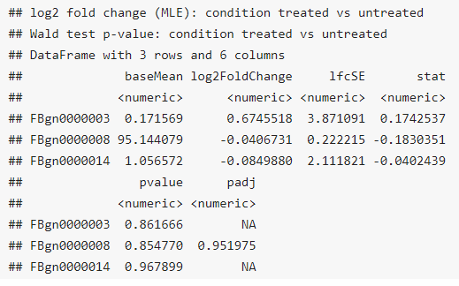
8.9 – Two-factor analysis of the pasilla data
The convention is to put the variable of interest at the end of the formula.

Slide 31
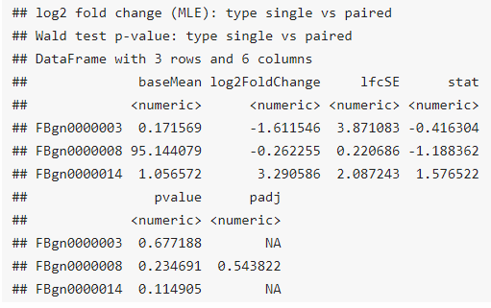
8.9 – Two-factor analysis of the pasilla data
It is possible to retrieve the results associated with the ‘type’ variable.

Slide 32
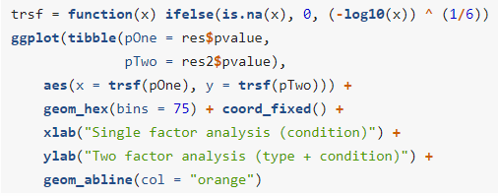
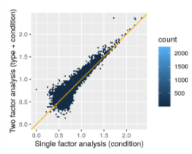
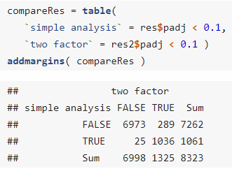
8.9 – Two-factor analysis of the pasilla data
Let’s see how the results differ when ‘type’ is added to the formula (“nuisance factor” = “blocking factor”).
The p-values in the two-factor analysis are similar to those from the on-factor analysis, but are generally smaller (= an increase in power).
We can also see this by counting the number of genes that pass a certain significance threshold in each case (FDR < 10%).
The two-factor analysis has increased detection power.
In general, the gain can be larger or smaller depending on the data.

Slide 33
8.9 – Two-factor analysis of the pasilla data
Why do we detect fewer significant genes when we do not take into account the ‘type’ variable?
Without modeling the blocking factor, the variability in the data that is due to it has to be absorbed by the εs (making them larger).
The higher level of noise leads to higher uncertainty in the coefficient estimates.
The model with the blocking factor has more parameters to be estimated (fewer “degrees of freedom”).

Slide 34
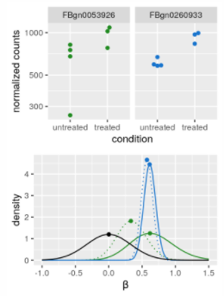
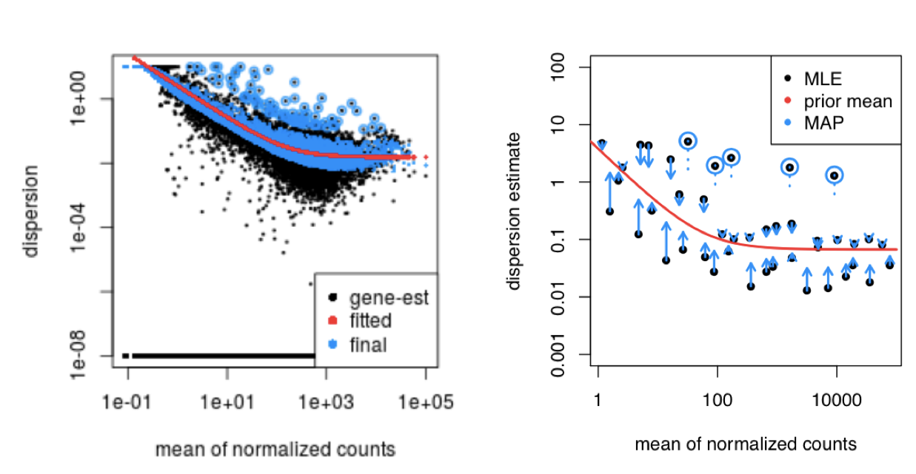
8.10 – Further statistical concepts
Sharing of dispersion information across genes
Bayesian analysis can be used to improve our estimates of the dispersion parameters (α) and, optionally, the logarithmic fold changes (β).
The priors are, in both cases, taken from the distributions of the maximum-likelihood estimates (MLEs) across all genes.
It turns out that both of these distributions are unimodal:
β: peaks around 0
α: at the typical dispersion
The empirical Bayes machinery the shrinks each per-gene MLE towards the particular peak.

Slide 35
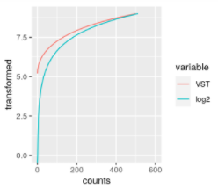
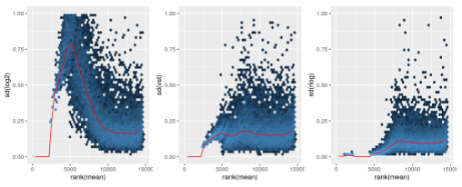
8.10 – Further statistical concepts
Count data transformations
For testing for differential expression we operate on raw counts and use discrete distributions.
For other downstream analyses (e.g., visualization or clustering) it might be useful to work with transformed versions of the count data.
Logarithm (w/ pseudocounts)
Variance-stabilizing transformation (VST)
Implemented in the DESeq2 package
Regularized logarithm (rlog) transformation
Transforms the original count data to a log2-like scale by fitting a “trivial” model with a separate term for each sample and a prior distribution on the coefficients which is estimated from the data.
In practice, the rlog transformation is also approximately variance-stabilizing but deals better with data in which the size factors of the different samples are very distinct than VST.

Slide 36
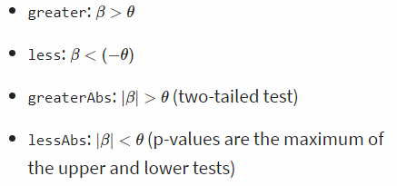
8.10 – Further statistical concepts
Tests of log2 fold change above or below a threshold
Two arguments to the results function allow for threshold-based Wald tests
lfcThreshold: a non-negative threshold value
altHypothesis: the kind of test

Slide 37
8.11 - Summary
We have seen how to analyze count tables from high-throughput sequencing (and analagous data types) for differential abundance. We built upon the powerful and elegant framework of linear models. In this framework, we can analyze a basic two-groups comparison as well as more complex multifactorial designs, or experiments with covariates that have more than two levels or are continuous. In ordinary linear models, the sampling distribution of the data around the expected value is assumed to be independent and normal, with zero mean and the same variances. For count data, the distributions are discrete and tend to be skewed (asymmetric) with highly different variances across the dynamic range. We therefore employed a generalization of ordinary linear models, called generalized linear models (GLMs), and in particular considered gamma-Poisson distributed data with dispersion parameters that we needed to estimate from the data.
Since the sampling depth is typically different for different sequencing runs (replicates), we need to estimate the effect of this variable parameter and take it into account in our model. We did this through the size factors s_{i}. Often this part of the analysis is called normalization (the term is not particularly descriptive, but unfortunately it is now well-settled in the literature).
For designed experiments, the number of replicates is (and should be) usually too small to estimate the dispersion parameter (and perhaps even the model coefficients) from the data for each gene alone. Therefore we use shrinkage or empirical Bayes techniques, which promise large gains in precision for relatively small costs of bias.
While GLMs let us model the data on their original scale, sometimes it is useful to transform the data to a scale where the data are more homoscedastic and fill out the range more uniformly – for instance, for plotting the data, or for subjecting them to general purpose clustering, dimension reduction or learning methods. To this end, we saw the variance stabilizing transformation.
A major, and quite valid critique of differential expression testing such as exercised here is that the null hypothesis – the effect size is exactly zero – is almost never true, and therefore our approach does not provide consistent estimates of what the differentially expressed gene are. In practice, this may be overcome by considering effect size as well as statistical significance. Moreover, we saw how to use “banded” null hypotheses.

