Slide 1
11 Image data
Hanji Kim

Slide 2
Working with images
See how quantitative information can be extracted from images and
how we can use statistical methods to summarize and understand the data.
The field touches many areas of signal processing, information theory, mathematics, engineering and computer science.
mainly study two-dimensional images (in particular, cells)
identify the cell’s positions and shapes
measure characteristics of their shapes and patterns (ex. size, intensity, color, relative position)
Similarities between high-throughput imaging and other data in genomics
Batch effects ( staining efficiency, illumination …)
[Goals]
Learn how to read, write and manipulate images in R.
Understand how to apply filters and transformations to images.
Combine these skills to do segmentation and feature extraction; we will use cell segmentation as an example.
Learn how to use statistical methods to analyse spatial distributions and dependencies.
Get to know the most basic distribution for a spatial point process: the homogeneous Poisson process.
Recognize whether your data fit that basic assumption or whether they show evidence of clumping or exclusion.

Slide 3
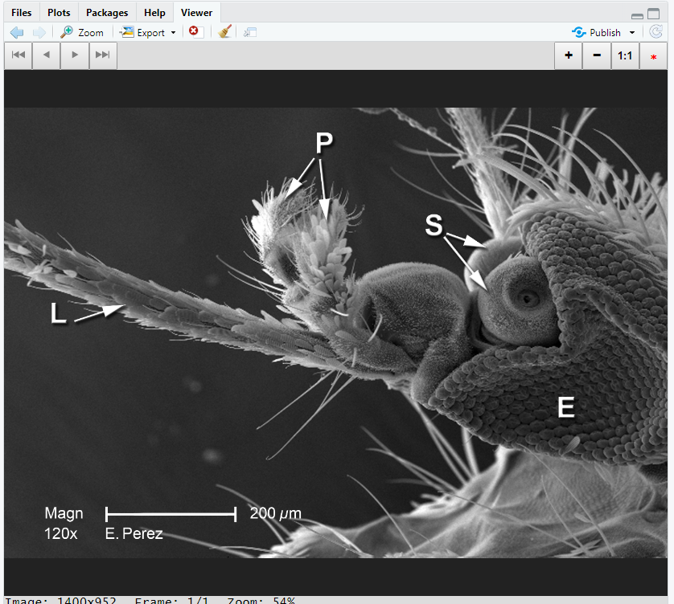
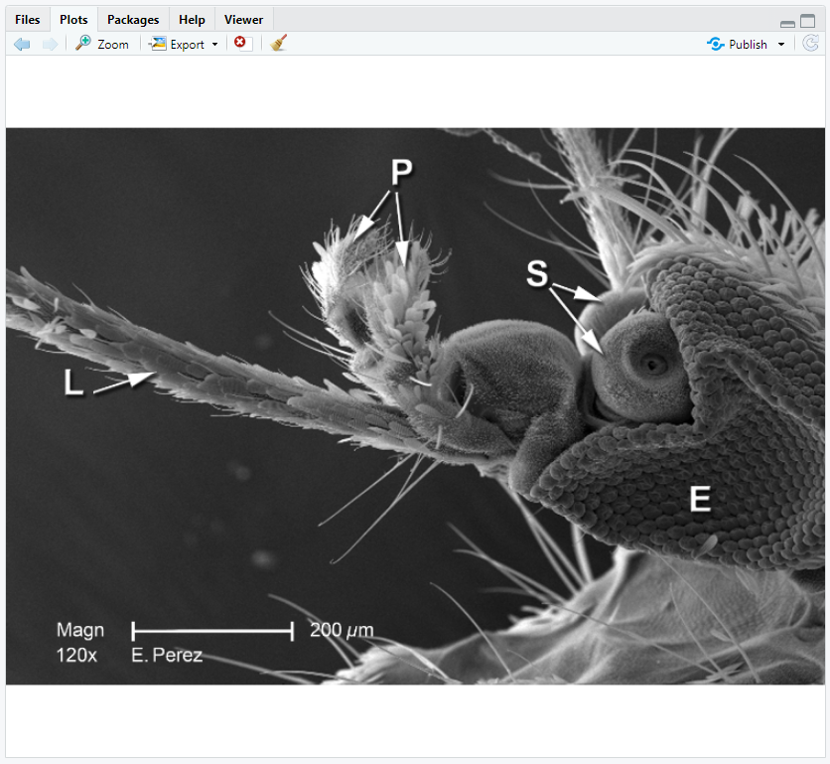
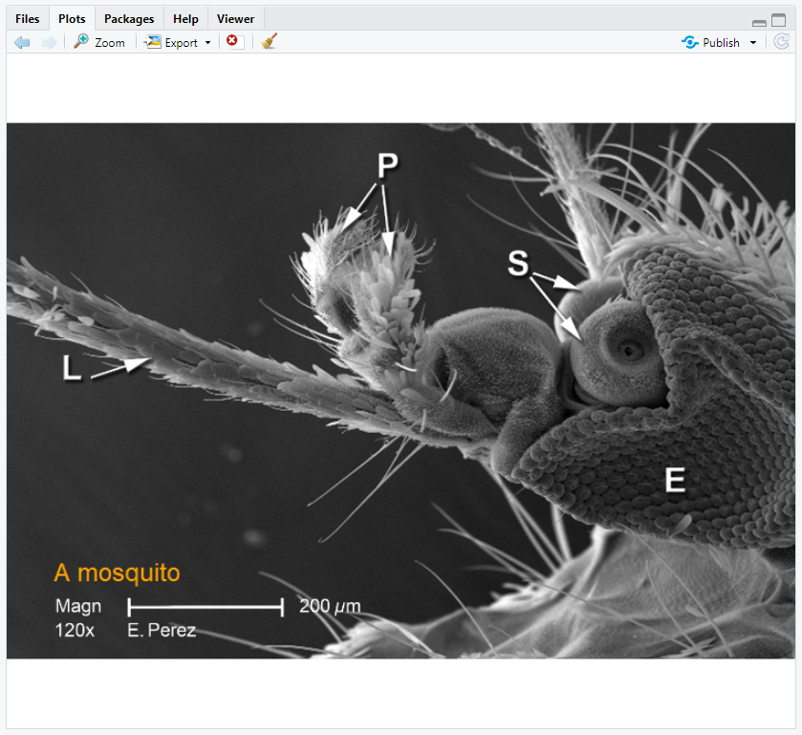
11.2-3 Loading and displaying images
EBImage provides general purpose functionality for image processing and analysis. In the context of (high-throughput) microscopy-based cellular assays, EBImage offers tools to segment cells and extract quantitative cellular descriptors. This allows the automation of such tasks using the R programming language and facilitates the use of other tools in the R environment for signal processing, statistical modeling, machine learning and visualization with image data.

Slide 4
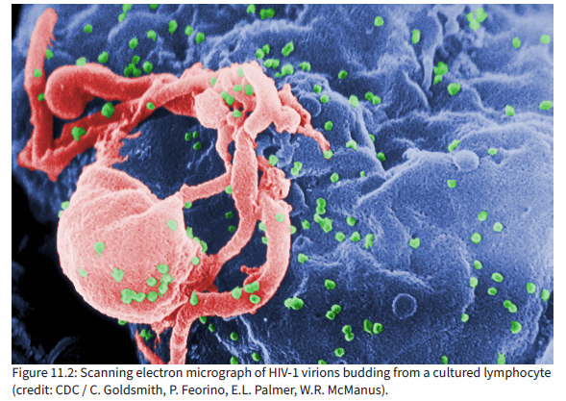
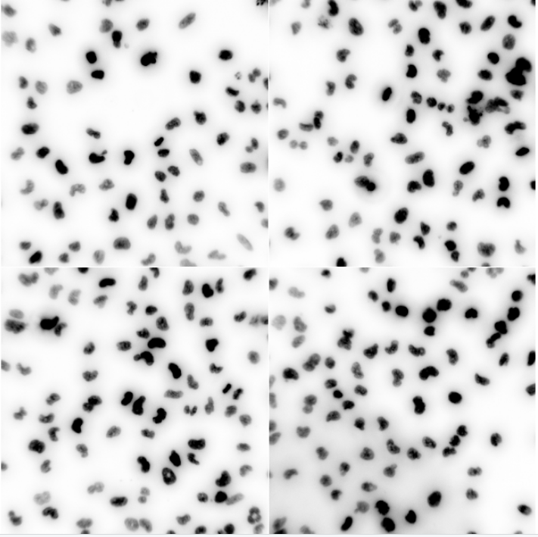
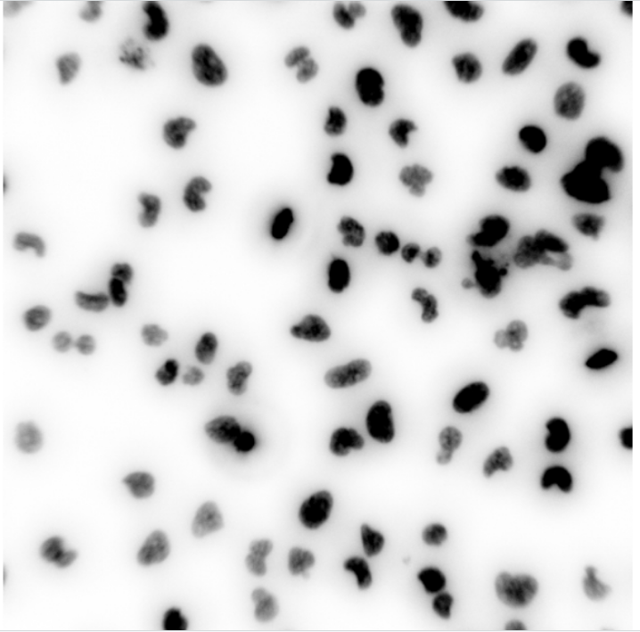
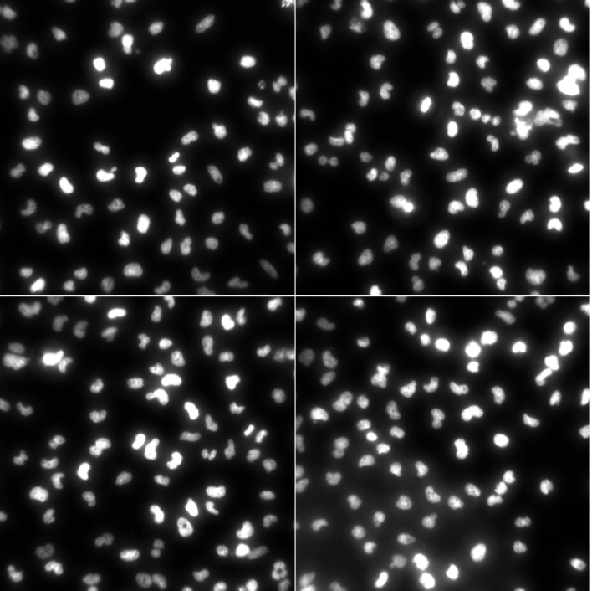
11.2-3 Loading and displaying images
display ‘nuc’ directly?
a
b

Slide 5
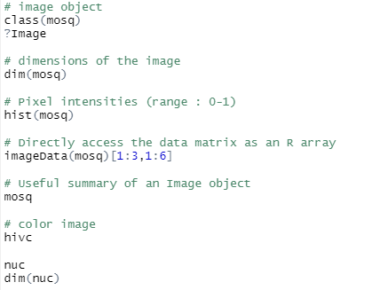
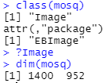
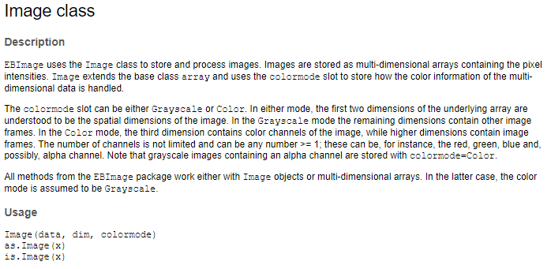
11.4 How are images stored in R?

Slide 6
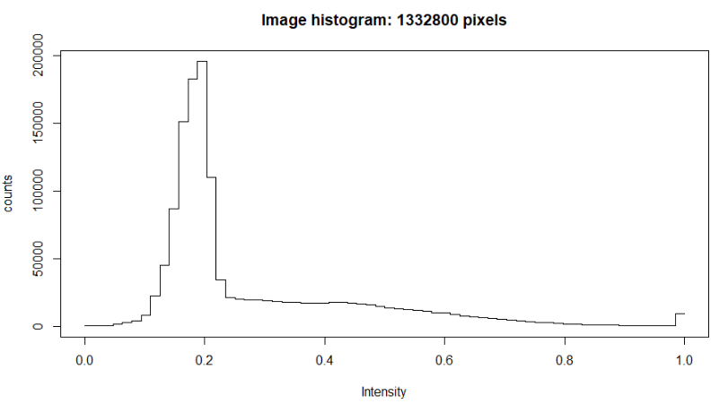
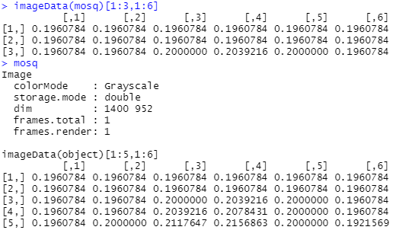
11.4 How are images stored in R?

Slide 7
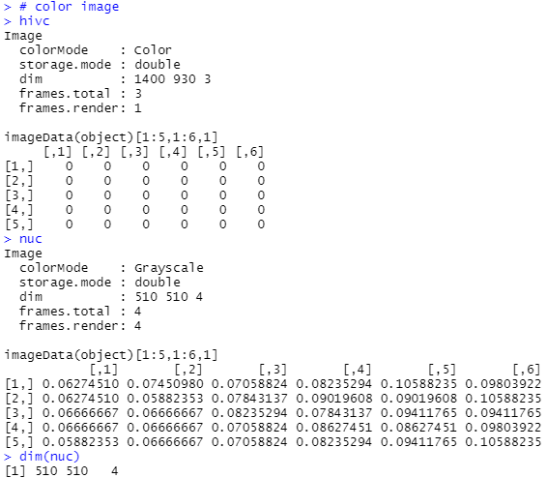
11.4 How are images stored in R?
11.5 Writing images to file

Slide 8
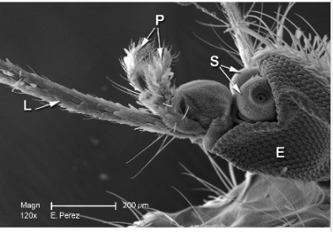
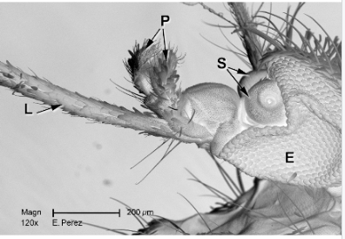
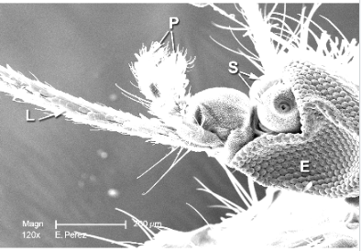
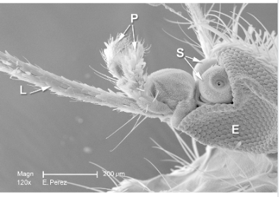
11.6 Manipulating images
Images are stored as arrays of numbers in R ⇒ method of manipulating images becomes ‘simple algebra’
we can take our original image and flip the bright areas to dark and vice versa by multiplying the image with -1
* provides a more flexible interface to the scaling of images.
original
flip
adjust the contrast
(multiplication)
adjust the gamma-factor
(exponentiation)

Slide 9
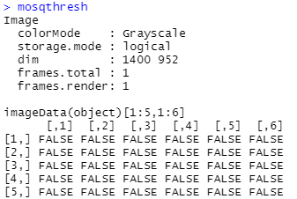
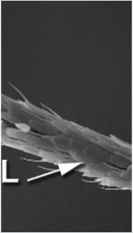
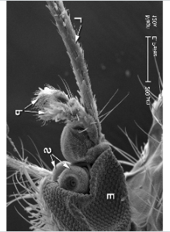
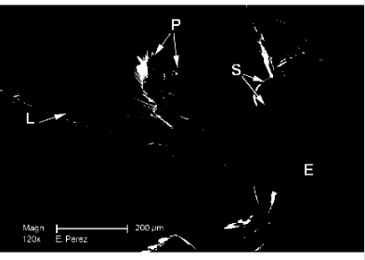
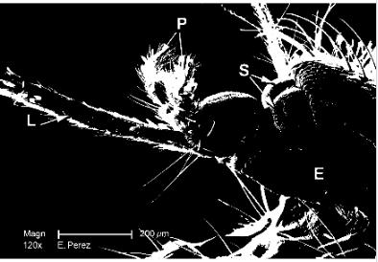
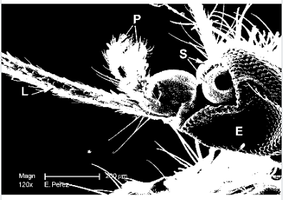
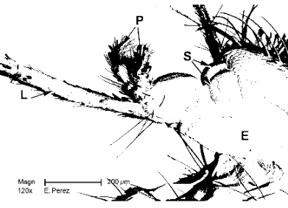
11.6 Manipulating images
Further manipulating images with matrix operations
crop
threshold
transpose
> 0.8 > 0.5 > 0.3
< 0.5

Slide 10
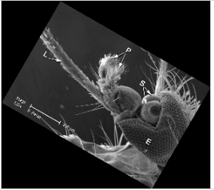
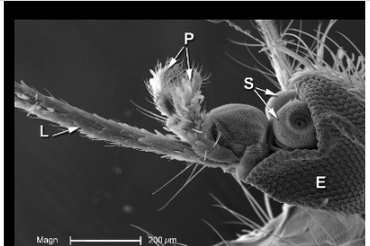
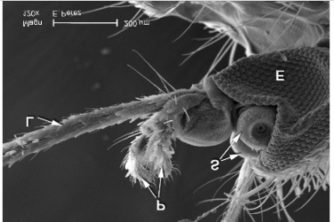
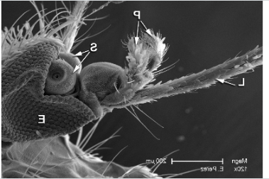
11.7 Spatial transformations
We just saw one type of spatial transformation, transposition, but there are many more
rotates the image clockwise w/ the given angle
moves by the given 2D vector
reflect the image around the central horizontal
vertical axis

Slide 11
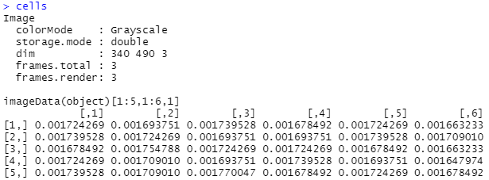
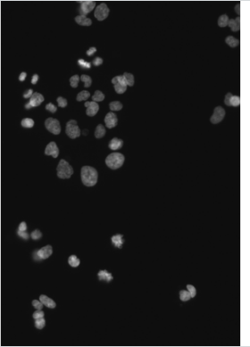
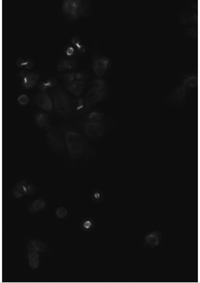
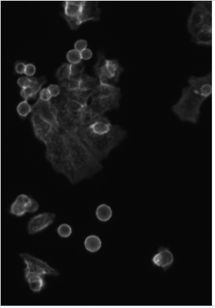
11.8 Linear filters
Switch to an application in cell biology images of human cancer cells (Laufer et al. 2013).
11.8.1 Interlude: the intensity scale of images
there are three individual grayscale frames
1
2
1
readImage() -> the theoretical range is mapped to the interval [0,1]
But the scanner used less bits -> small maximum values in the images
⇒ Rescale these data to approximately cover the range [0,1]
2
DAPI staining of the cells’ DNA
immunostaining against α-tubulin
immunostaining against actin

Slide 12
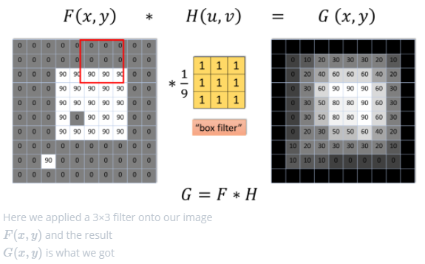
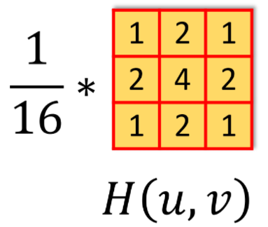
11.8 Linear filters
11.8.2 Noise reduction by smoothing
first goal : segmentation of the images to identify the individual cells
start by removing local artifacts or noise through smoothing (Averaging filter)
intuitive approach
define a window of a selected size around each pixel
average the values within that window.
applying this procedure to all pixels
Weighted averaging filter ( Gaussian filter ) ⇔
replace the moving average by a weighted average
Notes:
왜 무한대?
- For notational convenience, we let the summations range from −∞−∞ to ∞∞, even if in practice the sums are finite as ww has only a finite number of non-zero values.

Slide 13
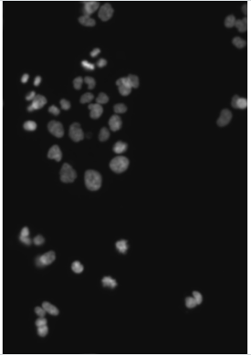
11.8 Linear filters
11.8.2 Noise reduction by smoothing
Weighted averaging filter ( Gaussian filter ) ⇔
makeBrush() : generate weight functions $w$
filter2() : implementing 2D convolution
Figure 11.12: nucSmooth,
a smoothed version of the DNA channel in the image object cells
The smoothed images have reduced pixel noise, yet still the needed resolution.

Slide 14
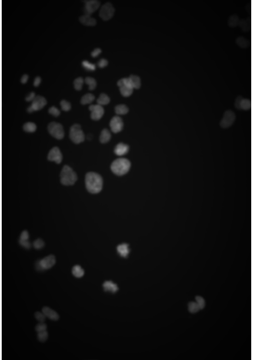
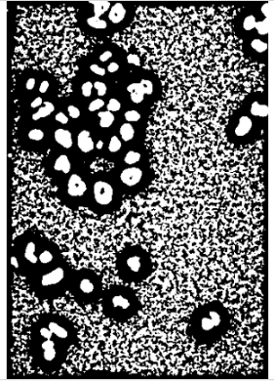
11.9 Adaptive thresholding
$≠$straightforward thresholding : different threshold in different regions of the image
can anticipate spatial dependencies of the underlying background signal
(ex. uneven illumination or stray signal from nearby bright objects)
example
Simulating uneven illumination to colon cancer images
illuminationGradient
nucBadlyIlluminated
localBackground
nucBadThresh
maximum at the center & falls off towards the sides
multiplying the DNA channel in cellsSmooth with illuminationGradient
applied linear filter
(bandwidth is larger than the objs to be detected)
result of adaptive thresholding.
The nuclei are reasonably well identified, despite the drop off in signal strength.
offset 0 0.08

Slide 15
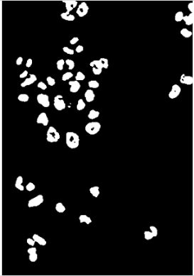
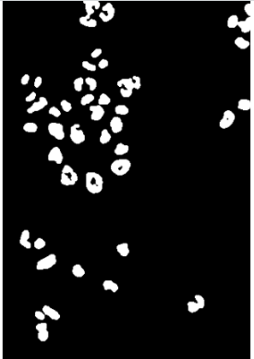
11.10 Morphological operations on binary images
Do the same again for the actual(not artificially degraded) image
> boundaries of the nuclei are slightly rugged, and there is noise at the single-pixel level.
nucThresh
nucOpened
[ Morphological operations ] on binary image, no linearity
erode: For every foreground pixel, put the mask around it, and if any pixel under the mask is from the background, then set all these pixels to background.
dilate: For every background pixel, put the mask around it, and if any pixel under the mask is from the foreground, then set all these pixels to foreground.
open: perform erode → dilate.
recovering original size
mostly used for removing small noises

Slide 16
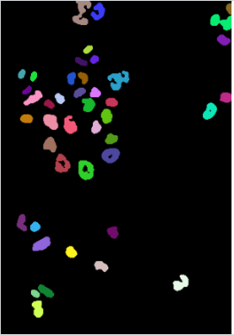
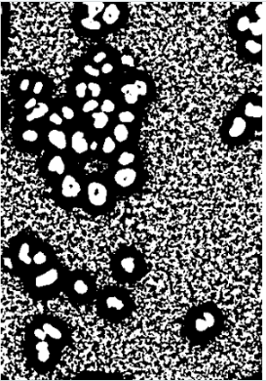
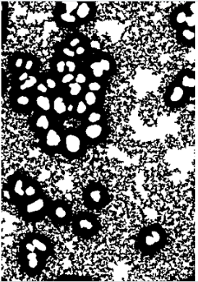
11.11 Segmentation of a binary image into objects
nucOpened represents a segmentation of the image into fore- and background pixels, but not into individual nuclei
Extract individual objects defined as connected sets of pixels.
different identified objects (1-43)
area (in pixels)
0: background
int(grayscale) image -> color image
Some neighboring objects were not properly separated.
Some objects contain holes.
Notes:
To improve nucSeed, we can now propagate its segmented objects until they fill the mask defined by nucMask. Boundaries between nuclei, in those places where the mask is connected, can be drawn by Voronoi tessellation, which is implemented in the function propagate, and will be explained in the next section.

Slide 17
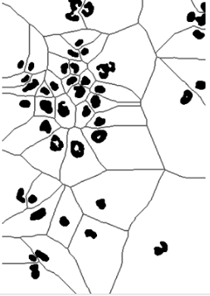
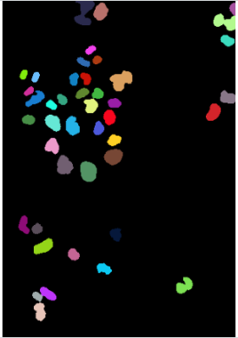
11.12 Voronoi tessellation
Voronoi tessellation
if we have a set of seed points (or regions) and want to partition the space that lies between the seeds
each point in the space is assigned to its closest seed.
Using nuclei as seeds
nucMask
nuclei
two generalizations
the space that we partition is the full, rectangular image area – but indeed we could restrict ourselves to any arbitrary subspace.
mask parameter in propagate()
distance between two points in the landscape not only depends on their x-, y- but also on the z-direction(elevation).
x argument in propagate()
Figure 11.15: Example of a Voronoi segmentation, indicated by the gray lines, using the nuclei (indicated by black regions) as seeds..
voronoiPaint
Notes:
테셀레이션(tessellation) 이란 마루나 욕실 바닥에 깔려 있는 타일처럼 어떠한 틈이나 포개짐이 없이 평면이나 공간을 도형으로 완벽하게 덮는 것
보로노이 다이어그램은 어떤 시드 점(seed point)들과의 거리에 따라서 평면을 분할한 그림으로서,
평면위에 주어진 시드 점 p1, p2, ..., pn에 대한 보로노이 다이어그램은
평면위의 점들이 어떤 pi와 가장 가까운지에 따라서 영역을 분할한 다이어그램

Slide 18
11.12 Voronoi tessellation
Voronoi tessellation
if we have a set of seed points (or regions) and want to partition the space that lies between the seeds
each point in the space is assigned to its closest seed.
Using nuclei as seeds
Perform on a Riemann manifold
distance btw two neighboring points
convenient ctrl of the relative weighting btw x, y, z
Figure 11.15: Example of a Voronoi segmentation, indicated by the gray lines, using the nuclei (indicated by black regions) as seeds..
Notes:
보로노이 다이어그램은 어떤 시드 점(seed point)들과의 거리에 따라서 평면을 분할한 그림으로서,
평면위에 주어진 시드 점 p1, p2, ..., pn에 대한 보로노이 다이어그램은
평면위의 점들이 어떤 pi와 가장 가까운지에 따라서 영역을 분할한 다이어그램

Slide 19
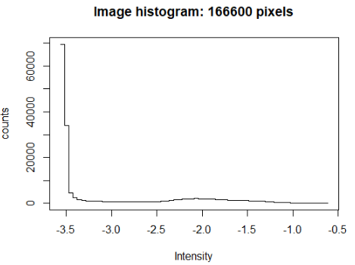
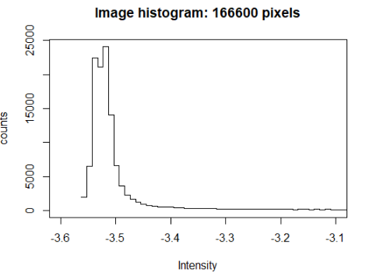
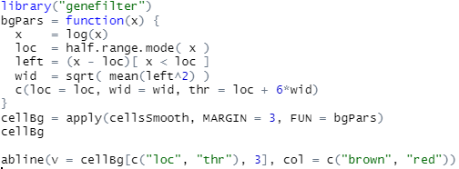
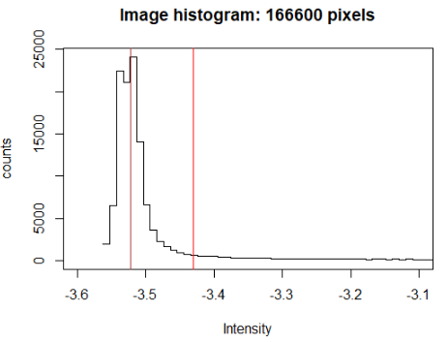
11.13 Segmenting the cell bodies
Determine a mask of cytoplasmic area in the images, using global threshold found by fitting a mixture model to the data
A mixture of two distributions
a log-Normal background
a foreground with another, unspecified, rather flat,
but mostly non-overlapping distribution
The majority of pixels are from the background
Global threshold found by fitting a mixture model to the data

Slide 20
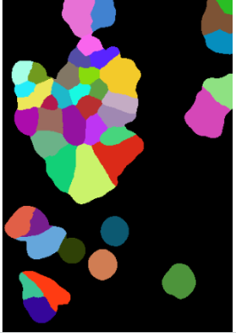
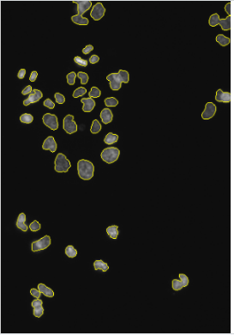
11.13 Segmenting the cell bodies
cytoplasm-Mask : Union of all the pixels
that are above the threshold in the actin or tubulin image
that we have already classified as nuclear in the image ‘nuclei’.
simply extend the nucleus segmentation within this mask

Slide 21
11.14 Feature extraction
Compute the mean intensities
Efficiently computing a large collection of features
F1 is a matrix, array with 43 rows(cell) and 89 columns, one for each of the computed features
can now use multivariate analysis methods
(clustering, classification, comparison .. etc)

Slide 22
11.15 Spatial statistics: point processes
We have seen ways how to use images of cells to extract their positions and various shape and morphological features.
Now explore spatial distributions of the position – dataset of breast cancer lymph node biopsies.
11.15.1 A case study: Interaction between immune cells and cancer cells
The lymph nodes function as an immunologic filter for the bodily fluid, lymph.
drain fluid from most of our tissues, and are composed mostly of T, B cells, DCs and macrophages
The lymph ducts of the breast usually drain to one lymph node first (sentinel lymph node) before draining through the rest of the lymph nodes underneath the arm.
Typing the cells can be done by staining the cells with protein antibodies that provide specific signatures.
different types of immune cells have different proteins expressed, mostly in their cell membranes.
Marked point process
After segmentating the image, they obtained the coordinates and the type of all the cells in the image. We call this type of data a marked point process, and it can be seen as a simple table with 3 columns.
Setiadi et al. (2010)
Notes:
transmute() : to keep only new variables (dplyr)

Slide 23
11.15 Spatial statistics: point processes
We have seen ways how to use images of cells to extract their positions and various shape and morphological features.
Now explore spatial distributions of the position – dataset of breast cancer lymph node biopsies.
11.15.1 A case study: Interaction between immune cells and cancer cells
missing or were not analyzed.

Slide 24
11.15 Spatial statistics: point processes
We have seen ways how to use images of cells to extract their positions and various shape and morphological features.
Now explore spatial distributions of the position – dataset of breast cancer lymph node biopsies.
11.15.1 A case study: Interaction between immune cells and cancer cells
To use the functionality of the spatstat package, convert our data in brcalymphnode into an object of class ppp
ppp object
designed to capture realizations of a spatial point process
(a set of isolated points located in a mathematical space)
the points can be marked with certain properties.
ex. attributes, times or quantitative data..
in ‘ln’ :
space = 2D rectangle
mark = factor variable ‘class’
Marked point process and image are similar, but
mpp : the points can lie anywhere within the space
image : the pixels are covering the space in regular, rectangular way.

Slide 25
11.15 Spatial statistics: point processes
We have seen ways how to use images of cells to extract their positions and various shape and morphological features.
Now explore spatial distributions of the position – dataset of breast cancer lymph node biopsies.
11.15.2 Convex hull
Above, we considered space in which the point process lies as a rectangle.
In fact, the space is more confined, and we can compute a tighter region from the convex hull of the points.
Notes:
Namely, the ppp function expects the hull to be described by a closed polygon line, while convhulln() presents its result as a set of line segments in no particular order.

Slide 26
11.15 Spatial statistics: point processes
We have seen ways how to use images of cells to extract their positions and various shape and morphological features.
Now explore spatial distributions of the position – dataset of breast cancer lymph node biopsies.
11.15.2 Convex hull
Above, we considered space in which the point process lies as a rectangle.
In fact, the space is more confined, and we can compute a tighter region from the convex hull of the points.
Figure 11.24: Polygon describing the convex hull of the points in ln.
Notes:
Namely, the ppp function expects the hull to be described by a closed polygon line, while convhulln presents its result as a set of line segments in no particular order.
the entries of chull are integer indices into the array coords that refer to the points defining each simplex.

Slide 27
11.16 First order effects: the intensity
11.16.1 Poisson Process
The simplest spatial process -> null model
stationary with intensity $λ$
no further dependencies between occurrences of points
in non-overlapping regions of the space
the number of points (N) in a region of area $A$follows
a Poisson distribution with rate $λA$.
Figure 11.25: Rain drops
The number of drops falling on a particular spot only depends on the rate λ (and on the size of the spot), but not on what happens at other spots.
11.16.2 Estimating the intensity
First order effects : associated w/ external factors
uneven distribution of the population
Second order effects : based on mutual endogenous interrelationships among the spatial objects
internal forces can be exchange mechanisms btw spatial objects
ex. sharing of info / common values
divide up the area into subregions
small enough to see potential local variations of $λ(p)$
big enough to contain a sufficient sample of points
similar to 2D density estimation
$σ$ (smoothing parameter) $∝$
local estimate of regions for each $p$
smooth kernel function
edge correction factor
consider the estimation bias caused when the kernel would fall outside the defined space.

Slide 28
11.16 First order effects: the intensity
11.16.1 Poisson Process
The simplest spatial process -> null model
stationary with intensity $λ$
no further dependencies between occurrences of points
in non-overlapping regions of the space
the number of points in a region of area $A$follows
a Poisson distribution with rate $λA$.
Figure 11.25: Rain drops
The number of drops falling on a particular spot only depends on the rate λ (and on the size of the spot), but not on what happens at other spots.
11.16.2 Estimating the intensity
Density gives us as estimate of the intensity of the point process
probability that a cell that is present at particular spatial location will be a tumor cell
Figure 11.28: Estimates of the spatially varying probability of each of the cell classes, conditional on there being cells.
Figure 11.26: Intensity estimate for the cells marked Tumor in ppp.

Slide 29
11.17 Second order effects: spatial dependence
If we pick a point at random in our spatial process, what is the distance $W$to its nearest neighbor?
For a homogenous Poisson process, the cumulative distribution function of this distance is

Slide 30
11.17 Second order effects: spatial dependence
11.17.1 Ripley’s $K$ function
The average number of points found near a randomly picked point of the process
will indicate fluctuations from the complete spatial randomness model,
for which this number grows with the distance $r$ as the area of the circle, $πr^{2}$.
$λK\left(r\right)$ is the expected number of (additional) points within a distance $r$ of a given, randomly picked point.
($λ$= intensity of the process, i.e, the expected number of points per unit area.)
The definition of $K$ can be generalized to inhomogeneous point processes
For estimation and visualization, it is useful to consider a
transformation of $K$(and $K_{inhom}$), the so-called $L$function.
distance btw points $p_{i},p_{j}$
edge correction factor
stabilizing the variance of the estimator
⇒ compared to 𝐾, 𝐿 is more appropriate for data analysis and simulations.

Slide 31
11.17 Second order effects: spatial dependence
11.17.1 Ripley’s $K$ function
The pair correlation function
how point density varies as a function of distance from a reference point?
For a stationary Poisson process, the pair correlation function is identically equal to 1
$g\left(r\right)<1$ : inhibition btw points
$g\left(r\right)>1$ : clustering
g can be applied to the estimate of $K_{inhom}$
Figure 11.31: Estimate of the pair correlation function, the above equation, of the T cell pattern.
Figure 11.32: right panel of Figure 11.31, but with denser sampling.

Slide 32
11.18 Summary of this chapter
We learned to work with image data in R. Images are basically just arrays, and we can use familiar idioms to manipulate them. We can extract quantitative features from images, and then many of the analytical questions are not unlike those with other high-throughput data: we summarize the features into statistics such as means and variances, do hypothesis testing for differences between conditions, perform analysis of variance, apply dimension reduction, clustering and classification.
Often we want to compute such quantitative features not on the whole image, but for individual objects shown in the image, and then we need to first segment the image to demarcate the boundaries of the objects of interest. We saw how to do this for images of nuclei and cells.
When the interest is on the positions of the objects and how these positions relate to each other, we enter the realm of spatial statistics. We have explored some of the functionality of the spatstat package, have encountered the point process class, and we learned some of the specific diagnostic statistics used for point patterns, like Ripley’s K function.

