Slide 1
6 Testing
(part 2 from 6-9)
Jang-il Sohn
Jul 21, 2021

Slide 2
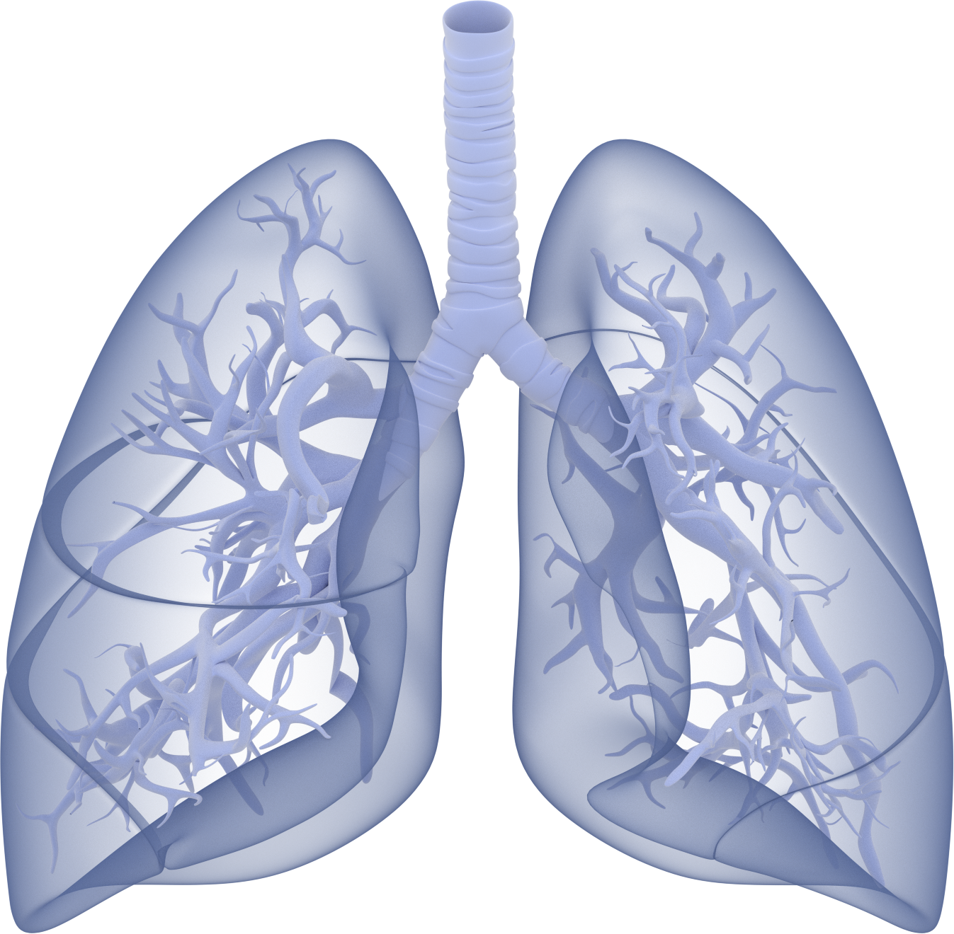
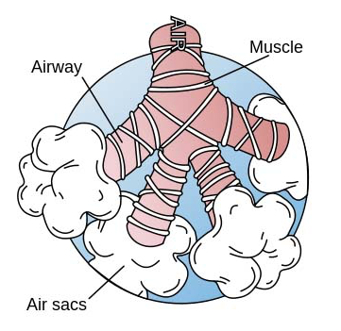
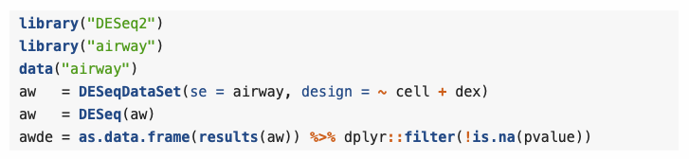

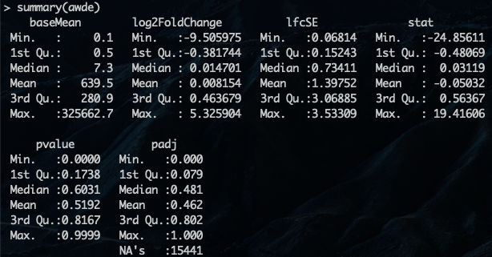
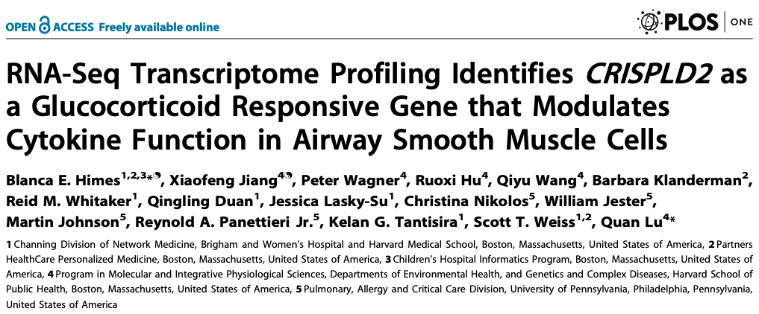
Airway dataset
gene expression measurements (gene-level counts)
four primary human airway smooth muscle cell lines
w/wo dexamethasone

Slide 3
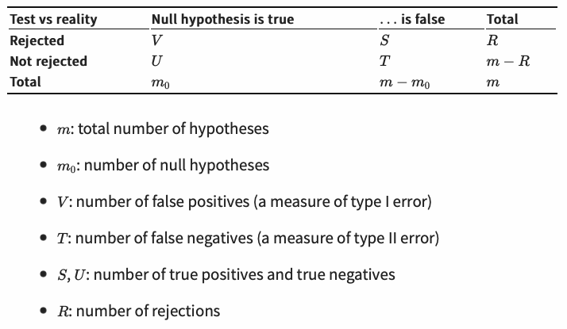
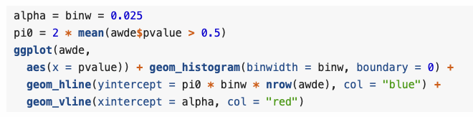

?
1.129284 > 1
the proportion of true null hypotheses
4772
false rejections
?
945
False discovery rate (FDR)
alpha

Slide 4
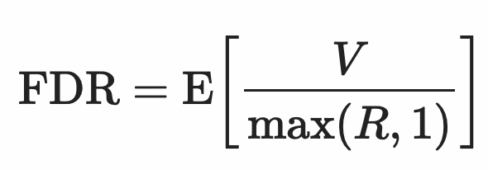
(If R=0 (or TP+FP=0), then FDR=0)

Slide 5
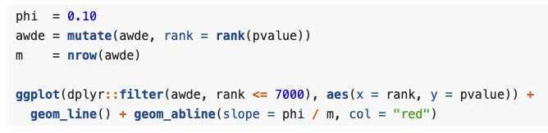
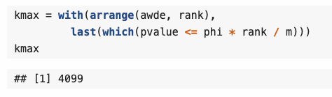
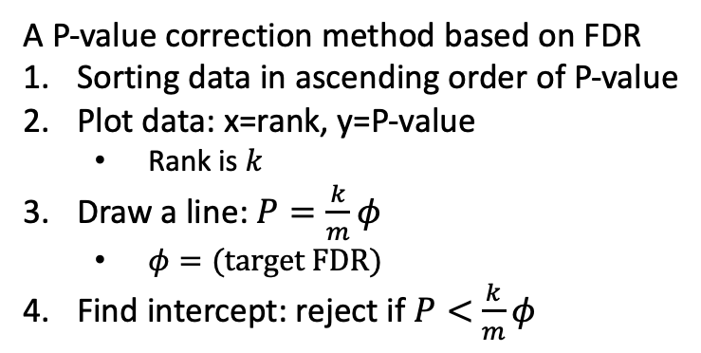

* Benjamini-Hochberg procedure
A P-value correction method based on FDR
Sorting data in ascending order of P-value
Plot data: x=rank, y=P-value
  Rank is $k$
Draw a line: $P=\frac{k}{m}φ$
  $φ=(target FDR)$
Find intercept: reject if $P<$ $\frac{k}{m}φ$
4099
Reject
Adj.P-value
Slope = $\frac{φ}{m}$
Target FDR →
Sorting →
Draw a curve
and a line→
Intercept →

Slide 6
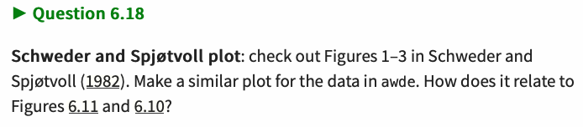
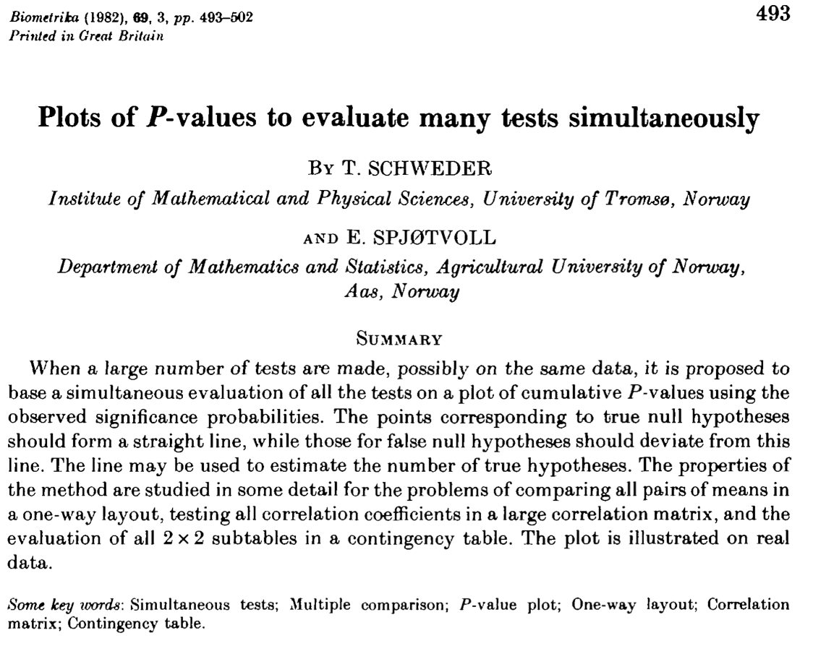
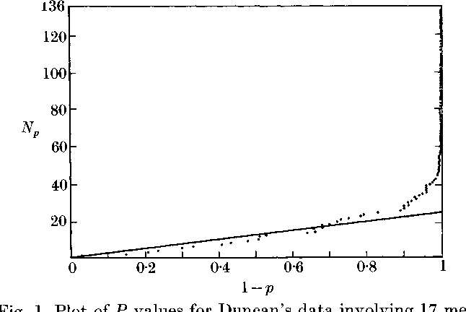
N(p) is the number of p-values greater than p
Reject
Null hypotheses

Slide 7
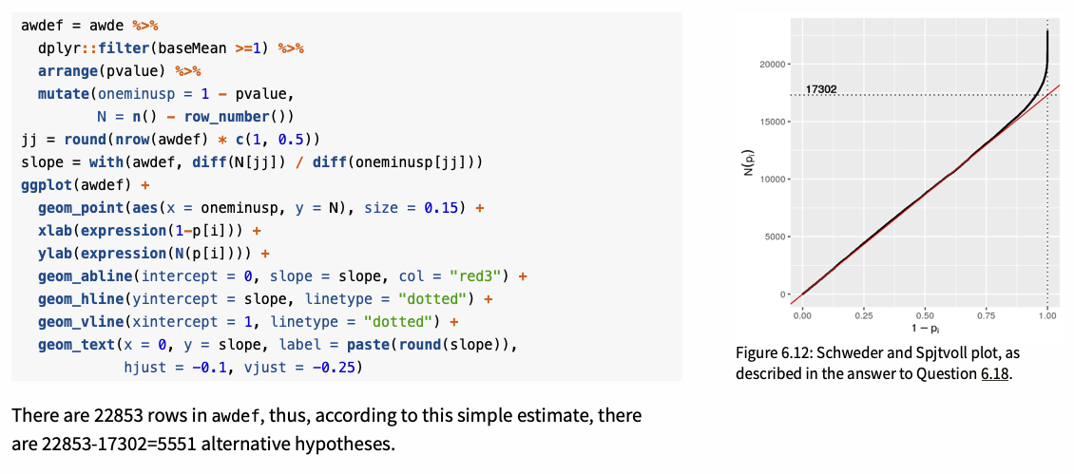

Slide 8


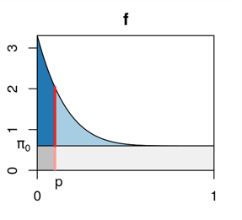
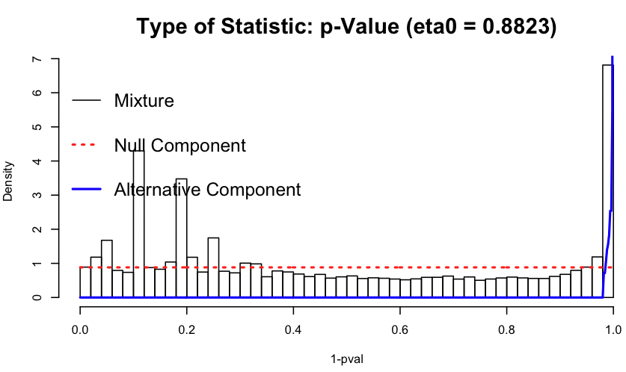
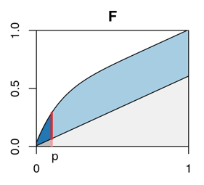
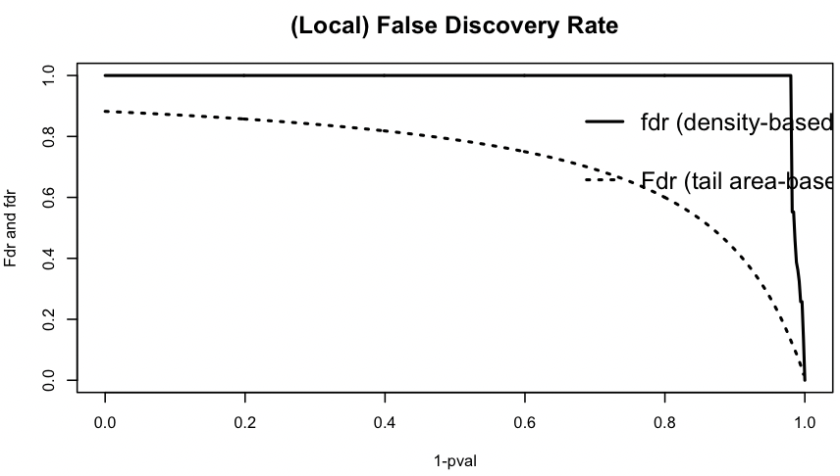
total FDR
False discovery
P-value cutoff
Density
Cumulative

Slide 9
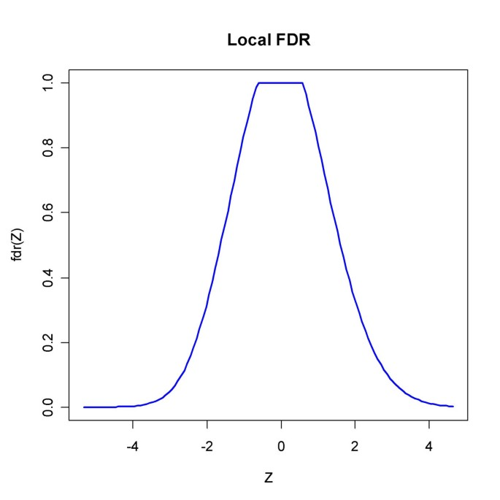
Broberg, P. A comparative review of estimates of the proportion unchanged genes and the false discovery rate. BMC Bioinformatics 6, 199 (2005). https://doi.org/10.1186/1471-2105-6-199
Original study about local FDR:
Efron B, Tibshirani R, Storey JD, Tusher VG: Empirical Bayes analysis of a microarray experiment. Journal of the American Statistical Association 2001, 96: 1151–1160. 10.1198/016214501753382129

Slide 10
Testing power depends on expression levels.
P-value is not enough…

Slide 11
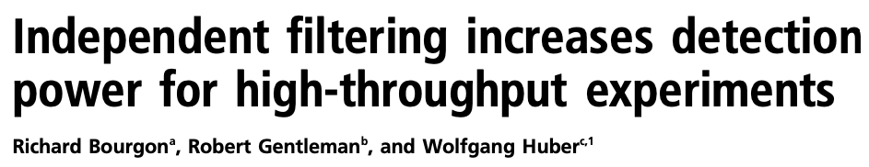
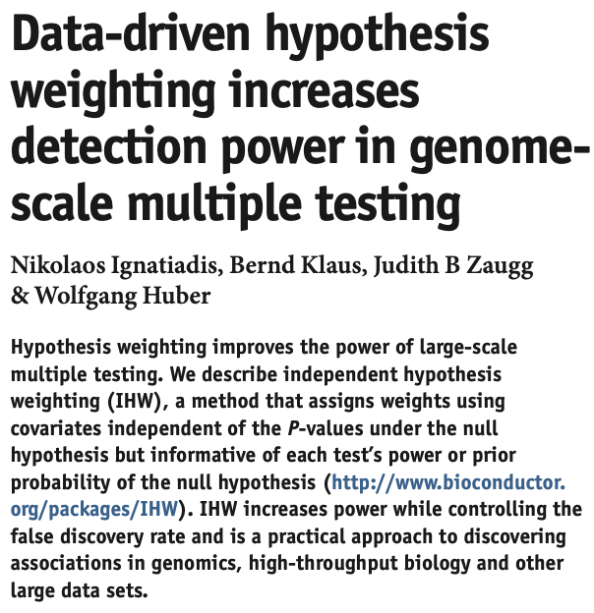
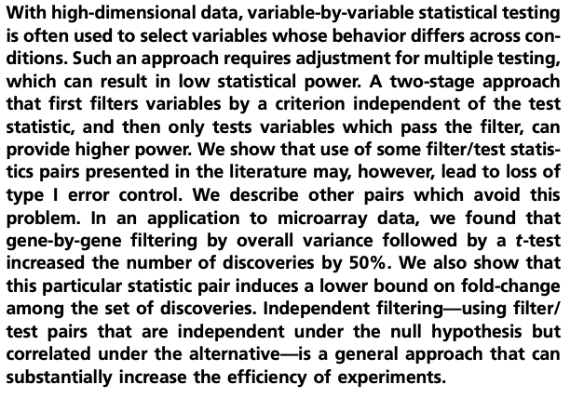
P-value is not enough…
Independent filtering
Independent hypothesis weighting
Bourgon, Richard, Robert Gentleman, and Wolfgang Huber. "Independent filtering increases detection power for high-throughput experiments." Proceedings of the National Academy of Sciences 107.21 (2010): 9546-9551.
Ignatiadis, N., Klaus, B., Zaugg, J. et al. Data-driven hypothesis weighting increases detection power in genome-scale multiple testing. Nat Methods 13, 577–580 (2016). https://doi.org/10.1038/nmeth.3885

