Slide 1
Chapter 13.
Design of High Throughput Experiments and their Analysis
Yi Dohun
Bioinformatics and Genomics Lab
Department of Life Science, Hanyang University
Aug 2, 2021

Slide 2
Contents
Goal of this chapter
Type of experiments
Partitioning error: bias and noise
Basic principles in the design of experiments
Mean-variance relationships and variance-stabilizing transformations
Data quality assessment and quality control
Longitudinal data
Data integration: use everything you (could) know
Sharpen your tools: reproducible research
Data representation
Tidy data
Leaky pipelines and statistical sufficiency
Efficient computing
Summary of this chapter

Slide 3
1. Goal of this chapter
Develop simple categorization of what type of experiments there are and varying amount of control we have with each of them
Recap how to distinguish the different type of variability: error, noise, bias
Discuss what we need to worry about: confounding, dependencies, batch effect, and how many replicates?
Recap the ideas behind mean-variance relationship and how they inform us on whether and how to transform our data
Discuss efficient workflow design, data representation and computation
Aware data summarization steps and questions of sufficiency in our analytical workflows, so we don’t throw away informations upstream

Slide 4
2. Type of experiments
In real world, our resources are finite, instruments not perfect, samples sizes are limitied, there are background noise, and the phenomenon of interest may be measured indirectly rather than directly.
To get best possible outcome, this leads us to hard decisions and tradeoffs.
Experimental design aim to rationalize such decisions.
Well designed experiments is one that sufficiently powered and technical artifacts /biological features that may affect measurements are balanced, randomized or controlled.

Slide 5
2. Type of experiments
There are major different types of experiments which require different approaches.
In controlled experiments
Have control over all relevant variables (model system, condition, experimental readout…)
In study with less control
Observational study
Like observing predator in nature in ecological field study the nutrition, weather and even condition of major interest could not be controlled
Randomized controlled trial
Like in clinical study in drug test, We have control for variable of interest But other condition may be hard to have controll
However, with high enough sample size, nuisance effect average out.
Meta-analysis
Observational study on several previous experiments or studies
Can average out study-level problems (researcher bias or other biases)

Slide 6
3. Partitioning error: bias and noise
Error can be broadly distinguished to noise and bias.
Noise: average out with enough replicates
Bias: remains. More difficult to deal withor even recognize
Appropriate Error model can help decompose variability into noise and bias,
For example, LDA in chapter 12 compute total sum of square C as
Sometime we explicitly know about factors cause bias, like different reagent batch. This is called batch effect. At other times, we may expect such factors exists but no record of them. We call these latent factors. We can treat them as adding to noise, use mixture model in Chapter 4. But as they tends to be correltated, this could be faulty inference. Better way could be in (Leek and Storey 2007; Stegle et al. 2010)
Units vs. fold-chagnes
In physics we use SI units. It is Standardizable.
In Biology, metrics are rarely stadardizable. So use measure as multiples of some local reference, like fold-change
But a denominator is instable, is Very unequal variance. lack an indication of their precision

Slide 7
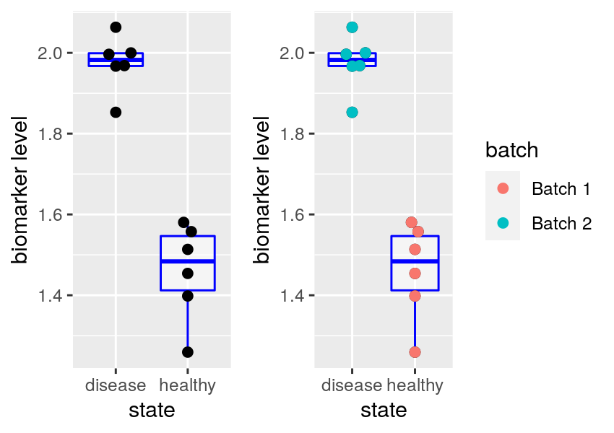
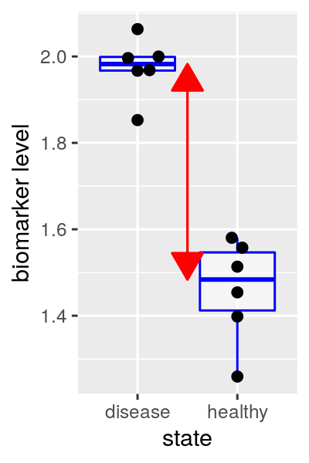
4. Basic principles in the design of experiments
Confounding
In shown figure, how can we decide whether observed difference level are due to disease vs healthy or due to batch?
These could be not only biological/technical variable, also life style that causes disease or inflammation
Effect size
difference between group center.
Larger samples in each group increase precision which which location of each group and effect size are known, thus increase our power to detect difference.

Slide 8
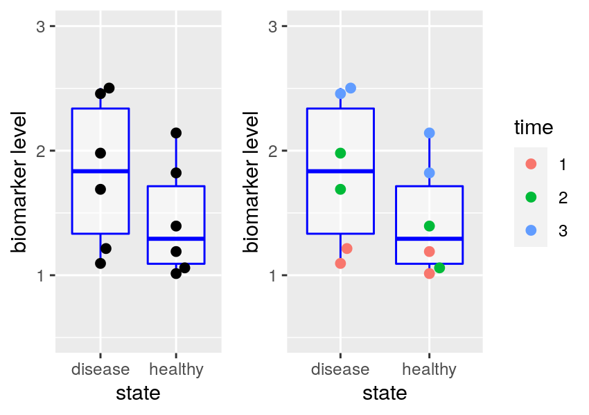
4. Basic principles in the design of experiments
Blocking and pairing
Block: only the factor of interest, called treatment, is different within each block
Block what you can, randomize what you cannot
Paired design: use natural paring of observations – twin study, study of patient before/after treatment → matched desing (matching age, sexes, background health etc.)
Balanced design: different factor combination have same number of observation replicates. Effect of each factor is identifiable. If nuisance factor exists, they should be balanced.
Randomization: if don’t know which factors are important and hard to plan, we need to randomize these factor. This will help these variables average-out

Slide 9
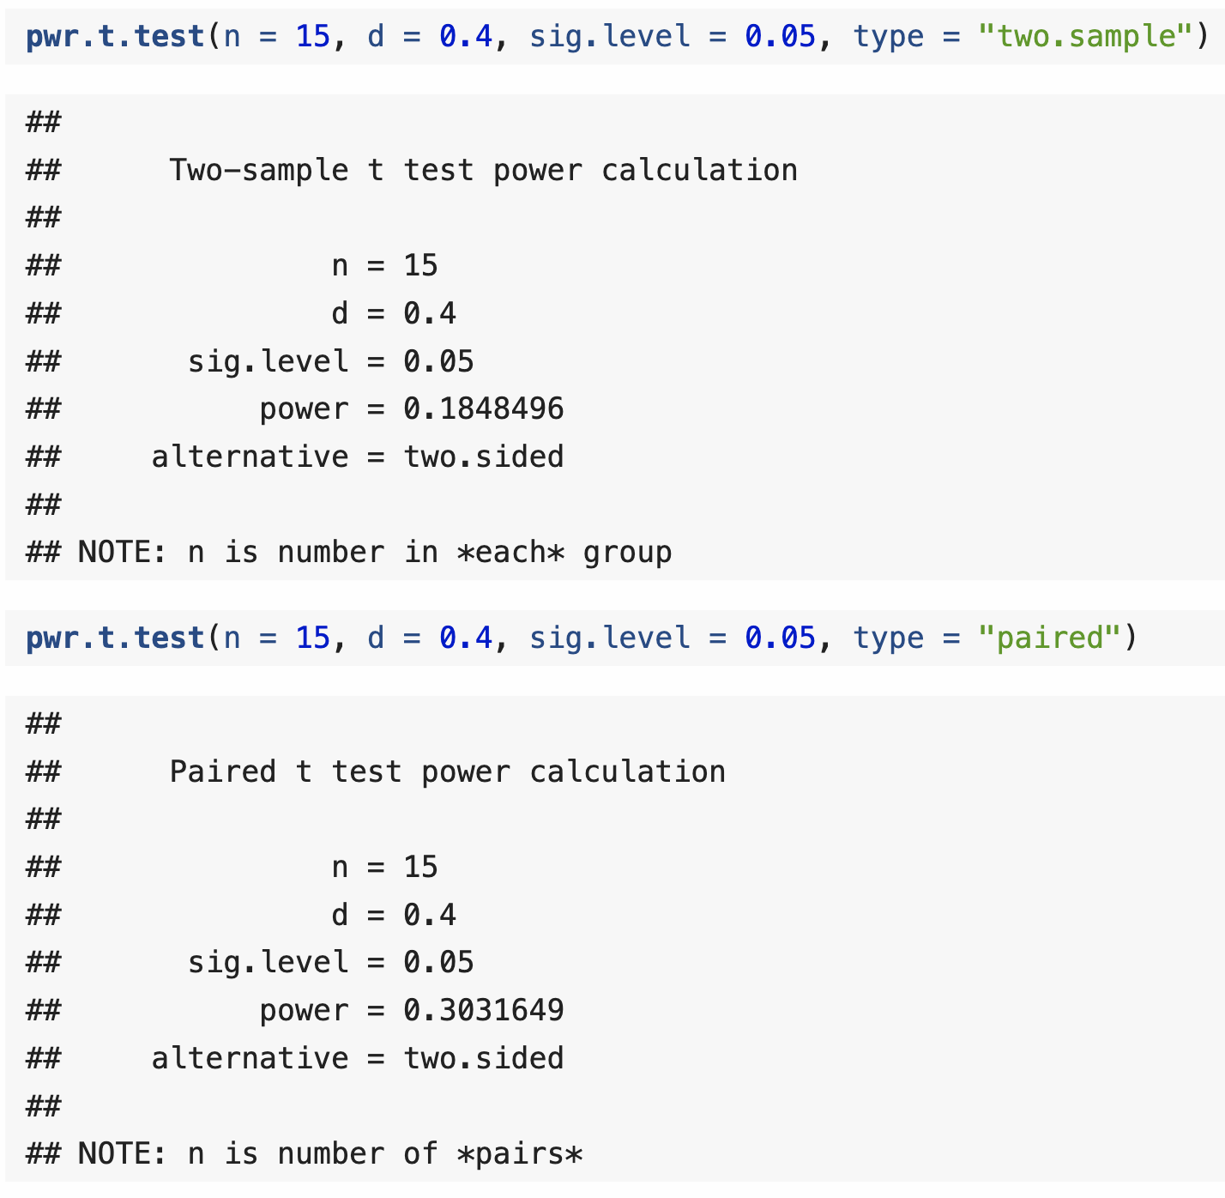
4. Basic principles in the design of experiments
Power depends on sample sizes, effect sizes and variability.
Two sample and paired test requrie different sample size for same power

Slide 10
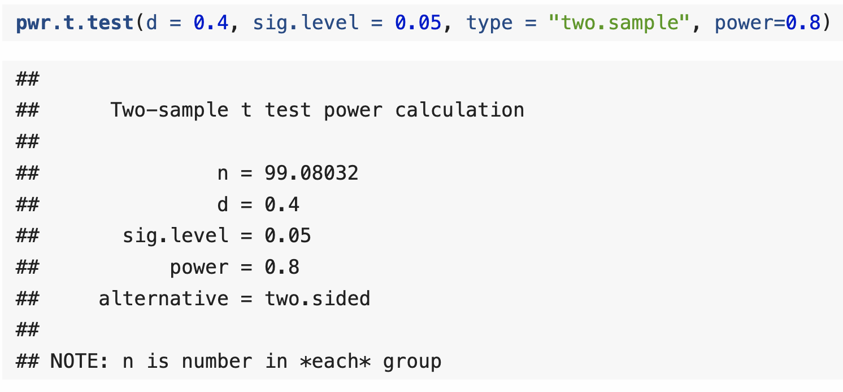
4. Basic principles in the design of experiments
If we want to know what sample size would be required to detect a given effect size:

Slide 11
5. Mean-variance relationships and variance-stabilizing transformations
In chapter 4,8 we saw data transformations that compress or stretch space of measurements’ variance, thus variance between replicate measurement is no longer highly dependent on mean value.
Mean-variance relationship before transformation can be any function, but followings are prototypic relationships
But, real data can be affected by combination of these.

Slide 12
6. Data quality assessment and quality control
We distinguish data quality assessment (QA) monitoring data quality, and quality control (QC), removing bad data. And related questions include
How marginal distribution of variables looks (histogram, ECDF)
How joint distribution look (scatter, pair plot)
How well do replicates agree, are magnitude of differences plausible
Is there evidence of batch effect?
In case of 3-4, we can use heatmaps, PCA and other ordination plots (Chapter 7,9)

Slide 13
7. Longitudinal data
Longitudinal data has time as covariate, and there are two types
1. Time points are a handful (e.g. 24h, 48h, 72h)
2. Time points are long/densly samples (movie from life cell microscopy)
In (1) case, time is just another discrete experimental factor.
In (2) case, we may want to fit dynamical models to data.
Writing X(t) for state of our system at time t, we have many choices
X is continuous or discrete
Dynamics of X are deterministic or stochastic
Dynamics are smooth and/or jumpy
We observe X directly or only some noise and/or reduced version Y=g(X)+e (g is signal reduction and e is error)

Slide 14
7. Longitudinal data
We have many modeling tools, including
Markov model: discrete state, dynamics are stochastic, occur by jumping b/w states
Ordinary/partial differential equations: continuous stats space, dynamics are deterministic and smooth and are described by differential equation
Master equation, Fokker-Plank equation: dynamics are stochastic. Described by differential equations for probability distribution of X in space and time
Piece-wise deterministic stochastic process: combination of above, samples from process involve deterministic, smooth movement as well as occasional jumps.
In case we don’t observe X directly, Hidden Markov Model makes it relatively straightforward to fit such models.
Many methods are from physics, econometrics, signal processing. So it’s worthwhile to scan literature in these fields.

Slide 15
8. Data integration: use everything you (could) know
Generic approach, analyzing without already known reference, could be seemingly “unbiased”, but is often wastefull.
Better use prior knowledge guide our interpretation
A potential example is
Penalization or feature selection in high-dimensional regression or classification. It is easy to treat all features the same, (standardize all to zero mean and unit variance). But sometime we know some features are likely to bew more / less informative. We can usalso use graph or network to represent other data (graph-, group rasso) to structure your penalties

Slide 16
9. Sharpen your tools: reproducible research
Analysis begins with simple script, to try initial idea and explore data.
After more ideas are added, more data comes in , other datasets integrated, more people become involved, paper needs to be written, figures be done ‘properly’, and record needs to be documented. Some principles to help this process are
Use IDE (Rstudio, Emacs, Eclips)
Use Literate programming tools (Rmarkdown / jupyter) which can embed figures and tables in documentation. Good for reporting analysis to collaborators
Anticipate re-engineering data formats and software.
Reuse existing codes before using self-made heuristic or temporary short-cut, spend time to find already tested solutions
Use version control
Use functions rather than copy-paste
Use R package system to save your frequently used funcitons
Centralize location of raw data files and automate derivation of data
Keep hyperlinked webpage with an index of all analysis for methods part of your paper

Slide 17
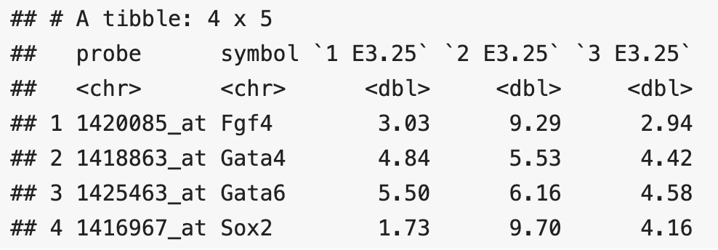
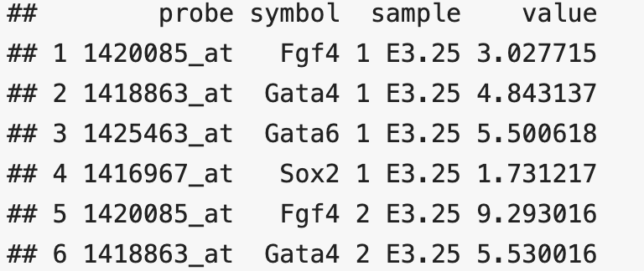
10. Data representation
In data representation, “ggplot2” prefer data in long format. reasons behind this choice are in Wickham 2014
Wide/long table format
In Hiiragi data, each row of reports 101 expression values (3 shown), this is example of wide format (=untidy)
Below, each row correspond exactly one of measured values, stored in column value, and other columns store associated covariates. This is example of long format (tidy)
In long format, we can simply add additional columns like gene id or chromosome and can sure we will not break existing code.
Example of wide format
Example of long format

Slide 18
11. Tidy data
In tidy data,
Each variabel forms a column
Each observation forms a row
Each type of observational unit forms a table
Tidy format is usefull, but is not a panacea. Keep in mind that:
In long data format we have to repeatedly store some same information in some case this storage cost could be considerable.
There is no place for data provenance, like who performed experiment and where it was published.
Diffusion of information. Some data in same categories are spread over, and hard to re-collect or update. Thus, not suitable for long-term data storage.
Many data have natural matrix-like structure, like number of features assayed on multiple samples. Unrolling matrix into long form makes some operations awkward (PCA, SVD, …)

Slide 19
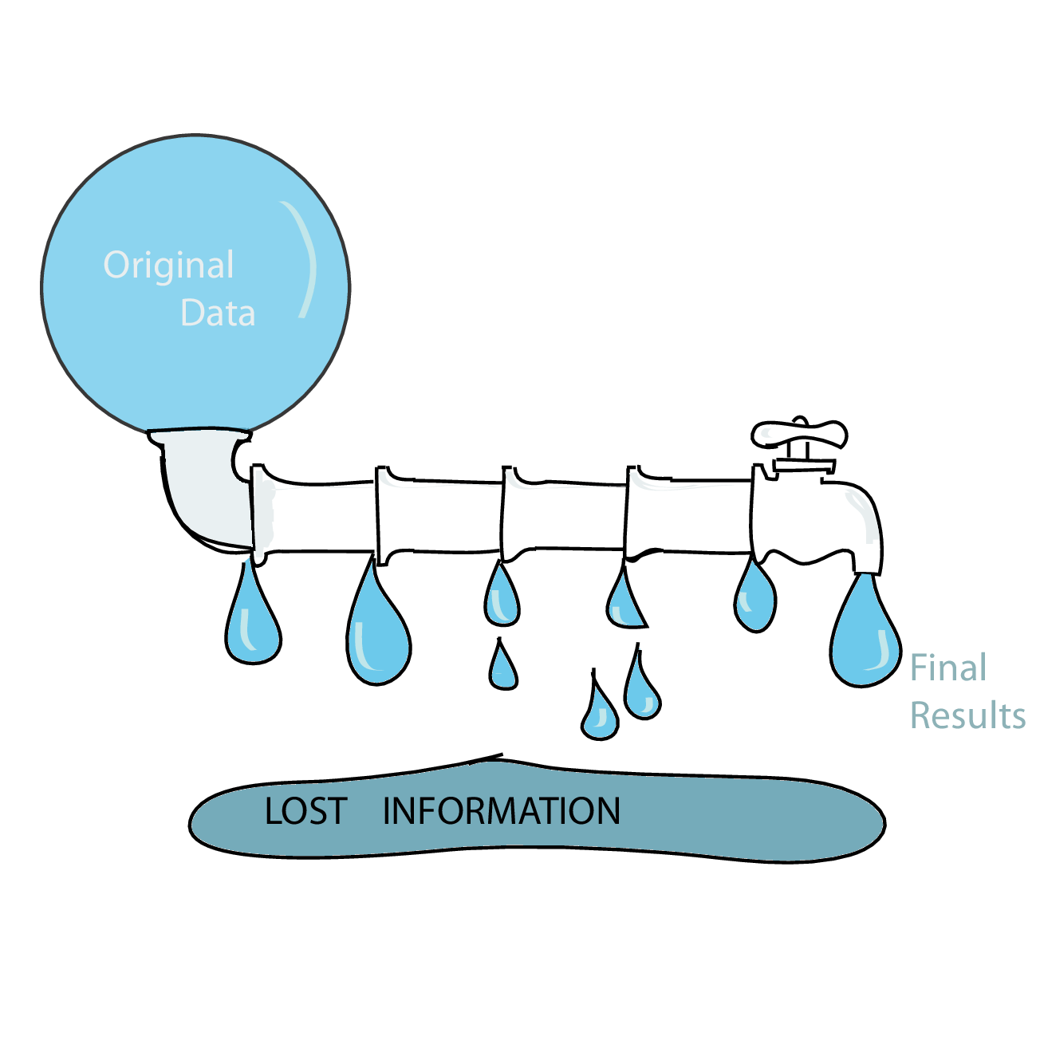
12. Leaky pipelines and statistical sufficiency
Data analysis pipelines in high through-put data often works as “funnels”, that successively summaries and compress the data, like
Image from Base calling → derived sequence → align to reference → only count aligned readds → summarise position to genes → normalize these by library size
Each step, we lose information. Yet it is important to make sure we still have enough information for the tast at hand.
We should consider sufficiency (=whether certain summaries enable reconstruction of all the relevant information in data.
In Bernoulli with known number of trial, number of successes is sufficient statstics for estimating the probability of success p.

Slide 20
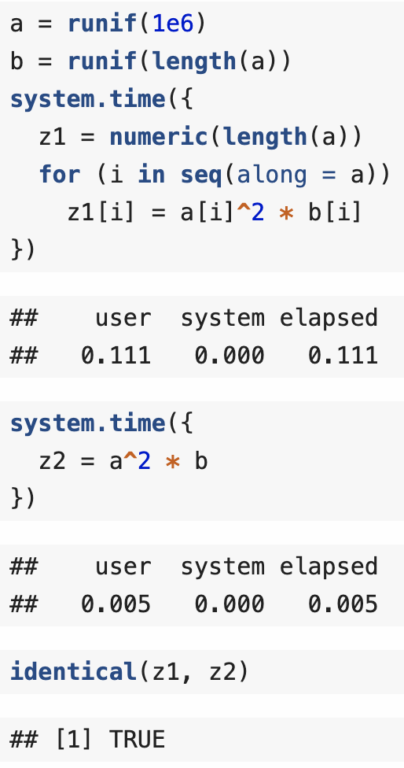
13. Efficient computing
When dealing with large dataset, it is temping to jump right into software technologies that are designed for big data and scalability.
But usually it is more helpful to first stake a step back, because of risk of premature optimization.
Slow and clumsy solution to right problem is worth good deal more than fast and saclable solution to wrong problem
Also consider cpu time vs human time
Vectorization
Use “dplyr” for fast and readable vector level computation

Slide 21
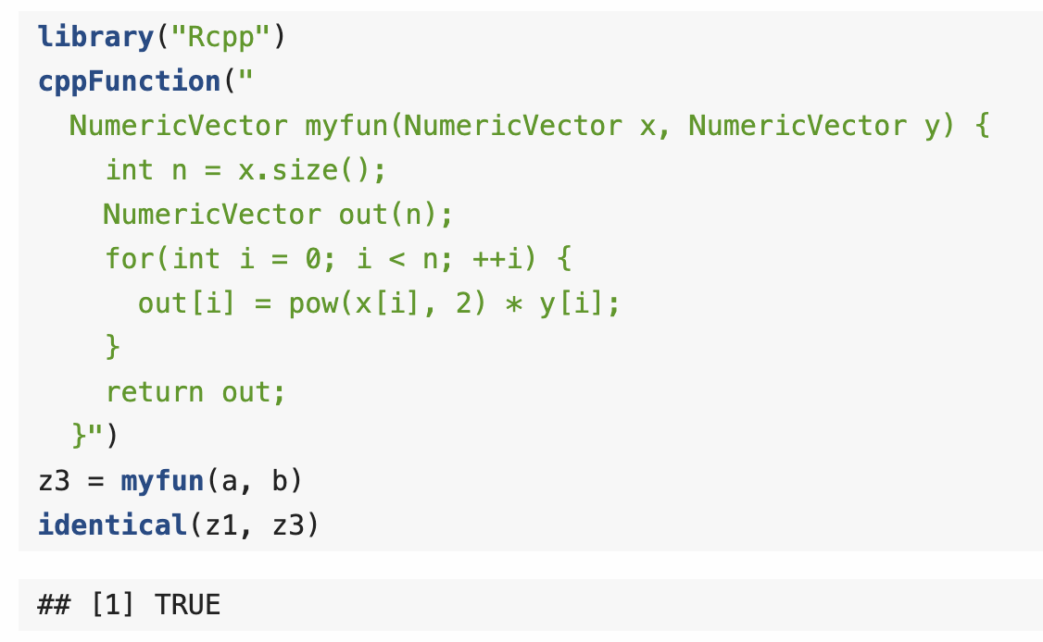
13. Efficient computing
Paralellization
Paralleization in R is easy, check “BiocParallel” as starting point
In case of large dataset to be load on RAM
consider chunking data into manageable portion
Store on disk in relational database management system (DBI package) or HDF5
Lower level languages
In most time critical parts,
Codes can be written in lower level language to accelerate code
“Rcpp” package is convenient wrapper for C++.

