Slide 1
Modern Statistics for Biology
Chapter 1.
Generative Models for Discrete Data
Presenter
Jihoon Kim
2023.07.18
https://web.stanford.edu/class/bios221/book/01-chap.html

Slide 2
Introduction
In molecular biology, many situations involve counting events
How many codons use a certain RNA sequence?
How many point mutations are present in a patient?
These counts give us discrete variables, as opposed to continuous variables such as mass
If we know the rules of biological events, we can generate the probabilities of events by computations and standard probability laws
This is a top-down approach based on deduction and our knowledge of how to manipulate probabilities

Slide 3
1.1. Goals for the Chapter
Learn how to obtain the probabilities of all possible outcomes from a given model and see how we can compare the theoretical frequencies with those observed in real data
Explore a complete example of how to use the Poisson distribution to analyze data on epitope detection
See how we can experiment with the most useful generative models for discrete data
Poisson, binomial, multinomial
Use the R functions for computing probabilities and counting rare events
Generate random numbers from specified distributions

Slide 4
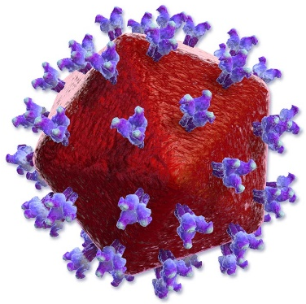
1.2. A Real Example
Replication
Mutation Rate
5 * 10⁻⁴ per nt per rep.
HIV (Human Immunodeficiency Virus)
Genome Size: About 10⁴ (10,000)
5 * 10⁻⁴ * 10⁴
The number of mutations over one replication cycle will be close to 5
Africa CDC, HIV (Human Immunodeficiency Virus), https://africacdc.org/disease/hiv-human-immunodeficiency-virus/

Slide 5
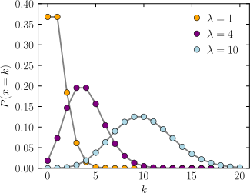
1.2. A Real Example
Poisson Distribution
The discrete probability distribution that expresses the probability of a given number of events occurring in a fixed interval of time or space
All events occur with a known constant mean rate (λ) and independently of the time since the last event
How often 3 mutations could occur under the Poisson(5) model?
Probabilities of 0~12 mutations under the Poisson(5) model
Wikipedia, Poisson distribution, https://en.wikipedia.org/wiki/Poisson_distribution

Slide 6
1.3. Using Discrete Probability Models
Point mutation is a binary event
Two possible outcomes (Yes, No) are called the levels of the categorical variable
However, some events are non-binary events
Genotypes in a diploid organism (AA, Aa, aa; 3 levels)
The number of codons formed of 3 nucleotides (4³ = 64 levels)
In R, factors are a special encoding for categorical variables

Slide 7
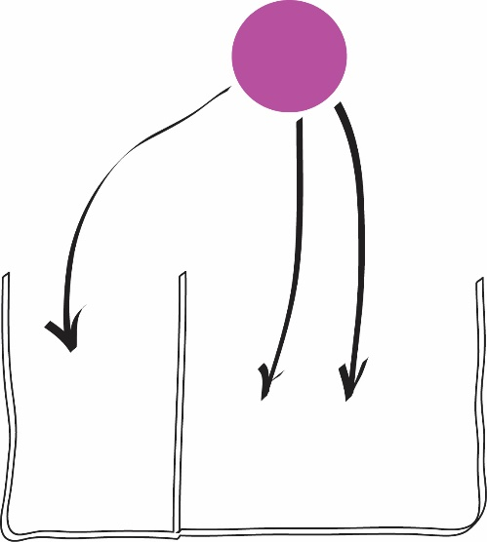
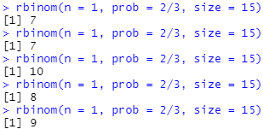
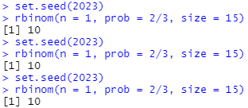
1.3.1. Bernoulli Trials
Bernoulli trials are the events that give 2 possible outcomes
Events with equal probabilities: Coin Toss
Events with unequal probabilities: Ball Drop
Bernoulli trials in R (Ball Drop)
n: number of trials
prob: probability of event
size: number of balls

Slide 8
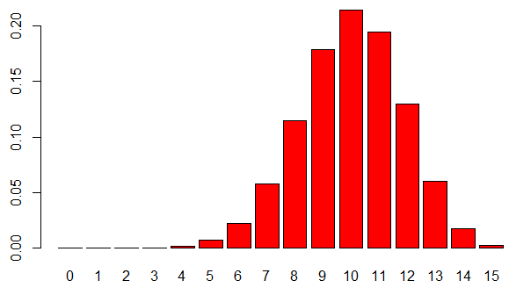
1.3.2. Binomial Success Counts
Probability mass distribution of Bernoulli trials

Slide 9
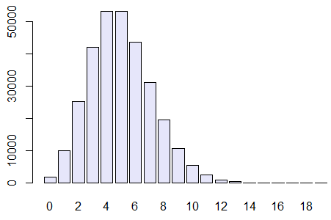
1.3.3. Poisson Distributions
When the probability of p is small and the number of trials n large, the binomial distribution B(n, p) can be approximated by a simpler Poisson distribution with rate parameter λ = n * p

Slide 10
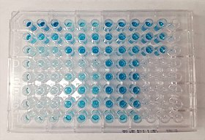
1.3.4. A Generative Model for Epitope Detection
When testing certain pharmaceutical compounds, it is important to detect proteins that provoke an allergic reaction
Detecting the epitopes makes it possible to find allergy-provoking proteins
Epitope: The molecular sites that are responsible for such reactions
ELISA (Enzyme-Linked ImmunoSorbent Assay)
ELISA is used to detect specific epitopes at different positions along a protein
...
Factor Form

Slide 11
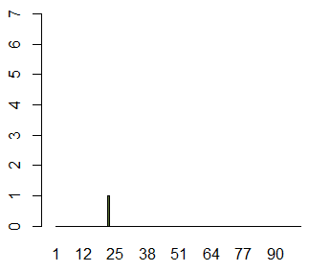
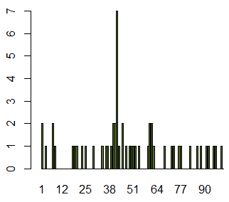
1.3.4. A Generative Model for Epitope Detection
ELISA result of 1 patient
ELISA result of 50 patients

Slide 12
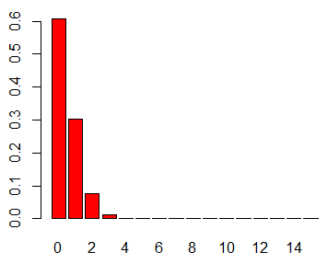
1.3.4. A Generative Model for Epitope Detection
What are the chances of seeing a value as large as 7, if no epitope is present?
The false positive rate of ELISA is 0.01, thus, in 50 patients, the expected value is 0.5
At any given position, the sum of the 50 observed variables has a Poisson distribution (λ = 0.5)
The chance of seeing a value as large as 7, if no epitope is present, is calculated as:
This is the same as $1−P(X≤6)$

Slide 13
1.3.4. A Generative Model for Epitope Detection
10⁻⁶ is the chance of seeing a value as large as 7 at one position, but we see different 100 positions
When we order the data like the below, $x_{(1)}$ is the minimum value, and $x_{(100)}$ is the maximum value
Ordering
$$x_{1},x_{2},x_{3}⋯x_{100}$$
$$x_{(1)},x_{(2)},x_{(3)}⋯x_{(100)}$$
Because all events are independent,

Slide 14
1.3.4. A Generative Model for Epitope Detection
Using the binomial theorem, we can compute ${(1−ε)}^{100}$ approximately
Because $ε$ is a much small value than 1, $ε^{2},ε^{3},ε^{4}⋯$ can be ignored
The probability of seeing a number of hits as large or larger than 7 in the 100 positions is 10⁻⁴ approximately
$$P\left(x_{\left(100\right)}≥7\right)=1−\prod_{i=1}^{100}{P\left(x_{i}≤6\right)=1−{\left(1−ε\right)}^{100}}≅1−\left(1−{10}^{−4}\right)= {10}^{−4}=0.0001$$
This value is smaller than the standard significance (0.05, 0.01, 0.001), so the null hypothesis is rejected
Null hypothesis: There is no epitope when the number of hits as large or larger than 7

Slide 15
1.3.4. A Generative Model for Epitope Detection
Probabilities also can be computed by simulation
Monte Carlo method
Computational algorithms that rely on repeated random sampling
Trial
Positions
Rate Parameter
This is an example of probability or generative modeling
All the parameters are known, and the mathematical theory allows us to work by deduction in a top-down fashion
In a more realistic situation, we have to use statistical modeling (Chapter 2)

Slide 16
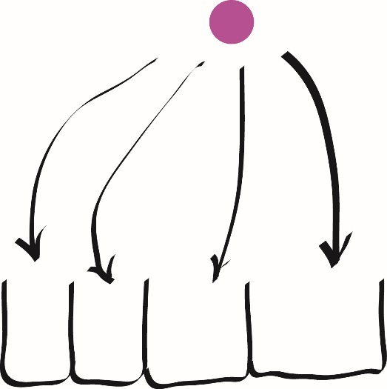
1.4. Multinomial Distributions: The Case of DNA
We need to extend the binomial model when there are more than 2 outcomes
Counts of the four nucleotides (A, T, G, C)
In the multinomial case, the sum of all probabilities is 1
$P\left(A\right)+P\left(T\right)+P\left(G\right)+P\left(C\right)=1$
Simulation experiments of multinomial case can be performed using a few R commands

Slide 17
1.4.1. Simulating for Power
The term "Power" in statistics is the probability of detecting something if it is there
Also called "True Positive Rate"
Example of calculating the power of the test
Null Hypothesis: The DNA data comes from a fair process
$\left(P_{A},P_{T},P_{G},P_{C}\right)=(0.25, 0.25, 0.25, 0.25)$
1,000 simulations are generated from the null hypothesis
pvec

Slide 18
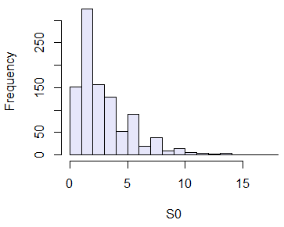
1.4.1. Simulating for Power
Example of calculating the power of the test
To test that the observed values follow the expected values, the stat function with the sum of the squares is defined

Slide 19
1.4.1. Simulating for Power
Example of calculating the power of the test
If the stat is larger than 7.6 in real data, the null hypothesis will be rejected
New simulations are generated come from an unfair process

Slide 20
1.5. Summary of Chapter
Basic distributions to compute probabilities of various discrete events
Bernoulli distribution
To compute a probability of a single binary trial
Binomial distribution
To compute probabilities of multiple binary trials
Poisson distribution
A special form of binomial distribution when p is small & n is large
Multinomial distribution
To compute probabilities for discrete events that have more than two possible levels

