Slide 1
Seokju Park
2023.08.03

Slide 2
Introduction
We will mainly study series of two-dimensional images.
We will learn how to identify the cells’ positions and shapes and how to quantitatively measure characteristics of the identified shapes and patterns, such as sizes, intensities, color distributions and relative positions.
We can compare cells between different conditions, say under the effect of different drugs, or in different stages of differentiation and growth.
We can measure relationship between objects, e.g., whether they like to cluster together or repel each other, or whether certain characteristics tend to be shared between neighboring objects, indicative of cell-to-cell communication.

Slide 3
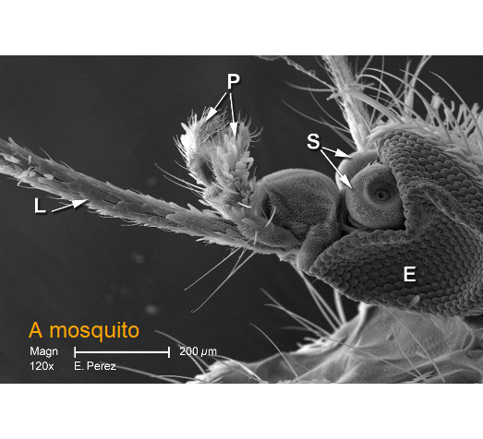
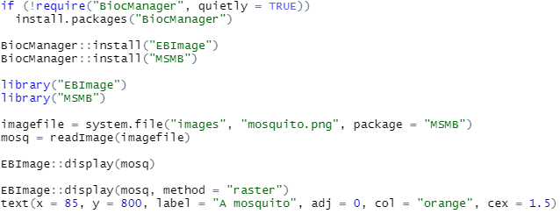
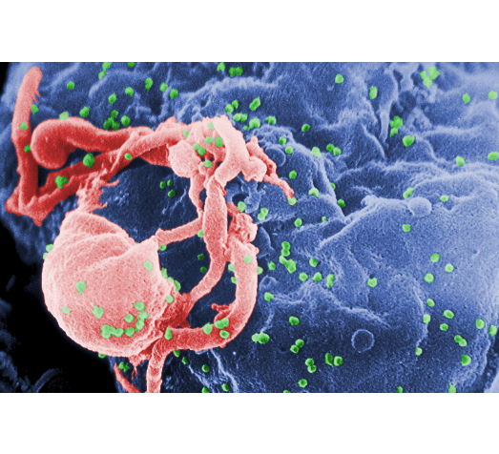
Loading and displaying images

Slide 4
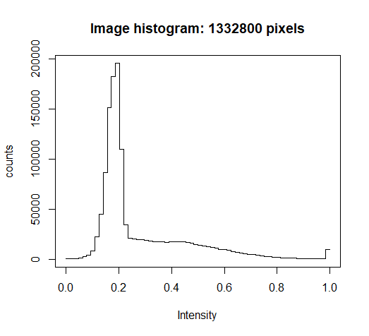
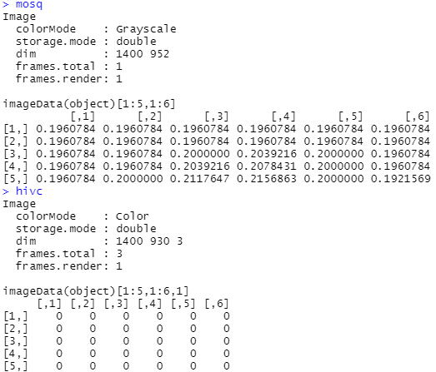
How are images stored in R

Slide 5
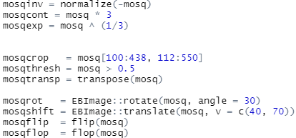
Manipulating images

Slide 6
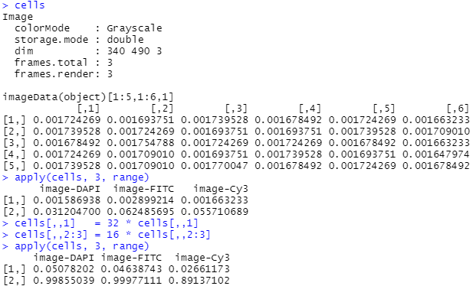
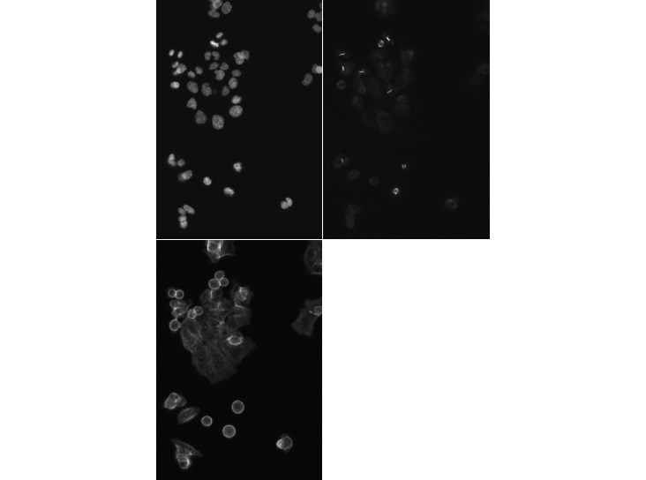
Linear filters – intensity scale
DNA
Alpha-tubulin
actin

Slide 7
Linear filters – noise reduction by smoothing
Moving average
Weighted average

Slide 8
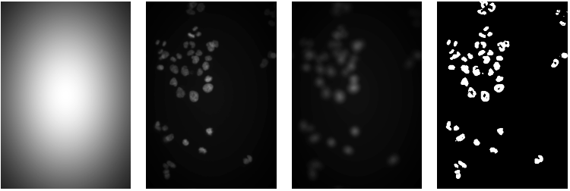
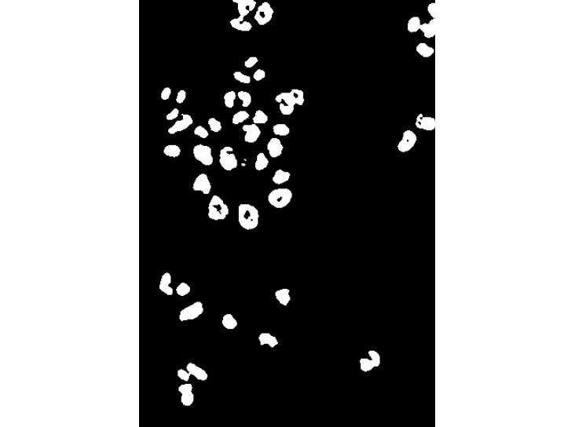
Adaptive thresholding

Slide 9
Morphological operations on binary images

Slide 10
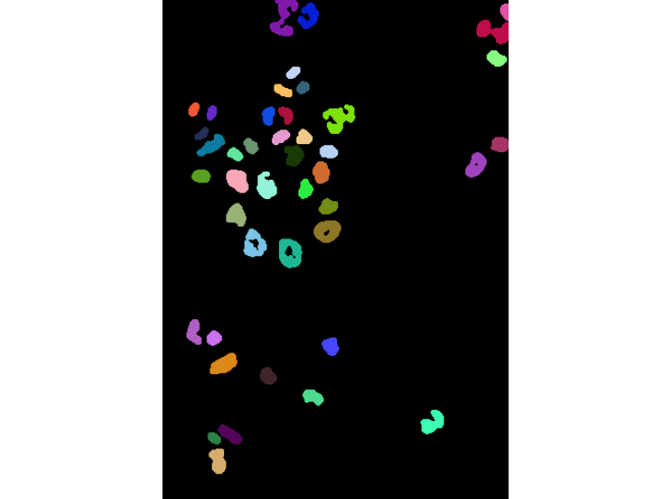
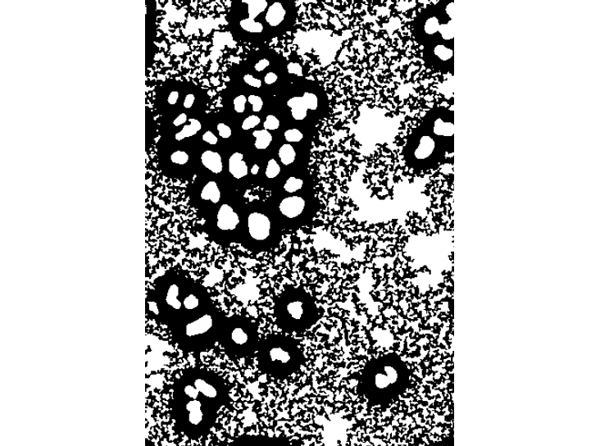
Segmentation of a binary image into objects

Slide 11
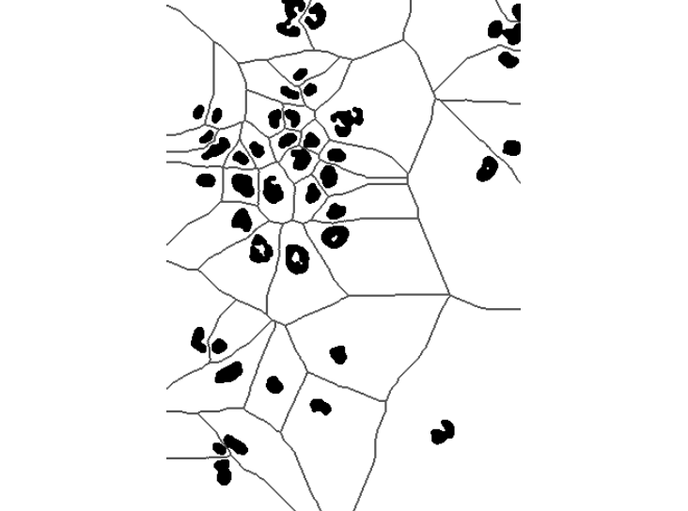
Voronoi tessellation

Slide 12
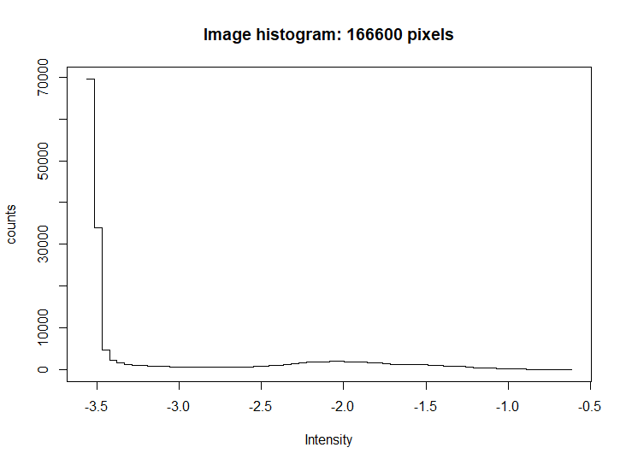
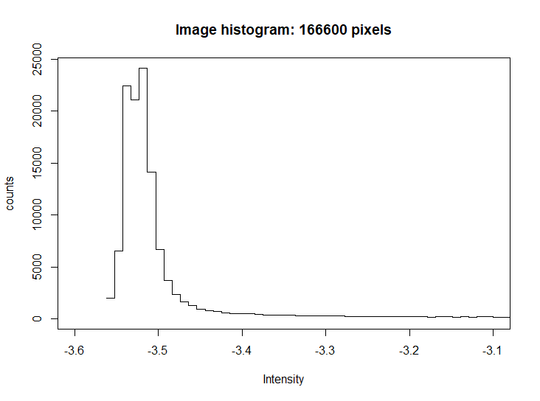
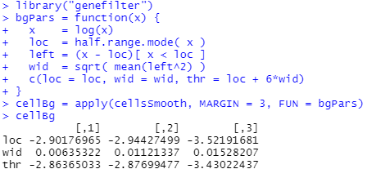
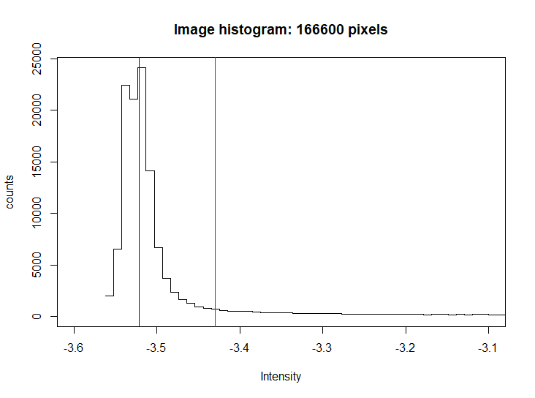
Segmenting the cell body

Slide 13
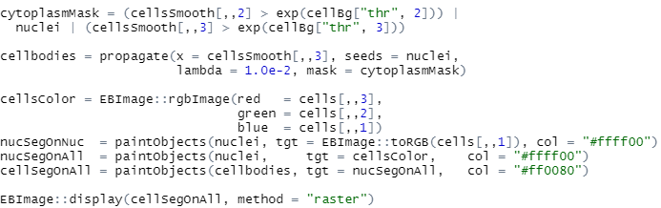
Segmenting the cell body

Slide 14
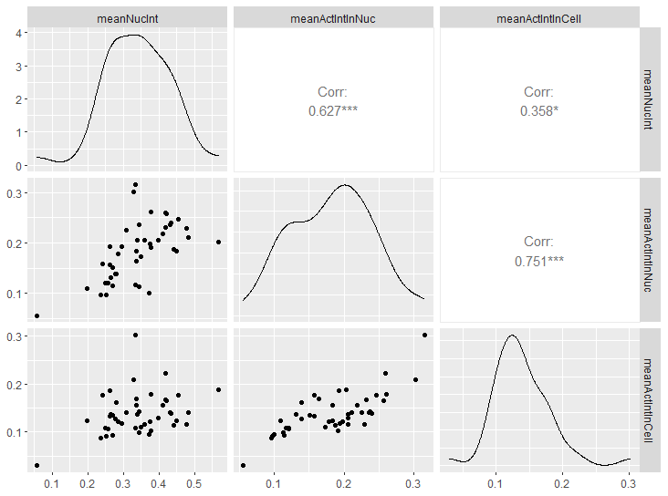
Feature extraction

Slide 15
Spatial statistics: point processes
https://enginius.tistory.com/494

Slide 16
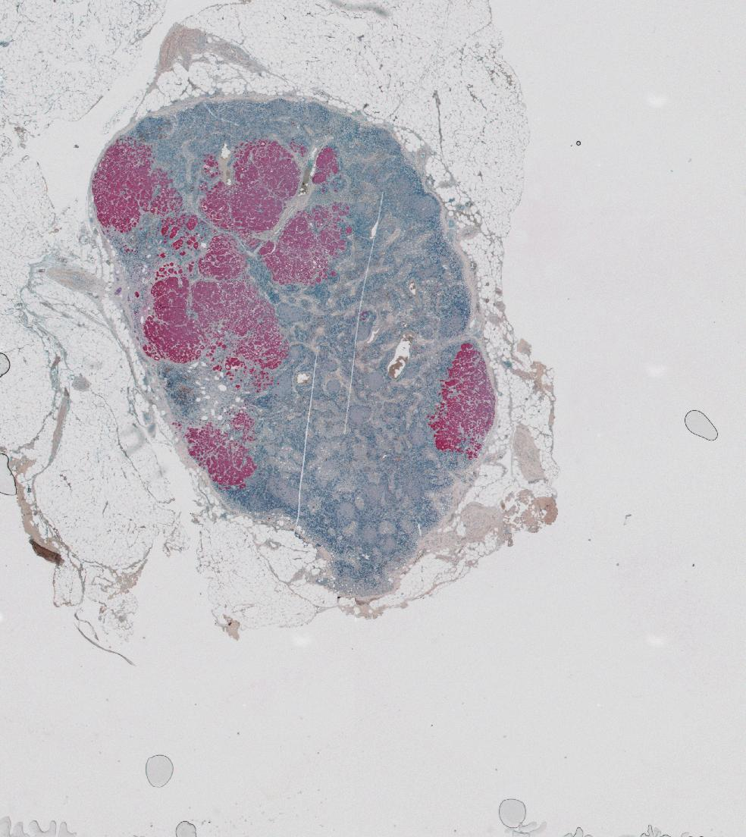
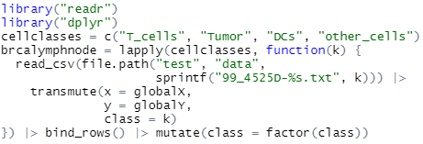
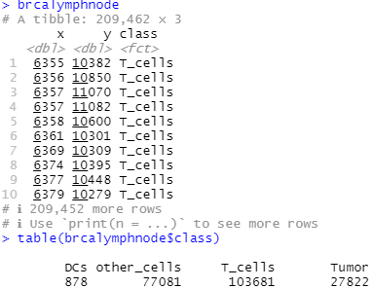
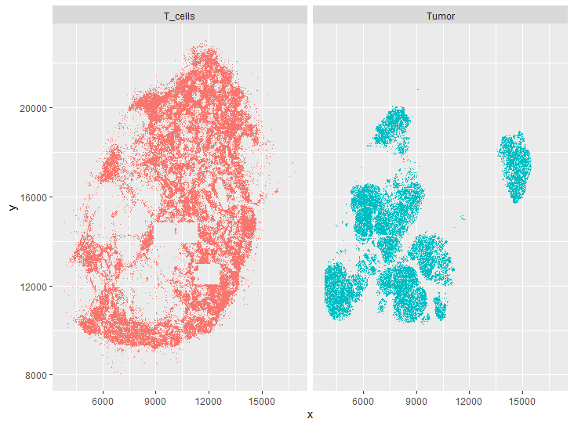
Spatial statistics: point processes

Slide 17
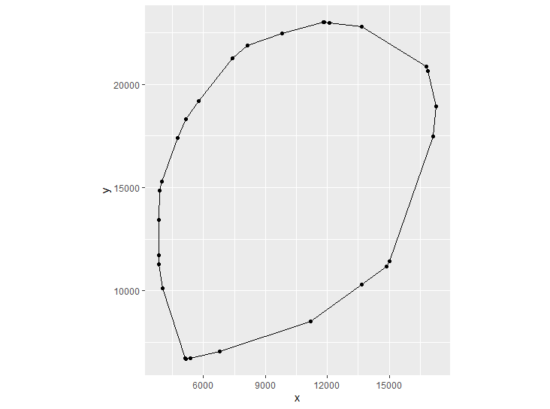
Spatial statistics: point processes
The points can be marked with certain properties.
For the marked point process, the points can lie anywhere within the space, whereas in an image, the pixels are covering the space in regular, rectangular way.

Slide 18
First order effects: the intensity
Intensity of process
Spatial covariance
$a$: a circle of area around a point p = $(x, y)$
$N(p, a)$: the number of points lying in $a$
As a null model,
The number of points in a region of area $A$ follows a Poisson distribution with rate $λA.$

Slide 19
First order effects: the intensity
Estimating the intensity ~ 2D density estimation
Edge bias
computes a nonparametric estimate of the spatially varying risk of a particular event type.

Slide 20
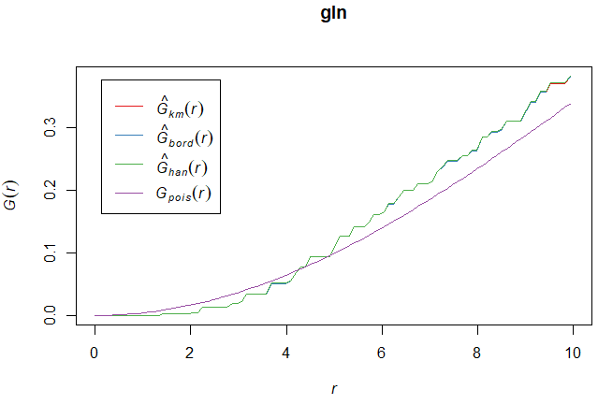
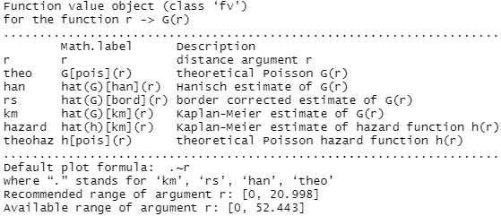
Second order effects: spatial dependence
Distance (W) between a random point and its nearest neighbor
For a homogeneous Poisson process, the cdf:
Takes into account edge effect
Distance are shorter than
for the null model
→ cluster ?

Slide 21
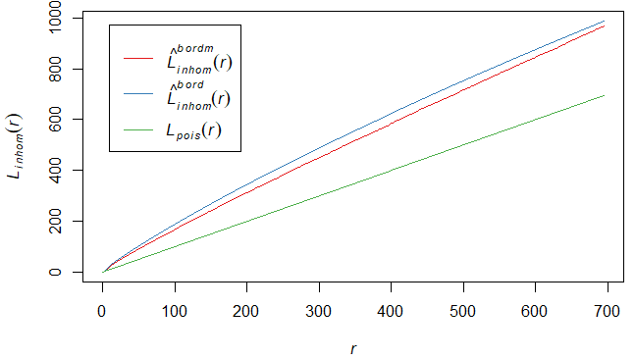
Second order effects: spatial dependence
Ripley’s K-function (reduced second moment function)
$λK(r)$: the expected number of points within a distance r of a given, randomly picked point.
Generalized K in inhomogeneous point processes:
Edge correction factor
Transformation of K:

Slide 22
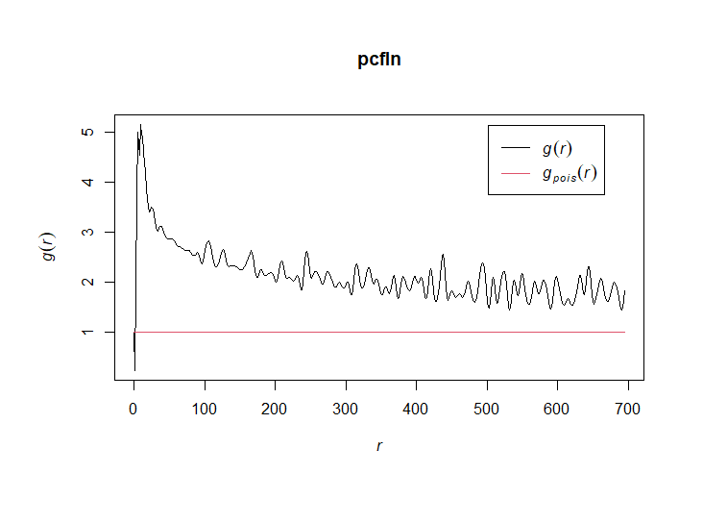
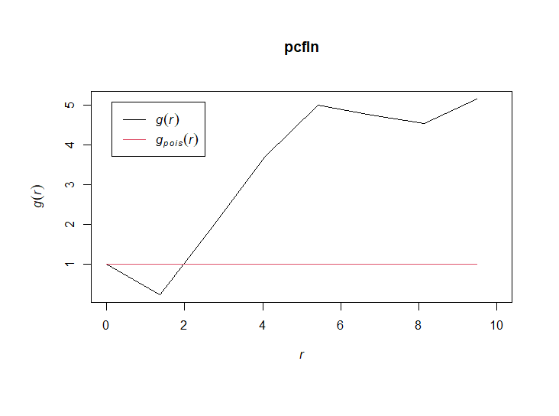
Second order effects: spatial dependence
The pair correlation function
described how point density varies as a function of distance from a reference point
For a stationary point process:
Cluster
Avoidance

