Slide 1
Modern Statistics for Modern Biology 4. Mixture Models
Seokju Park

Slide 2
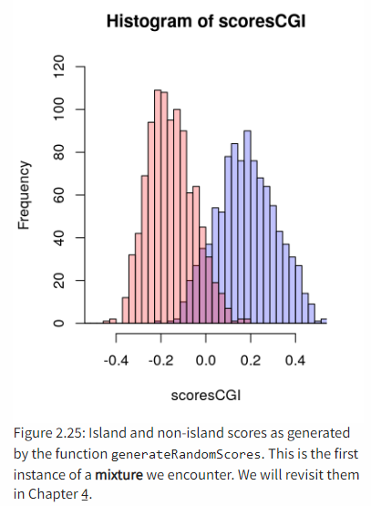
4. Mixture models
Introduction
The quantities we are interested in often do not show a simple, unimodal “textbook distribution”.
Finite mixtures (a few components) Vs infinite mixtures (as many as observations)
Simple models (normal or Poisson) can serve as building blocks for more realistic models
Mixtures occur naturally for flow cytometry data, RNA-seq, ChIP-seq, microbiome, …
In this chapter
Generate our own mixture model
See how we can reverse engineer the underlying mixtures using Expectation-Maximization (EM) algorithm
See zero-inflated data such as ChIP-seq
Discover the empirical cumulative distribution and see how we can simulate the variability of our estimates using the bootstrap
Build the Laplace distribution to model promoter lengths and microarray intensities
Build the gamma-Poisson distribution to model RNA-seq data
See data transformations

Slide 3
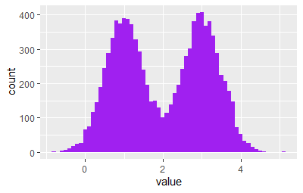
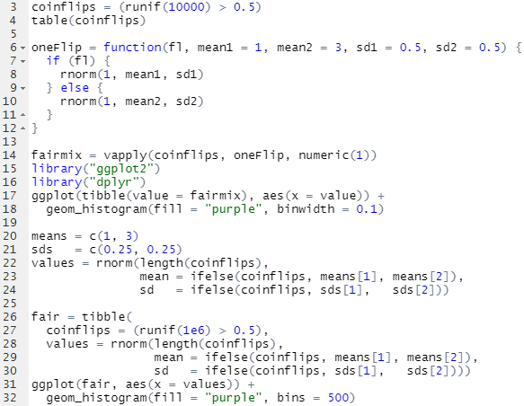
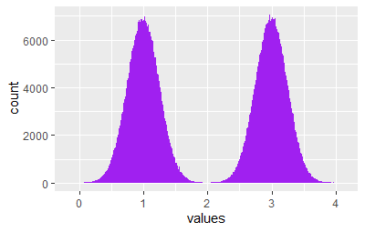
4. Mixture models
Finite mixtures

Slide 4
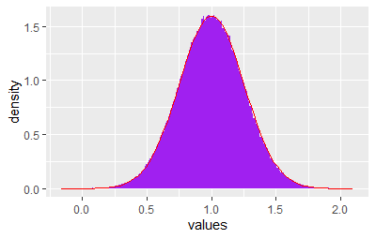
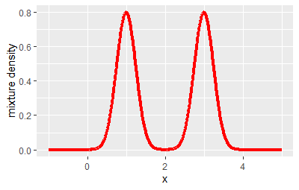
4. Mixture models
Finite mixtures

Slide 5
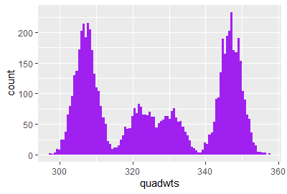
4. Mixture models
More than two components
Nucleotide mass

Slide 6
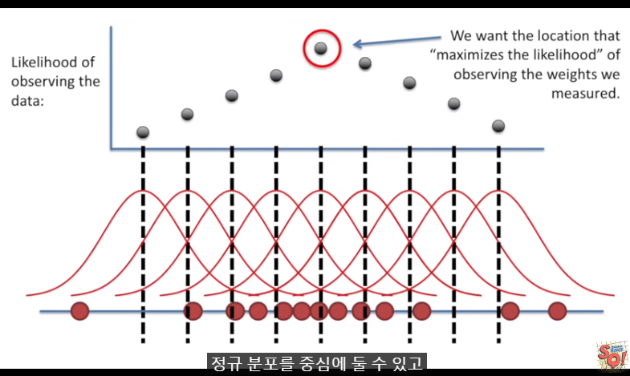
4. Mixture models
EM algorithm
To infer the value of the hidden groupings, we use expectation-maximization (EM) algorithm
Perform iterative procedure that alternates between
Pretending we know the probability with which each observation belongs to a component and estimating the distribution parameters of the components
Pretending we know the parameters of the component distributions and estimating the probability with which each observation belongs to the components
Bivariate distribution
Fair coin
MLE

Slide 7
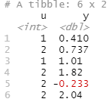
4. Mixture models
EM algorithm
For example, we have a mixture of two normals with mean parameters unknown and standard deviations 1; thus, (μ1=?,μ2=?,σ1=σ2=1).

Slide 8
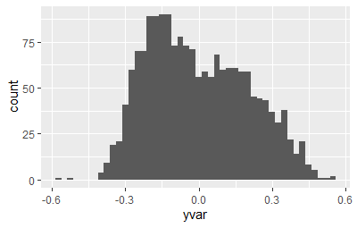
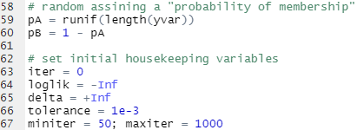
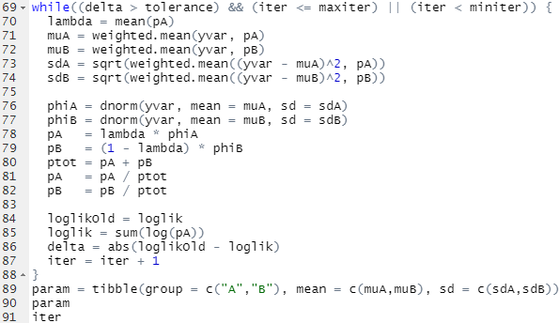
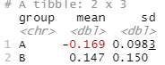
4. Mixture models
EM algorithm
Soft averaging
Maximization using maximum likelihood estimation
Expectation

Slide 9
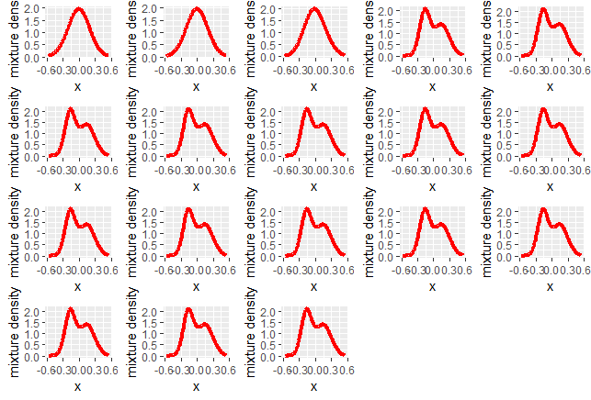
4. Mixture models
EM algorithm

Slide 10
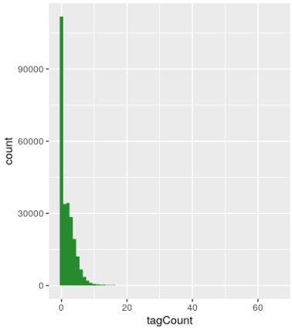
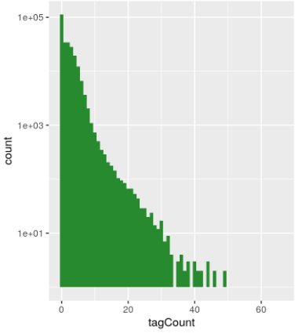
4. Mixture models
Zero inflated data
ChIP-seq data
δ: Dirac’s delta function

Slide 11
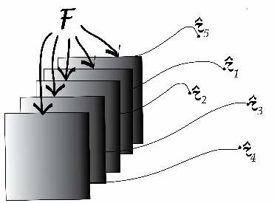
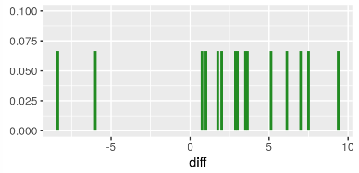
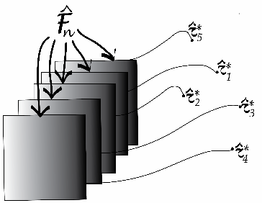
4. Mixture models
Empirical distributions and the nonparametric bootstrap
Underlying distribution
Darwin’s Zea Mays
- Compared the heights of 15 pairs of Zea Mays plants
Sampling
variability
Sampling distribution
Empirical distribution
Empirical cumulative distribution function
Sampling distribution’

Slide 12
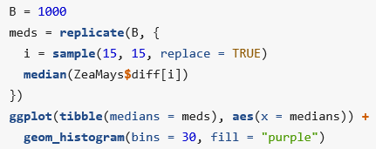
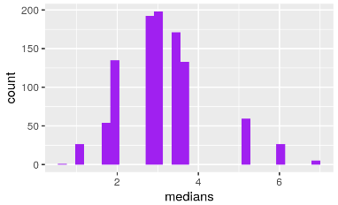
4. Mixture models
Empirical distributions and the nonparametric bootstrap
For example, if the sample is composed of n=3 different values, how many different bootstrap resamples are possible? How about n=15 ?

Slide 13
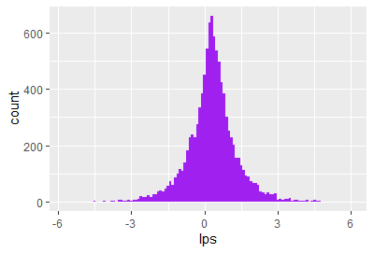
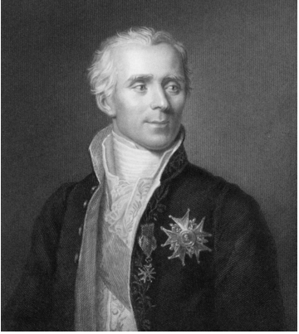
4. Mixture models
Infinite mixtures
Symmetric Laplace distribution
Laplace(θ , ϕ)
https://towardsdatascience.com/questions-that-you-can-answer-using-exponential-distribution-2af9da54dfd8?gi=c7106053238c

Slide 14
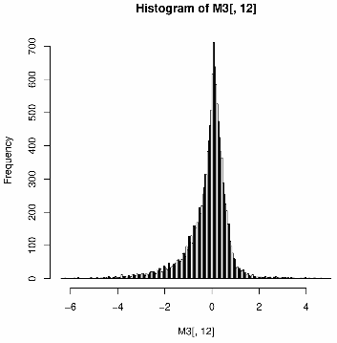
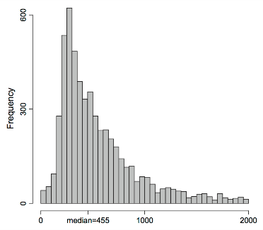
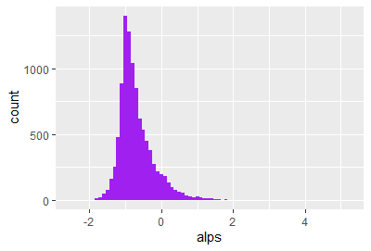
4. Mixture models
Infinite mixtures
Asymmetric Laplace distribution
X∼AL(θ,μ,σ)
Promoter lengths from Saccaromyces cerevisiae
Log-ratios of microarray gene expression for 20,000 genes

Slide 15
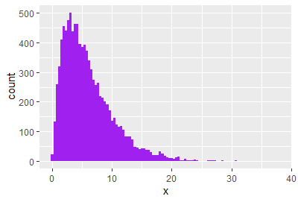
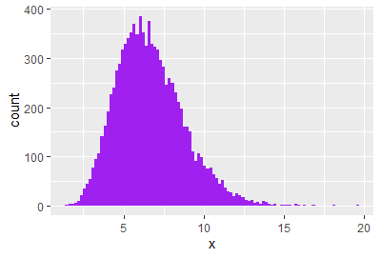
4. Mixture models
Infinite mixtures
Poisson distribution
- For example, sampling the fish species in each lake to estimate their true abundances, and that could be modeled by a Poisson.
- But the true abundances will vary from lake to lake and the different Poisson rate parameters should be modeled for this.
Gamma distribution
- Extension of the exponential distribution (one parameter) -> two parameters, shape and rate

Slide 16
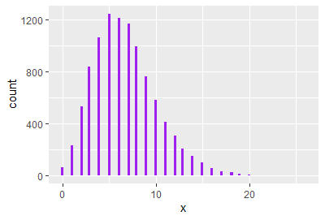
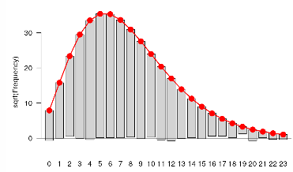
4. Mixture models
Infinite mixtures
Gamma-Poisson mixture
Mean:
Var:

Slide 17
4. Mixture models
Infinite mixtures
Gamma-Poisson mixture

Slide 18
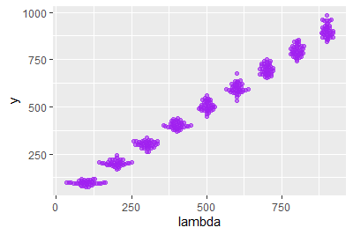
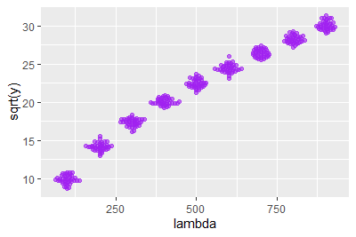
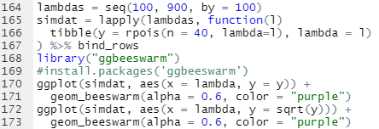
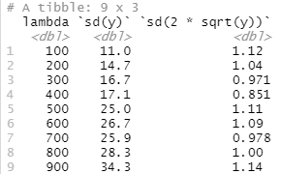
4. Mixture models
Variance stabilizing transformations
Heteroskedasticity: the standard deviations (or, equivalently, the variance) of our data is different in different regions of our data space.

Slide 19
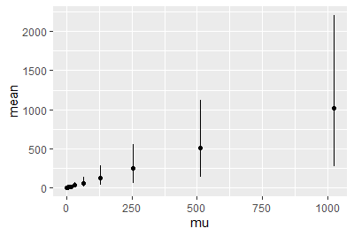
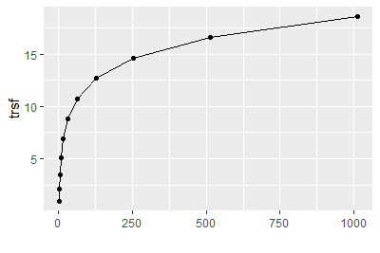
4. Mixture models
Variance stabilizing transformations
Heteroskedasticity: the standard deviations (or, equivalently, the variance) of our data is different in different regions of our data space.

Slide 20
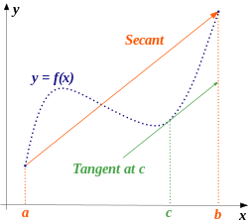
4. Mixture models
Variance stabilizing transformations
Delta method
g: transformation function
X_{i}: random variable
μ_{i}: means
ν_{i}: variances
ν_{i} = ν(μ_{i})
Mean value theorem

Slide 21
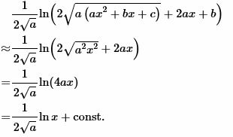
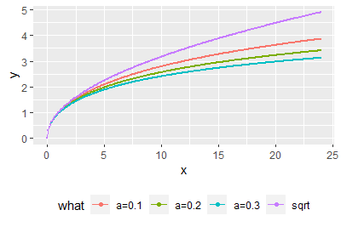
4. Mixture models
Variance stabilizing transformations
Delta method
if v(μ)=μ (Poisson), g(x)=√x
If v(μ)=αμ², g(x)=log(x)

