Slide 1
Modern Statistics for Modern Biology
Chapter 3:
High quality graphics in R
2022.07.06
Seo-Won Choi
Bioinformatics and Genomics Lab

Slide 2
3.1 Goals for this chapter
Learn how to rapidly and flexibly explore datasets by visualization
Review the basics of base R plotting
Understand the logic begind the grammar of graphics concept
See how to plot data in multiple dimensions and explore faceting
Create “along-genome” plots for molecular biology data
Discuss some of our options of interactive graphics

Slide 3
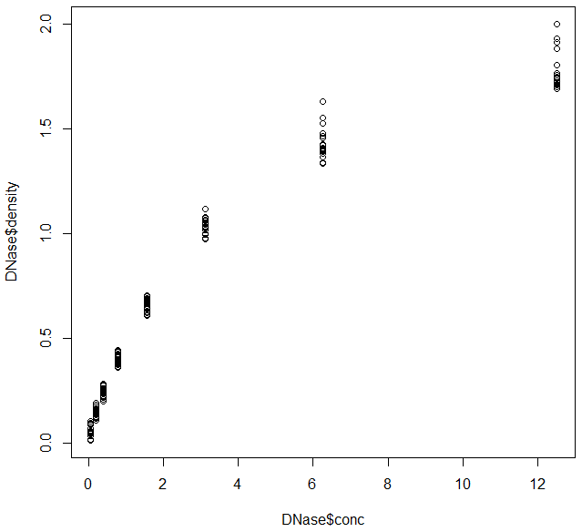
3.2 Base R plotting
Simple, procedural and easy to call
Building up more complex plots or exchanging one for another can be very difficult or even impossible
# ELISA assay results; enzyme=DNase
# Run = assay run
# conc = protein concentration
# density = measured optical density

Slide 4
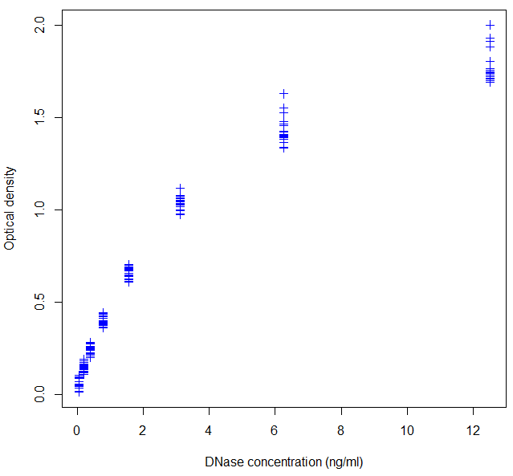
3.2 Base R plotting
Basic plot can be customized in various ways
Information about the variables stored in the object can be accessible with the attr function
# plot(x,y,
# y axis label = ‘optical density’
# x axis label = ‘DNase concentration (ng/ml)’
# point shape type = 3

Slide 5
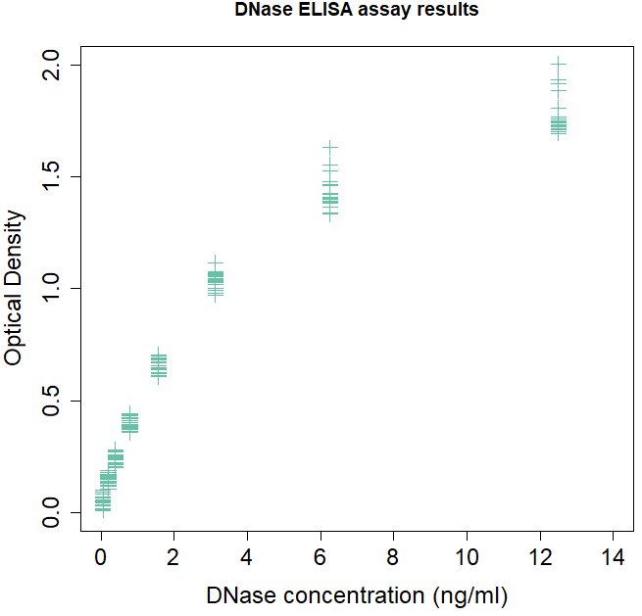
3.2 Base R plotting - example
Basic plot can be customized in various ways
Information about the variables stored in the object can be accessible with the attr function
# margin = c(bottom, left, top, right); default= c(1.02, 0.82, 0.82, 0.42)
# color from RColorBrewer, point size=1.5
# x axis range=0-14, y axis range=0-2
# label size=1.5, axis number size = 1.5
# title

Slide 6
3.3 An example dataset
Microarray data of 100 mouse embryo cells sampled from different time points
# load library
# load data x
# print dimension of expression data
# 45101 rows and 101 columns
# print the first 2 rows of x
sampleGroup: 8 biological groups the authors defined for each cell
sampleColour: a color scheme used to represent sample groups
To install library, try:

Slide 7
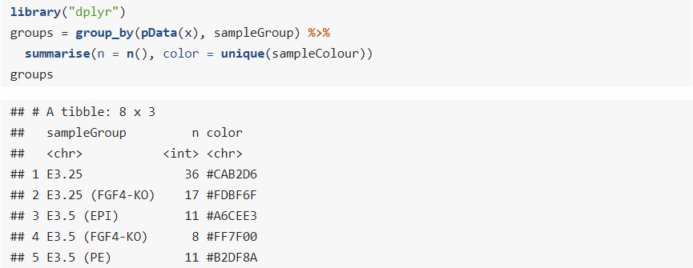
3.3 An example dataset
Question: how do we make a new dataframe that contains 1) sampleGroup, 2) total number of cells in each group and 3) the preferred color of each group?
# evaluate f(x) and pass the result (first arg) to g with y (second arg, then pass the result to h
# same as above
# load library
# Downstream operations applied per sampleGroup
# summarise no. of rows and color for each group

Slide 8
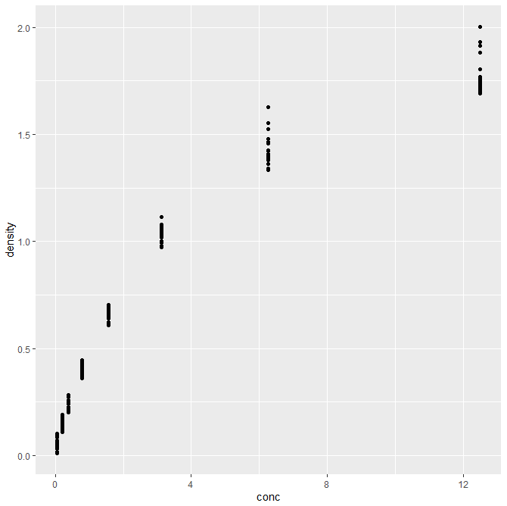
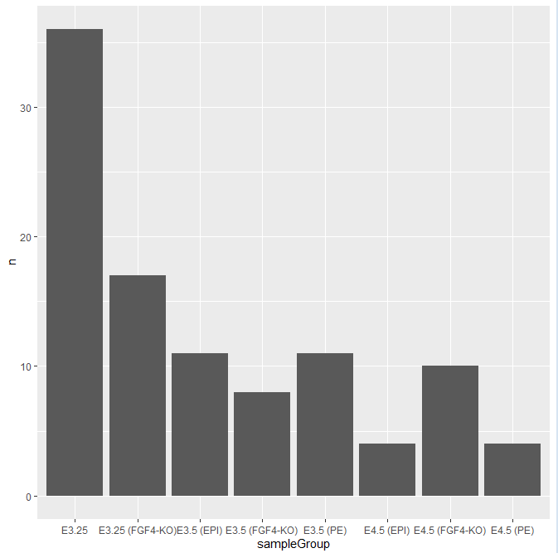
3.4 ggplot2
Grammar of graphics: more similar to human languages
# load library
# ggplot(data, aes=(x, y)) + plot_as_points
# data = group, x= sampleGroup, y=no. of cells in group
# plot bars, do nothing instead of default (stat = count)

Slide 9
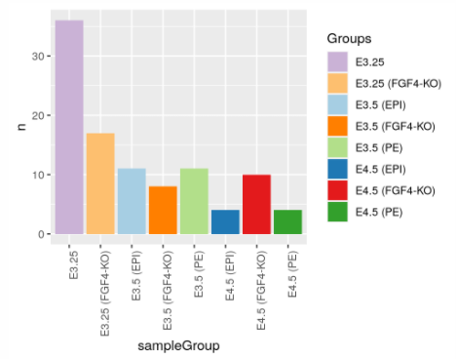
3.4 ggplot2
Adding colors to plots
# vector = setNames(value, name)
# fill differently according to group
# colors = groupColor, legend = ‘Groups’
# x label rotated and right-aligned

Slide 10
3.4.1&2 Data flow & Saving figures
ggplot expects your data in a dataframe
dplyr and broom, among others, can help converting your data to dataframe
# saved the figure to gg; no printing
# figure printed
# figure printed
Two major ways of storing plots:
vector graphics
Can edit in Illustrator, typically saved as PDF
Can be converted to raster formats of any desired resolution
raster (pixel) graphics
Cannot edit in Illustrator, typically saved as PNG
Cannot be converted to vector formats
Resolution depends on the number of pixels available
# save plot gg as a pdf file

Slide 11
3.5 The grammar of graphics
Components of ggplot2’s grammar of graphics:
one or more datasets
one or more geometric objects (i.e. points, lines, bars, etc)
description of how the variables in the data are mapped to visual properties (aesthetics) of the geometric objects (i.e. aes(x, y, fill=group))
one or more coordinate systems (Cartesian by default)
statistical summarization rules (i.e. stat=count)
a facet specification, i.e. the use of multiple similar subplots to look at subsets of the same data
optional parameters that affect the layout and rendering (i.e. text size, font, alignment, etc)

Slide 12
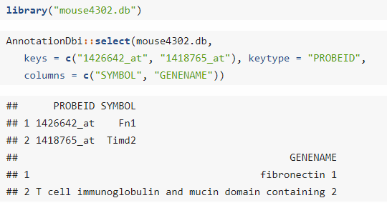
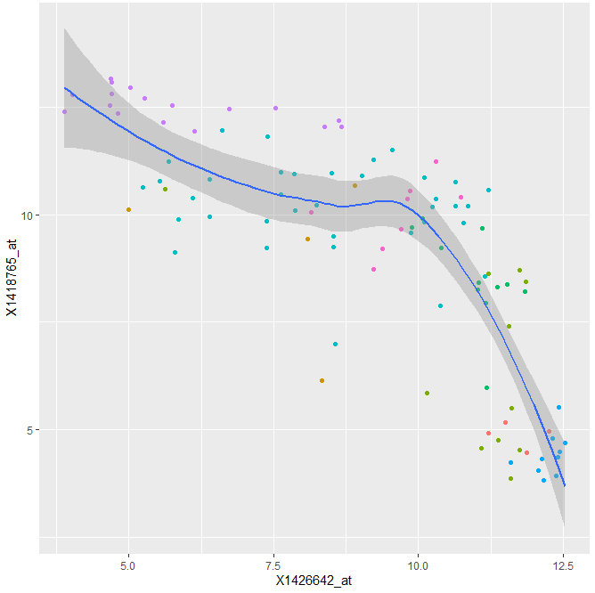
3.5 The grammar of graphics
Same type of components can be used multiple times, in what are called layers
# rows = cells, columns = array probe expression
# ggplot(data, aes(x=probe1, y=probe2))
# plot points, color as sampleColour, point shape= 19
# add regression line and confidence band using local fitting (loess)
# suppress legend, but use guide=‘none’, as guide=FALSE is deprecated
If we want to find out which genes are targeted by these probe identifiers, we can call:

Slide 13
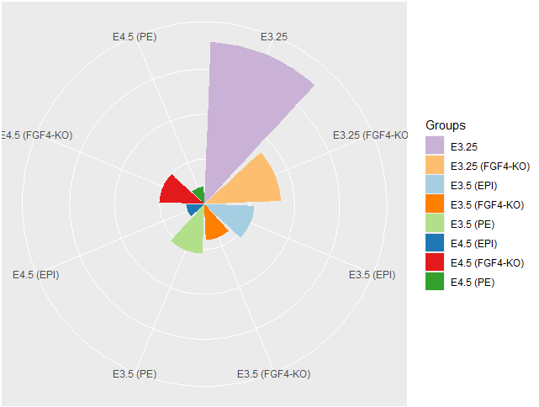
3.5 The grammar of graphics
ggplot2 allows step-wise buildup, which can be more convenient and easy to manage
# no geometric object; will create an empty plot
# add bars
# fill colors according to sampleGroup
# rotate and right align x axis
# color legends
# print plot
# adding on the bar above, use polar coordinates
# right align x axis without rotation
# no y axis
# no ticks
# no axis labels
# print plot

Slide 14
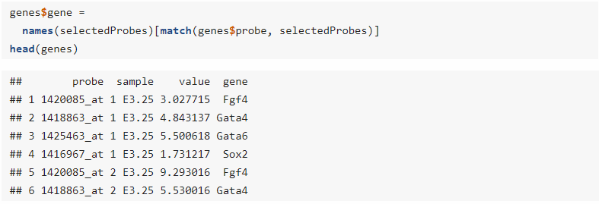
3.6 Visualizing data in 1D
Comparison between several samples of univariate measurements
# names(selectedProbes) = c(Fgf4, Gata4, Gata6, Sox2)
# get selected matrix from exprs(x), and make it 1D. exprs(x) has 101 cells and we’re looking at 4 genes -> 404 rows
# genes$gene = names(selectedProbes)[index]
# match genes$probe to selectedProbes and returns index (1, 2, 3 or 4)

Slide 15
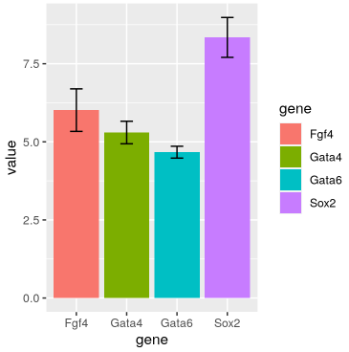
3.6.1 Barplots
# summary stat, function=mean, geometric object=bar
# color each gene types differently
# summary stat, function=mean, geometric object=bar
# function=standard error, plot as error bar

Slide 16
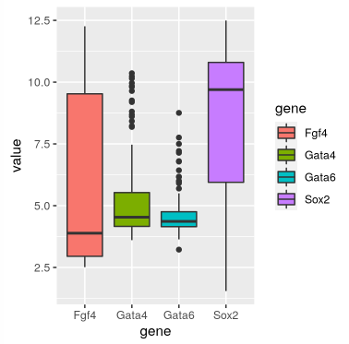
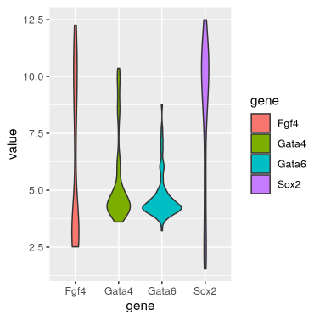
3.6.2-3 Boxplots & Violin plots
Boxplots are much more informatics than bar plots
Violin plot is a variation of the boxplot, but with more direct representation of the shape of the data distribution

Slide 17
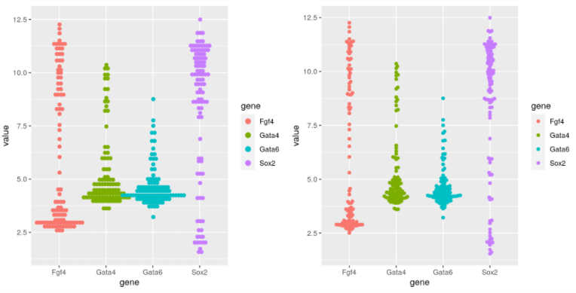
3.6.4 Dot plots and beeswarm plots
Displaying data points directly without obscuring the data
# bin y axis, bin size=1/6
# center align dots, width per column=0.75

Slide 18
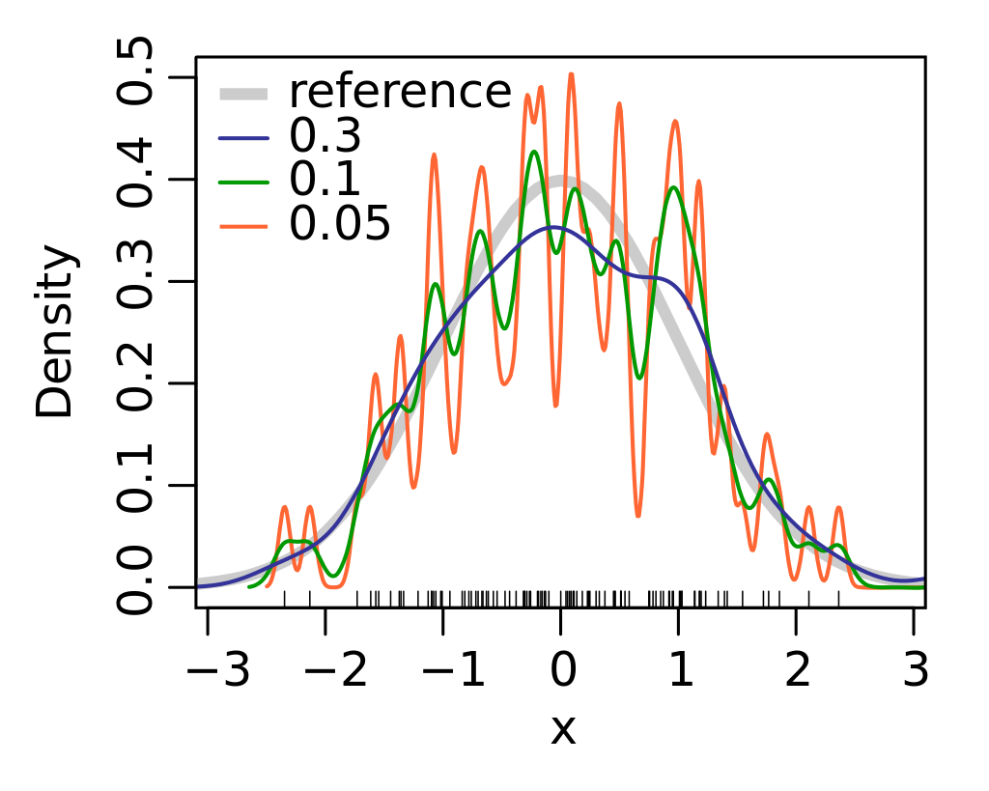
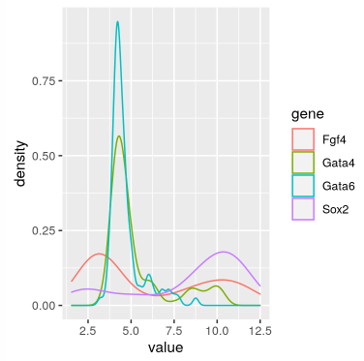
3.6.5 Density plots
Density estimation has a number of complications, i.e. choosing a smoothing window
Smaller window will make the estimates ‘wiggly’
Bigger window will smooth out pronounced features
The density lines do not convey the information on how much data was used to estimate them, which can be problematic if the sample sizes for the curves differ
Wikipedia, KDE

Slide 19
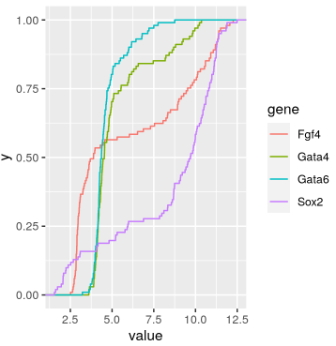
3.6.6 ECDF plots
Empirical cumulative distribution function (ECDF) has nice properties:
loseless: ECDF contains all the information contained in the original sample, except for the order of the values
As $n$ grows, the ECDF converges to the true CDF. Even for limited sample sizes, the difference between the two functions tens to be small

Slide 20
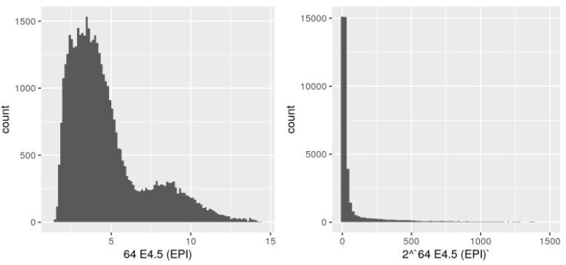
3.6.7 The effect of transformations on densities
Before inspecting histograms/density plots for evidence of bi/multimodality, one should remember that the number of modes depends on scale transformations of the data
# get raw data, because dfx is log2 transformed

Slide 21
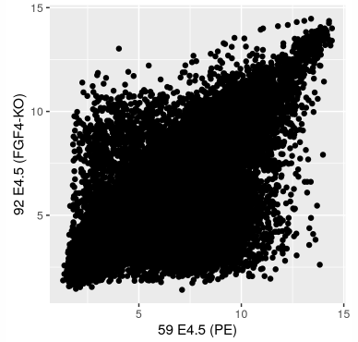
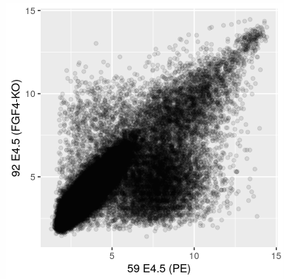
3.6.7 Visualizing data in 2D: scatter plots
Useful for visualizing associations / paired data / treatment-response comparisons

Slide 22
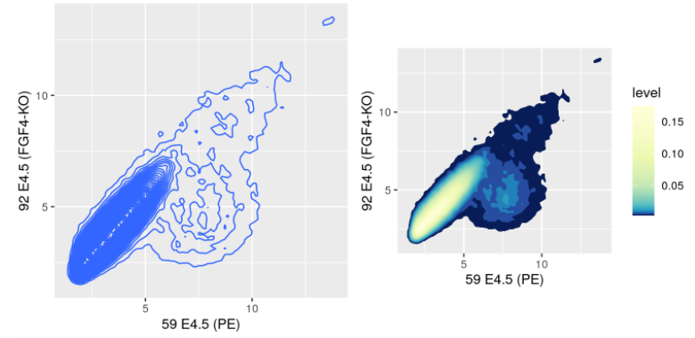
3.6.7 Visualizing data in 2D: scatter plots

Slide 23
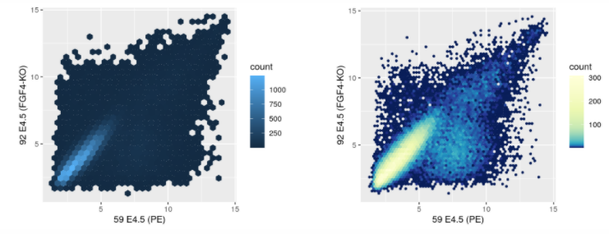
3.6.7 Visualizing data in 2D: scatter plots

Slide 24
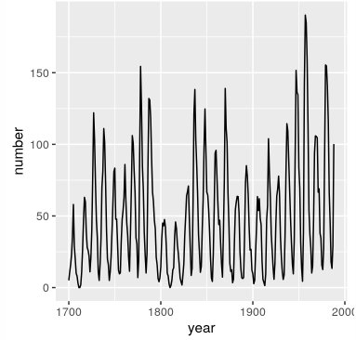
3.7.1 Plot shapes
If the data more or less follow a line, looking at the typical slope of the line can be useful. This is called banking
The idea is that the average line slope in a line chart should be 45○

Slide 25
3.8 Visualilzing more than two dimensions
The geom_point object offers the following aesthetics
fill
color (outline)
shape
size
alpha (transparency)
Usually we are better off to limit ourselves to choosing only one or two of these

Slide 26
3.8.1 Faceting
Multiple plots that result from repeatedly subsetting (or ‘slicing’) our data
# substitute blank values with ‘no’

Slide 27
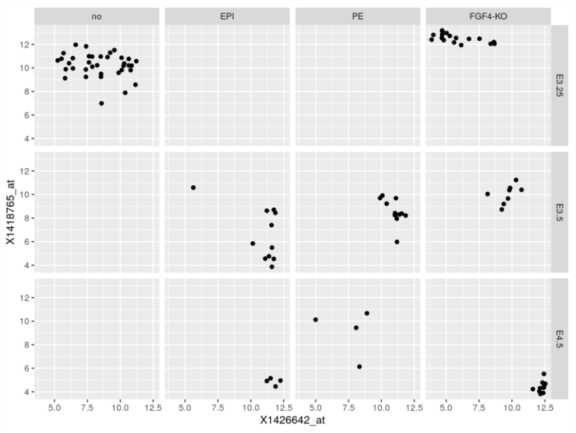
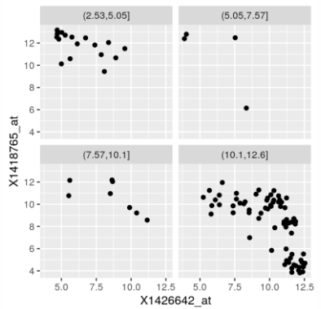
3.8.1 Faceting
Specifying two faceting variables
# cut probe expression into 4 blocks

Slide 28
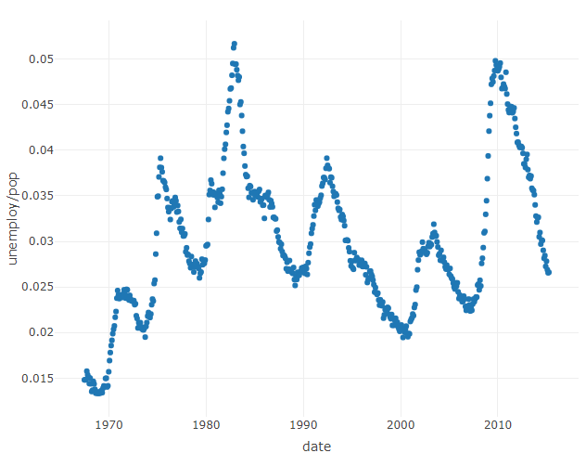
3.8.2 Interactive graphics
shiny
a web application framework for R
The language used for describing the interactive options is separated from the production of the graphics via ggplot2 and the grammar of graphics
ggvis
ggvis is an attempt at extending the good features of ggplot2 into the realm of interactive graphics
Is inspired by grammar of graphics concepts but uses distinct syntax
Leverages shiny’s infrastructure
plotly
web-based tool for interactive graphic generation

Slide 29
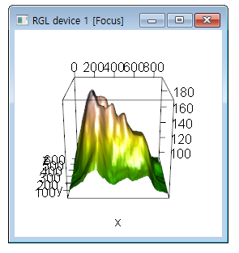
3.8.2 Interactive graphics
For visualizing 3D objects, there is the package rgl
# 10 * seq(1, nrow(volcano))
# mapping from the value range of the volcano data to the integers between 1 and 500
# plot 3D data with volcanoData

Slide 30
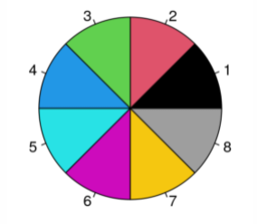
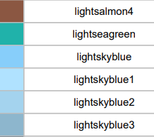
3.9 Color
build-in R color scheme (search ‘colors in R’ on Google)

Slide 31
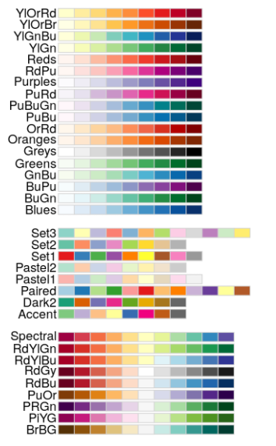
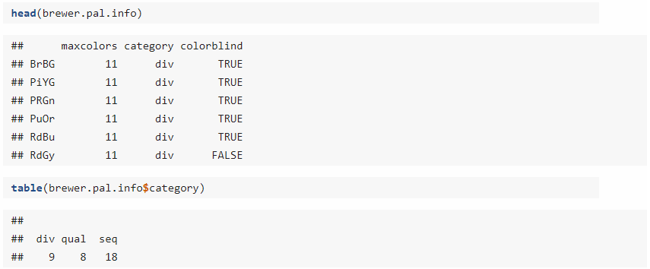
3.9 Color
Importing cooler color palettes with RColorBrewer package
# show all palettes
Sequential
Qualitative
Diverging

Slide 32
3.9 Color
To obtain the colors from a particular palette we use the function brewer.pal
# left = darkorange3, middle=white, right=darkblue and split into 100 colors
# no x label, no y label

Slide 33
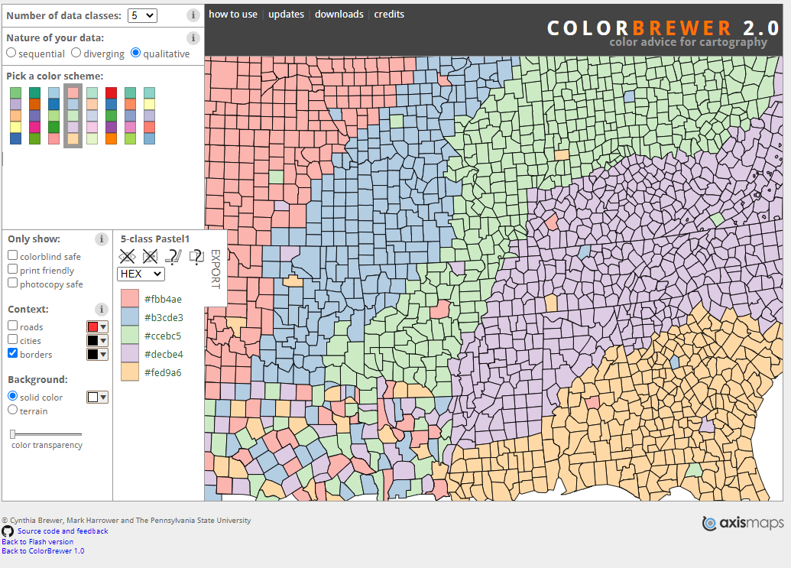
3.9 Color
Search Rcolorbrewer for more

Slide 34
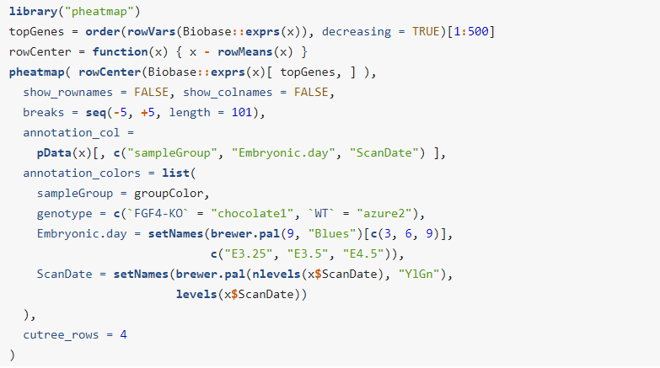
3.10 Heatmaps
Heatmaps are a powerful way of visualizing large, matrix-like datasets and providing a quick overview of the patterns that might be in the data
However, one should keep in mind that ordering the rows and columns by cluster dendrogram is an arbitrary choice
# Top 500 most variable genes
# centers each row by substracting the mean across columns
# a sequence of numbers used for mapping values to colors
# get 3rd, 6th, 9th color from blue palette of len=9
# get YlGn palette of len=#. of levels in ScanDate
# cut tree rows into 4 blocks

Slide 35
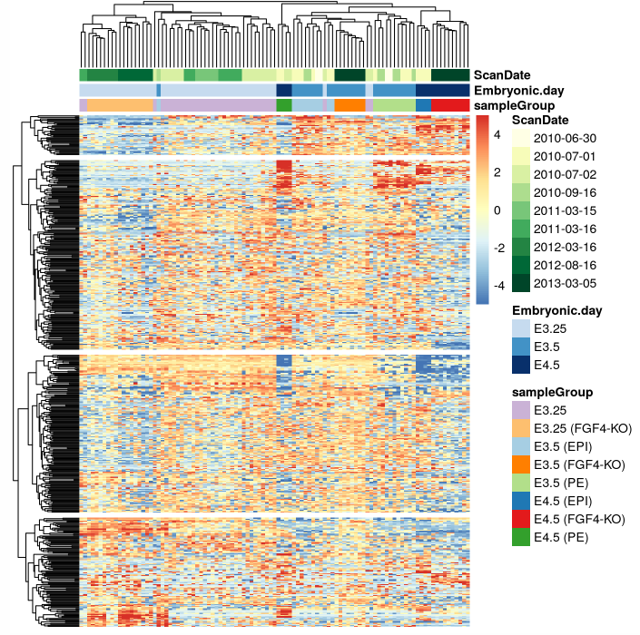
3.10 Heatmaps

Slide 36
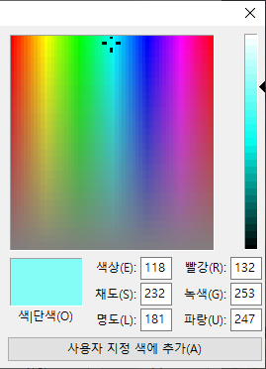
3.10.2 Color spaces
Color perceptions in humans is three-dimentional, i.e. RGB hexadecimal code (#CAB2D6)
The function hcl uses a different coordinate system: hue H, chroma C (angle in the range 0-360), luminance L
By keeping chroma and luminance constant and only varying hue, it is easy to produce color palette that are harmonious
Hue
Chroma
Luminance

Slide 37
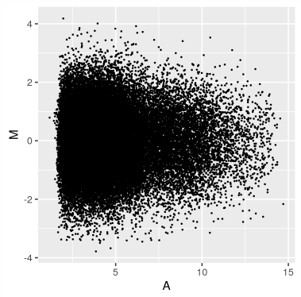
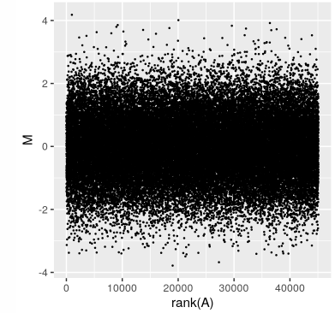
3.11 Data transformations
Transforming data by applying x and y aesthetics
The logarithm transformation is one of the most widely used ones
Sometimes even logarithm transformation can be misleading when even on the logarithmic scale the data distribution is highly uneven
# use gg + scale_x_log10() + scale_y_log10()

Slide 38
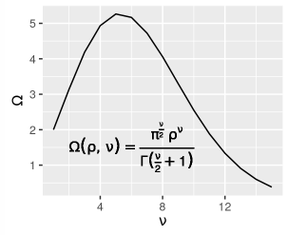
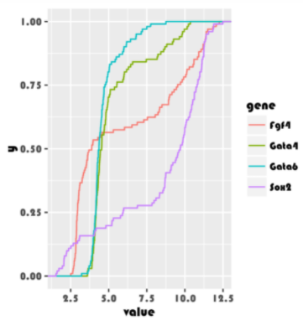
3.12 Mathematical symbols and other fonts
# function definition
# x=range(1,15)
# y=function(1, 1 to 15)
# expression() to plot mathematical symbols
# parse=TRUE to plot symbols, x and y coordinate for label
# family=‘Times’ to switch font to Times

Slide 39
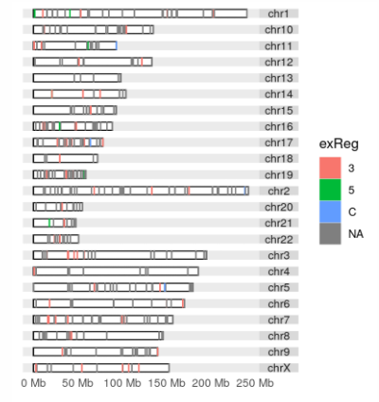
3.13 Genomic data
The main challenge of genomic data visualization is the size of genomes

Slide 40
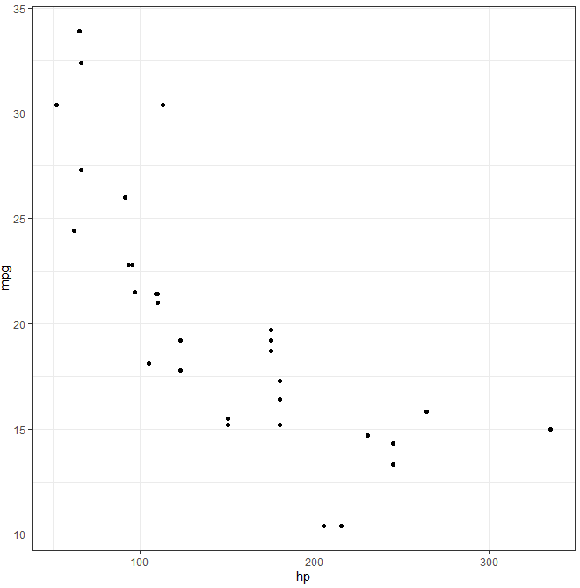
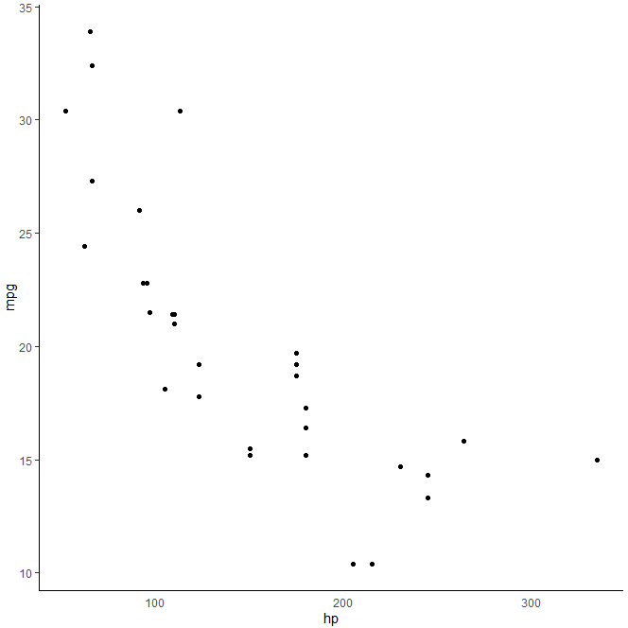
3.16 Exercises
Use themes to change the visual appearance of your plots
ggcars + theme_bw() + theme(legend.position='none', axis.ticks.x=element_blank(), panel.border = element_blank(), panel.grid.major = element_blank(),panel.grid.minor = element_blank(), axis.line = element_line(colour = "black"))

