Slide 1
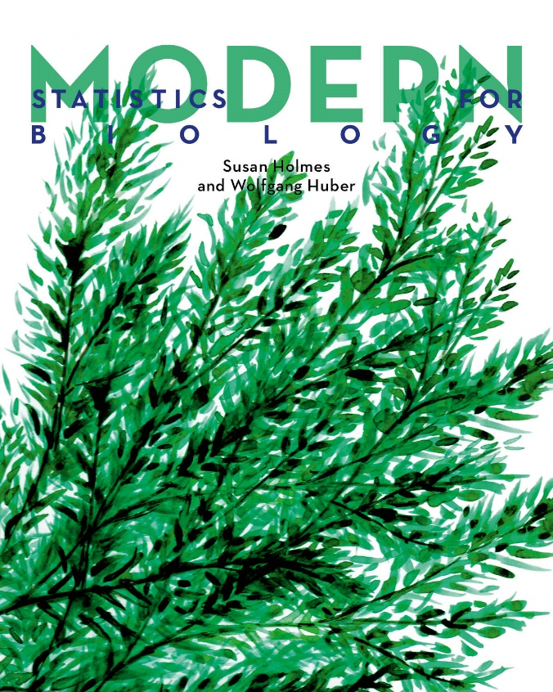
R Study #2
2023年 7月 18日
Modern Statistics for Biology
Chapter 2. Statistical Modeling
Hyun Woo Kim

Slide 2
contents
introduction & justification
What will we learn in chapter 2?
-Probability vs Statistics
-Maximum likelihood
-Bayesian inference when we have prior information
-Markov chain on dependent data
textbook.visang.com
Modern statistcis for Modern Biology

Slide 3
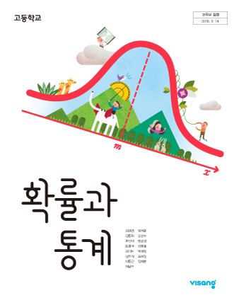
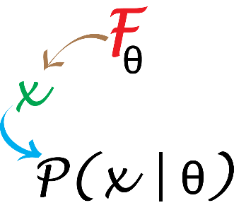
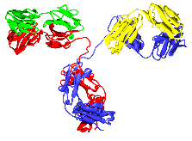
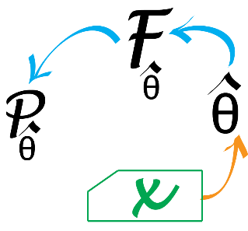
introduction
introduction & justification
2.2 Difference b/w statistical & probabilitic models
Probability : when we know the distribution F and its parameter θ
-> deduction
F = Possion
θ(λ) = 0.5 with known false positive rate
Statistics : when we “do not” know the distribution F and its parameter θ
-> inference
F = ?
θ(λ) = ?
textbook.visang.com
Modern statistcis for Modern Biology

Slide 4
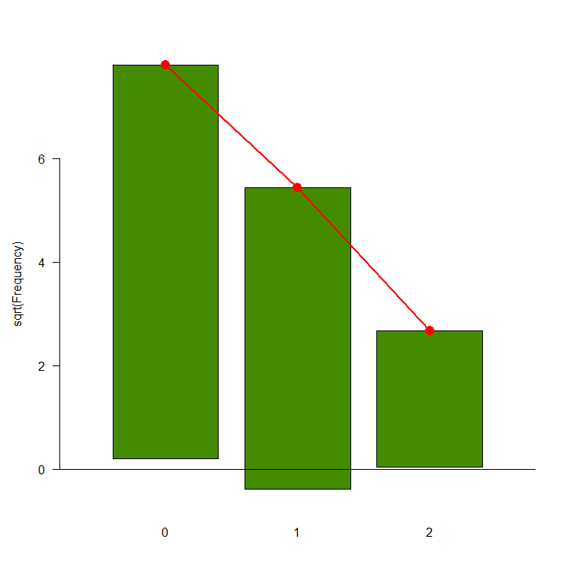
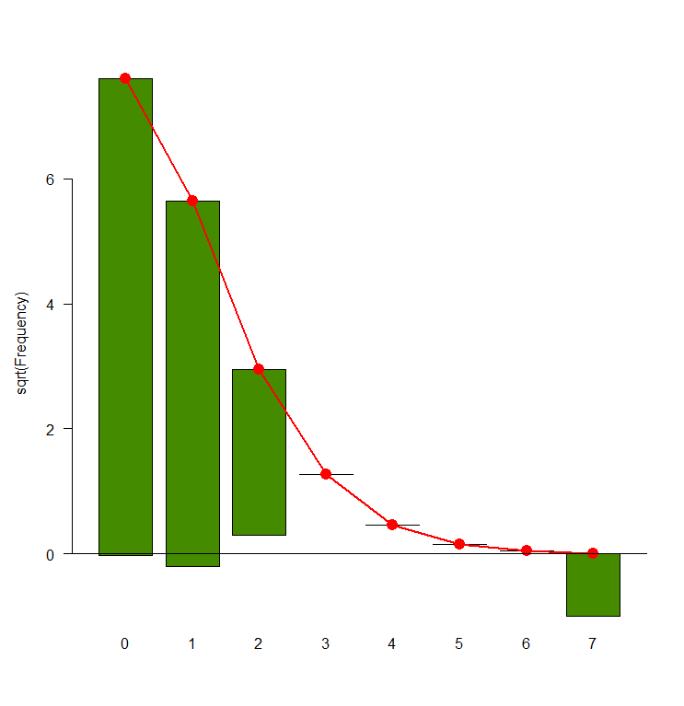
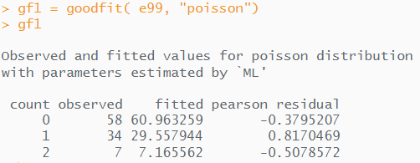
Statistical Modeling
analytical results
2.3 A simple example of statistical modeling
1. We need a reasonable probability distrubution
ㄴGoodness-of-fit & rootogram
One visual goodness-of-fit diagram is known as rootogram
Rootogram hangs the bars with the obersed counts from the theoretical red points
If the counts correspond to their theoretical values, the bottom of the boxes align exactly with the x-axis
textbook.visang.com
Modern statistcis for Modern Biology

Slide 5
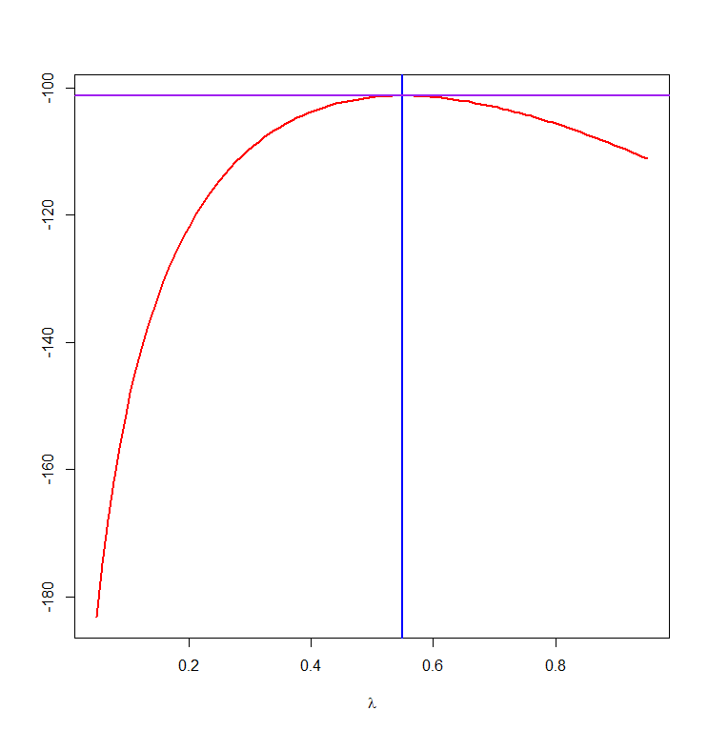
Statistical Modeling
analytical results
2.3.1Classical statistics for classical data
2. We need to choose a reasonable parameter; estimating rate parameter λ
ㄴmaximum likelihoood estimator(MLE)
textbook.visang.com
Modern statistcis for Modern Biology

Slide 6
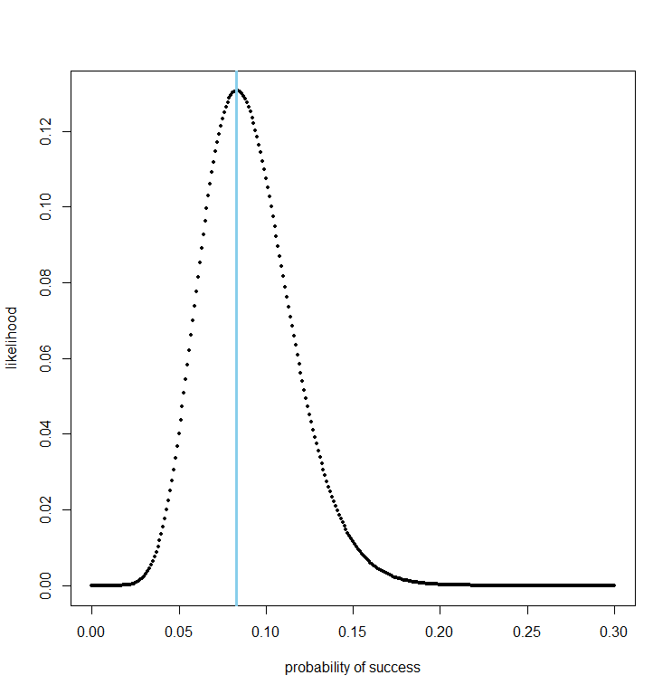
Binomial distributions and maximum likelihood
analytical results
2.4.1 Binomial distributions and maximum likelihood example
Binomial distrubtion has 2 parameters n, p
ㄴmaximum likelihoood to estimate p
e.g. n =120 males tested for red-green blindness 0: non RG-blindness, 1: RG-blindness
p^{hat} = 1/12
Modern statistcis for Modern Biology

Slide 7
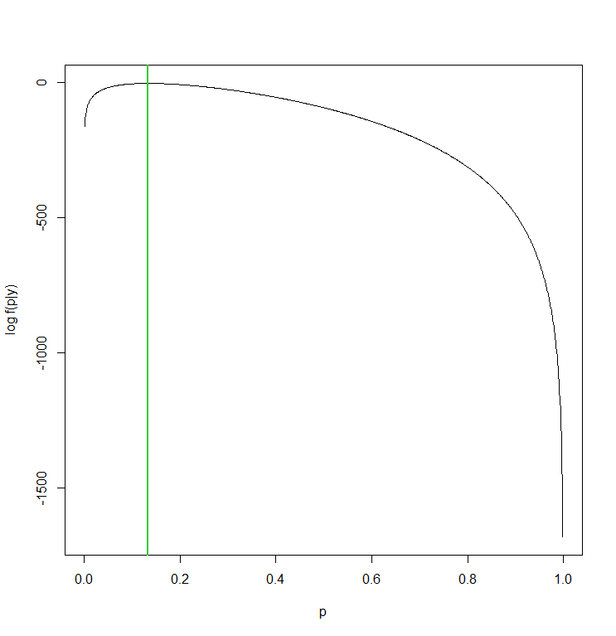
Binomial distributions and maximum likelihood
analytical results
2.4.2 Likelihood for the binomial distribution
probability vs likelihood?
ㄴprobability : how probable to observe a particular set of values given θ
ㄴlikelihood : when a data given, ask for θ that likely generated the data
e.g. n = 300, y = 40 success following a binomial distribution
Modern statistcis for Modern Biology

Slide 8
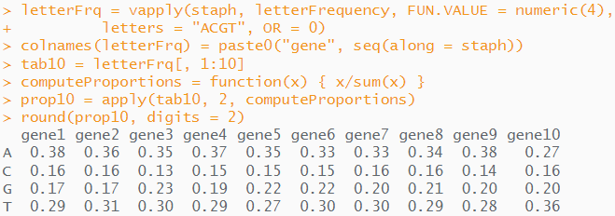
Multinomial data
analytical results
2.5.1&2 DNA count modeling & nucleotide bias
what about multi-class problems? -> we can use a multinomial model!
e.g. nucleotides (4 class – A, T, G, C)
H0 : nucleotide occur in the same proportions
ㄴfirst 10 genes of S.aureus
Modern statistcis for Modern Biology

Slide 9
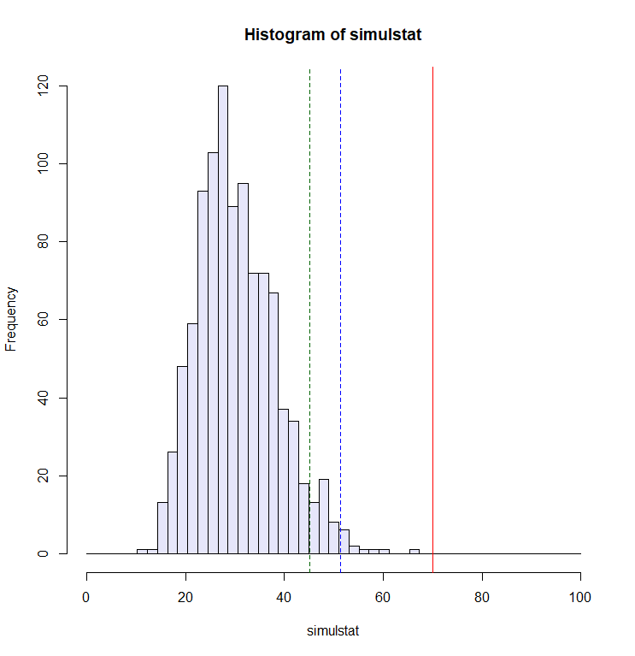
Multinomial data
analytical results
2.5.1&2 DNA count modeling & nucleotide bias
expected frequency with average proportion
H0 : nucleotide occur in the same proportions (from a multinomial distribution)
across 10 genes of S.aureus
-> H0 rejrected
Modern statistcis for Modern Biology

Slide 10
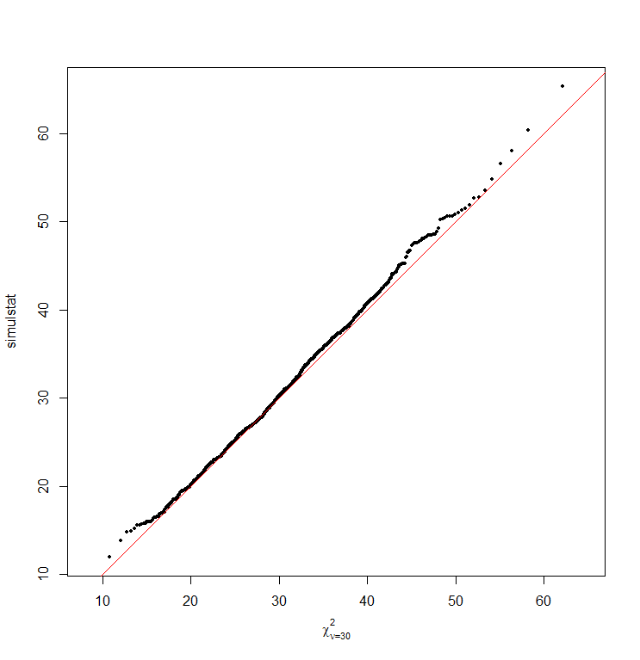
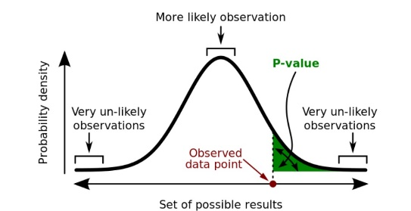
χ² distribution
analytical results
2.6.1 QQ plots and chi-squared test for goodnes-of-fit
a visual tool to compare two distributions
ㄴplotting simultation stat quantile with an theoretical null distribution
The theoretical distribution simulstat is called the chi-squared distribution with df= 30 (=10*(4-1))
simulated under H0
p-value(probability that under H0, we observe a value as high as S1=70.1)
theoretical null distribution
ㄴ simulstat is well described by X²₃₀ distribution
Modern statistcis for Modern Biology

Slide 11
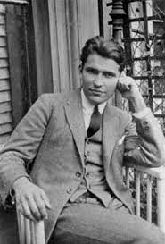
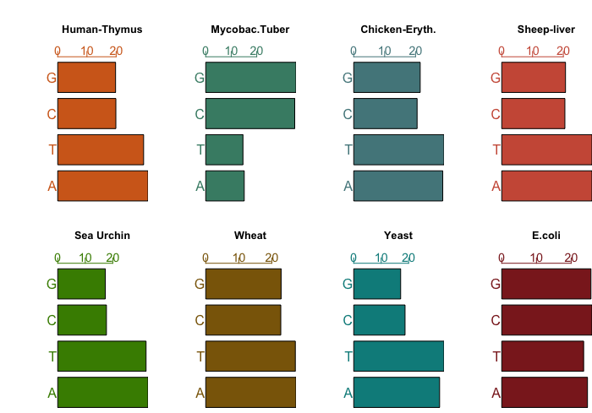
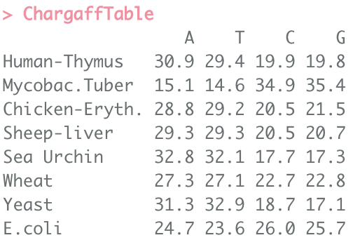
Chargaff’s Rule
analytical results
2.7. Chargaff’s tetranucleotide hypothesis
whether the nucleotides occurred at equal frquencies based on molecular mass
Modern statistcis for Modern Biology
macroevolution.net/erwin-chargaff.html

Slide 12
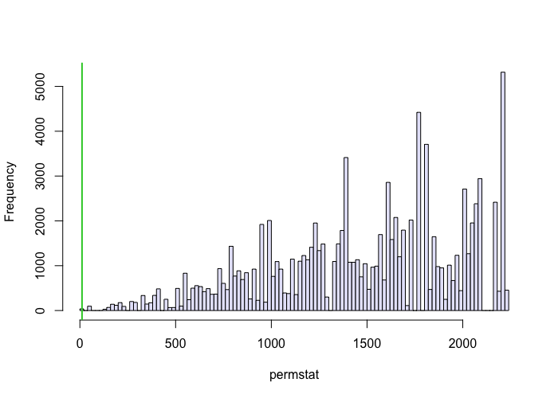
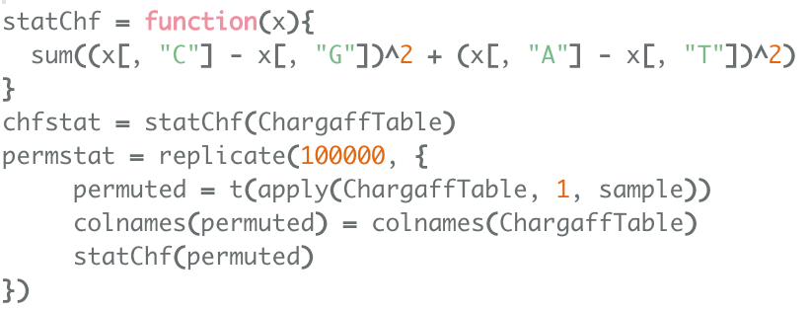
Chargaff’s Rule
analytical results
2.7. Chargaff’s tetranucleotide hypothesis
a test statistic based on Chargaff’s rule
H0 : no relationship b/w A-T, G-C
-> H0 reject
Modern statistcis for Modern Biology

Slide 13
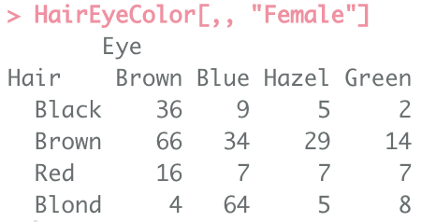
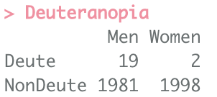
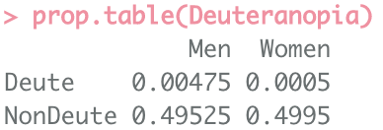
Chargaff’s Rule
analytical results
2.7.1 Two cagegorical variables
eye & hair color combination to make a contingency table
relationship b/w sex & red-green color blindness?
H0 with 2 independent binomial models : 1 for sex, 1 for color blindness -> multinomial probability to test for obs vs exp count
ㄴ fractions of color-blindness among women and men were the same
-> H0 reject
Modern statistcis for Modern Biology

Slide 14
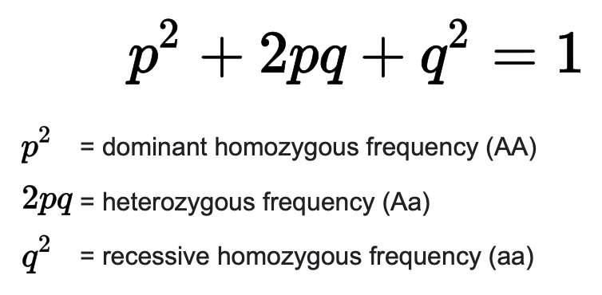
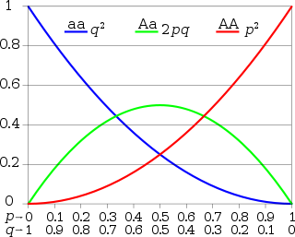
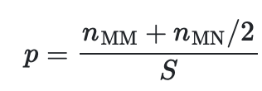
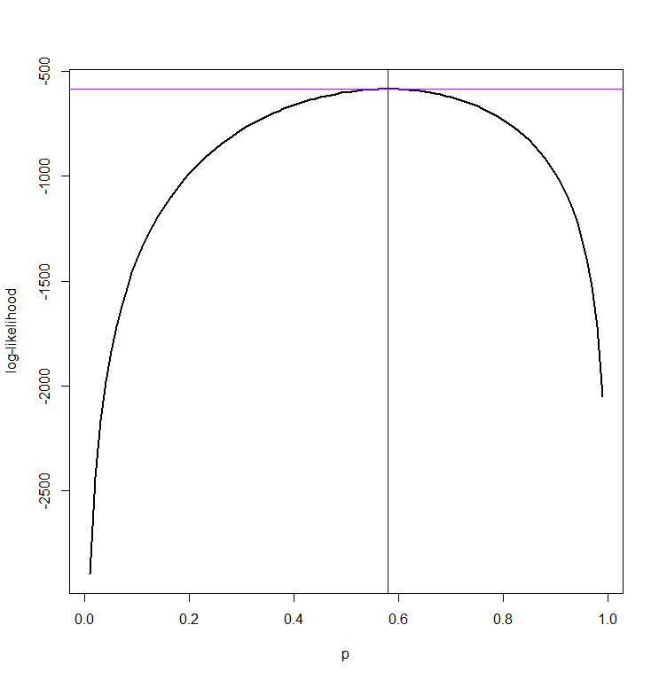
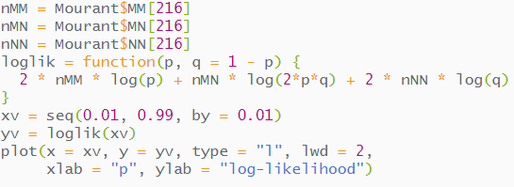
multinomial testing on HWE
analytical results
2.7.2 A special multinomial : HWE
Hardy-Weinberg equilibrium(HWE)
the relationship b/w p and q,
if there is independence of the frequency of both alleles in a genotype
Mourant data : genotype frequency data of blood group allele
ㄴ p that maximizes the log-likelihood
Modern statistcis for Modern Biology
en.wikipedia.org/wiki/Hardy–Weinberg_principle

Slide 15
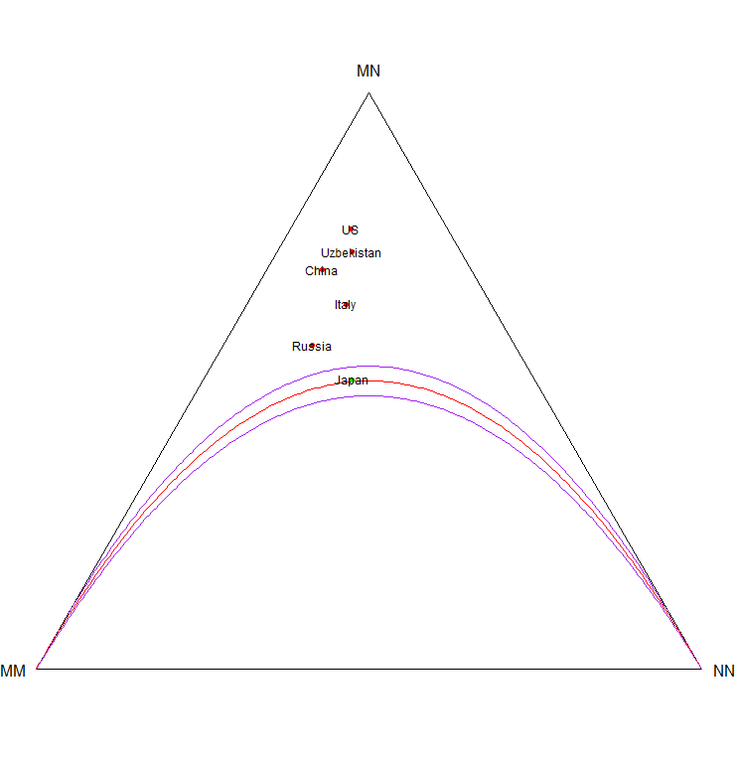
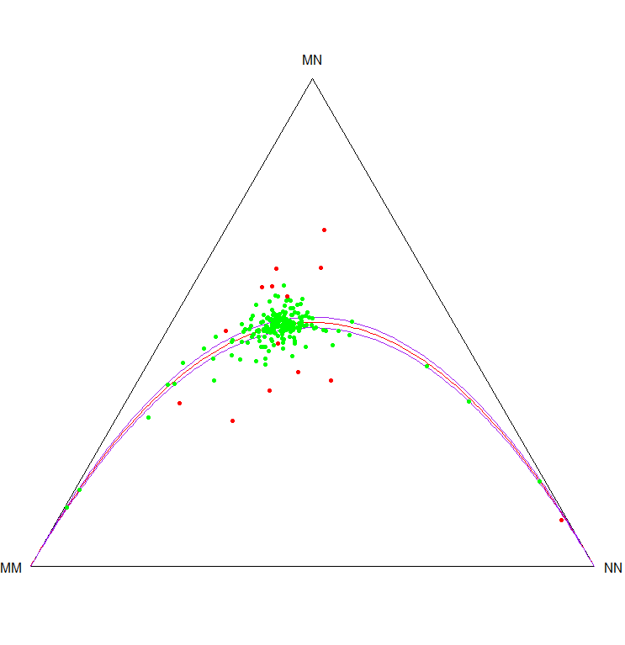
Chargaff’s Rule
analytical results
2.7.2 A special multinomial : HWE
Hardy-Weinberg equilibrium(HWE)
ㄴphat = (188*2 + 296) / (580*2)
barycenter of 3 frequencies
HWE
acceptance region
Modern statistcis for Modern Biology
Notes:
무게중심

Slide 16
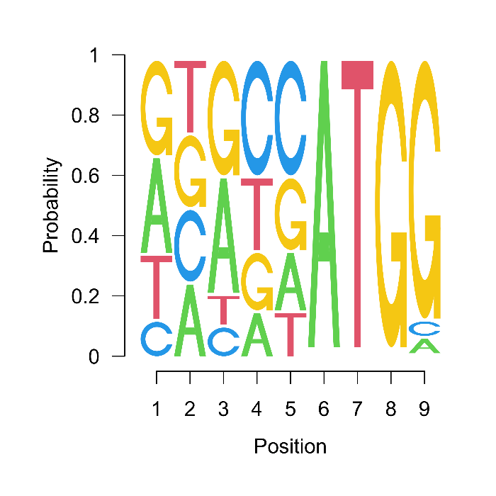
Chargaff’s Rule
analytical results
2.7.3 Concatenating several multinomials : sequence motifs & logos
kozak motif – position weight matrix(PWM) | position-specific scoring matrix(PSSM) for multinomial probability
With multiple categorical variables, each variables are rarely independent(sex & colorblindness, hair & eye color etc.)
ㄴlet’s see the dependencies b/w categorical variables along a sequence of categorical varialbe
Modern statistcis for Modern Biology
Notes:
무게중심

Slide 17
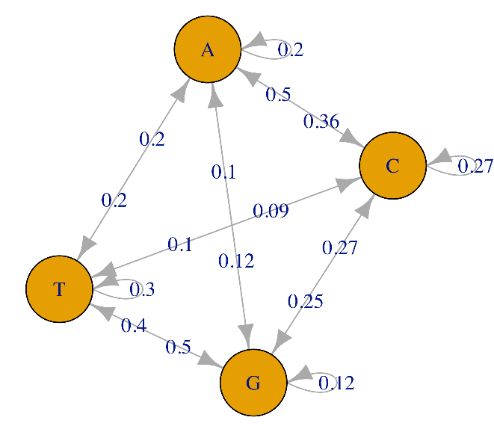
Modeling sequencial dependencies : Markov chains
analytical results
2.8 Dependency on categorical variables
When predicting tomorrow’s weather, it will most likely be the same as today’s
A Markov chain or Markov process is a stochastic model describing a sequence of possible events in which the
probability of each event depends only on the state attained in the previous event
ㄴan example of Markov assumption : the prediction of tomorrow’s weather only depends on the state of today
-> the process has finite memory, and prediction only need to look back for a finite amount of time
DNA sequence with specific succession of patterns
Modern statistcis for Modern Biology
Notes:
무게중심

Slide 18
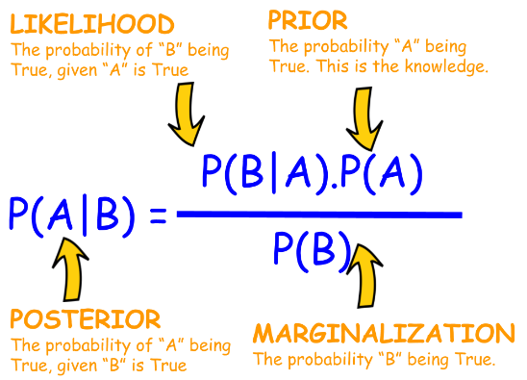
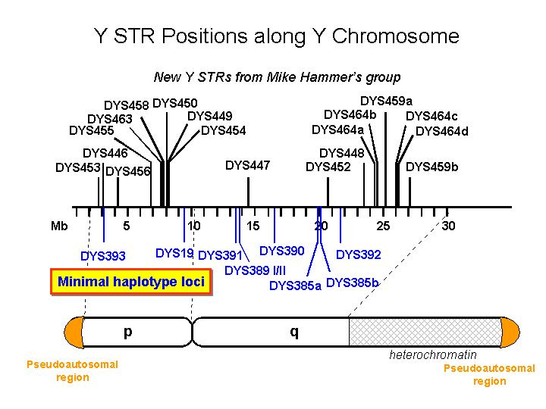
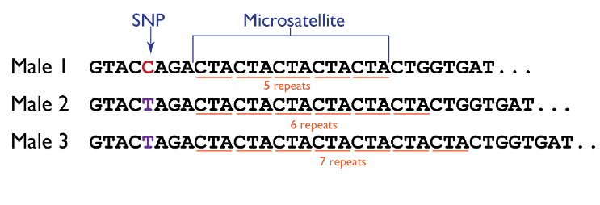
Bayesian thinking
analytical results
2.9.1 Haplotype frequencies
Using probabilistic models to express our prior knowledge about the parameters, and use the current data to update it
ㄴBayesian paradigm : prior and posterior distributions to model our knowledge before & after collecting data
e.g. linked variants on the Y chromosome
STR number is highly variable across individuals -> used as genetic signature
To find the underlying proportion p of a particular haplotype in a population, H1 n=40 among 300 .
We can apply Bayesian paradigm for the binomial distribution
Modern statistcis for Modern Biology
siamohajer.com/bayesian-thinking/
Notes:
무게중심

Slide 19
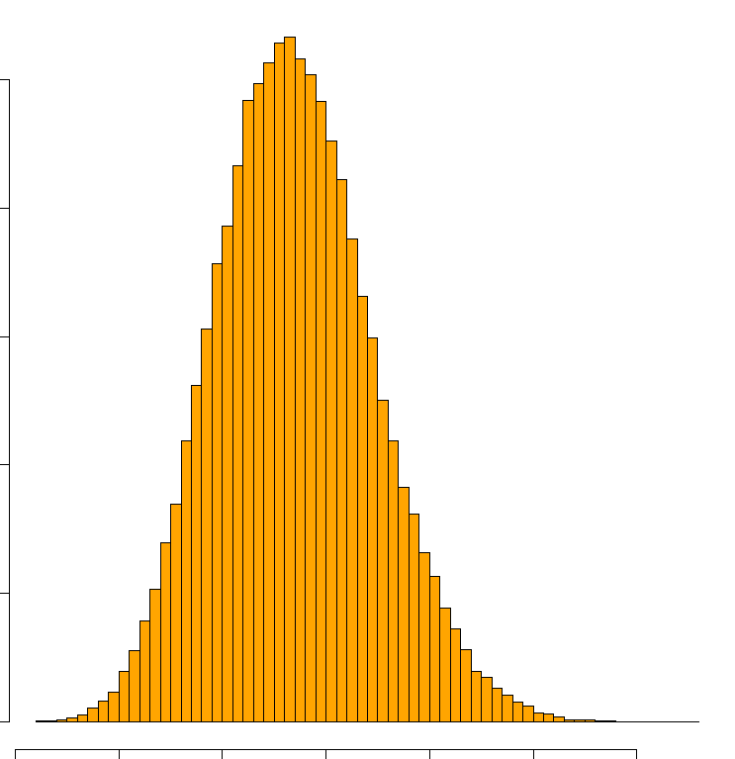
Bayesian thinking
analytical results
2.9.3 Simulation study of a Bayesian paradigm for the binomial distribution
instead of a fixed p=40/300, the Bayesian approach allows us to see it as a draw from a statistical distribution
p as a parameter of proportion which is [0,1] -> p following a Beta disribution
with various ps -> marginal distribution of Y
Modern statistcis for Modern Biology
Notes:
무게중심

Slide 20
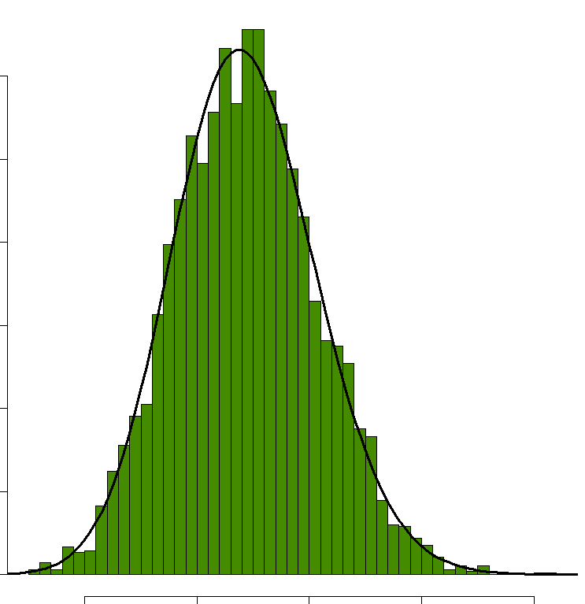
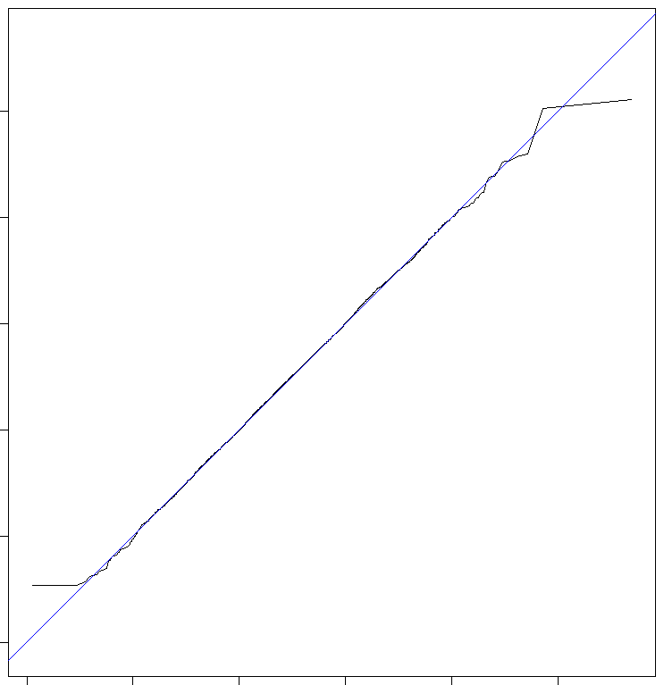
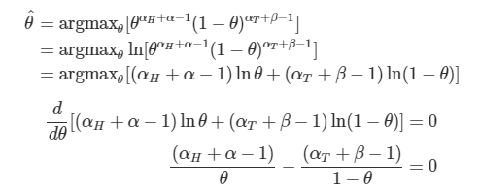
Bayesian thinking
analytical results
hyeongminlee.github.io/post/bnn002_mle_map/
2.9.4&5 ps such that Y = 40; the posterior distribution is also a Beta
the posterior distribution of p on the outcome where Y = 40
theoretical posterior
observed success y = 40, failure n-y=300-40
prior parameter a = 50, b = 350
maximum a posteriori(MAP); that maximizes posterior
Modern statistcis for Modern Biology
Notes:
무게중심

Slide 21
Bayesian thinking
analytical results
2.9.6 Suppose we had a second series of data
the posterior distribution of p is now a new prior for the second data. Beta(90, 610)
MAP on Beta(115, 735) = (115-1)/(115+735-2) ~= 0.134
posterior credibility interval
Modern statistcis for Modern Biology
Notes:
무게중심

Slide 22
Ocurrence of a nucleotide pattern in a geome
analytical results
2.10 The Shine-Dalgarno motif on E.coli genome
Exploring the occurrence of shine-dalgarno motif “AGGAGGT”
count the pattern occurence
n(windows) with matching #
-> model for the distribution of gap sized b/w motifs
Modern statistcis for Modern Biology
Notes:
무게중심

Slide 23
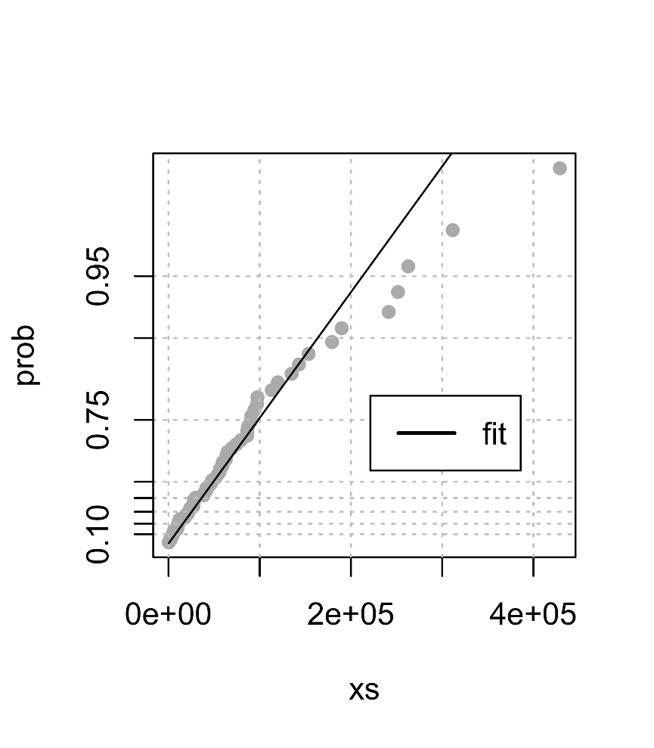
Ocurrence of a nucleotide pattern in a geome
analytical results
en.wikipedia.org/wiki/Exponential_distribution
2.10 The Shine-Dalgarno motif on E.coli genome
we expect gap lengths to follow an exponential distributon
Modern statistcis for Modern Biology
Notes:
무게중심

Slide 24
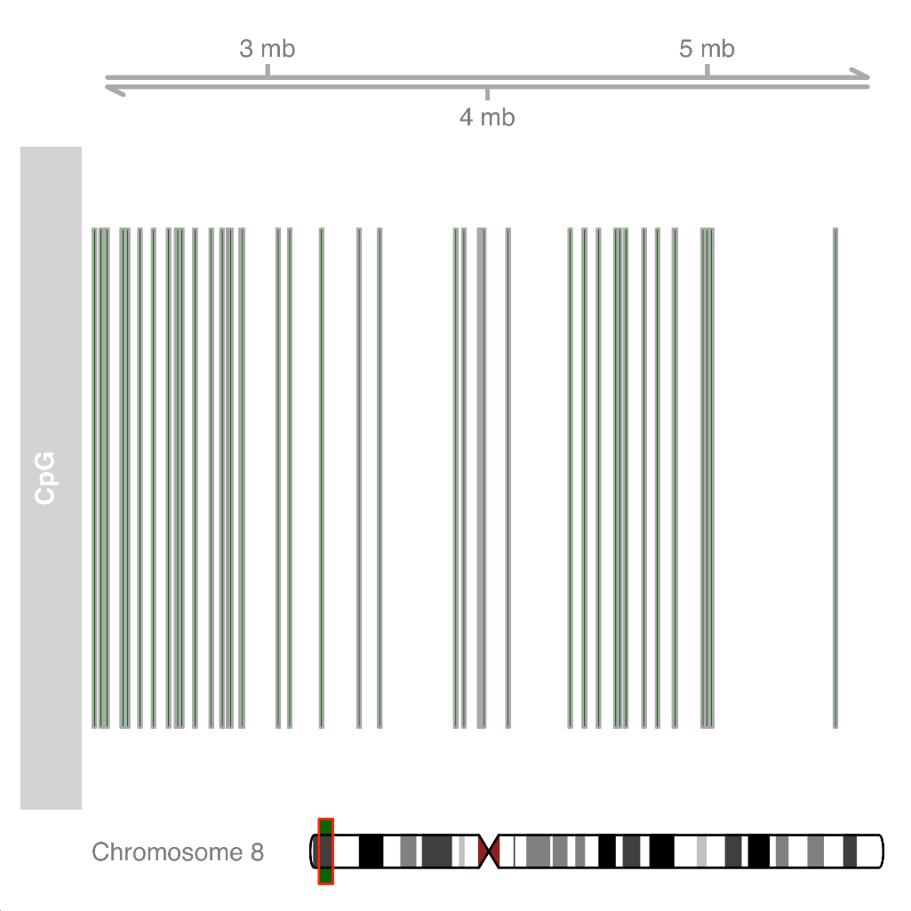
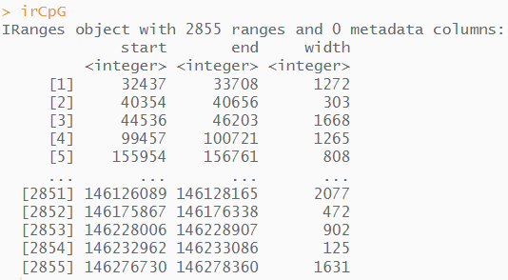
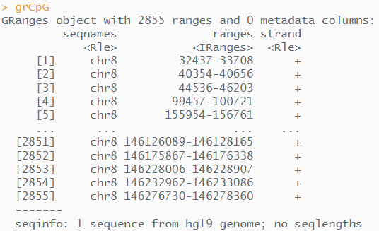
Ocurrence of a nucleotide pattern in a geome
analytical results
en.wikipedia.org/wiki/Exponential_distribution
2.10.1 Modeling in the case of dependencies
Since certain nucleotide depend on the surrounding sequence, let make a dependency modeling using Markov chain
CpG islands on human genome chr8
Modern statistcis for Modern Biology
Notes:
무게중심

Slide 25
Ocurrence of a nucleotide pattern in a geome
analytical results
en.wikipedia.org/wiki/Exponential_distribution
2.10.1 Modeling in the case of dependencies
Since certain nucleotide depend on the surrounding sequence, let make a dependency modeling using Markov chain
CpG & non CpG islands coordinates on human genome chr8 stored in CGI/NonCGIview
transition matrix on CpG islands
transition matrix on non-CpG islands
Modern statistcis for Modern Biology
Notes:
무게중심

Slide 26
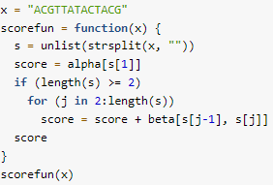
Ocurrence of a nucleotide pattern in a geome
analytical results
2.10.1 Modeling in the case of dependencies
Given a sequence which we do not know whether it is in CpG island, ask the probability it belongs to CpGi
ㄴodds ratio
the log-likelihood ratio score
Modern statistcis for Modern Biology
Notes:
무게중심

Slide 27
Conclusion & Summary
conclusion & further study
Statistical models on categorical outcomes (binomial, multinomial)
Goodness of fit
ㄴvisualize with QQ-plot & chi-square statistic
Estimation
ㄴmaximum likelihood, Bayesian estimation
Prior and posterior distributions
Markov chain on dependencies along DNA sequences
ㄴCGIscore based on likelihood ratio
human pangenome reference

