Slide 1
Chapter8.
High-Throughput Count Data

Slide 2

바이오데이터의 상당 부분은 High-throughput count data로 되어 있다.
바이오 데이터 중에서 High-throughput count data에는 어떤 것들이 있을까?
우리가 이미 Hypothesis testing을 알고 있지만 High-throughput count data의 분석을 위해 추가적으로 고려해 주어야 할 것은 무엇인가?
실제로 R 을 이용해서 이러한 문제를 어떻게 해결할 수 있을까?

Slide 3
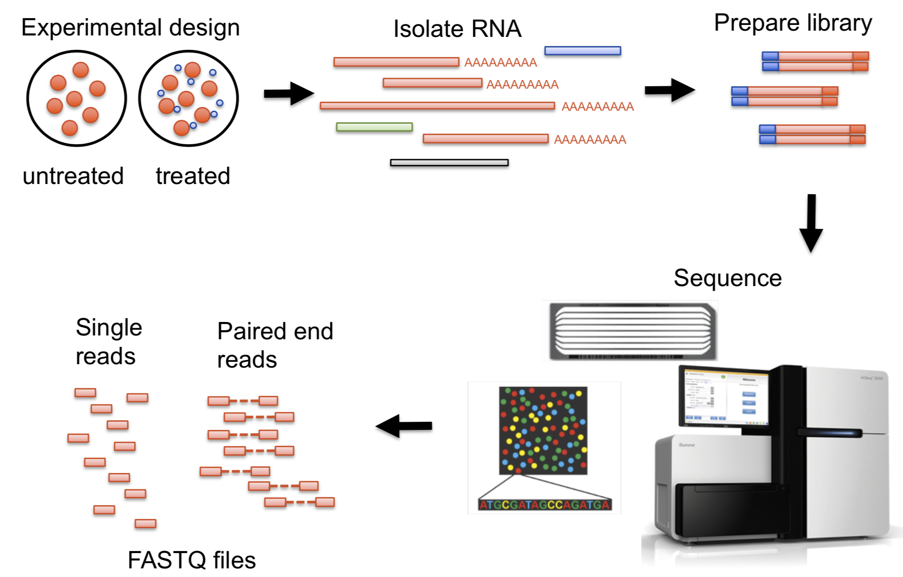
High-throughput count data in biology : RNA-seq 데이터

Slide 4
High-throughput count data in biology : Additional examples
In ChIP-Seq, we sequence DNA regions that are bound to particular DNA-binding proteins (selected by immuno-precipitation);
in RIP-Seq, RNA molecules or regions of them bound to a particular RNA-binding protein;
in DNA-Seq, we sequence genomic DNA and are interested in the prevalence of genetic variants in heterogeneous populations of cells, for instance the clonal composition of a tumor.
In high-throughput chromatin conformation capture (HiC) we aim to map the 3D spatial arrangement of DNA;
in genetic screens (using, say, RNAi or CRISPR-Cas9 libraries for perturbation and high-throughput sequencing for readout), we’re interested in the proliferation or survival of cells upon gene knockdown, knockout or modification.
In microbiome analysis, we study the abundance of different microbial species in complex microbial habitats.

Slide 5


Case study : The pasilla data (RNA-seq)
Combined RNAi and RNA-seq to identify the genes regulated by Pasilla (PS)
RNAi of Pasilla

Slide 6


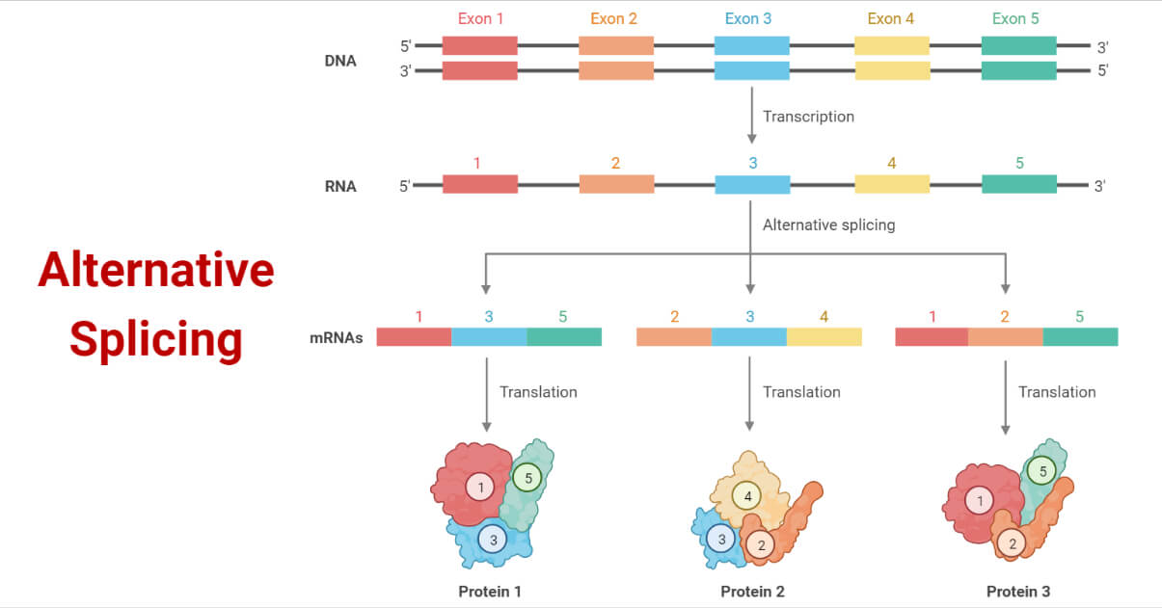
RNA-seq to study conservation and evolution
Pasilla
NOVA1/2
NOVA1/2
?

Slide 7
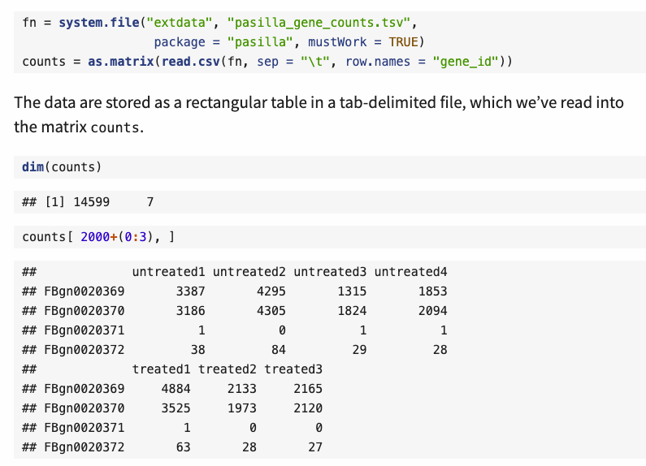
Back to the case study : The pasilla data (RNA-seq)

Slide 8
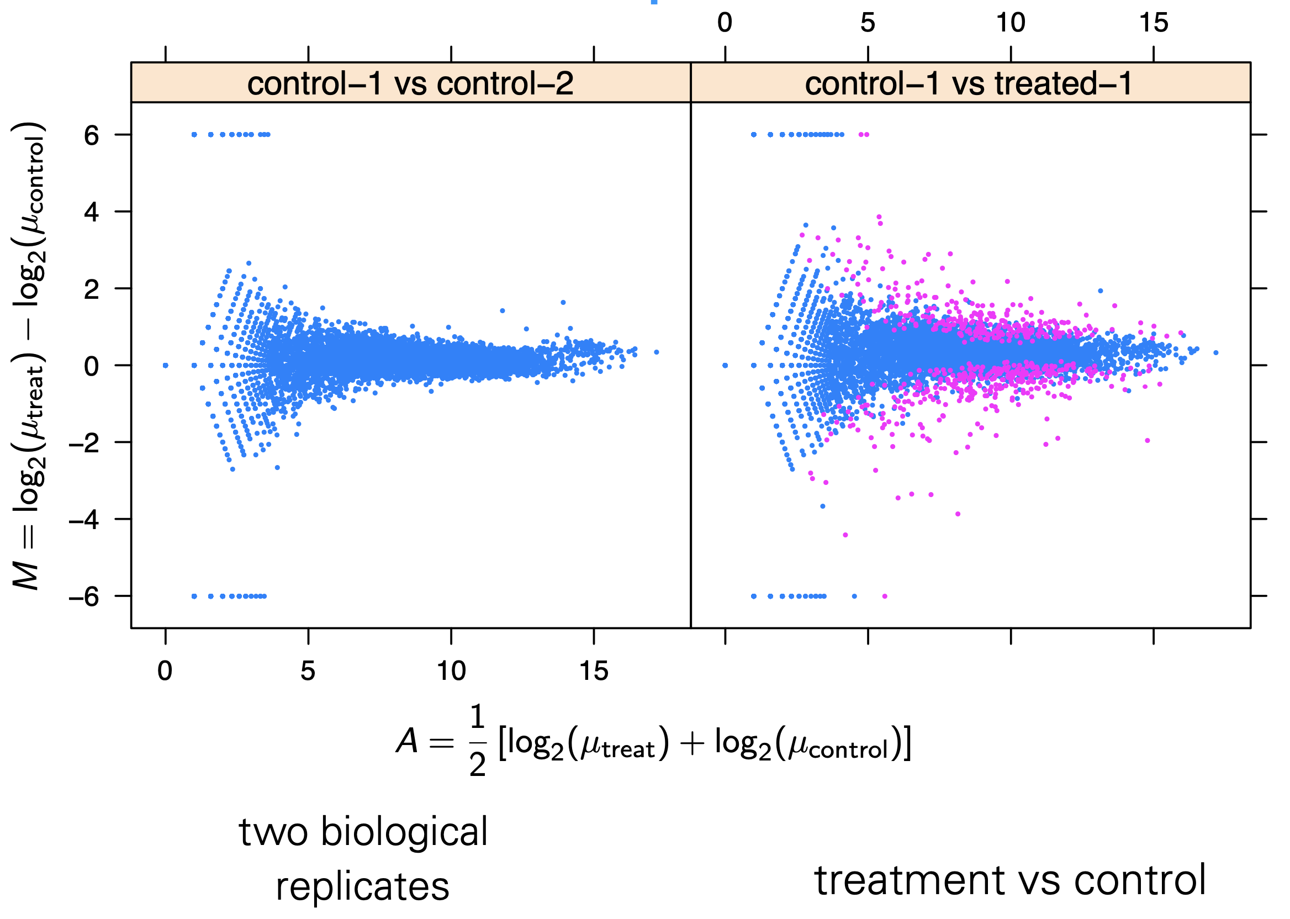
Goal of analysing high-throughput bio data : MA-plots
How can we distinguish biological difference from the difference comes from noise?

Slide 9
The challenges of high-throughput count data
Large dynamic range (starting from zero up to millions)
  → The distribution shape of the data in different parts of the dynamic range are very different
  → heteroskedasticity
The data are non-negative integers and not symmetric
  → normal distribution models may be a poor fit
Systematic sampling biases needs to be adjusted : normalization
Stochastic properties of the sampling (sample sizes tend to be limited)

Slide 10
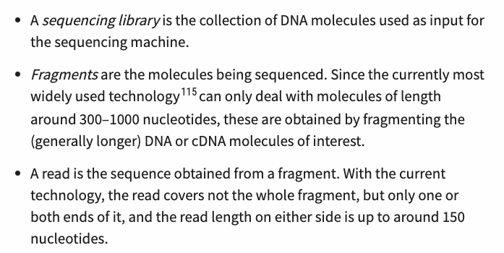
이번 챕터에서 다룰 용어 정리

Slide 11
Topic1. Modeling count data

Slide 12
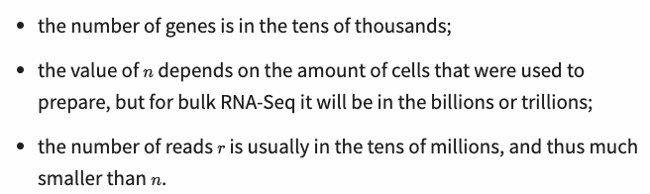
Modeling count data : Which distribution do we need to use?
Distributions can be parameterized in various ways; often the parameters correspond to some measure of location and some measure of dispersion; a familiar measure of location is the mean, and a familiar measure of dispersion is the variance (or standard deviation), but for some distributions other measures are also in use.
Would this be really the best choice for modeling RNA-seq data?

Slide 13
Modeling count data : Which distribution do we need to use?
In practice, we are usually not interested in modelling the read counts within a single library, but in comparing the counts between libraries!
Multiple libraries
Empirically, it turns out that replicate experiments vary more than what the Poisson distribution predicts. Intuitively, what happens is that pipi and therefore also λiλi vary even between biological replicates; perhaps the temperature at which the cells grew was slightly different, or the amount of drug added varied by a few percent, or the incubation time was slightly longer.
Library1
gamma-Poisson (a.k.a. negative binomial) distribution suits our modeling needs. Instead of a single λ – which represents both mean and variance –, this distribution has two parameters.

Slide 14
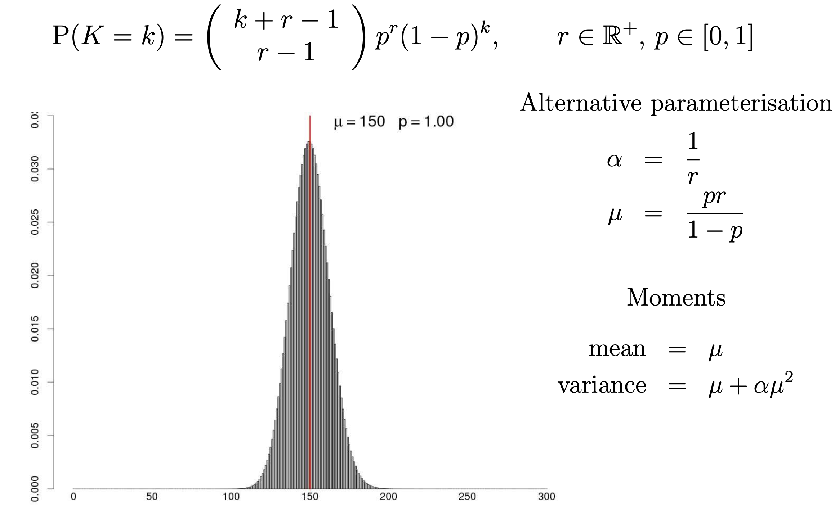
The Gamma-Poisson (a.k.a. Negative Binomial) distribution
p denotes the probability of a success r represents target for number of successful trials, or dispersion parameter
→ Then the random number of observed failures, X follows the negative binomial distribution

Slide 15
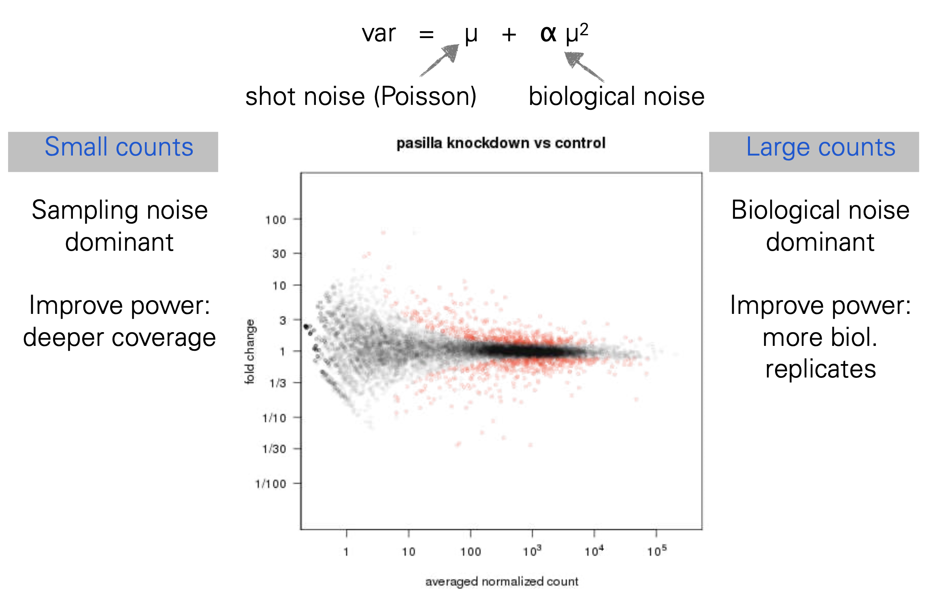
Two component noise model

Slide 16
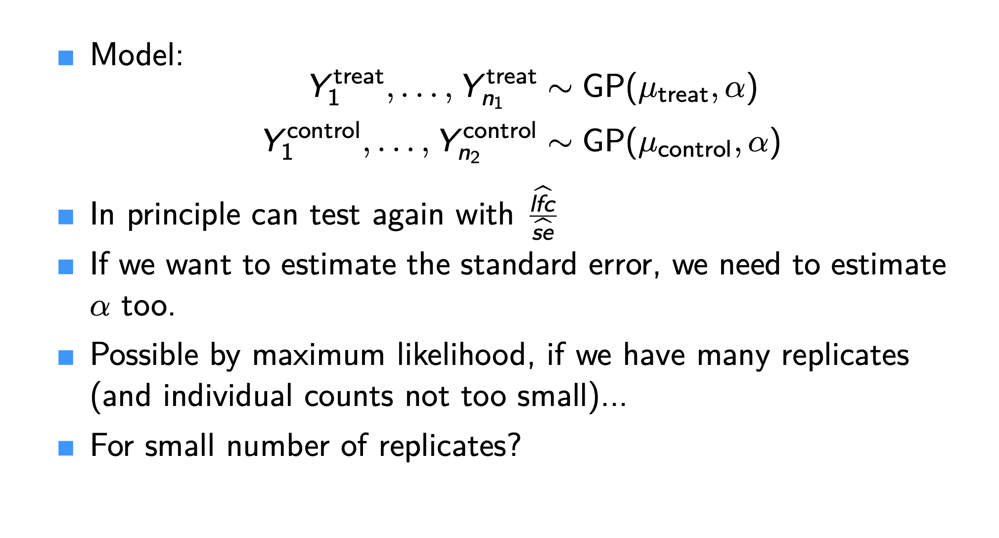
Gamma-Poisson

Slide 17
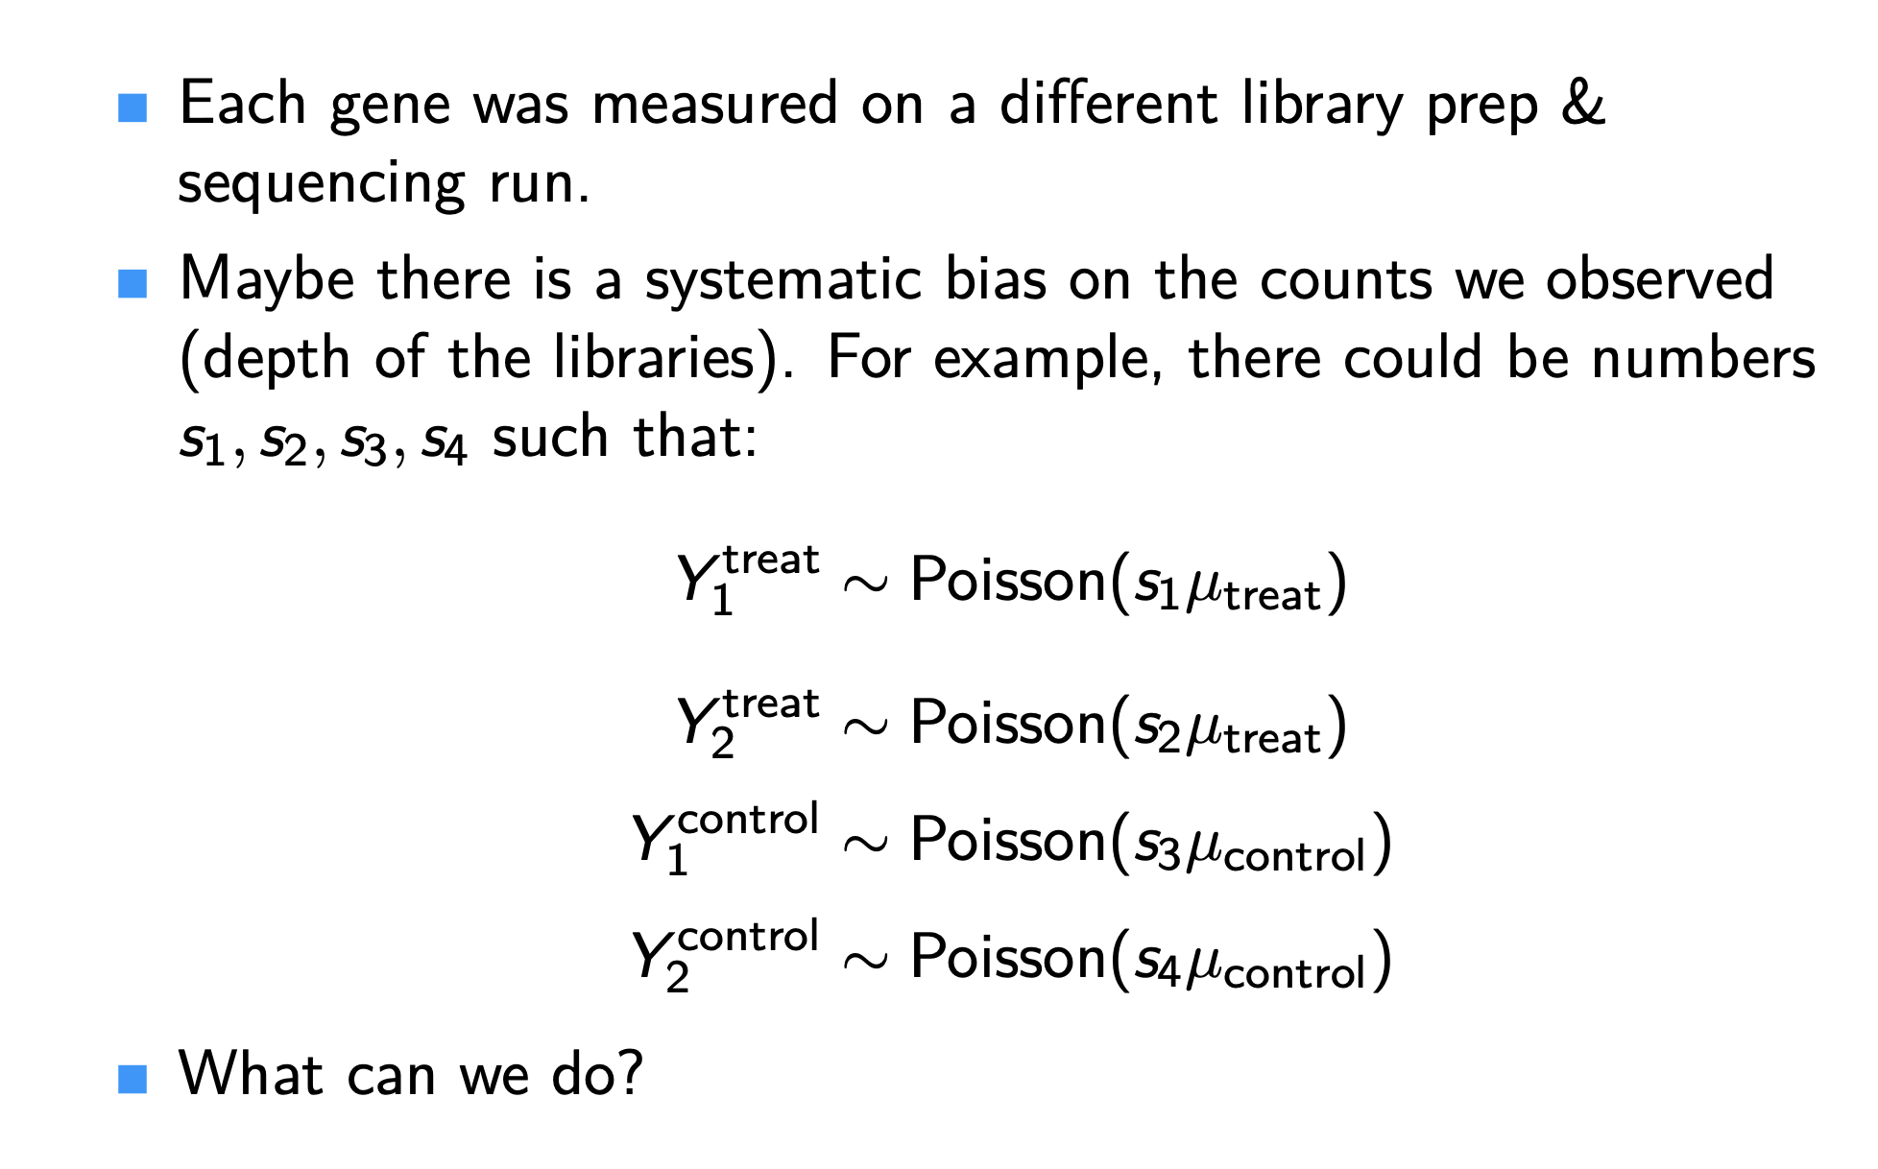
Challenges of modeling count data : Systematic biases

Slide 18
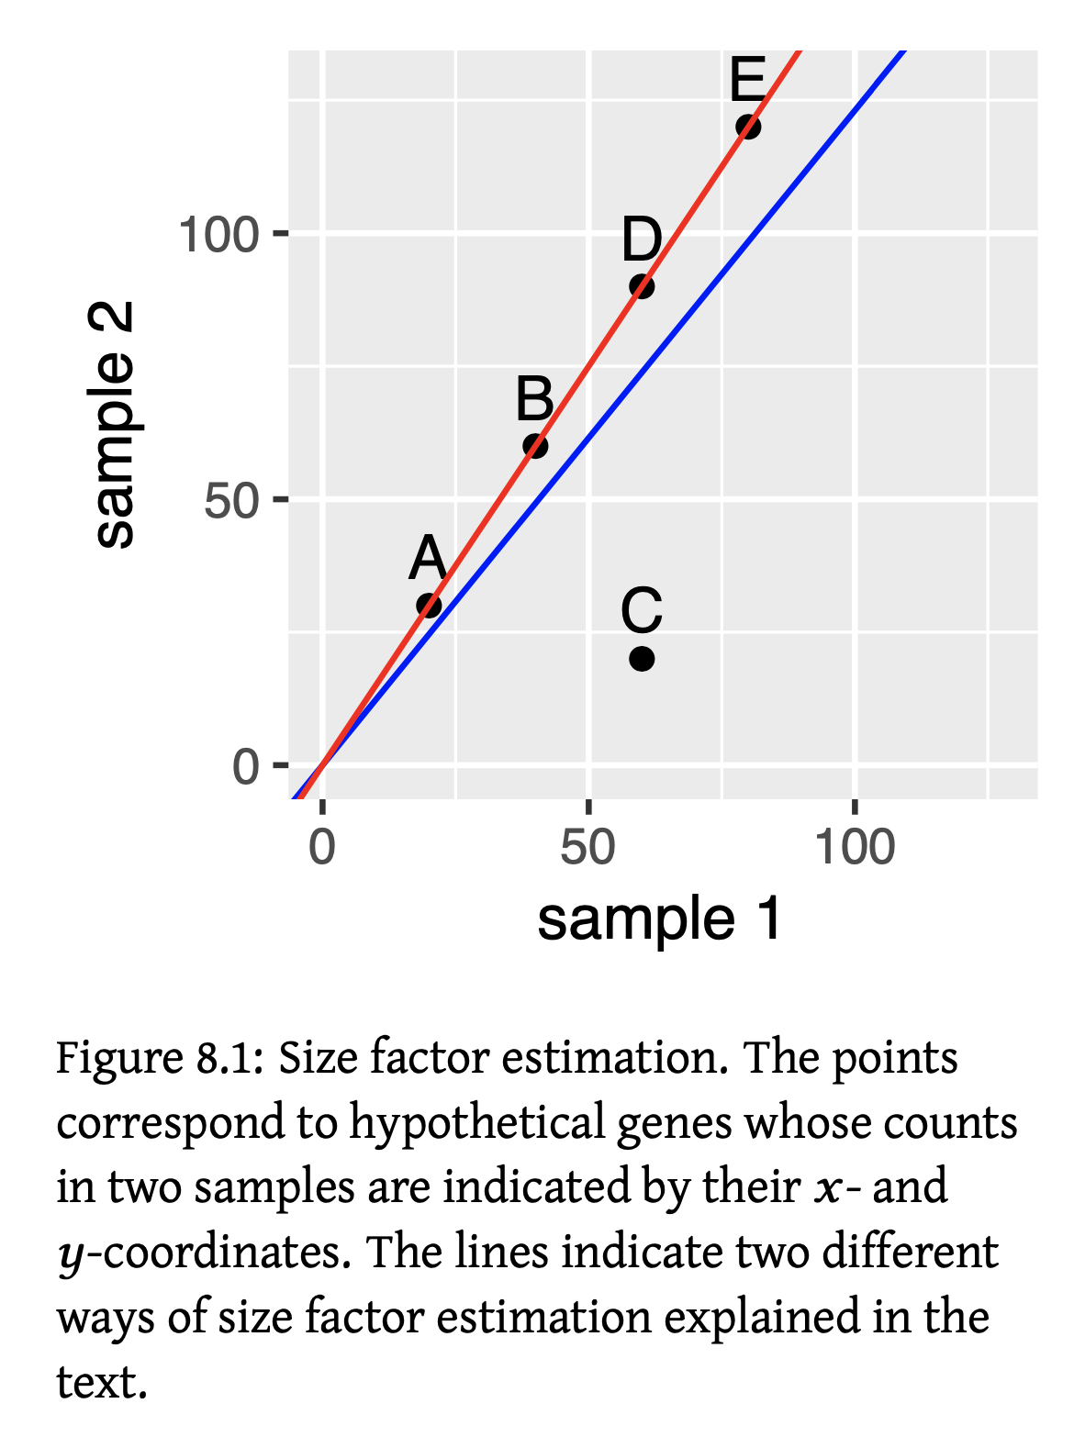
Modeling count data : Normalization
Which points do we need to include to find size factors for normalization?

Slide 19
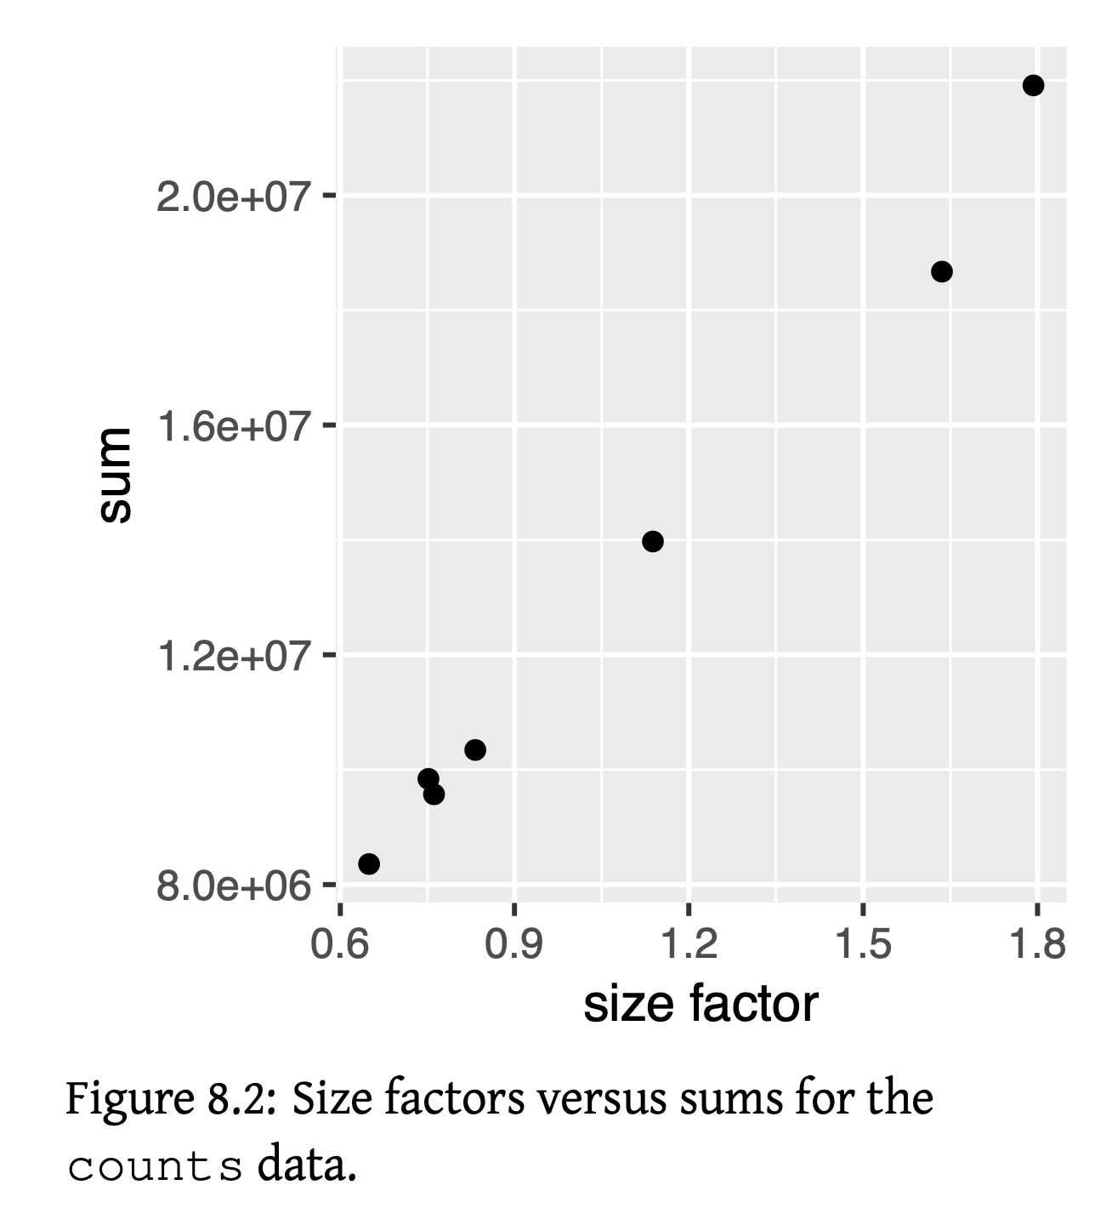
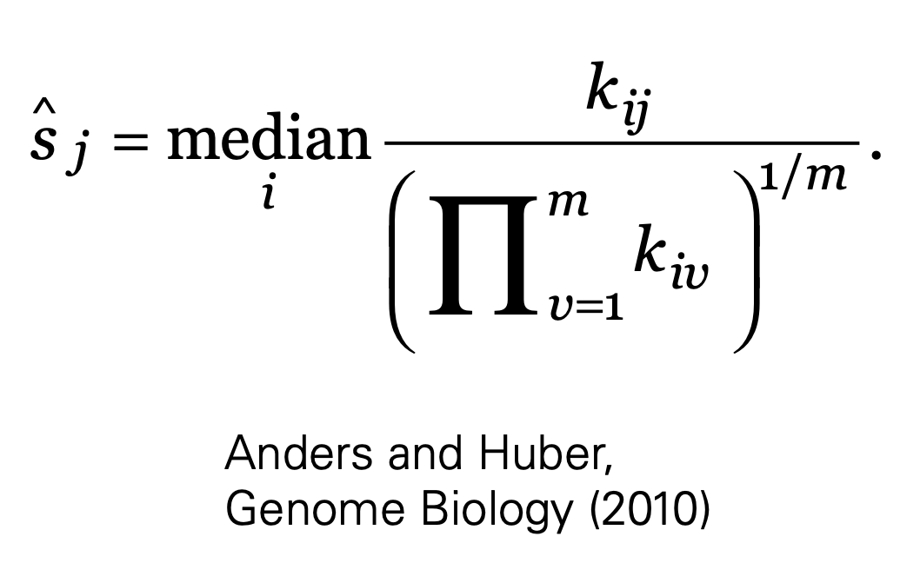
Modeling count data : Normalization

Slide 20
Topic2. Basic analysis using DESeq2

Slide 21
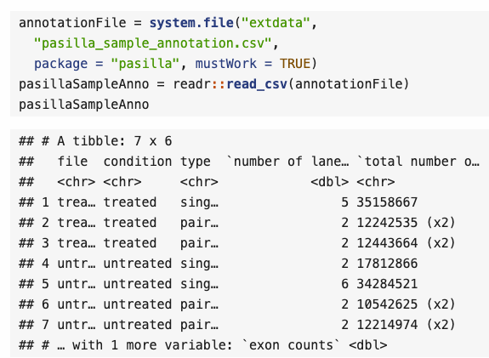
Example dataset: the pasilla data
These data are from an experiment on Drosophila melanogaster cell cultures that investigated the effect of RNAi knock-down of the splicing factor pasilla (Brooks et al. 2011) on the cells’ transcriptome

Slide 22

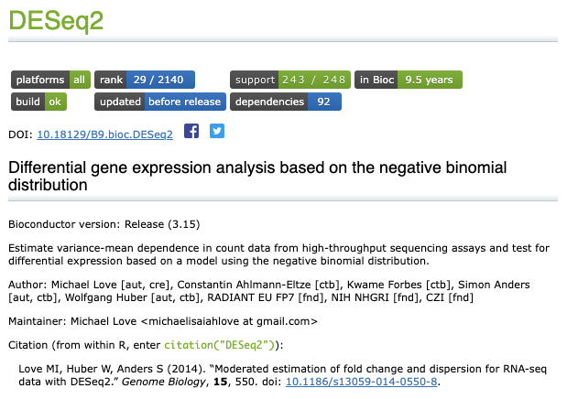

R package to use : DESeq2
Dr. Wolfgang Huber at EMBL, Heidelberg

Slide 23
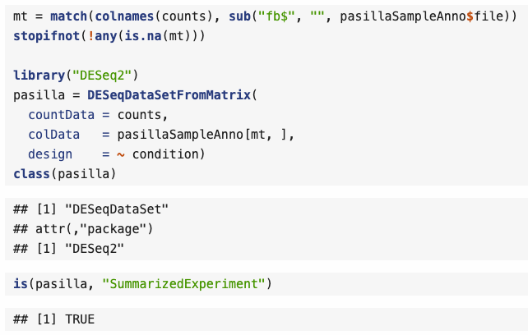
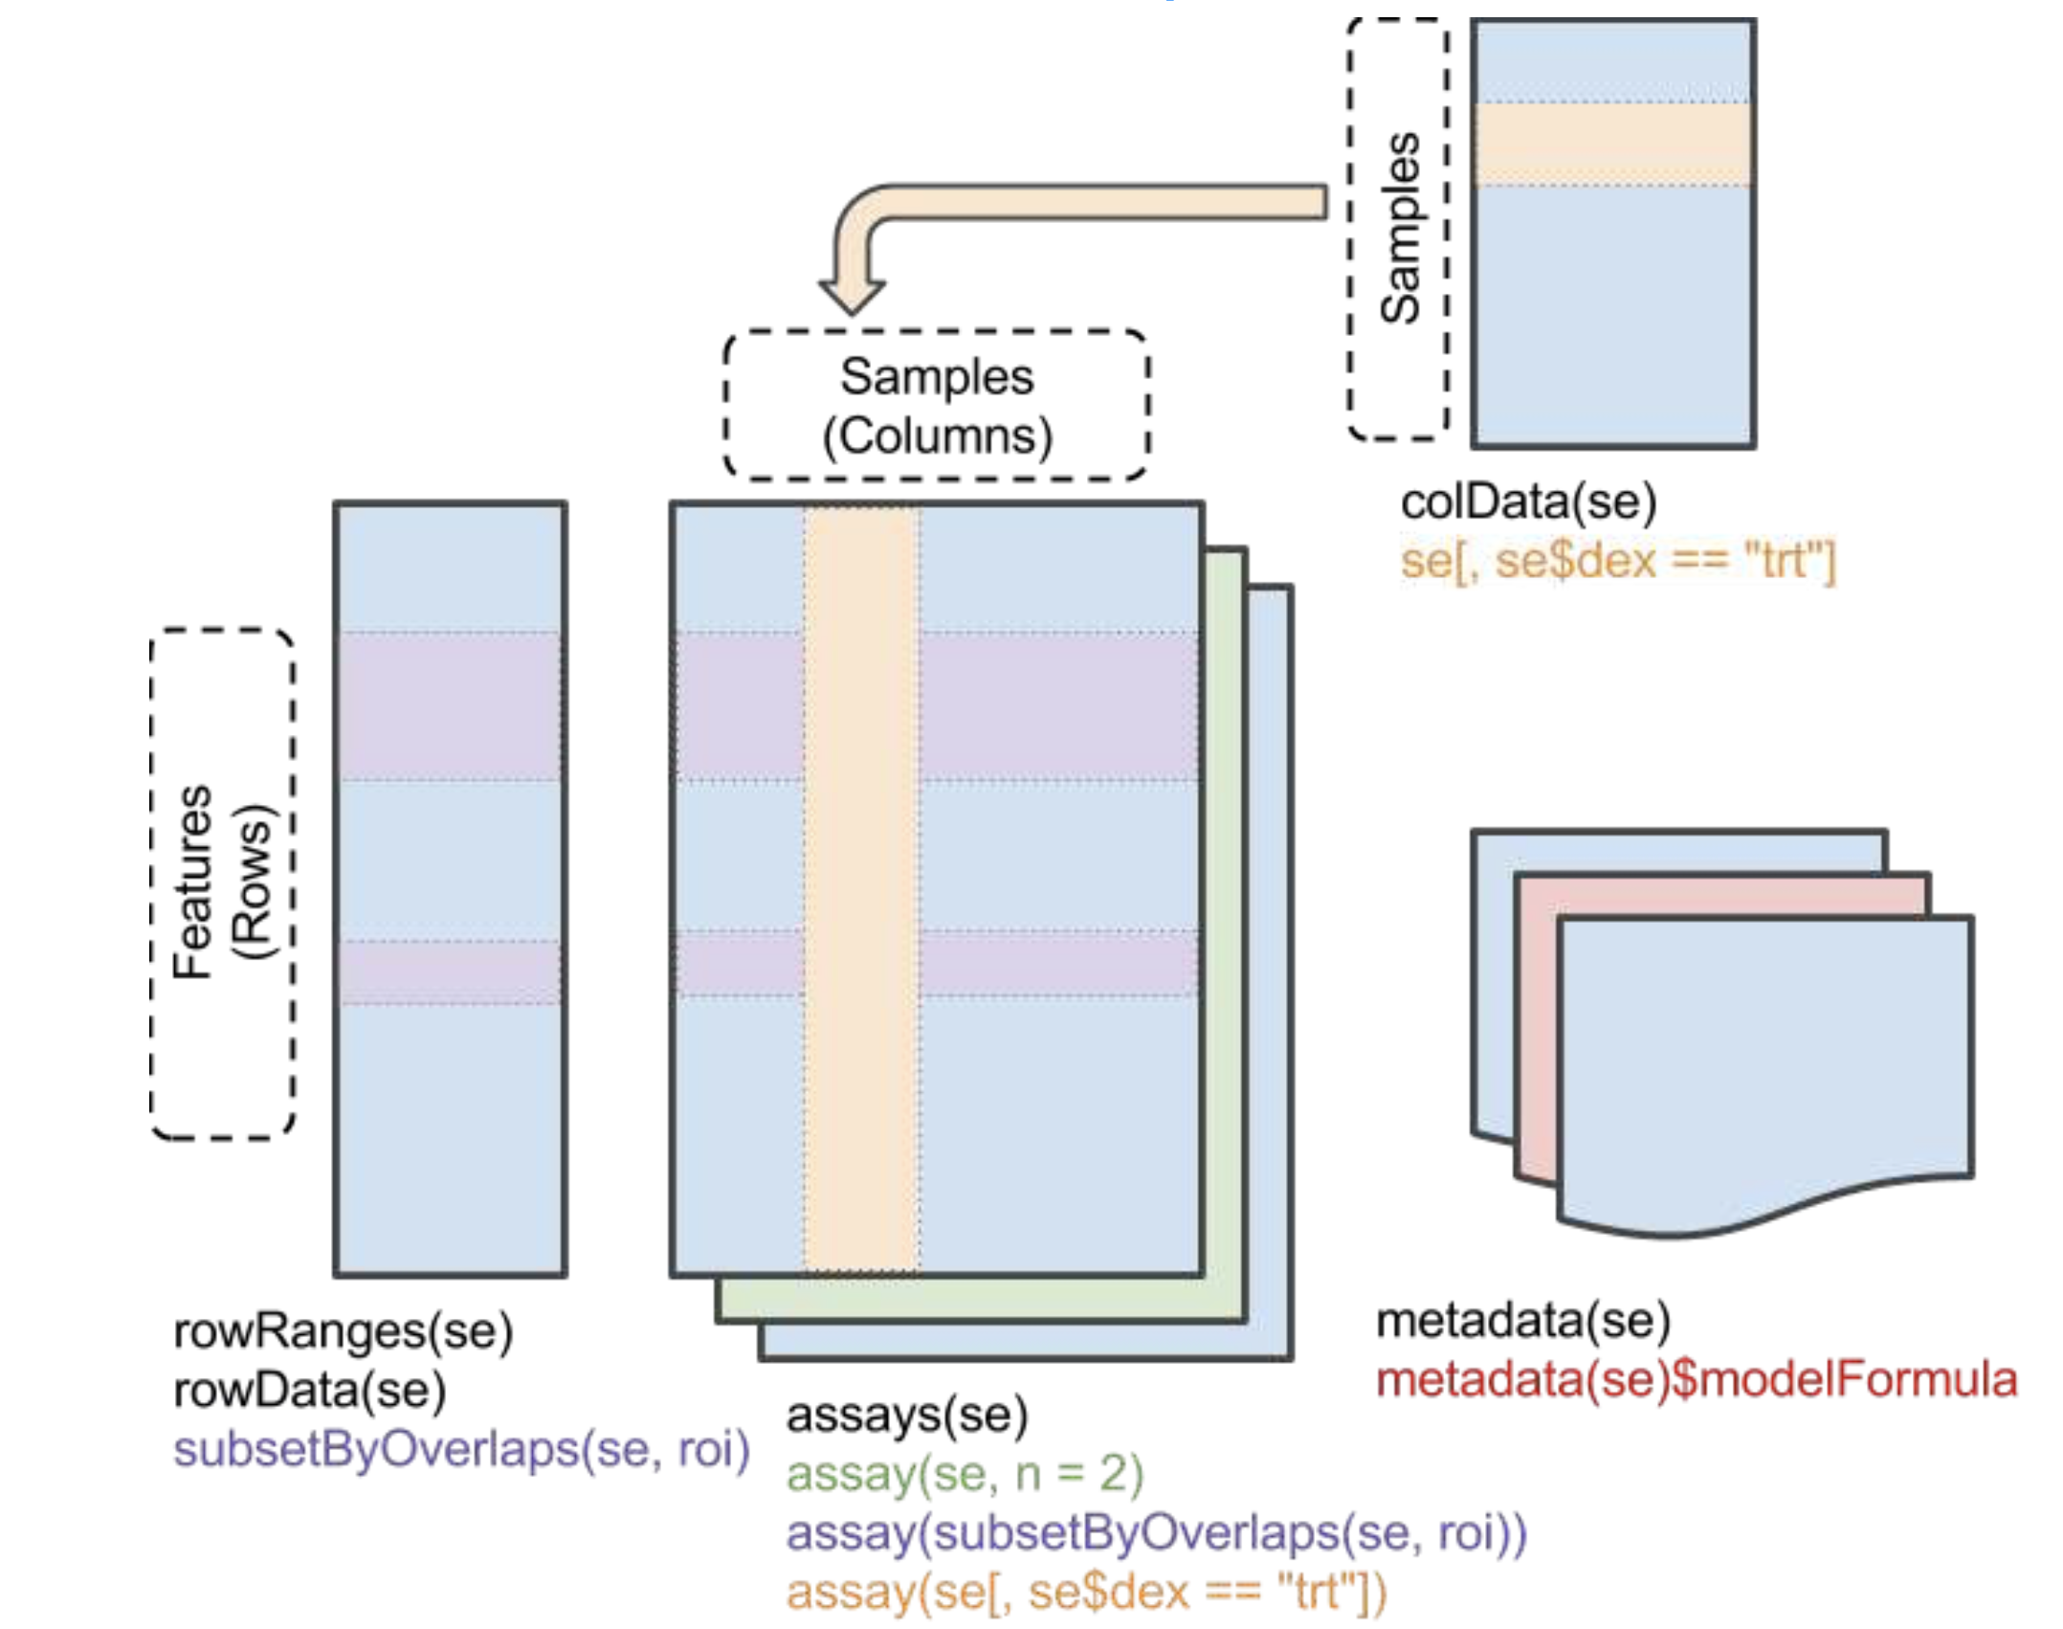
Load the data and create a DESeqDataSet
SummarizedExperiment class

Slide 24

Perform differential expression analysis using DESeq2
Our aim is to identify genes that are differentially abundant between the treated and the untreated cells.
STEP1. estimateSizeFactors (for normalization)
STEP2. estimateDispersions (dispersion estimation)
STEP3. nbinomWaldTest (hypothesis tests for differential abundance)

Slide 25
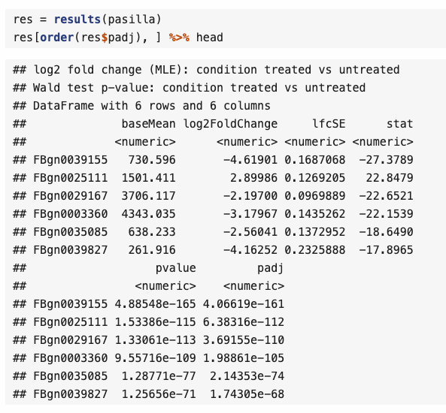
Interpretation of the result from DESeq2

Slide 26
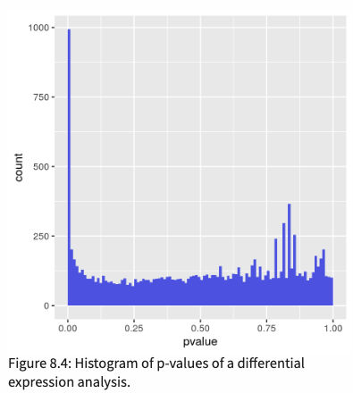
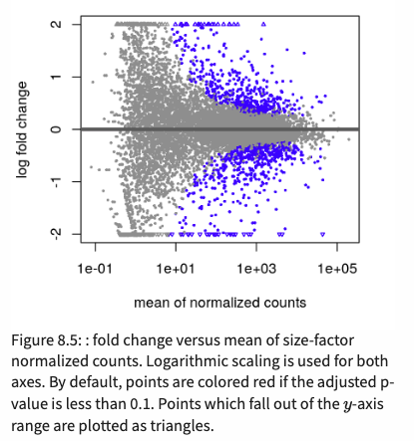
Interpretation in graphic : the histogram of p-values and MA plot

Slide 27
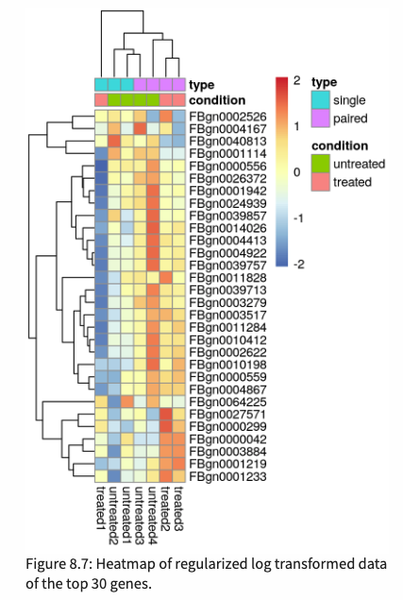
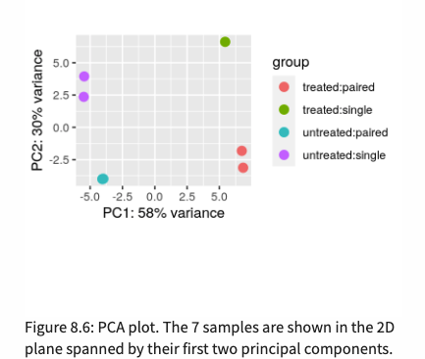
Interpretation in graphic : an ordination plot and a heatmap

Slide 28
Topic3. Multi-factor designs and linear models

Slide 29
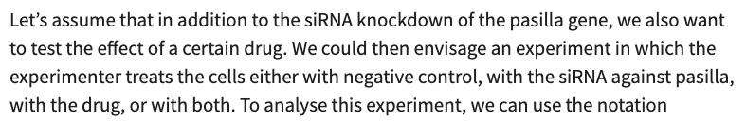

What is a multifactorial design?
Experimental measurement of interest
(expression level of gene)
Experimental measurement of interest
(expression level of gene)
Experimental measurement of interest
(expression level of gene)
For Gene C
For Gene B
Design factor for siRNA
1 : siRNA was transfected
0 : not transfected
Design factor for drug
1 : drug treated
0 : not treated
Design factor for siRNA
1 : siRNA was transfected
0 : not transfected
Design factor for drug
1 : drug treated
0 : not treated
For Gene A
Design factor for siRNA
1 : siRNA was transfected
0 : not transfected
Design factor for drug
1 : drug treated
0 : not treated

Slide 30
What is a multifactorial design?
Experimental measurement of interest
(expression level of gene)
Experimental measurement of interest
(expression level of gene)
Experimental measurement of interest
(expression level of gene)
What is this?
For Gene C
For Gene B
Design factor for siRNA
1 : siRNA was transfected
0 : not transfected
Design factor for drug
1 : drug treated
0 : not treated
Design factor for siRNA
1 : siRNA was transfected
0 : not transfected
Design factor for drug
1 : drug treated
0 : not treated
For Gene A
Design factor for siRNA
1 : siRNA was transfected
0 : not transfected
Design factor for drug
1 : drug treated
0 : not treated

Slide 31
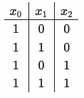
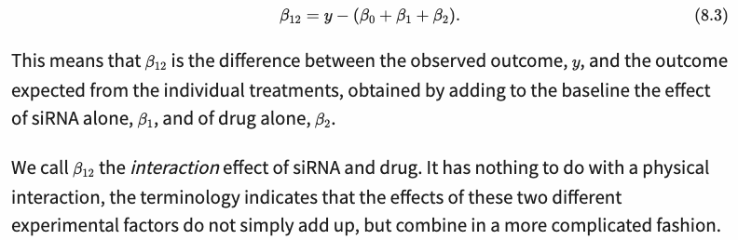
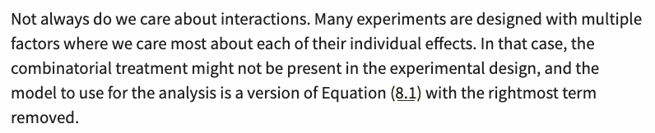
design matrix (DESeq2)
Interaction effect of siRNA and drug
If x1 = 1, and x2 = 1

Slide 32
What about noise and replicates?
Of course, we usually wish to analyze real data that are affected by noise. We then need replicates to estimate the levels of noise and assess the uncertainty of our estimated βs. Only then we can empirically assess whether any of the observed changes between conditions are significantly larger than those occuring just due to experimental or natural variation. We need to slightly extend the equation,
βs represent the average effects of each of the experimental factors,
residuals εj reflect the experimental fluctuations around the mean between the replicates.
This approach is called the least sum of squares fitting
it can achieved by straightforward matrix algebra (It is what the R function lm does.)

Slide 33
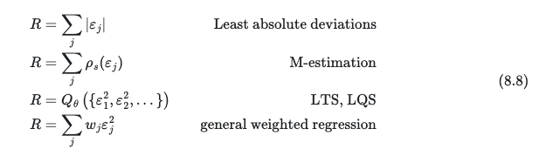
Robustness
Sensitive to outlier data
Robust to outlier data
presumably down-weighting outliers

Slide 34
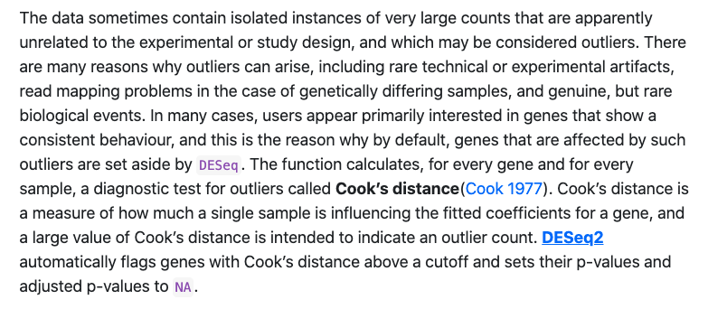
Dealing with outliers

Slide 35



Generalized linear models : concepts
This would not directly be useful for modelling outcomes bounded within [0,1] (e.g. indicator of disease risk)
However, if we transform the expression with a sigmoid function, then the range of this function is bounded between 0 and 1
This criterion can be derived from a specific probabilistic model and the maximum likelihood principle.

Slide 36
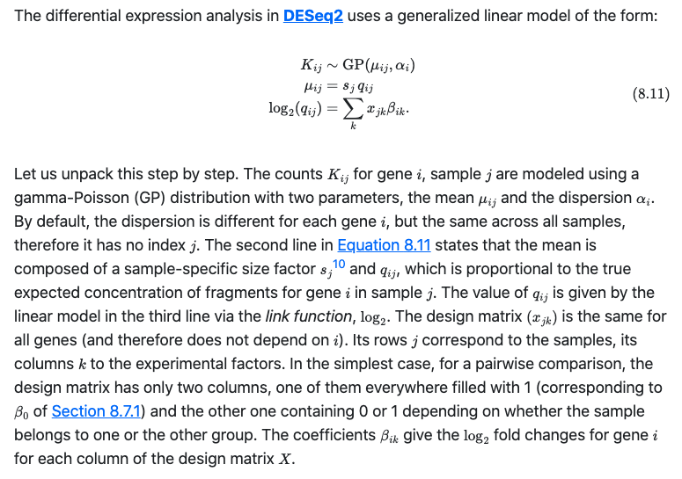
Generalized linear models for count data

Slide 37
Topic4. Two-factor analysis of the real data

Slide 38
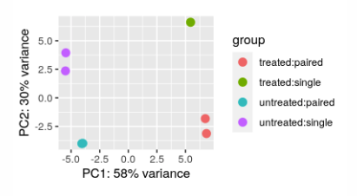
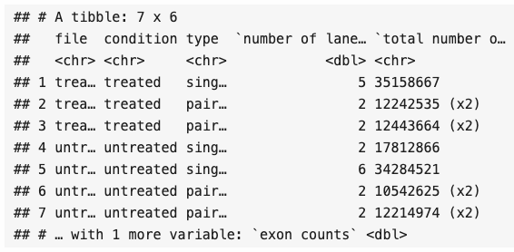
Sequencing type is taking into account in the differential expression analysis
Besides the treatment with siRNA, which we have already considered in Section 8.5, the pasilla data have another covariate, type, which indicates the type of sequencing that was performed.
We saw in the exploratory data analysis (EDA) plots in Section 8.5.3 that the latter had a considerable systematic effect on the data. Our basic analysis of Section 8.5 did not take this account, but we will do so now. This should help us get a more correct picture of which differences in the data are attributable to the treatment, and which are confounded – or masked – by the sequencing type.

Slide 39

How to take into account ‘sequencing type’ in the DE analysis?
Default DESeq2 analysis in Topic 3.
Blocking factor
(sequencing type)
primary interest
(siRNA treatment)
Two-factor DESeq2 analysis
What do we gain from this more sophisticated two-factor analysis?

Slide 40
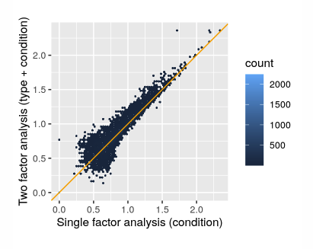
Two-factor analysis increases the statistical power
The two-factor analysis found 1325 genes differentially expressed at an FDR threshold of 10%, while the one-factor analysis found 1061. The two-factor analysis has increased detection power. In general, the gain can be even much larger, or also smaller, depending on the data. The proper choice of the model requires informed adaptation to the experimental design and data quality.

Slide 41
Thank you for your attention!

