Slide 1
Chapter 5. Clustering
Junseob Han
Date : 2022-07-25

Slide 2
5.1 Goals for this chapter
Study the different types of data that can be beneficially clustered.
See measures of (dis)similarity and distances that help us define clusters.
Uncover hidden or latent clustering by partitioning the data into tighter sets.
Use clustering when given biomarkers on each of hundreds of thousands of cells. We’ll see that for instance immune cells can be naturally grouped into tight subpopulations.
Run nonparametric algorithm such as k-means, k-medoids on real single cell data.
Experiment with recursive approaches to clustering that combine observations and groups into a hierarchy of sets; these methods are known as hierarchical clustering.
Study how to validate clusters through resampling-based bootstrap approaches, which we will demonstrate on a single-cell dataset

Slide 3
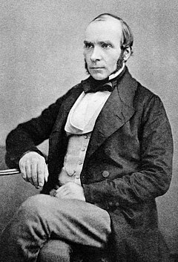
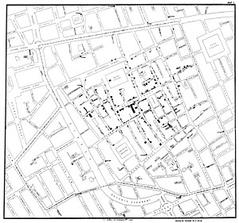
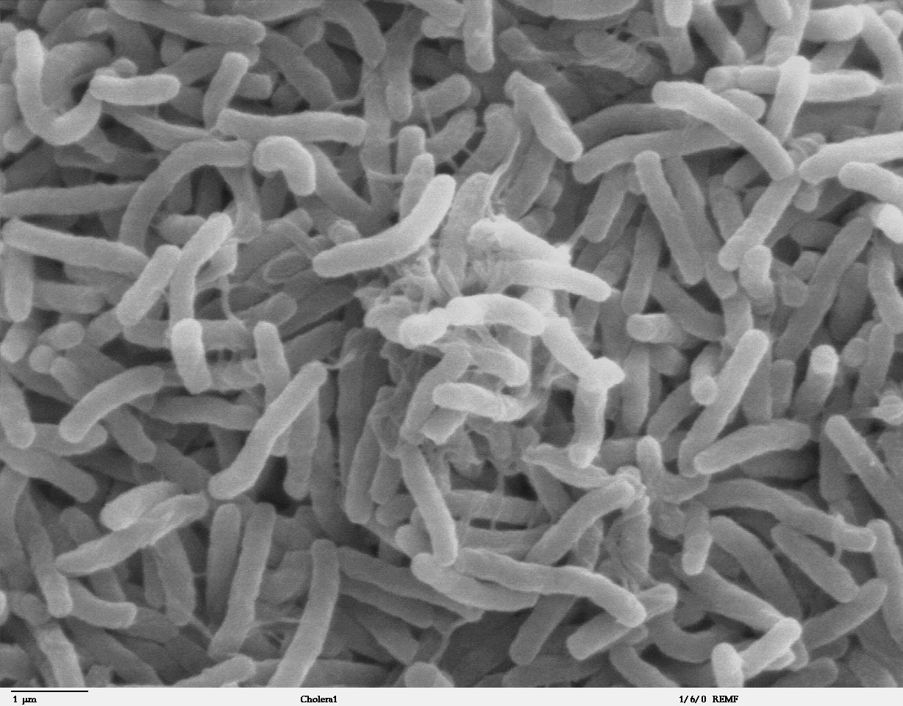
5.2 What are the data and why do we cluster them?
5.2.1 Clustering can sometimes lead to discoveries
John Snow (1813.3.15~1858.6.16)
Sewage-polluted sections of the Thames
From: https://en.wikipedia.org/wiki/John_Snow

Slide 4
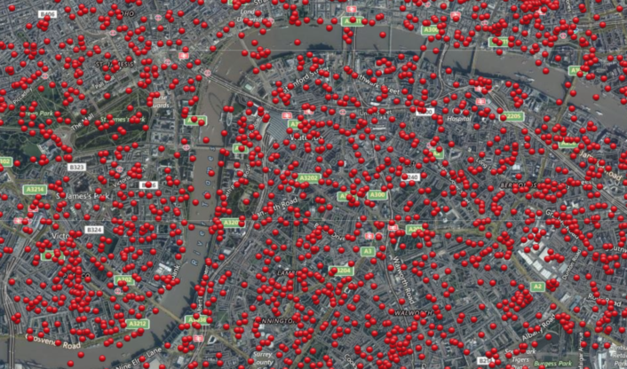
5.2 What are the data and why do we cluster them?
5.2.1 Clustering can sometimes lead to discoveries
The bombings were randomly distributed without any attempt at hitting particular targets

Slide 5
5.2 What are the data and why do we cluster them?

Slide 6
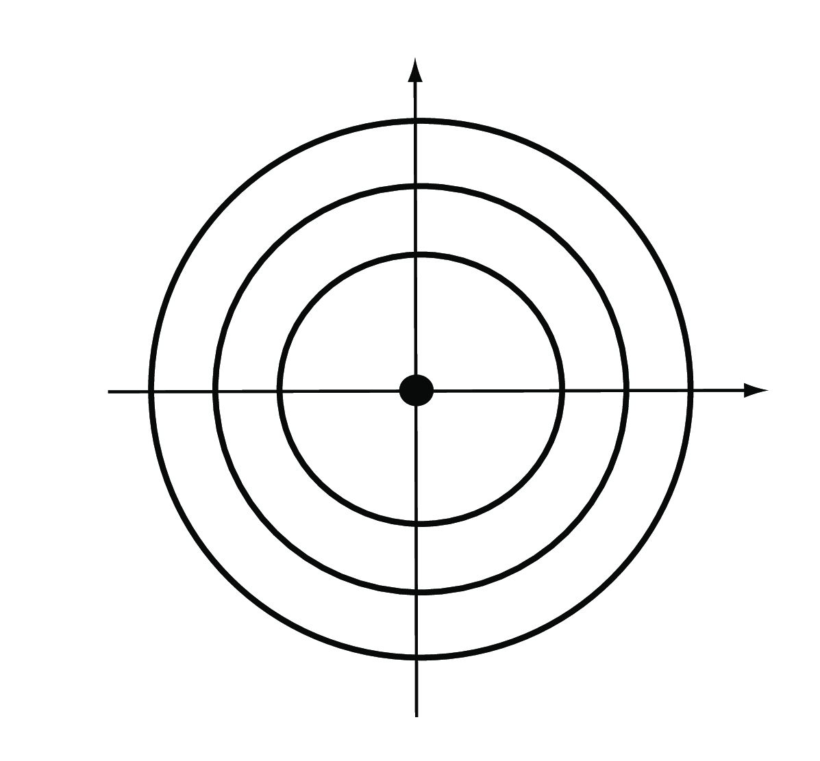
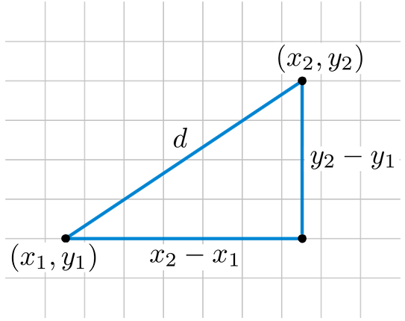
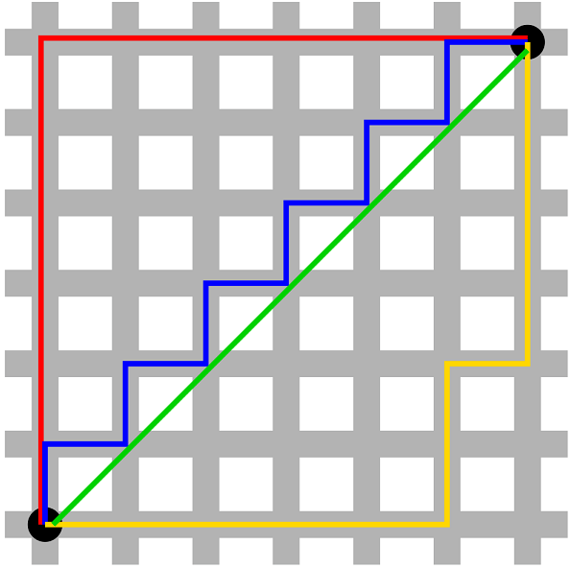
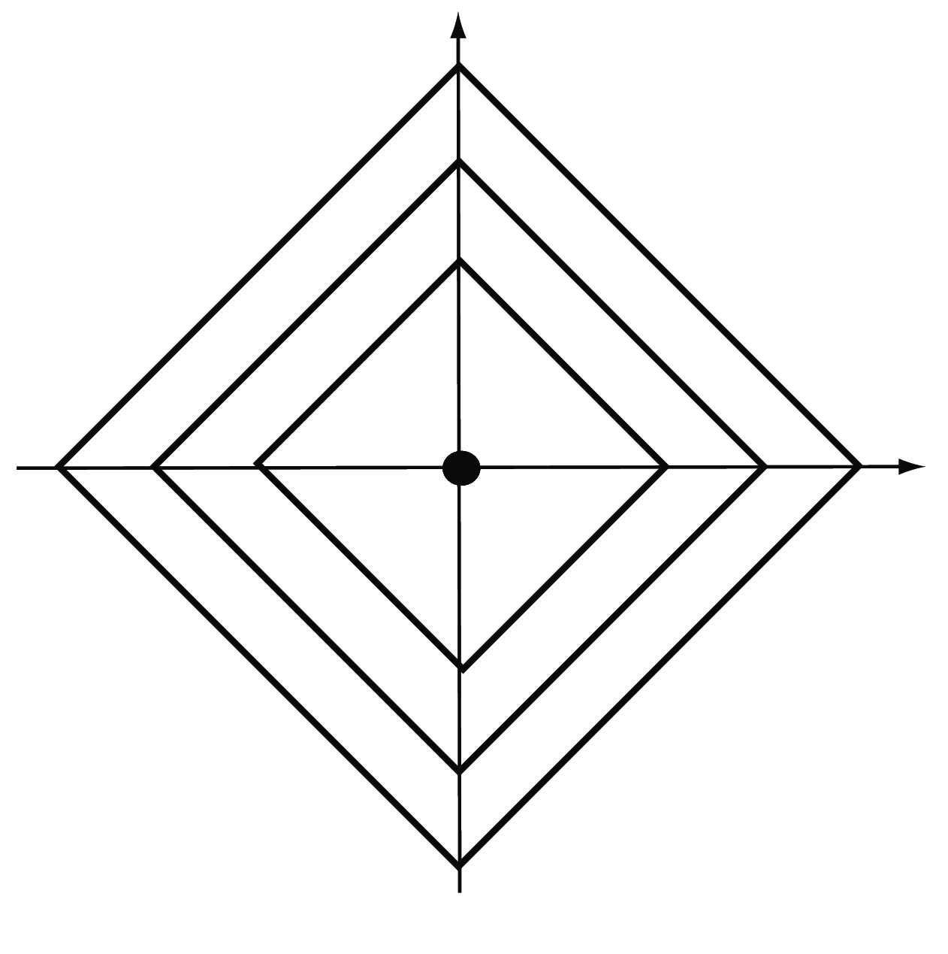
5.3 How do we measure similarity?
Euclidean distance
Manhattan distance
From: https://needjarvis.tistory.com/454
Notes:
호환성: k-nearest neighbor, clustering algorithm, dimensionality reduction과 같이 호환되는 것들이 있음.

Slide 7
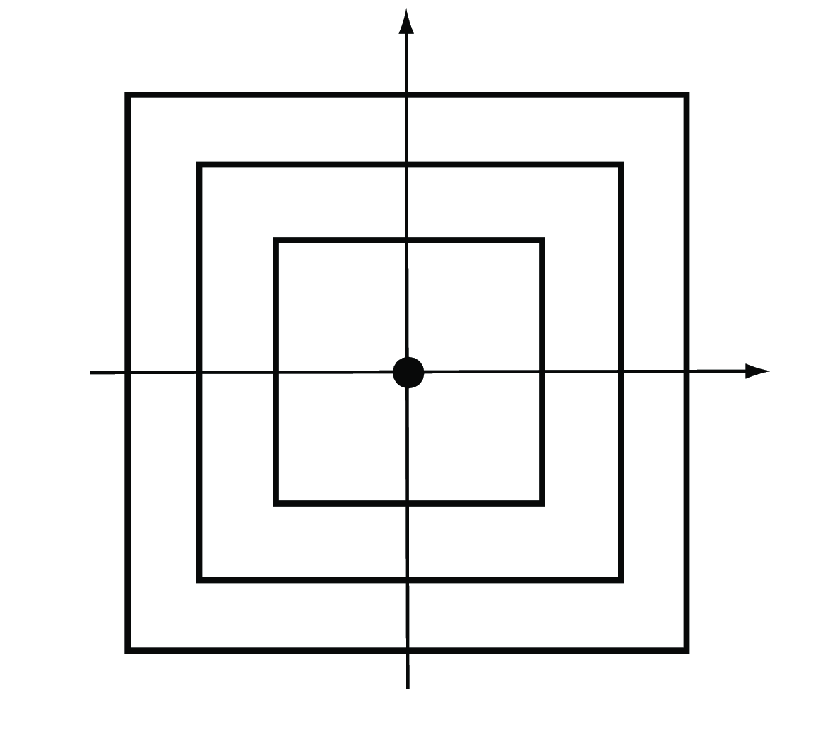
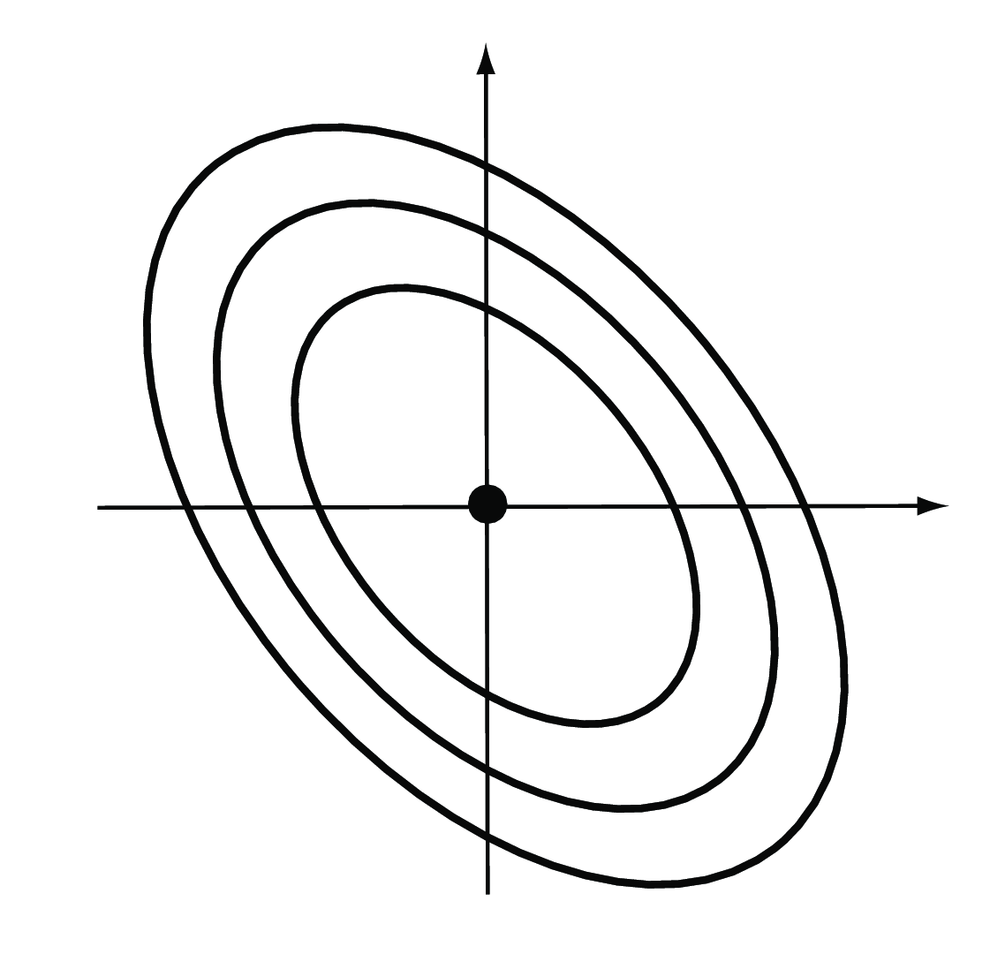
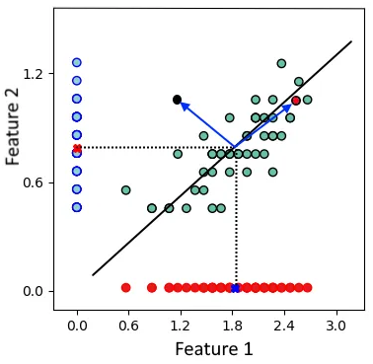
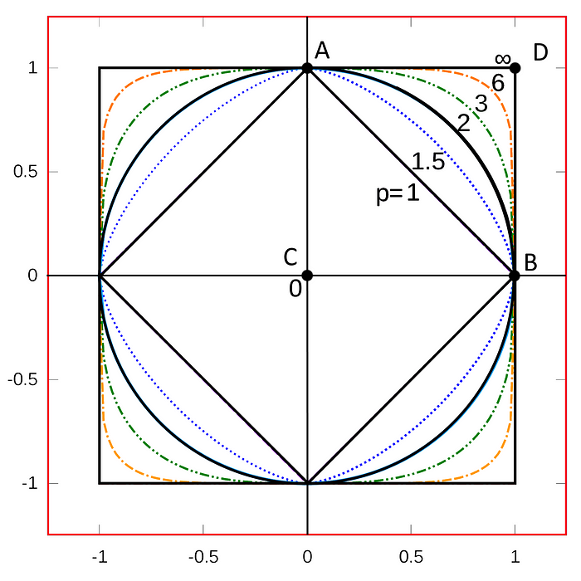
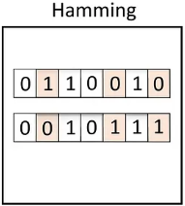
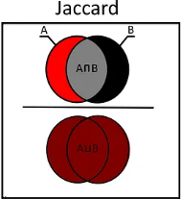
5.3 How do we measure similarity?
Maximum distance
Weighted Euclidean distance
→ Mahalanobis distance
Minkowski distance
From: https://towardsdatascience.com/17-types-of-similarity-and-dissimilarity-measures-used-in-data-science-3eb914d2681

Slide 8
5.3 How do we measure similarity?
5.3.1 Computations related to distances in R

Slide 9
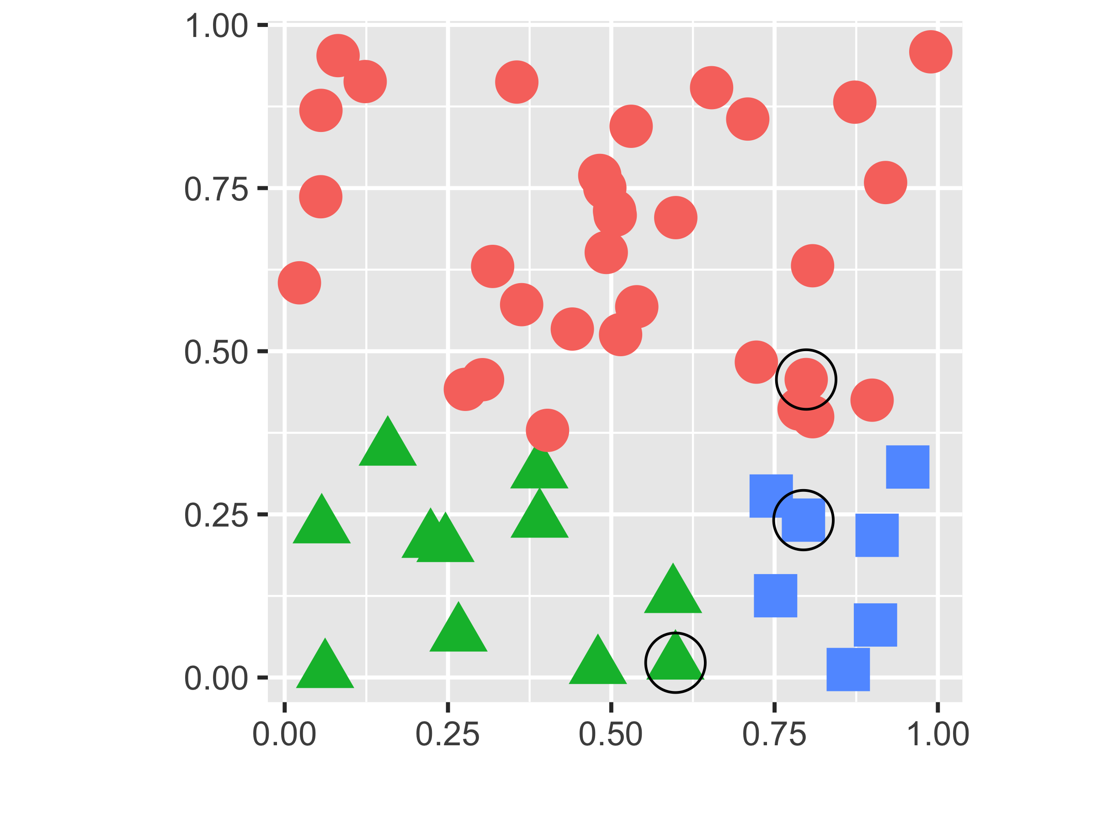
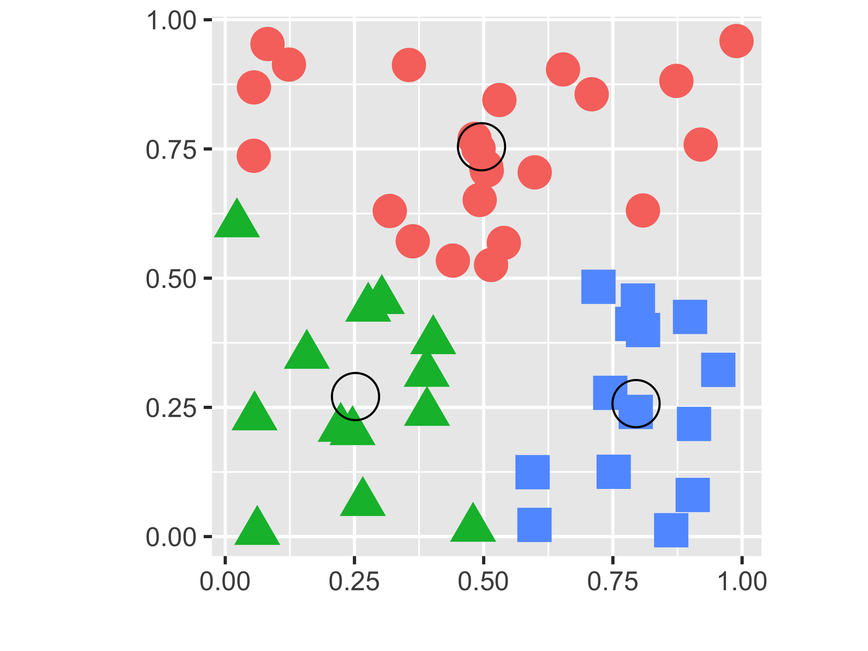
5.4 Nonparametric mixture detection
5.4.1 k-methods: k-means, k-medoids and PAM
k-medoid (PAM (Partitioning Around Medoid)) & k-mean
Starts from a matrix of p features measured on a set of n observations.
Randomly pick k distinct cluster centers out of the n observations (“seeds”).
Assign each of the remaining observations to the group to whose center it is the closet.
For each group, choose a new center from the observations in the group, such that the sum of the distances of group members to the center is minimal; this is called the medoid. ( → k-mean uses centers of gravity)
Repeat Steps 3 and 4 until the groups stabilize.

Slide 10
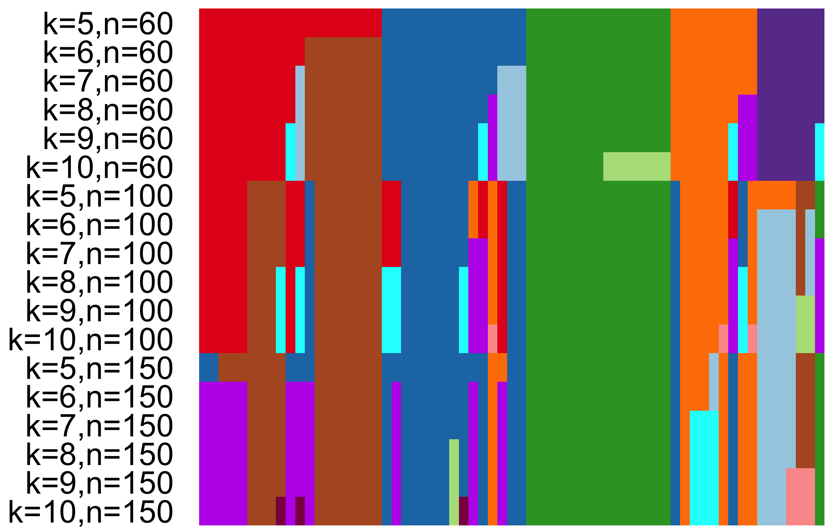
5.4 Nonparametric mixture detection
5.4.2 Tight clusters with resampling
Resampling
For a better choice of the number of clusters
Strong form: create by repeating a clustering procedure multiple times on the same data, but with different starting points
Tight cluster: repeated subsampling of the dataset and applying a clustering method will result in groups of observations that are “almost always” grouped together
Notes:
Strong form: 시작점이 다르게 하고, 동일한 data에 대해 clustering procedure를 여러 번 반복하는 것.
Tight cluster: Dataset의 subsampling을 반복하고 clustering 방법을 적용하면 "거의 항상" 함께 그룹화된 관찰 그룹이 생성

Slide 11
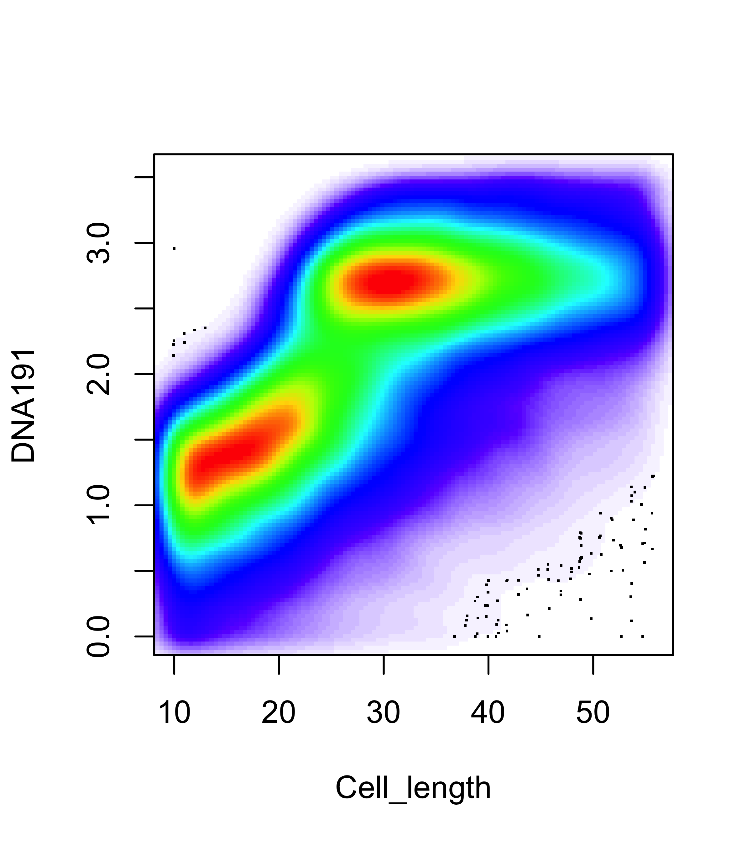
5.5 Clustering examples: flow cytometry and mass cytometry
5.5.1 Flow cytometry and mass cytometry
CD4 flow cytometry result data
Notes:
2차원 plotting하면 cell을 subpopulation으로 group화할 수 있음을 볼 수 있음. 때로는 marker 중 하나만 사용하여 자체적인 population를 정의가 가능.

Slide 12
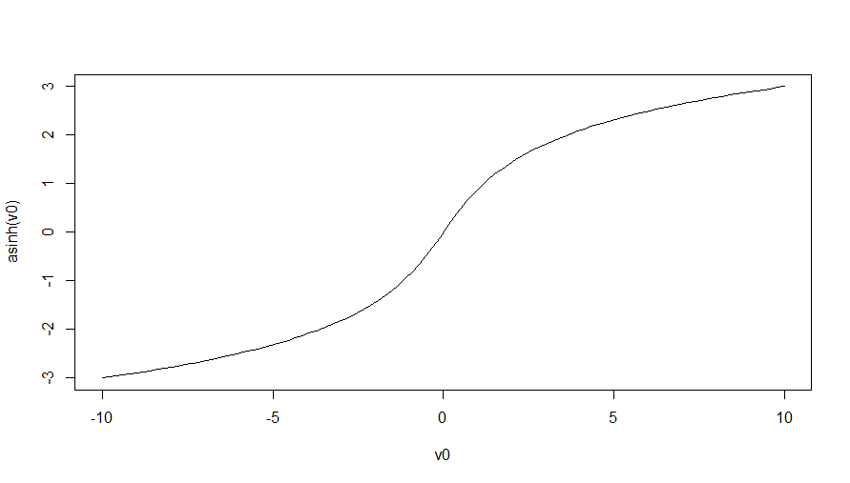
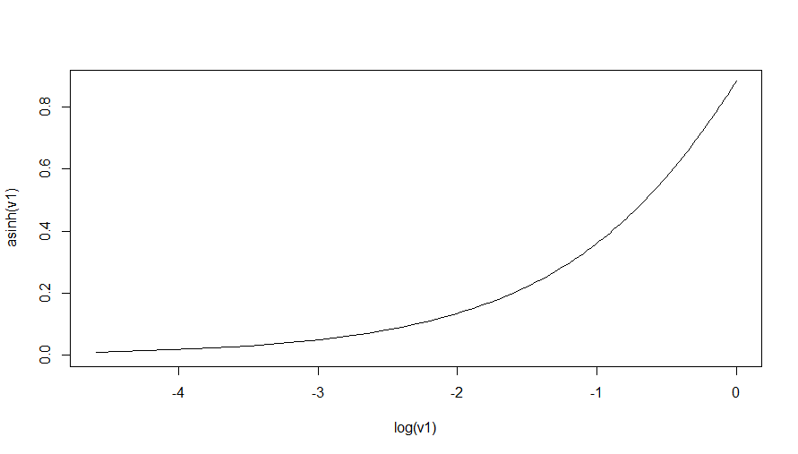
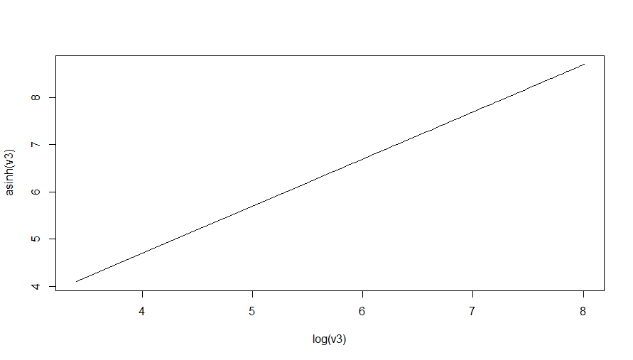
5.5 Clustering examples: flow cytometry and mass cytometry
5.5.2 Data preprocessing
Rectangular gating is used to separate the populations

Slide 13
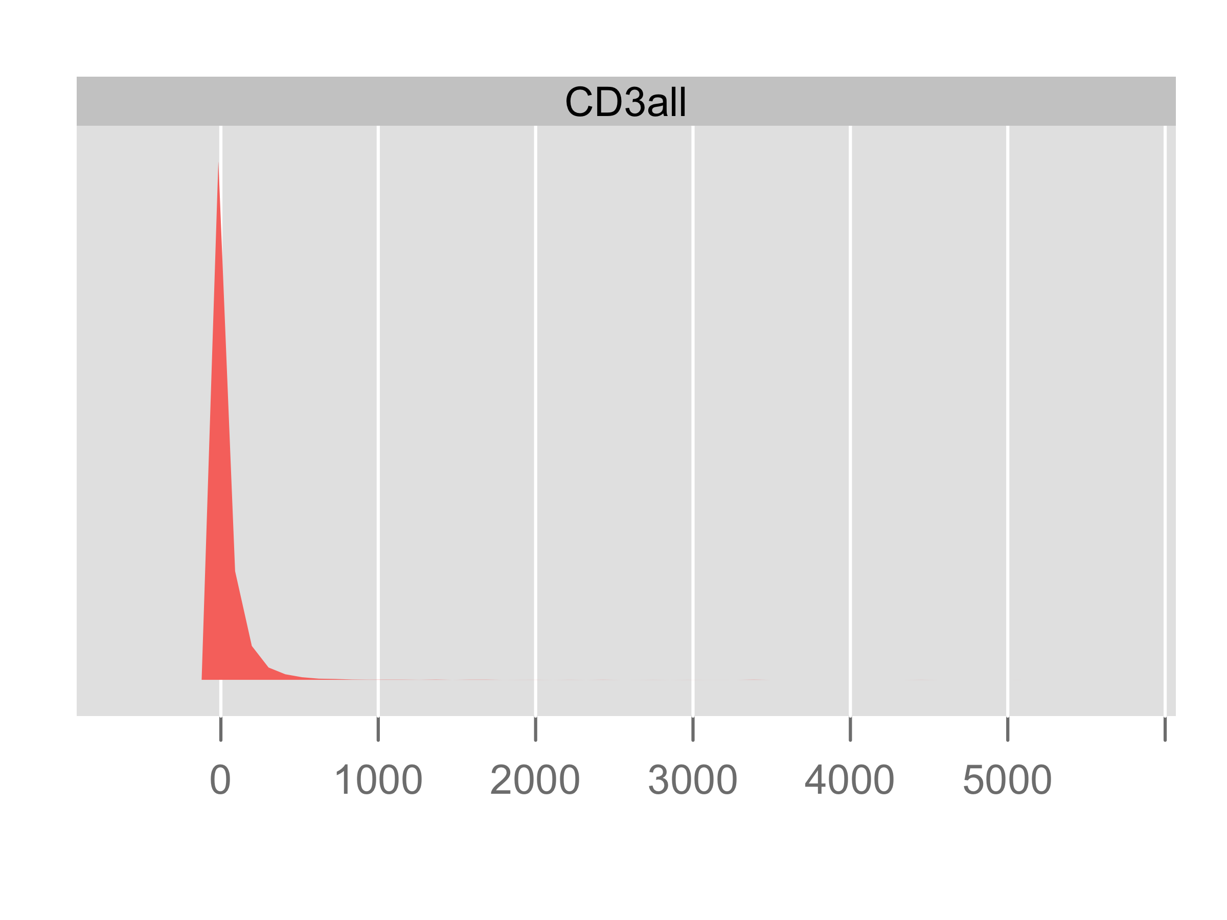
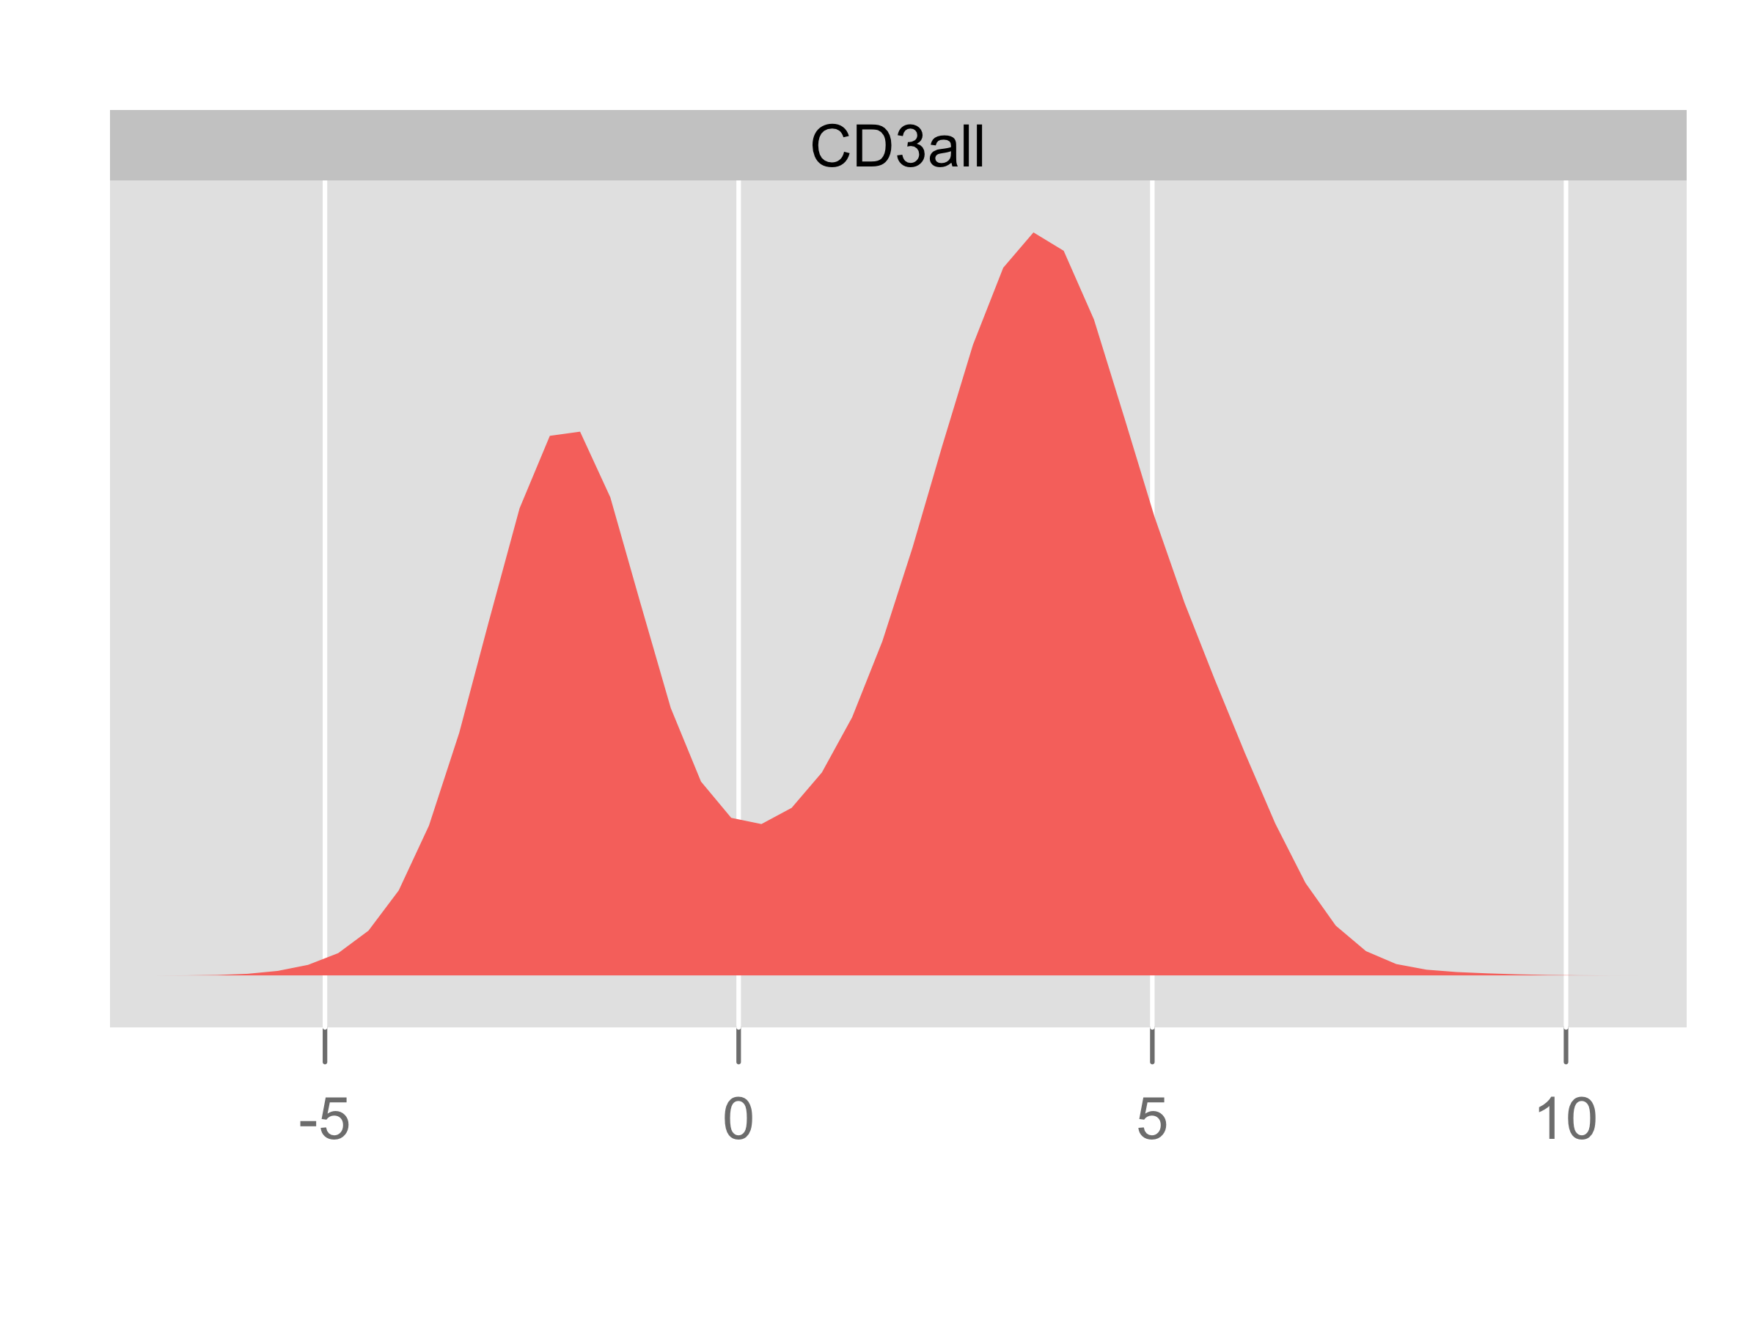
5.5 Clustering examples: flow cytometry and mass cytometry
5.5.2 Data preprocessing
Notes:
arcsinhTransform의 a,b는 hyperparameter로 a는 log의 밑 수 b는 배율

Slide 14
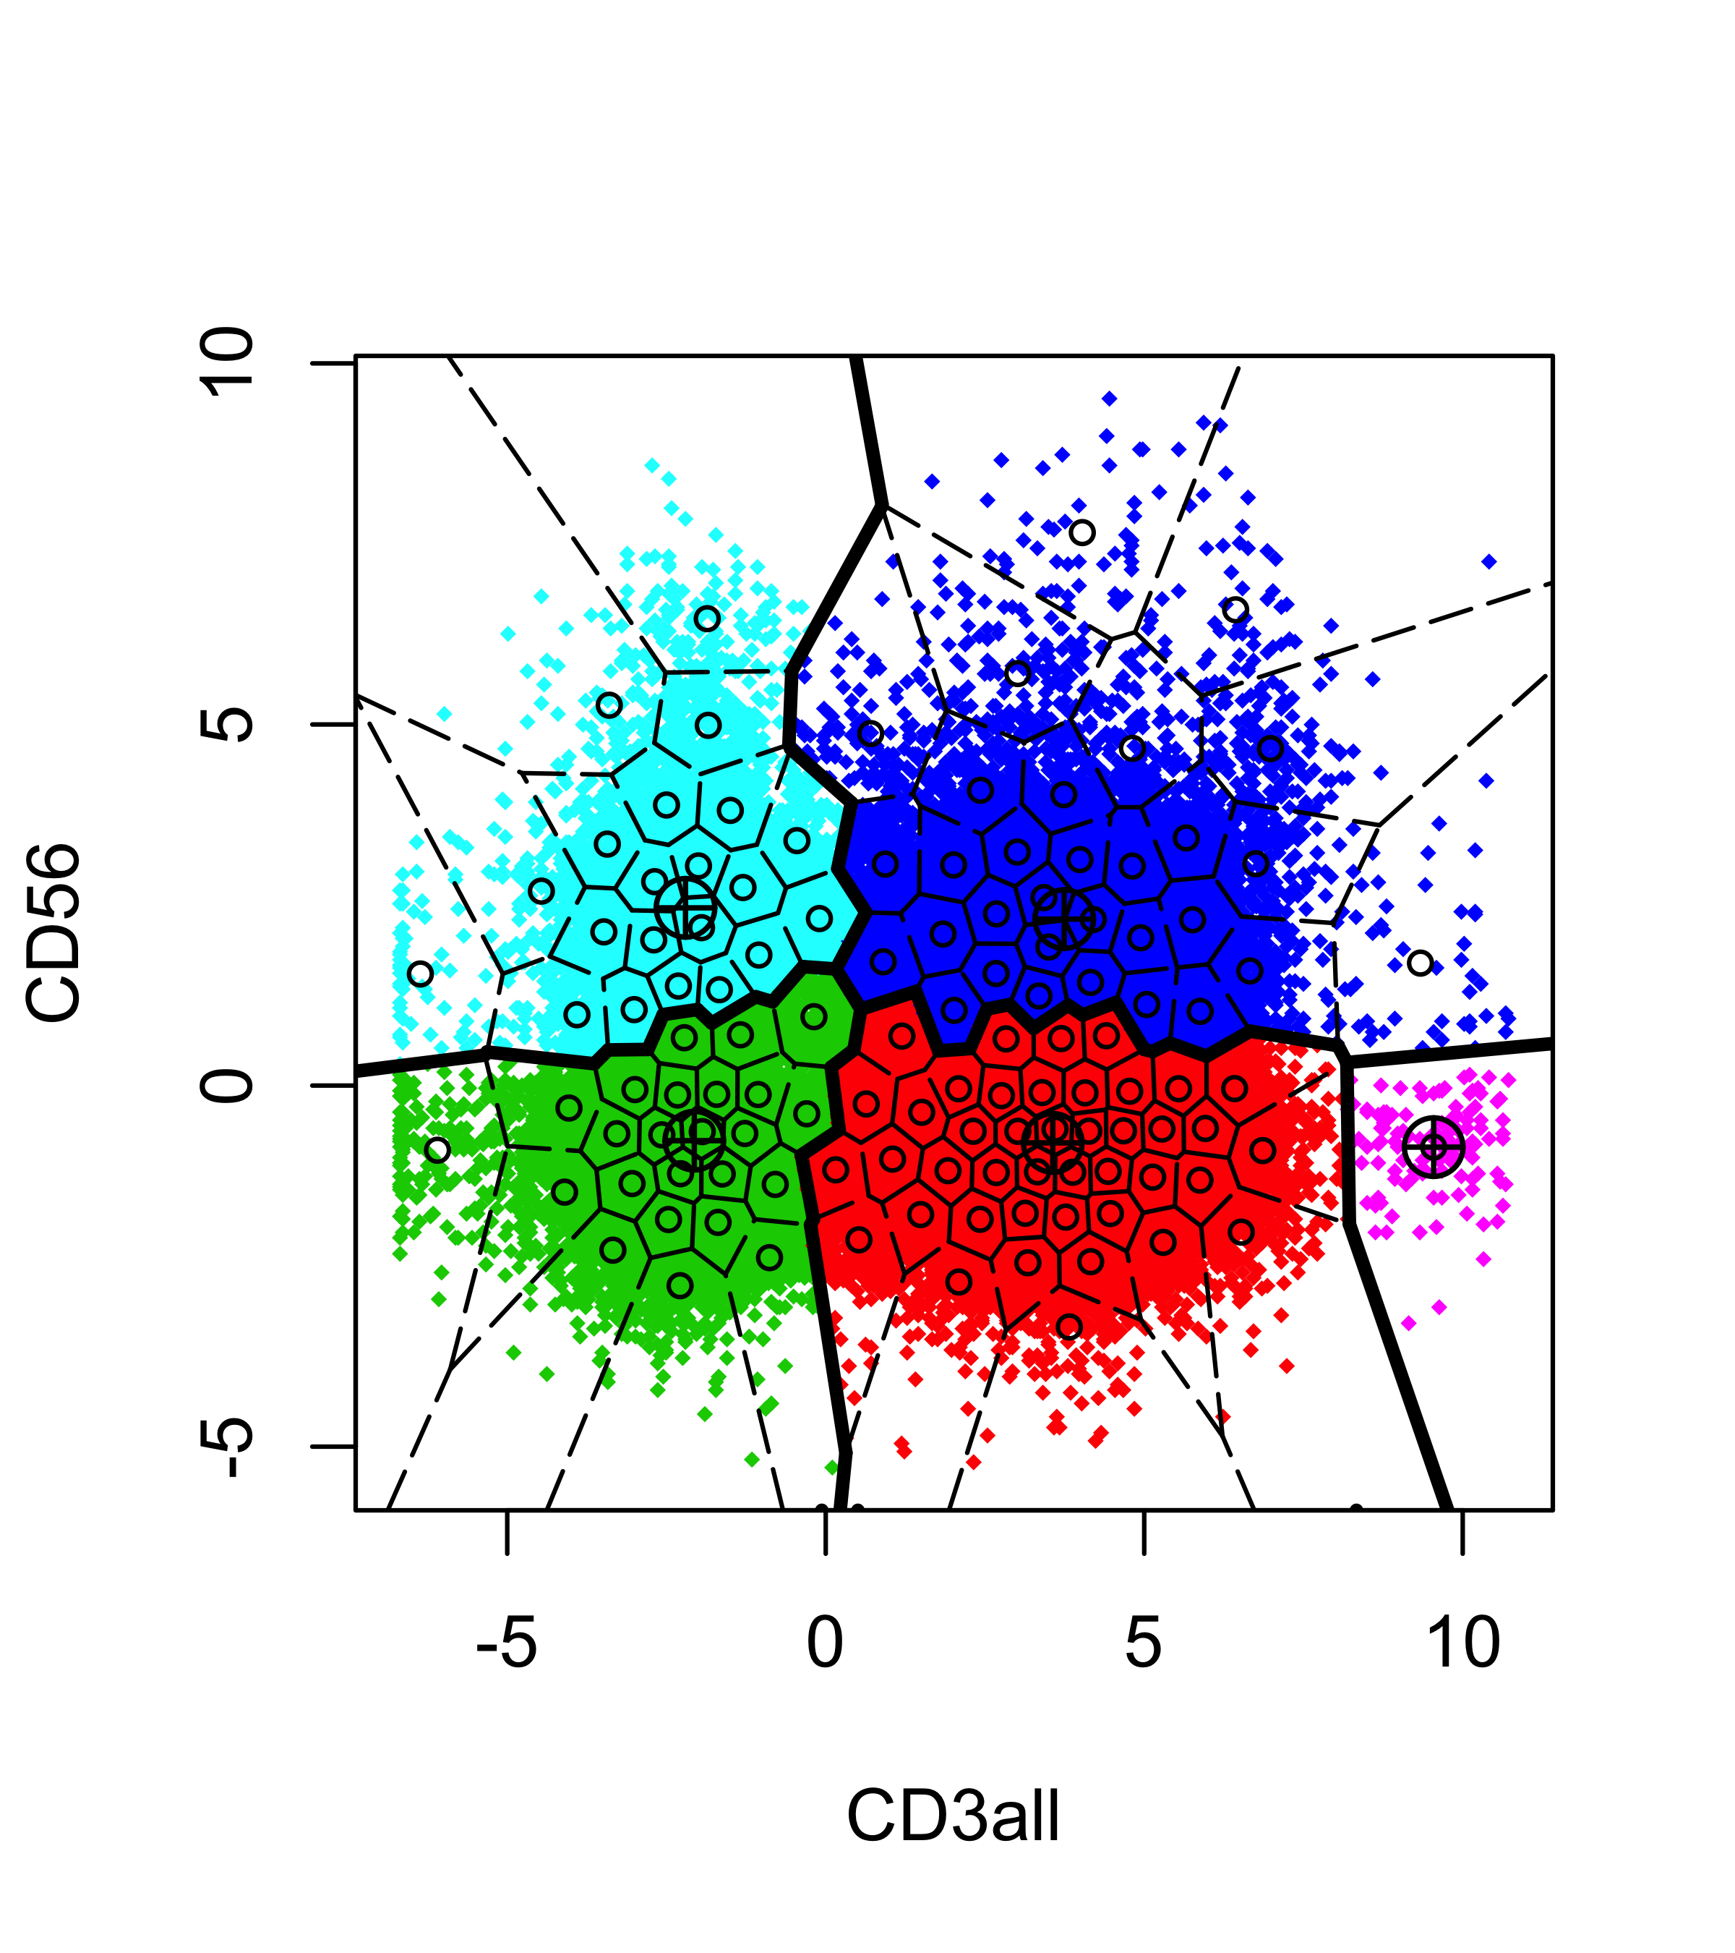
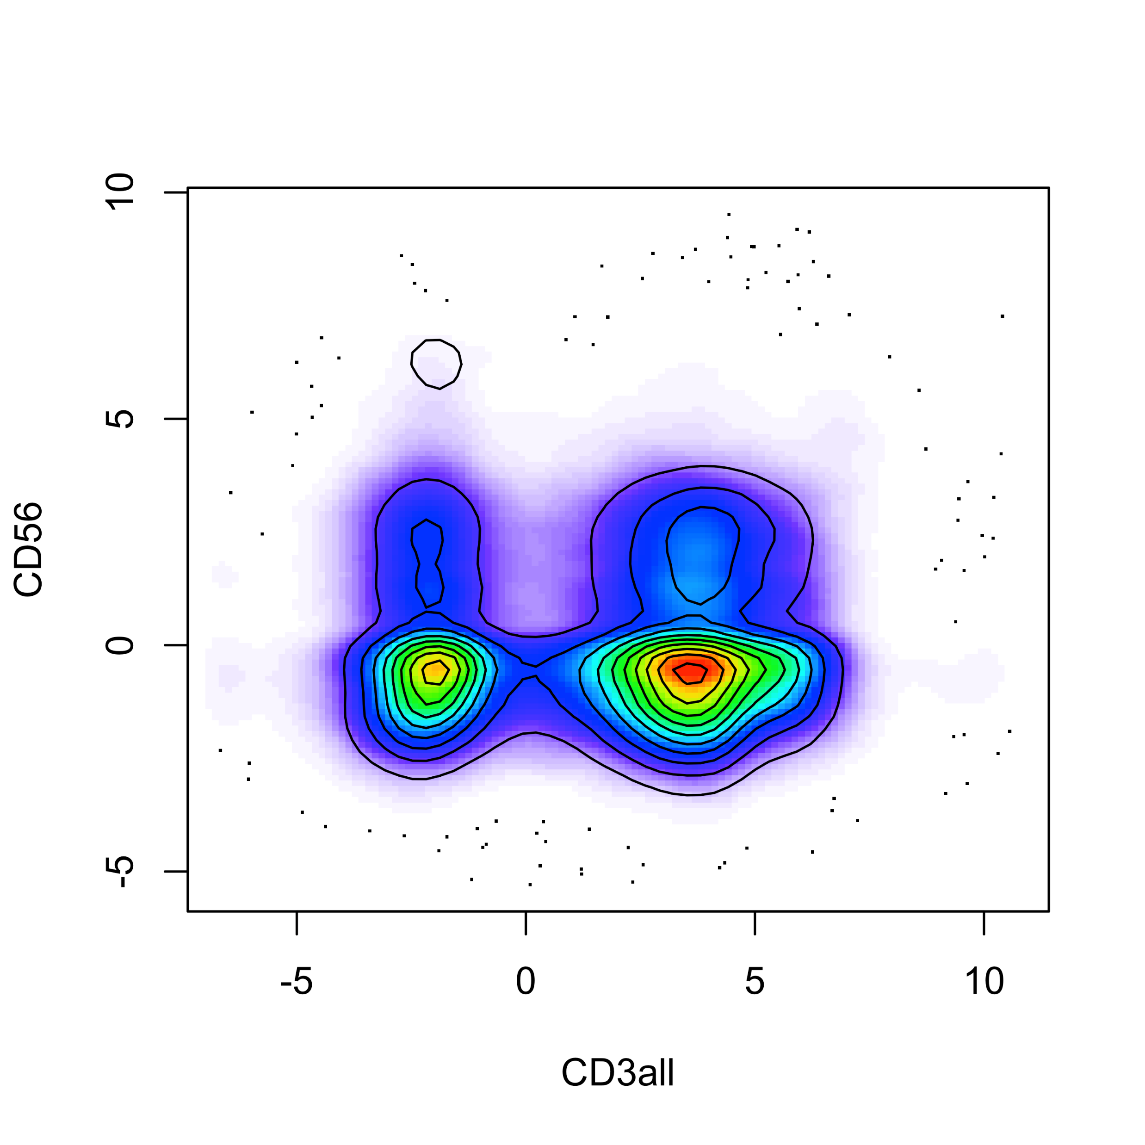
5.5 Clustering examples: flow cytometry and mass cytometry
5.5.2 Data preprocessing

Slide 15
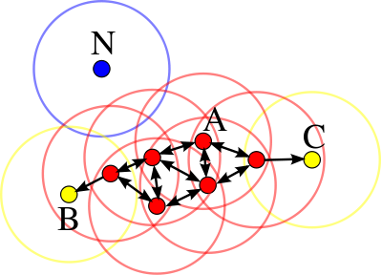
5.5 Clustering examples: flow cytometry and mass cytometry
5.5.3 Density-based clustering
DBSCAN (Density-Based Spatial Clustering of Application with Noise)
It is an algorithm that groups data points close to each other together based on the density of multi-dimensional data.
Elements of DBSCAN
minPts: the minimum number of close points from core point
Epsilon: the distance from the core point
From: https://en.wikipedia.org/wiki/DBSCAN

Slide 16
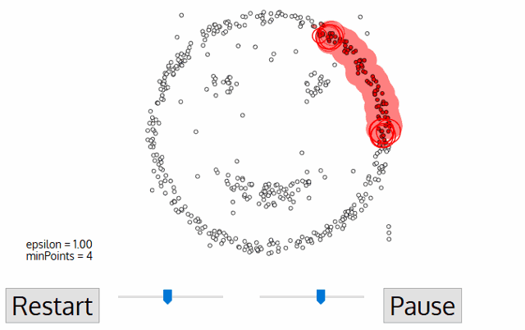
5.5 Clustering examples: flow cytometry and mass cytometry
5.5.3 Density-based clustering
From: https://tinyurl.com/24urqmn6

Slide 17
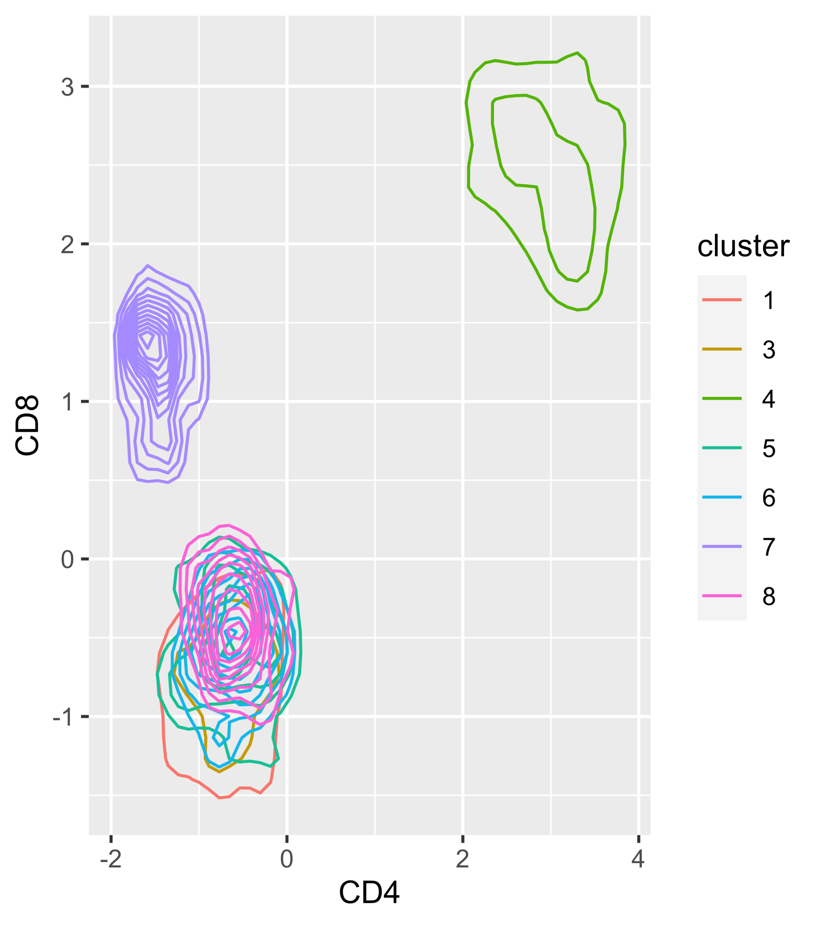
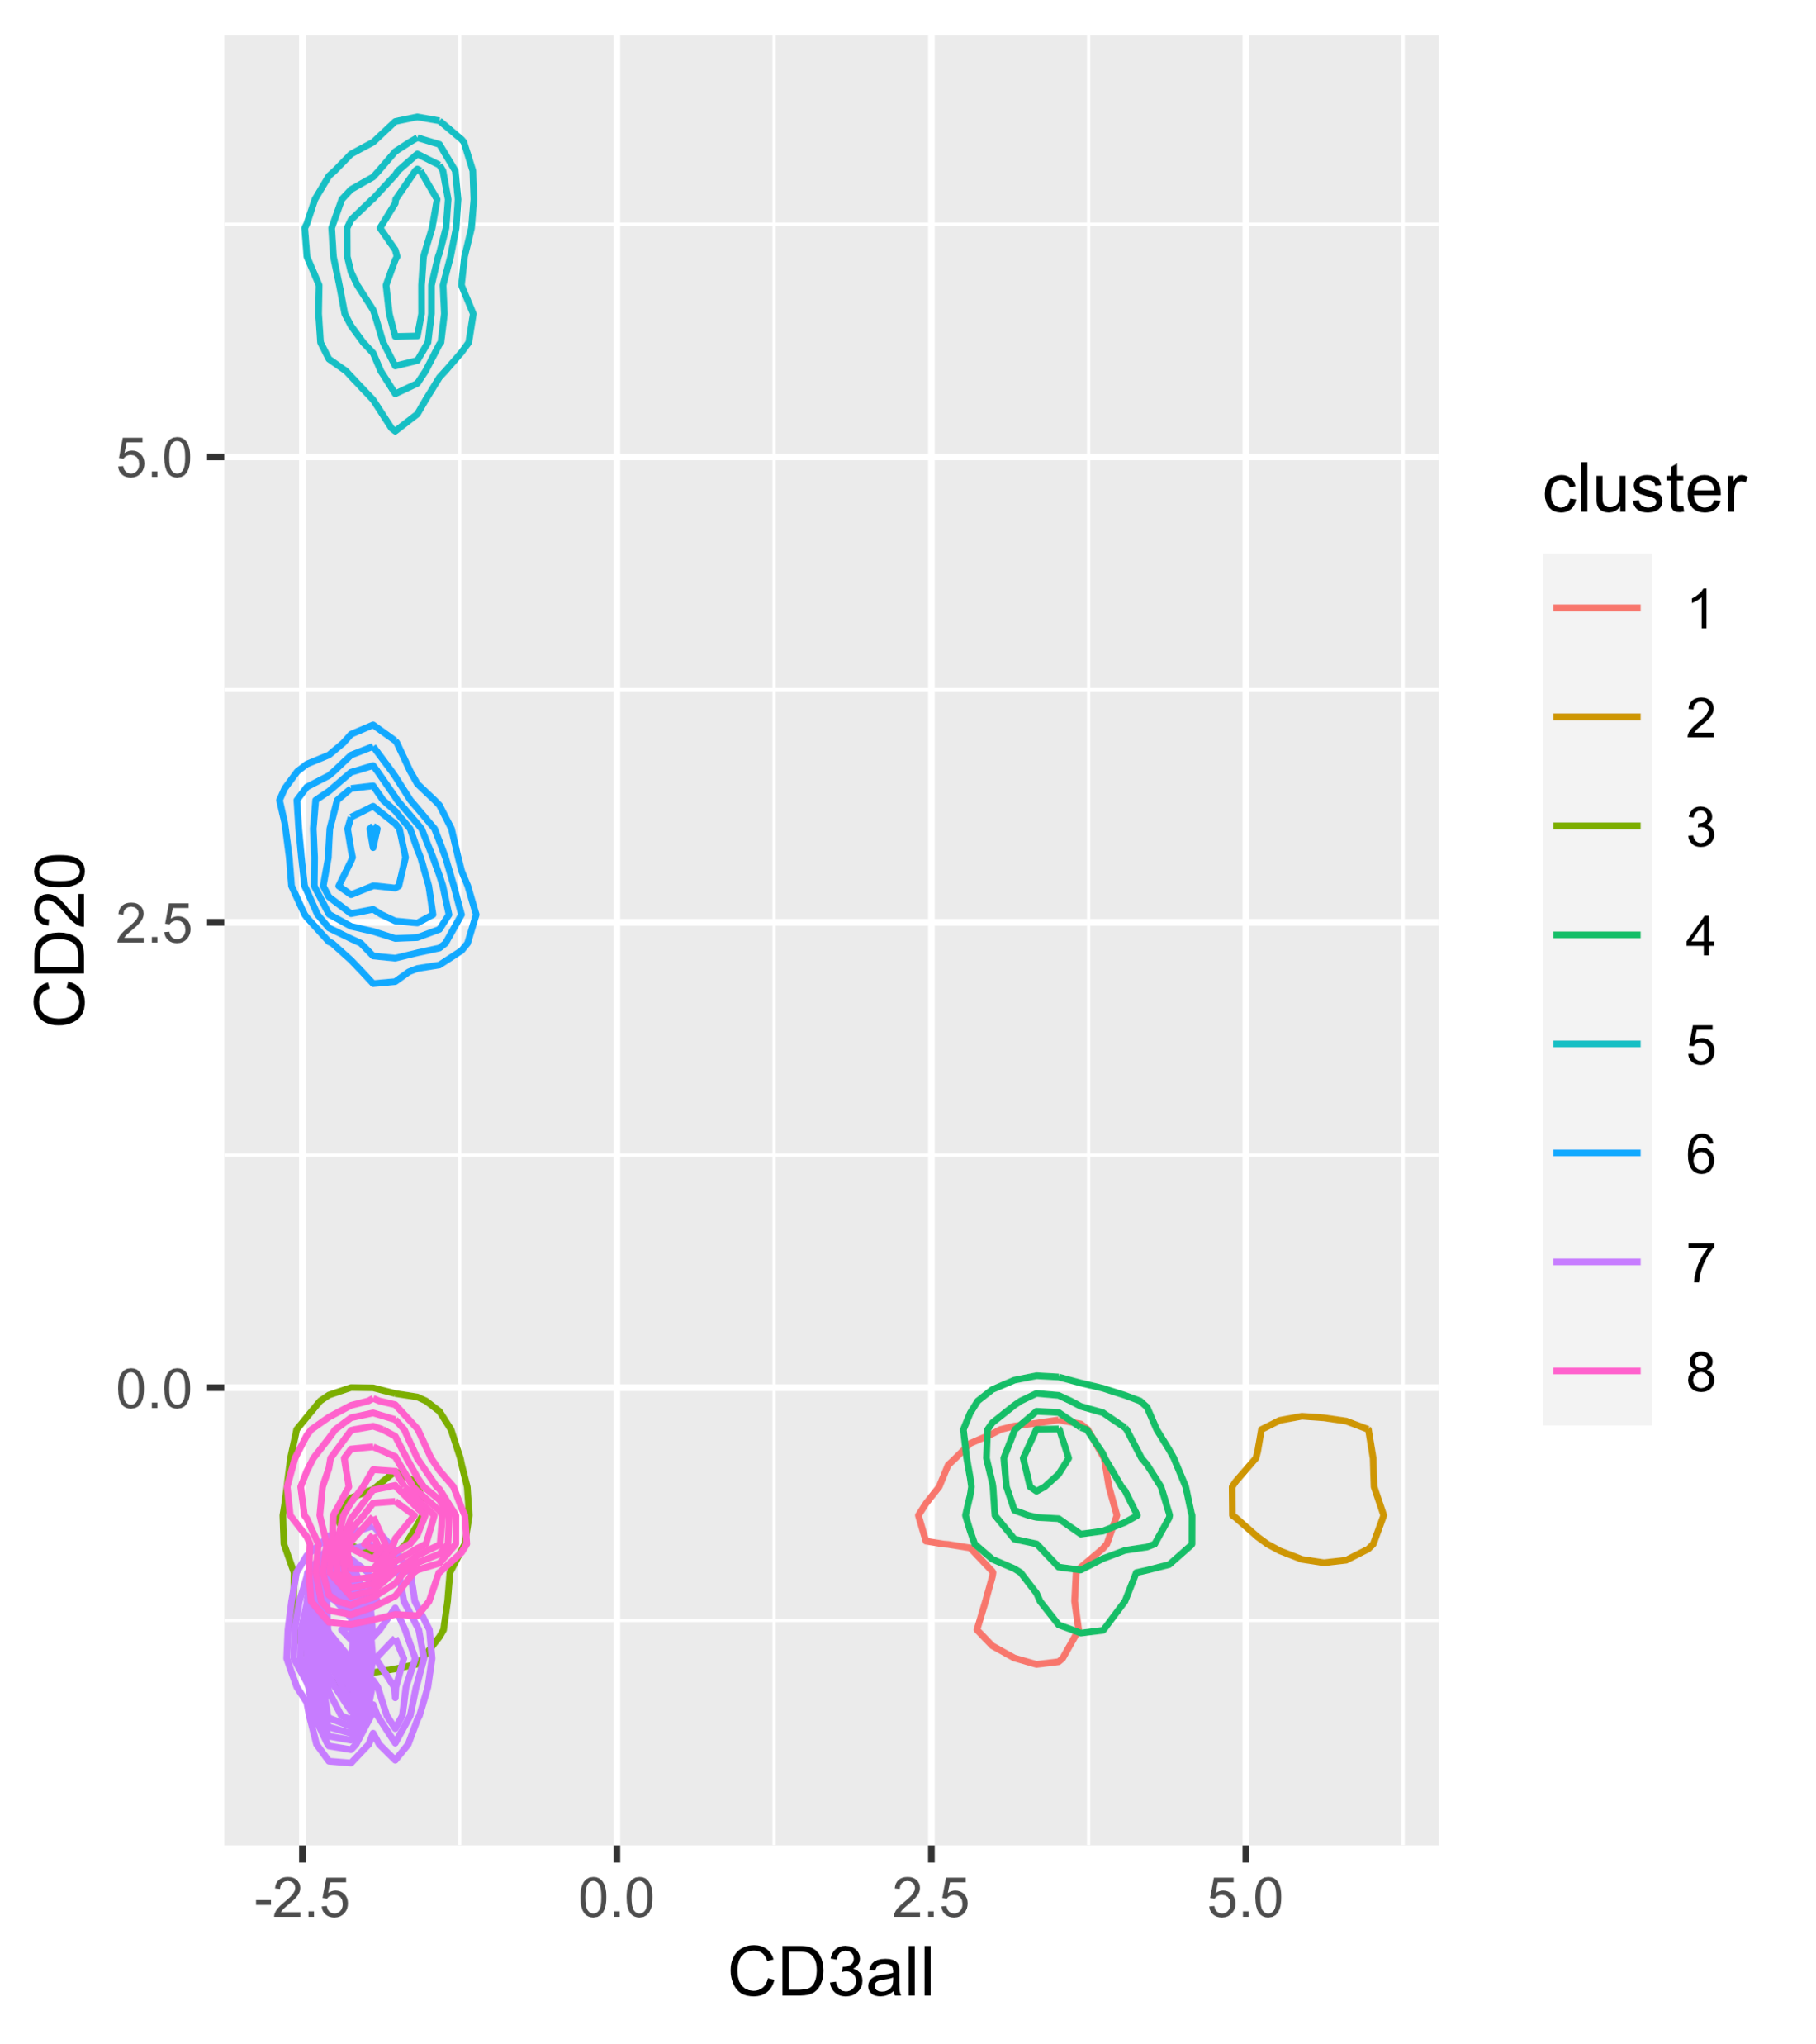
5.5 Clustering examples: flow cytometry and mass cytometry
5.5.3 Density-based clustering

Slide 18
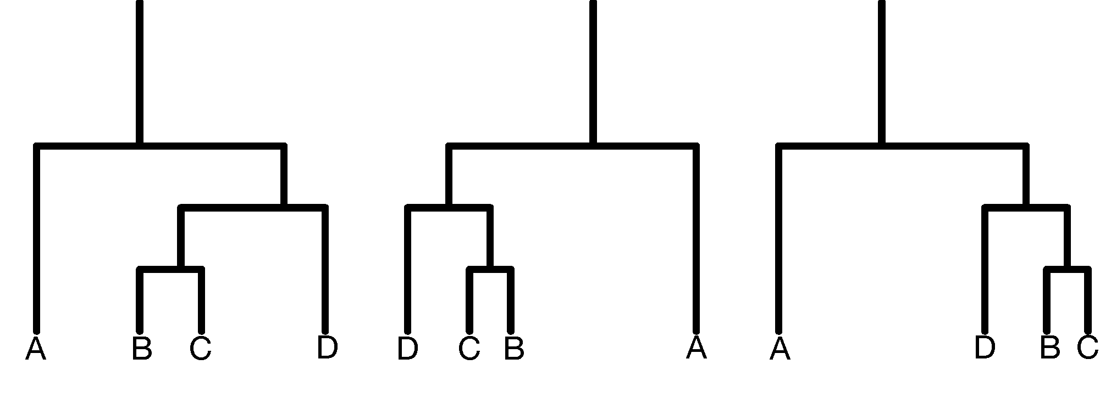
5.6 Hierarchical clustering
Hierarchical clustering
Dendrogram ordering: the vertical distances encode the similarity or the distance between each other.
Top-down hierarchies: it takes all the objects and splits them sequentially according to a chosen criterion.
Recursive partitioning methods are often used to make decision trees.

Slide 19
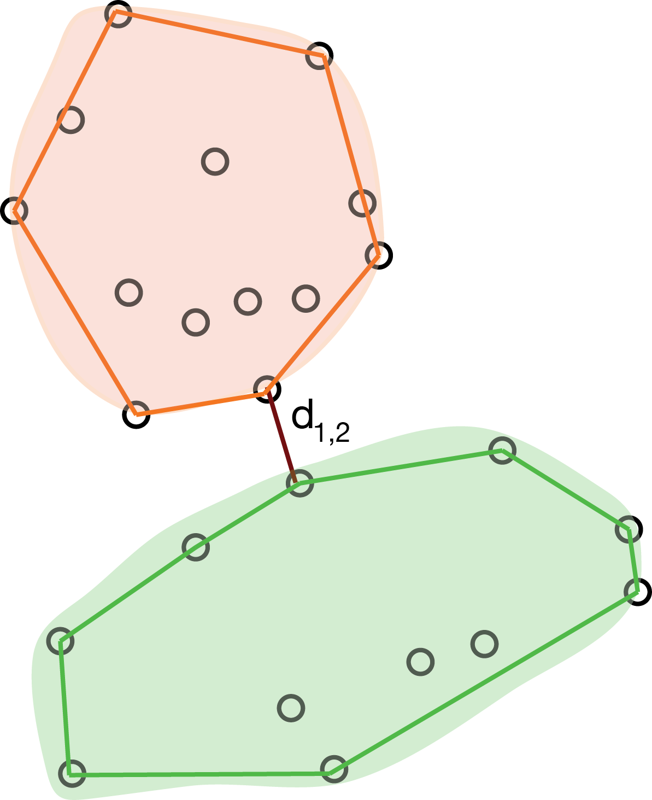
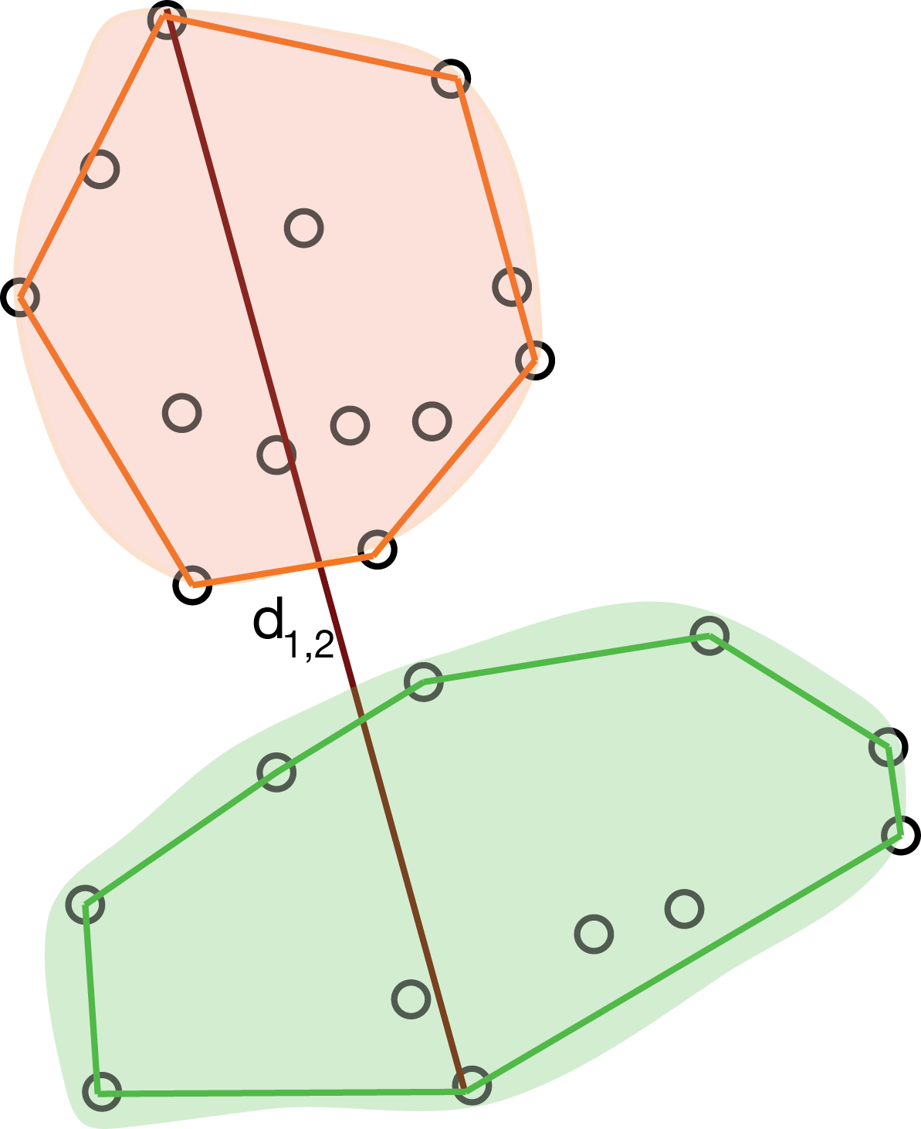
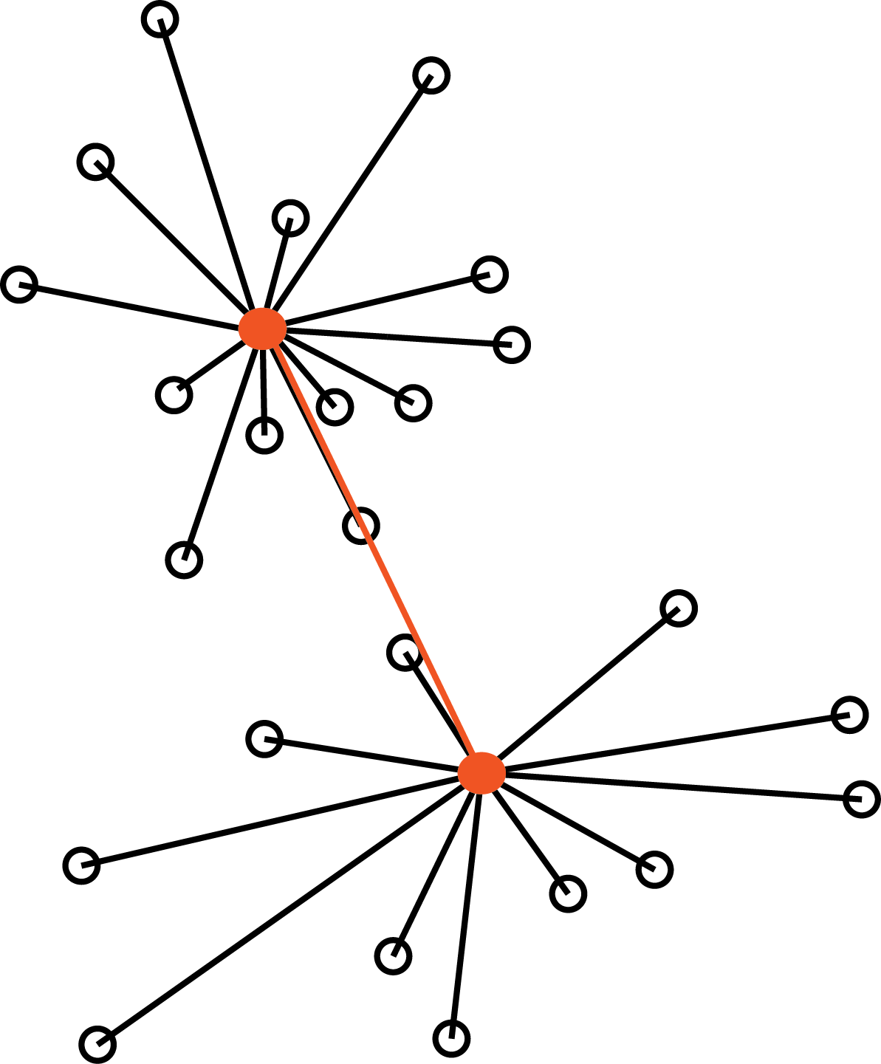
5.6 Hierarchical clustering
5.6.1 How to compute (dis)similarities between aggregated clusters?
3. Average link:
1. Single link:
2. Complete link:
4. Centroid link

Slide 20
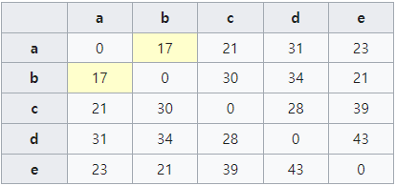
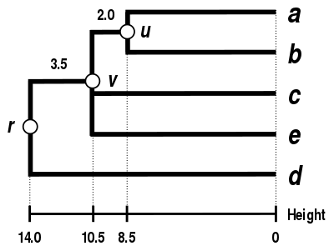
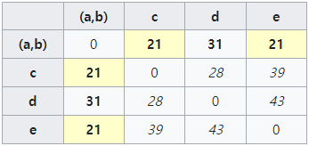
5.6 Hierarchical clustering
5.6.1 How to compute (dis)similarities between aggregated clusters?
1. Single link: This example uses distances.

Slide 21
5.7 Validating and choosing the number of clusters
The quality of a clustering result is evaluated by identifying the maximum group differences while keeping the within-group distances small.
WSS (Within-groups sum of Squared Distances)
An alternative expression for WSS
$${WSS}_{k}=\sum_{l=1}^{k}{\sum_{x_{i}∈C_{l}}{d^{2}(x_{i},{\overline{x}}_{l})}}$$
$k$: the number of clusters
$C_{l}$: the set of objects in the $l$-th cluster
${\overline{x}}_{l}$: the center of mass in the $l$-th cluster
$${WSS}_{k}=\sum_{l=1}^{k}{\frac{1}{2n_{l}}\sum_{x_{i}∈C_{l}}{\sum_{x_{j}∈C_{l}}{d^{2}(x_{i},x_{j})}}}$$
$k$: the number of clusters
$C_{l}$: the set of objects in the $l$-th cluster
$n_{l}$: the size of the $l$-th cluster

Slide 22
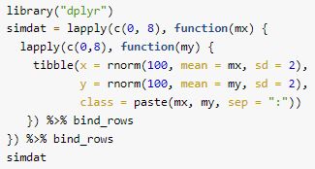
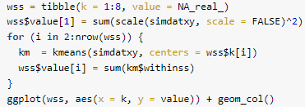
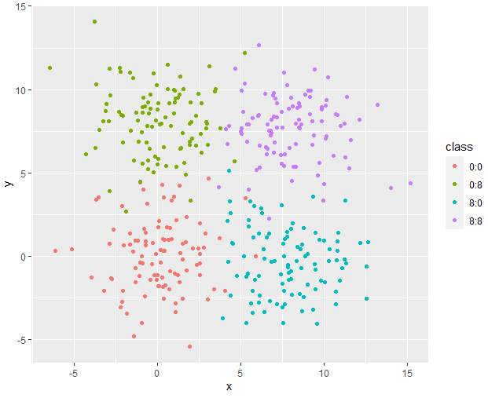
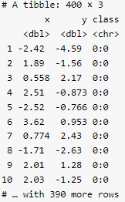
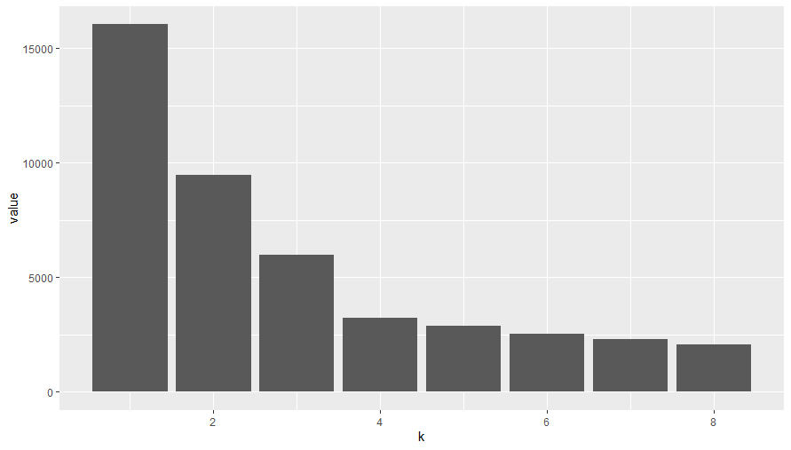
5.7 Validating and choosing the number of clusters

Slide 23
5.7 Validating and choosing the number of clusters
5.7.1 Using the gap statistic
Gap Statistic
Cluster the data with k clusters and compute ${WSS}_{k}$ for the various choices of k.
Generate B plausible reference data sets, using Monte Carlo sampling from a homogeneous distribution, and redo Step 1 above for these new simulated data. This results in B new within-sum-of-squares for simulated data $W_{kb′}^{∗}$ for $b=1, …, B$.
Compute the gap(k)-statistic:
If the clustering is good, the first term is expected to be bigger than the second one.
We can use the standard deviation:
Notes:
k개의 클러스터로 데이터를 클러스터링하고 k의 다양한 선택에 대해 WSS를 계산합니다.
Homologous distribution에서 Monte Carlo sampling을 사용하여 B plausible reference dataset를 생성하고 이러한 새로운 simulation data에 대해 step 1를 다시 실행합니다. 결과적으로 b=1,...,B인 경우 simulate된 데이터 B에 대한 Wkb의 새로운 제곱합 이내가 됩니다.

Slide 24
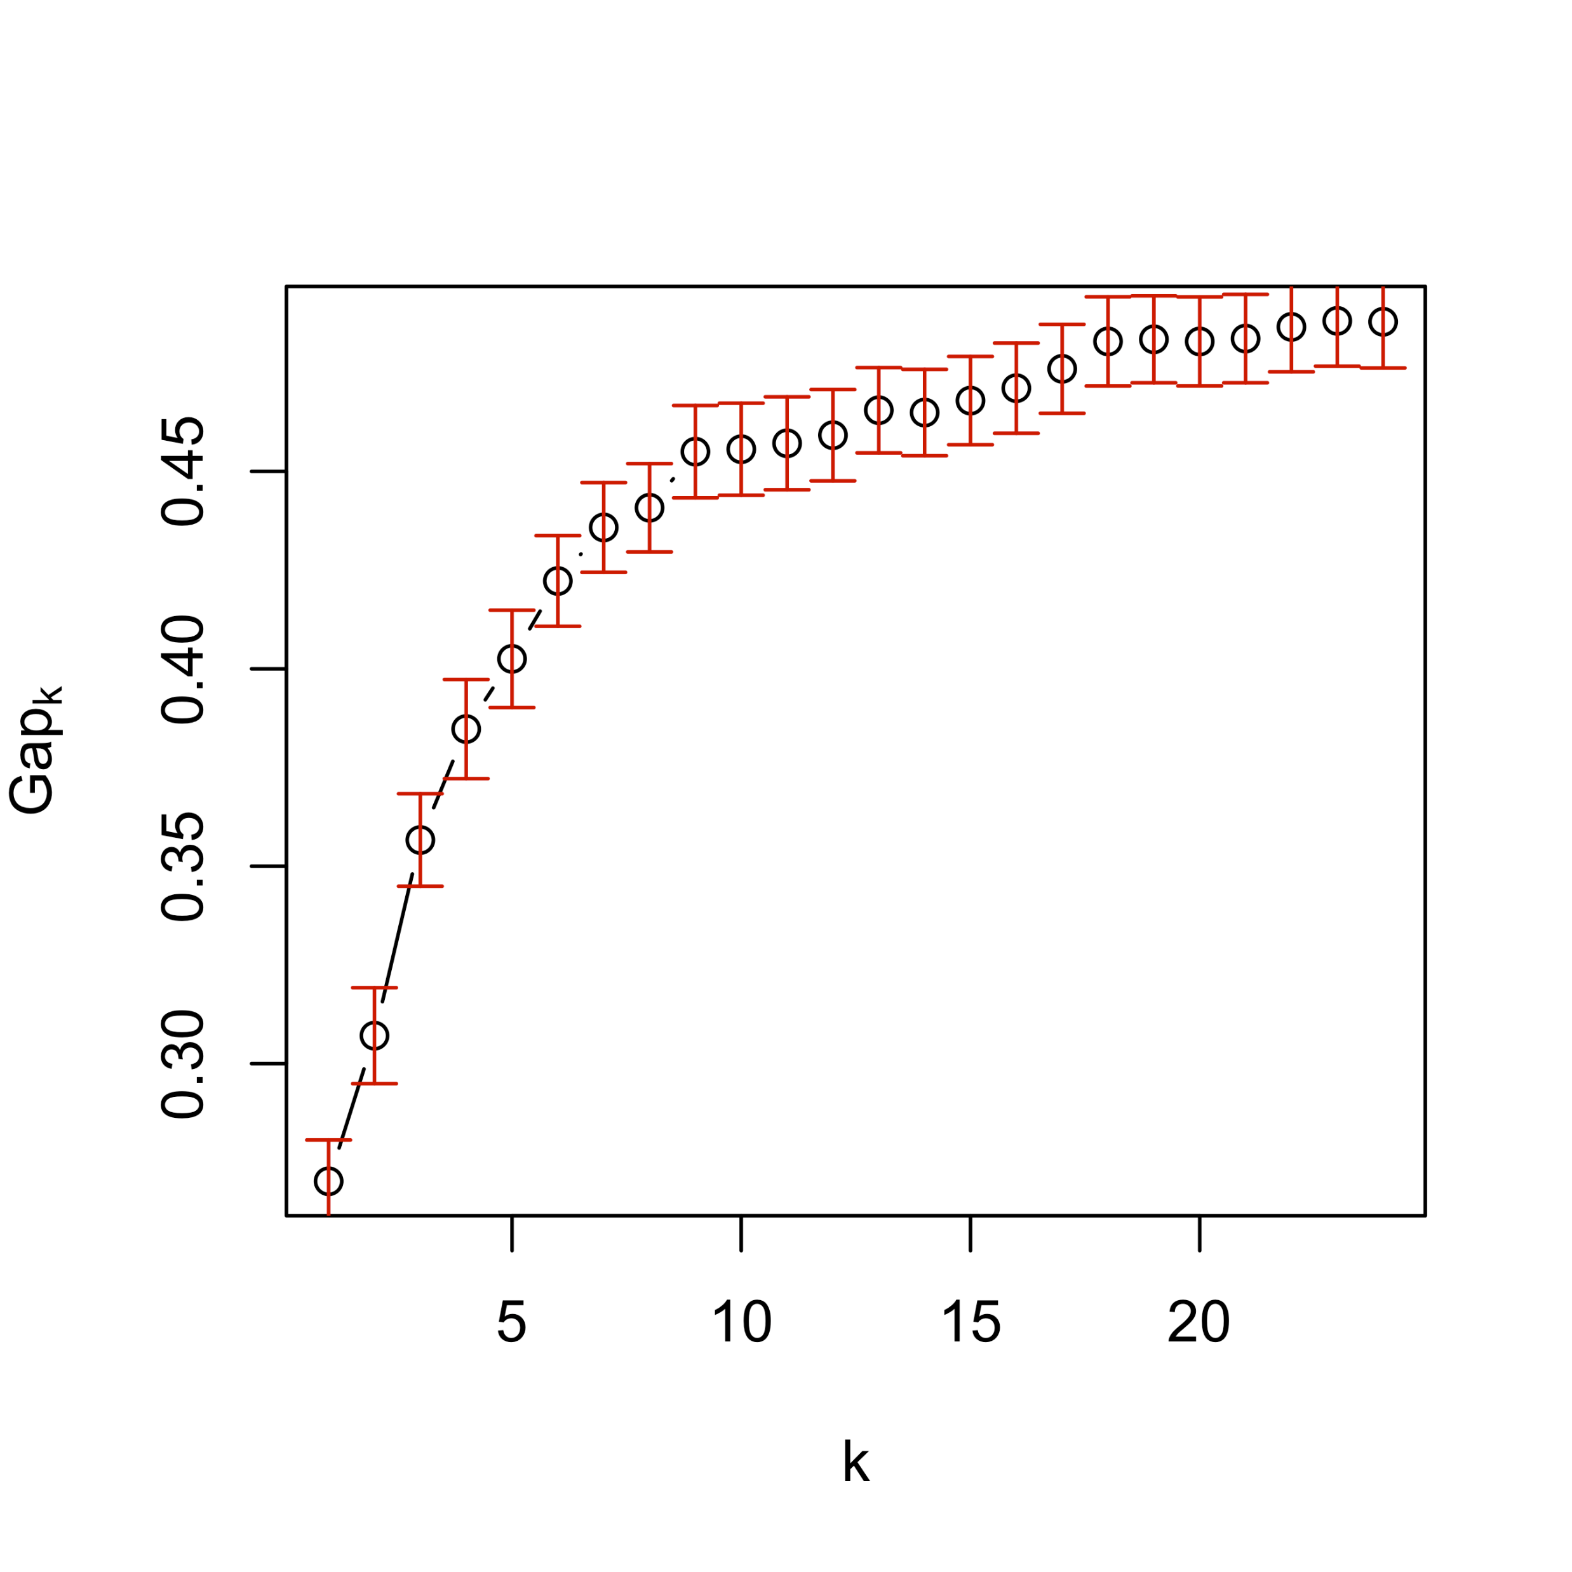
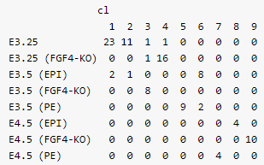
5.7 Validating and choosing the number of clusters
5.7.1 Using the gap statistic

Slide 25
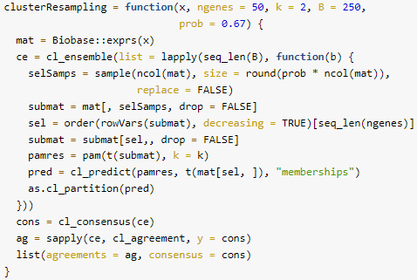
5.7 Validating and choosing the number of clusters
5.7.2 Cluster validation using the bootstrap
Bootstrap: get (oneself or something) into or out of a situation using existing resources
→ The random resampling method
In Hiiragi, the inner cell mass of the mouse blastocyst in embryonic day 3.5 (E3.5) falls “naturally” into two clusters corresponding to pluripotent epiblast (EPI) vs primitive endoderm (PE), while the data for the embryonic day 3.25 (E3.25) do not yet show this symmetry breaking

Slide 26
5.7 Validating and choosing the number of clusters
5.7.2 Cluster validation using the bootstrap
Bootstrap – ClusterResampling
Draw a random subset of the data (the data are either all E3.25 or all E3.5 samples) by selecting 67% of the samples without replacement.
Select the top ngenes features by overall variance (in the subset).
Apply k–means clustering and predicting the cluster memberships of the samples that were not in the subset with the cl_predict method from the clue package, through their proximity to the cluster centres.
Repeat steps 1-3 B times
Apply consensus clustering (cl_consensus).
For each of the B clusterings, measure the agreement with the consensus through the function(cl_agreement). Here a good agreement is indicated by a value of 1, and less agreement by smaller values. If the agreement is generally high, then the clustering into k classes can be considered stable and reproducible; inversely, if it is low, then no stable partition of the samples into k clusters is evident.

Slide 27
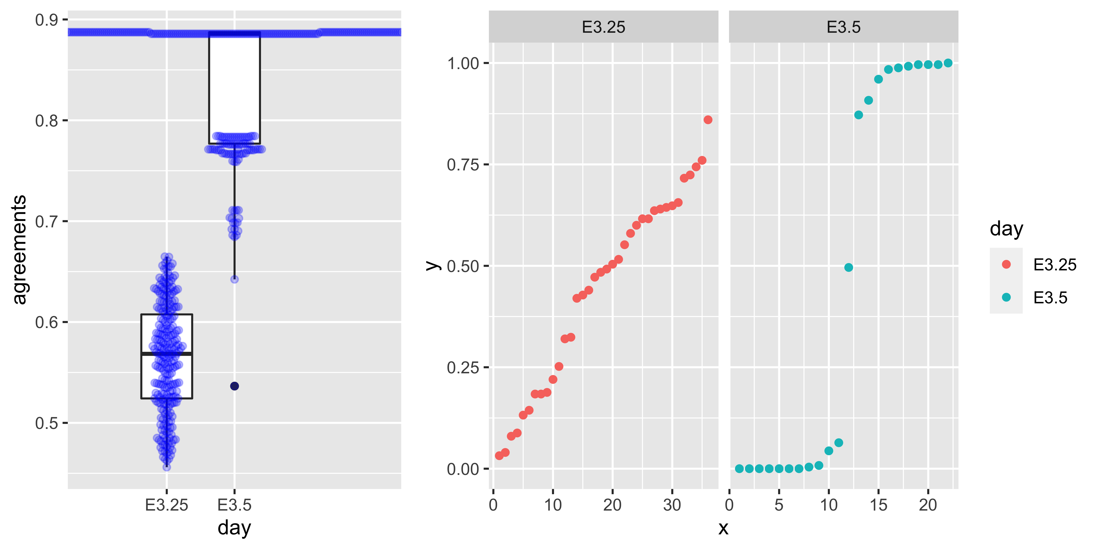
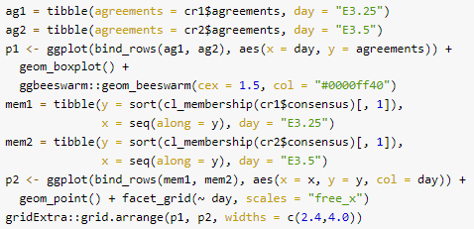
5.7 Validating and choosing the number of clusters
5.7.2 Cluster validation using the bootstrap

Slide 28
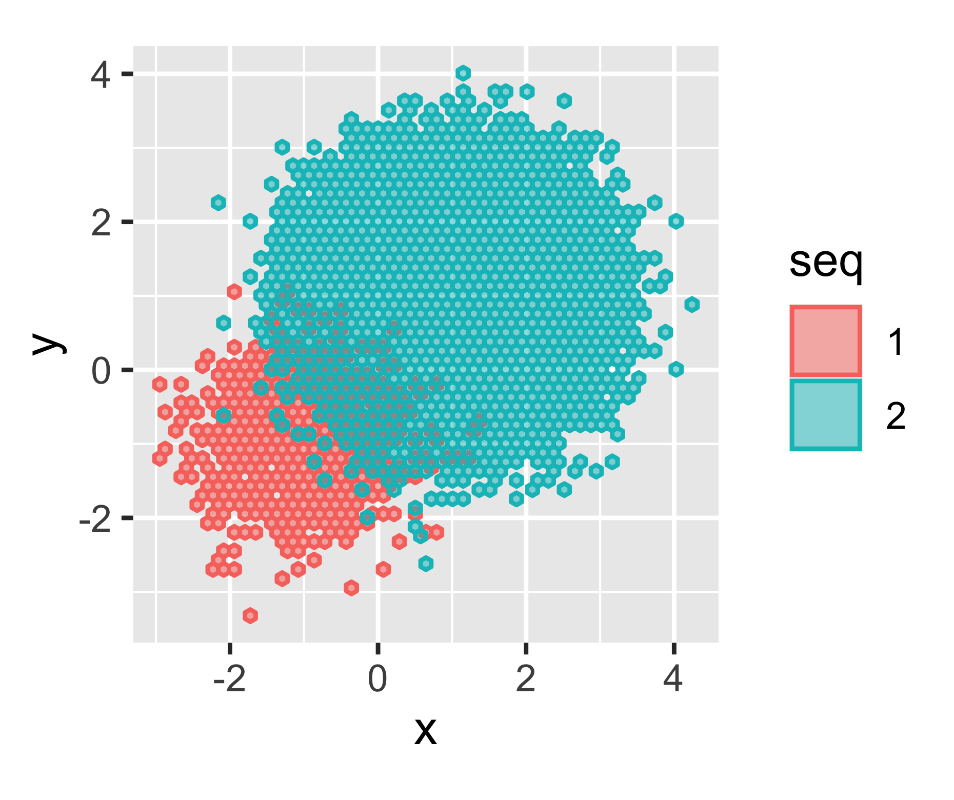
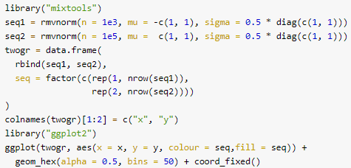
5.8 Clustering as a means for denoising
5.8.1 Noisy observations with different baseline frequencies
The distances do not always give the right answer.

Slide 29
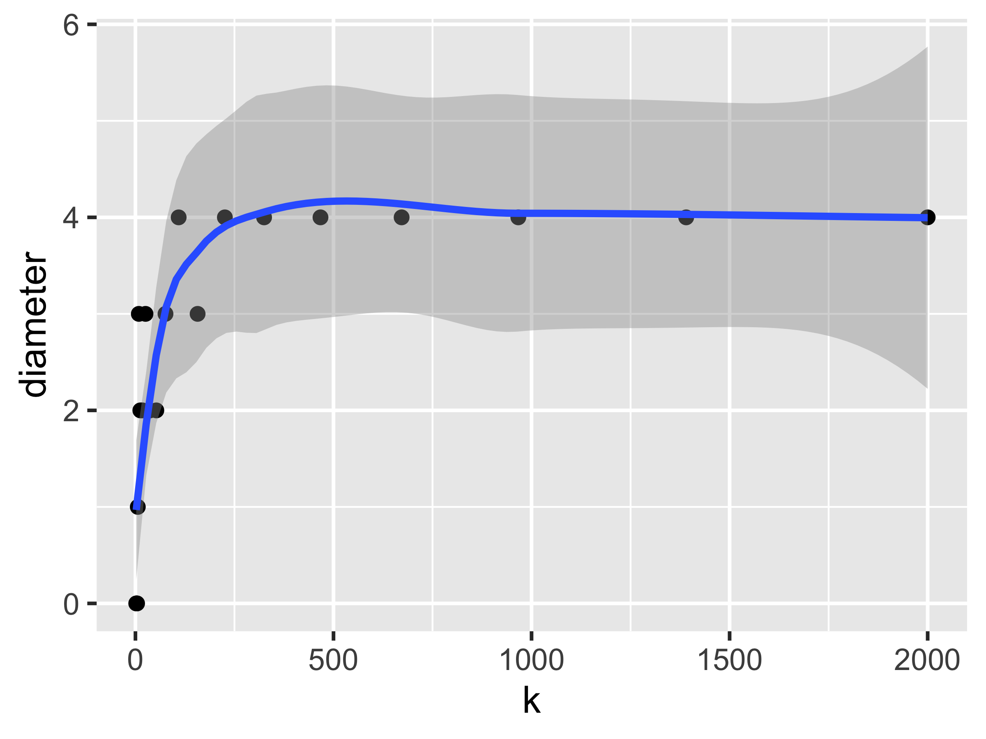
5.8 Clustering as a means for denoising
5.8.1 Noisy observations with different baseline frequencies
For denoising, clustering needs enough the number of samples

Slide 30
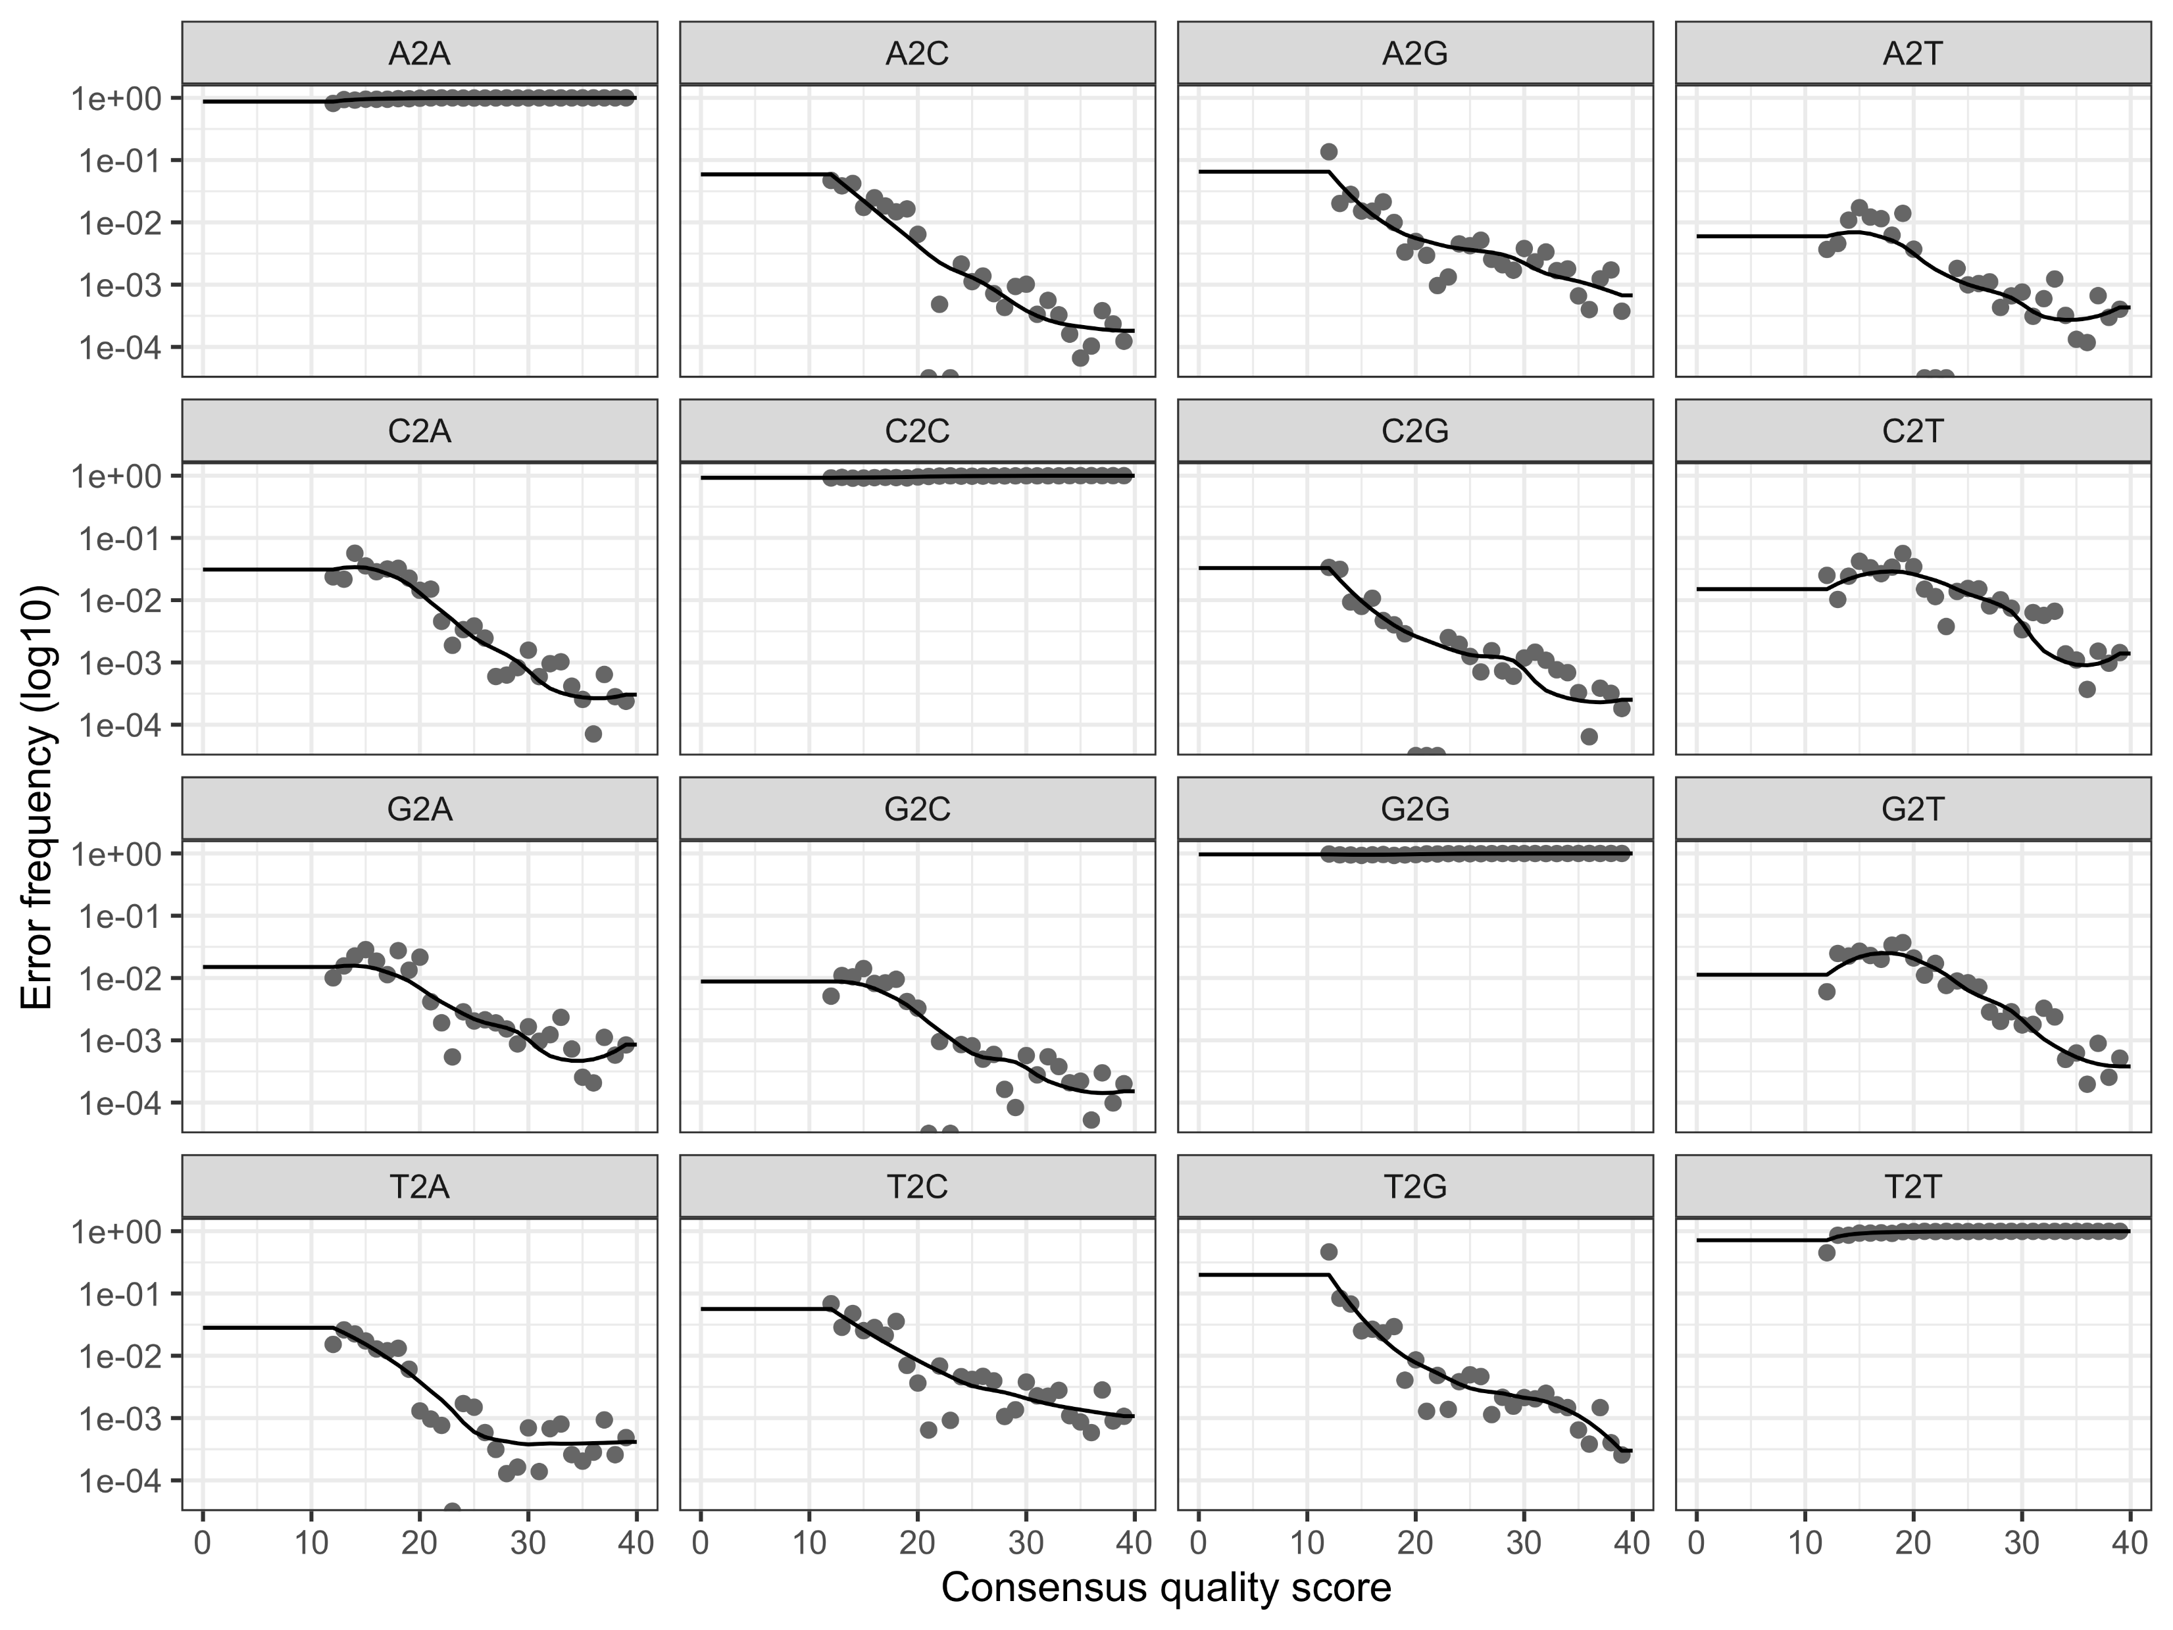
5.8 Clustering as a means for denoising
5.8.3 Infer sequence variants
DADA (Divisive Amplicon Denoising Algorithm):
A parameterized model of substitution errors that distinguishes sequencing error from real biological variation

