Slide 1

Chapter 7. Multivariate Analysis
2023-07-28
Kyung-Tae Lee

Slide 2

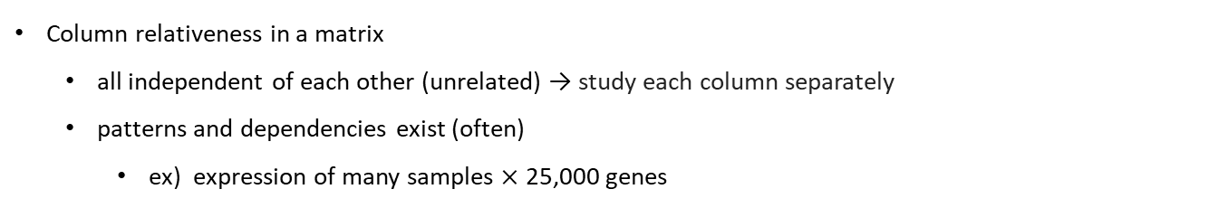
7.1 Goals for the chapter
Column relativeness in a matrix
  all independent of each other (unrelated) → study each column separately
  patterns and dependencies exist (often)
    ex) expression of many samples $×$ 25,000 genes
How to reduce the data to a smaller number of most important dimensions
without losing too much information ?
This chapter presents..
  examples of multivariate data matrices
  dimension reduction
    - Principal Component Analysis (PCA)

Slide 3
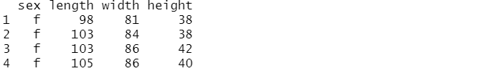

7.2.1 Low-dimensional data summaries and preparation
Data dimension
3-dimension
10-dimension

Slide 4

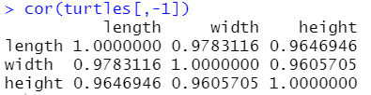
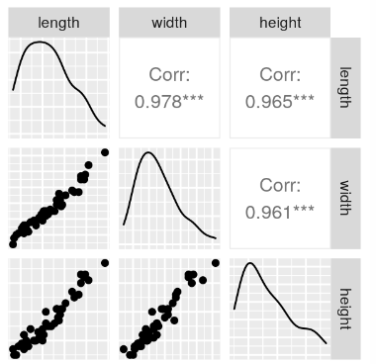
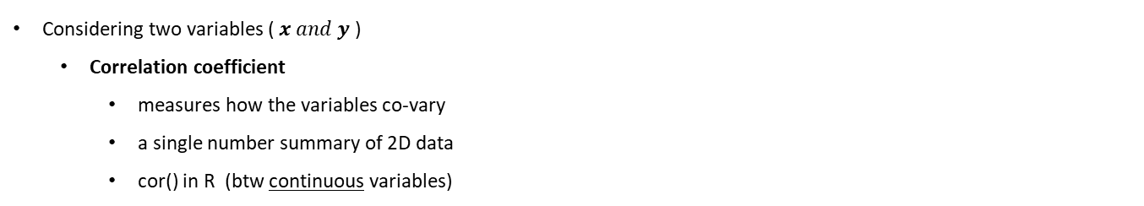
7.2.1 Low-dimensional data summaries and preparation
Considering two variables ( $x and y$ )
  Correlation coefficient
    measures how the variables co-vary
    a single number summary of 2D data
    cor() in R (btw continuous variables)
symmetric
all close to 1
diagonal values are always 1
“all three of the variables mostly reflect the same ‘underlying’ variable, which we might interpret as the size of the turtle”.
legnth
The size of turtle
correlated
width
hdight

Slide 5
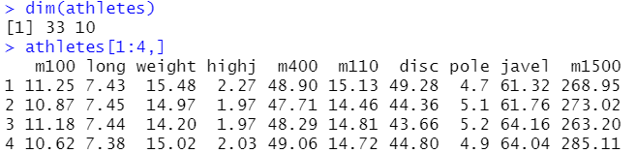
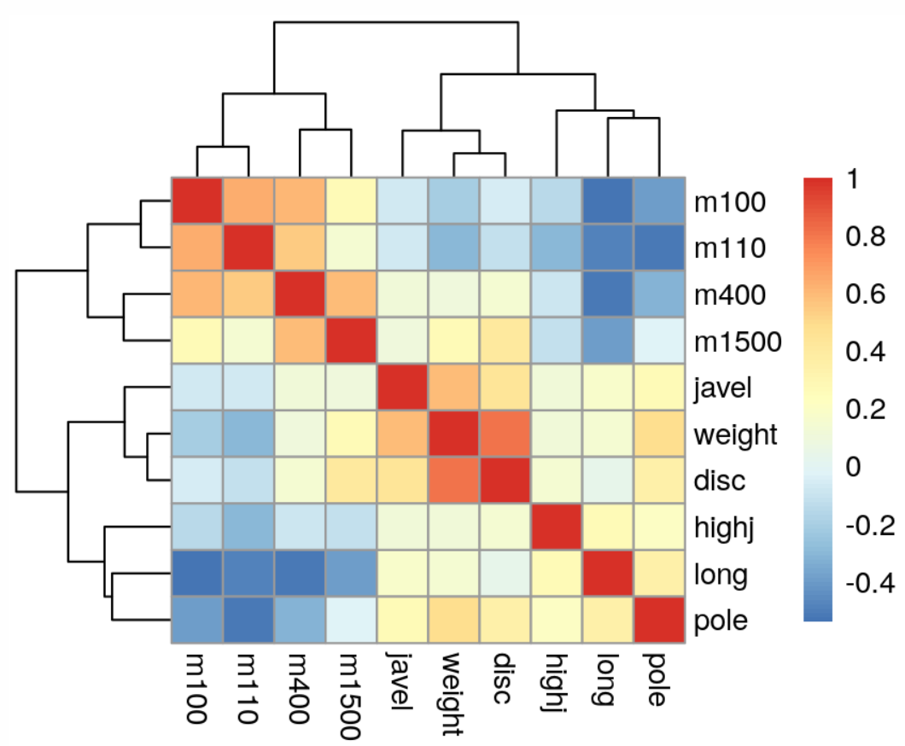
7.2.1 Low-dimensional data summaries and preparation
Hierarchical clustering shows the grouping of the related disciplines

Slide 6
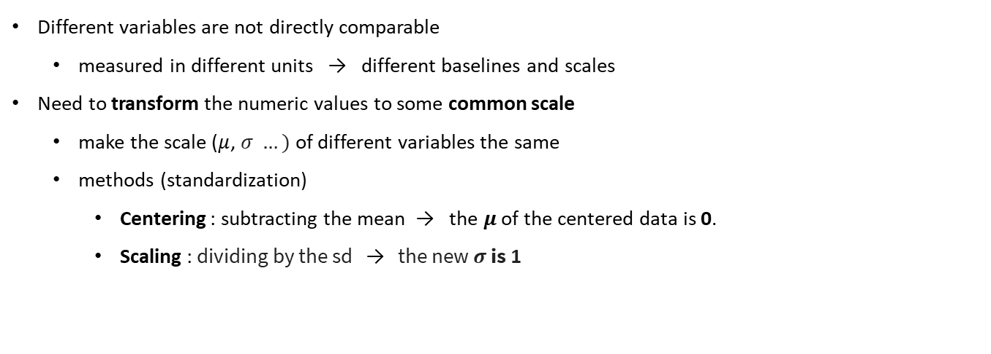
7.2.2 Preprocessing the data
Different variables are not directly comparable
  measured in different units → different baselines and scales
Need to transform the numeric values to some common scale
  make the scale ($μ$, $σ …)$ of different variables the same
  methods (standardization)
    Centering : subtracting the mean → the $μ$ of the centered data is 0.
    Scaling : dividing by the sd → the new $σ$ is 1
Centering
Correlation coefficient is simply the vector product of centered and scaled variables
Scaling or standardizing

Slide 7
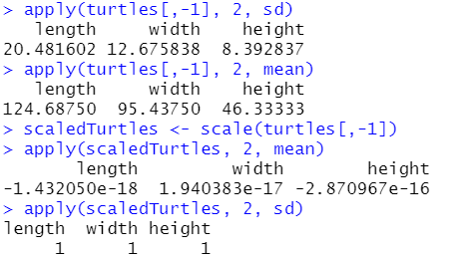
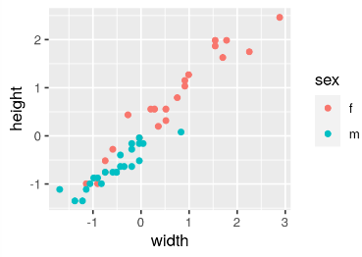

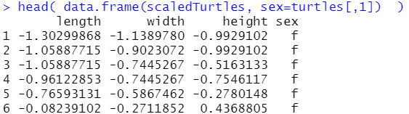
7.2.2 Preprocessing the data
R – scale()
  Makes every column of a given matrix or data frame have mean=0 and sd=1
  Visualization
We are ready to undertake data simplification through dimension reduction.

Slide 8
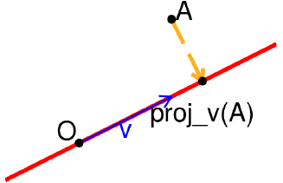

7.3 Dimension reduction
Principal Component Analysis (PCA)
  unsupervised learning
  produces maps that show the relations between variables and between observations
  use geometrical projections
    taking points in high dim spaces and project them onto lower dims.
  a linear technique that looks for linear relations btw variables
    use new variables that are linear functions of the original ones :
orthogonal projection of A
Notes:
개관을 하자면, PCA (주성분 분석)이란, 여러 변수를 선형 결합 -> 분산이 큰 축을 변수의 개수만큼 생성하는 것입니다

Slide 9
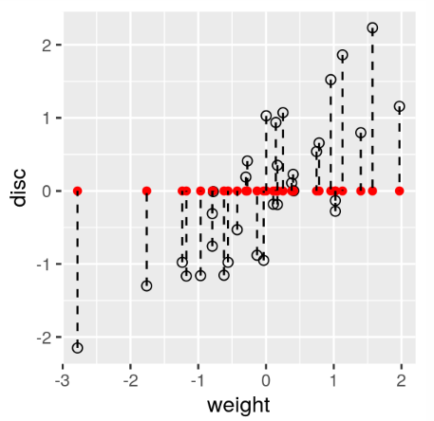
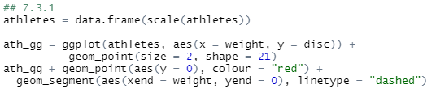
7.3.1 Lower-dimensional projections
  Projecting 2D data onto a line
    using athletes data
  projection on the horizontal x axis (y=0)
In general, we lose information about the points if we just use the original coordinates !
Goal : keeping as much information as we can about both variables (weight, disc)
Notes:
예를 들어, 어떤 2D data를 line으로 projection 시켜보겠습니다.
책에서는 athletes data를 사용했는데,
제공된 이 데이터는 load 함수를 통해 불러올 수 있고 33 by 10 행렬형태임을 알 수 있고
4행까지 확인을 해보면 33명의 선수들의 m별 달리기 기록, 멀리뛰기 (long), 높이뛰기(highj), 허들달리기(m110),
? (weight), 원반던지기(disc), 장대높이뛰기(pole), 창 던지기 (javel) 를 나타내고 있습니다.
이제 이 데이터에서 weight 변수의 각 점들을 표시하고 , 각 점을 y=0 에 projection을 해서 red로 표현된 것을 볼 수 있습니다.
보통의 경우에, 2d (평면) 데이터를 하나의 선으로 투영하게 되면 기존의 정보를 잃을 수 밖에 없음

Slide 10
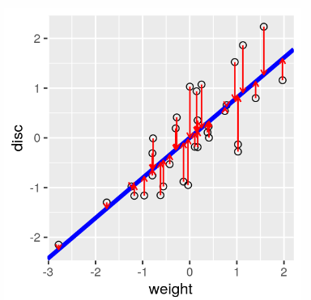
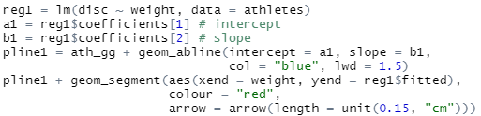
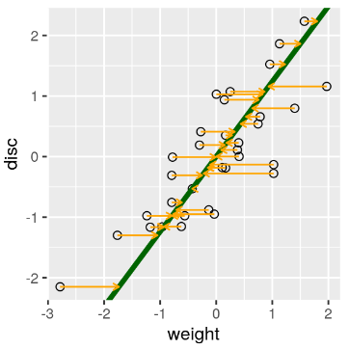
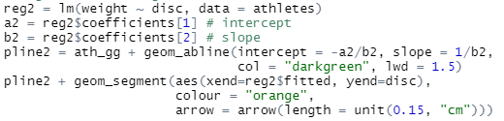
7.3.2 How do we summarize two-dimensional data by a line?
One way of projecting the points onto a line : regression lines
Regressing one variable on the other
Regressing one variable on the other
(A)
(A)
finding the best linear relationship between the independent and dependent variables
gives preference minimizing the residual sum of squares in one direction: that of the response variable
Regression of the disc on weight (A)
Regression of the disc on weight (A)
(B)
(B)
Regressing of weight on disc (B)
These results gives an approximate linear relationship between disc and weight.
These results gives an approximate linear relationship between disc and weight.
However, the relationship differs depending on the variables chosen to be the predictor and the response.
Notes:
사실 projection의 방법에는 실제 여러가지가 있고, 그 중 하나는 regression line 즉, 회귀 직선을 찾는 것임.
한 변수를 다른 변수에 회귀한다?? = 반응 변수 쪽 방향으로 잔차를 최소화하도록 우선순위를 준다는 것.
vertical residuals 가 최소화
horizontal residuals가 최소화

Slide 11
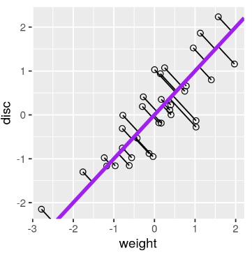
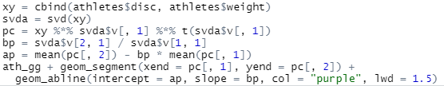
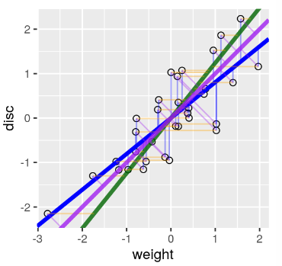
7.3.2 How do we summarize two-dimensional data by a line?
A line that minimizes distances in both directions
A line that minimizes distances in both directions
  the line chosen to minimize the sum of squares of the orthogonal projections of data points onto it = “the principal component line„
  All three ways of fitting a line together in one plot
minimizes the sum of squares of the vertical residuals (variance = 1.650204)
minimizes the sum of squares of the horizontal residuals
minimizes the sum of squares of the orthogonal projections
( principal component, variance = 1.806352 )
centered → passes through the origin (0, 0)
scaled → diagonal that cuts exactly in the middle of both lines

Slide 12

7.4 The new linear combinations
The PC line found in the previous section could be written as :
PC (Principal components)
  linear combinations of the variables that were originally measured → provide a new coordinate system.
    Linear combination
      ex) a recipe for making a healthy juice mix
    A linear combination of variables defines a line in higher dimensions
      there are many ways to choose lines onto which we project the data
PC loadings
(coefficient)
new variable
original variable

Slide 13
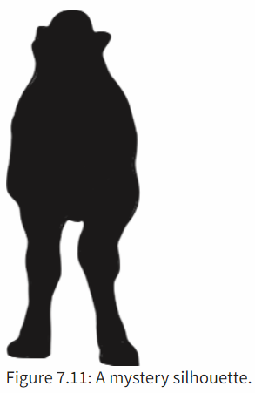

7.4.1 Optimal lines
‘Best’ line onto which we project the data for our purpose
  The total variance of all the points in all the variables can be decomposed
  PCA (Principal component analysis)
    PC minimizes the distance to the line & maximizes the variance of the projections along the line.
    Why is maximizing the variance along a line a good idea?
      ex) a projection from 3D into 2D
the projection that maximizes the area of the shadow shows more `information’.
the projection that maximizes the area of the shadow shows more `information’.

Slide 14
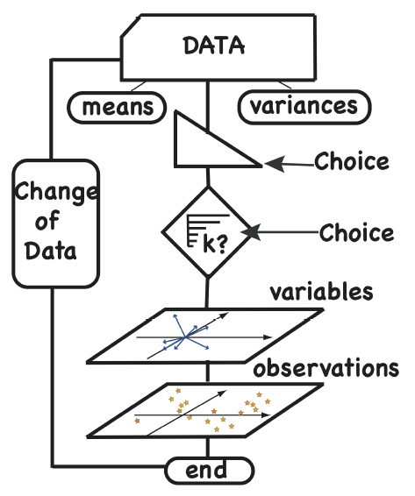
7.5 The PCA workflow
PCA : finding the axis showing the largest variability
& iterating to find the next best orthogonal axis so on
whether to work with rescaled covariances ( the correlation matrix ) or not
number of components relevant to the data. (rank of the approximation we choose)
requires looking at a plot of the variances explained by the successive principal components before proceeding to the projections of the data
useful maps of both the variables and the samples
we do not have to run iterations, all the axes can be found in one operation
( Singular Value Decomposition, SVD )

Slide 15
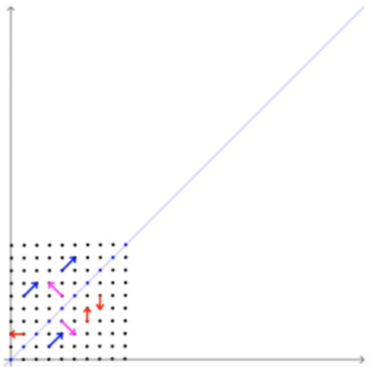
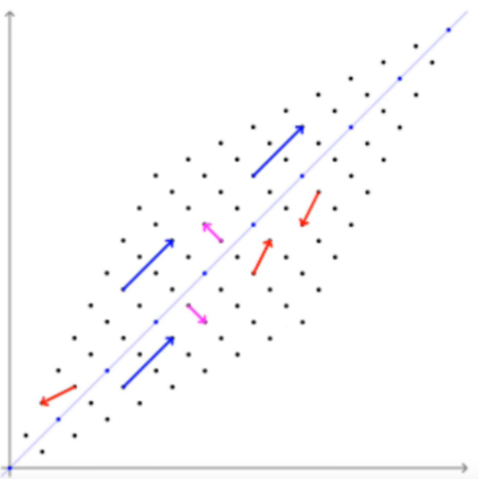


Eigen value decomposition (EVD)
고유값 분해 (EVD)
열벡터 v 에 N x N 정방행렬 A를 곱했을 때 방향은 바뀌지 않고 크기만 변했다면, v 는 고유벡터 (eigen vector)
변한 크기가 원래 크기의 $λ$ 배라면, $λ$는 고유값 (eigen value)
선형변환
A= n x n 정방 행렬 (square matrix)
v= vector (eigen vector)
Λ (=λ) = 상수 (scalar, eigenvalue)
Vector 값에다가 matrix 를 곱하였을 때 vector의 방향은 변하지 않고 크기만 변화하는 상황 (Matrix 의 곱이 상수를 곱한 것과 같은 효과를 일으킴 -> Vector의 방향 축은 변화하지 않음)

Slide 16
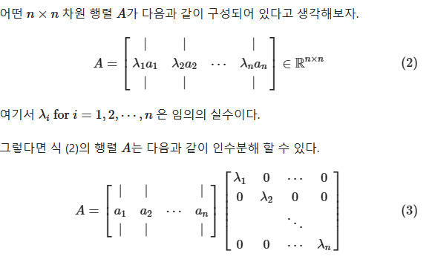
Eigen value decomposition (EVD)
고윳값 분해(eigen-value decomposition) - 공돌이의 수학정리노트 (Angelo's Math Notes) (angeloyeo.github.io)

Slide 17
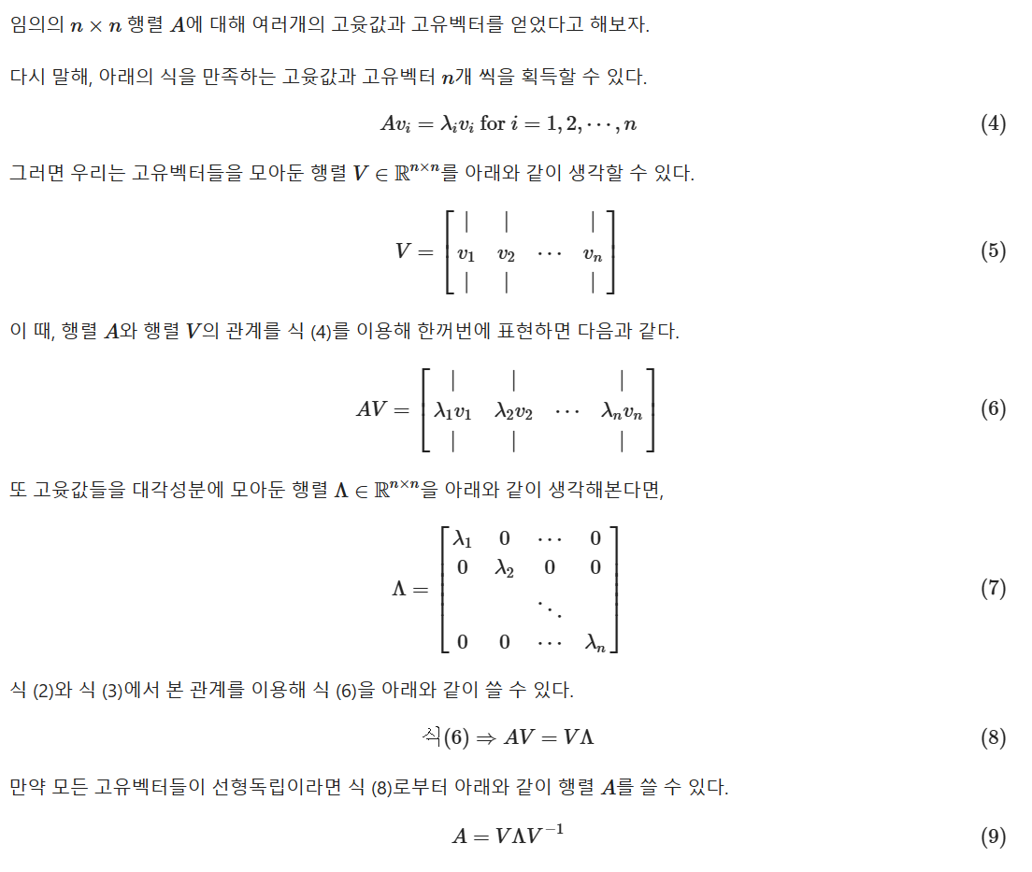
Eigen value decomposition (EVD)
고윳값 분해(eigen-value decomposition) - 공돌이의 수학정리노트 (Angelo's Math Notes) (angeloyeo.github.io)

Slide 18
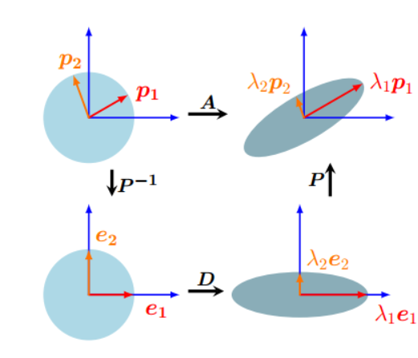
Eigen value decomposition (EVD)
P= eigenvector, D= eigenvalues
A (matrix)를 eigen decomposition 을 하여 eigenvector, eigenvalue를 찾는 것이 EVD의 목적
A는 선형 변환임. A= PDP⁻¹ 에서 P는 rotation, D는 resizing 의 효과를 주게 됨.
Eigendecomposition (tistory.com)

Slide 19
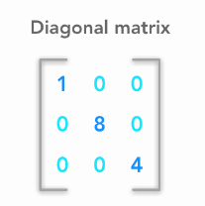
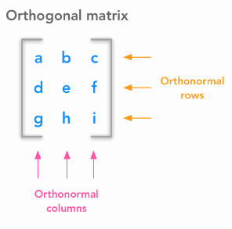
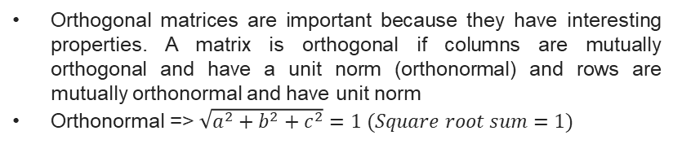
Diagonal and orthogonal matrix
A matrix A_{i,j} is diagonal if its entries are all zeros except on the diagonal (when i-=j)
Orthogonal matrices are important because they have interesting properties. A matrix is orthogonal if columns are mutually orthogonal and have a unit norm (orthonormal) and rows are mutually orthonormal and have unit norm
Orthonormal => $\sqrt{a^{2}+b^{2}+c^{2}}=1 (Square root sum=1)$

Slide 20
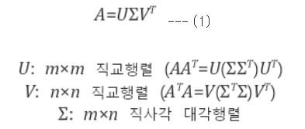
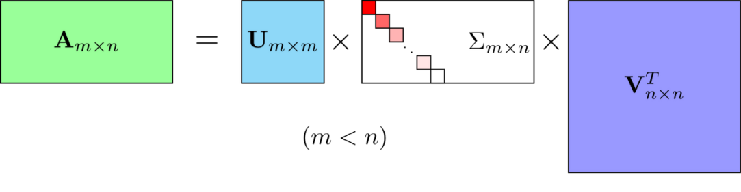
Singular value decomposition (SVD)
EVD는 정방 행렬 (m x m matrix) 에서만 선형 변환이 가능하지만 SVD 는 직각 행렬 (m x n matrix) 에서도 가능
U = Left singular vector
Σ = Singular values
V = Right singular vector
다크 프로그래머 :: [선형대수학 #4] 특이값 분해(Singular Value Decomposition, SVD)의 활용 (tistory.com)

Slide 21
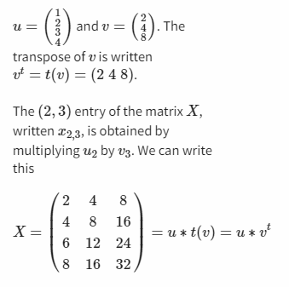
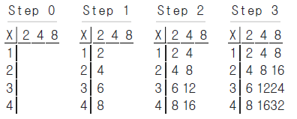
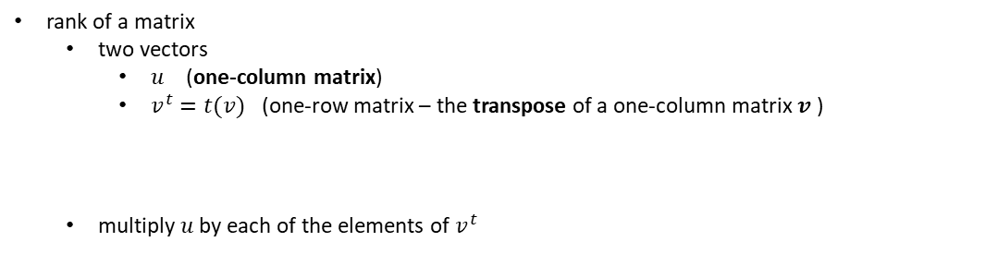

7.6.1 Rank-one matrices (SVD example)
rank of a matrix
  two vectors
    $u$ (one-column matrix)
    $v^{t}=t(v)$ (one-row matrix – the transpose of a one-column matrix $v$ )
  multiply $u$ by each of the elements of $v^{t}$
matrix $Χ$ : rank 1
because both $u$ and $v$have one column

Slide 22
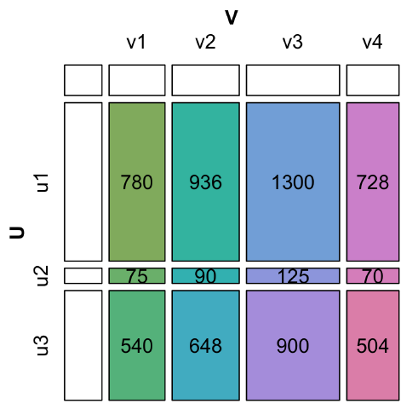
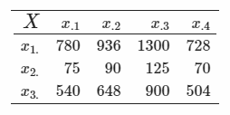
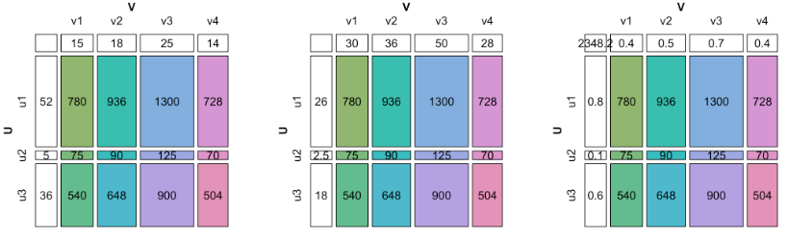
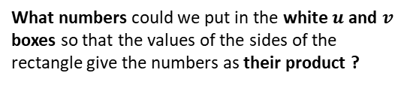
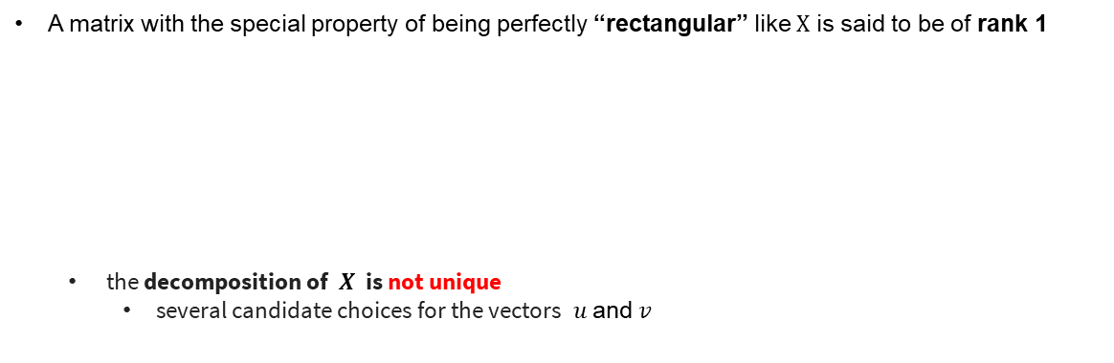
7.6.1 Rank-one matrices (SVD example)
Question 7.13
  want to decompose a matrix $Χ$
What numbers could we put in the white $u$and $v$ boxes so that the values of the sides of the rectangle give the numbers as their product ?
A matrix with the special property of being perfectly “rectangular” like $Χ$ is said to be of rank 1
  the decomposition of $Χ$ is not unique
    several candidate choices for the vectors $u$and $v$
Notes:
marginal vectors 에서 각 vector의 좌표값의 sum of squares (각 제곱의 합) = 1 인 형태로 만든 것임.
(= the u and v vectors have norm 1)

Slide 23
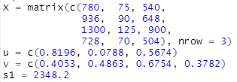
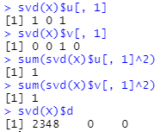
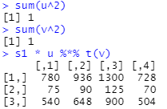


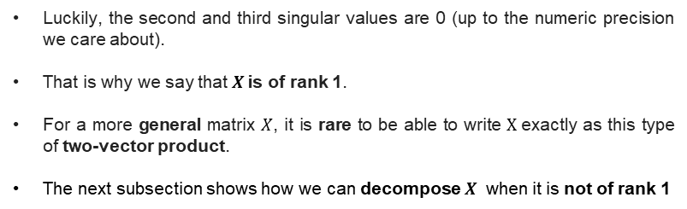
7.6.1 Rank-one matrices (SVD example)
Question 7.13
  Supposing we know the values in $u, v$ and $s_{1}$
    checking the multiplication and norm properties in R
Luckily, the second and third singular values are 0 (up to the numeric precision we care about).
That is why we say that $Χ$is of rank 1.
For a more general matrix $Χ$, it is rare to be able to write $Χ$exactly as this type of two-vector product.
The next subsection shows how we can decompose $Χ$ when it is not of rank 1

Slide 24
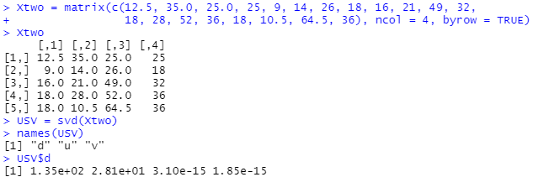
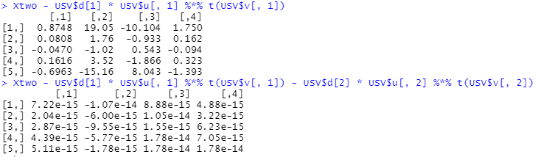
7.6.2 How do we find such a decomposition in a unique way?
Three elements in the above decomposition
  the horizontal and vertical singular vectors, and the diagonal corner, called the singular value.
  can be found by function svd().
  ex)
      135 is the first singular value ( USV$d[1] )
  Question 7.16 Check how each successive pair of singular vectors improves our approximation to Xtwo.
The 3rd and 4th singular values are so small (do not improve the approximation) → Xtwo is of rank 2.

Slide 25

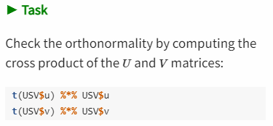
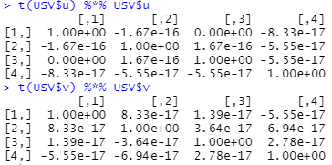
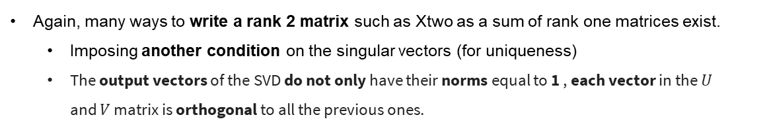
7.6.2 How do we find such a decomposition in a unique way?
Again, many ways to write a rank 2 matrix such as Xtwo as a sum of rank one matrices exist.
  Imposing another condition on the singular vectors (for uniqueness)
  The output vectors of the SVD do not only have their norms equal to 1 , each vector in the $U$ and $V$ matrix is orthogonal to all the previous ones.
the sum of the products of the values in the same positions is 0

Slide 26


7.6.3 Singular value decomposition
$Χ$ is decomposed additively into rank 1 pieces.
Each of the $u$($v$) vectors is combined into the $U (V$) matrix
Singular Value decomposition :
  $S =$the diagonal matrix of singular values
  $V^{t}=$ the transpose of $V$
  $I$ = Identity matrix
  written elementwise as :
    $U$ and $V$ are “orthonormal”
      because their self-crossproducts are the identity matrix.
Notes:
orthogonal + normal이다.
orthogonal, 즉 모든 column 벡터들이 서로 직교한다는 뜻이다. 수식적으로는 내적 (inner product)이 0이라는 것이다.
normal, 모든 벡터의 크기가 1로 맞춰져 있다는 것이다. 참고로, 벡터의 크기는 자기 자신과 내적한 뒤, 제곱근을 구하면 된다.
orthonormal 하면, 역행렬(직교행렬의 경우 전치행렬)과 행렬의 곱은 단위행렬.

Slide 27

Singular vector and values can be deemed as eigenvector and eigenvalue
A^{T}A = 정방 행렬 (n x x matrix)
V is eigenvector of A^{T}A and Σ ^{T} Σ is eigenvalue of A^{T}A
U is eigenvector of AA^{T} and Σ ^{T} Σ is eigenvalue of AA^{T}
SVD 는 결국 EVD 와 같은 선형변환이라는 걸 알 수 있음
Singular Value Decomposition (the SVD) - YouTube

Slide 28

Singular vector and values can be deemed as eigenvector and eigenvalue
Wikipedia

Slide 29
What do singular vectors and values (U, V, S ) represent in SVD?
U contains the coefficients for each data point to be expressed as a linear combination of the principal components. These coefficients are also known as the principal component scores → Coordinates on PC plane
Σ is a diagonal matrix containing the singular values, which represent the amount of variance each PC accounts for in the data.
V^{T} contains the principal component loadings, which are the coefficients for expressing each original variable as a linear combination of the principal components → PC loadings

Slide 30




7.6.4 Principal components
Function svd in R → the singular vectors
  contain the coefficients to put in front of the original variables to make the more informative ones (“principal components”)
    If usv = svd(X) → (c1,c2,c3...) will be given by usv$v[,1] (PC loadings)
    X_{i} are observed variables
    new vars will have variances that decrease in size
Question 7.18
Compute the first principal component for the turtles data by multiplying by the first singular value usv$d[1] by usv$u[,1].
What is another way of computing it ?
Matrix manipulations can show that $XV=US$
Notes:
마지막 문단 : (accounts for as much of the variability in the data as possible ),

Slide 31

7.6.4 Principal components
Remember the dimension of the principal components:
  each is of length $n$
    the number of observations (# of rows of each of the vectors )
  # of PC (k) is always chosen to be less than the # of original variables / observations,
    “lowering” the dimension of the problem :
Principal component transformation
  the 1st comp has the largest possible variance
  each successive comp in turn has the highest variance possible & be orthogonal to the preceding components :
Notes:
마지막 문단 : (accounts for as much of the variability in the data as possible ),

Slide 32




7.7 Plotting the observations in the principal plane
two-variable athletes data (disc, weight)
  computed the first principal component (purple)
  $Z_{1}$ was the linear combination given by the diagonal.
    As the coefficients have to have their sum of squares add to 1, we have that
What part of the svd(X) leads us to the first PC coefficients (PC loadings) ?
What part of the svd(X) leads us to the first PC coefficients (PC loadings) ?
$Z_{1}$= $−0.707∗{athletes}_{disc}−0.707∗{athletes}_{weight}$
$Z_{1}$= $−0.707∗{athletes}_{disc}−0.707∗{athletes}_{weight}$
Recipe for making juice
PC loadings
(coefficient)
new variable
original variable

Slide 33


7.7 Plotting the observations in the principal plane
two-variable athletes data (disc, weight)
  computed the first principal component (purple)
  $Z_{1}$ was the linear combination given by the diagonal.
$Z_{1}$= $−0.707∗{athletes}_{disc}−0.707∗{athletes}_{weight}$
If we make the purple line the horizontal $x$axis by rotating the plane, we obtain the first principal plane

Slide 34


7.7 Plotting the observations in the principal plane
two-variable athletes data (disc, weight)
  computed the first principal component (purple)
  $Z_{1}$ was the linear combination given by the diagonal.
$Z_{1}$= $−0.707∗{athletes}_{disc}−0.707∗{athletes}_{weight}$
If we make the purple line the horizontal $x$axis by rotating the plane, we obtain the first principal plane
In the case where we only have two original variables, the PCA transformation is a simple rotation

Slide 35

7.7 Plotting the observations in the principal plane
two-variable athletes data (disc, weight)
  computed the first principal component (purple)
  $Z_{1}$ was the linear combination given by the diagonal.
$Z_{1}$= $−0.707∗{athletes}_{disc}−0.707∗{athletes}_{weight}$
Question 7.20
  What is the mean of the sum(red segments^2) s equal to?
a) corresponds to the square of the second singular value:

Slide 36
7.7 Plotting the observations in the principal plane
two-variable athletes data (disc, weight)
  computed the first principal component (purple)
  $Z_{1}$ was the linear combination given by the diagonal.
$Z_{1}$= $−0.707∗{athletes}_{disc}−0.707∗{athletes}_{weight}$
Question 7.20
  How does this compare to the variance of the red points?
The variance of the red points is var(ppdf$PC1n),
  var(ppdf$PC1n) > 6.196729 by design of the first PC.

Slide 37
7.7 Plotting the observations in the principal plane
two-variable athletes data (disc, weight)
  computed the first principal component (purple)
  $Z_{1}$ was the linear combination given by the diagonal.
$Z_{1}$= $−0.707∗{athletes}_{disc}−0.707∗{athletes}_{weight}$
Question 7.20
  Compute the ratio of the standard deviation (sd) of the red segments to the blue segments.
  Compare this to the ratio of singular values 1 and 2.
ratios of the standard deviations explained by the points on the vertical and horizontal axes by,

Slide 38



7.7.2 A complete analysis: the decathlon athletes
looking at the screeplot that helps us choose a rank $k$ for these data.
A clear drop after the second eigenvalue
This indicates a good approximation will be obtained at rank 2.
Notes:
데카르톤 (10종 경기) 란 이틀간 열개 종목의 경기를 해서 그 기록을 점수로 환산해서 총점을 내서 순위를 매기는 경기이다.
round(1) : correlation matrix 의 각 값을 소수점 첫째자리까지 반올림.

Slide 39


7.7.2 A complete analysis: the decathlon athletes
Interpretation of the first two axes
  Correlation circle (projection of the original variables onto the two first new principal axes)
Angles btw vectors = correlations
track & field events (m110, m100, m400, m1500) ↔ throwing and jumping events
  Maybe there is an opposition of skills (ref- correlation mtx)
  $⇔$ those who throw the best have lower scores in the track competitions.
What transformations of the variables induce the best athletic performances to vary in the same direction,
  i.e. be mostly positively correlated?

Slide 40


7.7.2 A complete analysis: the decathlon athletes
Interpretation of the first two axes
  Correlation circle (projection of the original variables onto the two first new principal axes)
Angles btw vectors = correlations
track & field events (m110, m100, m400, m1500) ↔ throwing and jumping events
  Maybe there is an opposition of skills (ref- correlation mtx)
  $⇔$ those who throw the best have lower scores in the track competitions.
If we change the signs on the running performances, almost all the variables will be positively correlated.

Slide 41


7.7.2 A complete analysis: the decathlon athletes
Interpretation of the first two axes
  Correlation circle (projection of the original variables onto the two first new principal axes)
Angles btw vectors = correlations
track & field events (m110, m100, m400, m1500) ↔ throwing and jumping events
  Maybe there is an opposition of skills (ref- correlation mtx)
  $⇔$ those who throw the best have lower scores in the track competitions.
If we change the signs on the running performances, almost all the variables will be positively correlated.
Now, all the arrows are pointing in the same direction, and all the negative correlations are quite small ones.
The eigenvalues are unchanged.
Only the signs in the coefficients of the PC loadings for the $m$variables changes.

Slide 42
7.8 PCA as an exploratory tool: using extra information
PCA treats all variables equally (to the extent that they were preprocessed to have equivalent sd)
still possible to map other continuous variables or categorical factors onto the plots
Often we have complementary information on the samples
  ex) diagnostic labels in the diabetes data / cell types in the T-cell gene expression data
Here we see how we can use such extra variables to inform our interpretation.
  Best place to store such so-called metadata : appropriate slots of the data object
  The second-best : additional columns of the data frame that also contains the numeric data.
using substr gymnastics to extract the cell types and show the screeplot and the PCA

Slide 43


7.8 PCA as an exploratory tool: using extra information
Cell types data
  Holmes et al. (2005) studied gene expression profiles of sorted T-cell populations from different subjects.
    columns : subset of differential expression measurements of 156 genes
T-cell expression PCA screeplot

Slide 44


7.8 PCA as an exploratory tool: using extra information
Cell types data
  Holmes et al. (2005) studied gene expression profiles of sorted T-cell populations from different subjects.
    columns : subset of differential expression measurements of 156 genes
(effector, memory, naïve)
(Healthy, Melanoma)

Slide 45



7.8 PCA as an exploratory tool: using extra information
Cell types data
  Holmes et al. (2005) studied gene expression profiles of sorted T-cell populations from different subjects.
    columns : subset of differential expression measurements of 156 genes
The plot is elongated along the the first axis, as that explains much of the variance.
Notice that one of the T-cells seems to be mislabeled.

Slide 46


7.8.2 Biplots and scaling
Plotting the PCA biplot of a simple wine dataset
  chemical measurements on different wines with a categorical variable “wine.class”
looking at the 2D correlations and a heatmap of the variables.
a heatmap of the associations between the variables.
distance between variables
Notes:
이전 예시들 에서는, 변수와 샘플 모두를 동시에 플롯팅하기에는 변수 개수가 너무 많았음.

Slide 47


7.8.2 Biplots and scaling
Plotting the PCA biplot of a simple wine dataset
  chemical measurements on different wines with a categorical variable “wine.class”
Biplot - a simultaneous representation of both the space of observations and variables
arrow : directions of the old variables
observations : colored dots
  including ellipses for the three types of wine
Phenols, Flav and Proa are strongly correlated.
Hue and Alcohol are uncorrelated.
interpreting variables’ directions with regards to the sample points
  ex) blue points (barbera)
    : higher Malic Acid content than the other wines.
Notes:
각 PC축에 가깝게 평행을 이루는 변수가 해당 PC에 영향을 가장 많이 주는 변수.
각 화살표 길이는 원변수의 분산을 표현, 길이가 길수록 분산이 길다.
각 화살표가 가까울수록 서로 상관관계가 있다.

Slide 48



7.8.3 An example of weighted PCA
Sometimes we want to weight a variability between different groups or observations
  e.g., if the groups have very different sizes.
Hiiragi data (Ohnishi et al. 2014)
  selecting the wildtype (WT) samples and the top 100 features with the highest overall variance.
: groups are represented rather unequally

Slide 49


7.8.3 An example of weighted PCA
Sometimes we want to weight a variability between different groups or observations
  e.g., if the groups have very different sizes.
Hiiragi data (Ohnishi et al. 2014)
  selecting the wildtype (WT) samples and the top 100 features with the highest overall variance.
row.w : the weights

Slide 50


Danger!!!

Slide 51

7.9 Summary of this chapter
Preprocessing matrices Multivariate data analysis require “conscious” preprocessing. After consulting all the means, variances and 1D histograms we saw how to rescale and recenter the data.
Projecting onto new variables We saw how we can make projections on lower dimensions of very high dimensional data without losing too much information. PCA searches for new more informative variables which are linear combinations of the original (old) ones.
Matrix decomposition PCA is based on finding decompositions of the matrix $X$ called SVD, this decomposition provides lower rank approximation and is equivalent to the eigen analysis of $X^{t}X$. The squares of the singular values are equal to the eigenvalues and to the variances of the new variables. We systematically plotted these values before deciding how many axes are necessary to reproduce the signal in the data.
Two eigenvalues which are quite close can give rise to scores or PC scores which are highly unstable. It is always necessary to look at the screeplot of the eigenvalues and avoid separating the axes corresponding to these close eigenvalues. This may require using interactive three or four-dimensional projections, these are available in several R packages.
Biplot representations The space of observations is naturally a p-dimensional space (the p original variables provide the coordinates). The space of variables is n-dimensional. Both decompositions we have studied (singular values/eigenvalue and singular vectors/eigenvectors) provide new coordinates for both of these spaces, sometimes we call one the dual of the other. We can plot the projection of both the observations and the variables onto the same eigenvectors. This provides a biplot that can be useful for interpreting the PCA output.
Projecting other group variables Interpretation of PCA can also be facilitated by redundant or contiguous data about the observations.

