Slide 1
10. Networks and Trees
BIG lab, Hanyang University
Min-hak Choi 2023-08-04

Slide 2
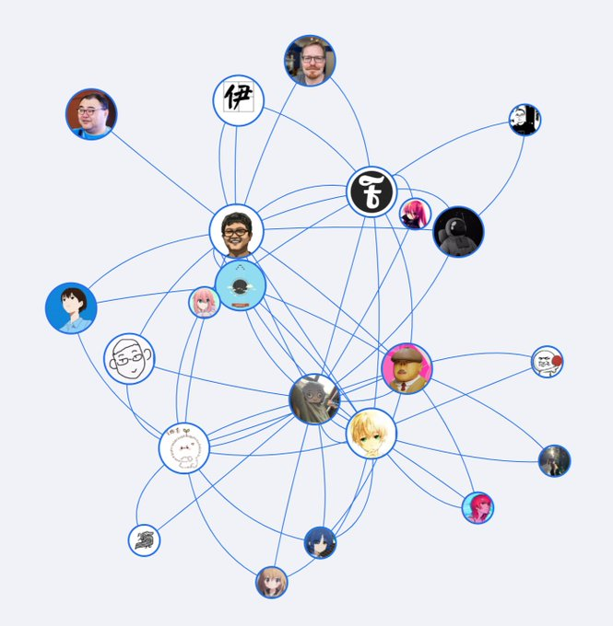
Introduction (1)
Question
✦ If you use any social media application, you may have come across the friend or follower suggestions feature. Have you ever wondered how they work?
“Network”
What is a Network?
✦ A network is a structure that represents a group of objects/people and the relationships between them.
✦ Networks and trees are often used to represent both biological data and knowledge about a system.

Slide 3
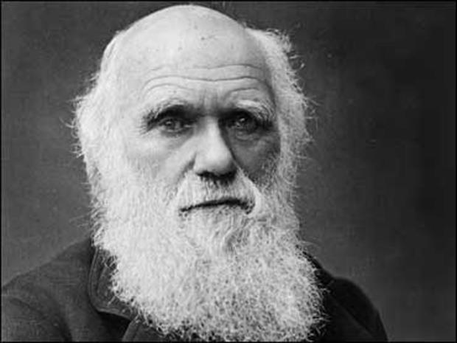
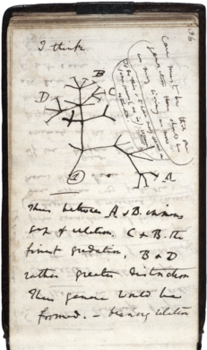
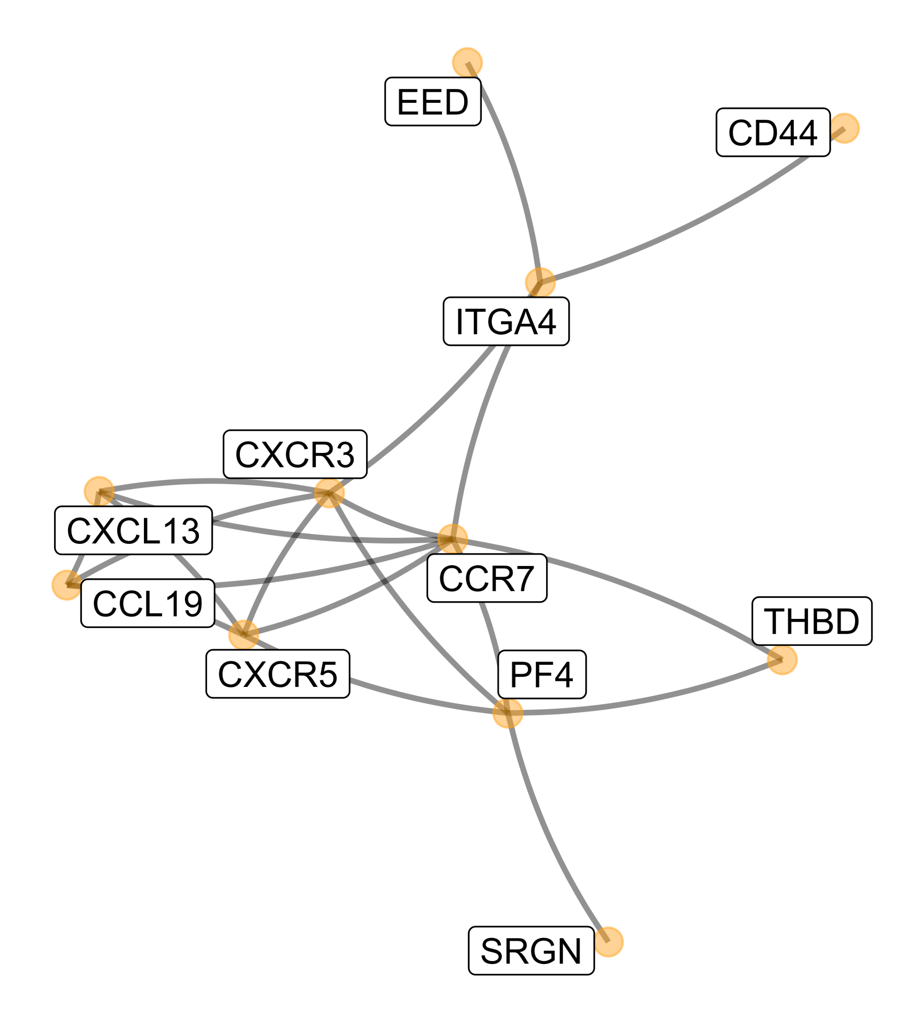
Introduction (2)
Phylogenetic trees were used to represent family relationships between species even before Darwin’s famous notebook sketch.
Networks are often used to schematize complex interactions between proteins involved in diseases as in Figure 10.1.
https://www.cbsnews.com/news/charles-darwin-notebooks-evolution-tree-of-life-stolen-cambridge-university/
https://web.stanford.edu/class/bios221/book/10-chap.html
Notes:
https://www.cbsnews.com/news/charles-darwin-notebooks-evolution-tree-of-life-stolen-cambridge-university/

Slide 4
10.1 Goals for this chapter
In this chapter we will
Use the formal definition of a graph’s components: edges, vertices, layout
We will transform a graph object from igraph into an object that can be visualized according to the layers approach in ggplot2 using ggnetwork.
Graphs are useful ways of encoding prior knowledge about a system, and we will see how they enable us to go from simple gene set analyses to meaningful biological recommendations by mapping significance scores onto the network to detect perturbation hotspots.
We will build phylogenetic trees starting with from DNA sequences and then visualize these trees with the specifically designed R packages ape and ggtree.
We will combine a phylogenetic tree built from microbiome 16S rRNA data with covariates to show how the hierarchical relationship between taxa can increase the power in multiple hypothesis testing.
A special tree called a minimum spanning tree (MST) is very useful for testing the relations between a graph and other covariates. We’ll see how to implement different versions of what is known as the Friedman-Rafsky test. We’ll study both co-occurrence of bacteria in mice litters and strain similarities in HIV contagion networks.

Slide 5
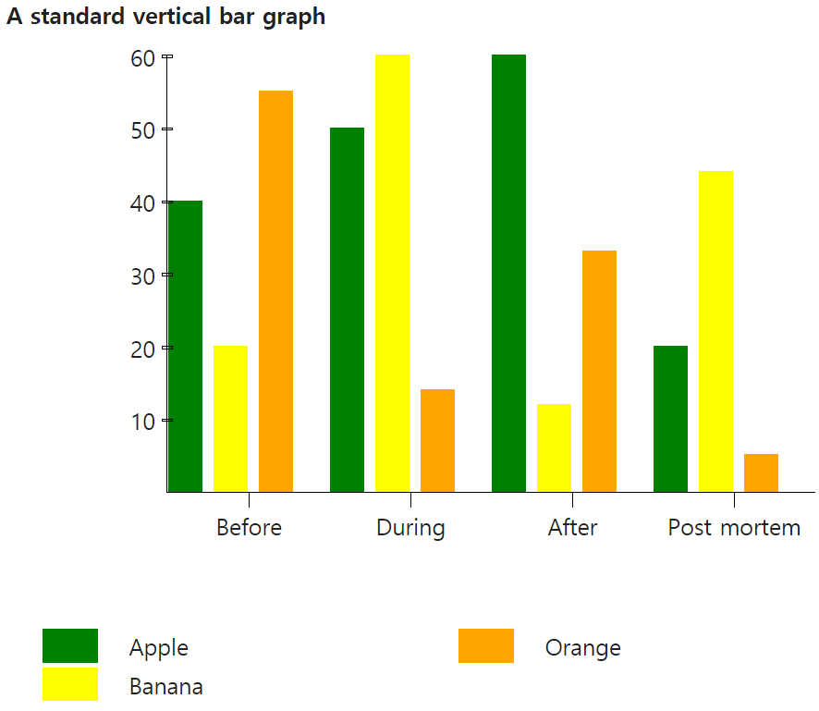
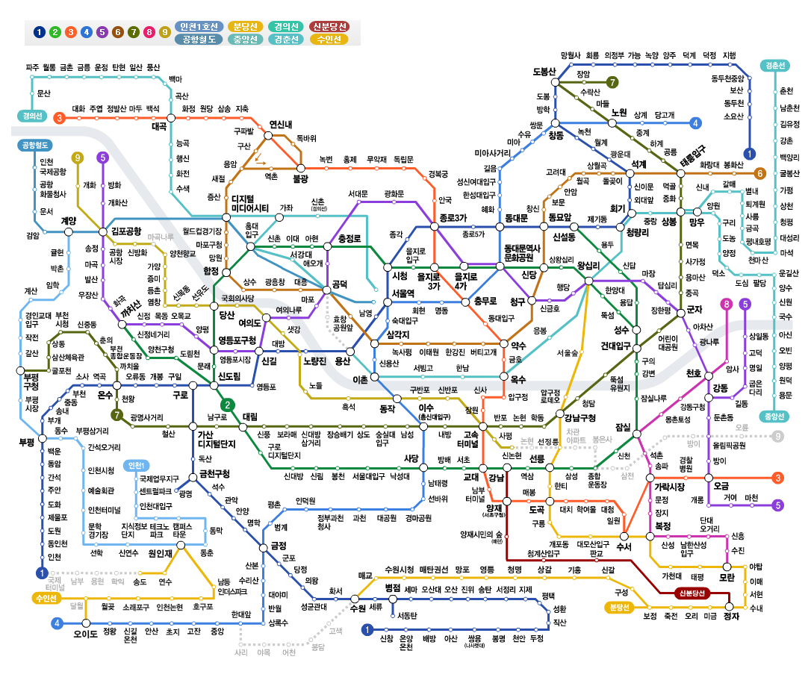
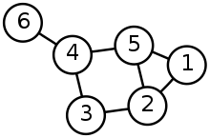
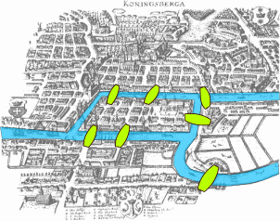
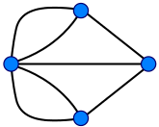
10.2.1 What is a graph and how can it be encoded? (1)
A graph is formed by a set of nodes or vertices (often called V) and a set of edges between these vertices E. – “undirected graphs” and “directed or oriented graphs”
Koenigsberg bridge problem (Seven Bridges of Königsberg)
Eulerian trail (1736)
From wikipedia
Notes:
https://en.wikipedia.org/wiki/Seven_Bridges_of_K%C3%B6nigsberg

Slide 6
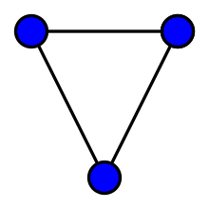
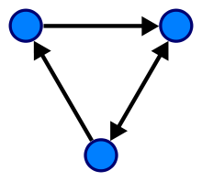
10.2.1 What is a graph and how can it be encoded? (2)
A graph is formed by a set of nodes or vertices (often called V) and a set of edges between these vertices E. – “undirected graph” and “directed or oriented graph”
A graph (sometimes called undirected graph or simple graph) is a pair G = (V, E), where V is a set whose elements are called vertices and E is a set of paired vertices, whose elements are called edges (sometimes links or lines).
Directed graph (or digraph) is a graph in which edges have orientations
From wikipedia

Slide 7
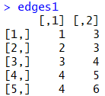
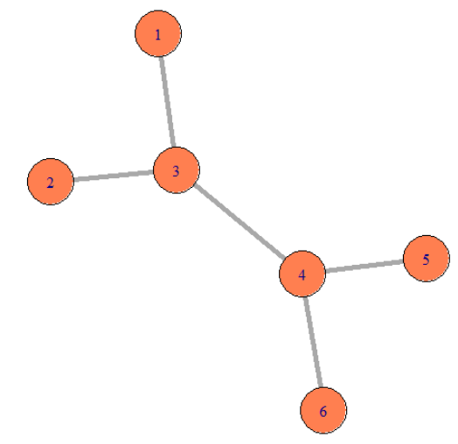
Question 10.1
An adjacency matrix is a square matrix used to represent a finite graph.
For a simple graph with vertex set U = {u₁, …, u_{n}}, the adjacency matrix is a square n × n matrix A such that its element A_{ij} is one when there is an edge from vertex u_{i} to vertex u_{j}, and zero when there is no edge.
U₁
 | U₁ | U₂ | U₃
U₁ | 0 | 1 | 1
U₂ | 1 | 0 | 1
U₃ | 1 | 1 | 0
U₂
U₃

Slide 8
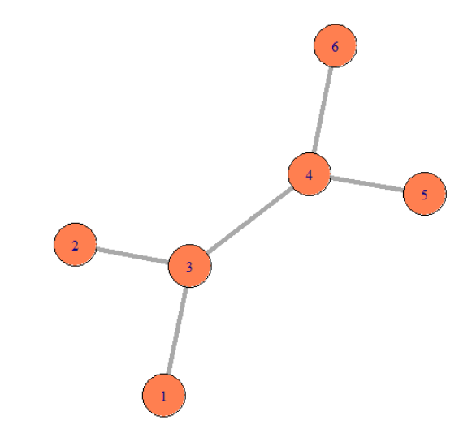
Question 10.2
An adjacency matrix is a square matrix used to represent a finite graph.
For a simple graph with vertex set U = {u₁, …, u_{n}}, the adjacency matrix is a square n × n matrix A such that its element A_{ij} is one when there is an edge from vertex u_{i} to vertex u_{j}, and zero when there is no edge.

Slide 9
Elements of a simple graph (1)
The nodes or vertices. These are the colored circles with numbers in them in Figure 10.2.
Edges or connections, the segments that join the nodes and which can be directed or not.
Edge attributes, such edge length. When not specified, we suppose the edge lengths are all the same, typically, one. “For instance, to compute the distance between two nodes in the graph, we sum up the lengths of the edges along the shortest path.”
We also call a directed graph with edge lengths a network.
The adjacency matric of a network is an n×n matrix of positive numbers corresponding to the edge lengths.

Slide 10
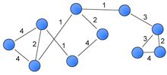
Elements of a simple graph (2)
Weighted graph A weighted graph or a network is a graph in which a number (the weight) is assigned to each edge. For example, in shortest path problems such as the traveling salesman problem

Slide 11
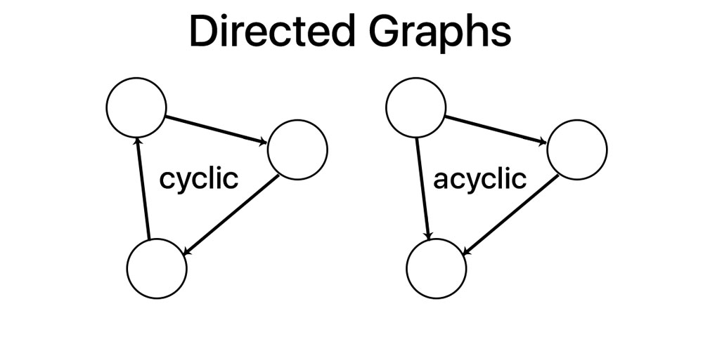
Basic concepts (1)
The degree of a node is the number of edges connected to it.
In directed graphs we differentiate between in-degree and out-degree for incoming and outgoing edges.
We may further distinguish between directed graphs that contain cycles and those that do not (termed cyclic and acyclic graphs).
https://www.steveclarkapps.com/graphs/

Slide 12
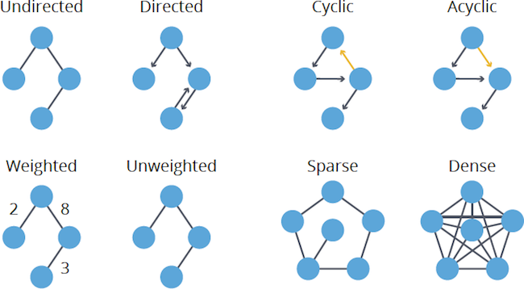
Basic concepts (2)
https://neo4j.com/blog/graph-algorithms-neo4j-graph-algorithm-concepts/

Slide 13
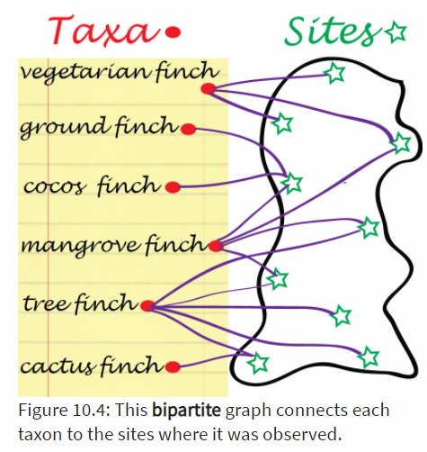
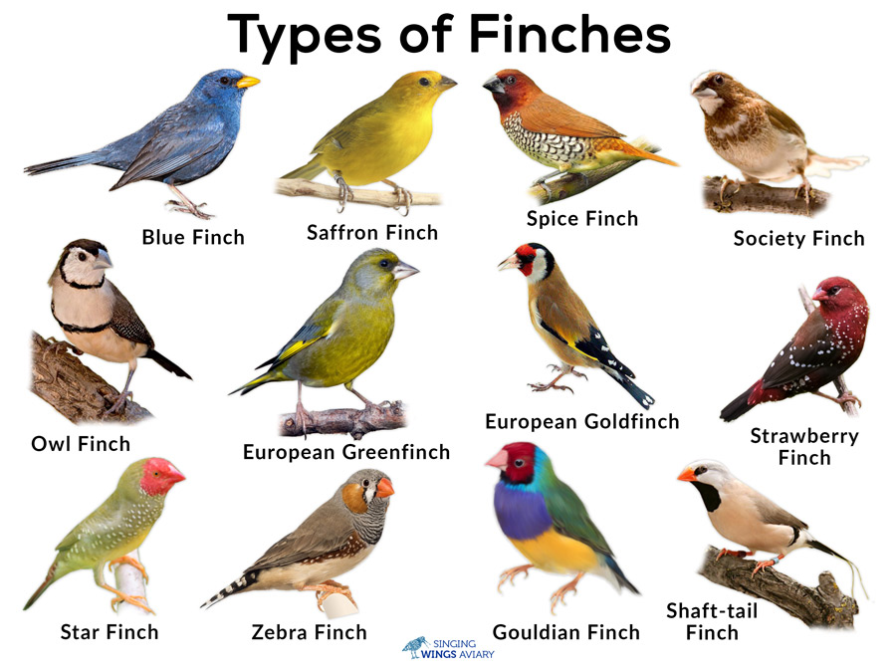
Graphs from data
Graphs from data Usually data do not arrive in the form of graphs.
From distance: Graphs can simplify distance matrices by rounding the smaller distances down to zero. This requires defining a threshold t and then making edges between points whose distances are smaller than the threshold t; these are often called geometric graphs
Binary data: Some data arrive naturally as 0/1 matrices, for instance presence or absence of the different finches in the Galapagos archipelago can be encoded with a 0/1 table.

Slide 14
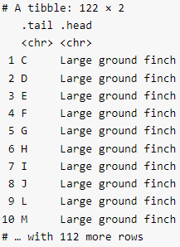
Question 10.3 (1)
Load the finch.csv data and experiment plotting them to highlight that they represent a bipartite network.

Slide 15
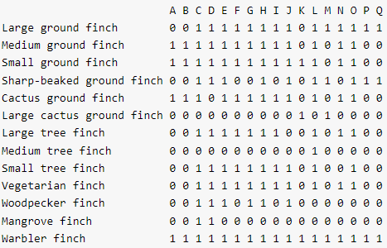
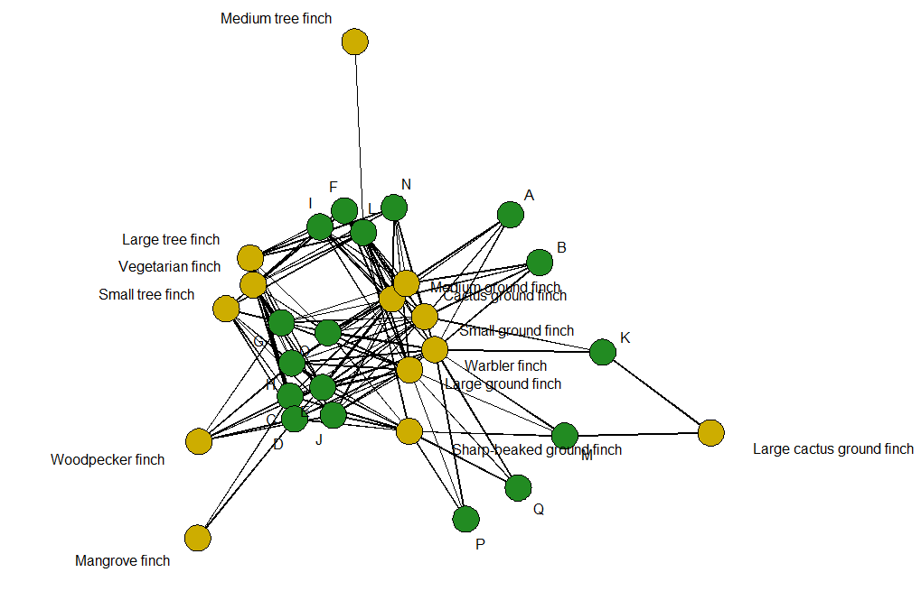
Question 10.3 (2)
Load the finch.csv data and experiment plotting them to highlight that they represent a bipartite network.

Slide 16
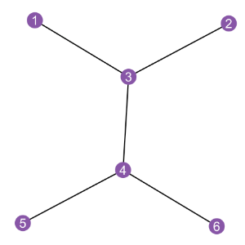
Question 10.4
Make a dataframe from the graph g1 using the ggnetwork package, then plot it using ggplot and the provided geoms geom_edges, geom_nodes, and geom_nodetext.

Slide 17
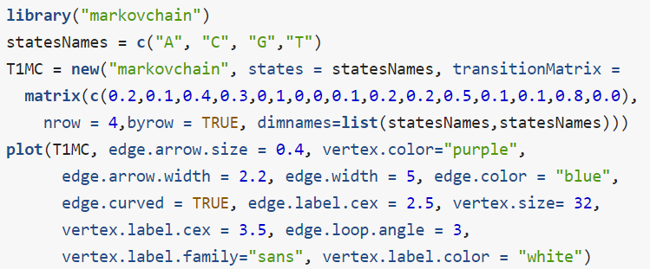
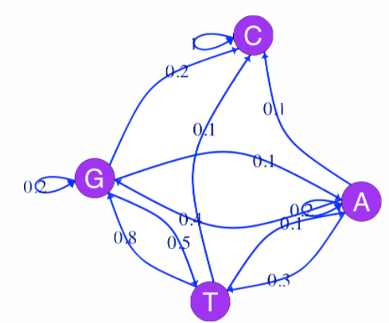
An example: a four state Markov chain
In Chapter 2 we saw how a Markov chain can summarize transitions between nucleotides (considered the states of the system).

Slide 18
Question 10.5
Which state do you think this Markov chain will end up in?
“All nodes except C have outgoing edges, C only has in-going edges and a self-edge. Thus, C is an absorbing state. Sooner or later any process from this chain ends up and stays in C.”

Slide 19
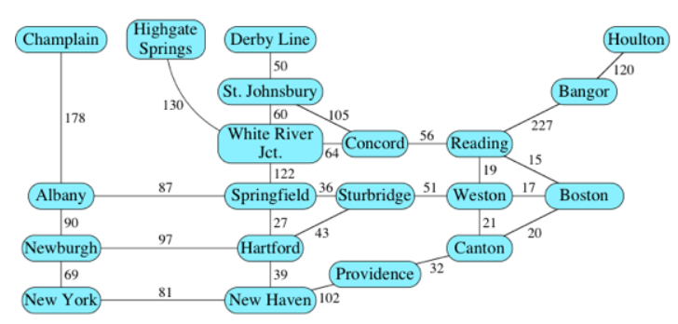
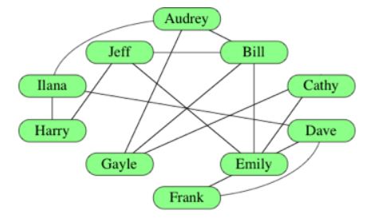
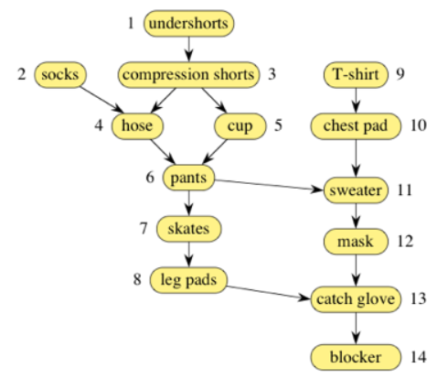
10.2.1 What is a graph and how can it be encoded?
For example) → Social network
For example) → Road map
For example) → Order of clothes
From https://ko.khanacademy.org

Slide 20
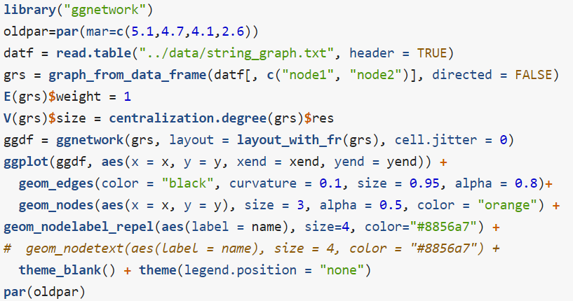
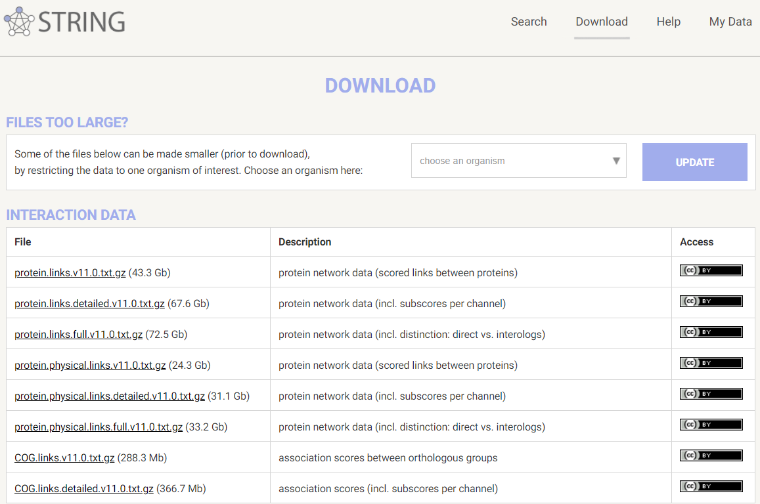
10.2.2 Graphs with many layers: labels on edges and nodes
Here is an example of plotting a graph downloaded from the STRING database with annotations at the vertices.

Slide 21
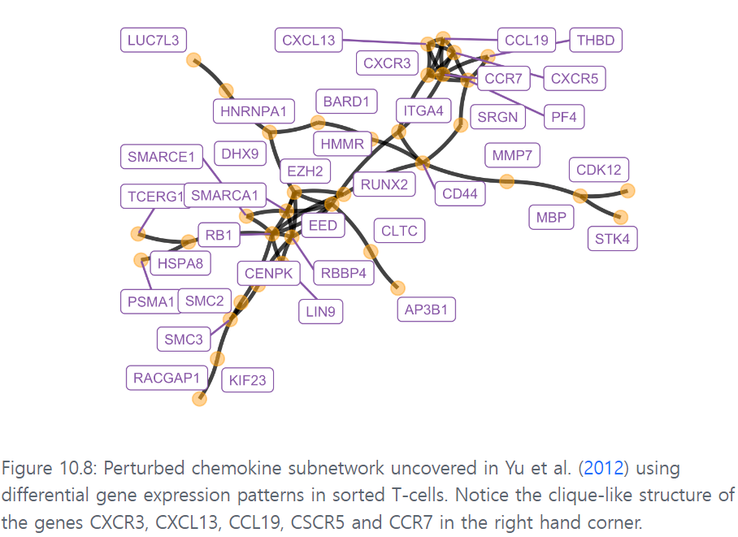
10.2.2 Graphs with many layers: labels on edges and nodes
Here is an example of plotting a graph downloaded from the STRING database with annotations at the vertices.
Figure 10.8 shows the full perturbed chemokine subnetwork discovered in the study of breast cancer metastasis using GXNA (Nacu et al. 2007) and reported by Yu et al. (2012).

Slide 22
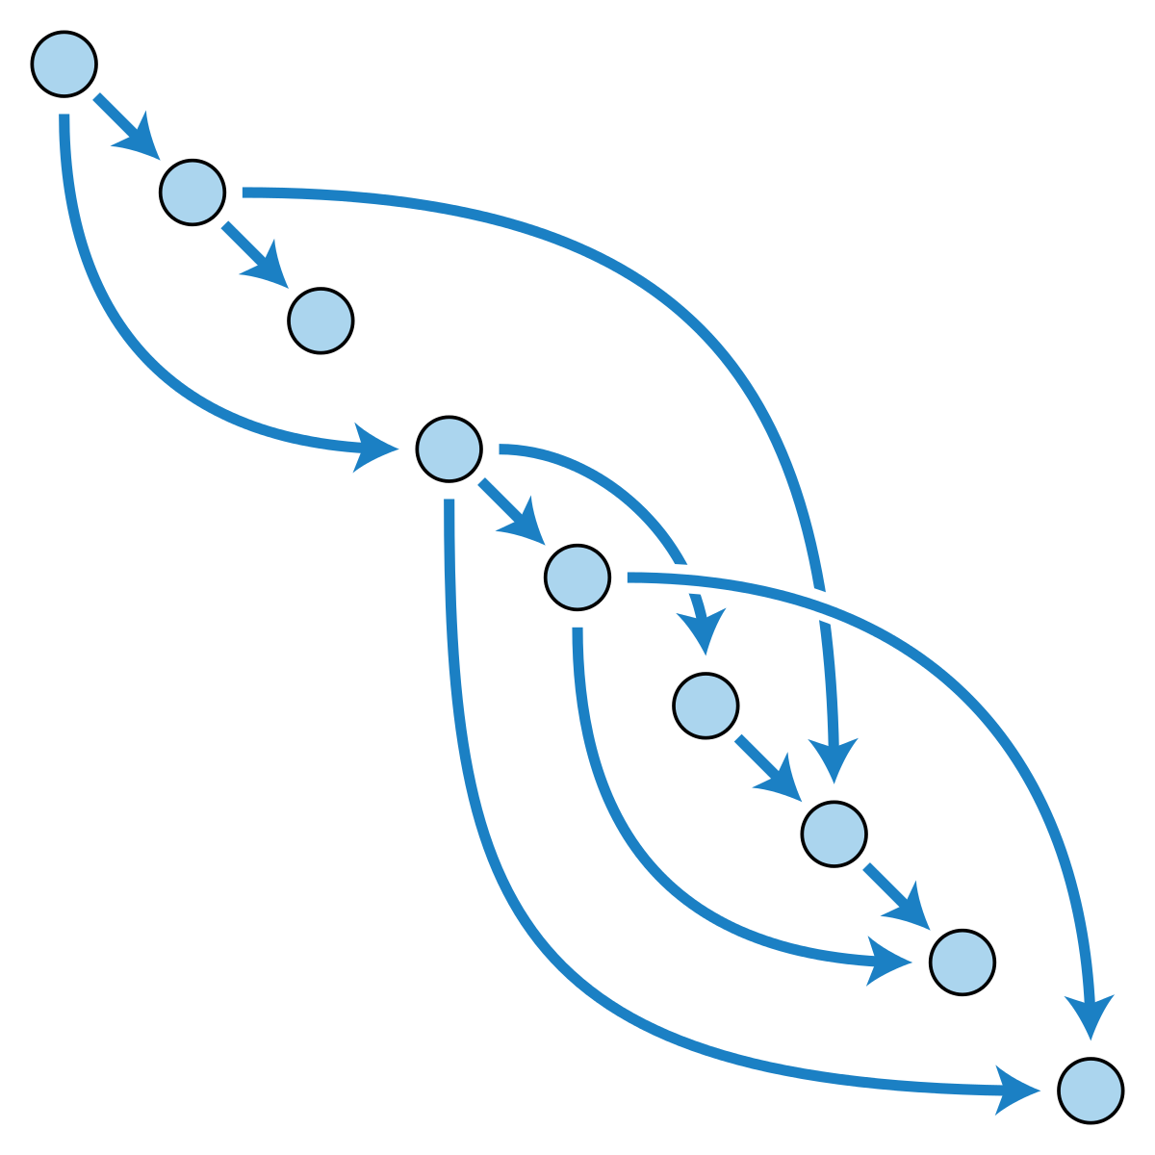
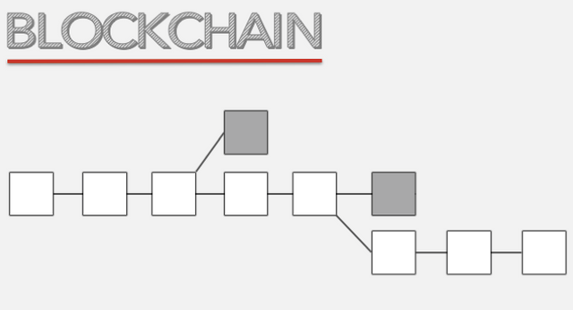
10.3 From gene set enrichment to networks
10.3.1 Methods using pre-defined gene sets (GSEA)
Gene Set Enrichment Analysis (GSEA) is a computational method that determines whether an a priori defined set of genes shows statistically significant, concordant differences between two biological states (e.g. phenotypes).
The Gene Ontology (GO) is a collection of three ontologies that describe genes and gene products. - Molecular function, Biological process, Cellular component
These ontologies have the structure of directed acyclic graph (DAGs)
From https://steemit.com/
From wikipedia

Slide 23
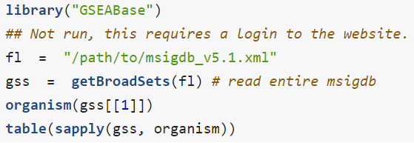
Find a useful database of gene sets
The main purpose of using GO annotations for a particular set of Genes designated as significant in an experiment is to look for the enrichment of a GO term in this list, we will give this term a statistical meaning below.

Slide 24
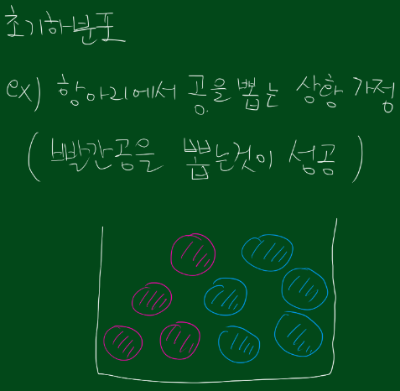
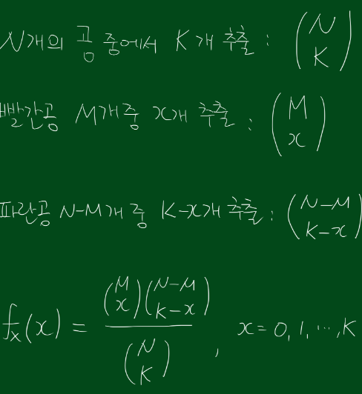
10.3.2 Gene set analysis with two-way table tests
Here, we start by explaining a basic approach often called Fisher’s “exact” test or hypergeometric testing.
For example) → 로또 1등 당첨
From https://losskatsu.github.io/statistics/hypergeometric/#1-%EC%B4%88%EA%B8%B0%ED%95%98%EB%B6%84%ED%8F%AC-%EC%A0%95%EC%9D%98
https://blog.naver.com/mykepzzang/220607187232
N=1,000, m=75 (genes are labeled as significant), Is the blue category enriched or overrepresented?
 | Yellow | Blue | Red
Significant | 25 | 25 | 25
Universe | 500 | 100 | 400

Slide 25
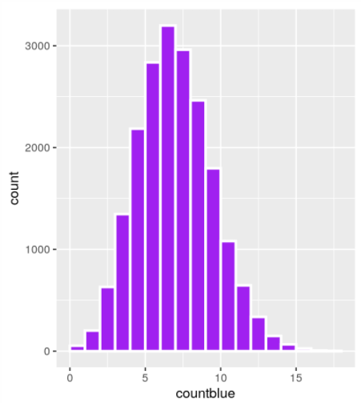
Question 10.6
Run a Monte Carlo experiment with 20,000 simulations and compute the p-value of significance of having 25 blues under the null hypothesis that no category is over- represented in the significant set.
 | Yellow | Blue | Red
Significant | 25 | 25 | 25
Universe | 500 | 100 | 400

Slide 26
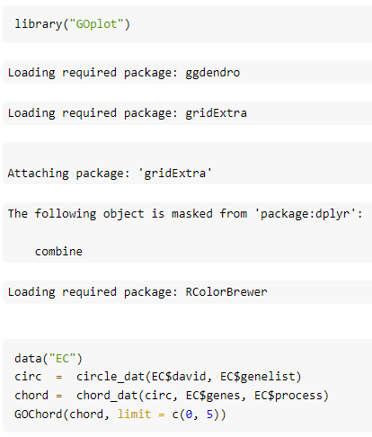
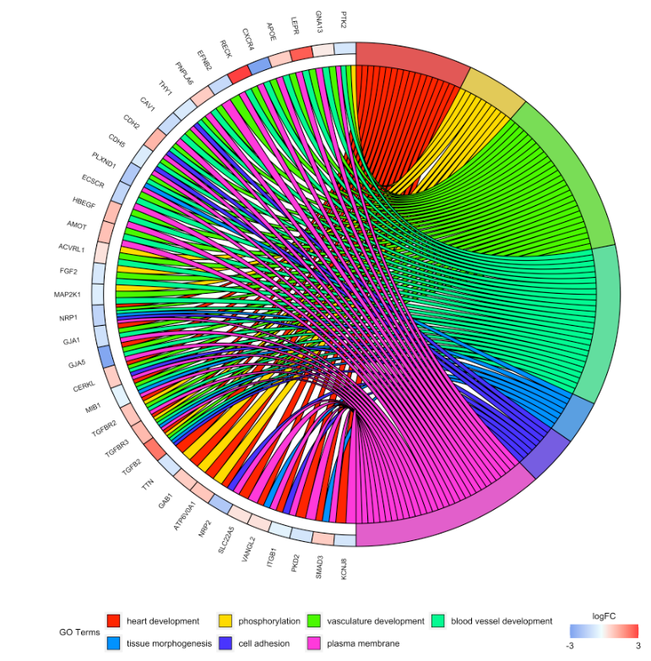
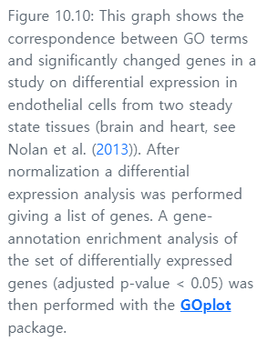
Plotting gene enrichment networks with GOplot

Slide 27
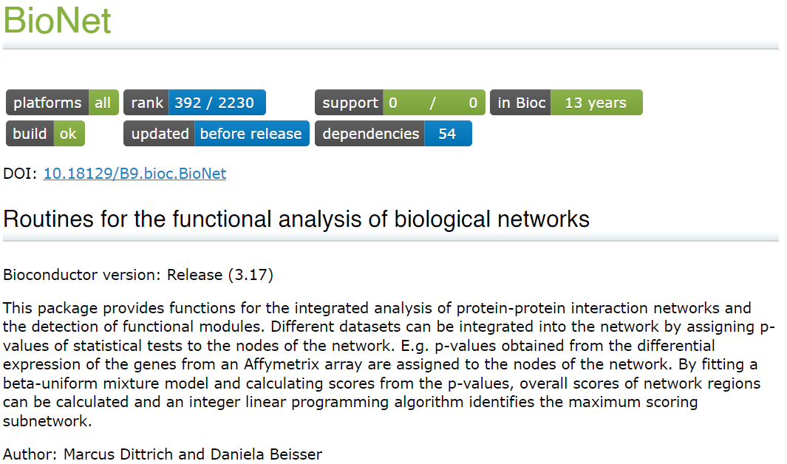
10.3.3 Significant subgraphs and high scoring modules
A careful implementation with many improvements is available as the Bioconductor package BioNet (Beisser et al. 2010). These methods all search for the subgraphs or modules of a scored-skeleton network that seem to be particularly perturbed. Each gene-node in the network is assigned a score that can either be calculated from a t-statistic or a p-value.

Slide 28
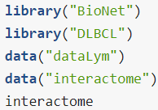
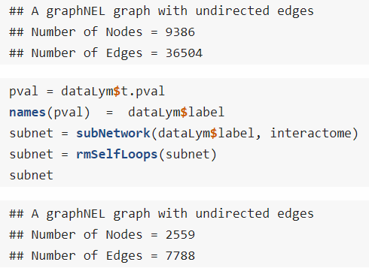
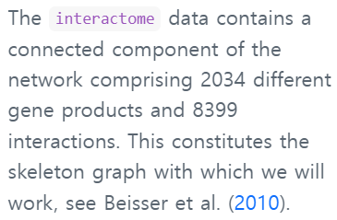
10.3.4 An example with the BioNet implementation
To illustrate the method, we show data from the BioNet package.

Slide 29
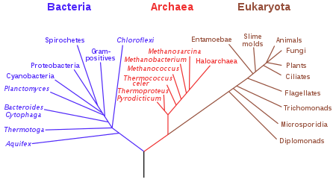
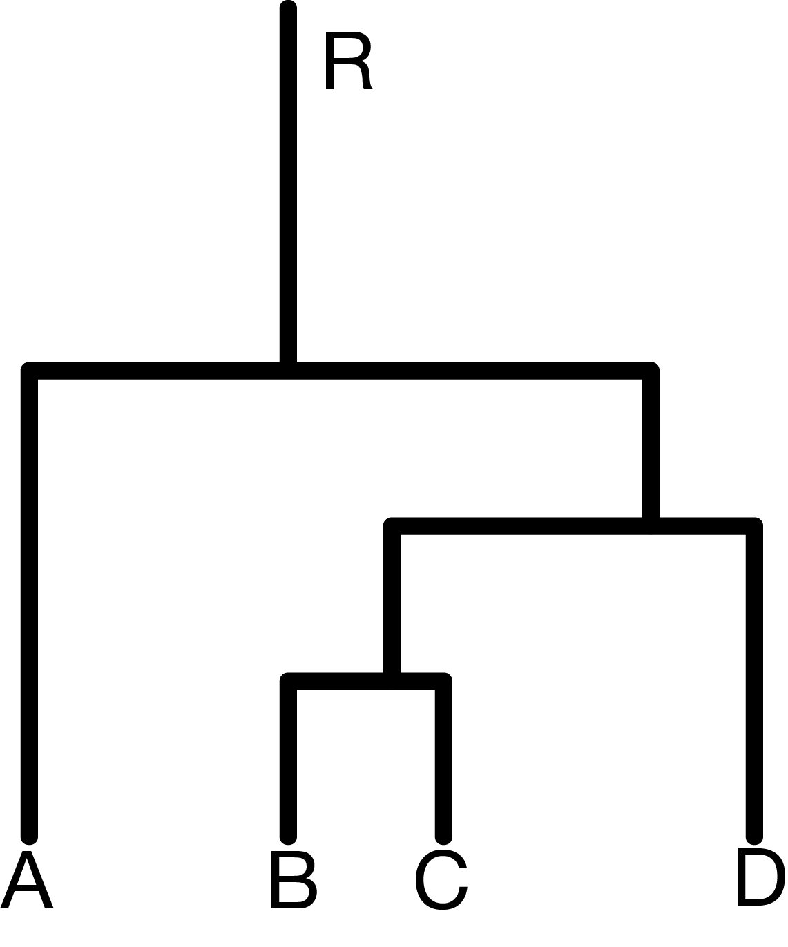
10.4 Phylogenetics Trees
One really important use of graphs in biology is the construction of phylogenetic trees.
Trees are graphs with no cycles (the official word for loops, whether self loops, or ones that go through several vertices).
A phylogenetic tree (also phylogeny or evolutionary tree is a branching diagram or a tree showing the evolutionary relationships among various biological species or other entities based upon similarities and differences in their physical or genetic characteristics.
From wikipedia

Slide 30
The example of HIV (1)
HIV is a virus that protects itself by evolving very fast (within months, several mutations can appear).
Its evolution can thus be followed in real time; whereas the evolution of large organisms which has happened over millions of years.
HIV trees are built for medical purposes such as the detection and understanding of drug resistance.
They are estimated for individual genes. Different genes can show differences in their evolutionary histories and thus produce different gene trees.

Slide 31
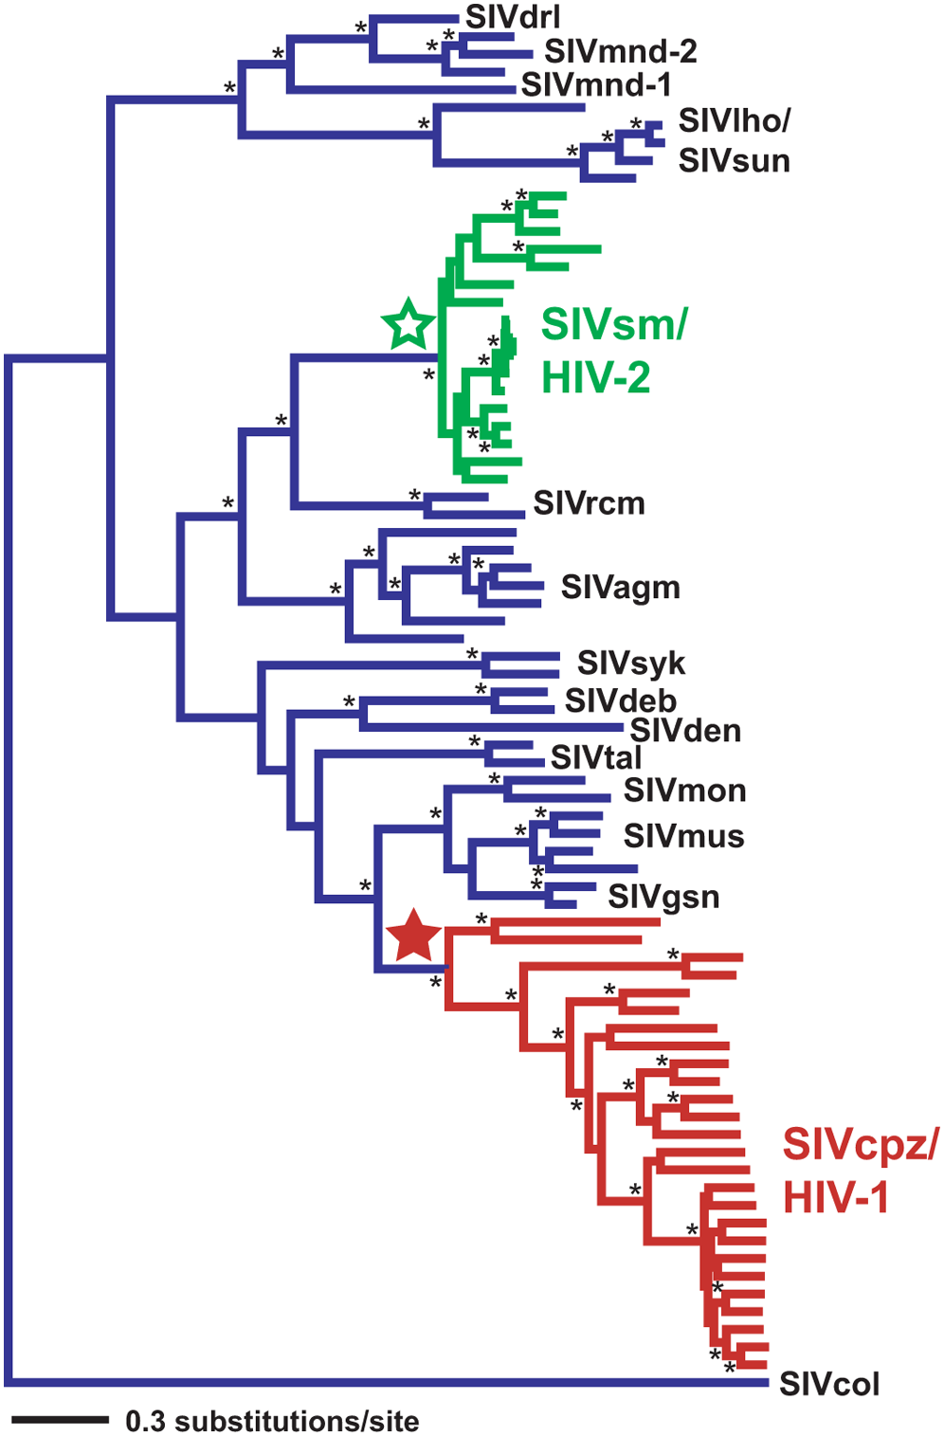
The example of HIV (2)
The phylogenetic tree in Figure 10.15 shows times when the virus switched from monkeys to humans (Wertheim and Worobey 2009).

Slide 32
Special elements in phylogenies
Most phylogenetic trees are shown rooted, the `root’ is usually found by including an outgroup in the tree tips, as we will see later.
Characters that are derived from this common ancestry are called homologous (geneticists doing population studies replace the term homology by identity by descent (IBD)).
Sisters on the tree defined by a common ancestor are called clades or monophyletic groups, they have more than just similarities in common.

Slide 33
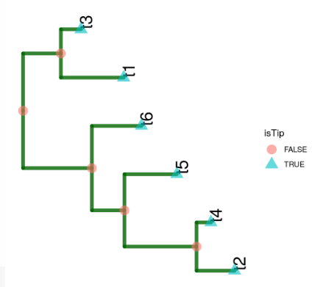
10.4.2 Simulating data and plotting a tree (1)
Suppose we already know our phylogenetic tree and want to simulate the evolution of the nucleotides down this tree.

Slide 34
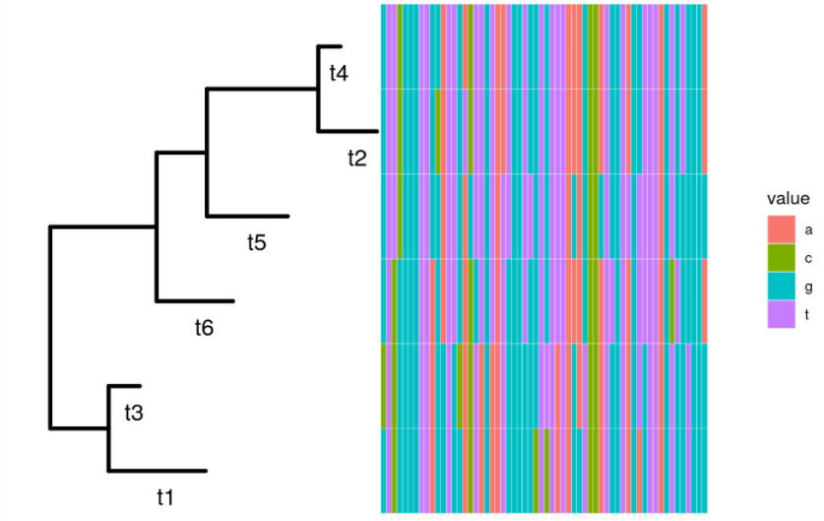
10.4.2 Simulating data and plotting a tree (2)
Now we generate some sequences from our tree. Each sequence starts with a new nucleotide letter generated randomly at the root; mutations may occur as we go down the tree.

Slide 35
10.4.3 Estimating a phylogenetics tree (1)
When the true tree-parameter is known, the above-mentioned probabilistic generative models of evolution tells us what patterns to expect in the sequences.
As we have seen in earlier chapters, statistics means going back from the data to reasonable estimates of the parameters; here the tree itself and the branch lengths, even the evolutionary rates can be considered to be the parameters.

Slide 36
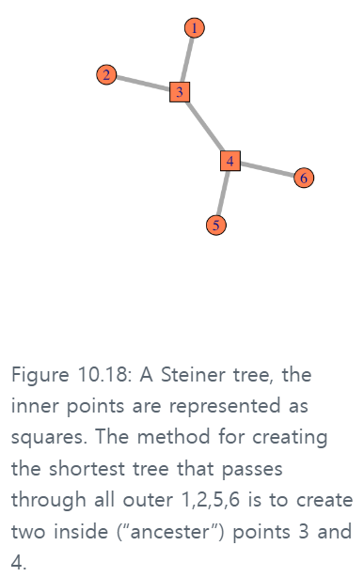
10.4.3 Estimating a phylogenetics tree (2)
There are several approaches to estimation: tree `building’ is no exception, here are the main ones:
A nonparametric estimate: Parsimony is a nonparametric method that minimizes the number of changes necessary to explain the data, it’s solution is the same as that of the Steiner tree problem.
A parametric estimate: the maximum likelihood tree:
In order to estimate the tree using a maximum likelihood or Bayesian approach one needs a model for molecular evolution that integrates mutation rates and branch edge lengths.

Slide 37
10.4.3 Estimating a phylogenetics tree (2)
There are several approaches to estimation: tree `building’ is no exception, here are the main ones:
A nonparametric estimate: Parsimony is a nonparametric method that minimizes the number of changes necessary to explain the data, it’s solution is the same as that of the Steiner tree problem.
A parametric estimate: the maximum likelihood tree:
In order to estimate the tree using a maximum likelihood or Bayesian approach one needs a model for molecular evolution that integrates mutation rates and branch edge lengths.

Slide 38
10.4.3 Estimating a phylogenetics tree (2)
There are several approaches to estimation: tree `building’ is no exception, here are the main ones:
A nonparametric estimate: Parsimony is a nonparametric method that minimizes the number of changes necessary to explain the data, it’s solution is the same as that of the Steiner tree problem.
A parametric estimate: the maximum likelihood tree:
In order to estimate the tree using a maximum likelihood or Bayesian approach one needs a model for molecular evolution that integrates mutation rates and branch edge lengths.

Slide 39
10.4.3 Estimating a phylogenetics tree (3)
There are several approaches to estimation: tree `building’ is no exception, here are the main ones:
Bayesian posterior distributions for trees: Bayesian estimation, MrBayes (Ronquist et al. 2012) or BEAST (Bouckaert et al. 2014) both use MCMC to find posterior distributions of the phylogenies.
The semi-parametric approach: distance based methods These methods, called Neighbor Joining and UPGMA, are quite similar to the hierachical clustering algorithms we already encountered in Chapter 5.

Slide 40
10.4.3 Estimating a phylogenetics tree (4)
There are several approaches to estimation: tree `building’ is no exception, here are the main ones:
The semi-parametric approach: distance based methods : Neighbor Joining and UPGMA
From wikipedia

Slide 41
10.4.3 Estimating a phylogenetics tree (5)
There are several approaches to estimation: tree `building’ is no exception, here are the main ones:
The semi-parametric approach: distance based methods : Neighbor Joining and UPGMA
From wikipedia

Slide 42
10.4.3 Estimating a phylogenetics tree (6)
There are several approaches to estimation: tree `building’ is no exception, here are the main ones:
The semi-parametric approach: distance based methods : Neighbor Joining and UPGMA
From wikipedia

Slide 43
Question 10.11
Generate the maximum likelihood scores of the tree1 given the seqs6 data and compare them to those of the neighbor joining tree

Slide 44
10.4.4 Application to 16S rRNA
In Chapter 5 we saw how to use a probabilistic clustering method to denoise 16S rRNA sequences. We can now reload these denoised sequences and preprocess them before building their phylogeny.

Slide 45
10.6 Minimum spanning trees (1)
A very simple and useful graph is the so-called minimum spanning tree (MST). Given distances between vertices; the MST is the tree that spans all the points and has the minimum total length
Here we are going to take the DNA sequence distances between strains of HIV from patients all over the world and construct their minimum spanning tree.
https://blog.naver.com/babobigi/221884140229

Slide 46
10.6 Minimum spanning trees (2)
Here we are going to take the DNA sequence distances between strains of HIV from patients all over the world and construct their minimum spanning tree.

Slide 47
10.6 Minimum spanning trees (3)
Here we are going to take the DNA sequence distances between strains of HIV from patients all over the world and construct their minimum spanning tree.

Slide 48
Question 10.16
Make the network plot again, but replace geom_nodetext with labels that repel each other to minimize the overlapping node labels.
epel: 408 unlabeled data points (too many overlaps).

Slide 49
10.6 Minimum spanning trees (4)

Slide 50
10.6 Minimum spanning trees (5)

Slide 51
10.6.1 MST based testing: the Friedman-Rafsky test
Graph-based two-sample tests were introduced by Friedman and Rafsky (Friedman and Rafsky 1979) as a generalization of the Wald-Wolfowitz runs test.
The Wald–Wolfowitz runs test (or simply runs test), named after statisticians Abraham Wald and Jacob Wolfowitz is a non-parametric statistical test that checks a randomness hypothesis for a two-valued data sequence.
The Friedman-Rafsky tests for two/multiple sample segregation on a minimum spanning tree.
Instead of looking for consecutive values of one type (‘runs’), we count the number of connected nodes of the same type.

Slide 52
10.6.2 Example: Bacteria sharing between mice
Here we illustrate the idea on a collection of samples from mice whose stool were analyzed for their microbial content.

Slide 53
10.7 Summary of this chapter
Annotated graphs
In this chapter we have learnt how to store and plot data that have more structure than simple arrays: graphs have edges and nodes that can also be associated to extra annotations that can be displayed usefully.
Important examples of graphs and useful R packages
We started by specific examples such as Markov chain graphs, phylogenetic trees and minimum spanning trees.
Combining graphs with statistical data
We then approached the problem of incorporating a known `skeleton’ graph into differential expression analyses.
Linking co-occurrence to other variables
Graph and network tools also enable the creation of networks from co-occurrence data and can be used to visualize and test the effect of factor covariates.
Context and intepretation aids
Previous knowledge or outcome

