Slide 1
Chapter6. Hypothesis testing

Slide 2
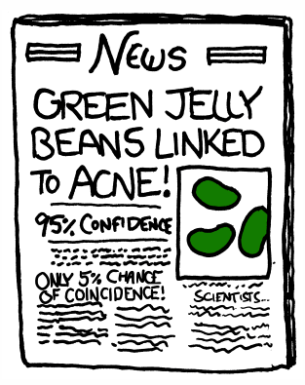
“Statistically significant” : hypothesis testing을 통해 얻어지는 결론
researchers screen genetic variants for associations with a phenotype, or gene expression levels for associations with disease
면포성 여드름, Acne comedonica

Slide 3
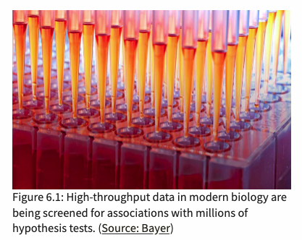
현대 바이오 데이터 분석에서는 수천 수만개의 테스트를 통해 결론을 내리게 된다.
in whole genome sequencing, we scan every position in the genome for a difference between the DNA library at hand and a reference (or, another library): that’s on the order of three billion tests if we are looking at human data!
In genetic or chemical compound screening, we test each of the reagents for an effect in the assay, compared to a control: that’s again tens of thousands, if not millions of tests.
In Chapter 8, we will analyse RNA-Seq data for differential expression by applying a hypothesis test to each of the thousands of genes assayed.

Slide 4
이번 챕터에서 다룰 내용들
Understand the basic principles of decision making by hypothesis testing, pitfalls, strengths, use cases and limitations
What changes when we go from single to multiple testing?
False discovery rates
P-values
Multiple testing ‘adjustments’
Hypothesis filtering and weighting

Slide 5
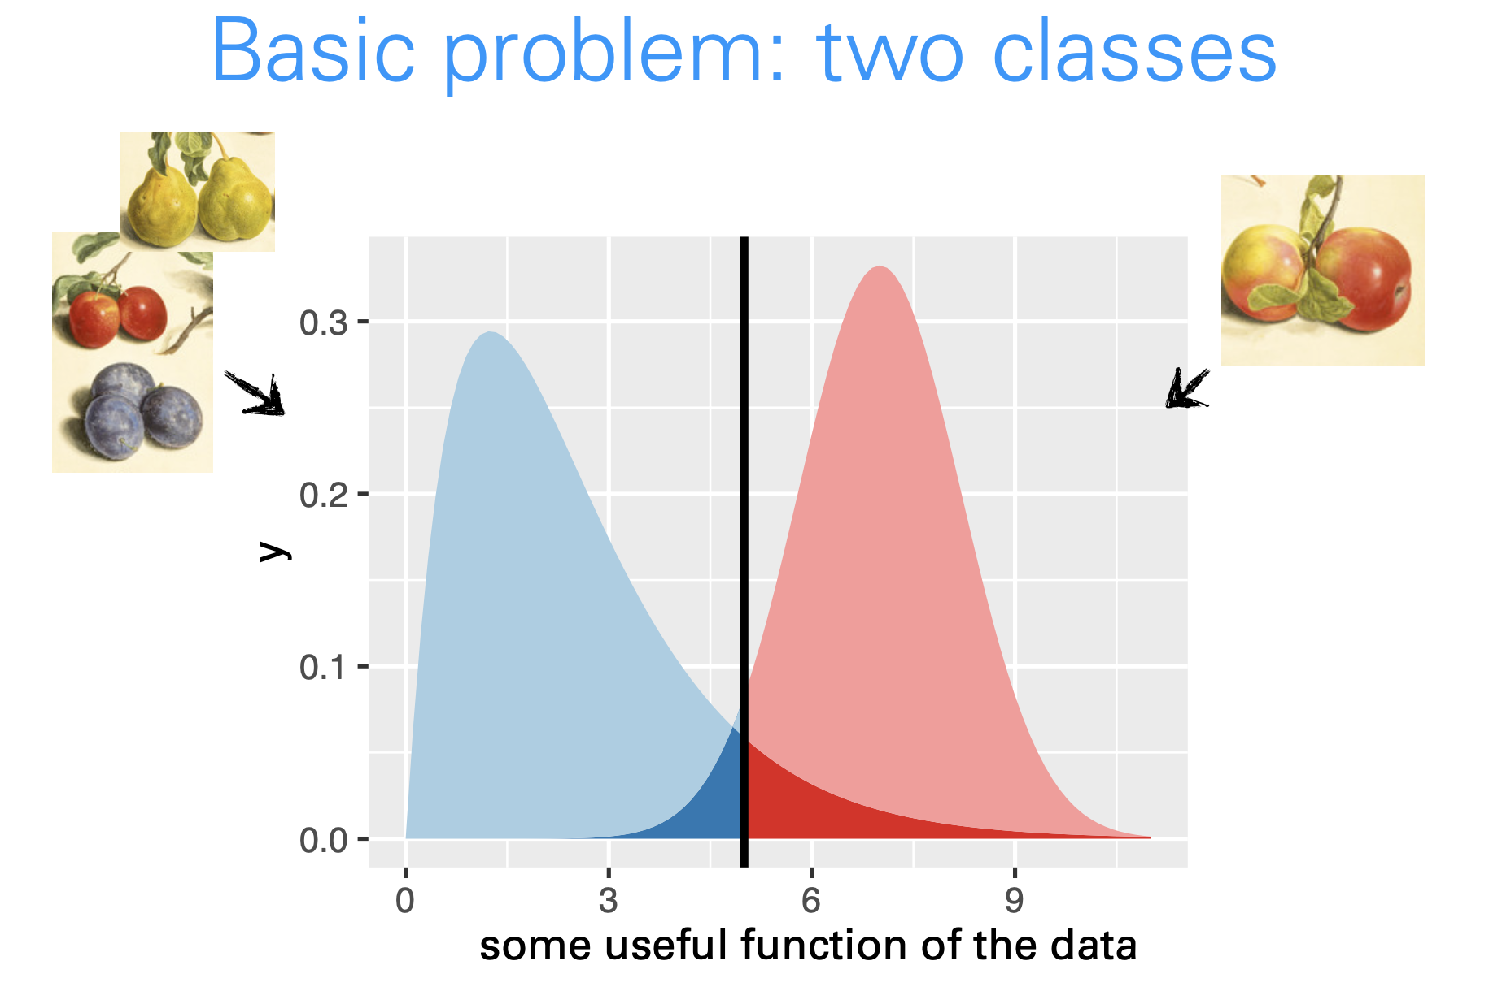
Testing versus classification

Slide 6
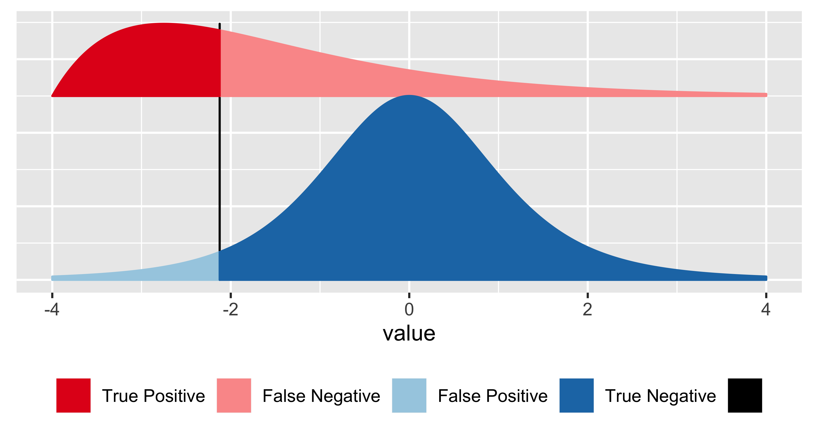
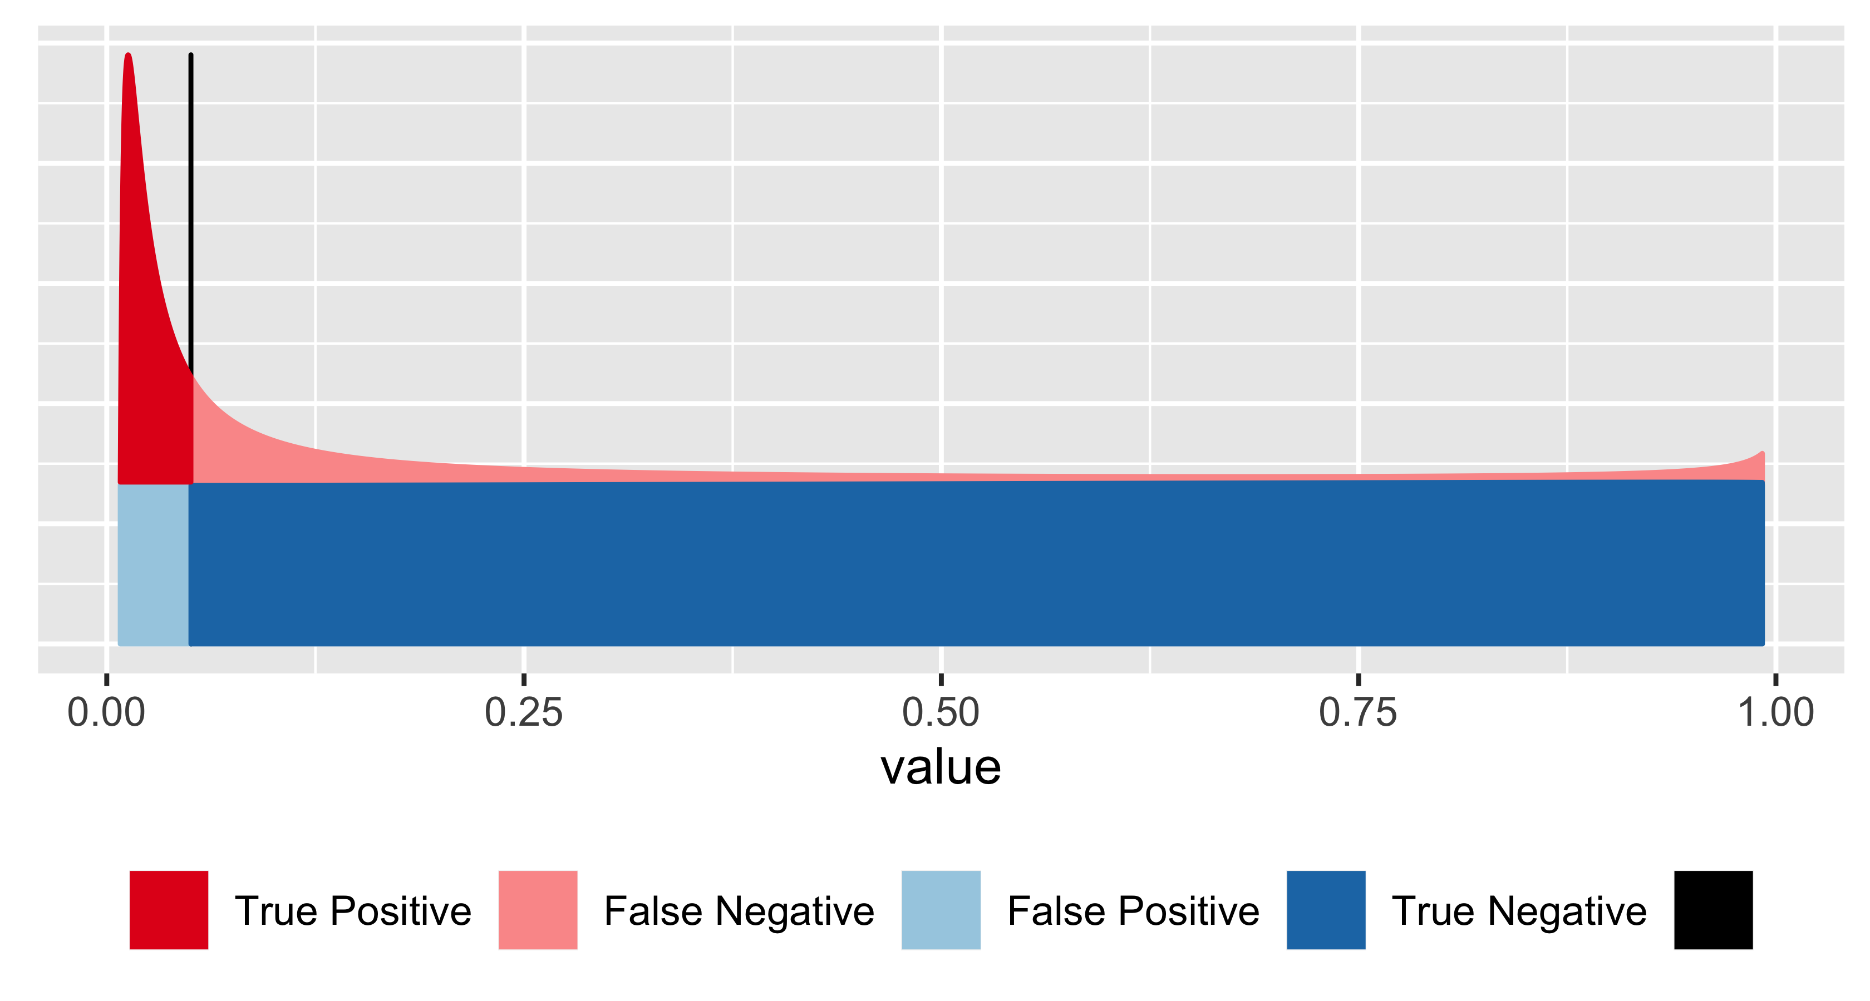
False discovery rate versus p-value

Slide 7
Hypothesis testing에 필요한 용어 정리

Slide 8
How to make rational decisions based on noisy, finite data

Slide 9
Topic1. 동전 던지기와 binomial test

Slide 10
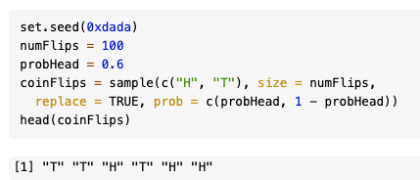
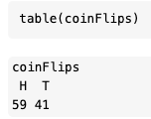
R 을 이용한 동전던지기 시뮬레이션

Slide 11
동전 던지기 결과를 놓고서, 동전이 공정한지 판단하는 방법?
Would the data be strong enough to make them conclude that this coin isn’t fair? They know that random sampling differences are to be expected.

Slide 12
동전 던지기는 Binomial distribution을 통해 테스팅할 수 있다!
As expected, the most likely number of heads is 50, that is, half the number of coin flips. But we see that other numbers near 50 are also quite likely. How do we quantify whether the observed value, 59, is among those values that we are likely to see from a fair coin, or whether its deviation from the expected value is already large enough for us to conclude with enough confidence that the coin is biased?

Slide 13
동전 던지기에 사용된 동전이 공정한지 아닌지 판단하는 컷오프 : Rejection region
We divide the set of all possible kk (0 to 100) in two complementary subsets, the rejection region and the region of no rejection. Our choice here is to fill up the rejection region with as many kk as possible while keeping their total probability, assuming the null hypothesis, below some threshold αα (say, 0.05).

Slide 14
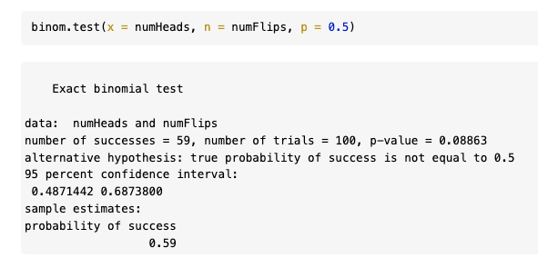
We have just gone through the steps of a binomial test

Slide 15
Topic2. Hypothesis Testing의 순서

Slide 16
The Five Steps of Hypothesis Testing

Slide 17
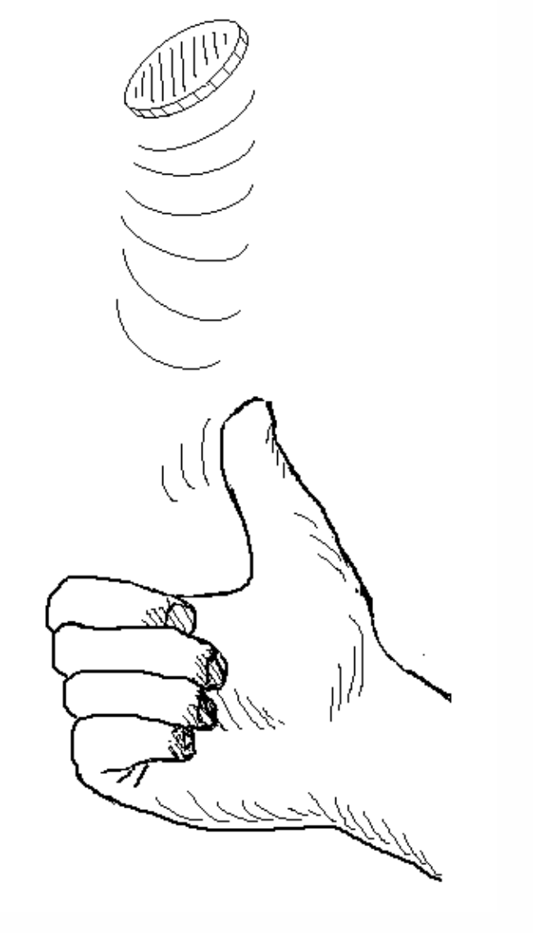
(1) Test statistic
The test statistic in our example was the total number of heads. Suppose we observed 50 tails in a row, and then 50 heads in a row. Our test statistic ignores the order of the outcomes, and we would conclude that this is a perfectly fair coin. However, if we used a different test statistic, say, the number of times we see two tails in a row, we might notice that there is something funny about this coin.

Slide 18
(2) Null hypothesis
Examples of null hypotheses:
The coin is fair
The new drug is no better or worse than a placebo
The effect of that RNAi-treatment on my cells is no different than that of a negative control treatment
These are not null hypotheses:
The number of heads and tails were the same
The coin is not fair
The drug should not be approved

Slide 19
(2) Null hypothesis를 만드는 두 가지 방법

Slide 20
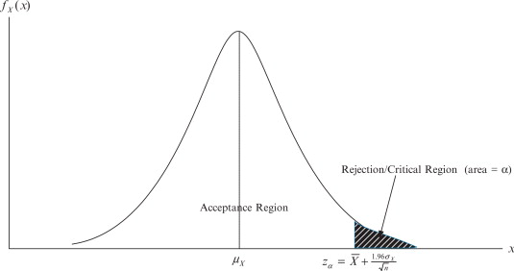
(3) The reject region

Slide 21
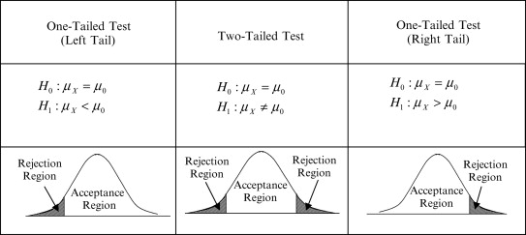
(3) The reject region – one-tailed and two-tailed test

Slide 22
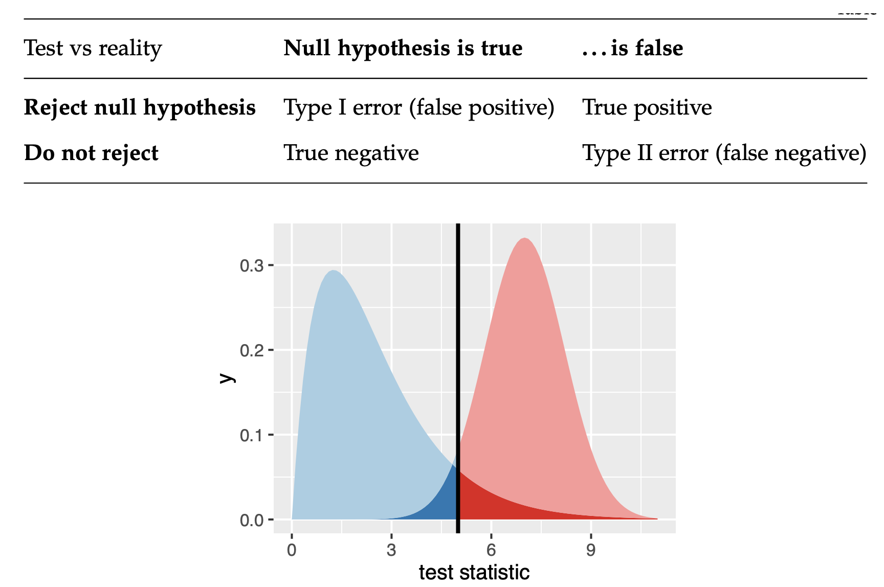
Types of Error in Testing
It’s always possible to reduce one of the two error types at the cost of increasing the other one. The real challenge is to find an acceptable trade-off between both of them.
False negative rate (FNR)
False positive rate (FPR) = alpha

Slide 23
Types of Error in Testing
Conservative!
False negative rate (FNR)
False positive rate (FPR) = alpha

Slide 24
Topic3. t-test

Slide 25
The t-test
simplest comparison we can make is between two groups, say, cells treated with a substance compared to cells that are not

Slide 26
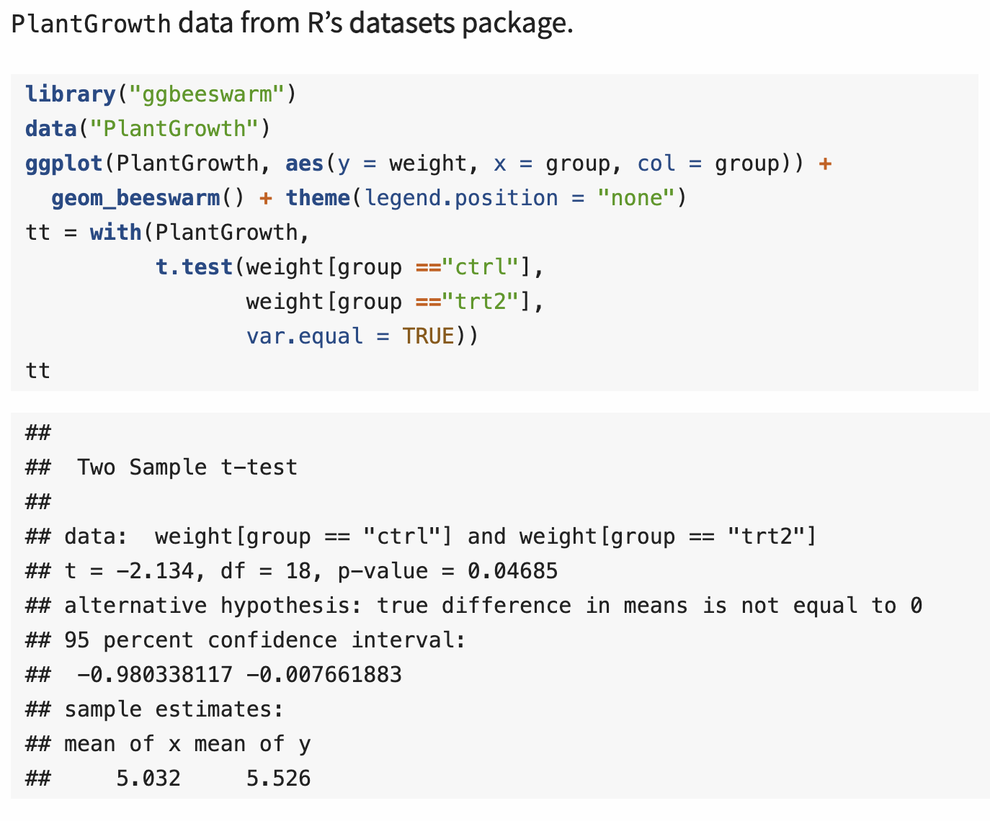
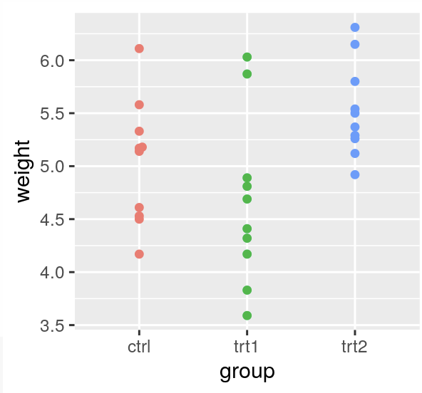
The t-test applied to plant growth data

Slide 27
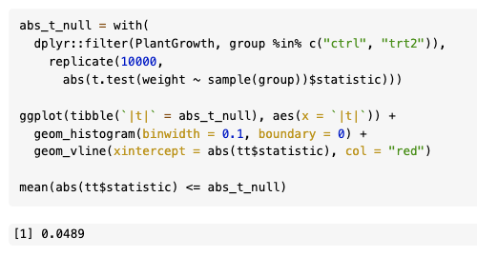
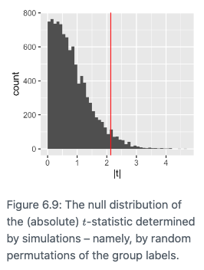
Assumptions in the t-test and permutation test (these are two different tests)
To compute the p-value, the t.test function uses the asymptotic theory for the t-statistic Equation 6.4; this theory states that under the null hypothesis of equal means in both groups, the statistic follows a known, mathematical distribution, the so-called t-distribution with n1+n2−2 degrees of freedom. The theory uses additional technical assumptions, namely that the data are independent and come from a normal distribution with the same standard deviation

Slide 28
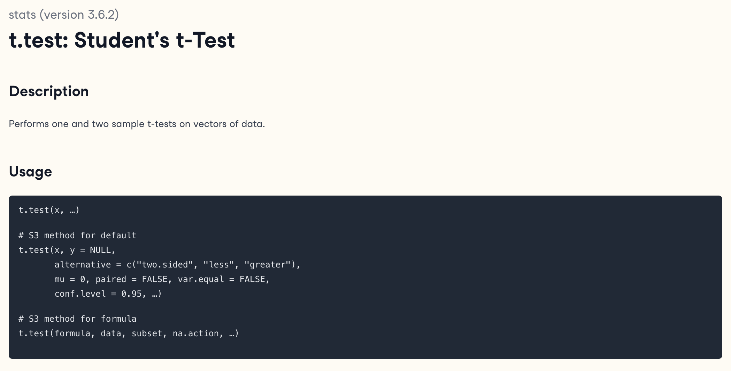
The t-test comes in multiple flavors
Two-sided or One-sided
Two-sample or One-sample
Unpaired or paired
Equal variance or unequal variance

Slide 29
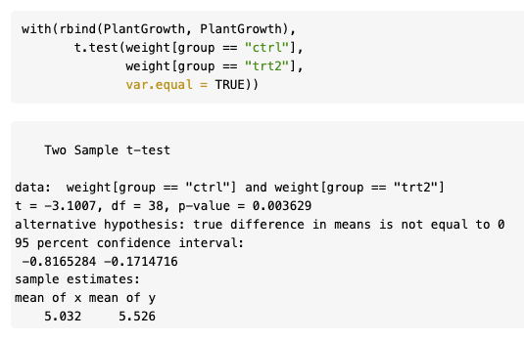
The independence assumption
Now let’s try something peculiar: duplicate the data.
The power of the t-test depends on the sample size
The assumption of independence between the measurements is really important (for instance, if you had data from 8 plants, but measured the same thing twice on each plant (technical replicates), then pretending that these are now 16 independent measurements is wrong.

Slide 30
Recap: Single hypothesis testing
P-values are random variables: uniformly distributed if the null hypothesis is true – and should be close to zero if the alternative holds
We prove something by disproving (‘rejecting’) the opposite (the null hypothesis). Reject = Discover
Not rejecting does not prove the null hypothesis
Repeating the experiment (under the null): Around 5% of the times the p-value will be less than 0.05 by change
All this reasoning is probabilistic. Testing & p-values are for rational decision making in uncertain contexts.

Slide 31
테스팅을 할 때 주의해야 하는 것들

Slide 32
Topic4. Multiple testing and false discovery rate

Slide 33
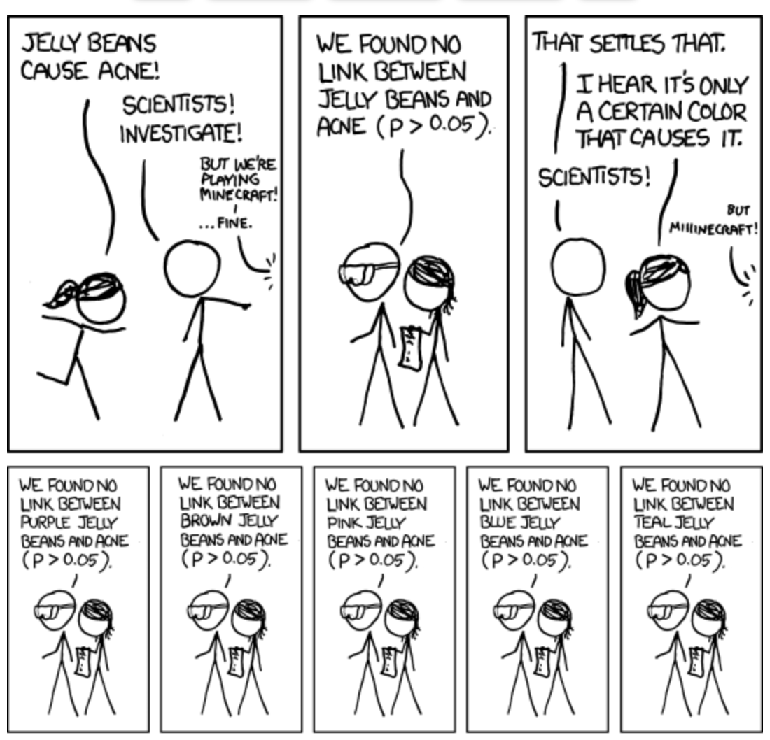
Multiple Testing

Slide 34
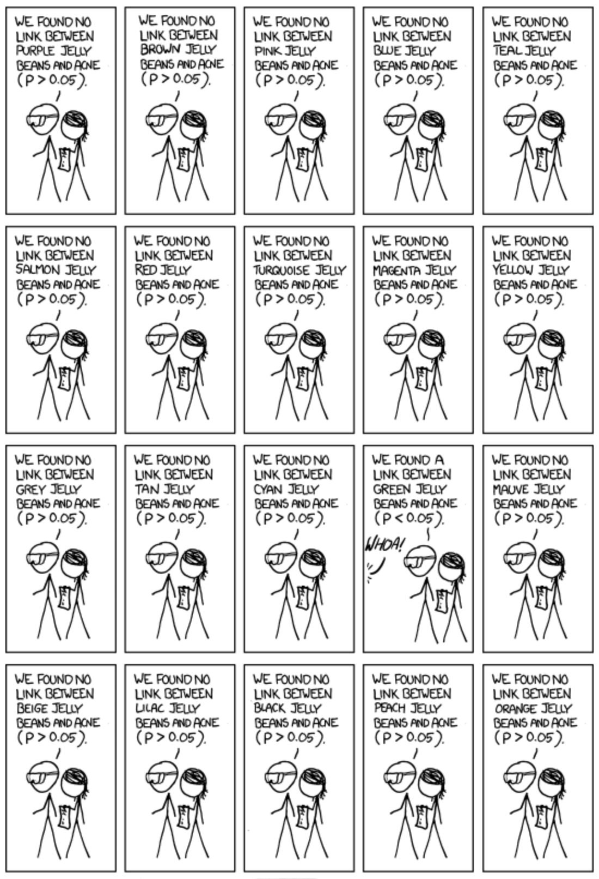
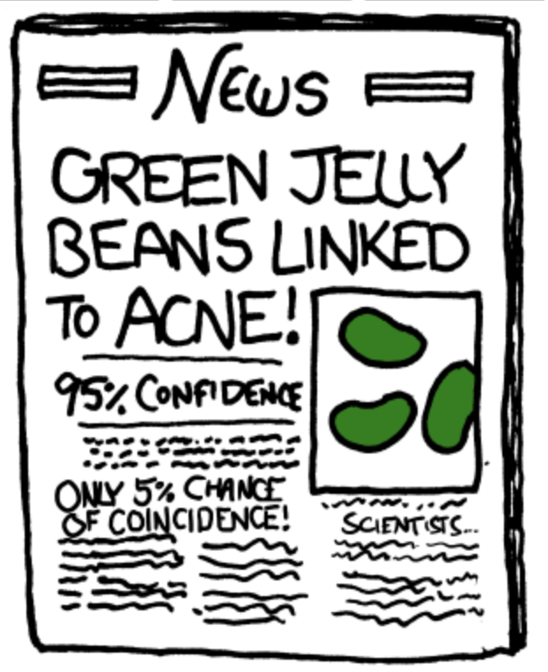
Why didn’t the newspaper report the results for the other colors?

Slide 35
바이오 데이터에서 Multiple testing이 일어나는 예시

Slide 36
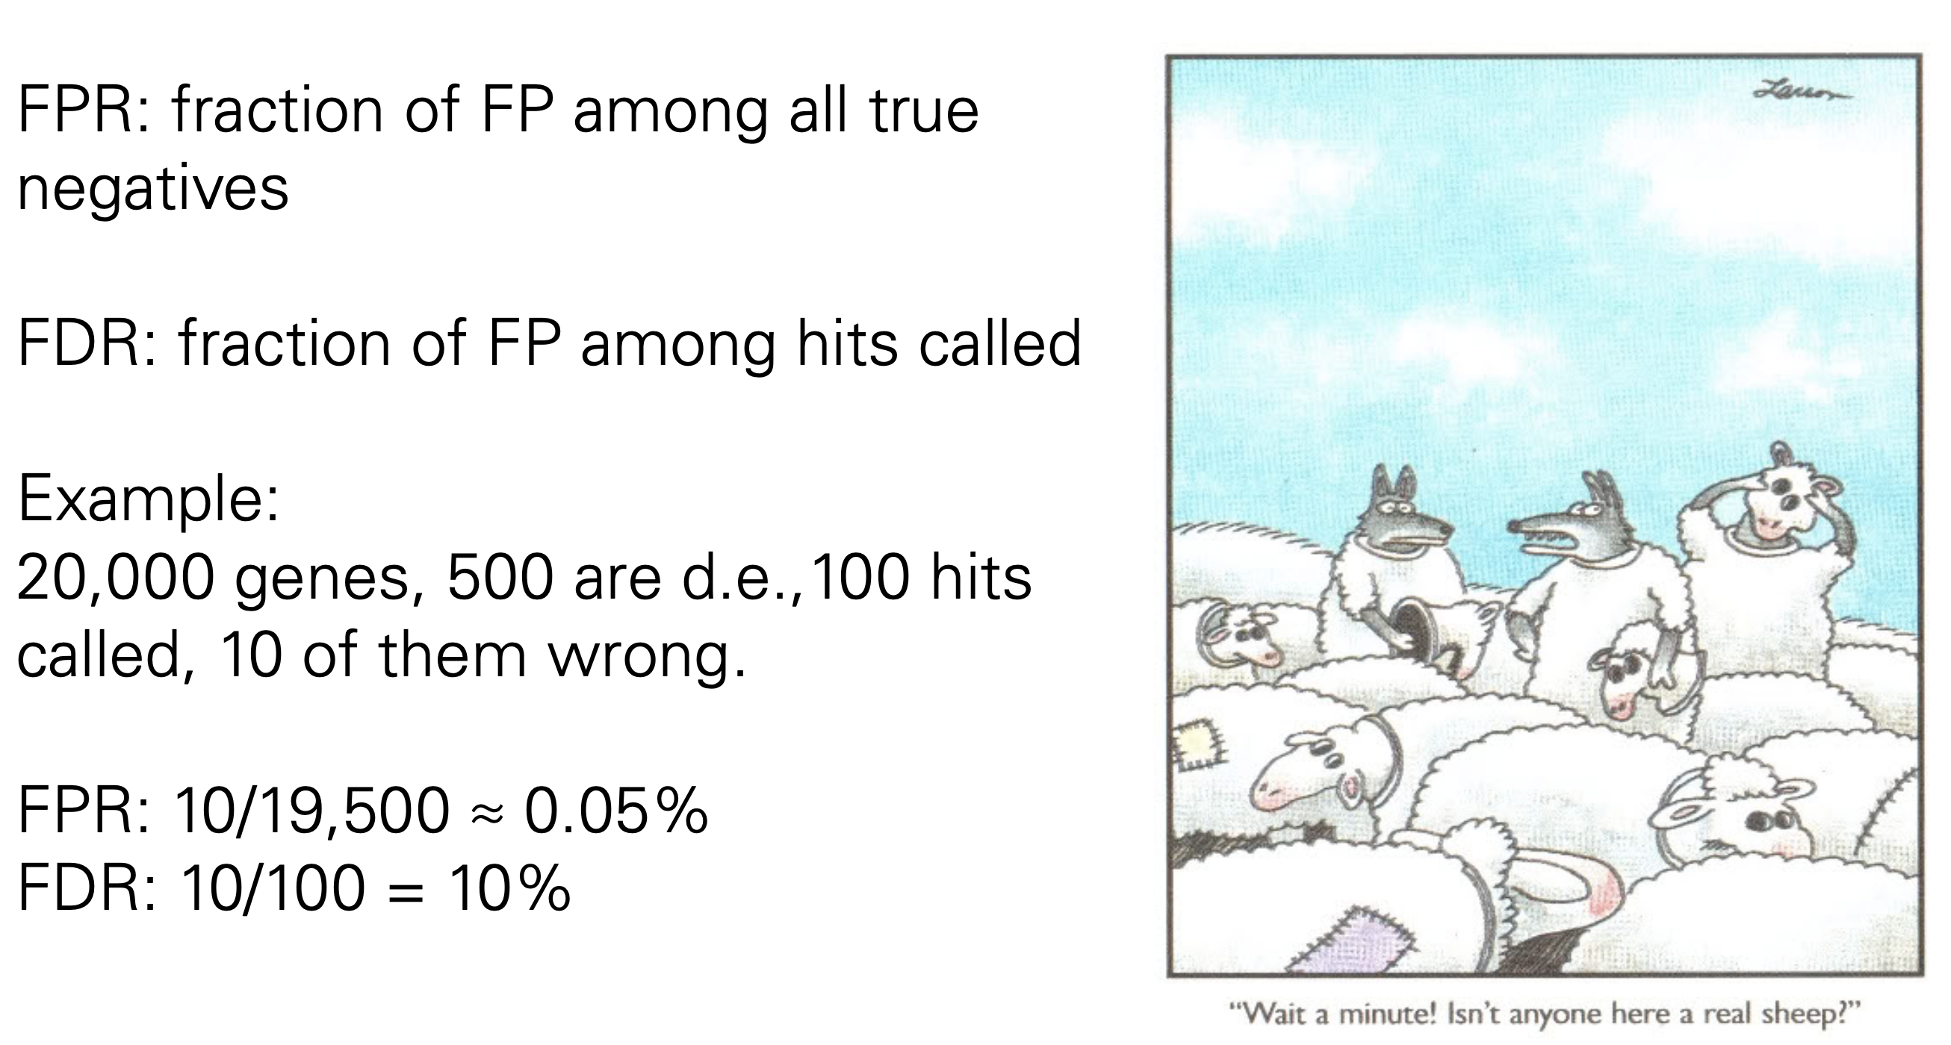
False positive rate and false discovery rate

Slide 37
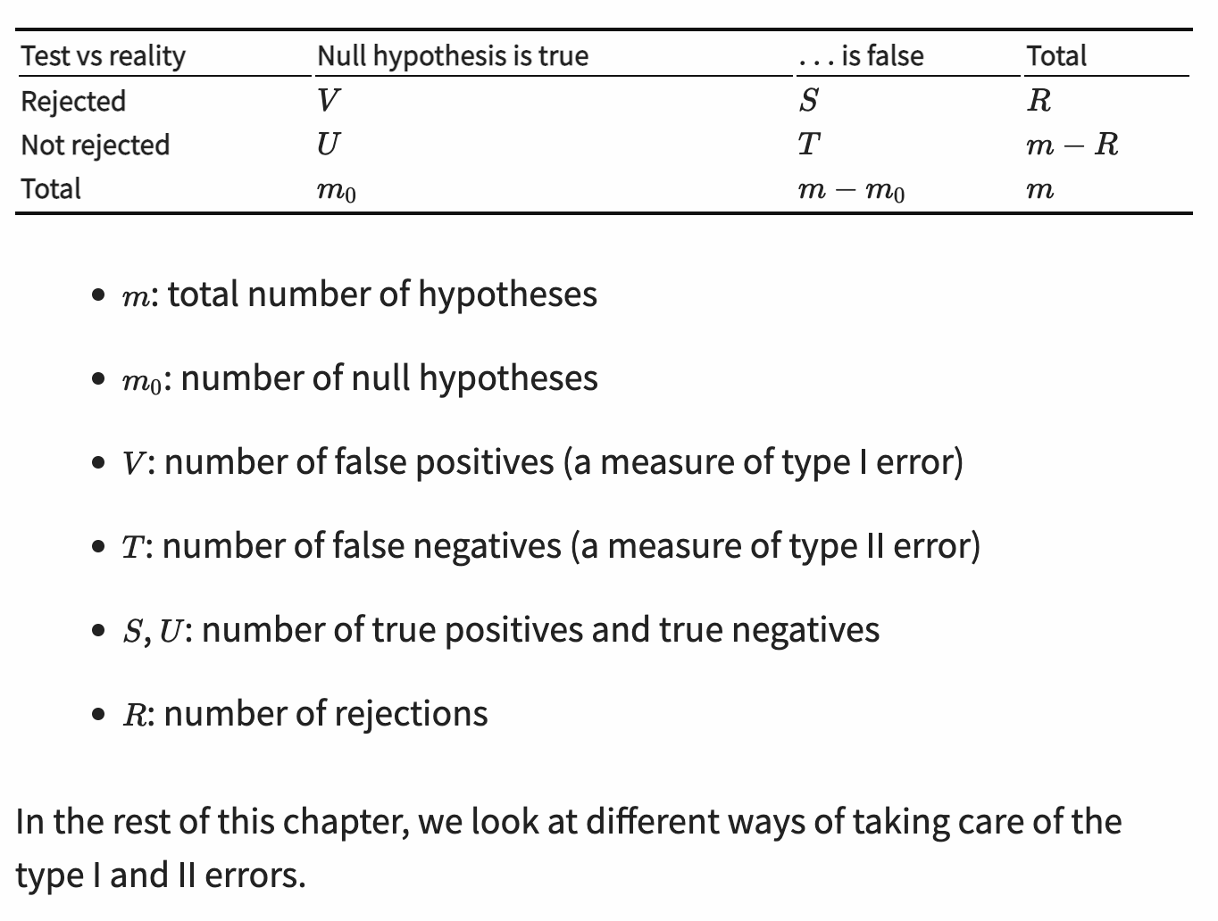
Types of errors in multiple testing

Slide 38
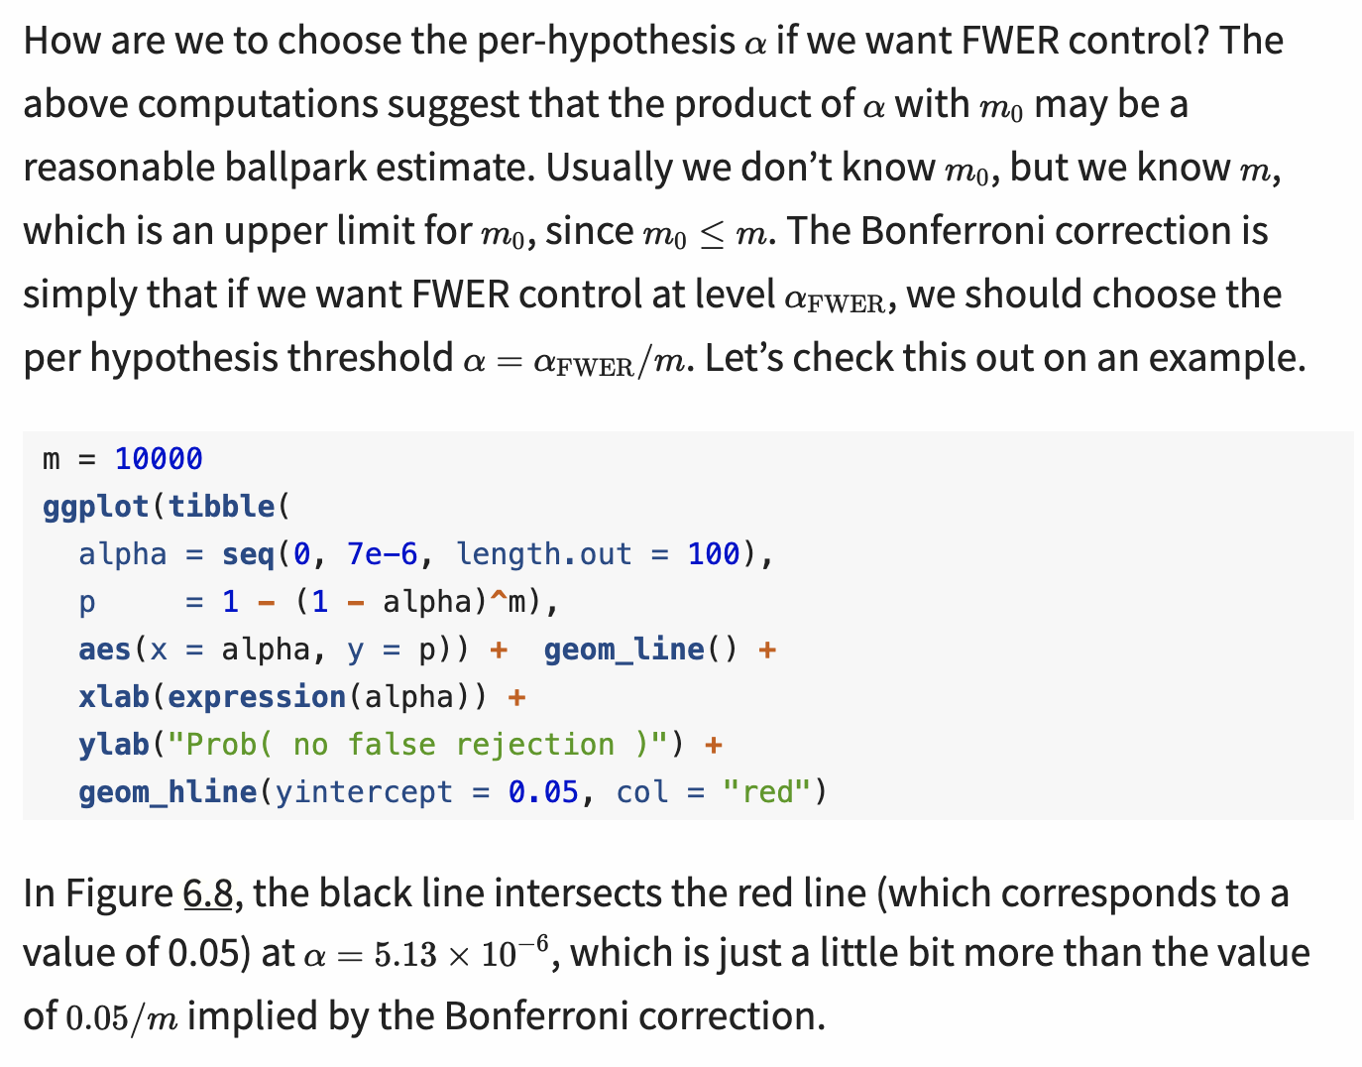
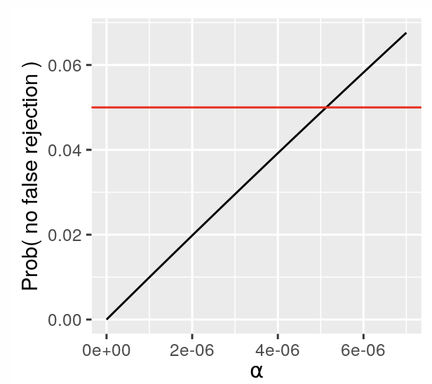
The family wise error rate (FWER) and Bonferroni correction
The family wise error rate (FWER) is the probability that V>0, i.e., that we make one or more false positive errors. We can compute it as the complement of making no false positive errors at all
A potential drawback of this method, however, is that if m0 is large, the rejection threshold is very small

Slide 39
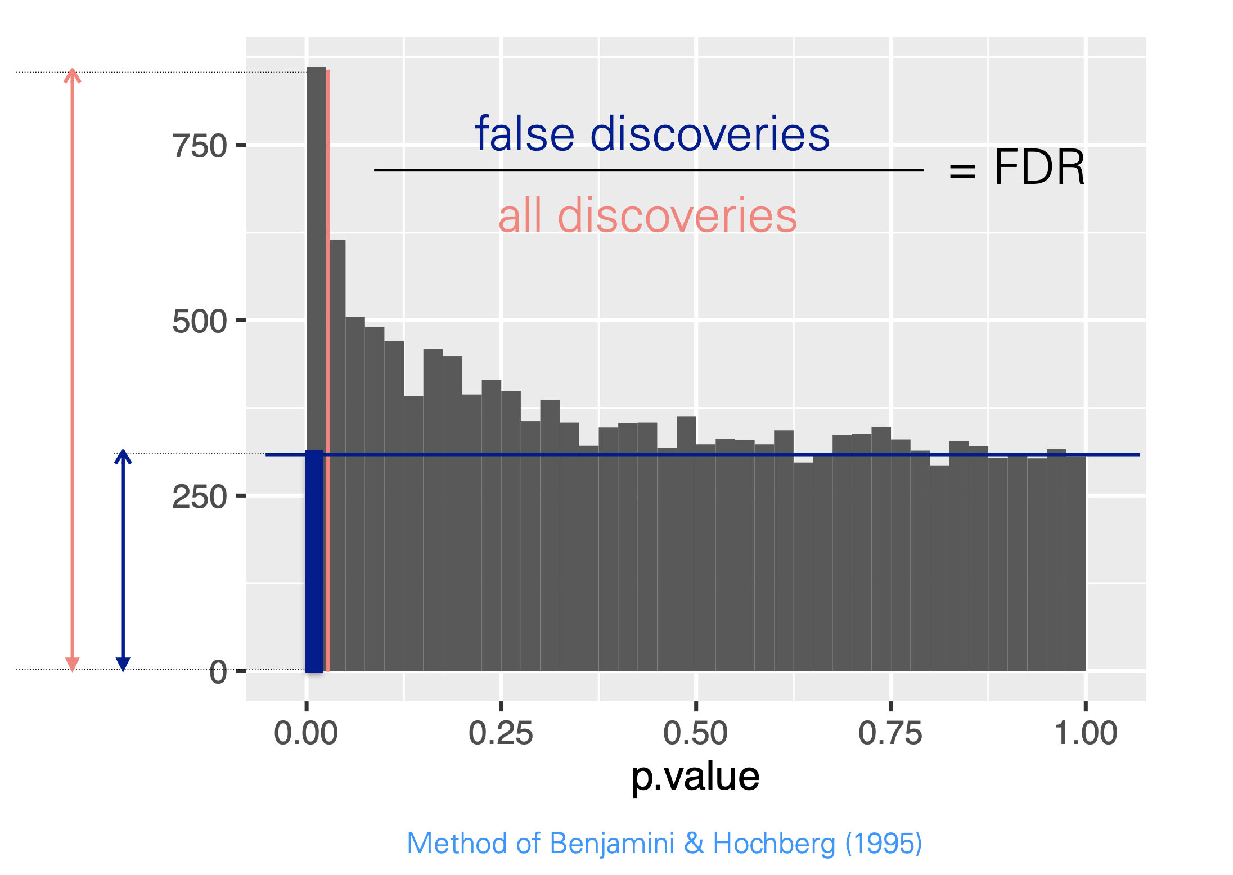
The False Discovery Rate (FDR) and Benjamini-Hochberg algorithm

Slide 40
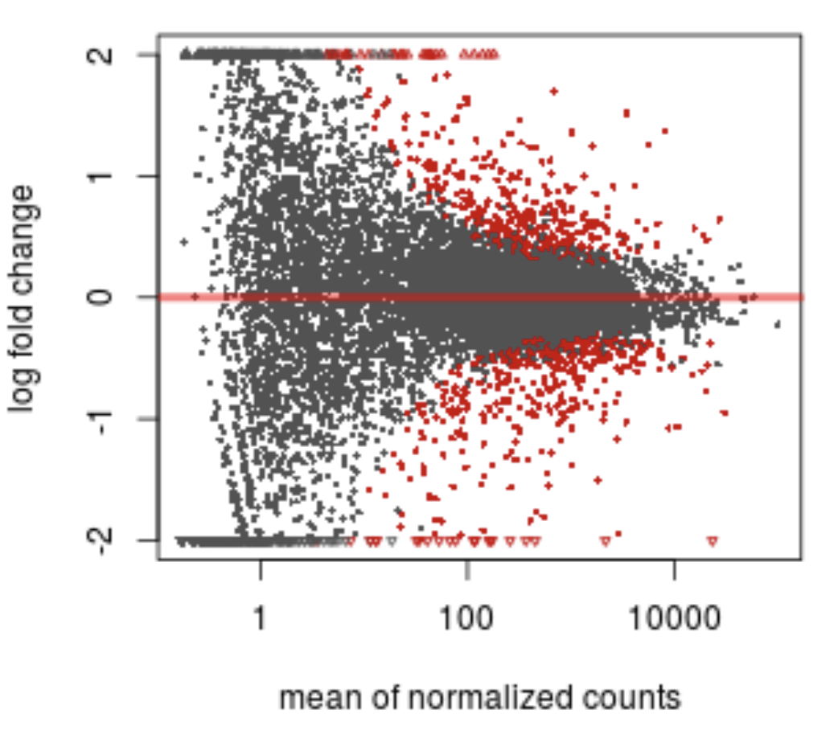
The False Discovery Rate (FDR) and Benjamini-Hochberg algorithm
각 유전자마다 testing의 결과로 p-value가 생성된다.

Slide 41
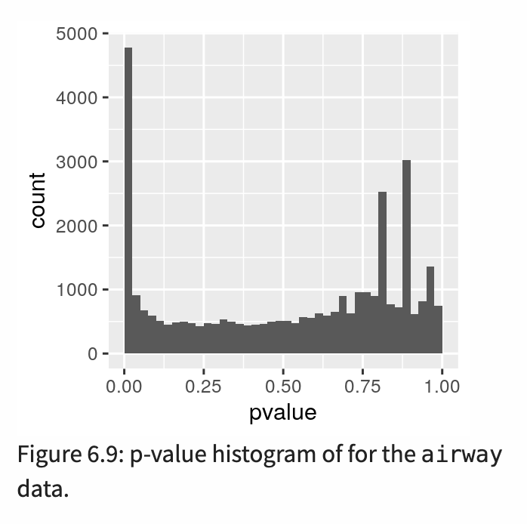
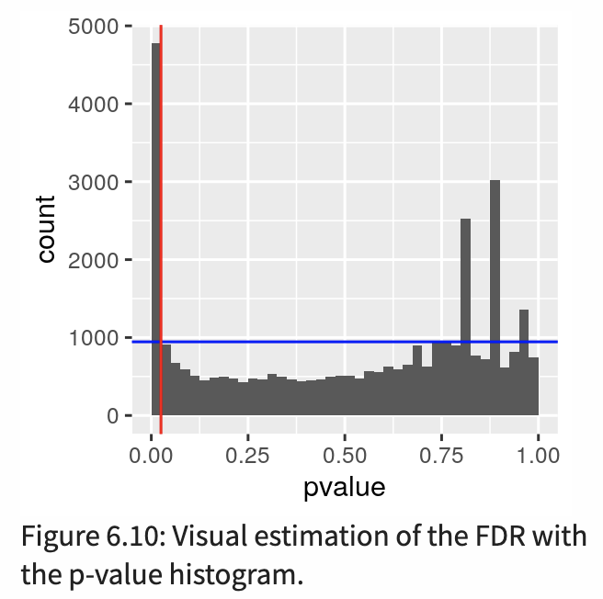
The p-value histogram
The p-value histogram is an important sanity check for any analysis that involves multiple tests. It is a mixture composed of two components:
the p-values resulting from the tests for which the null hypothesis is true.
the p-values resulting from the tests for which the null hypothesis is not true.

Slide 42
Calculate false discovery rate from the histogram

Slide 43
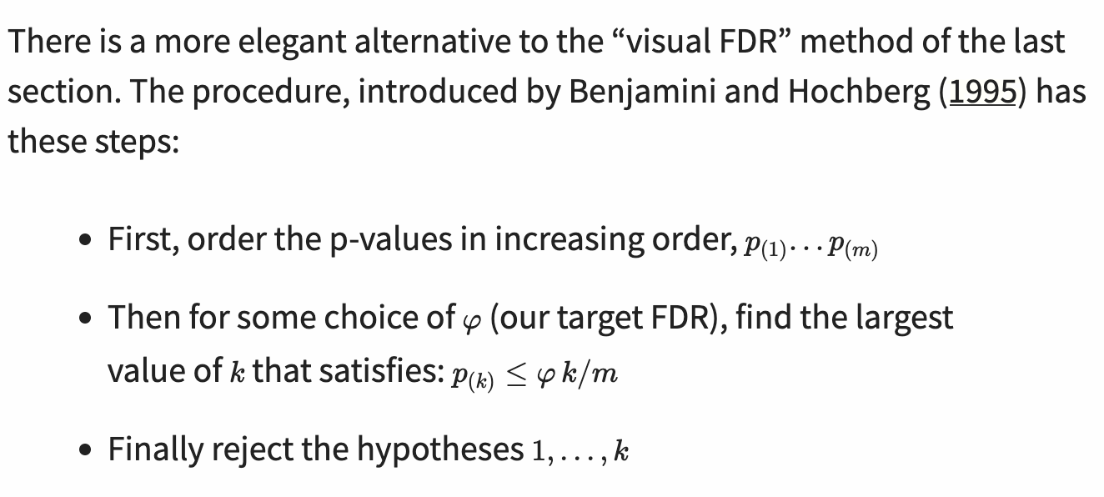
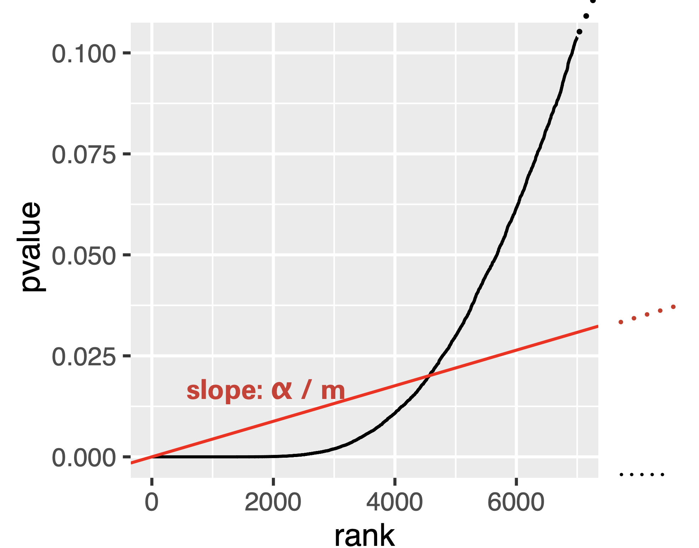
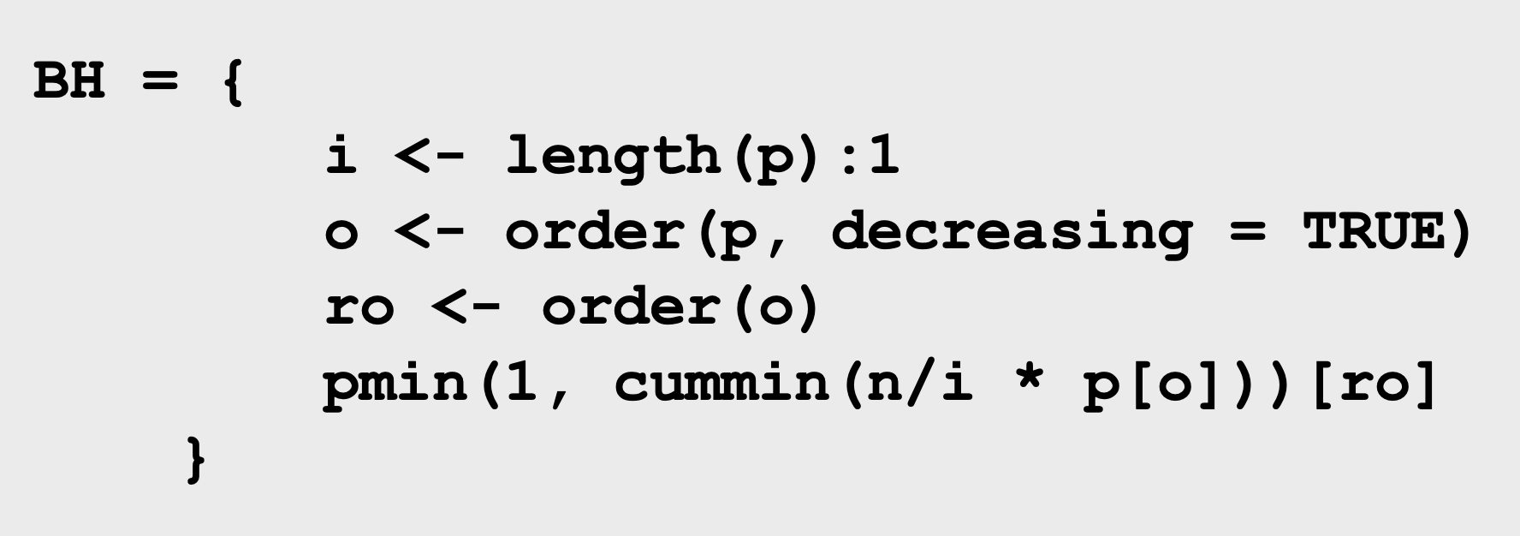
Method of Benjamini-Hochberg algorithm
Takes a list of p-values as input and returns a matched list of ‘adjusted’ p-values → p.adjust function in R (method=“BH”)

Slide 44
Topic5. Independent filtering and hypothesis weighting

Slide 45
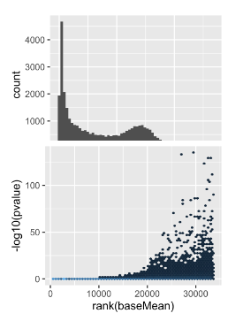
Not all hypothesis tests are created equal
The Benjamini-Hochberg method and the two-groups model, as we have seen them so far, implicitly assume exchangeability of the hypotheses: all we use are the p-values. Beyond these, we do not take into account any additional information. This is not always optimal, and here we’ll study ways of how to improve on this.
Intuitively, the signal-to-noise ratio for genes with larger numbers of reads mapped to them should be better than for genes with few reads, and that should affect the power of our tests.

Slide 46
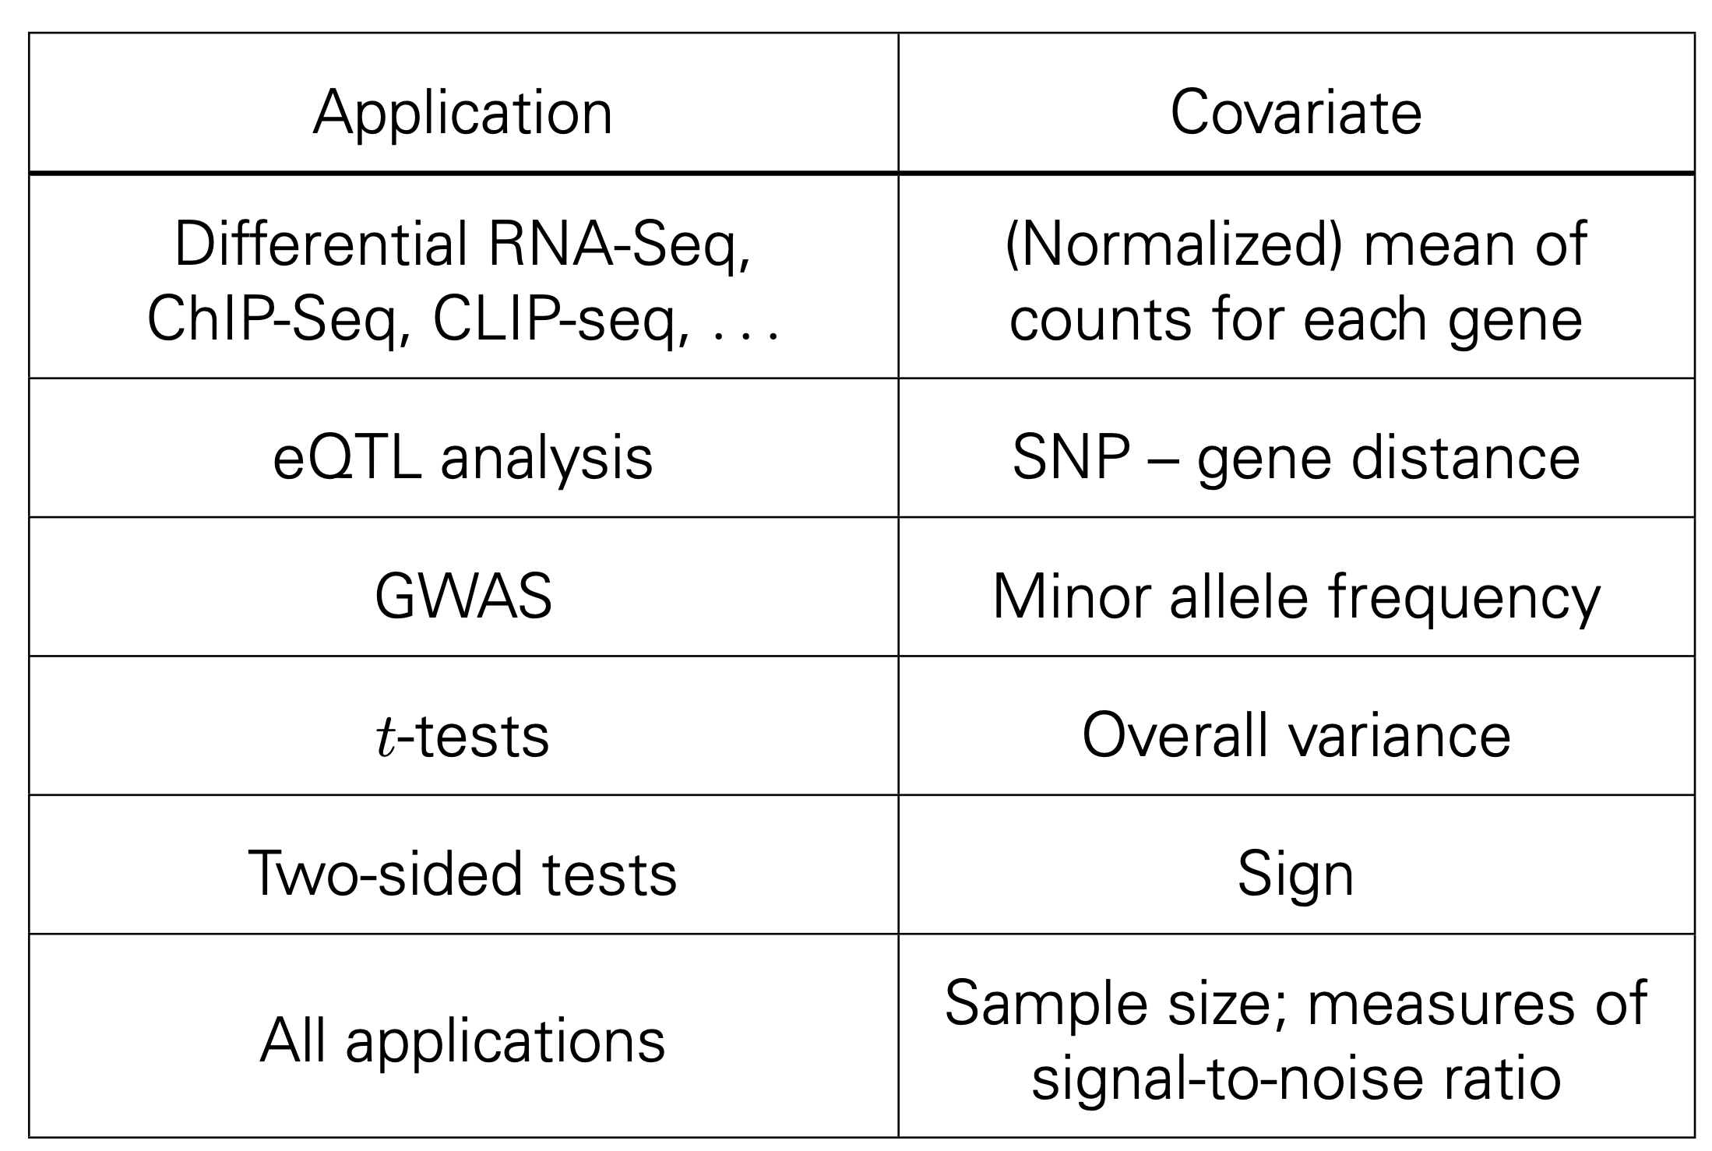
Covariates - examples

Slide 47
Independent filtering

Slide 48
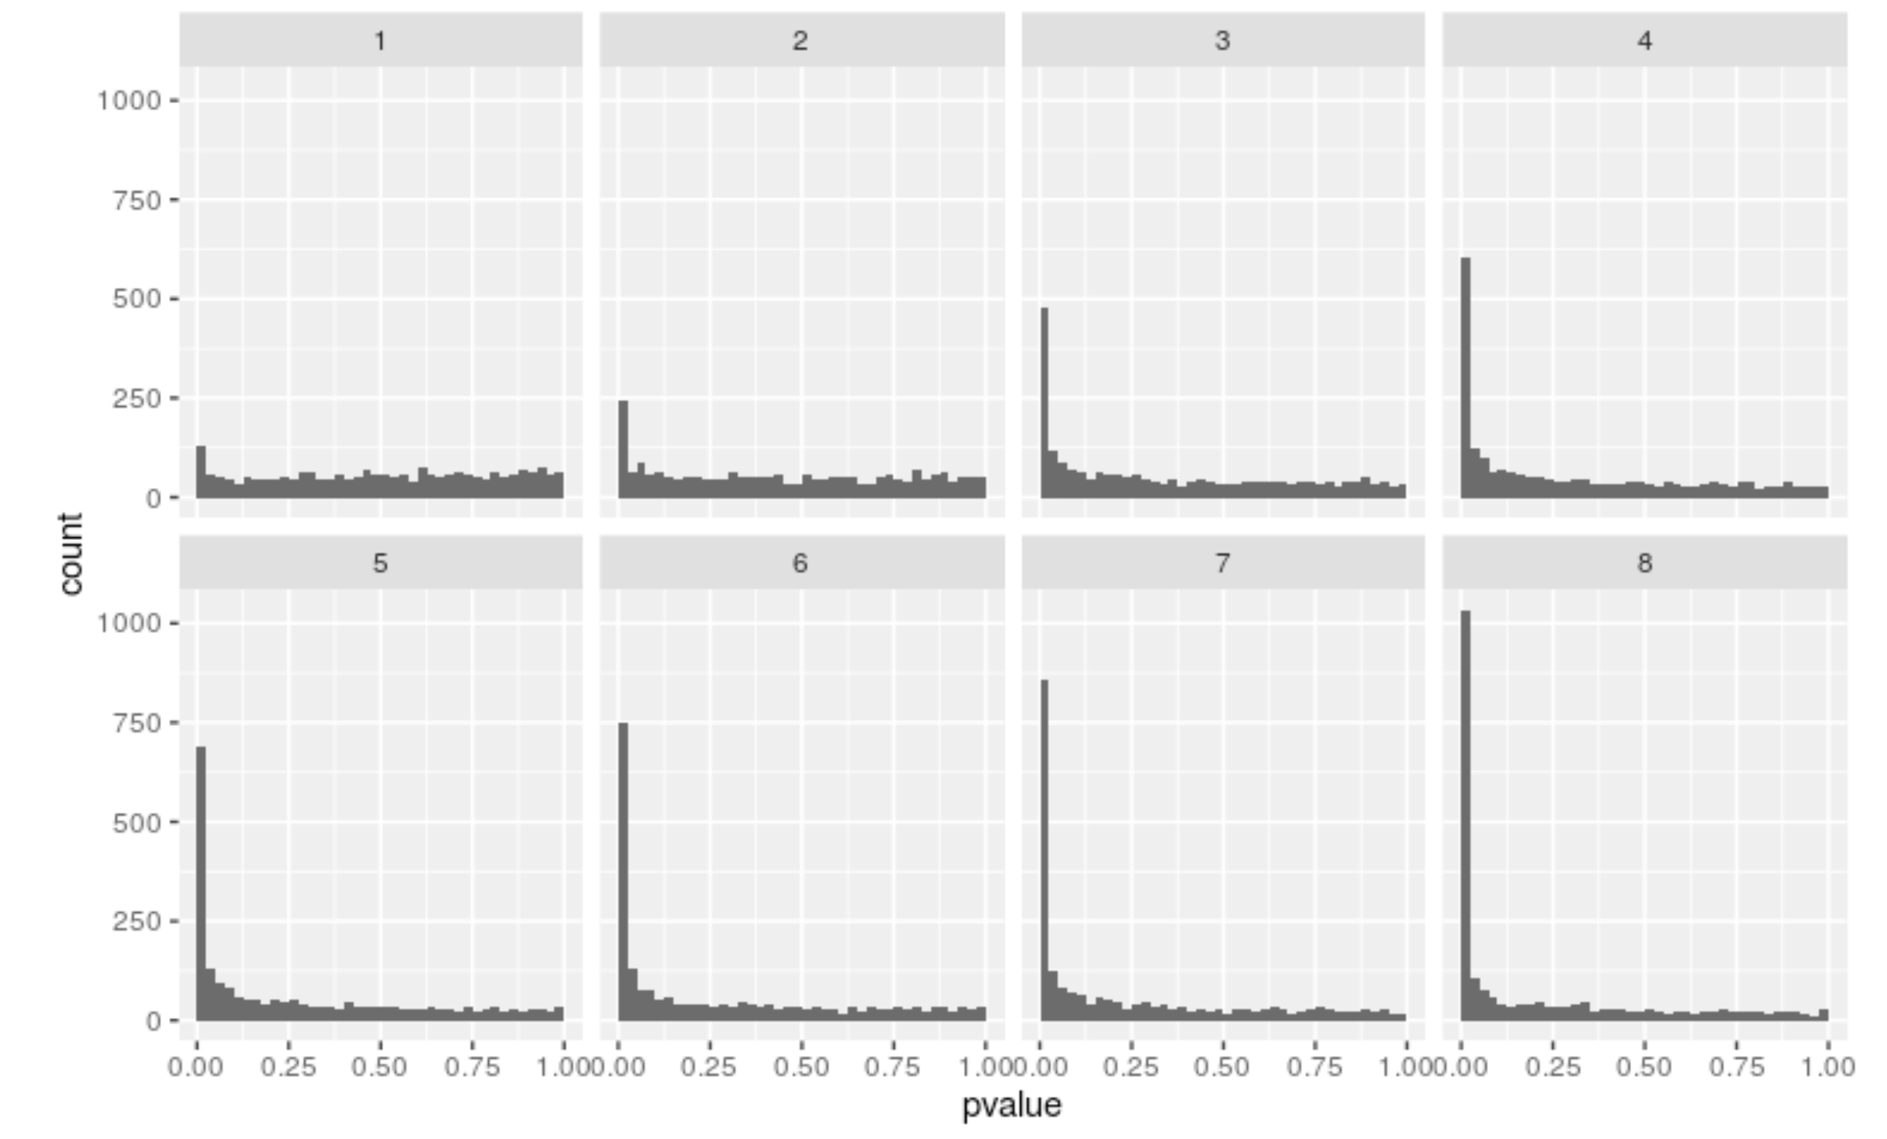
RNA-Seq p-value histogram stratified by average read count

Slide 49
Independent hypothesis weighting (IHW)

Slide 50
Independent hypothesis weighting (IHW) using R script

Slide 51
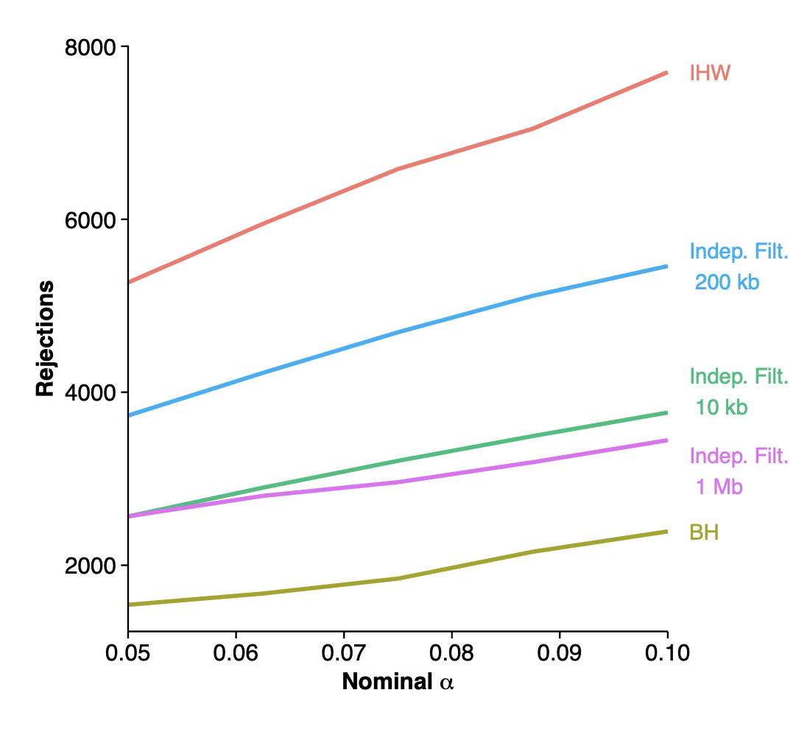
IHW를 실제 바이오 데이터에 적용한 예시

Slide 52
Thank you for your attention!

