Slide 1
Chapter 13. Design of High Throughput Experiments and their Analysis
Hansoll Na
BIG lab.
Dept. of Life Science, Hanyang University
2023.08.08

Slide 2
Goal for this chapter
In this chapter we will:
▪ Develop a simple categorization of what types of experiments there are and the varying amounts of control we have with each of them.
▪ Recap how to distinguish the different types of variability: error, noise and bias.
▪ Discuss the things that we need to worry about: confounding, dependencies, batch effects. We’ll ask the famous question: how many replicates?.
▪ Recap the essential ideas behind mean-variance relationships and how they inform us on whether and how to transform our data.
▪ Computational techniques and tools are essential for getting the job done. We will discuss efficient workflow design, data representation and computation.
▪ Try to be aware of data summarization steps and questions of sufficiency in our analytical workflows - so that we don’t throw away important information in some step “upstream”, which is then missing and making us trouble downstream.

Slide 3
Types of experiments
▪ In a controlled experiment,
- all relevant variables are under control (model system, environmental conditions, etc.).
▪ In a study with less control,
- important conditions that may affect the measured outcome are not under control.
▪ In an observational study,
- even tha variable of interest is not controlled by the researcher.
▪ In a randomized controlled trial,
- assignment of the variable of interest is controlled.
- all the nuisance effects would average out with high enough sample size.
▪ Meta-analysis
- is an observational study on several previous studies.
- increases power by increasing effective sample size.
- would average out study-level problems.

Slide 4
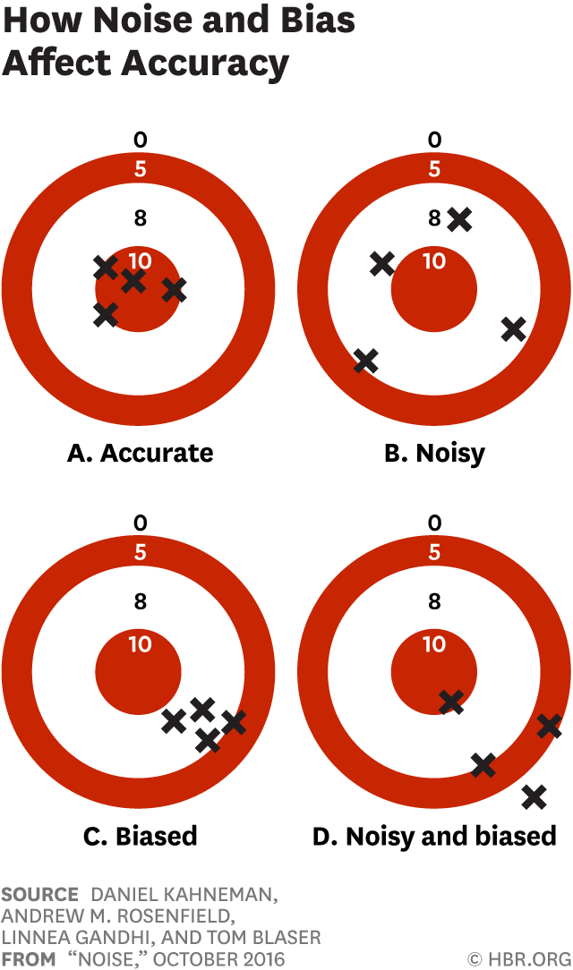
Partitioning error: bias and noise
▪ Noise averages out with enough replicates.
▪ Bias is more difficult to deal with than noise.
▪ With bias, it can be hard to even recognize that it is there, and then we need to find ways to measure it and adjust for it, usually with some quantitative model.

Slide 5
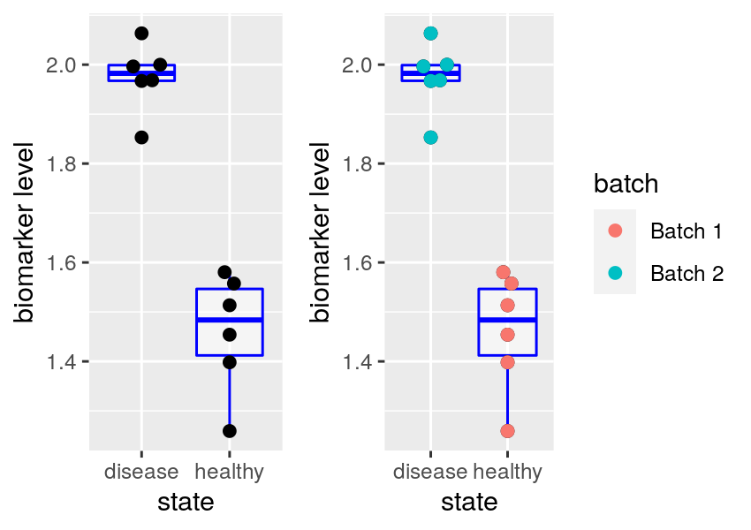
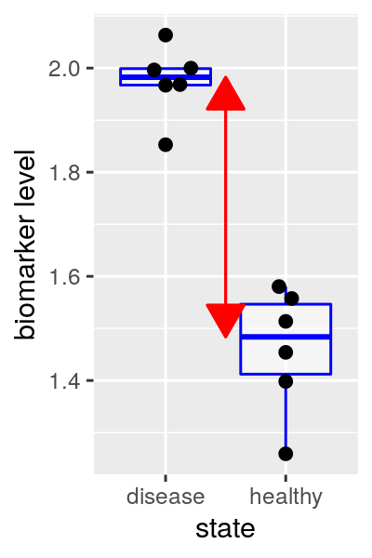
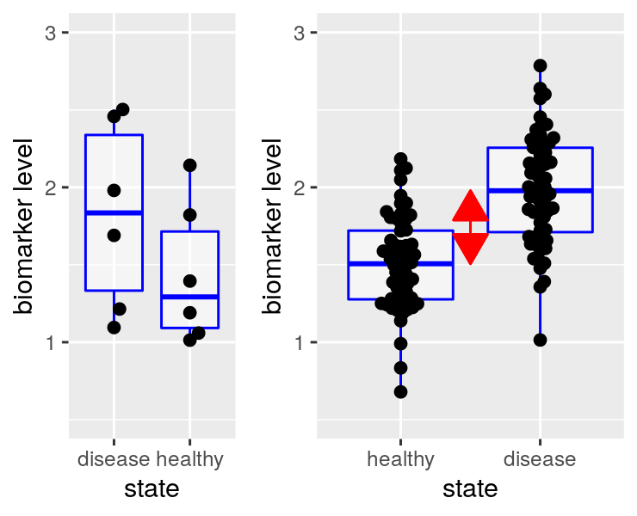
Basic principles in the design of experiments
▪ Confounding
▪ How can we decide whether the observed differences in the biomarker level are due to disease vs health, or due to the batch?
→ Impossible to know
▪ Effect size is difference b/w group centers.
▪ A larger sample size increases the precision and thus increases power to detect a difference.
▪ On the other hand, the performance of the biomarker as a diagnostic for distinguishing individual samples between healthy and disease states depends on the within-group distributions (and the relative prevalences of both states), and is not improved by replication

Slide 6
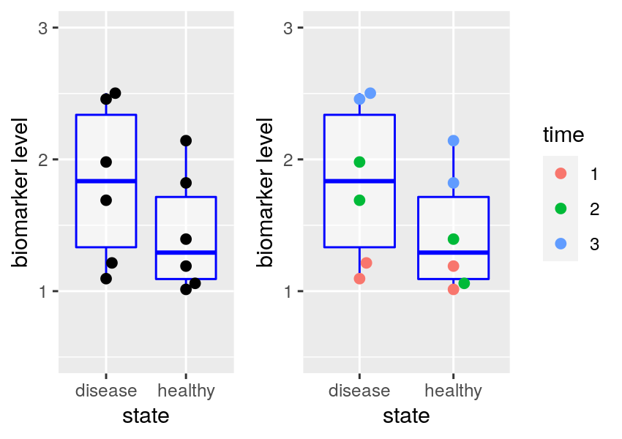
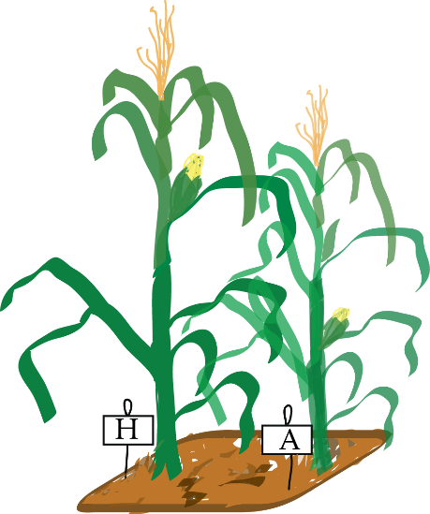
Basic principles in the design of experiments
▪ Blocking and pairing
▪ We can note a tendency of the data to fall into blocks according to these times. Because of this, comparison between the groups is diluted
▪ Pairing is the simplest case of blocking.
- Darwin suspected that corn growth is affected by the composition of the soil and the humidity in the pots.
- For this reason, when he wanted to compare plants grown from cross-pollinated seeds to plants grown from self-pollinated seeds, he planted one seedling of each type in each of 15 pots.
- Each pot in Darwin’s Zea Mays experiment is a block, only the factor of interest (pollination method), called the treatment, is different within each block.
H = hybrid = cross-pollinated
A = autoz = self-pollinated

Slide 7
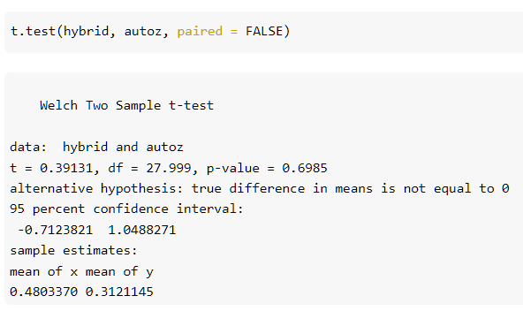
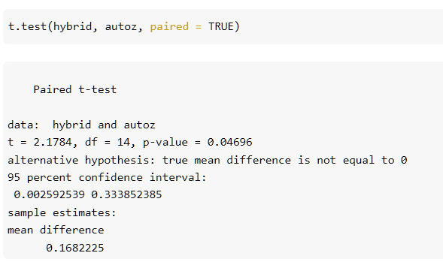
Basic principles in the design of experiments
▪ Comparing a paired vs an unpaired design
← Sample size
← Effect size
standard deviation = 0.25
Unpaired
Paired

Slide 8
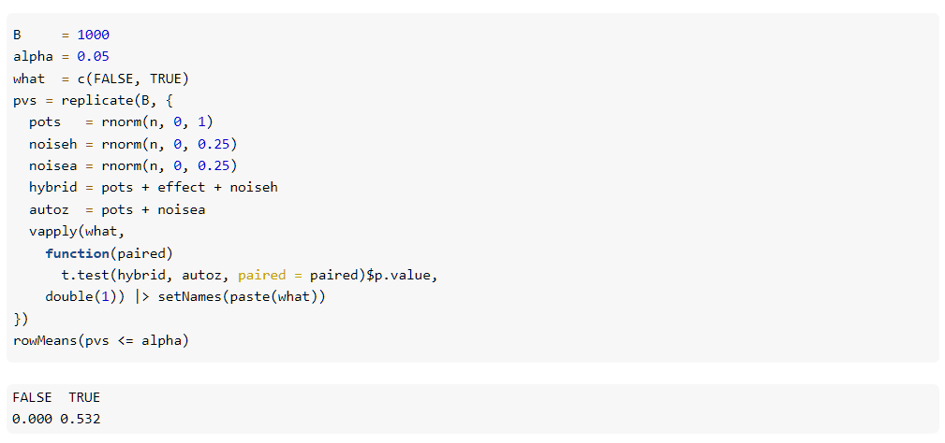
Basic principles in the design of experiments
▪ Paired t-test output lower p value than unpaired t-test in repeated trials.

Slide 9
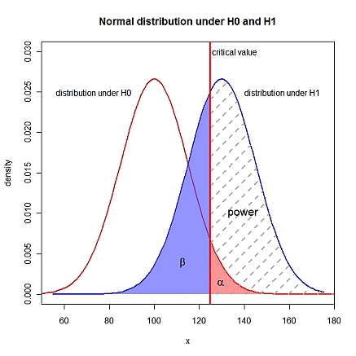
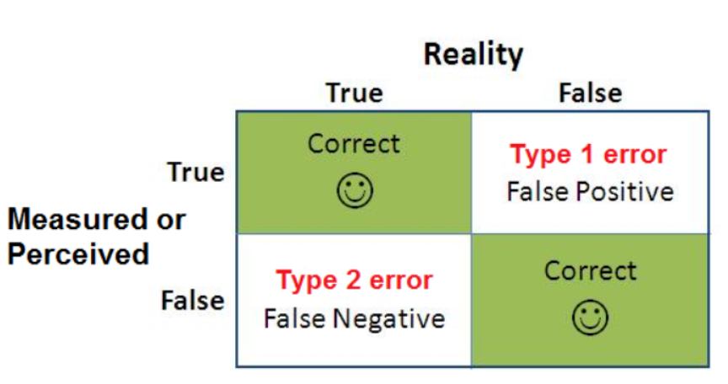
How many replicates do I need?
▪ Type II error (β) is the probability of failing to rejecting the null hypothesis (when the null hypothesis is not true).
▪ Power (1-β) is the probability correctly rejecting the null hypothesis (when the null hypothesis isn’t true).

Slide 10
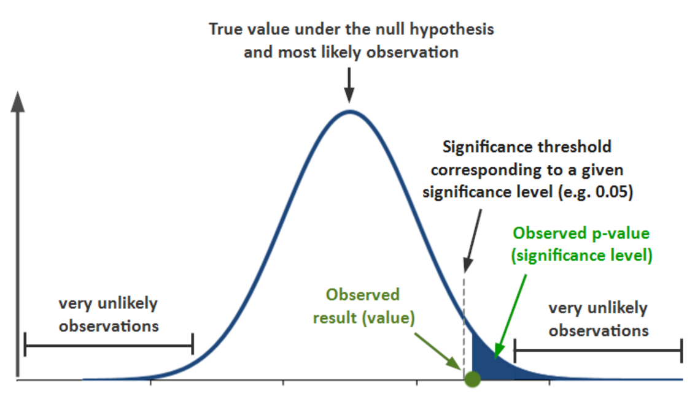

Slide 11
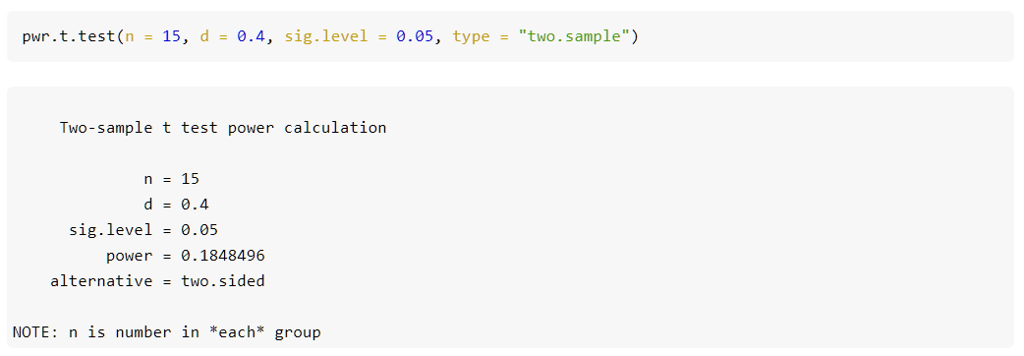
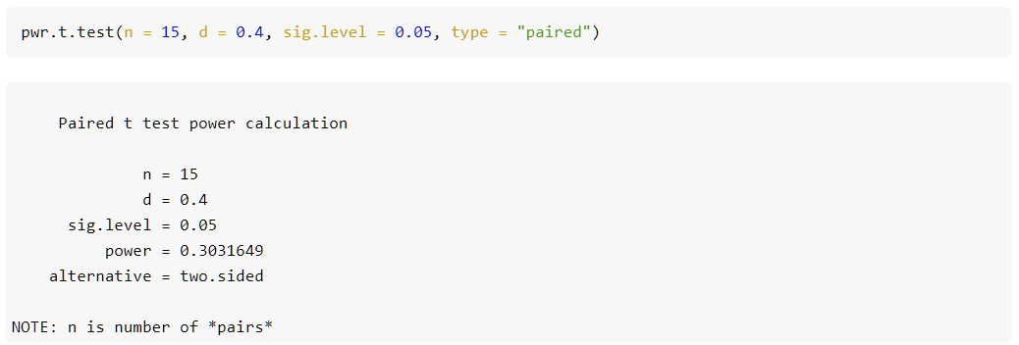
How many replicates do I need?
▪ Power depends on sample sizes, effect sizes and variablity
← Two sample t-test
← Paired t-test

Slide 12
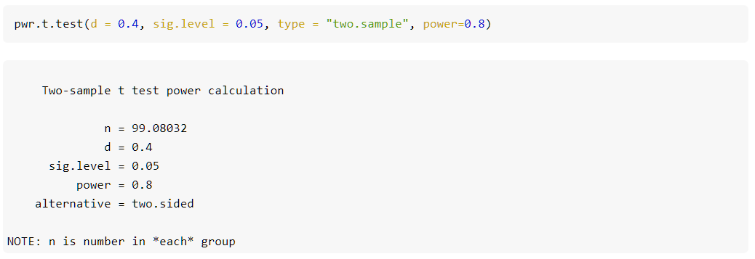
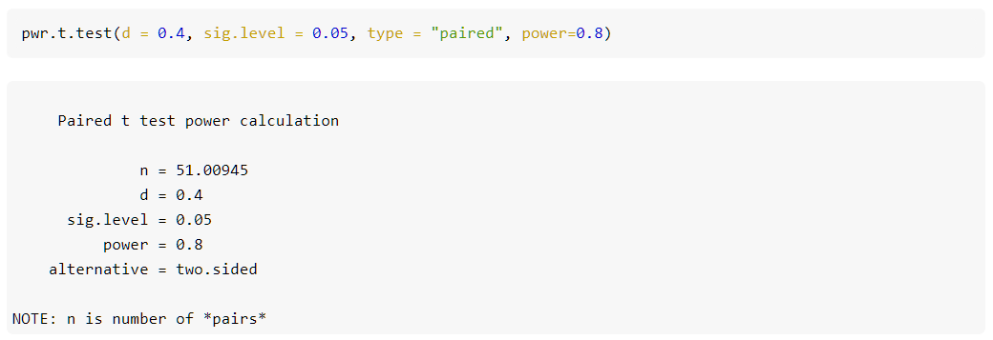
How many replicates do I need?
▪ If you want to know what sample size would be required to detect a given effect size:
← Two sample t-test
← Paired t-test
→ We would need about twice as many observations for the same power when not using a paired test.

Slide 13
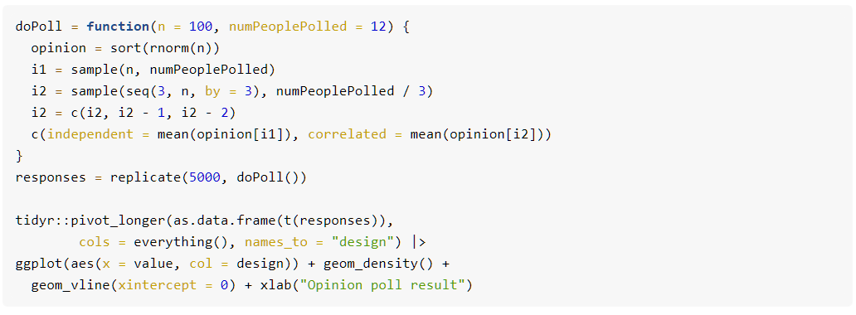
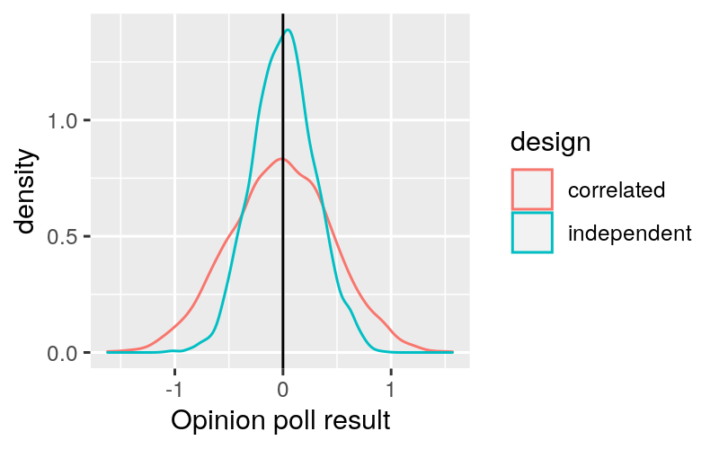
How many replicates do I need?
▪ Effective sample size
▪ A sample of independent observation is more informative than the same number of dependent observations.
▪ Suppose you want to do an opinion poll by knocking at people's doors and asking them a question.
1. You pick n people at n random places throughout the country.
2. You pick n/3 random places and at each of these interview 3 people who live next door to each other.
← Normal distribution (mean = 0, sd = 1)
→ The correlated method has higher spread (the truth is indicated by the vertical line).

Slide 14
Mean-variance relationships and variance-stabilizing transformations
▪ The mean-variance relationship of data before transformation can in principle be any function, byt in many cases, the following prototypic relationships are found, at least approximately:
Stanley E Lazic (2015), BMC Research Notes
▪ Real data can also be affected by a combination of these
- e.g. With DNA microarrays, the fluorescence intensities are subject to a combination of background noise that is largely independent of the signal, and multiplicative noise whose standard deviation is proportional to the signal.
➔ In this case, the mean-variance relationship is

Slide 15
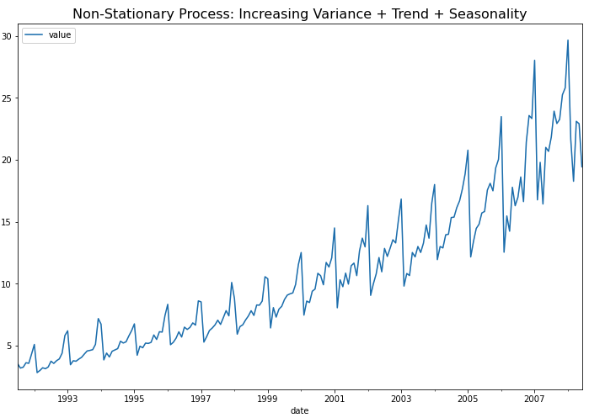
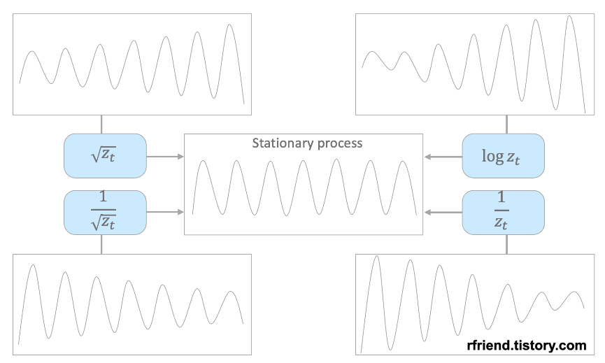
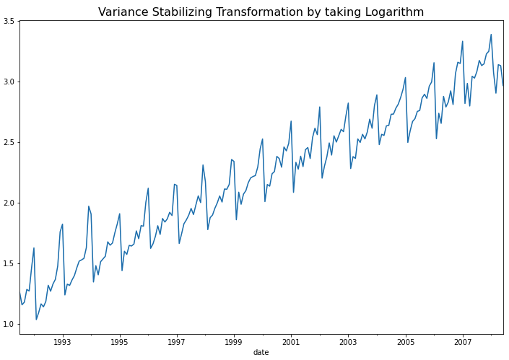
Mean-variance relationships and variance-stabilizing transformations
▪ Applying a variance-stabilizing transformation tends to:
- improve visualization
- improve the outcome or ordination methods such as PCA or clustering based on correlation.
- improve the estimates and inference from statistical models that are based on assuming identically distributed (and hence, homoskedastic) noise.
▪ Heteroskedasticity (이분산성)
Power transformation (거듭곱 변환)
https://rfriend.tistory.com/698

Slide 16
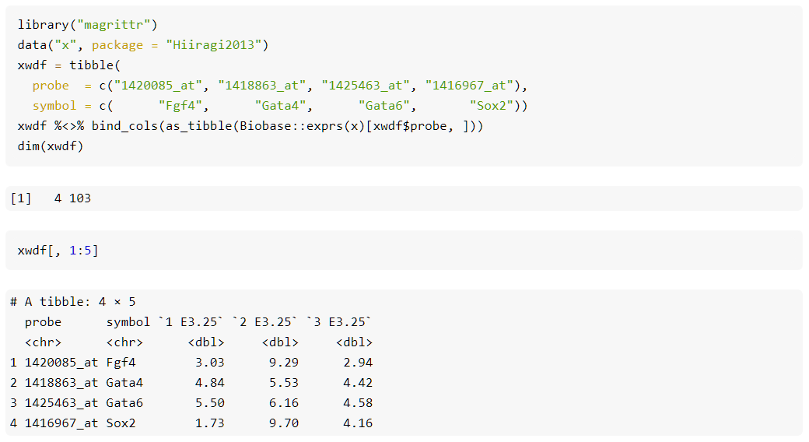
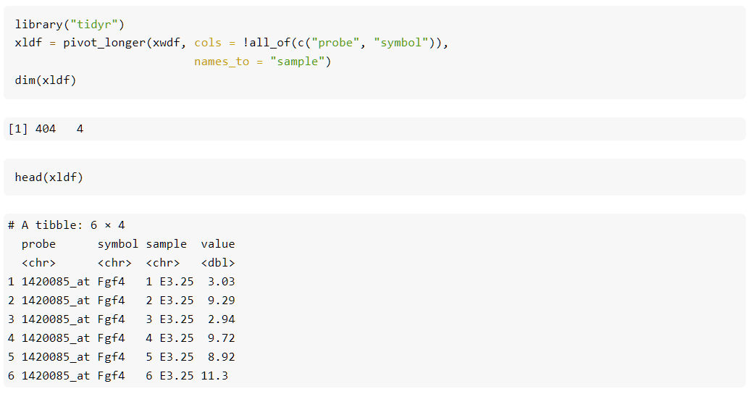
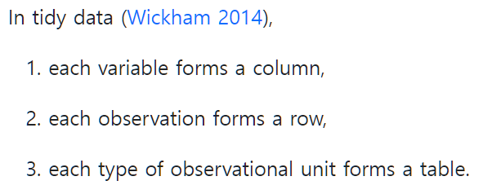
Data representation
▪ Wide vs long table format
Wide table
Remaining 101 columns report the measured expression values, one for each sample → Untidy
Long table

Slide 17
Efficient computing
▪ Due to the risk of premature optimization, it is more helpful to first take a step back.
▪ Slow and clumsy solution to right problem is worth a good deal more than a fast and scalable solution to the wrong problem.
▪ For statistical analyses, it is possible to write very efficient code using concepts as follows:
▪ Vectorization
→ Vectorized z2 is many times faster than the explicitly indexed z1.
▪ Parallelization
https://cran.r-project.org/view=HighPerformanceComputing

Slide 18
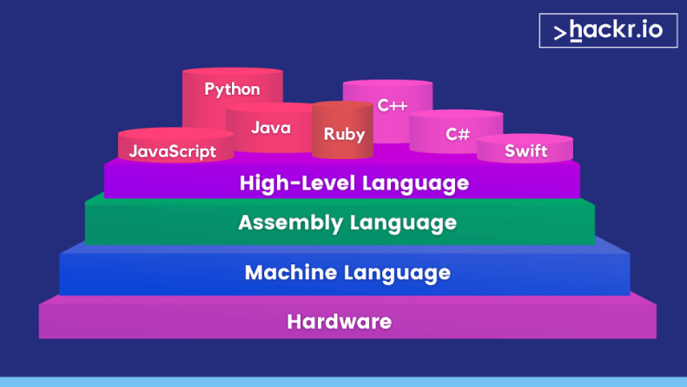
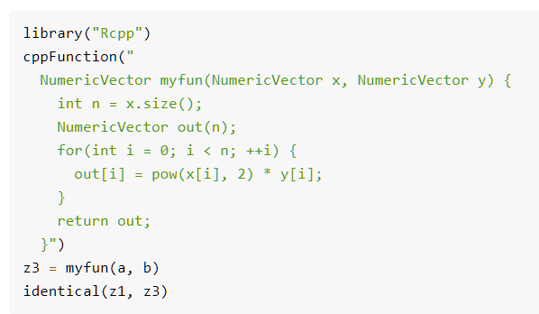
Efficient computing
▪ Out-of-memory-data and chunking
▪ Chunking means splitting the data into chunks, manageable portions, and then sequentially loading each portion from mass storage, computing on it, storing the result and removing the portion from RAM before loading the next one.
- DBI package, rhdf5 package, SummarizedExperiment class (Bioconductor)
▪ Judicious use of lower level languages
- Rcpp package makes it easy to write portions of your code in C++ and include them seamlessly withing your R code.

