Slide 1
Chapter 12.
Supervised Learning
Link to colaboratory
27th July 2022
SANG-HO YOON
Bioinformatic & Genomics Lab.
Link to diabetes data
Link to chapter 12

Slide 2
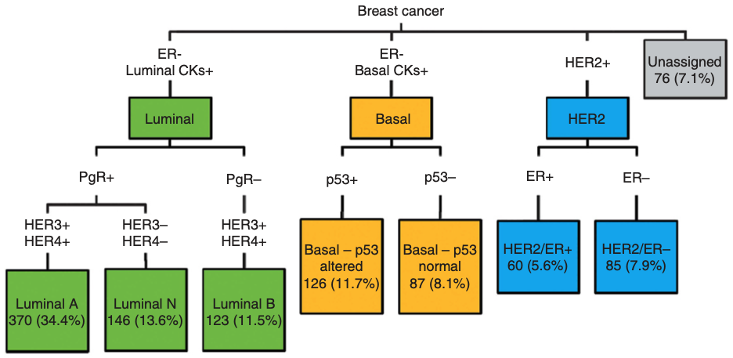
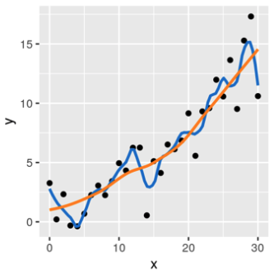
Introduction
Supervised learning (statistical learning)
- “Prediction” of a property of interest (disease type, cell type, etc.) using other properties (predictors)
Study data
Predictors
(objective
or
response)
Training data
Test data
- Unlike unsupervised learning, the answers are known in study data
- Issues in supervised learning: overfitting & generalizability
Apply to “new” data
- Overfitting: predict 100% accuracy on the training data, but poorly perform on any new data
- Generalizability: model learns some important features and can be applied to new data
- Continuous response variables → regression
- Categorical (discrete) response variables → classification
A. R. Green et al. British journal of cancer (2013)

Slide 3
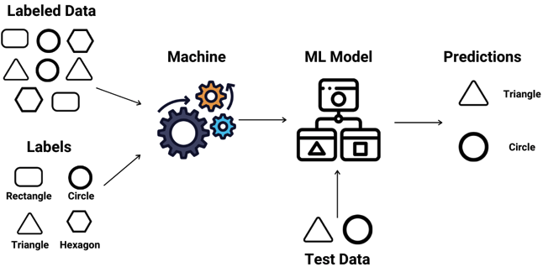
Study goals
Supervised learning (statistical learning)
1. Discriminant analysis
2. Performance measures
3. Overfitting
4. Regularization (penalization)
5. Cross-validation

Slide 4
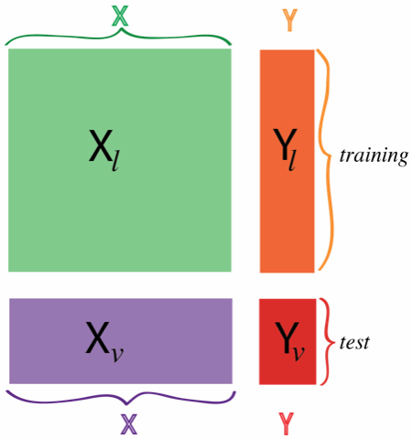
Predicting diabetes type
The data structure
- object x feature (dataframe); transposed gene x sample matrix
→ subjected to find a mathematical function that predicts the value of one of the features from the others
→ usu. without missing values
kernel methods use distances or measures of similarity between objects
→ the more objects, the better (many samples for training!)
→ too small training set in real world!

Slide 5
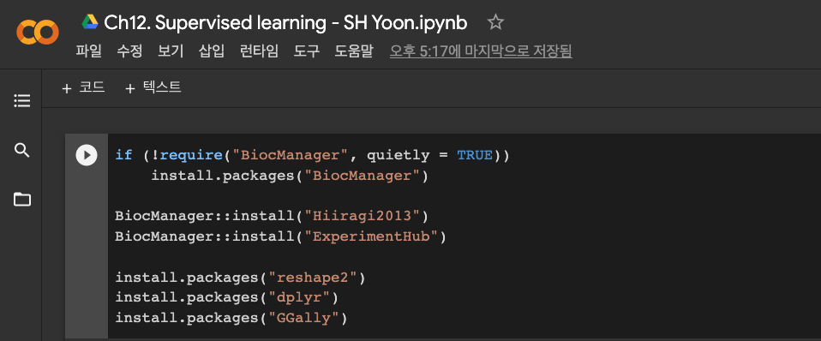
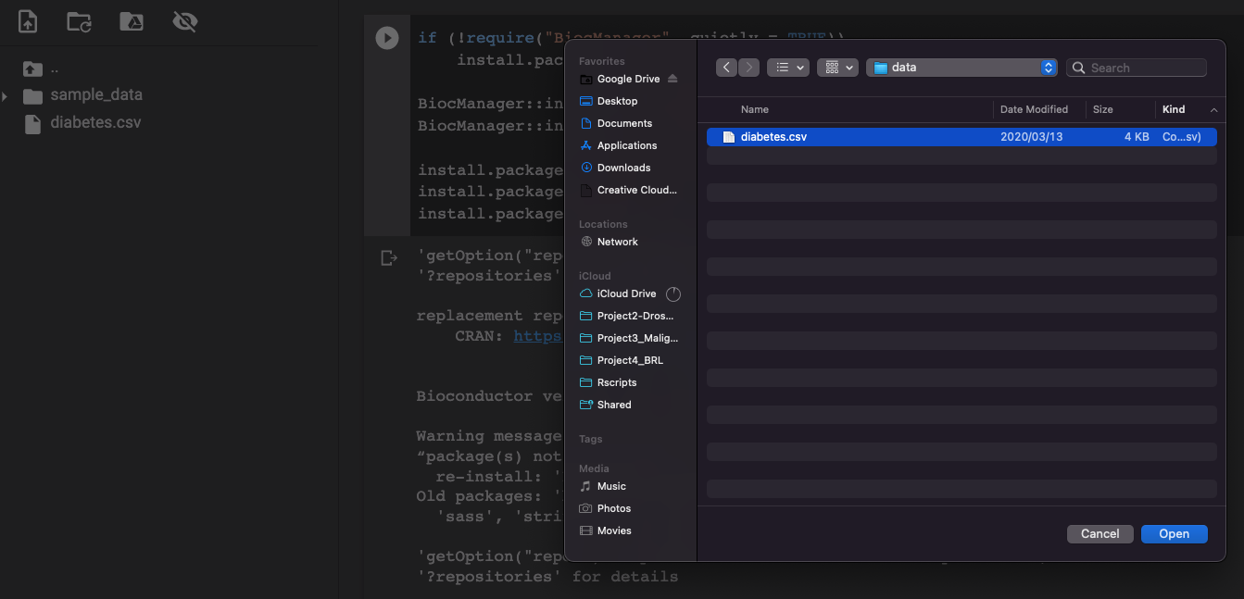
Predicting diabetes type
https://colab.research.google.com/drive/165FZWTUvBWjHncgEox6RWxCITLWCOo48?usp=sharing
https://drive.google.com/file/d/10IwWxe3L3AACKaUuR2KqTrPYxg51z5qh/view?usp=sharing
Upload “diabetes.csv”

Slide 6
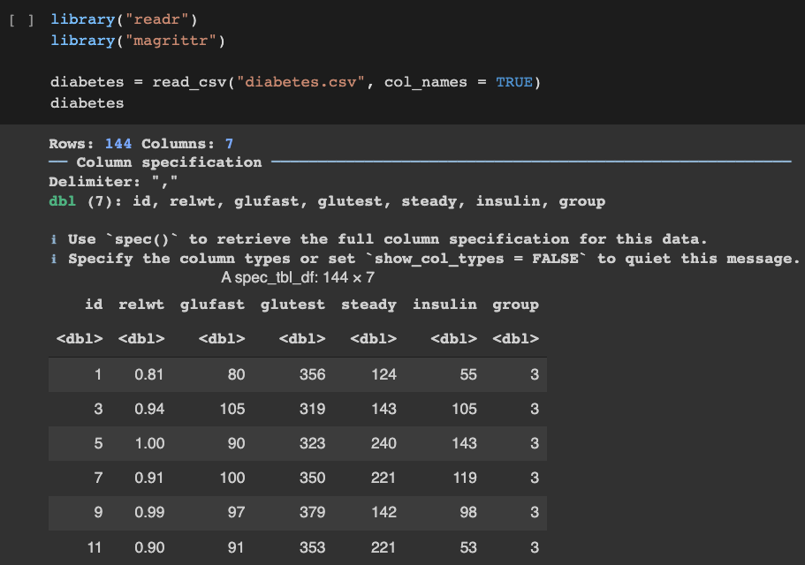
Predicting diabetes type
The diabetes dataset (Reaven and Miller 1979)
- Three different groups of diabetes patients and five clinical variables
“group” variable: double to factor type

Slide 7
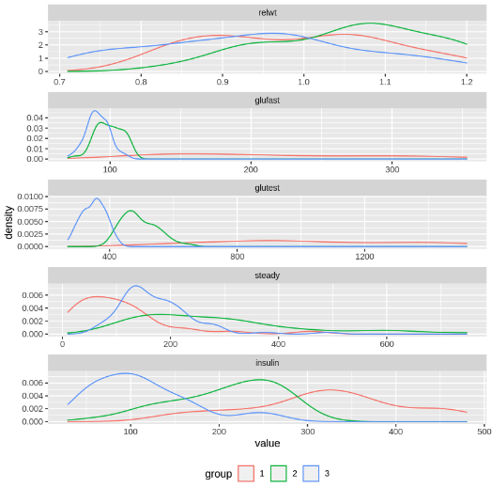
Predicting diabetes type
- Distribution of five clinical variables in patient groups
→ some variables may describe patient’s group
e.g., insulin conc. group 1 > 2 > 3
→ combination of variables for prediction

Slide 8
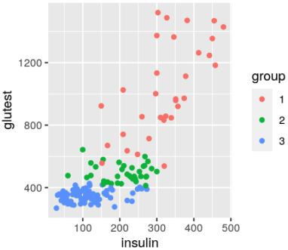
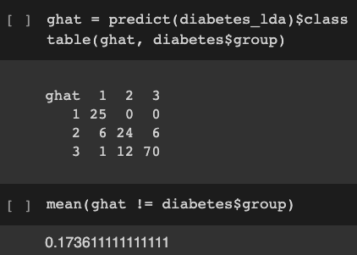
Linear discrimination
The simplest discrimination
- Objects described by two continuous features (2D plane)
- Objects fall into one of three groups
→ Aim to define class boundaries
- e.g., diabetes data using insulin and glutest variables
linear discriminant analysis (LDA)
True label
Misclassification rate
Prediction

Slide 9
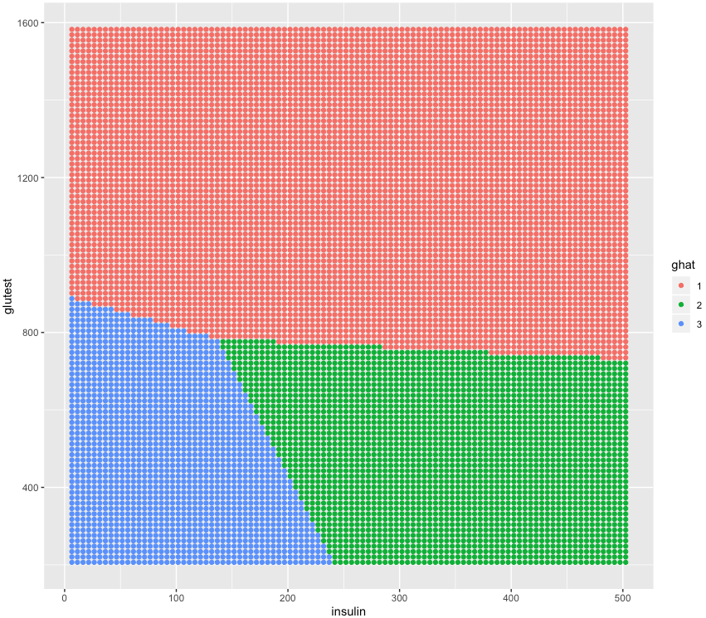
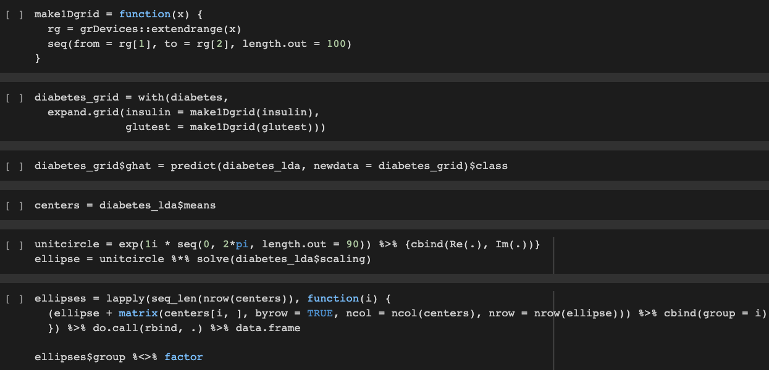
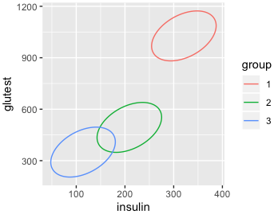
Linear discriminant analysis (LDA)
- Visualization of LDA result
→ prediction regions for each group, class center, and ellipses

Slide 10
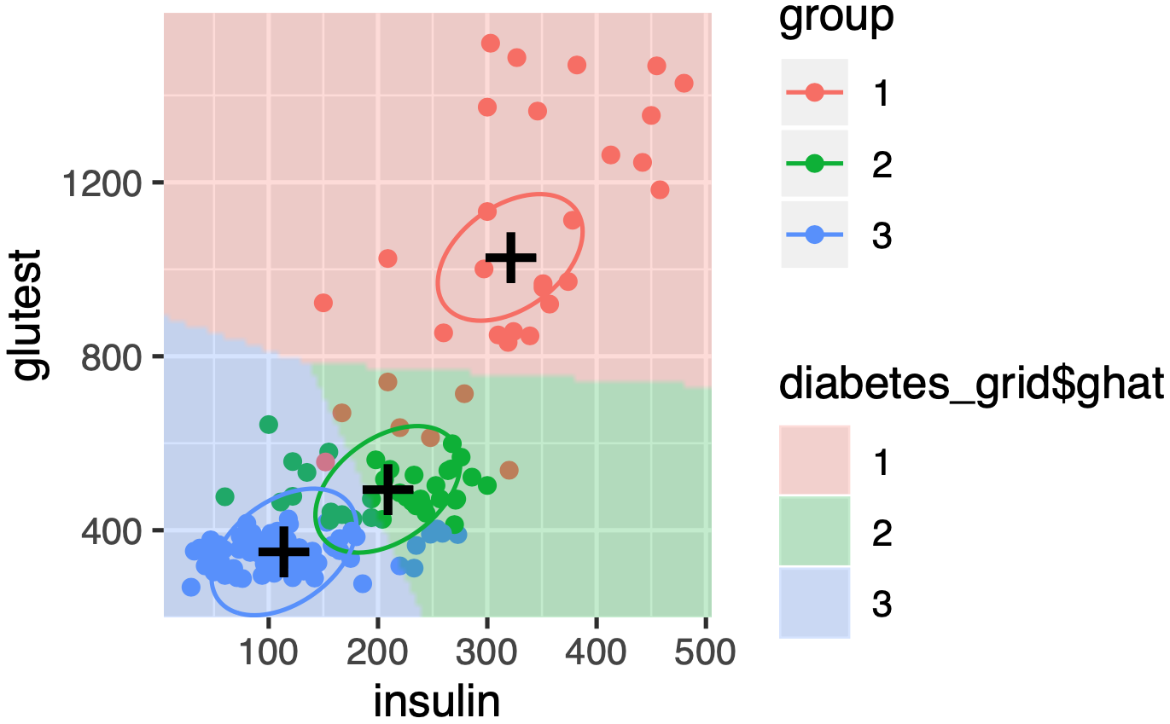
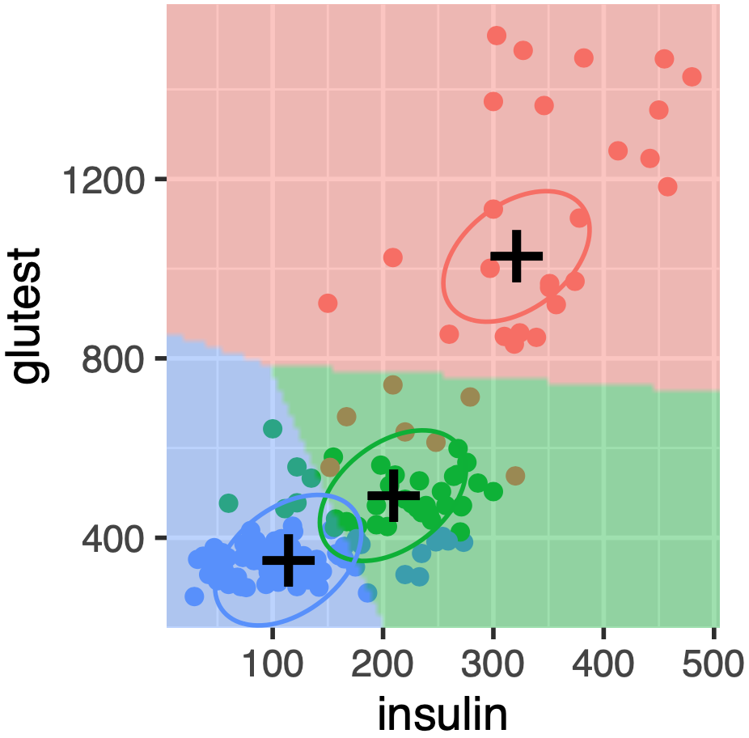
Linear discriminant analysis (LDA)
- Visualization of LDA result
→ prediction regions for each group, class center, and ellipses
Half-way b/w centers
Confidence: distance to the nearest center

Slide 11
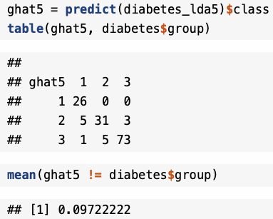
Linear discriminant analysis (LDA)
- LDA prediction using all five variables
Misclassification rate

Slide 12
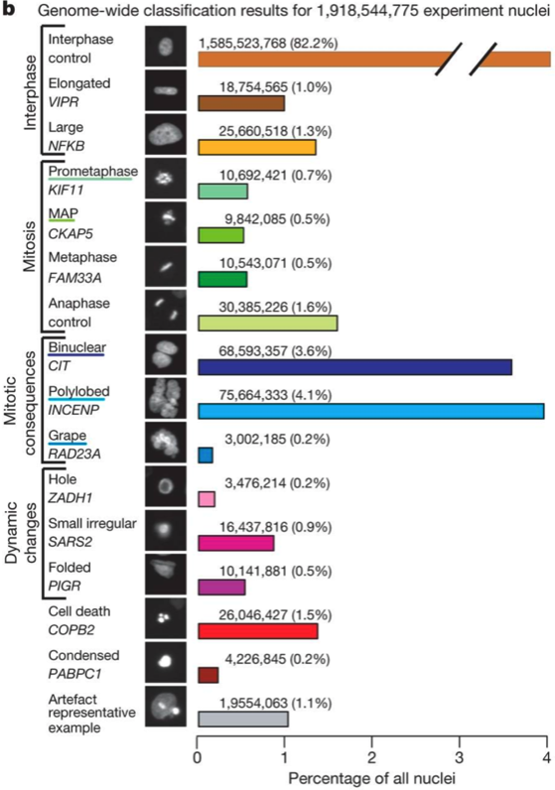
Predicting cellular phenotypes
Live-cell imaging by Neumann et al. Nature (2010)
- Human cancer cells w/ GFP tagged histones were screened with a genome-wide RNAi library
- Cells were recorded to observe effect of the siRNA

Slide 13
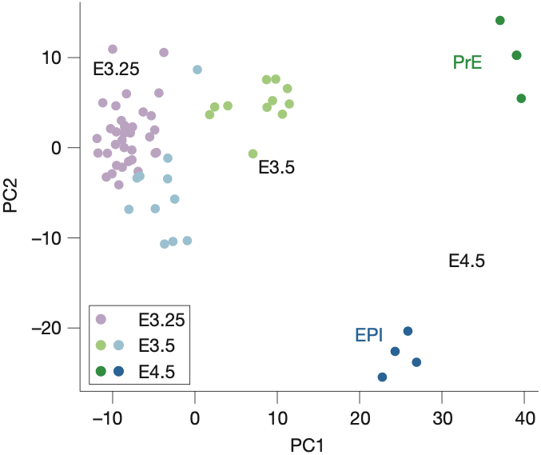
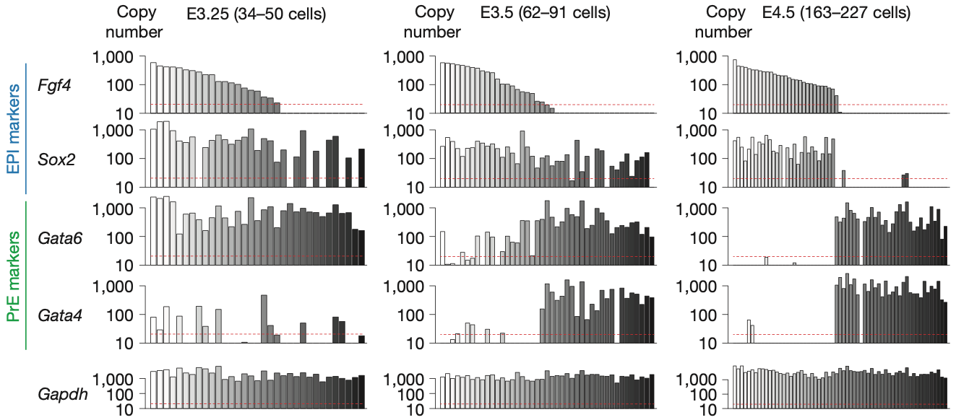
Predicting embryonic cell states
Single cell analysis of blastocyst by Ohnishi et al. Nature cell biology (2014)

Slide 14
Predicting embryonic cell states
- A classifier that predicts the developmental time (E3.25, E3.5, E4.5)
→ w/ prior knowledge: FN1, TIMD2, GATA4, and SOX7
Fn1
Timd2
Gata4
Sox7
Double-check using Bioconductor annotation package

Slide 15
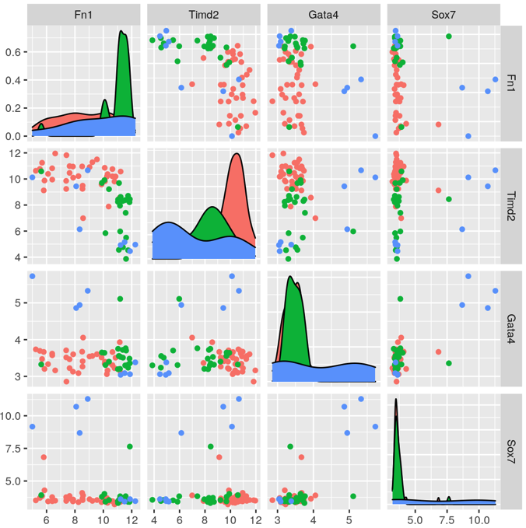
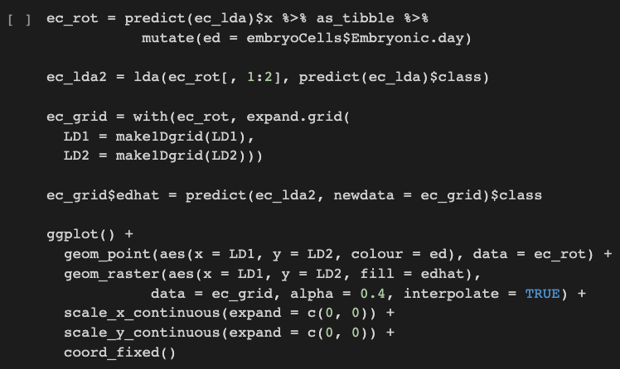
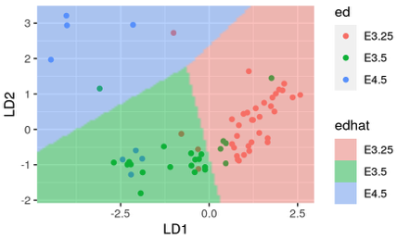
Predicting embryonic cell states
- A classifier that predicts the developmental time (E3.25, E3.5, E4.5)
→ w/ prior knowledge: FN1, TIMD2, GATA4, and SOX7
E4.5
E3.25
E3.5

Slide 16
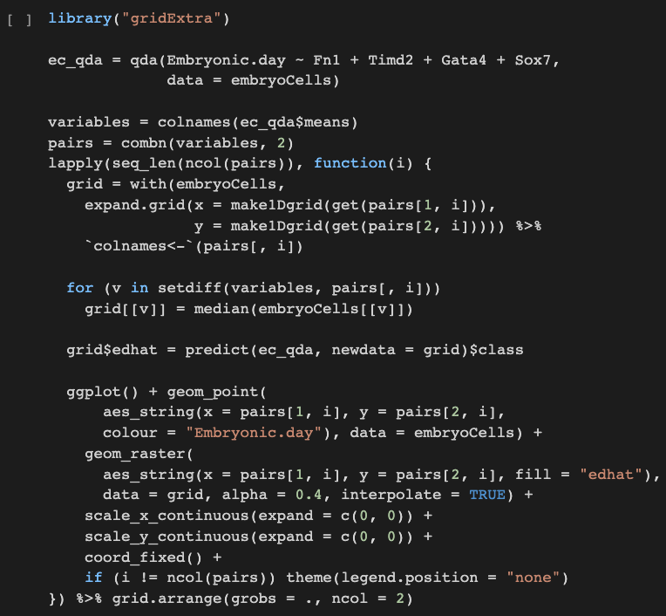
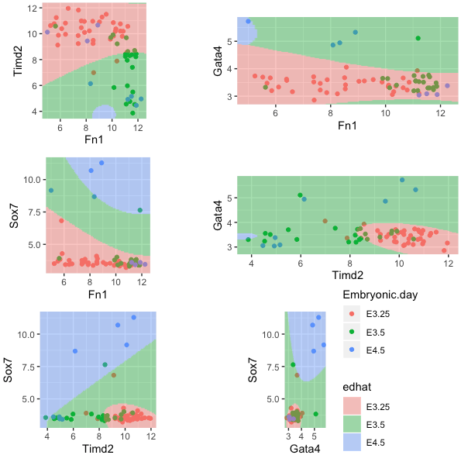
Predicting embryonic cell states (QDA)
Quadratic discriminant analysis (QDA)
- A variant of LDA which allows for non-linear separation of data

Slide 17
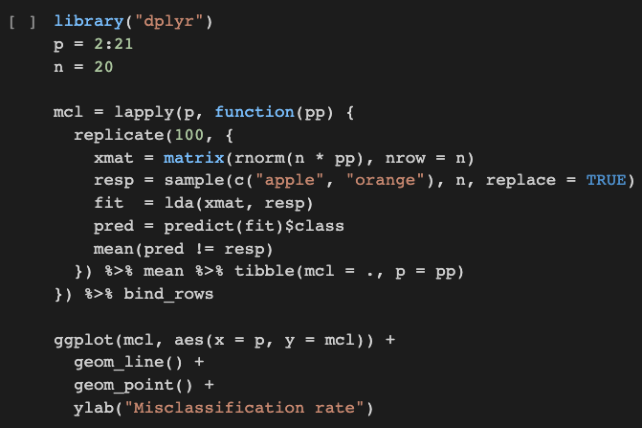
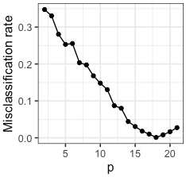
Machine learning vs. rote learning
Generalizability
- The major goal in statistical learning
A statistical model which can make good predictions about unseen data
e.g., Classification of apple or orange using random data w/ different number of features (p)
“over-parameterized”
Almost zero
# of features
→ The model performance was evaluated on the training data
→ Assess model performance on different data

Slide 18
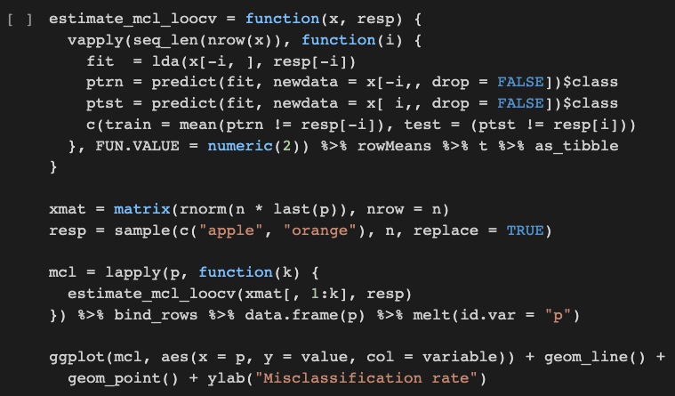
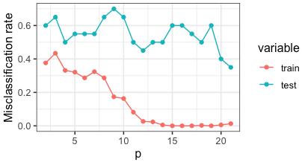
Cross-validation
Splitting data in training and test sets
1) Multiple times; to achieve more stable results than one-time random split
2) In unequal sizes; the performance depends on the number of observations (training > testing)
e.g., n-1 observations for training and the remaining one for testing; leave-one-out CV
When the sample size is limiting
Very similar training sets, time-consuming
k-fold cross-validation
- The observations are repeatedly split into a n(k-1)/k training set and a n/k test set
0.5
overfitted

Slide 19
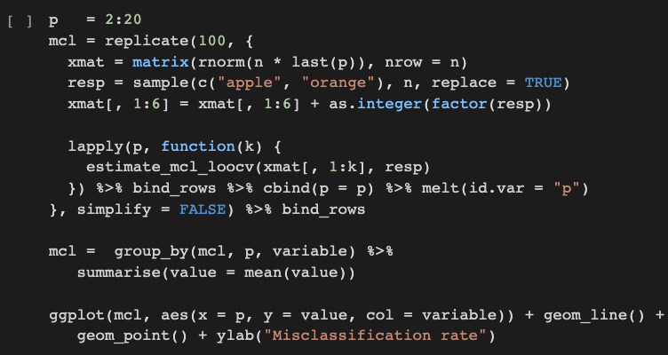
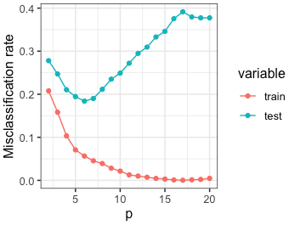
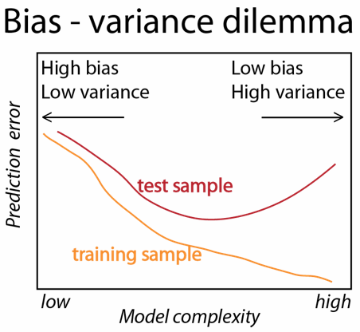
The curse of dimensionality
Data with a relevant class separation (features are meaningful)
@ p = 6
Misclassification increases
along with p
→ Distracted by additional features
Curse of dimensionality by Bellman (1961)
- high-dimensional spaces are very hard to sample thoroughly
- Fitting models to data with thousands of features (data << features)

Slide 20
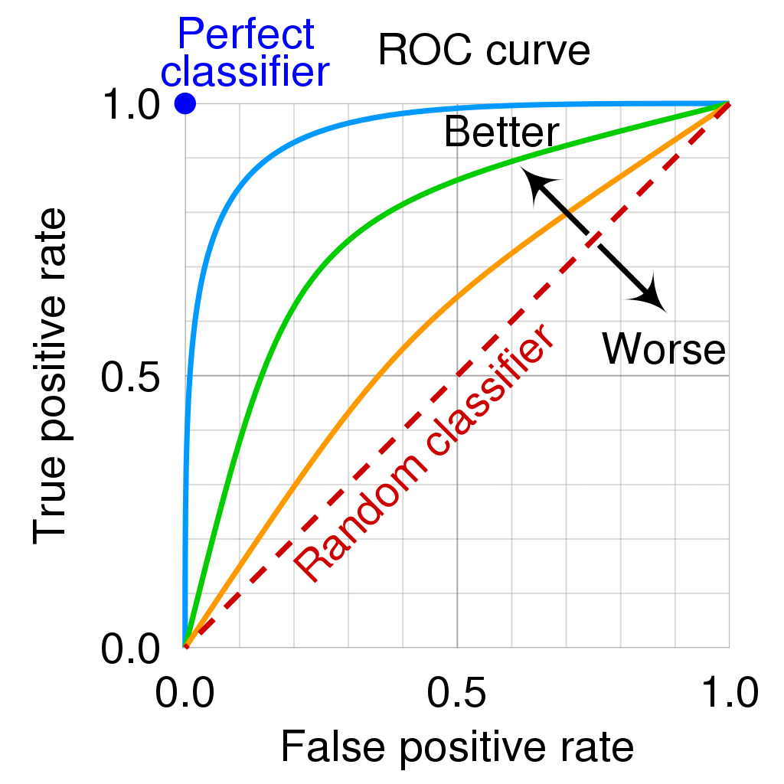
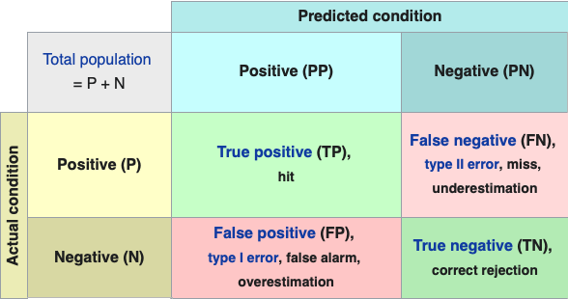
Objective (risk or cost) functions
Misclassification rate (MCR) – measures model performance
for a finite sample (n),
In binary classification (Yes or No, True or False, etc.),
ex) classification of healthy as healthy
- Sensitivity (true positive rate or recall)
ex) misclassification of ill as healthy
- Specificity (true negative rate)
- A parameter (a threshold) which can be modified → trade-off b/w sensitivity and specificity
→ All possible thresholds are tested → receiver operating characteristic (ROC) curve
Precision–recall curve

Slide 21
Objective (risk or cost) functions
Other objective functions
Jaccard index
0 ≤ J ≤ 1; the amount of overlap
Mean squared error (MSE)
- For continuous response variables (regression)

Slide 22
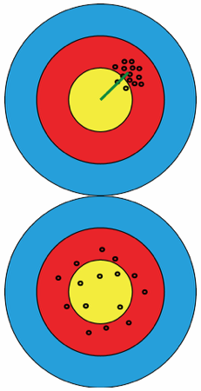
Variance-bias trade-off
For continuous variables (regression) – *MSE is widely used (the sum of two terms)
Bias:
One goes down while the other goes up
Variance:
- Minimization of MSE; a small bias & greatly reduced variance (trade-off)
- In classification (for discrete variables), other risk objective functions are used
those functions may not always be straightforward to decompose as such equation
- The discreteness of the response absorbs certain biases
higher bias with almost zero cost & smaller variance
How to control the trade-off relationship? → “penalization”

Slide 23
Variance-bias trade-off
Penalization (Regularization)
Not enough data to fit all the possible parameters in high-dimensional statistics
→ High variance in high-dimensional data (# of parameters > # of data points)
- One can control variance-bias trade-off using penalization
- Can be applied to LDA, however,
logistic regression is a more general approach for high-dimensional data

Slide 24
Penalization & logistic regression
Multinomial (more than 2 classes) logistic regression
- models the posterior log-odds between k classes
i = 1, ..., k-1 counts over the different classes
Data matrix x with n (observations) * p (features)
$β$_{i} is a p-dimensional vector which determines how the classification odds for class i versus class k depend on x
$β$_{i}⁰ is an intercept; classes’ prior probabilities
- The model is fit by maximizing the log-likelihood $ℓ$($β$, $β$⁰; x),
- But as p (features) increases while the sample size n remains the same,
the maximum likelihood estimate is unidentifiable
- We need to modify the objective function to overcome these limitations
→ Maximize a penalized version of the objective function
$λ$ ≥ 0 a real number
penalty function
ridge regression: pen($β$) = |$β$|²
lasso regression: pen($β$) = |$β$|¹

Slide 25
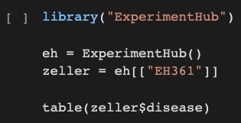
Penalization & logistic regression: Example
Metagenome sequencing data from fecal samples of 156 humans (CRC & tumor-free controls)
→ biomarkers (microbiome composition of certain taxa) related to early tumor detection
filter adenoma samples
Print random 3 lines

Slide 26
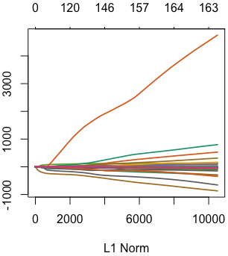
Penalization & logistic regression: Example
- Fit the data using a logistic regression (glmnet package)
→ The glmnet function fits for all possible λs at once
- If we want to extract the prediction performance for λ = 0.04
→ Performance on the training data (w/o cross-validation)
The # of non-zero coef.
coefficient
Different variables

Slide 27
Penalization & logistic regression: Example
- Fit the data using a logistic regression (glmnet package)
→ The glmnet function fits for all possible λs at once
- If we want to extract the prediction performance for λ = 0.04
→ Performance on the training data (w/o cross-validation)

Slide 28
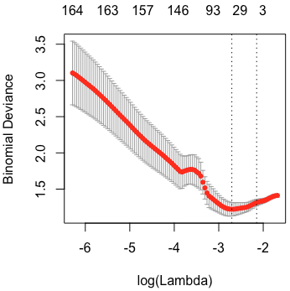
Penalization & logistic regression
How to choose an optimal 𝜆 parameter
- Try all possible choices of 𝜆 and assess classification performance (using cross-validation)
Built-in cross-validation
Often too small
→ weak penalization
: 1 standard error of the minimum

Slide 29
Exploring other methods
Many different learning algorithms
- CRAN: Machine learning & statistical learning
- Projects that provide unified interfaces to run different machine learning approaches
caret & mlr
- The caret package supports 238 different algorithms
To achieve higher accuracy and generalize to a new dataset
- Many methodical choices as possible
- Outer cross-validation loop
- Validation on truly unseen data

Slide 30
Summary
Prediction of categorial variables
- Linear and quadratic (non-linear) discriminant analysis
partitioning a two-dimensional data plane into regions using linear or non-linear separation lines
- Logistic regression
more amenable to operating in higher dimensions and to regularization
- Regularization; penalization
to avoid overfitting which happens in the context of the so-called curse of dimensionality

