Slide 1
Chapter 9. Multivariate methods for heterogeneous data
Yi Dohun
Bioinformatics and Genomics Lab
Department of Life Science, Hanyang University
July 31, 2023

Slide 2
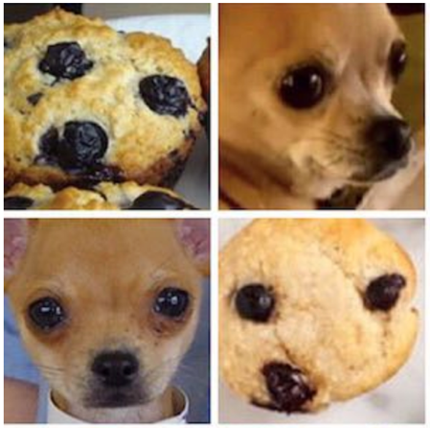
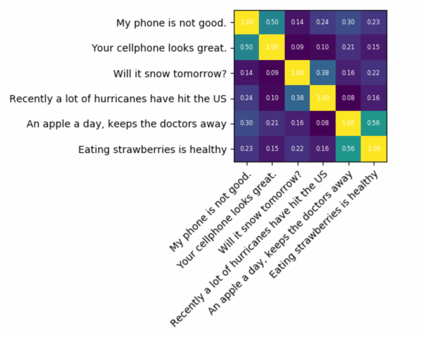
9. Introduction
Chapter 7 (Multivariate) covered how to summarize rectangular matrices data whose columns were continuous variables. And how to map data using dimensionality reduction such as PCA.
In biology there are complex heterogeneous data (continuous / categorical combined, or individual variables are not available)
And sometime observation cannot be described by features,
(image files , text documents)
But possible to determine distance or (dis)similarities
Chapter 9 will cover how to use nonlinear multivariate analysis techniques for such data

Slide 3
9.1 Goals of this chapter
In this chapter, we will:
Extend linear dimension reduction methods to cases when the distances between observations are available, known as multidimensional scaling (MDS) or principal coordinates analysis.
Find modifications of MDS that are nonlinear and robust to outliers.
Encode combinations of categorical data and continuous data as well as so-called ‘supplementary’ information. We will see that this enables us to remove batch effects.
Use chi-square distances and correspondence analysis (CA) to see where categorical data (contingency tables) contain notable dependencies.
Generalize clustering methods that can uncover latent variables that are not categorical. This will allow us to detect gradients, “pseudotime” and hidden nonlinear effects in our data.
Generalize the notion of variance and covariance to the study of tables of data from multiple different data domains.

Slide 4
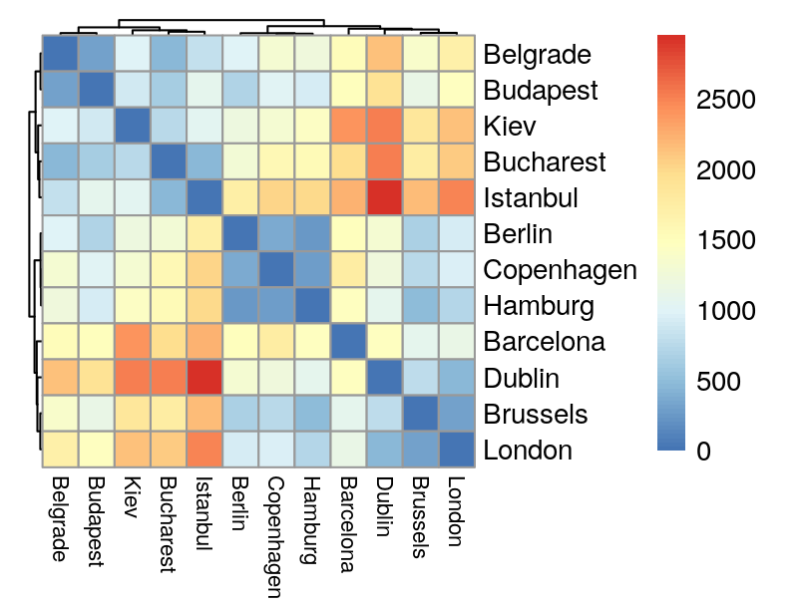
9.2 Multidimensional scaling and ordination
An example use of distance matrics: distance of cities

Slide 5
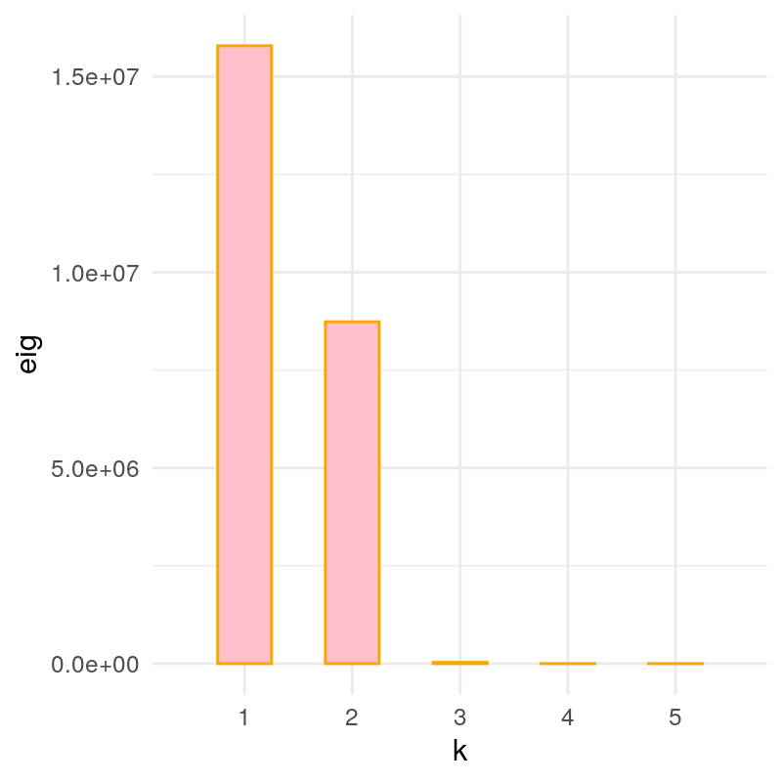
9.2 Multidimensional scaling and ordination

Slide 6
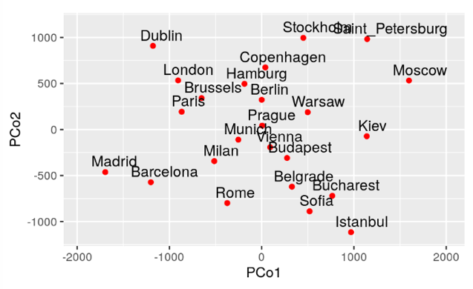
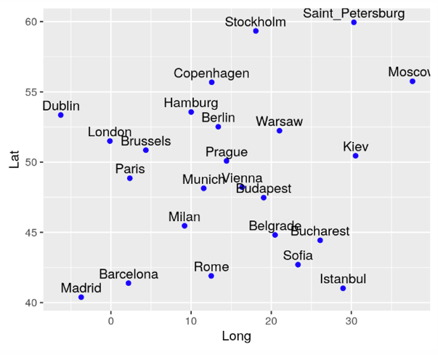
9.2 Multidimensional scaling and ordination
MDS gives approximation of coordinates of citeis

Slide 7
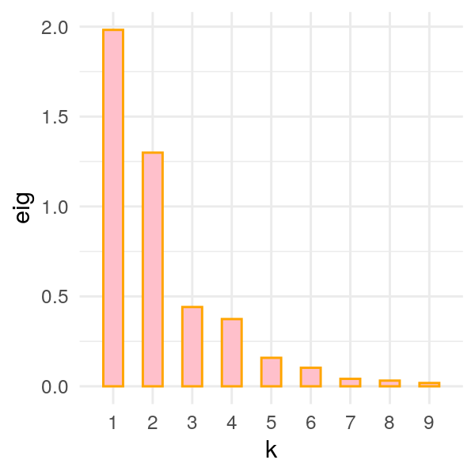
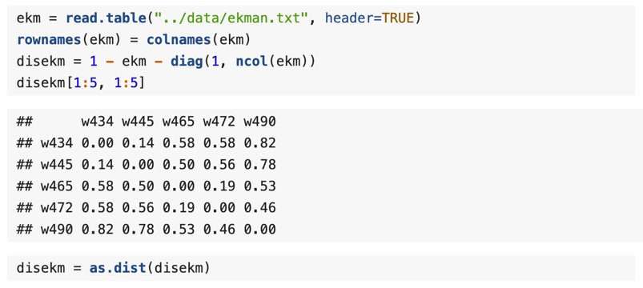
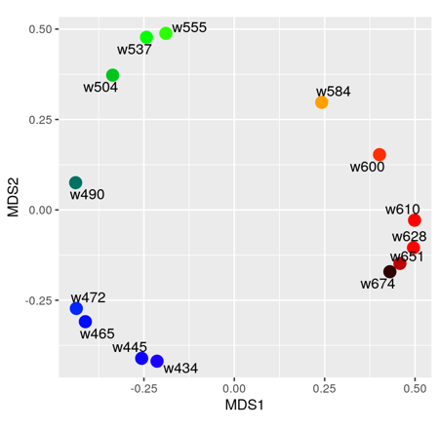
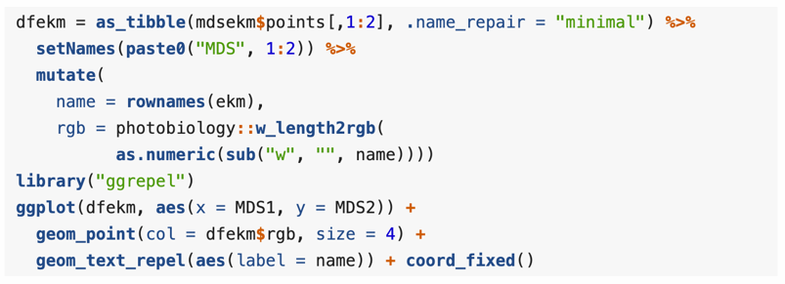
9.2 Multidimensional scaling and ordination
MDS: Given pairwise dissimilarities, reconstruct a map that preserves distances.
But what if there is no natural underlying Euclidean space?
Example: Ekman data. similarity matrix given for 14 different colors. (asked from 31 subjects to rank similarities of different colors)

Slide 8
9.2 Multidimensional scaling and ordination
Robust version of MDS: non-metric MDS (NMDS)
MDS tends to be sensitive to outliers: one single data point with large distances to everyone else can dominate, and thus skew, the whole analysis.
we like to use something that is more robust, and one way to achieve this is to disregard the actual values of the distances and only ask that the relative rankings of the original and the new distances are as similar as possible.
Because NMDS is dependent on k value,
We has to select k where stress has steep drop (stress=standardized residual sum of squares)
Find f(d) which preserve rank,
Thus, NMDS is random

Slide 9
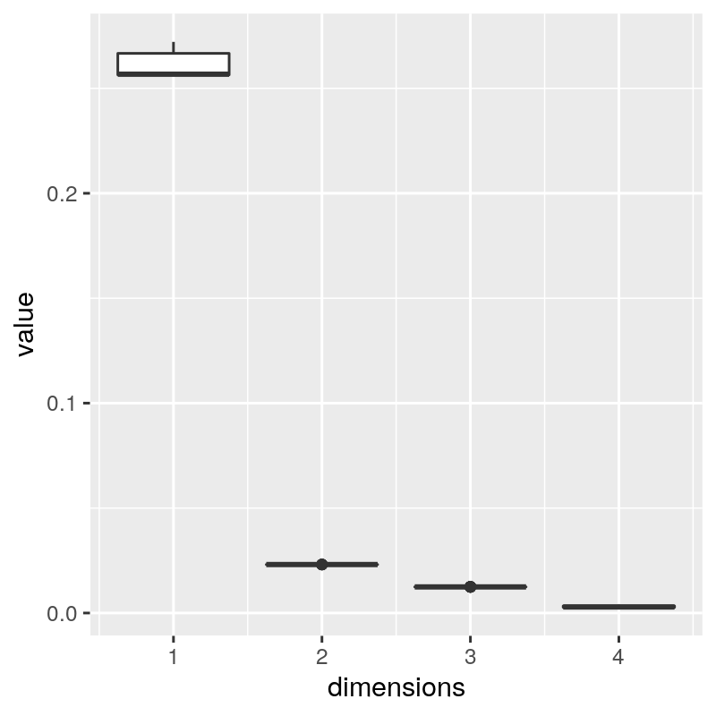
9.2 Multidimensional scaling and ordination
stress

Slide 10
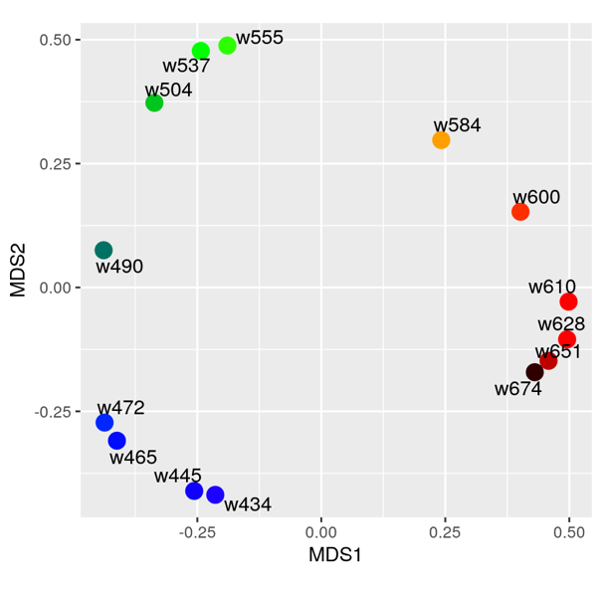
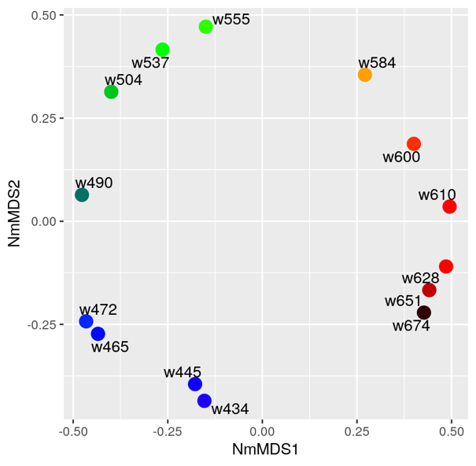
9.2 Multidimensional scaling and ordination

Slide 11
9.3 Contiguous or supplementary information
In Chapter 3 we introduced the R data.frame class that enables us to combine heterogeneous data types: categorical factors, text and continuous values.
Extra information about sample batches, dates of measurement, different protocols are often named metadata; this can be misnomer if it is implied that metadata are somehow less important.
Such information is real data that need to be integrated into the analyses. We typically store it in a data.frame or a similar R class and tightly link it to the primary assay data.

Slide 12
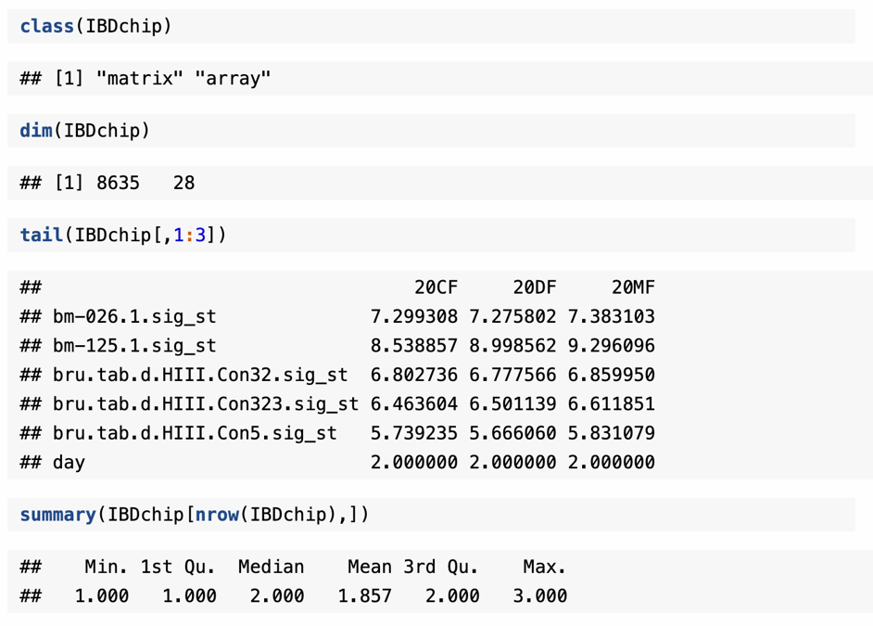
9.3 Contiguous or supplementary information
Example data: holmes et al.
bacterial abundance data from Phylochip (Brodie et al. 2006) microarrays.
The experiment was designed to detect differences between a group of healthy rats and a group who had Irritable Bowel Disease (Nelson et al. 2010).
There are 8634 taxa on 28 samples. Data collected from day 1,2,3.
We use rank-threshold transformation, giving top 3000 taxa score from 3000 to 1, and other 5634 score of 1
(for noise control)

Slide 13
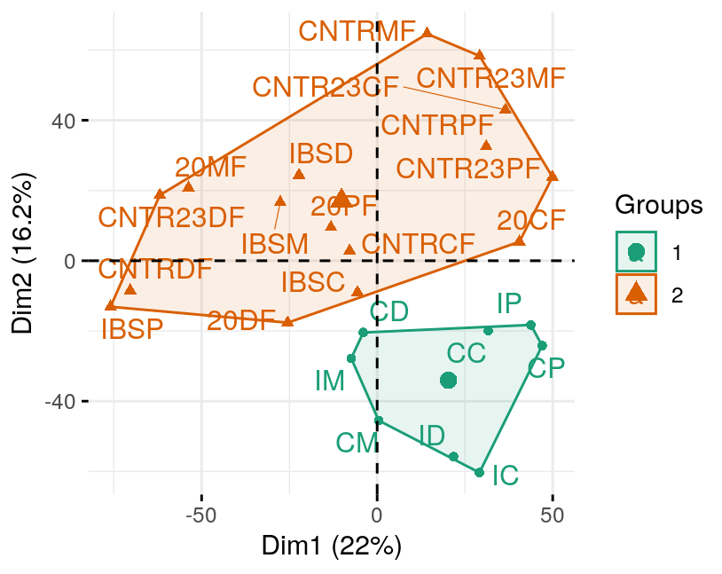
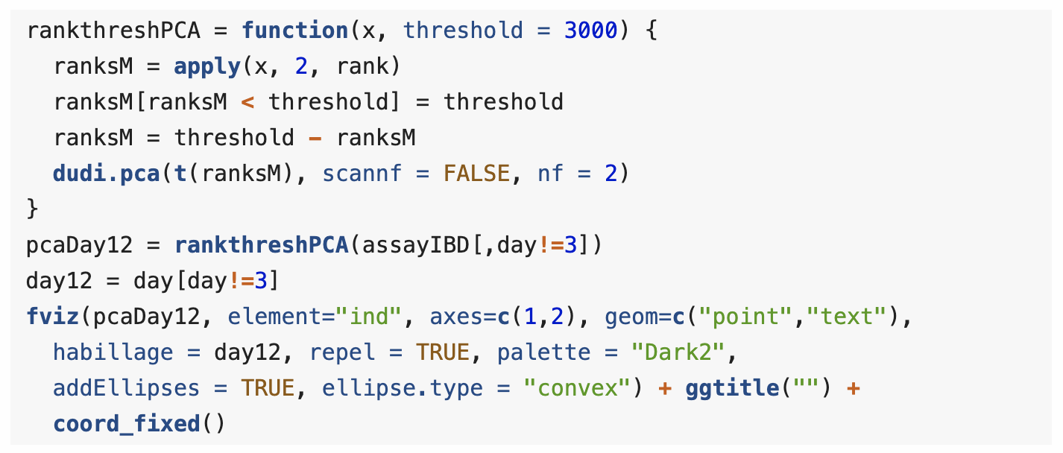
9.3 Contiguous or supplementary information
There are severe batch effect between Day 1, 2.
Unfortunately, Day 1,2 used different protocol and array.
This leads to uncertainty in the source of variation, we call this confounding of effects
Had to run one more experiment (day 3) with Array from day 2 and protocol from day 1.
Array
Protocol
Day 1
A
A
Day 2
B
B
Day 3
B
A

Slide 14
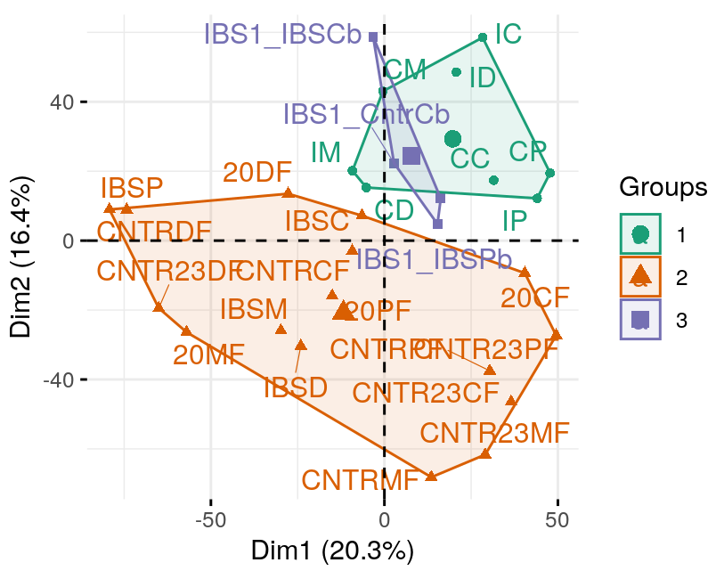
9.3 Contiguous or supplementary information
As Day3 overlap with Day1, we can say that the batch effect came from different protocol
Array
Protocol
Day 1
A
A
Day 2
B
B
Day 3
B
A

Slide 15
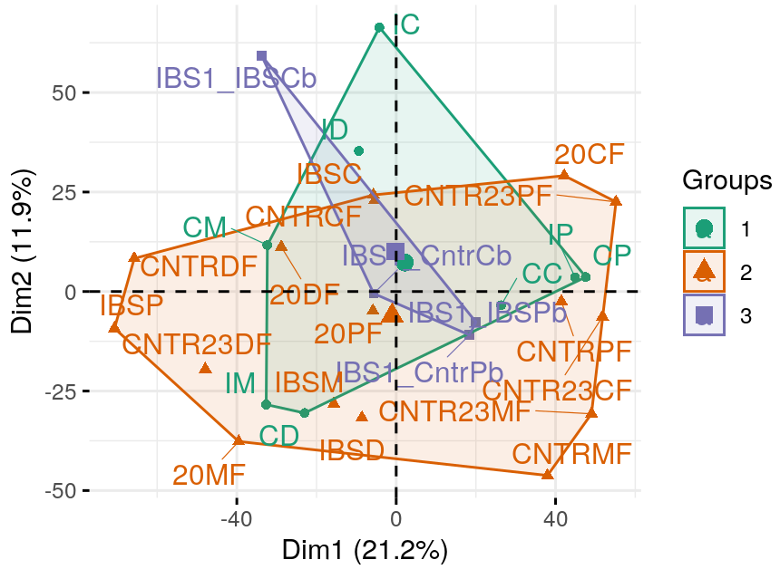
9.3 Contiguous or supplementary information
To remove batch effect, we can re-align the three group by subtracting the group means so all batch center on the origin.
More effective way is to use ComBat function in sva package

Slide 16
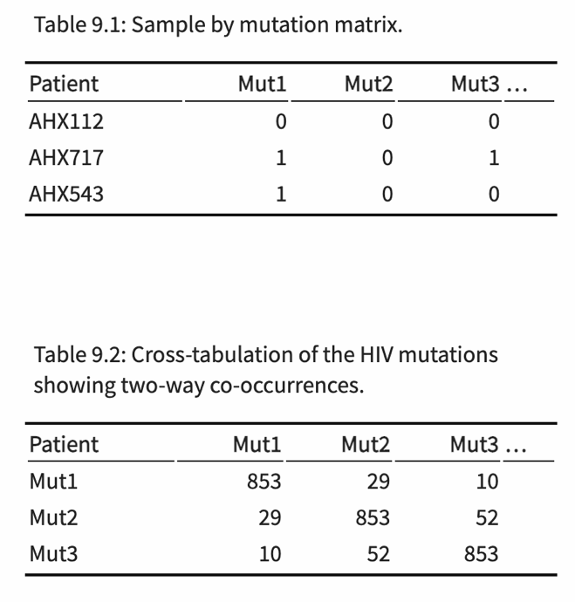
9.4 Correspondence analysis for contingency tables
Categorical data and correspondence analysis
Prerequisite: make contingency table from categorical matrix
In Chapter 2, We saw that the first step is to look at the independence of the two categorical variables; the standard statistical measure of independence uses the chi-square distance.
Correspondence analysis (CA) reveals the relative relationships between and within two groups of categorical variables, based on data given in a contingency table.

Slide 17
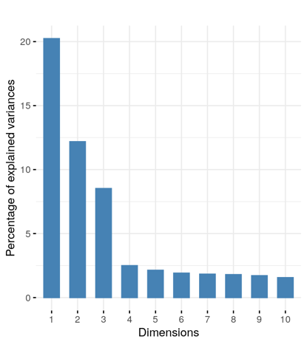
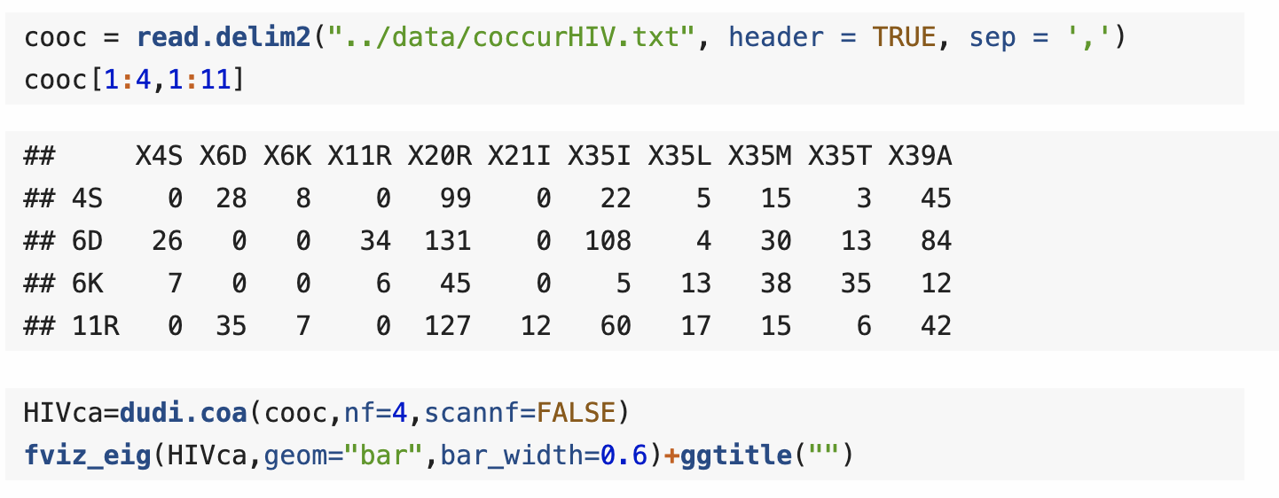
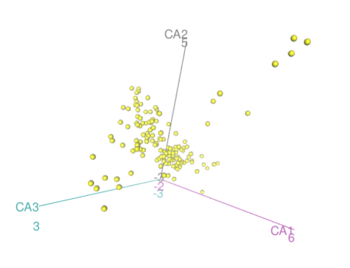
9.4 Correspondence analysis for contingency tables
Example of single categorical variables: HIV mutation co-occurrence data

Slide 18
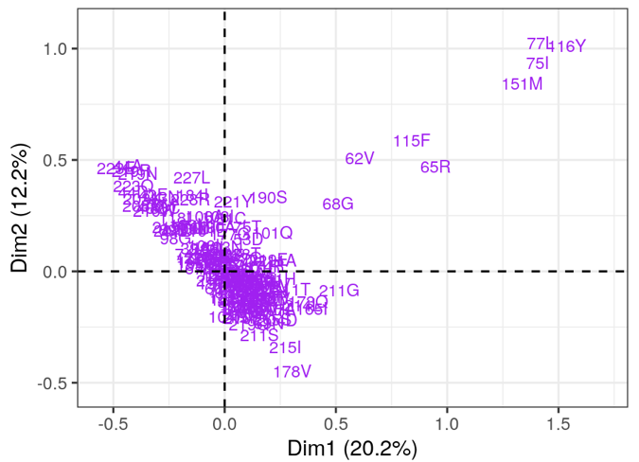
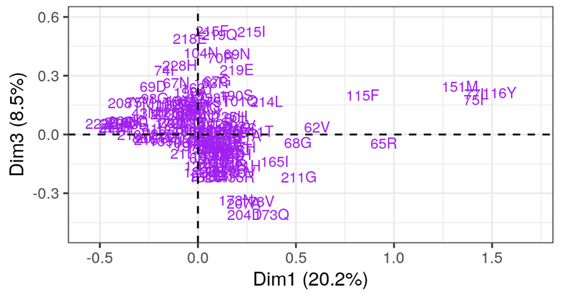
9.4 Correspondence analysis for contingency tables
In 2D, with Dim1&Dim2 or Dim1&Dim3.

Slide 19
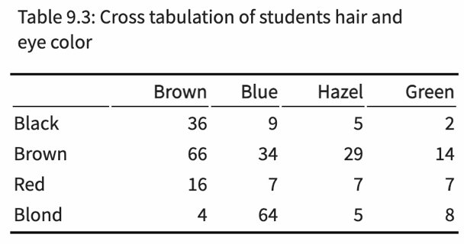
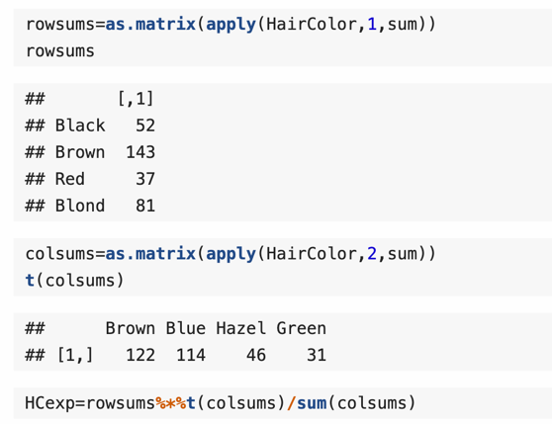
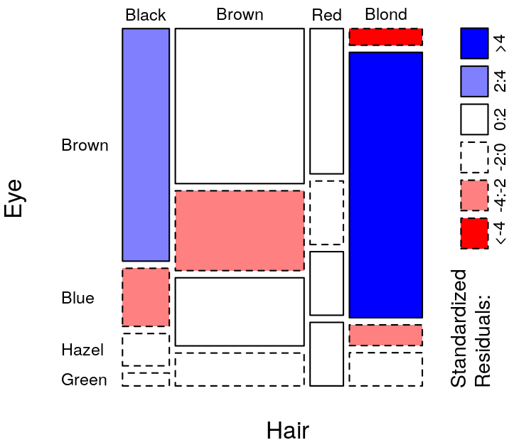
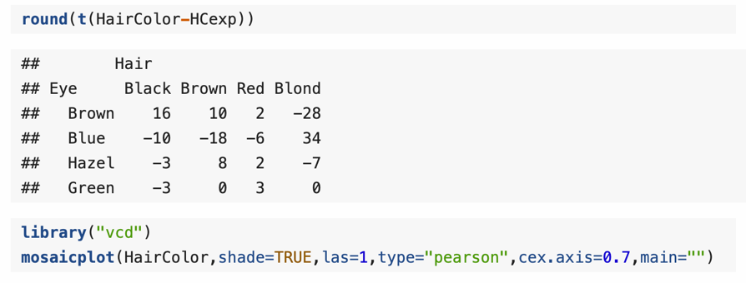
9.4 Correspondence analysis for contingency tables
Example of multiple categorical variables: hair color, eye color co-occurrence

Slide 20
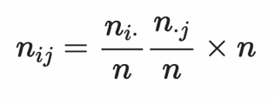
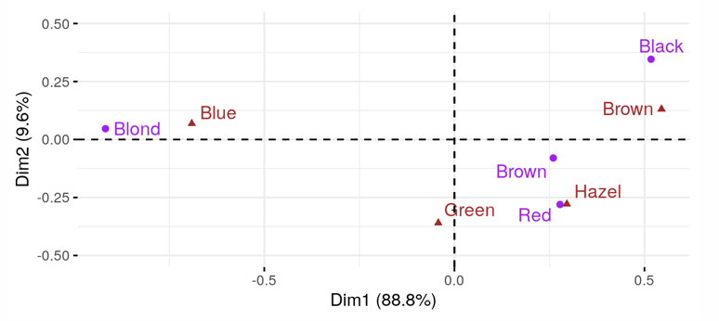
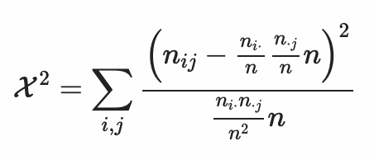
9.4 Correspondence analysis for contingency tables
For a general contingency table N with I rows and J columns and a total sample size of n, If the two categorical variables were independent, each cell frequency would be approximately equal to
The departure from independence is measured by the χ 2 statistic
Once we have ascertained that the two variables are not independent, we use a weighted multidimensional scaling using χ 2 distances to visualize the associations.
The method is called Correspondence Analysis (CA).

Slide 21
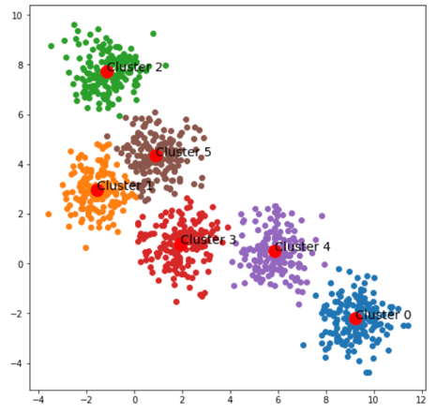
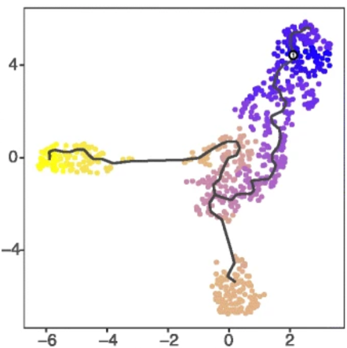
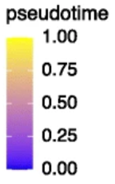
9.5 Finding time… and other important gradients
the methods we have studied in the last sections are known as ordination methods
In the same way clustering allowed us to detect and interpret a hidden factor/categorical variable, ordination enables us to detect and interpret a hidden ordering, gradient or latent variable in the data.
clustering
ordination

Slide 22
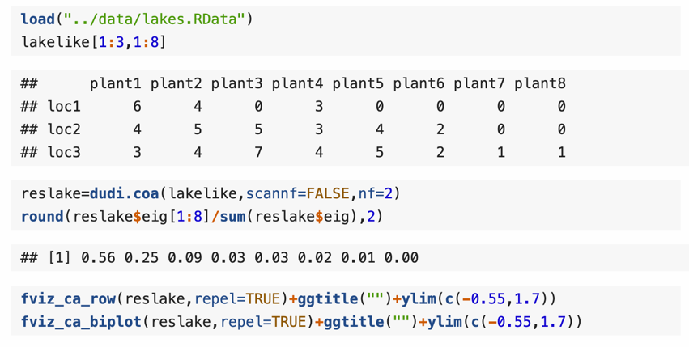
9.5 Finding time… and other important gradients
Ecologists use correspondence analysis and principal components as ecological gradients (Prentice 1977).
In this simple CA example with location near lake and plants, The locations near the lake are ordered along an arch.
we can see which plants are most frequent which locations by looking at the red triangles closest to the blue points.
In this example, CA finds hidden information about distance to lake
Lake

Slide 23
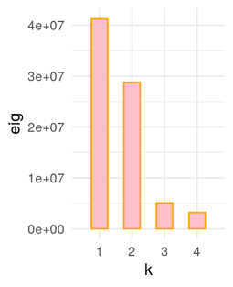
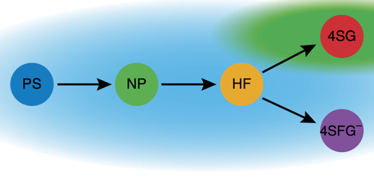
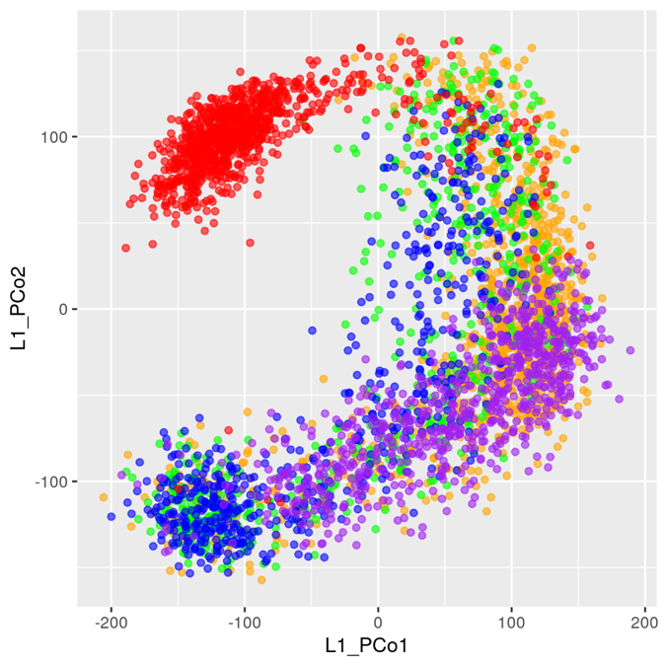
9.5 Finding time… and other important gradients
Second example: dynamics of cell development.
The data are single cell gene expression measurements of 3,934 cells with blood and endothelial potential from five populations

Slide 24
9.5 Finding time… and other important gradients
Local, and non-linear method
MDS and NMDS represent all distance as precisely as possible
So large distances between far away points skew the representations
It can be beneficial when looking for gradients or low dimensional manifolds to restrict ourselves to approximations of points that are close together.
Example of kernel, to decrease importance of far away points
t-SNE, one such method (but more sophisticated), clarify relations between the very close points, but the distances between more distal points cannot be interpreted.

Slide 25
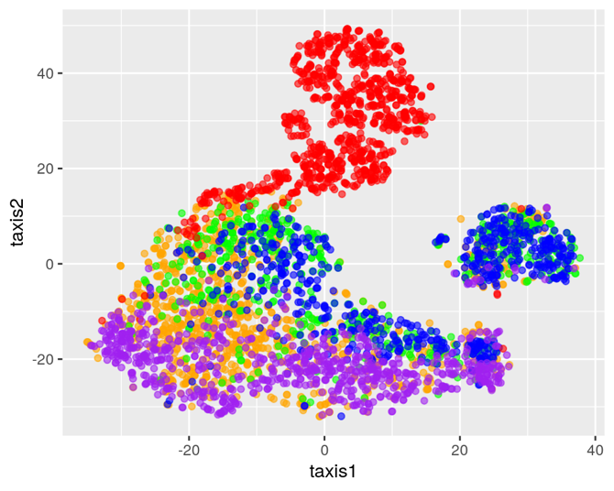
9.5 Finding time… and other important gradients
We see much stronger grouping of puple points
MDS
t-SNE

Slide 26
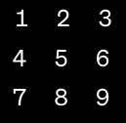
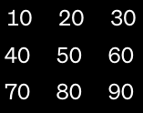
9.6 Multi-table techniques
Current studies often attempt to quantify variation in the microbial, genomic, and metabolic measurements across different experimental conditions.
As a result, it is common to perform multiple assays on the same biological samples and ask what features – microbes, genes, or metabolites, for example – are associated with different sample conditions.
There are many ways to approach these questions. Which to apply depends on the study’s focus.
Mantel coefficient
Used in ecology. two distance matrices are 'unfolded' into column vectors and a correlation calculated between these vectors. (linear correlation of matrices)
Significance of correlation is assessed via permutation test.
flatten
Linear corr
Canonical Correlation Analysis (CCA)
Is a generalization of PCA where variance we maximize is covariance between two matrices

