Slide 1

Modern Statistics for Modern Biology
Chap.4 Mixture Models
20230725
Gayoung Kim
BioInformatics&Genomics

Slide 2
Introduction
Chap.4 Mixture Models
Goals for this chapter
Generate our own mixture model data
See how the Expectation-Maximization (EM) algorithm enables us to “reverse engineer” the underlying mixtures in dataset.
Use a special type of mixture called zero-inflation for data such as ChIP-Seq data
Discover the empirical cumulative distribution: a special mixture that we can build from observed data. This will enable us to see how we can simulate the variability of our estimates using the bootstrap.
Build the Laplace distribution as an instance of an infinite mixture model with many components.
gamma-Poisson distribution, a hierarchical model useful for RNA-Seq data.
See how mixture models enable us to choose data transformations.
BioInformatics&Genomics

Slide 3
Finite mixtures
Chap.4 Mixture Models
Mixture with two equal sized components. (Finite mixtures)
Example
  Flip a fair coin
    Generate a random number from a normal distribution with mean 1 and variance 0.25.
    Generate a random number from a normal distribution with mean 3 and variance 0.25
BioInformatics&Genomics

Slide 4
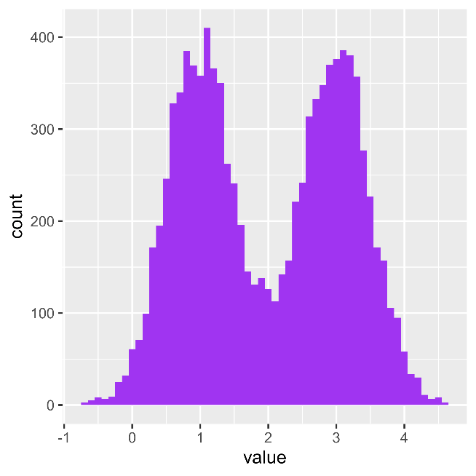

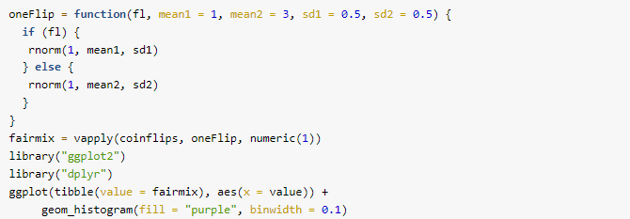
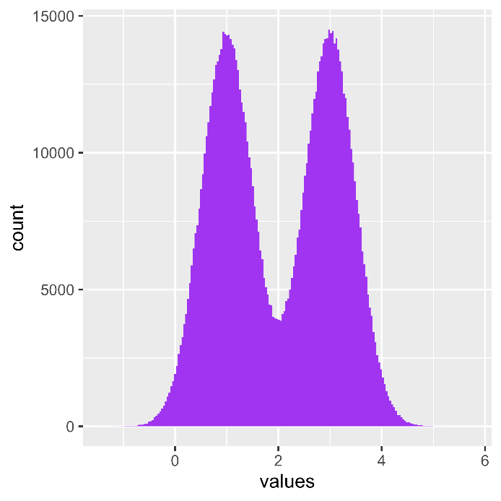

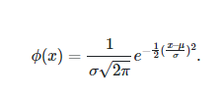
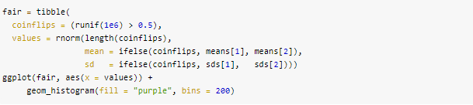
Finite mixtures
Chap.4 Mixture Models
BioInformatics&Genomics

Slide 5
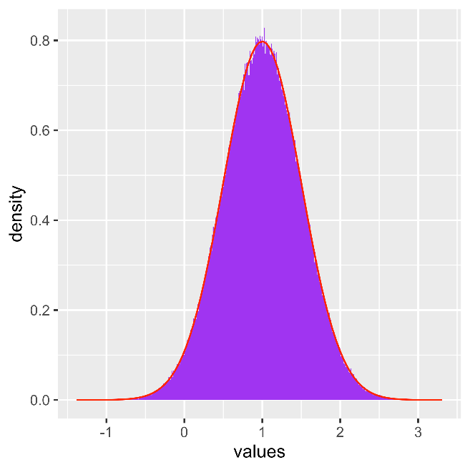


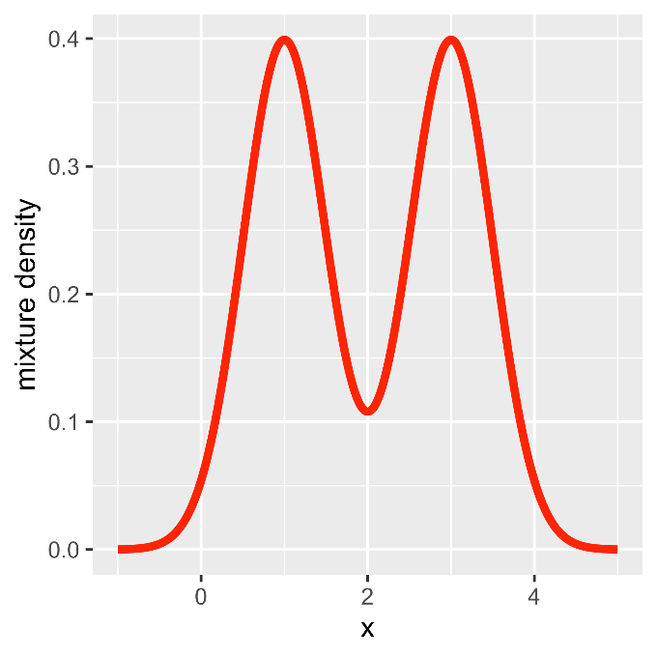
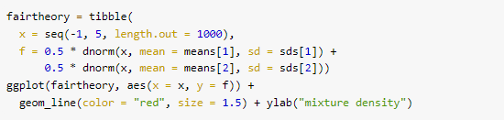
Finite mixtures
Chap.4 Mixture Models
bimodal distribution
BioInformatics&Genomics

Slide 6
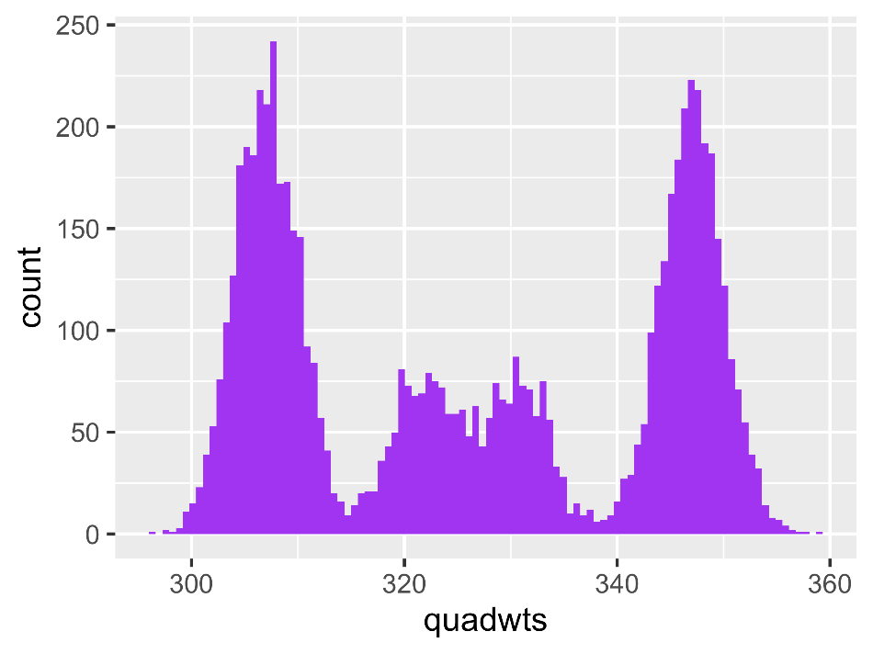
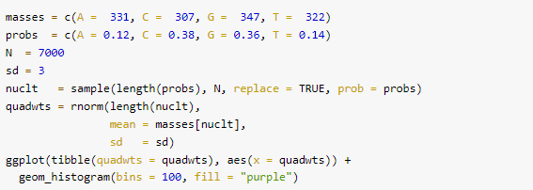
More than two components
Chap.4 Mixture Models
In many datasets which includes RNAseq, Chip-seq, etc…, may encounter mixture of more than two components.
N=7,000
SD=3
N=7,000
SD=10
N=1,000
SD=3
BioInformatics&Genomics

Slide 7
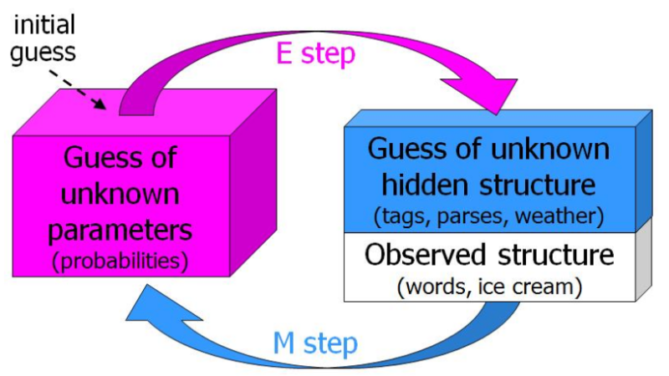
EM algorithm
Chap.4 Mixture Models
An Expectation–Maximization (EM) algorithm is an iterative method to find (local) maximum likelihood in statistical models, where the model depends on unobserved latent variables (inferred from other observed variable: like stage of disease of an individual may not be know but is inferred from given observed data).
EM algorithm iterative procedure follows for discovering hidden class labels
pretending we know the probability with which each observation belongs to a component and estimating the distribution parameters of the components.
pretending we know the parameters of the component distributions and estimating the probability with which each observation
BioInformatics&Genomics

Slide 8
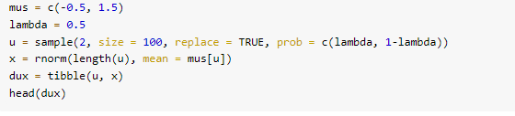
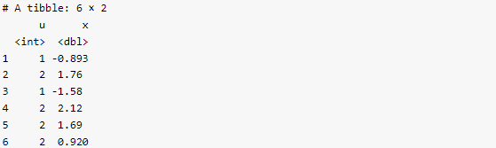

Discovering the hidden class labels
Chap.4 Mixture Models
BioInformatics&Genomics

Slide 9
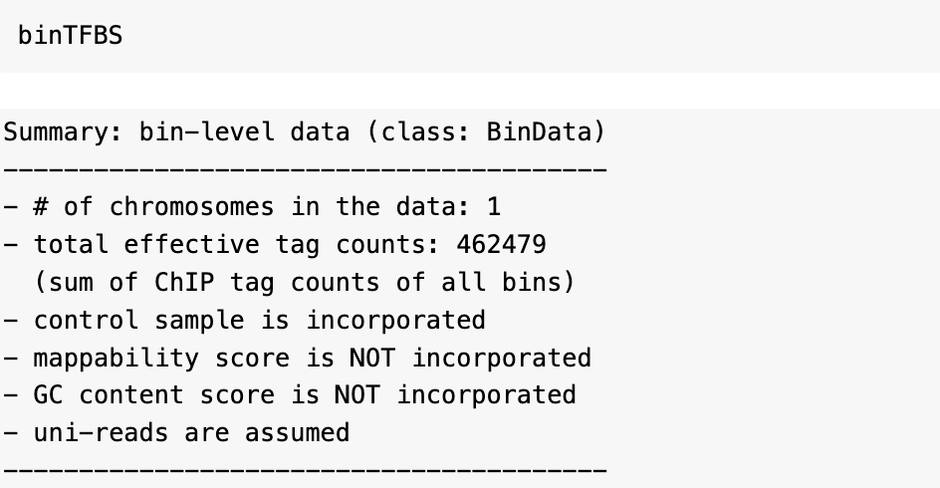
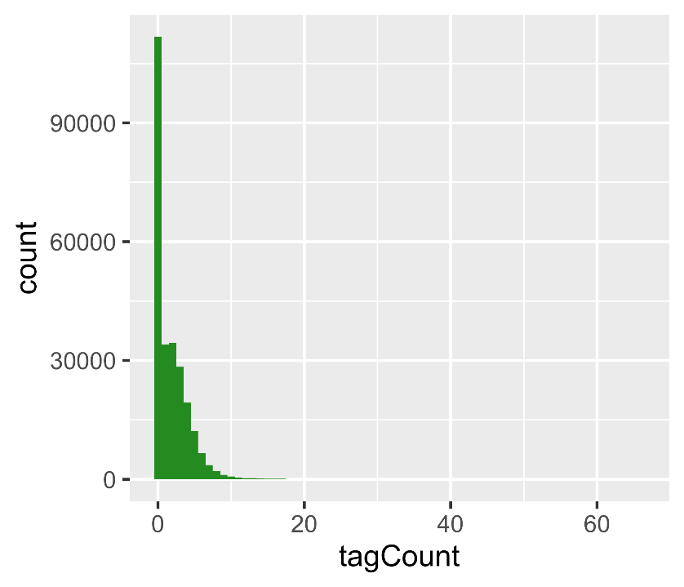
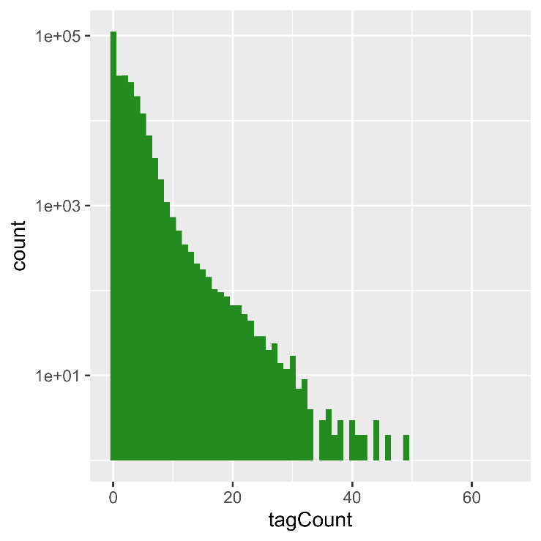
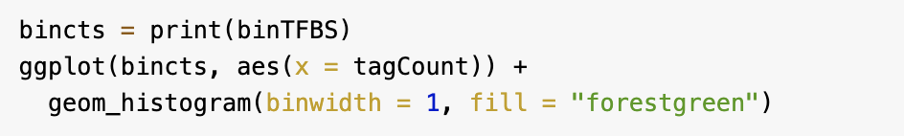
Models for zero inflated data
Chap.4 Mixture Models
Example: chromosome 22 from ChIP-Seq data
BioInformatics&Genomics

Slide 10
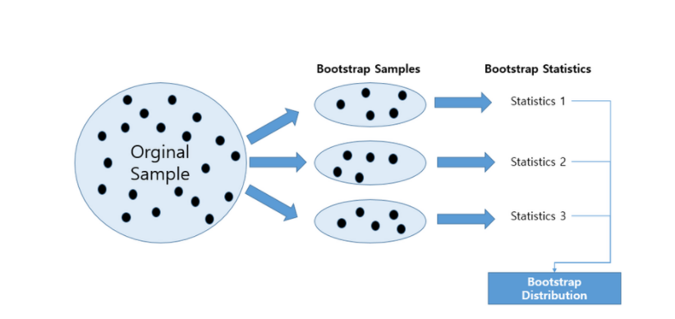
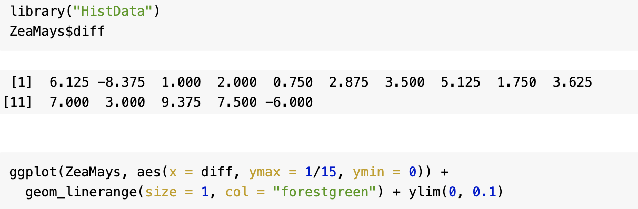
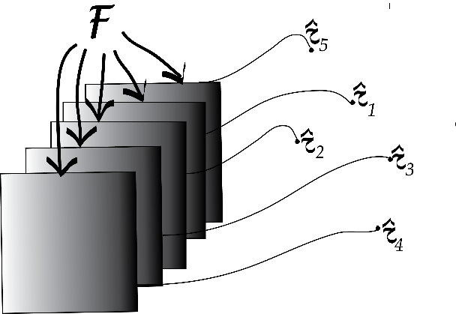
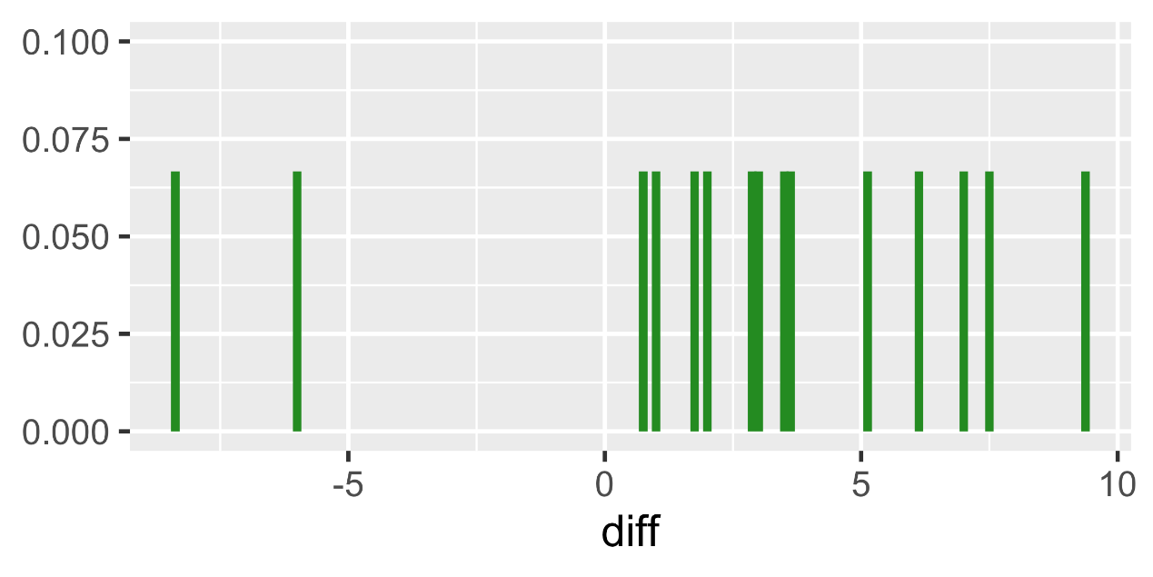
Empirical distributions and the nonparametric bootstrap
Chap.4 Mixture Models
Darwin’s Zea Mays data
compared the heights of 15 pairs of Zea Mays plants
The bootstrap simulates the sampling variability by drawing samples not from the underlying true distribution
BioInformatics&Genomics
https://velog.io/@hoyajhl/Biostatistics-%ED%86%B5%EA%B3%84-%EB%B6%84%EC%84%9D-Bootstrapping-%EB%B6%80%ED%8A%B8%EC%8A%A4%ED%8A%B8%EB%9E%A9

Slide 11
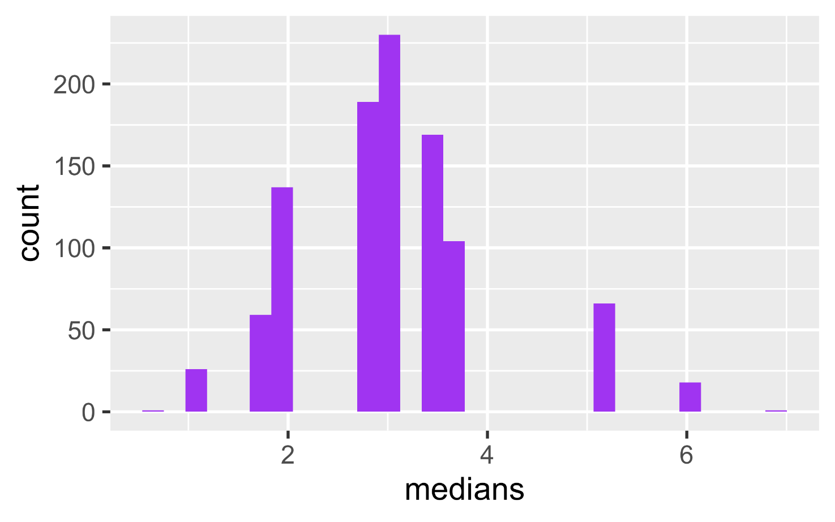
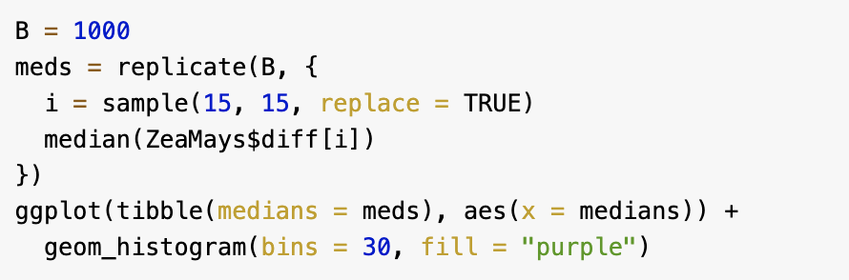
Empirical distributions and the nonparametric bootstrap
Chap.4 Mixture Models
BioInformatics&Genomics

Slide 12
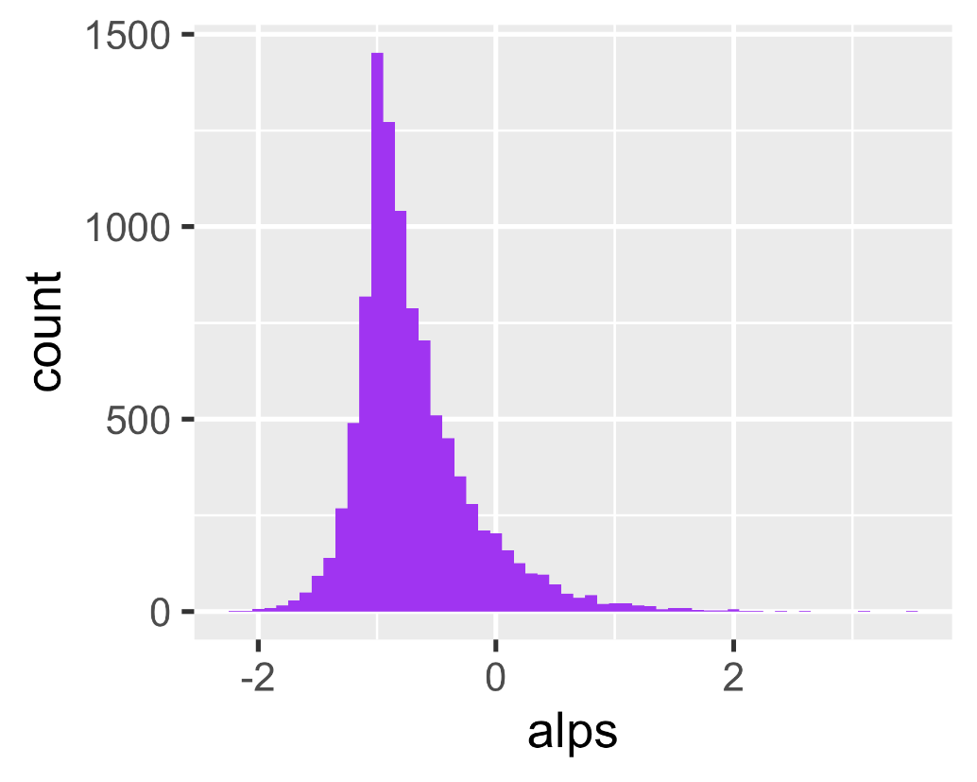
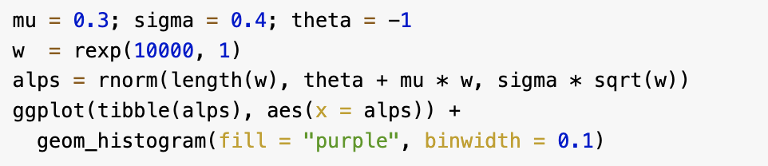
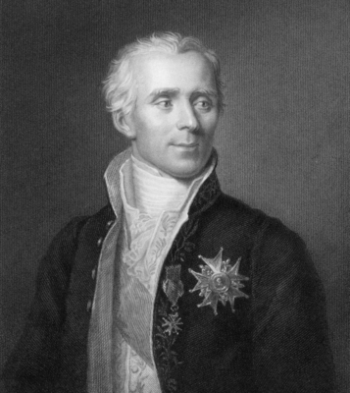

Infinite mixtures
Chap.4 Mixture Models
Laplace distribution
Laplace(θ , ϕ)
BioInformatics&Genomics

Slide 13
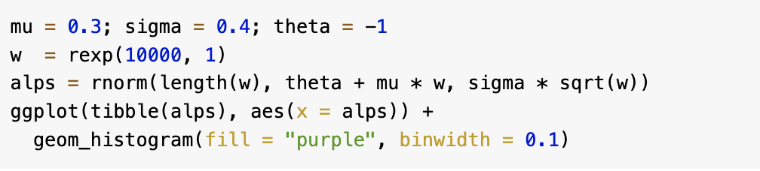
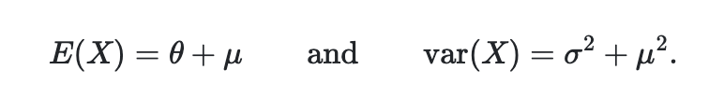
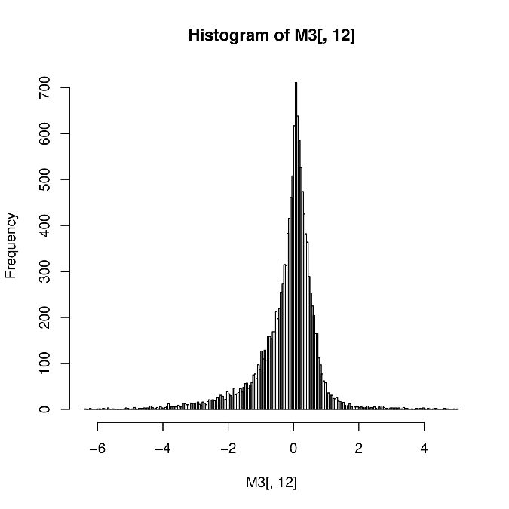

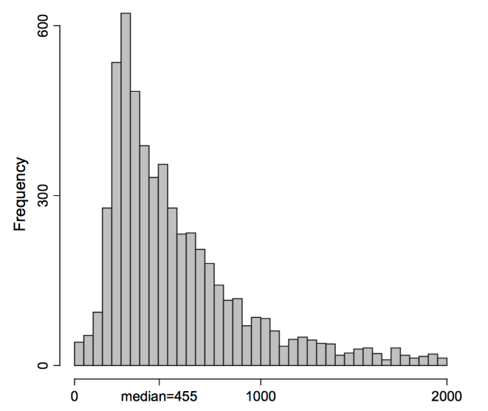
Infinite mixtures
Chap.4 Mixture Models
Asymmetric Laplace
X∼AL(θ,μ,σ)
The lengths of the promoters shorter than 2000bp from Saccharomyces cerevisiae
The log-ratios of microarray gene expression measurements for 20,000 genes
BioInformatics&Genomics

Slide 14
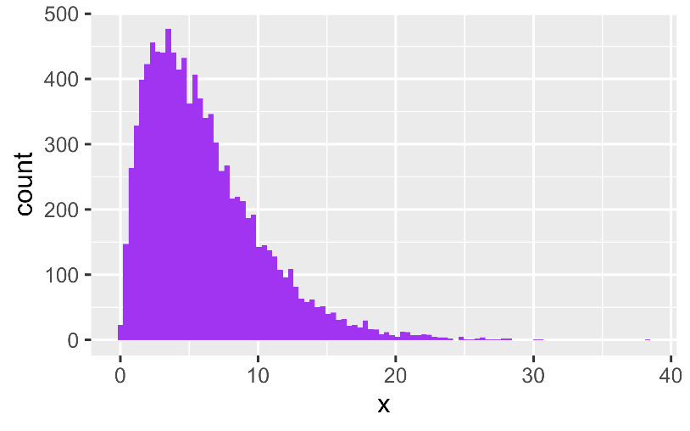
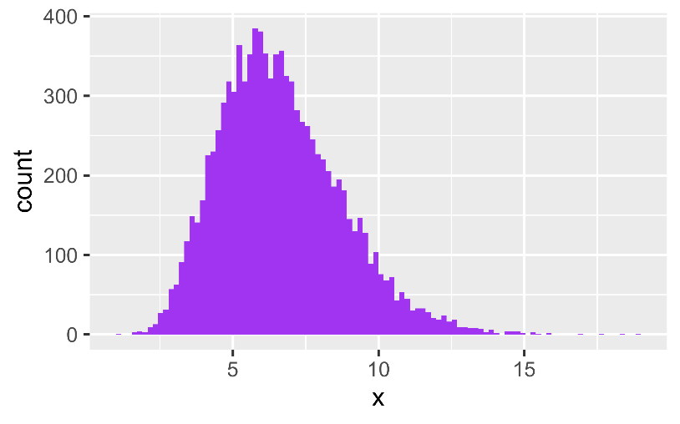
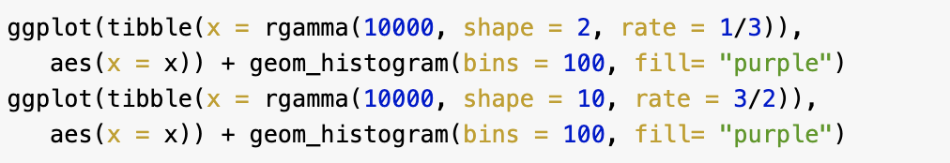
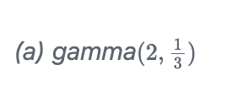

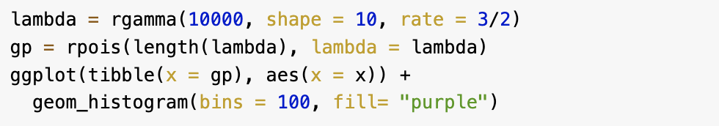
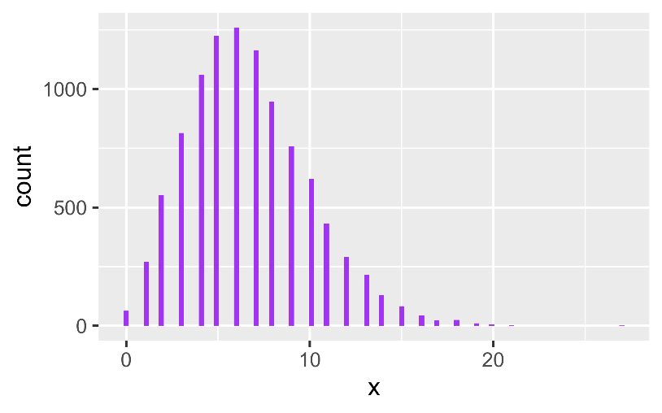
Infinite mixtures
Chap.4 Mixture Models
Gamma distribution: two parameters
gamma-Poisson hierachical model
BioInformatics&Genomics

Slide 15
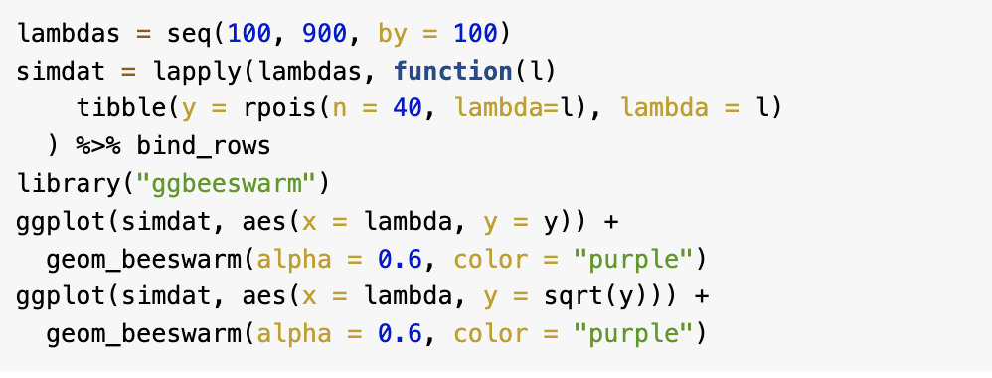
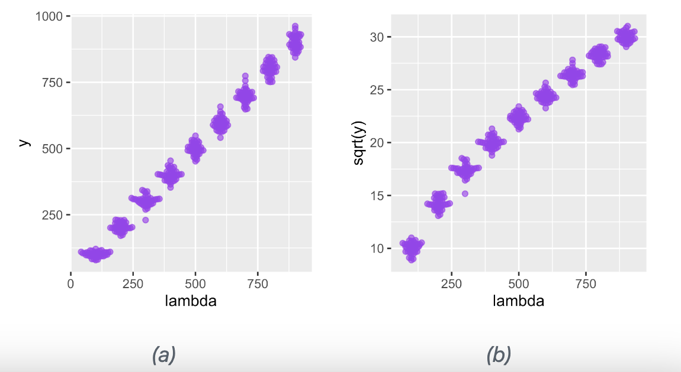
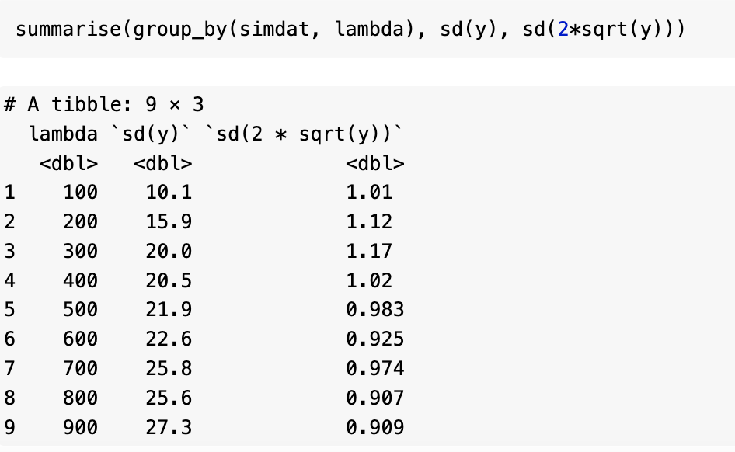
Variance stabilizing transformations
Chap.4 Mixture Models
BioInformatics&Genomics

Slide 16
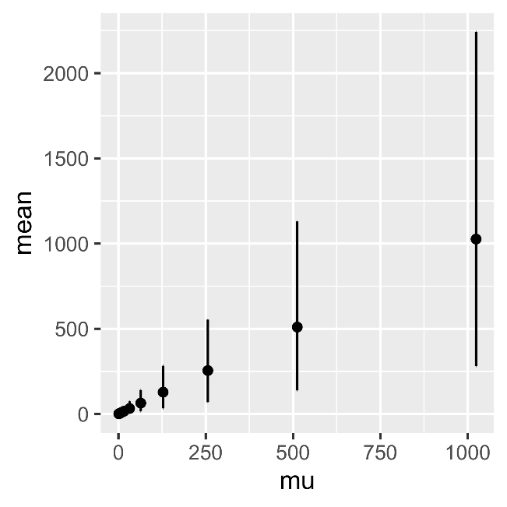
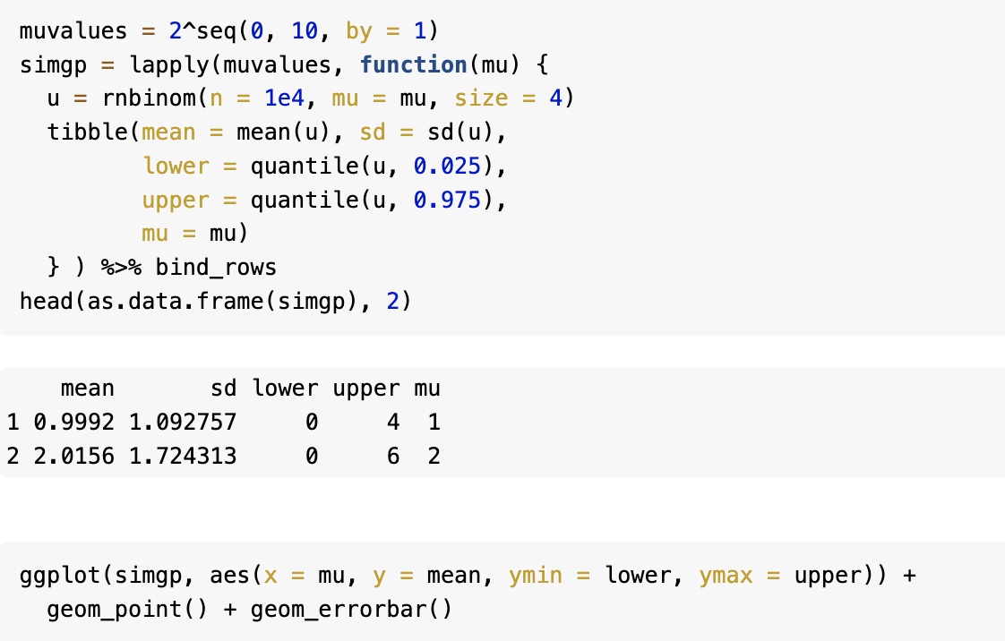
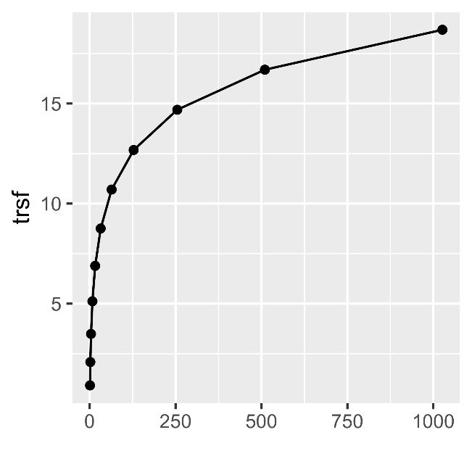
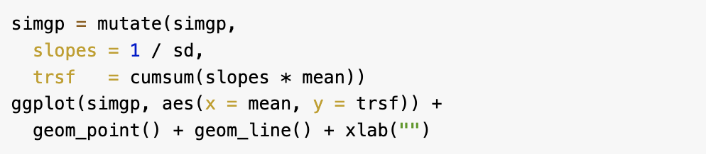
Variance stabilizing transformations
Chap.4 Mixture Models
BioInformatics&Genomics

