Slide 1
Session 5. Practice
Iron imbalance and the iron responsive element

Slide 2
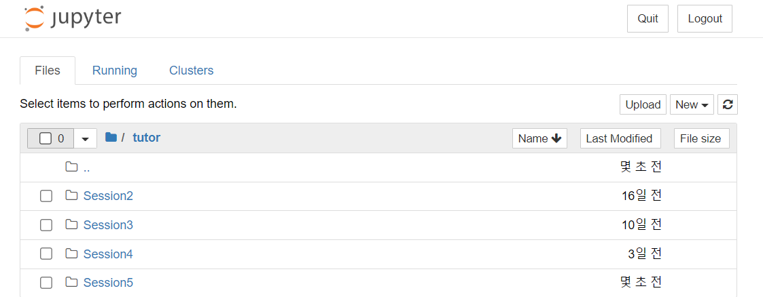
Make Session5 directory

Slide 3
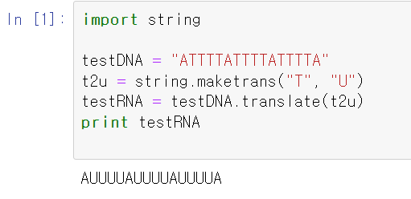
Replace Character(s) in String
stringModule.ipynb

Slide 4
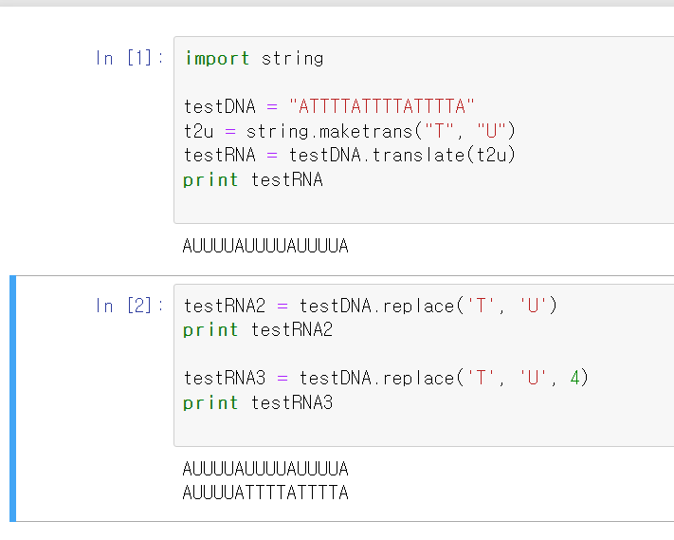
Continued from stringModule.ipynb

Slide 5
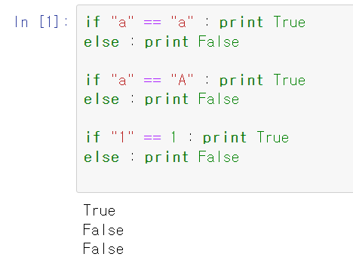
String comparison
strcmp.ipynb

Slide 6
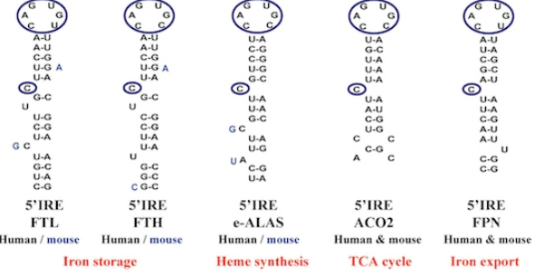
ire.py
Iron response element (IRE)
CAGUGN motif in the loop
16 nucleotide sequences

Slide 7
ire.py
G
U
A
G
C
U
_
A
U
C
G
=
G
=
C
=
G
C
Iron response element (IRE)
CAGUGN motif in the loop
_
U
G
16 sequences
fixed
UGCCACAGUGUUGGCG

Slide 8
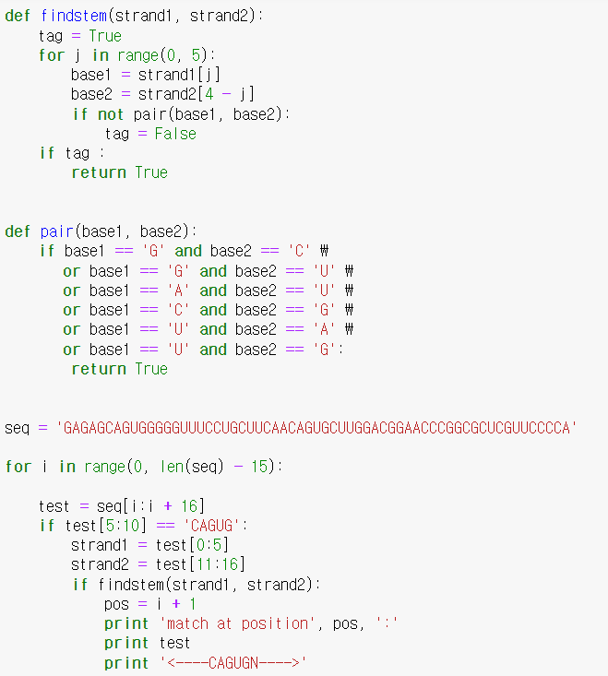
ire.py
G
U
A
G
C
U
_
A
U
C
G
=
G
=
C
=
G
C
_
U
G
strand1
strand2
UGCCACAGUGUUGGCG
16 sequences
Seq= “GAGAGCAGUGGGGGUUUCCUGCUUCAACAGUGCUUGGACGGAACCCGGCGCUCGUUCCCCA”

Slide 9
ire.py result

Slide 10
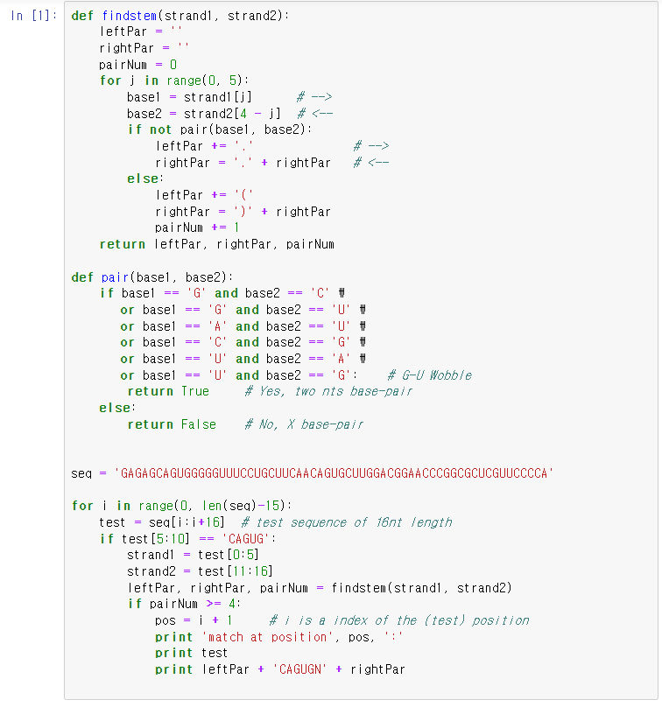
ire2.ipynb

Slide 11
ire2.ipynb result

Slide 12
Exercise 1
There are many ways to solve a problem in programming. Consider the construction in ‘ire2.py’ with a number of operations with substring functions, such as:
if test[5:10] == ‘CAGUG’:
However, we could instead make use of a regular expression:
if re.search(‘(.{5})(CAGUG.)(.{5})’, test)
In this expression, we may capture not only a loop sequence as group(2), but also strand1 and strand2 variables as group(1) and group(3), respectively.
Modify ‘ire2.py’ to use this type of regular expression

