Slide 1
Session 3. Practice
Cutting and ligating DNA

Slide 2
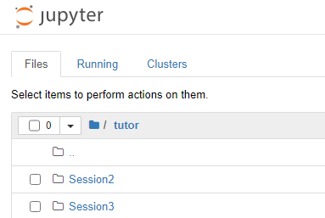
Make Session3 directory

Slide 3
Basic Python - if statement
$ python
>>> if 1==1: print “true”
>>> else: print “false”
→ true
>>> dna = 'AACGGAATTCCCTCTC'
>>> if 'GAATTC' in dna:
>>> print 'match'
→ match

Slide 4
Basic Python – regular expression
. ^ $ * + ? { } [ ] \ | ( )
Example
[CT]: C or T
[CT][AG]: C or T and A or G
[AB*]: A or AB or ABB or ABBB, …
[AB+]: AB or ABB or ABBB,…
[AB?]: A or AB
A{6}: AAAAAA
A{4,6}: AAAA, AAAAA, AAAAAA
More..

Slide 5
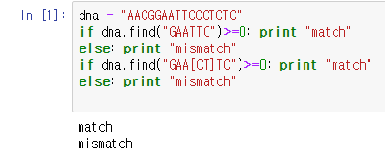
Pattern matching
patternMatch.ipynb
string_of_interest.find(target_seq) → string of interest 에 target_seq 가 있는 첫번째 index. 만약에 없으면 -1이 반환됨

Slide 6
Basic Python – re module
http://www.shutupandship.com/2012/02/regular-expressions-in-python-re-module.html

Slide 7
Basic Python – re module
Method | Description
re.search(pattern, string, flags=0) | Scan through string looking for the first location where the regular expression pattern produces a match, and return a corresponding MatchObject instance. Return None if no position in the string matches the pattern; note that this is different from finding a zero-length match at some point in the string.
re.match(pattern, string, flags=0) | If zero or more characters at the beginning of string match the regular expression pattern, return a corresponding MatchObject instance. Return None if the string does not match the pattern; note that this is different from a zero-length match.
re.findall(pattern, string, flags=0) | Return all non-overlapping matches of pattern in string, as a list of strings. The string is scanned left-to-right, and matches are returned in the order found. If one or more groups are present in the pattern, return a list of groups; this will be a list of tuples if the pattern has more than one group. Empty matches are included in the result unless they touch the beginning of another match.

Slide 8
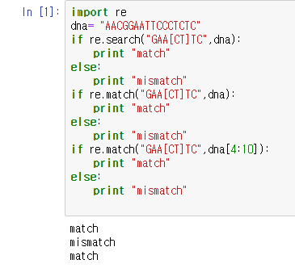
Pattern matching
rePattern.ipynb

Slide 9
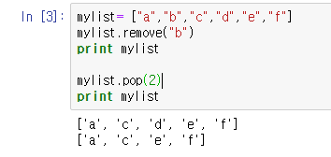
Basic Python – list
List에 있는 element를 직접 명시하여 제거
List index를 이용하여 제거

Slide 10
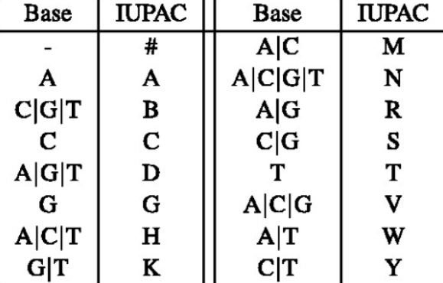
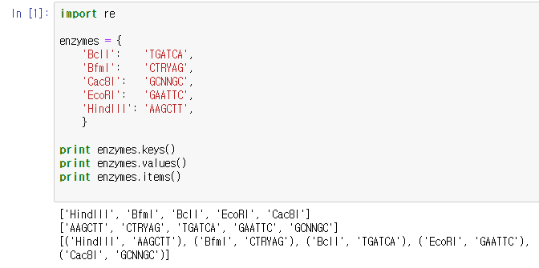
Basic Python – Dictionary usage
cut.ipynb

Slide 11
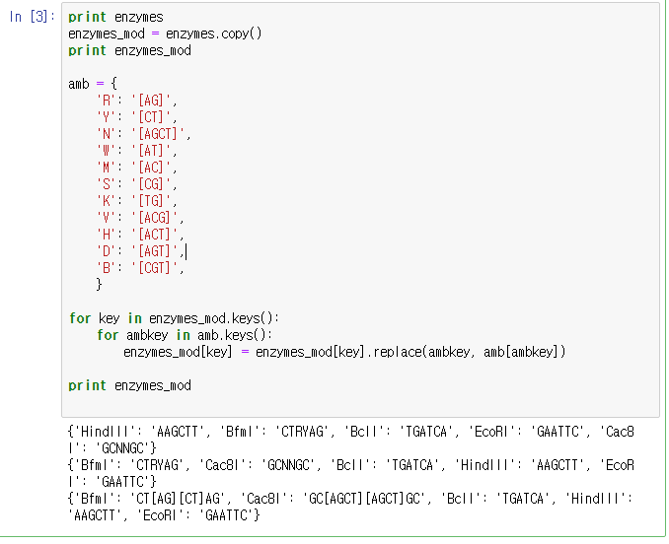
Basic Python – Dictionary usage

Slide 12
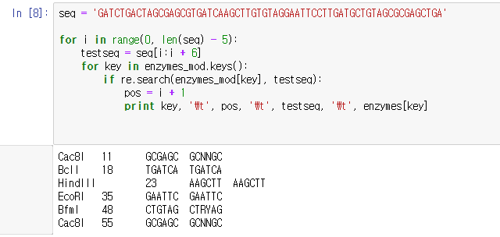
Code2.1 cut.py
seq = 'GATCTGACTAGCGAGCGTGATCAAGCTTGTGTAGGAATTCCTTGATGCTGTAGCGCGAGCTGA’
위에 문자열 복사해서 코드에 붙여넣기로 쓰세요 (직접 입력하기 힘들 시)

Slide 13
Exercise 1
Assume you want to analyse the same sequence as in Code 2.1, but instead you are interested in identifying recognition sites of the two enzymes Alu and DpnI. These enzymes recognize sequences AGCT and GATC, repectively. Modify Code 2.1 to achieve this analysis

Slide 14
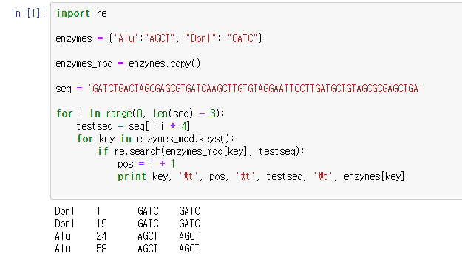
Exercise script and result

Slide 15
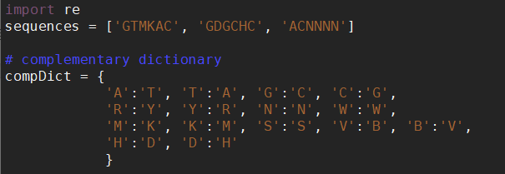
Assignment
Prints the reverse complement of the following restriction enzyme recognition sequence: GTMKAC, GDGCHC, and ACNNNN. For instance, the symbol R is either A or G. The complementary bases in that case are T and C, and these may be represented by Y. Therefore, the ‘complement’ of R is Y.
1. Reverse complement of GTMKAC, GDGCHC, and ACNNNN
2. Convert to regular expression using iupac dictionary

Slide 16
Assignment
3. Are there reverse complement sequence present in “seq” from code2.1? If so, print out 1)- position, 2) actual sequence of enzyme recognition in “seq” 3)- original enzyme recognition sequences.

