Slide 1
Gene Technology
Session 2. Cutting and ligating DNA
Knocking gene down
Amplifying DNA

Slide 2
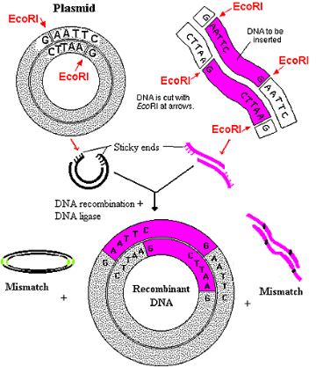
Genetic (Gene) Engineering impacted on medicine and biotechnology
Before PCR developed, how were biologists able to amplify DNA in large amount?
DNA Amplification
Sequencing
Gene Therapy
GMO
Resistance to insects
Crop yield
Cloning the DNA, transfecting it to bacteria, growing and harvesting them
The specific DNA cloning (cutting and ligation) is an essential technology in genetic engineering.

Slide 3
Cutting and ligation for cloning
DNA Cutting
Restriction enzyme
Sequence-specific manner
First evidence: 1952
→ This phenomena was later explained with a model “restriction-modification”.
Late 1960s – Type I random position far away from a recognition site.
1970 – Type II HindIII (Smith & Wilcox) sequence-specific and at specific position.
→ 1978 Nobel prize
Phage
Bacteria A
Bacteria B

Slide 4
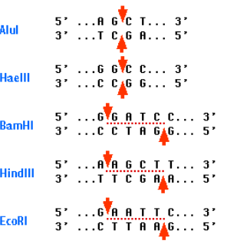
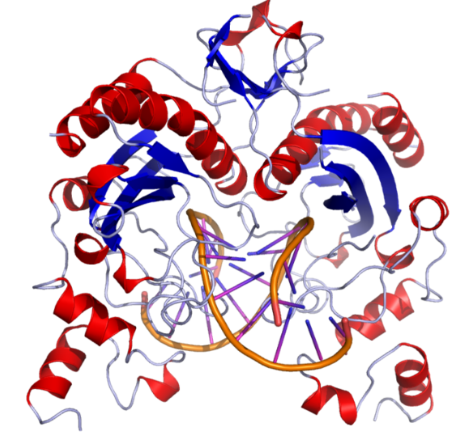
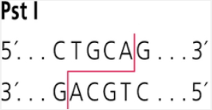
Restriction enzymes and recognition sites
Sites are palindromic (inverted repeat)
Blunt end vs Sticky end
5’ single-stranded vs 3’ single-stranded end
➔ REBASE

Slide 5
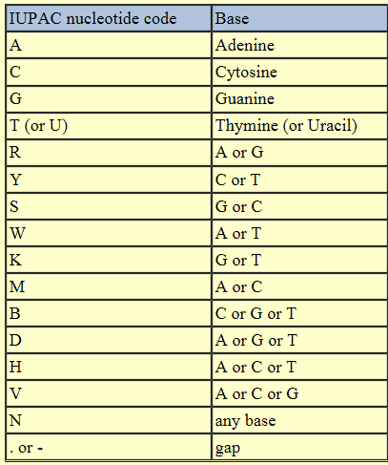
Restriction enzymes and recognition sites
In general, the length of site is 4~8 nt.
Length of recognition provides the specificity
AluI AGCT → 1/256
BamHI GGATCC → 1/4096
NotI → 1/65,536
Some enzymes are less specific.
BxtX2I RGATCY → 1/1024
R = A or G, Y = C or T, W = A or T
Type III: cleave at sites a short distance from recognition site

Slide 6
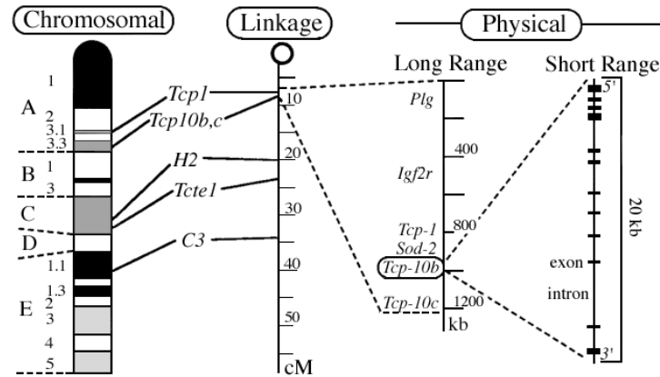
Genetic and physical chromosome map
Restriction enzyme (8bp)
Recombination rate
Restriction enzyme (6bp/4bp)

Slide 7
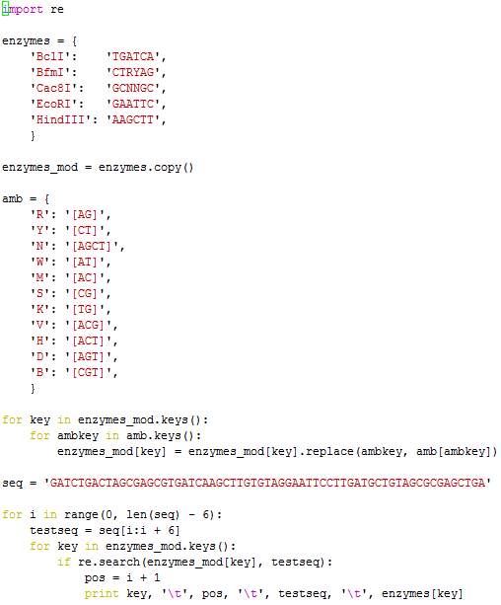
Finding restriction sites

Slide 8
Pattern matching
If statement
if 1==1: print “true”
else: print “false”
Regular expression are very useful in pattern matching.
[CT]: C or T
[CT][AG]: C or T and A or G
[AB*]: A or AB or ABB or ABBB, …
[AB+]: AB or ABB or ABBB,…
[AB?]: A or AB
A{6}: AAAAAA
A{4,6}: AAAA, AAAAA, AAAAAA
More..
dna = "AACGGAATTCCCTCTC"
if dna.find("GAATTC")>=0: print "match"
else: print "mismatch"
if dna.find("GAA[CT]TC")>=0: print "match"
else: print "mismatch"
match
mismatch
→ Regular expression module is required

Slide 9
Pattern matching
Regular expression are very useful in pattern matching.
import re
dna = "AACGGAATTCCCTCTC"
if re.search('GAA[CT]TC', dna): print "match"
else: print “mismatch”
if re.match('GAA[CT]TC', dna): print "match"
else: print “mismatch”
if re.match('GAA[CT]TC', dna[4:10]): print "match"
else: print “mismatch”
match
mismatch
match

Slide 10
Pattern matching
rna = "AACGGAAUUCCCUCUC"
if re.search('C{3}', rna): print "match"
else: print "mismatch"
if re.search(‘U*C*T', rna): print "match"
else: print "mismatch"
if re.search(‘U*C*U', rna): print "match"
else: print "mismatch"
match
mismatch
match

Slide 11
Character/String replacement
seq = 'GCAATAT'
seq = seq.replace('T', 'U')
print seq
Dictionary usage
enzymes = {
'BclI': 'TGATCA',
'BfmI': 'CTRYAG',
'Cac8I': 'GCNNGC',
'EcoRI': 'GAATTC',
'HindIII': 'AAGCTT',
}
print enzymes.keys()
print enzymes.values()
print enzymes.items()
['HindIII', 'BfmI', 'BclI', 'EcoRI', 'Cac8I']
['AAGCTT', 'CTRYAG', 'TGATCA', 'GAATTC', 'GCNNGC']
[('HindIII', 'AAGCTT'), ('BfmI', 'CTRYAG'), ('BclI', 'TGATCA'), ('EcoRI', 'GAATTC'), ('Cac8I', 'GCNNGC')]

Slide 12
code2.1 cut.py
#!/usr/bin/python
import re
enzymes = {
'BclI': 'TGATCA',
'BfmI': 'CTRYAG',
'Cac8I': 'GCNNGC',
'EcoRI': 'GAATTC',
'HindIII': 'AAGCTT',
}
enzymes_mod = enzymes.copy()
amb = {
'R': '[AG]','Y': '[CT]','N': '[AGCT]','W': '[AT]',
'M': '[AC]','S': '[CG]','K': '[TG]','V': '[ACG]',
'H': '[ACT]','D': '[AGT]','B': '[CGT]',
}
Cac8I 11 GCGAGC GCNNGC
BclI 18 TGATCA TGATCA
HindIII 23 AAGCTT AAGCTT
EcoRI 35 GAATTC GAATTC
BfmI 48 CTGTAG CTRYAG
Cac8I 55 GCGAGC GCNNGC
for key in enzymes_mod.keys():
for ambkey in amb.keys():
enzymes_mod[key] = enzymes_mod[key].replace(ambkey, amb[ambkey])
seq = 'GATCTGACTAGCGAGCGTGATCAAGCTTGTGTAGGAATTCCTTGATGCTGTAGCGCGAGCTGA'
for i in range(0, len(seq) - 6):
testseq = seq[i:i + 6]
for key in enzymes_mod.keys():
if re.search(enzymes_mod[key], testseq):
pos = i + 1
print key, '\t', pos, '\t', testseq, '\t', enzymes[key]

