Slide 1
Bioinformatics introduction to python 2022-09-06
Dept. of Life Science, HYU

Slide 2
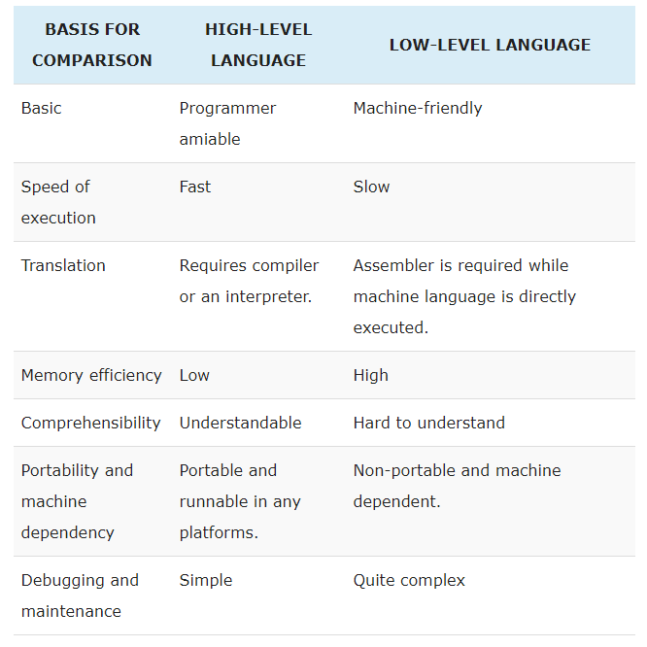
What is Python?
Python is a high level interpreted language, which is best suited for writing python scripts for automation and code re-usability
https://techdifferences.com/difference-between-high-level-language-and-low-level-language.html

Slide 3
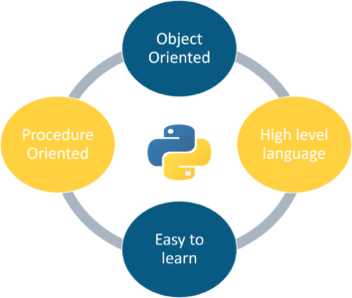
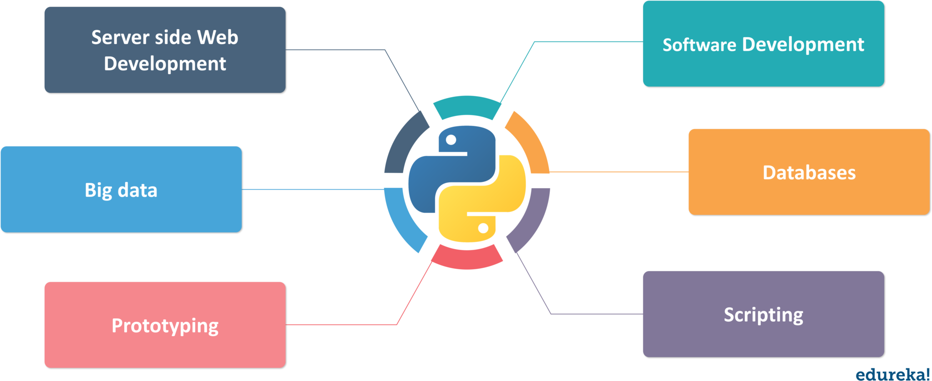
Creation of Python
It was created in 1991 by Guido Van Rossum
The origin of its name is inspired by the comedy series called “Monty Python”
<Features of Python>
<Application of Python>
Edureka

Slide 4
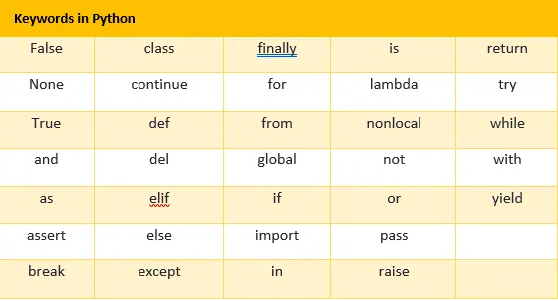
Key elements in Python – 1.Keywords
- Keywords are special names that are already present in Python. You can use these keywords for specific functionality while writing a Python program
http://makemeanalyst.com/python-programming/variable-names-and-keywords/

Slide 5
Key elements in Python – 2.Variables
Variables are like a memory location where you can store a value. This value, you may or may not change in the future
In the case above, x,y, name are newly created variables.
To declare a variable in python, you only have to assign a value to it. There are no additional commands needed to declare a variable in Python

Slide 6
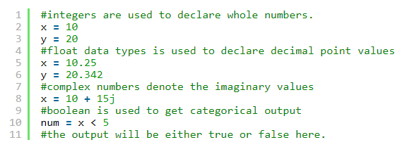
Key elements in Python – 3.Data types
Data types in Python : Numbers, String, List, Dictionary, Set, Tuple
Numbers : Numbers or numerical data type is used for numerical values.

Slide 7
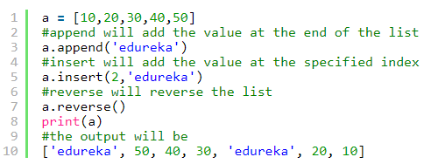
Key elements in Python – 3.Data types
String : it is used to represent characters or alphabets. You can declare a string using single “ or double quotes “”.
List : It is like a collection where you can store different values. It need not be uniform and can have different values

Slide 8
Key elements in Python – 3.Data types
Dictionary : It is unordered and changeable data structure. We use the key value pairs in a dictionary. Since the keys are unique, we can use them as indexes to access the values from dictionary
Tuple : It is another collection which is ordered and unchangeable. We declare the tuples in Python with round brackets.

Slide 9
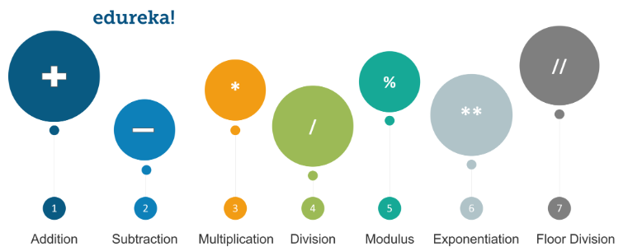
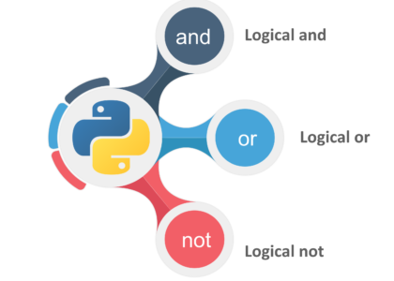
Key elements in Python – 4.Operators
Operators in Python are used to do operations between two values or variables
Arithmetic Operators
Logical Operators
edureka

Slide 10
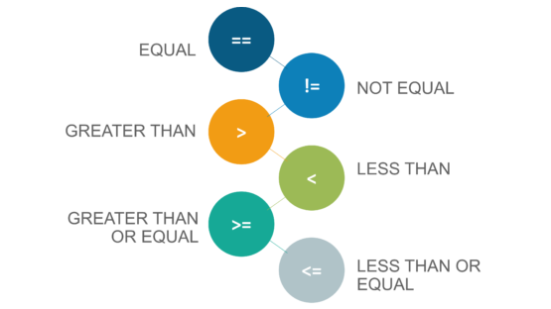
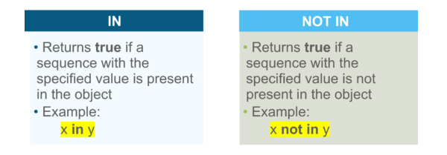
Key elements in Python – 4.Operators
Comparison Operators
Membership Operators
edureka

Slide 11
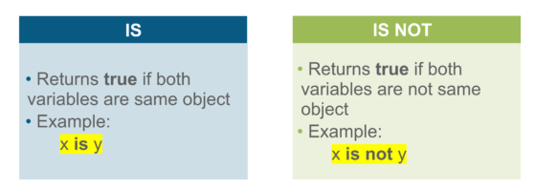
Key elements in Python – 4.Operators
Identity Operators
edureka

Slide 12
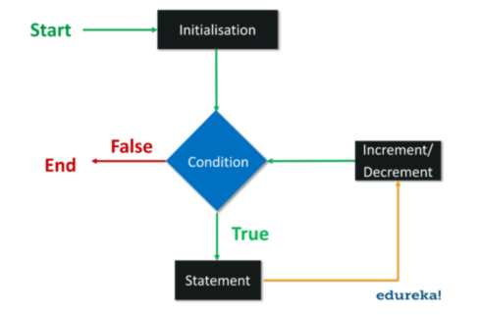
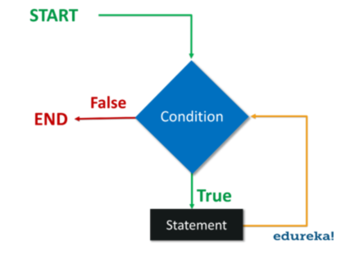
Key elements in Python – 5.Loops
<For loops>
<While loops>
A “For loop” is used to execute statements once every iteration. We already know the number of iterations that are going to execute
A “While loop” executes statements as long as the condition is true. We specify the condition in the beginning of the loop and as soon as the condition is false, the execute stops.

Slide 13
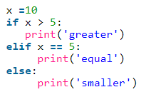
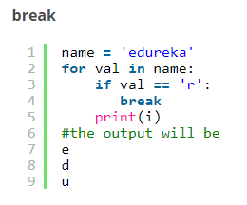
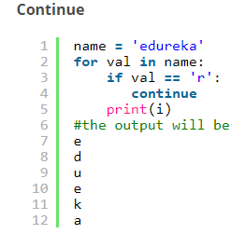
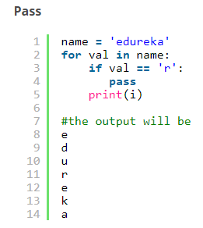
Key elements in Python – 6.Conditional and Control statements
Conditional statements :
Control statements :

Slide 14
Key elements in Python – 7.Functions
A function in Python is a block of code which will execute whenever it is called. We can pass parameters in the functions as well.

Slide 15
Online contents that will help you learn programming languages that will be covered in this course
Introduction to Python : https://www.edureka.co/blog/introduction-to-python/
Youtube vidoes
Python (Programming language that will be mainly covered during the semester)
https://www.youtube.com/watch?v=Y8Tko2YC5hA&list=LLoK27u6DBBrErwE0793NWhg&index=6&t=0s
https://www.youtube.com/watch?v=rfscVS0vtbw
https://www.youtube.com/playlist?list=PLFD32AF85033E6DDC
R (Programming language that will be covered only partially during the semester)
https://youtu.be/_V8eKsto3Ug
Highly recommend to visit and learn from the code academy, which is a free website that provides high quality and interactive learning courses of programming languages
https://www.codecademy.com

Slide 16
Using terminal program, Xshell, to use remote server
It’s ssh (Secure Shell Protocol) client that enables users from remote place to connect to host server through secured way
It needs either private public key
You can use Xshell6, one of ssh client that is free of charge, to connect to our server in BIGLAB (CentOS)

Slide 17
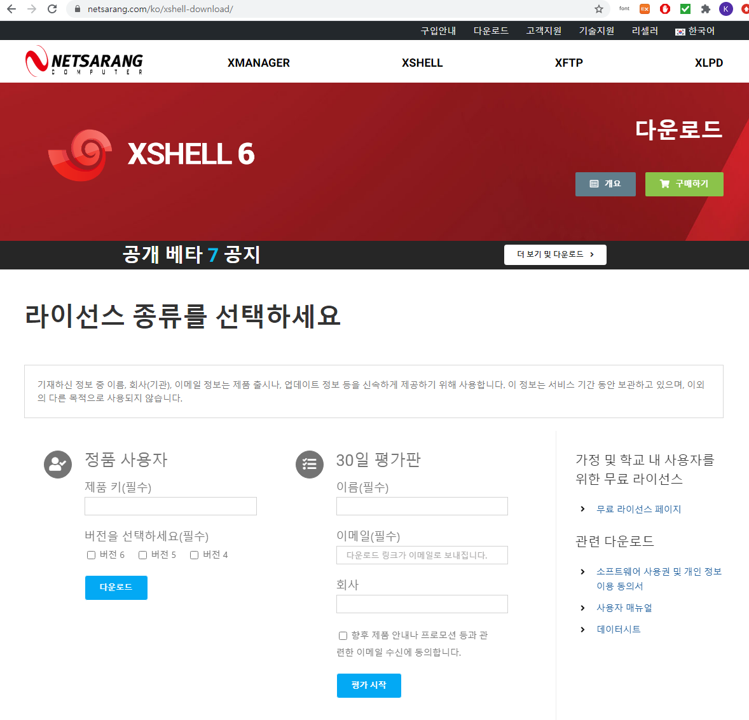
Get access for downloading the software (https://www.netsarang.com/ko/xshell-download/)
Click

Slide 18
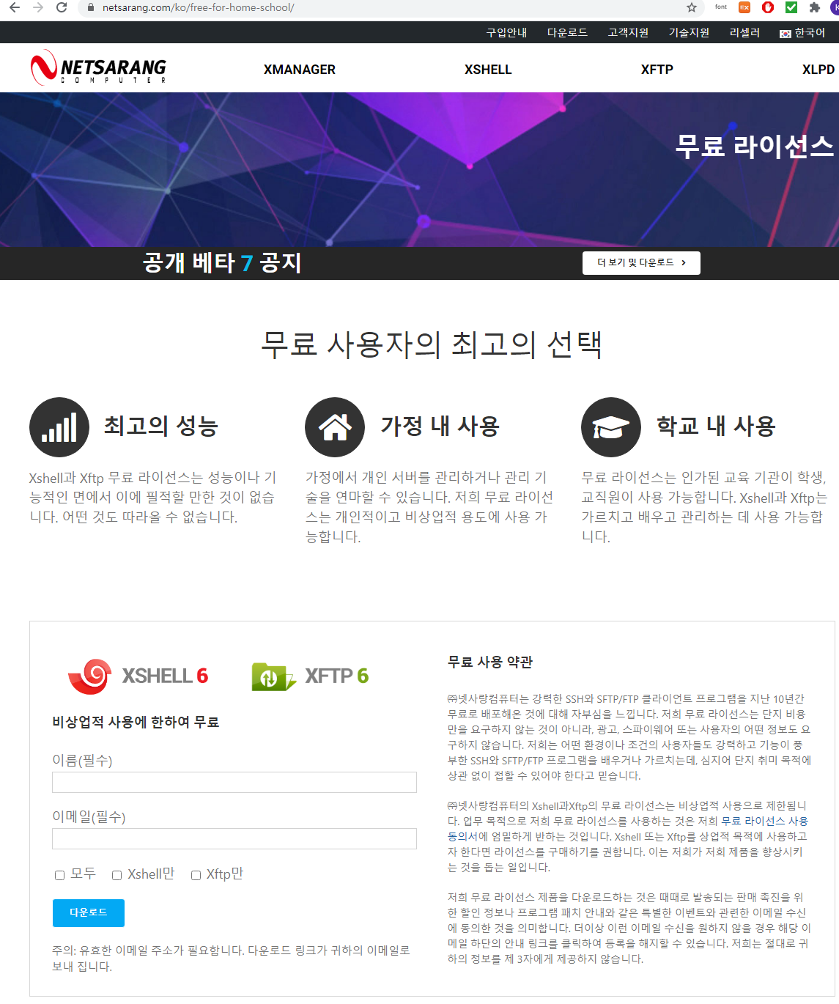
Get access for downloading the software
Fill-in the information
Download link will be sent the email specified
Download the software and install

Slide 19
Apply for VPN
가상사설망 (Virtual Private Network)을 의미하는 VPN은 사용자와 인터넷 간에 보안 연결을 구축합니다. 개인 정보 보호와 익명성 유지 기능을 제공하기 때문에 다음을 수행 할 수 있습니다
VPN을 이용하여 학교 외부에서 교내 서버에 접속 할 수 있음

Slide 20
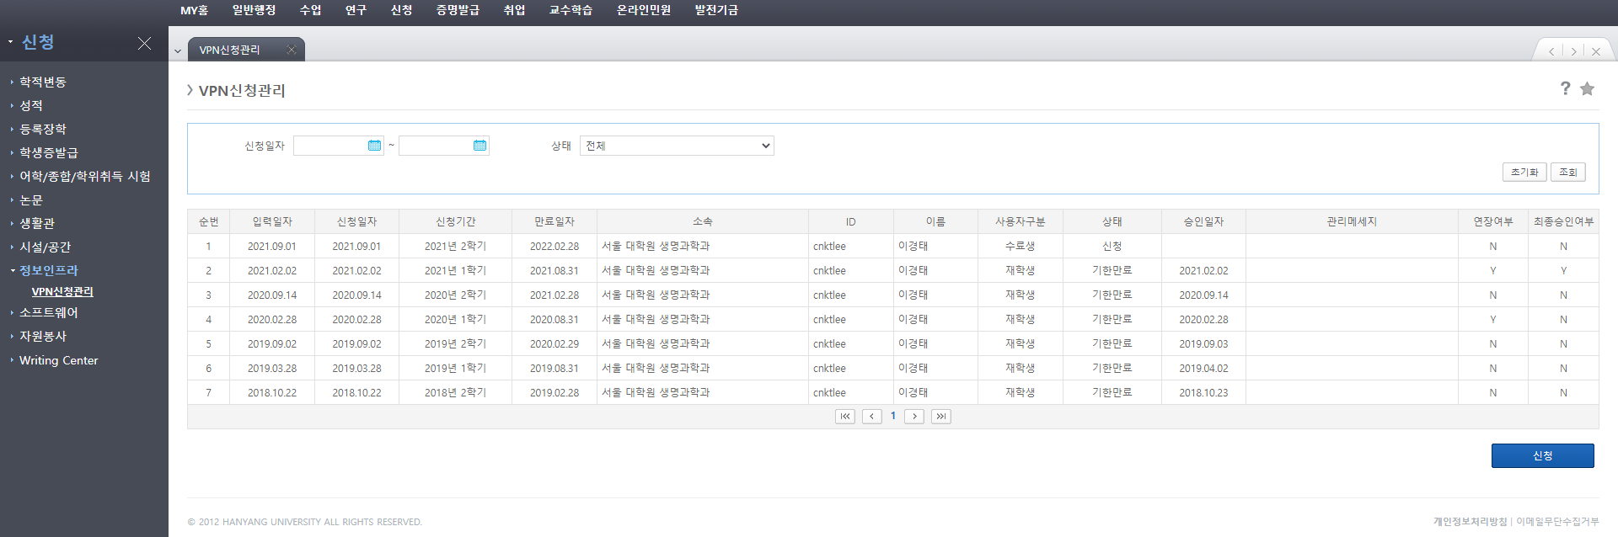
신청방법
접속 승인이 난 후에 http://vpn.hanyang.ac.kr 에 접속해서 사용방법 숙지 및 프로그램 설치

Slide 21
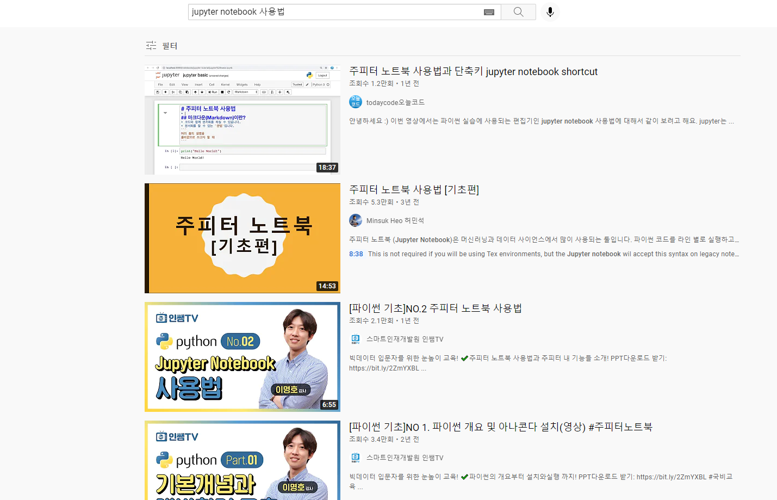
Jupyter notebook

Slide 22
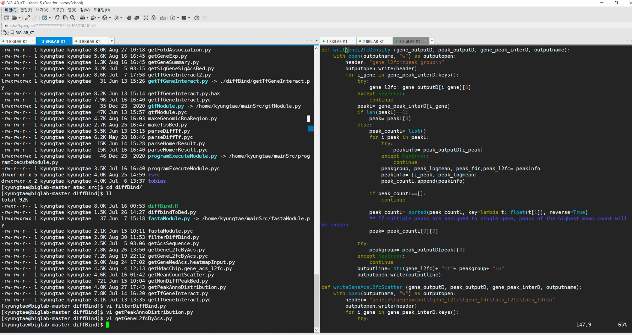
Xshell6
생물정보학 실습 환경

Slide 23
Until next week
VPN 신청
Jupyter notebook 사용법 숙지 (Youtube video 등을 활용)
Optional
학기가 진행되는 동안 Code academy, 첨부해준 youtube 영상을 개인적으로 공부하면 많은 도움이 될 것임

