Slide 1
Session 5. Human Disease
Iron imbalance and the iron-binding responsive element

Slide 2
An inherited disease affecting the iron-binding protein function
Hyperferritinaemia cataract syndrom
High levels of the protein ferritin in the blood
Cataracts: clouding of the lens of the eye.
The molecular basis of the disease is a mutation in the ferritin mRNA
Mutations on 5’UTRs but not on coding genes → regulatory element on 5’UTR

Slide 3
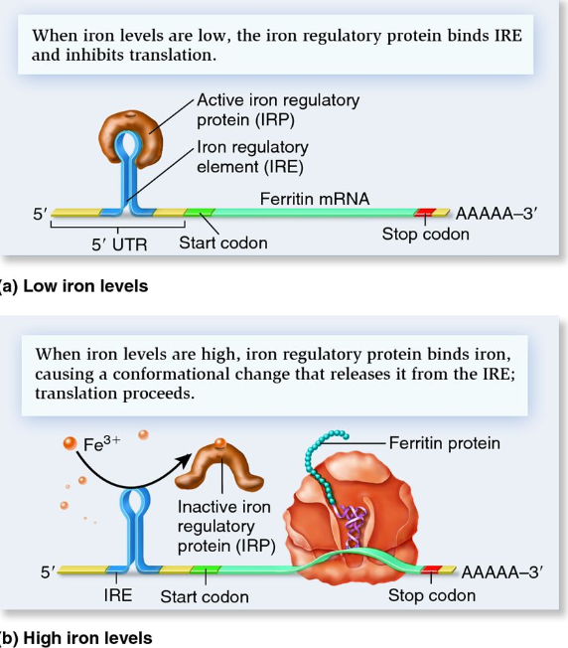
Many proteins of iron metabolism are regulated at the level of translation
Function of ferritin – free irons are toxic to cells and it has a protective function by binding the irons.
The production of ferritin is carefully regulated in order to maintain a suitable level of irons.

Slide 4
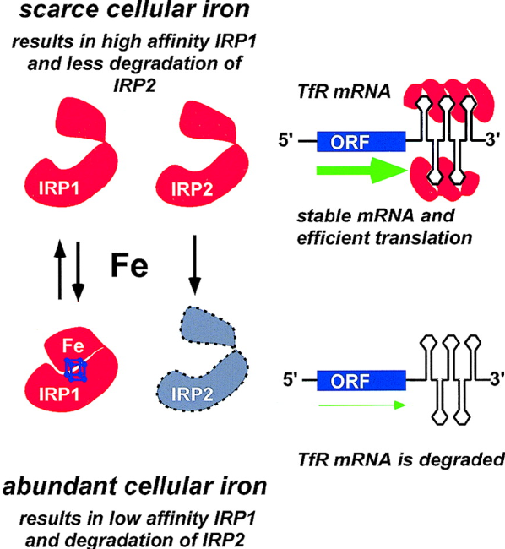
Transferrin
Function of transferrin is to deliver irons to a cell
When the irons are abundant, the Tfr mRNAs are suppressed.

Slide 5
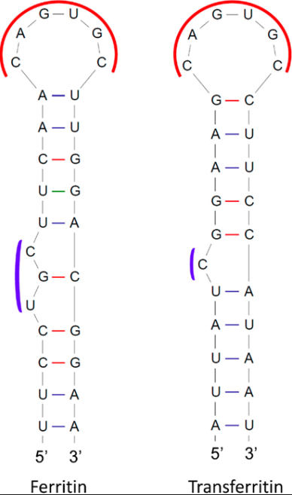
RNA regulatory elements
IRE
Riboswitches
Transcription stop by hairpin structure: replication-dependent histones.

Slide 6
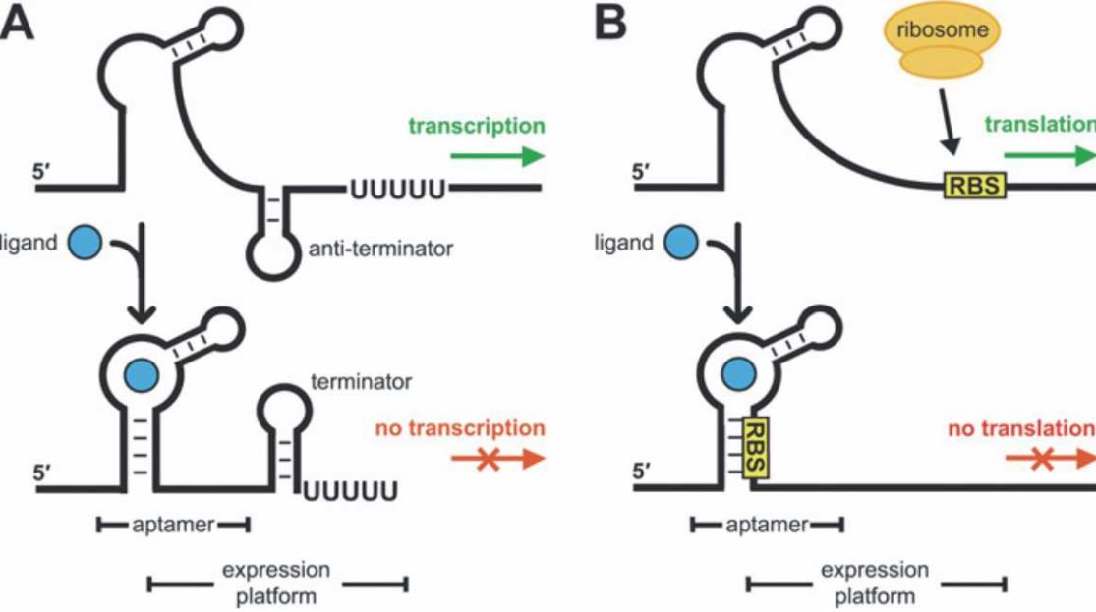
RNA regulatory elements
IRE
Riboswitches
Transcription stop by hairpin structure: replication-dependent histones.

Slide 7
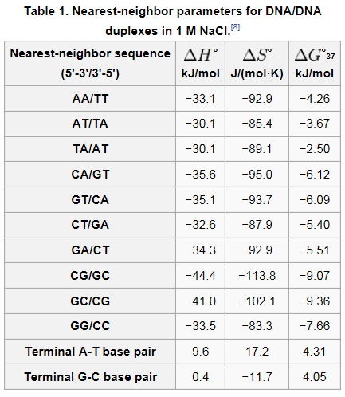
RNA secondary structure
Energy minimization method
A structure with the minimum free energy (kcal/mol)
Energy minimization using nearest-neighbor model of nucleotide stacking
Nearest-neighbor model: The interaction between bases on different strands depends somewhat on the neighboring bases.

Slide 8
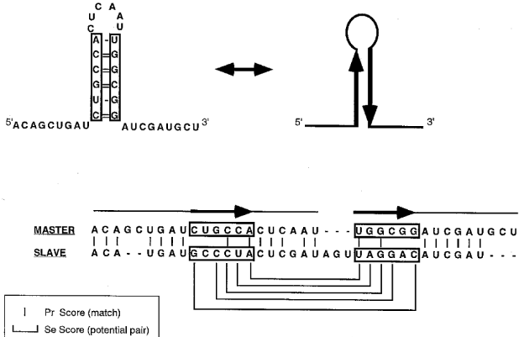
RNA secondary structure
Alignment-based method

Slide 9
Identifying the iron responsive element
IRE are also present in other mRNAs, most of them are related to iron metabolism
A computational method to identify all IREs over all mRNA sequences.
This may allow to discover new additional RNAs, regulated in the same way as ferritin and Tfr.

Slide 10
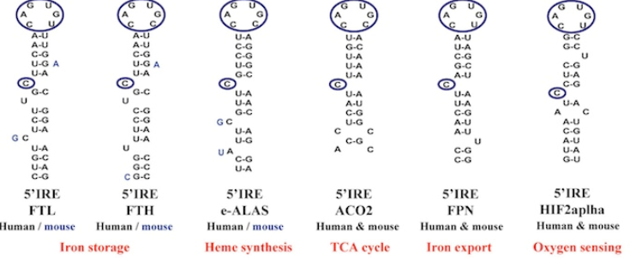
Identifying the iron responsive element
CAGUGN loop sequence
The conserved base-pairing pattern

Slide 11
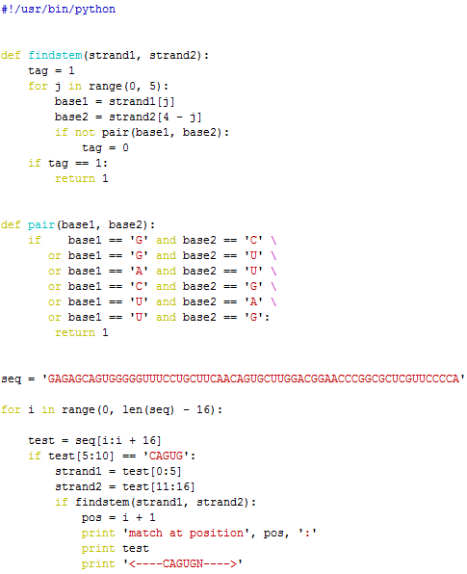
ire.py

Slide 12
String comparison
if 'a'=='a': print 'True'
else: print 'False'
if 'a'=='A': print 'True'
else: print 'False'
[jwnam@biglab-master Session5]$ python stringcomp.py
True
False

Slide 13
ire.py
[jwnam@biglab-master Session5]$ python ire.py
match at position 23 :
UUCAACAGUGCUUGGA
<----CAGUGN---->

Slide 14
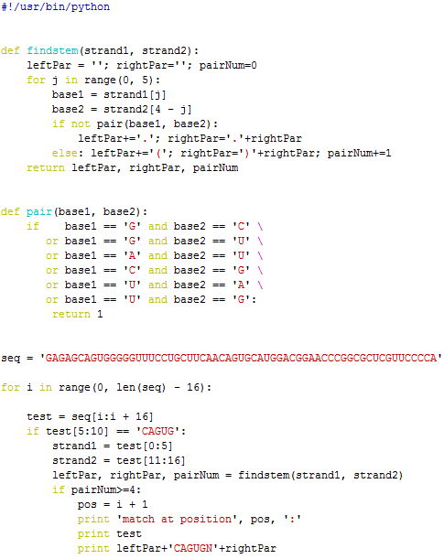
ire2.py
[jwnam@biglab-master Session5]$ python ire2.py
match at position 23 :
UUCAACAGUGCAUGGA
((((.CAGUGN.))))

