Slide 1
Session 4. Practice
When DNA sequences are toxic

Slide 2
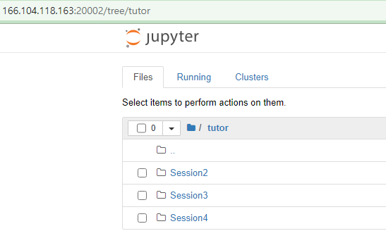
Make a Session4 directory

Slide 3
Basic Python – re module
Method | Description
re.search(pattern, string, flags=0) | Scan through string looking for the first location where the regular expression pattern produces a match, and return a corresponding MatchObject instance. Return None if no position in the string matches the pattern; note that this is different from finding a zero-length match at some point in the string.
re.match(pattern, string, flags=0) | If zero or more characters at the beginning of string match the regular expression pattern, return a corresponding MatchObject instance. Return None if the string does not match the pattern; note that this is different from a zero-length match.
re.findall(pattern, string, flags=0) | Return all non-overlapping matches of pattern in string, as a list of strings. The string is scanned left-to-right, and matches are returned in the order found. If one or more groups are present in the pattern, return a list of groups; this will be a list of tuples if the pattern has more than one group. Empty matches are included in the result unless they touch the beginning of another match.

Slide 4
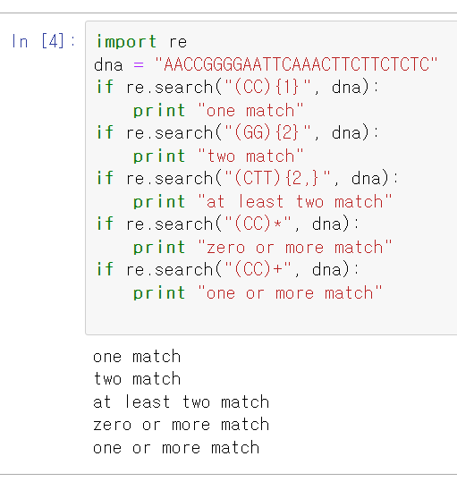
Pattern matching
[CT]: C or T
[AB*]: A or AB or ABB or ABBB, …
[AB+]: AB or ABB or ABBB,…
[AB?]: A or AB
A{6}: AAAAAA
A{4,6}: AAAA, AAAAA, AAAAAA
rePattern1.ipynb

Slide 5
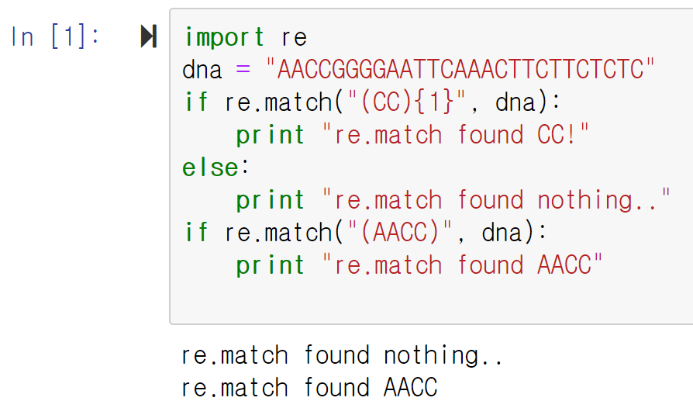
Pattern matching
re module
rePattern2.ipyb

Slide 6
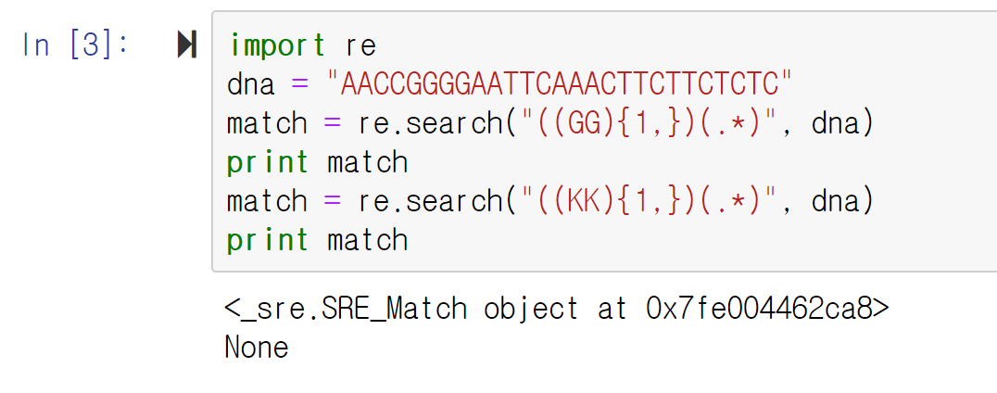
Pattern matching
re module
rePattern3.ipynb
Any character

Slide 7
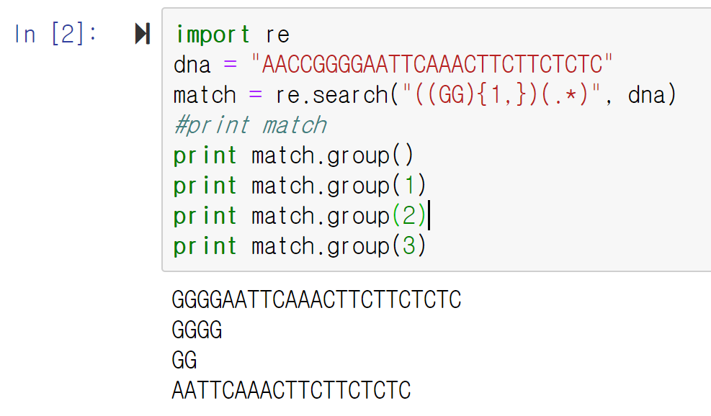
Pattern matching
rePattern4.ipynb
왼쪽에서 오른쪽 순서로 배치 돼 있는 소괄호로 구분!
Match= re.search(“(pattern1)(pattern2)”, dna)
Match.group() -> pattern1+pattern2
Match.group(1) -> pattern1
Match.group(2) -> pattern2

Slide 8
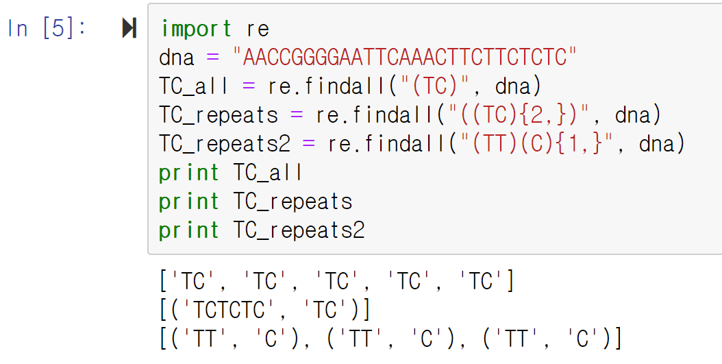
Pattern matching
rePattern5.ipynb
re.search 처럼 왼쪽에서 오른쪽 소괄호에 해당하는 내용을 저장함 (tuple에 )

Slide 9
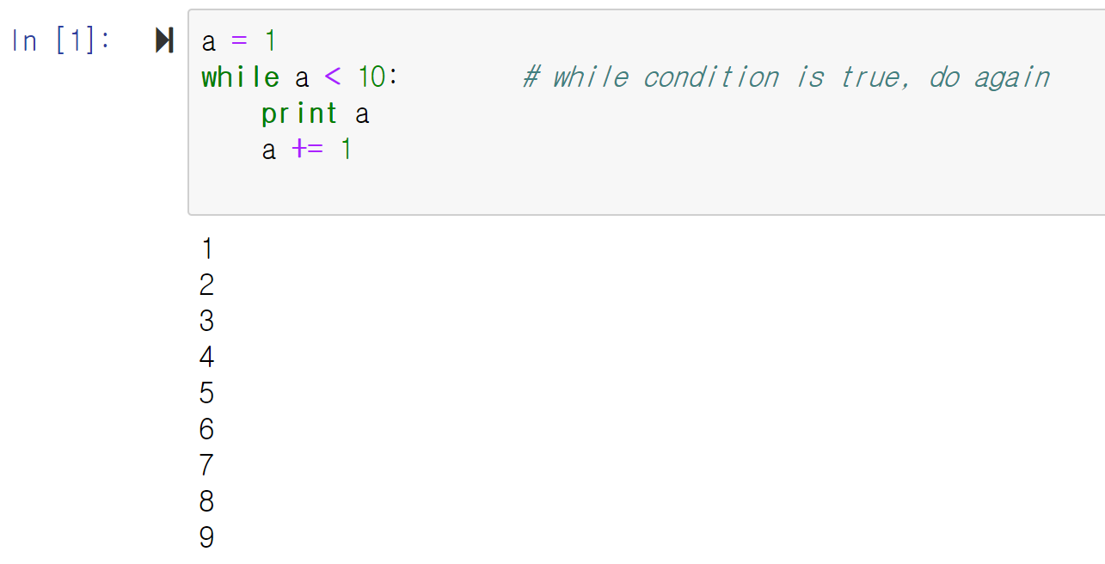
Conditional Expressions, While
While loop
whileloop.ipyb

Slide 10
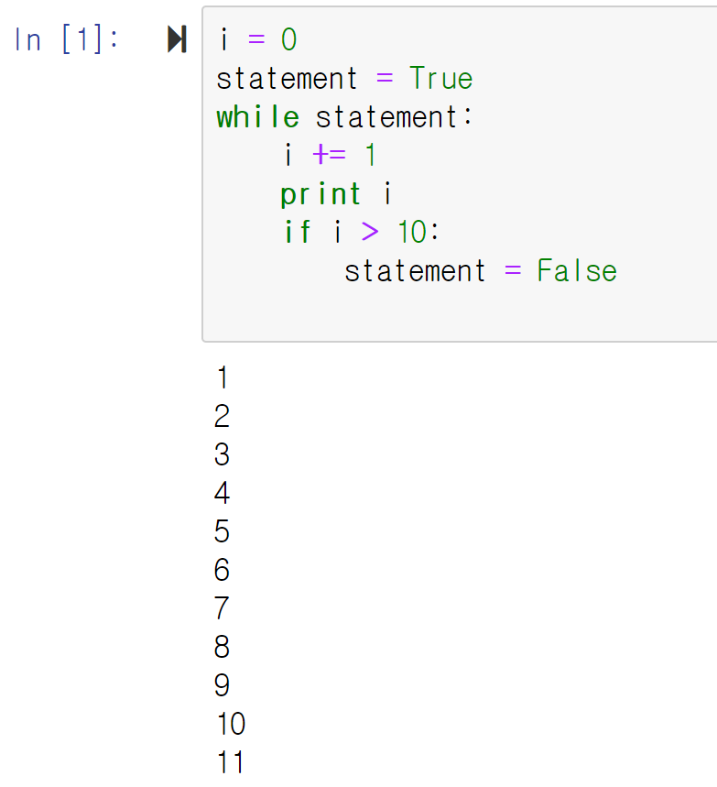
Conditional Expressions, While
While loop
while_statement.ipynb
Caution!
While loop을 잘못 만들면 무한 loop이 만들어 질 수 있음. 만약에 코드 실행이 종료 되지 않으면 강제로라도 코드 실행을 종료해야 함 ! 아니면 리소스를 무한정 사용하기 때문에 서버가 셧다운 될 수 있음

Slide 11
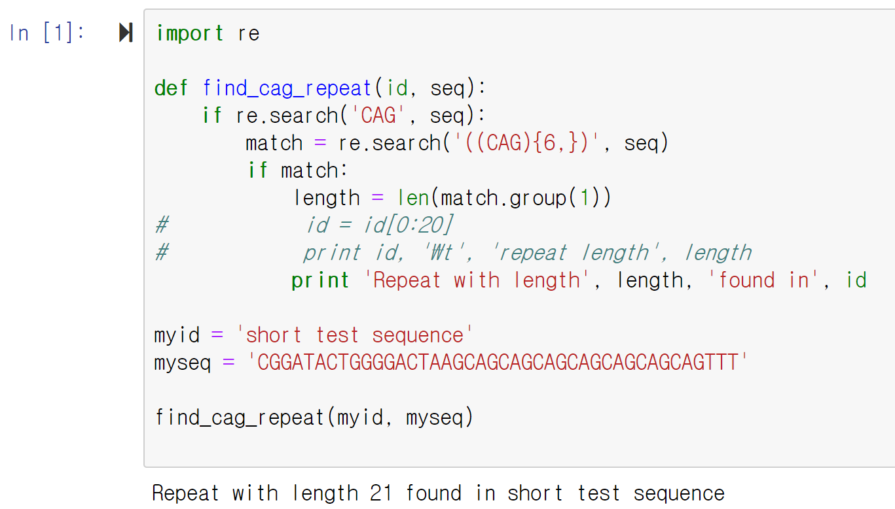
find_cag_short.ipynb

Slide 12
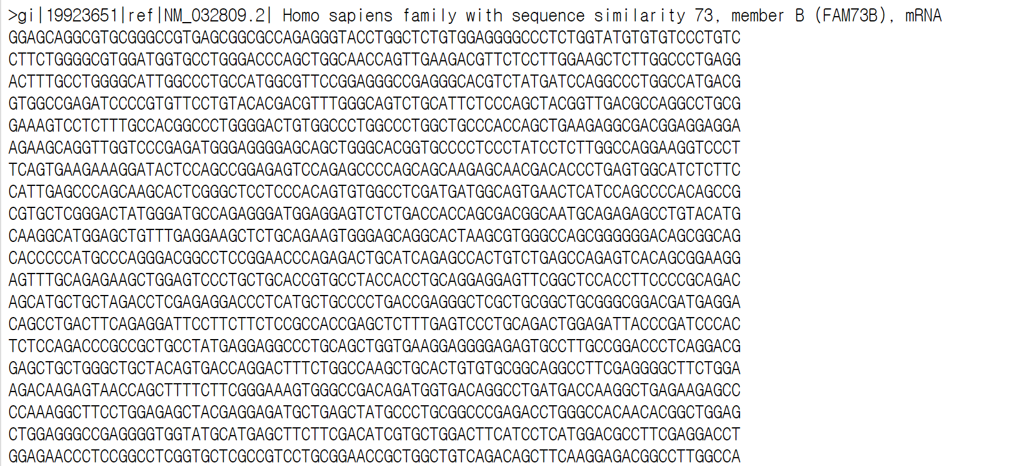
refseq_human.txt
Identifier
Sequences

Slide 13
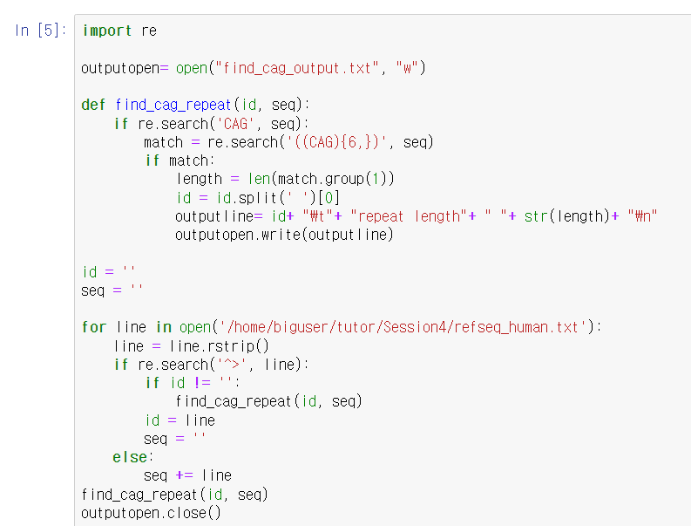
find_cag.ipynb
Remember that refseq_human.txt file
looks like below
>ID1
ATCGATCG
ATCGATCG
ATCGATCG
>ID2
ATCGATCG
ATCGATCG
>ID3
ATCGATCG
ATCGATCG
ATCGATCG
…

Slide 14
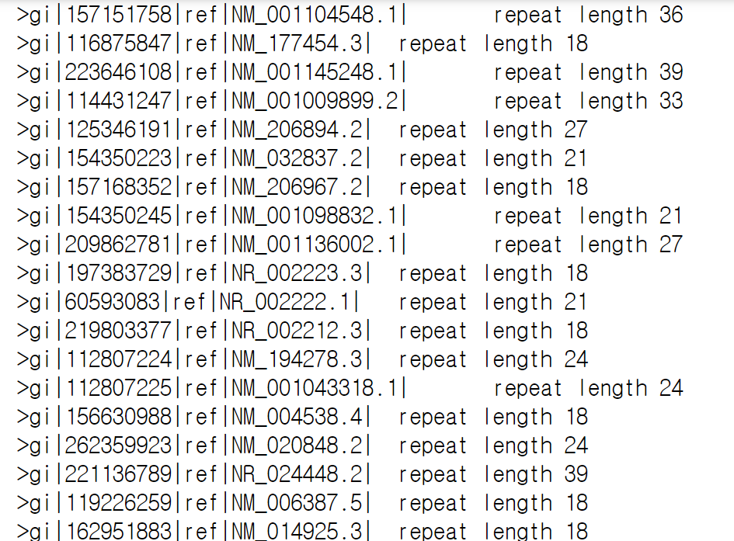
find_cag.ipynb output

Slide 15
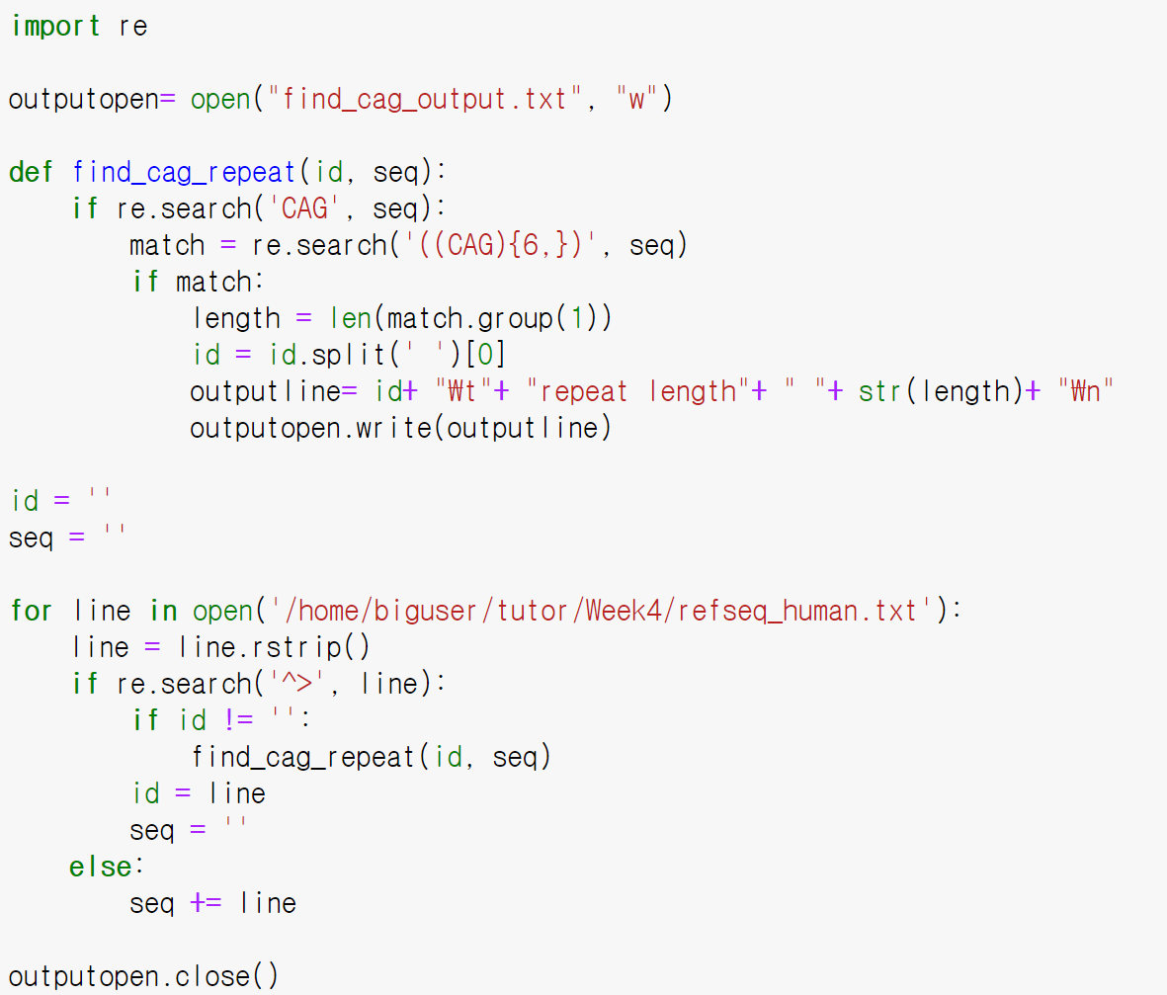
Write output using python code

Slide 16
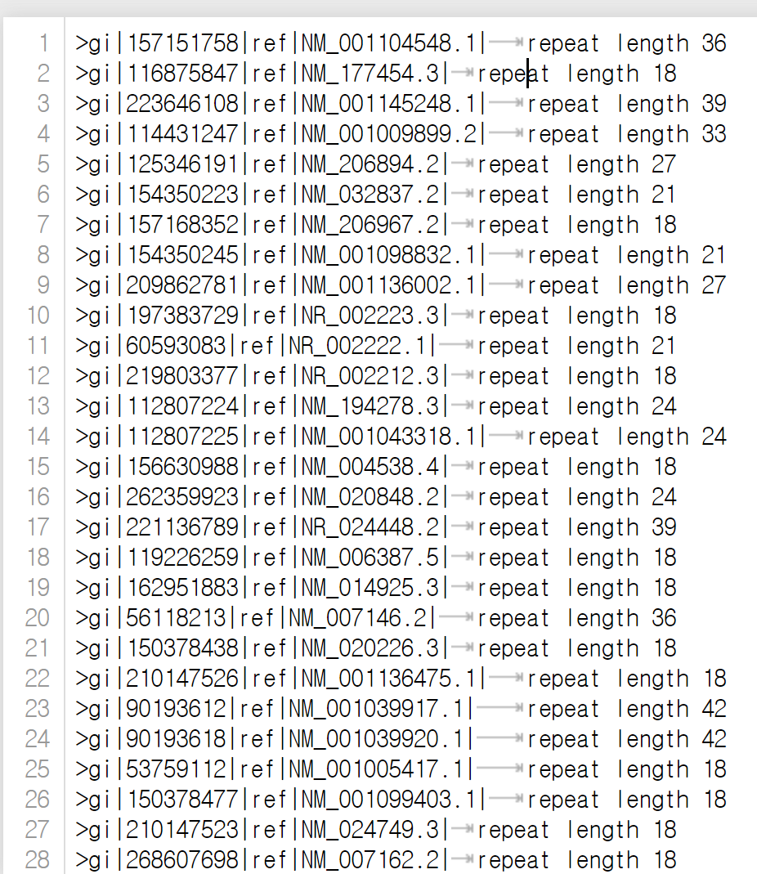
find_cag_output.txt

Slide 17
Exercise 1
Using find_cag.ipynb as a starting point, implement a method to analyze human mRNAs so that not only one region of CAG repeats is reported, but all such regions.
Hint : use re.findall
How many regions are you able to identify?

Slide 18
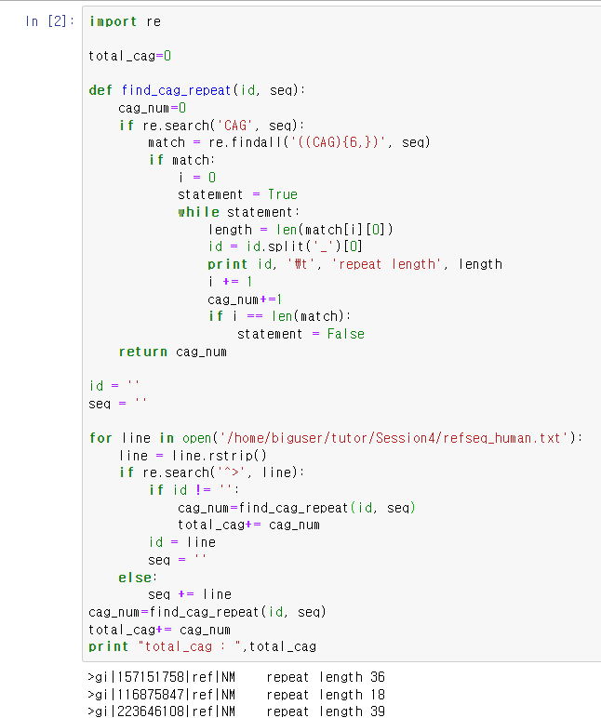
Finding all CAG repeats

Slide 19
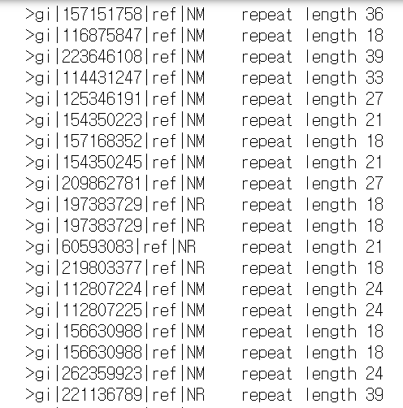
Output

Slide 20
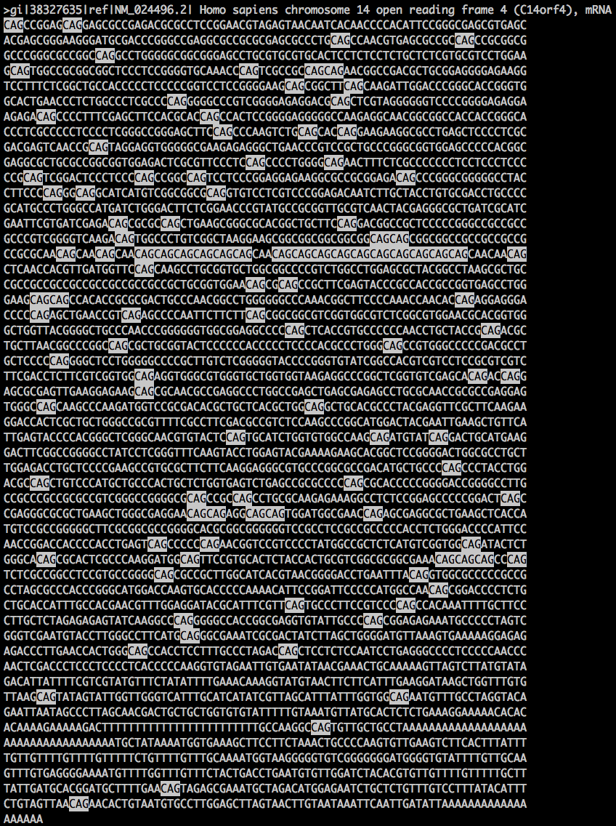
Exercise 1

Slide 21
Exercise 1
Using Code 5.2 as a starting point, implement a method to analyze human mRNAs so that not only one region of CAG repeats is reported, but all such regions.
How many regions are you able to identify?

Slide 22
Practice at home (제출 과제 아님! 정답은 다음주 수업시간에 공개 예정)
In the collection of RefSeq sequences used in find_cag.py (refseq_human.txt), mRNAs have their functional description. Modify the code so that this information, instead of the identifier, is reported in your output.
Do not move, copy or modify the “refseq_human.txt”
Screen capture part of output
Output을 출력한 다음에 2번째 슬라이드 처럼 output이 바뀌게 나오는지 확인하고 print 앞에 # 처리를 하기.
Are there proteins in the output that are described as ‘huntingtin’? If so, print out the corresponding protein ID
If Protein_id.find(“huntingtin”)>=0:
print Protein_id
Huntingtin 관련 protein들이 정상적으로 출력되는지 확인할 것!
Homo sapiens huntingtin (HTT)

Slide 23
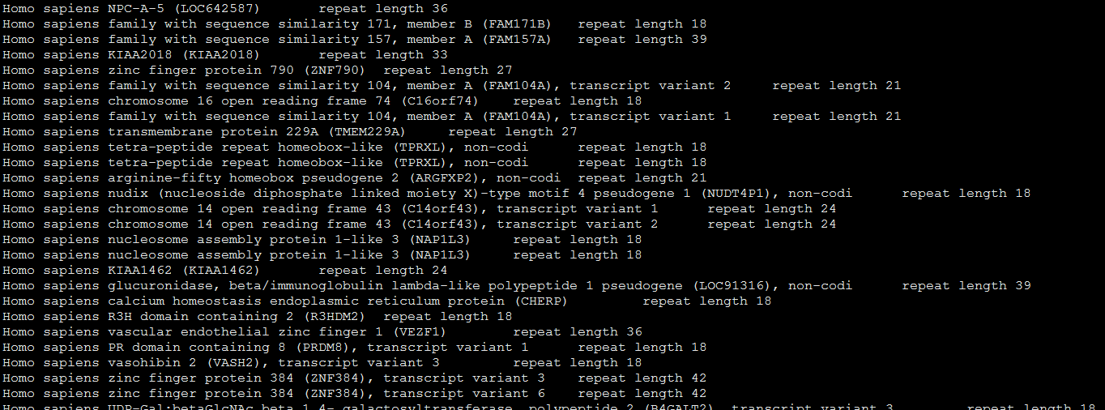
Example of correct output

