Slide 1
Session 4. Human Disease
When DNA sequences are toxic

Slide 2
Inherited vs non-inherited disease
Inherited disease – The Majority are Mendelian diseases (+ Germline or De novo mutation)
Non-inherited disease – Somatic mutations / Epigenetic changes
Genetic vs Epigenetic changes
Genetic change: with DNA change
Epigenetic change: without DNA change
DNA changes often give rise to disease.

Slide 3
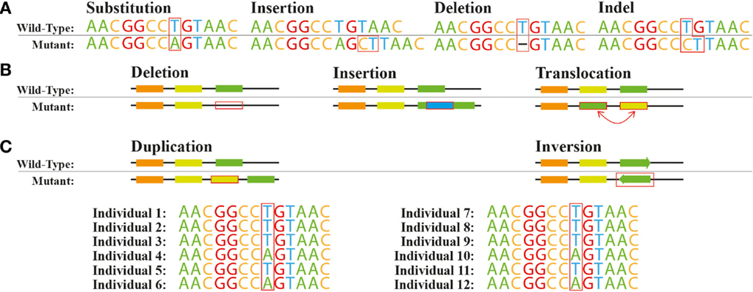
DNA alterations – local and largescale changes
Local changes
Single nucleotide variations (SNVs)
Insertion + Deletion (indels)
Largescale rearrangement
Inter/intra chromosomal translocation
Inversion
Large insertion/deletion
Duplication

Slide 4
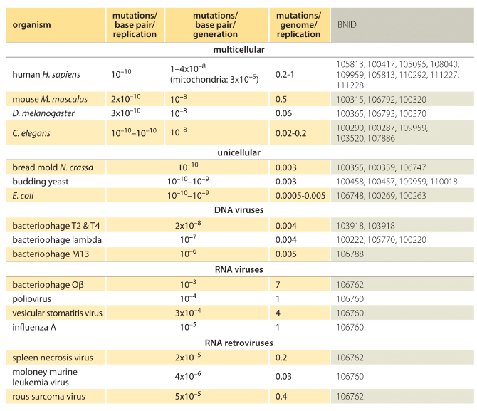
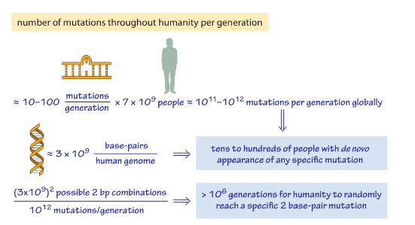
Mutation rate during replication
DNA polymerase, its proof-reading, and base-pairing affinity give a 10⁻⁸ error per bp
DNA repair enzymes fix 99% of the errors → 10⁻¹⁰ error per bp

Slide 5
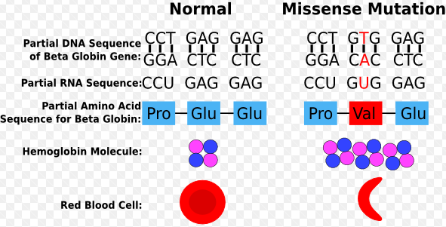
A classic example of point mutation is sickle-cell anemia
Point mutation (GAG:Glu→GUG:Val) affects one of the polypeptide chains of beta-globlin.
1% of the population in Western Africa have the sickle-cell gene in hetero-type that protects against malaria.

Slide 6
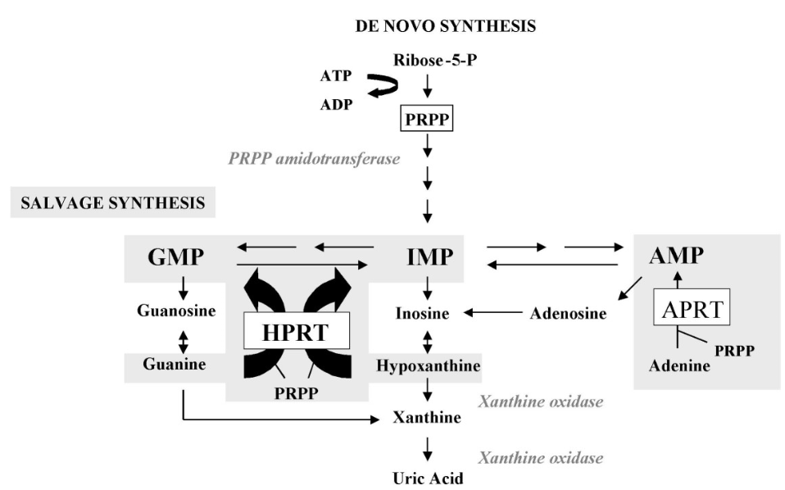
Rare disease: Lesch- Nyhan syndrome (LNS)
A disease with a neurological symptoms
Resulted by mutations in the gene encoding HPRT, leading to accumulation of Uric acid in body.

Slide 7
Huntington’s disease
Caused by expansion of short repeats (CAG)
The disease was first discovered in 1841 by Charles Oscar Water
The responsible gene, hungtingtin, was first reported in1993
Unfortunately, we still don’t know the function of the protein in cell.
The protein include a region where the glutaimine is repeated a large number of times (polyQ region)
Normally, less than 26 Qs but in rare cases, greater than 36, giving rise to Hungtington’s disease.
The polyQ stimulate the protein aggregation.
Replication slippage may cause the expansion of the repeats.

Slide 8
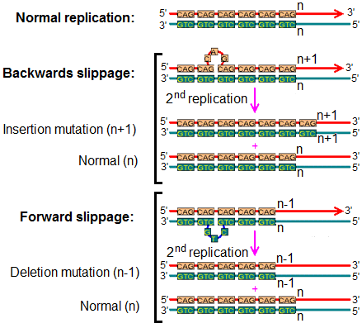
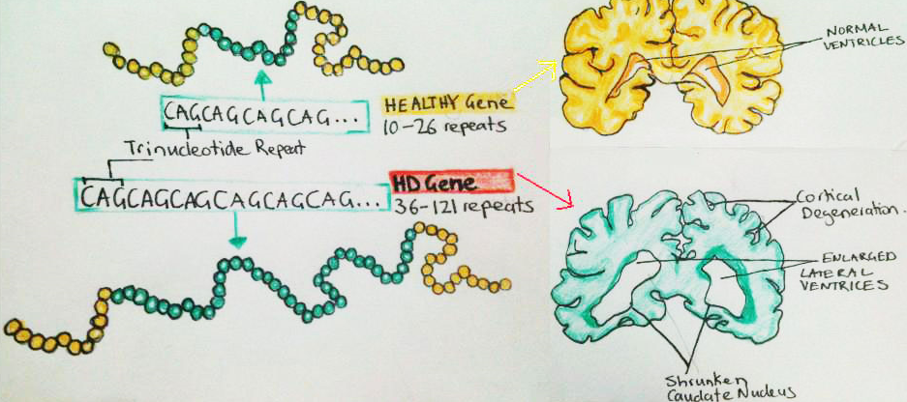
Huntington’s disease

Slide 9
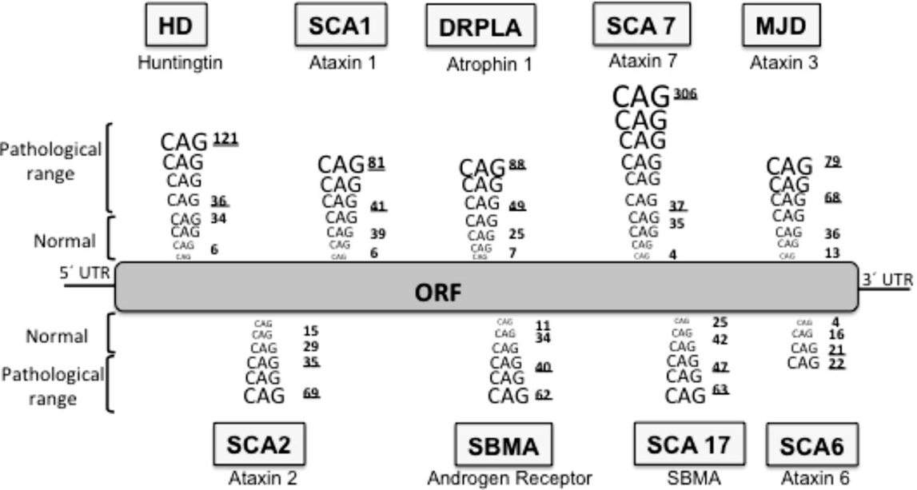
Other CAG repeat-related diseases

Slide 10
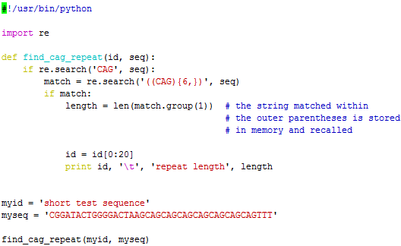
find_cag_short.py

Slide 11
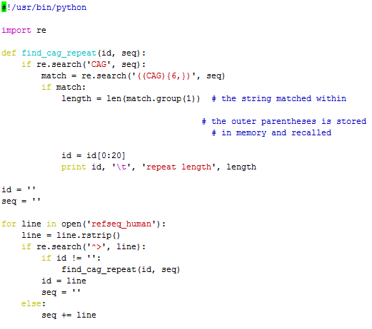
find_cag.py

Slide 12
Identifying mRNAs with CAG repeats
Regular expression
(CAG){6}
(CAG){6,9}
(CAG){6,}
(CAG)*
(CAG)+
Match group
‘((CAG){6,})’
The match within the outer parenthesis is stored.
match.group(1)
‘((CAG){6,})(.*)(.)$’
→ match.group(1), match.group(2), match.group(3)

Slide 13
Function : y=f(x)
def function_name(arg1, arg2):
ans=0
for i in xrange(int(arg1),int(arg2)): i+=1
return ans
print function_name(10, 20)
[jwnam@biglab-master Session4]$ python function_test.py
10

Slide 14
Write standard output and pipe
python function_test.py >test.out
→ Write a standard output of the python script into a file ‘test.out’
python function_test.py |wc
[jwnam@biglab-master Session4]$ python function_test.py |wc
1 1 3

Slide 15
While statement
i=0; statement=True
while statement:
i+=1
print i
if i >10: statement=False
[jwnam@biglab-master Session4]$ python while_statement.py
1
2
3
4
5
6
7
8
9
10
11

Slide 16
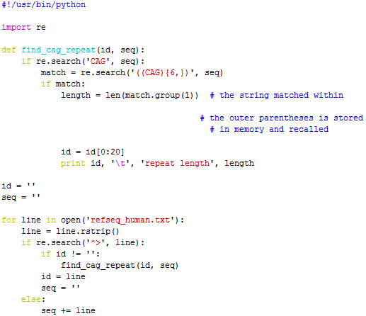
find._cag.py
[jwnam@biglab-master Session4]$ python find_cag.py refseq_human.txt
>gi|157151758|ref|NM repeat length 36
>gi|116875847|ref|NM repeat length 18
>gi|223646108|ref|NM repeat length 39
>gi|114431247|ref|NM repeat length 33
>gi|125346191|ref|NM repeat length 27
>gi|154350223|ref|NM repeat length 21
>gi|157168352|ref|NM repeat length 18
>gi|154350245|ref|NM repeat length 21
>gi|209862781|ref|NM repeat length 27

