Slide 1
Session 2 Practice
Working with the molecules of life in the computer

Slide 2
Contents
How to log-in Biglab server using Xshell
Basic Linux commands
Basic Python commands
  variable, dictionary or for loop
Exercise and assignment

Slide 3
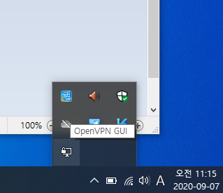

Connect to the server using openVPN
Double-click
Click

Slide 4
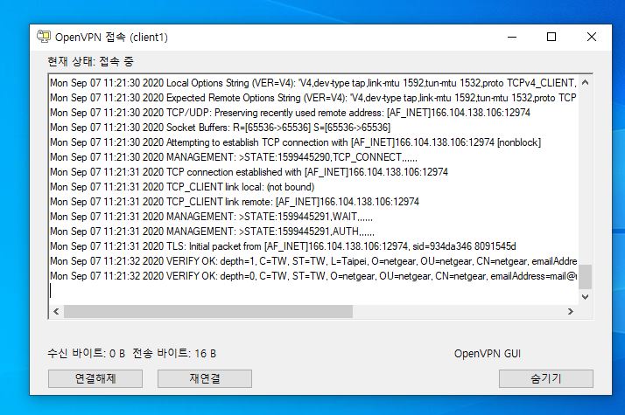
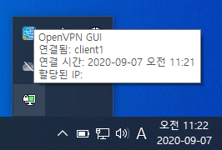
Connect to the server using openVPN
If connected
(You just have to wait)

Slide 5

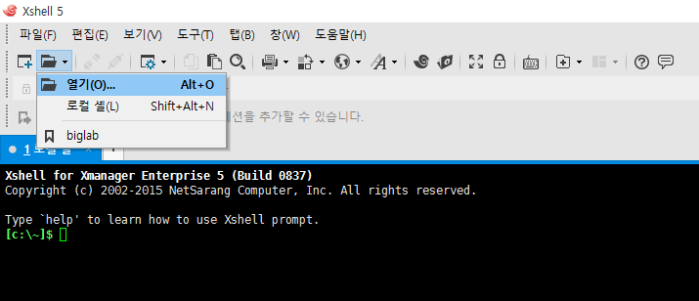
A First Step to Linux Shell

Slide 6
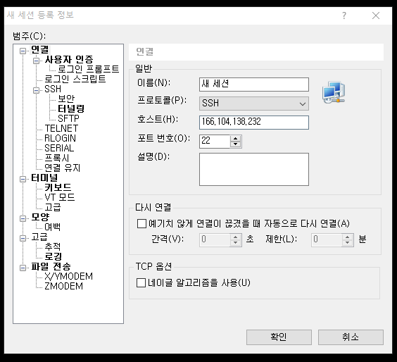
A First Step to Linux Shell
Host: 166.104.138.232
Port number: 22
(If OpenVPN connection was successfully established)
Or
Port number :3030
(If OpenVPN connection was not established)

Slide 7
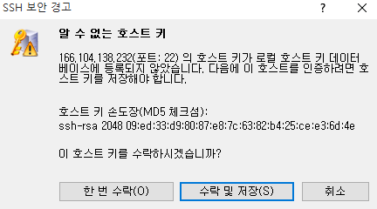
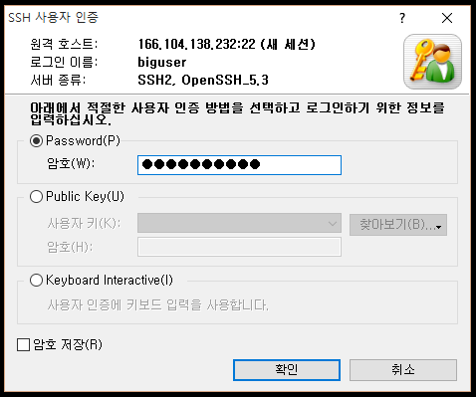
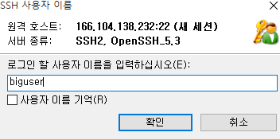
A First Step to Linux Shell
User: biguser
Password: biglab2428

Slide 8
Basic Shell Commands
$ ls
$ cd /home/biguser/class/bioinformatics_202002/students
$ mkdir studentID_Name (e.g. mkdir 2016251005_sangho)
$ cd studentID_Name
$ ll
ls – list directory contents
pwd – print name of working (current) directory
cd – change directory

Slide 9
Basic Shell Commands
$ pwd
$ mkdir session_1
$ cd session_1
$ pwd

Slide 10
Basic Shell Commands
$ ll
$ vi print_script.py
[In Vim]
i: insert
print “Today is Wednesday!”
[In Vim] “ESC”
wq: save and quit

Slide 11
Basic Shell Commands
$ ll
$ python print_script.py
[Output] Today is Wednesday!
$ less print_script.py
$ cat print_script.py
[Output] print “Today is Wednesday!”

Slide 12
Basic Shell Commands
$ mv print_script.py new_script.py
$ cp new_script.py new_script_copy.py
$ ll
cp : copy and paste
$ rm new_script_copy.py
$ ll
rm : remove

Slide 13
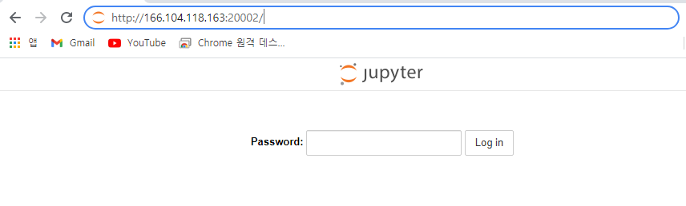
Jupyter notebook 접속
2022bio

Slide 14
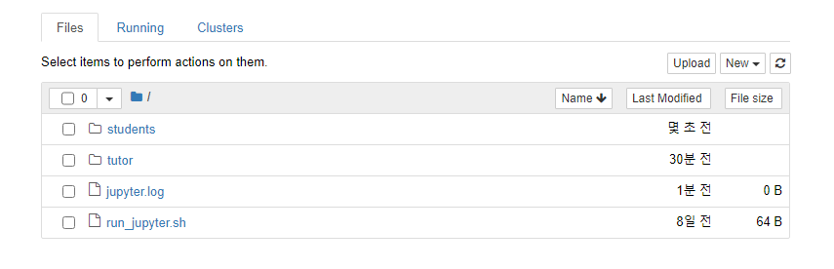
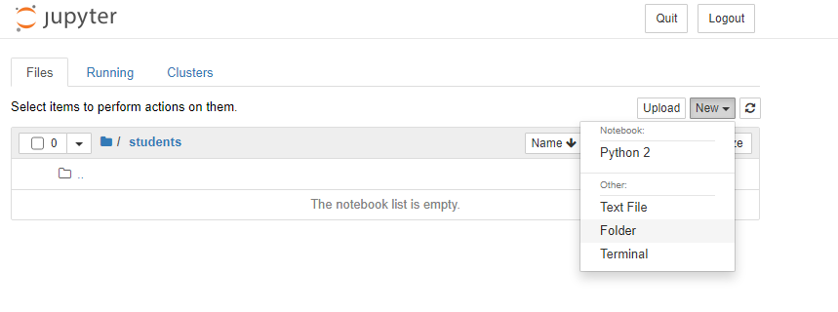
Jupyter notebook 접속
Make a new directory:
학번_영어이름
Ex) 2021245187_minsupark

Slide 15
Basic Python - string
$ python
[OUTPUT]
CT
A
TT
AGC
AGC
TTCGA
>>> rna='AGCTT’
>>> print rna[2:4]
>>> print rna[0:1]
>>> print rna[3:]
>>> print rna[:3]
>>> print rna[:-2]
>>> print rna[::-1]
http://www.nltk.org/book/ch03.html

Slide 16
Basic Python - string
>>> dna = 'GCAATGG'
>>> print dna
>>> rev = dna[::-1]
>>> print rev
“GGTAACG”

Slide 17
Basic Python - string
Code continues from the previous one
>>> import string
>>> comp = string.maketrans('ACGT','TGCA')
>>> rev_comp = rev.translate(comp)
>>> print rev_comp
“CCATTGC”

Slide 18
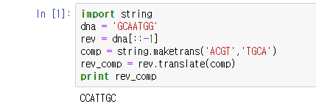
DNA replication I (ssDNA)
replication.ipynb

Slide 19
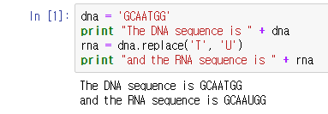
Inferring RNA products of transcription
transcription.ipynb

Slide 20

Basic Python - dictionary
https://cs.stanford.edu/people/nick/python-in-one-easy-lesson/

Slide 21
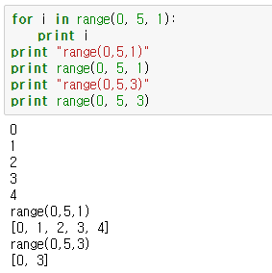
Basic Python - for loop
https://www.safaribooksonline.com/library/view/head-first-python/9781449397524/ch01.html

Slide 22
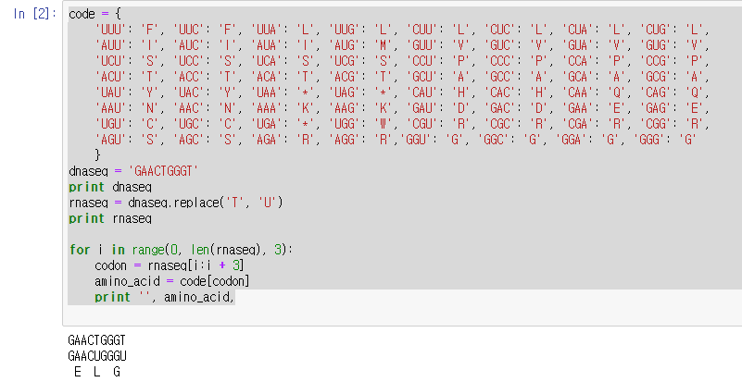
Code1.1 translation.py
translation.ipynb

Slide 23
Exercise
Modify code 1.1(translation.ipynb) so the reverse complementary strand of the original strand sequence (GAACTGGT) is translated. As with the original strand, we only consider the first reading frame of the nucleotide sequence, i.e. the first codon of the complementary strand is ACC

Slide 24
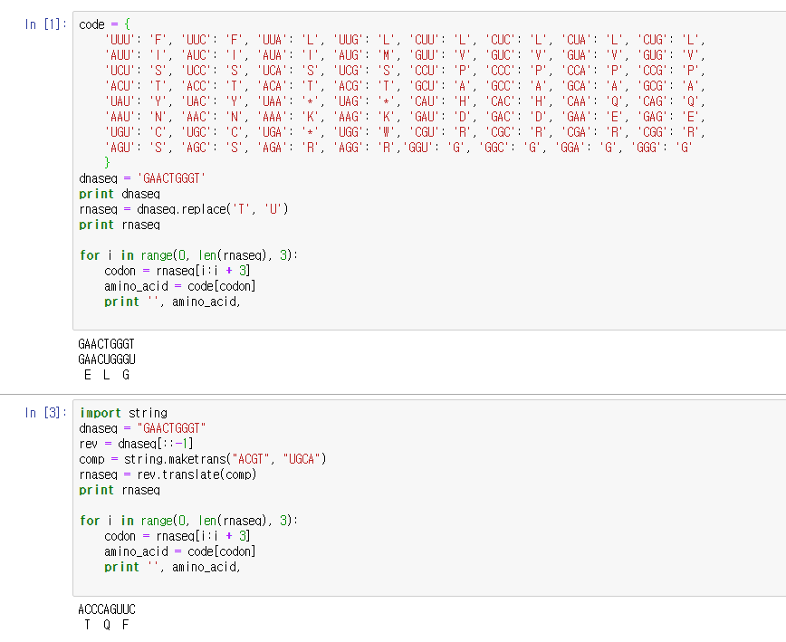
Exercise script and result

Slide 25
Assignment
Using code translation.ipynb and dna_seq below, generate and print 1) RNA (rna_seq) sequence which is reverse complementary to the underlined DNA sequence, and 2) its translated amino acid sequence (aminoacid_seq). The variable “dna_seq” must be present in your python script.
과제 제출 : 09/19 월요일 6:00 PM
해당 코드 캡처를 한 뒤 워드에 첨부. 워드에 학번 이름 기입 하고 코드에 대한 설명 간략히 작성
dna_seq = “ATGCTTGCAAATACGTCACGACAGTGAAAAA”
rna_seq = “UGUCGUAUUUGCAAG”
aminoacid_seq = ??
1) 해당 sequence 부분을 indexing (ex – dna_seq[x:x]) 을 사용해 추출 ->Reverse complementary
2) Translation

