Slide 1
Session 1.
Working with the molecules of life in the computer

Slide 2
Makeup for a missing lecture
No lecture on March 22 and, thus, we need to makeup for the lecture in that week.
Please let me know your preference of following times.
Thursday (24th) 6:30~8:30PM
Friday (25th) 4:30~6:30PM

Slide 3
Evaluation
Mid-term Exam 50% (A majority of questions will be Python programming tests)
Homework (Code Academy) and Practice (reports) 40%
Final project 10%

Slide 4
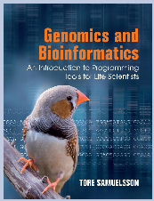
Textbook
Genomics and Bioinformatics: An Introduction to Programming Tools for Life Scientists. (Tore Samuelsson)
www.cambridge.org/samuelsson
Amazon kindle ($34.64) or paperback ($54.81)

Slide 5
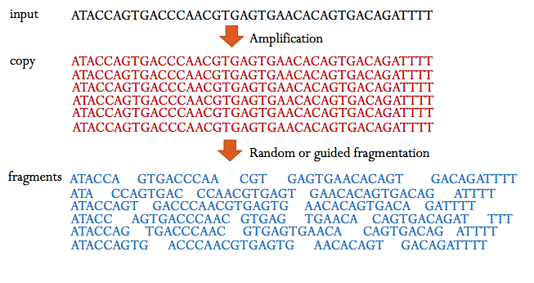
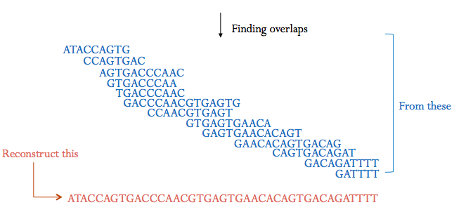
HGP and Computer Science
The completion of the first survey of the entire human genome on 26th June 2000 by both NIH-HUGO and Celera.
Data Assembly
NIH-HUGO Jim Kent
Celera Gene Myers
Computing is an essential part of biological research

Slide 6
Computing is an essential part of biological and biomedical researches
Life forms are very different but their basic genetic information is very similar from bacteria to human.
Why the information is similar?
All species are related and have a common ancestor (Mutation and selection on DNAs made a process of the evolution)
The concept of evolution is fundamental in genomics and bioinformatics.
→ Evolution

Slide 7
Discrete information of DNA (bases) is computable.
Mutations and inheritance are measurable to a discrete value.
Genetic materials are not computable but the genetic information is computable.
Homology of genes is not computable but the similarity is computable.
Similarity links the DNA sequences to a biological function.
Life (object) is comprised of “matter”, “energy”, and “information (or data)”.
Data vs Information
Expected lifespan of males vs females
Mutation profiles of smokers vs nonsmokers

Slide 8
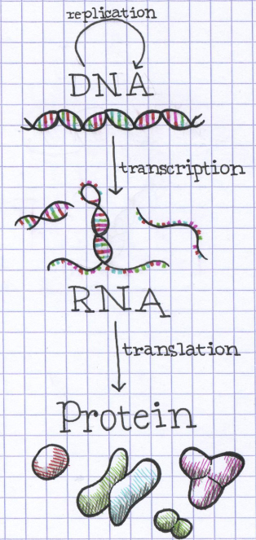
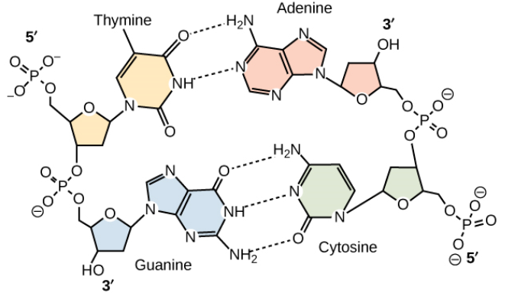
The machinery of genetic information: DNA
DNA (deoxyribonucleic acid)
Central dogma
Replication (DNA→DNA)
Transcription (DNA → RNA)
Post-transcriptional reg. (splicing, capping, and poly(A))
Reverse-transcription
Translation
RNA and protein sequences are also discrete values.
DNA has a chemical polarity (5’→3’) and antiparallel.
Base-complementarity (C,T=G,A)

Slide 9
Flow of genetic information in a eukaryotic cell
Gene structure – Exons (5’UTR, CDS, 3’UTR) and introns.
Mature mRNA – 5’UTR, CDS, 3’UTR, and Poly(A)
Single-stranded DNA sequences
5’-AGGACACGACGACTATTGG-3’
Double-stranded DNA sequences
5’-AGGACACGACGACTATTGG-3’
3’-TCCTGTGCTGCTGATAACC-3’
Forward/Reverse, +/-, Watson/Crick, sense/antisense
Save a ssDNA form in database due to interpretability.

Slide 10
Replication (DNA→DNA)
22 autosomes and Two sex chromosomes (X,Y)
The human genome – genetic information in all chromosomes (3 billion bases).
A strand is a backbone (template) of the other strand.
ssDNA to dsDNA
Some genes are specified by a strand of DNA, and others are specified by the other (complementary strand).

Slide 11
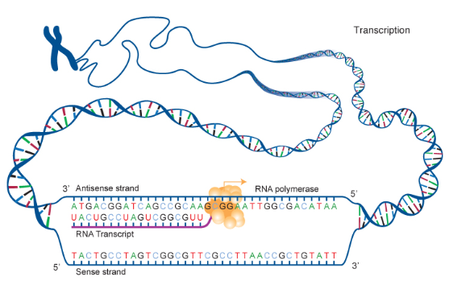
Transcription (DNA → RNA)
RNA polymerase uses antisense strand as a template DNA and RNA itself is same as the sense.
DNA→RNA : T to U
RNA is a single strand.
These RNAs contain information for the production of proteins.

Slide 12
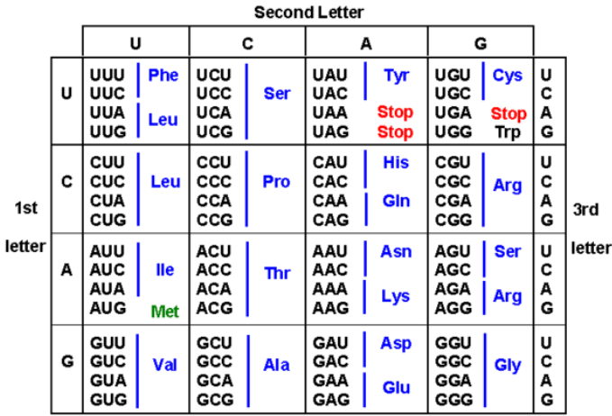
Translation
RNA to Protein
Proteins are large polymers like DNA and RNA, the building blocks are 20 amino acids (string-like, discrete).
A distinct aa is defined by a codon (three bases).
There are 64 codons (61 specify aa and 3 define stop codons).
Multiple codons code a aa (degeneracy)
AUG: start codon and codes methionine.
tRNAs link the RNA and protein codes.

Slide 13
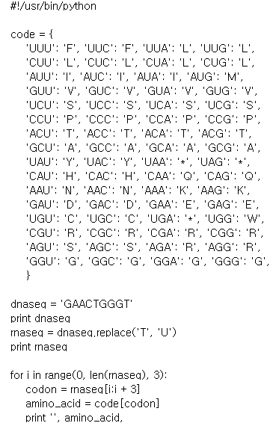
Computational aspects of the genetic information flow
Python
Basic syntax (grammar)
Defining variables
Print, reverse, string functions
For loops
Dictionary (hash table)
Genetic information flow

Slide 14
DNA replication I (ssDNA)
import string
dna = 'GCAATGG'
rev = dna[::-1]
comp = string.maketrans('ACGT','TGCA')
rev_comp = rev.translate(comp)
print rev_comp
CCATTGC
Write the above code into a file “replication.py”
And run like “python replication.py”

Slide 15
DNA replication II (dsDNA)
import string
dna = 'GCAATGG'
comp = string.maketrans('ACGT','TGCA')
rev_comp = dna.translate(comp)
print '5\'-' + dna + '-3\''
print '3\'-' + rev_comp + '-5\'‘
5'-GCAATGG-3'
3'-CGTTACC-5'
Write the above code into a file “replication2.py”
And run like “python replication2.py”

Slide 16
Inferring RNA products of transcription
dna = 'GCAATGG'
print "The DNA sequence is " + dna
rna = dna.replace(‘T’,’U’)
print "and the RNA sequence is " + rna
The DNA sequence is GCAATGG
and the RNA sequence is GCAAUGG
Write the above code into a file “transcription.py”
And run like “python transcription.py”

Slide 17
Inferring protein products of translation
codons → amino acids and stop codons using a dictionary (hash table)
code[‘UUU’]=‘F’
code[‘UUC’]=‘F’
…
code[‘GGG’]=‘G’
→
code = {‘UUU’:’F’, ‘UUC’:’F’, ‘UUA’:’L’, … } print code[‘UUU’], code[‘UUC’]
F F

Slide 18
Inferring protein products of translation
Reading the codon from the RNA sequence using a for loop statement.
for i in range(0, 5, 1):
print i,
0 1 2 3 4

Slide 19
Inferring protein products of translation
Subtract codons (substring) from a RNA sequence (string)
rna='AGCTT'
print rna[2:4]
print rna[0:1]
print rna[3:]
print rna[:3]
print rna[:-2]
print rna[::-1]
CT
A
TT
AGC
AGC
TTCGA

Slide 20
code1.1 translation.py
#!/usr/bin/python
code = {
'UUU': 'F', 'UUC': 'F', 'UUA': 'L', 'UUG': 'L', 'CUU': 'L', 'CUC': 'L', 'CUA': 'L', 'CUG': 'L',
'AUU': 'I', 'AUC': 'I', 'AUA': 'I', 'AUG': 'M', 'GUU': 'V', 'GUC': 'V', 'GUA': 'V', 'GUG': 'V',
'UCU': 'S', 'UCC': 'S', 'UCA': 'S', 'UCG': 'S‘, 'CCU': 'P', 'CCC': 'P', 'CCA': 'P', 'CCG': 'P',
'ACU': 'T', 'ACC': 'T', 'ACA': 'T', 'ACG': 'T', 'GCU': 'A', 'GCC': 'A', 'GCA': 'A', 'GCG': 'A',
'UAU': 'Y', 'UAC': 'Y', 'UAA': '*', 'UAG': '*‘, 'CAU': 'H', 'CAC': 'H', 'CAA': 'Q', 'CAG': 'Q',
'AAU': 'N', 'AAC': 'N', 'AAA': 'K', 'AAG': 'K‘, 'GAU': 'D', 'GAC': 'D', 'GAA': 'E', 'GAG': 'E',
'UGU': 'C', 'UGC': 'C', 'UGA': '*', 'UGG': 'W', 'CGU': 'R', 'CGC': 'R', 'CGA': 'R', 'CGG': 'R',
'AGU': 'S', 'AGC': 'S', 'AGA': 'R', 'AGG': 'R','GGU': 'G', 'GGC': 'G', 'GGA': 'G', 'GGG': 'G'
}
dnaseq = 'GAACTGGGT'
print dnaseq
rnaseq = dnaseq.replace('T', 'U')
print rnaseq
for i in range(0, len(rnaseq), 3):
codon = rnaseq[i:i + 3]
amino_acid = code[codon]
print '', amino_acid,
GAACTGGGT
GAACUGGGU
E L G

